Slide 1
Campaign Pitch: Black Lives Matter
By veerpal Kaur
Notes:
%%TTS_FEMALE%
Hello,
My name is Veerpal Kaur
And my topic is black lives matter

Slide 2



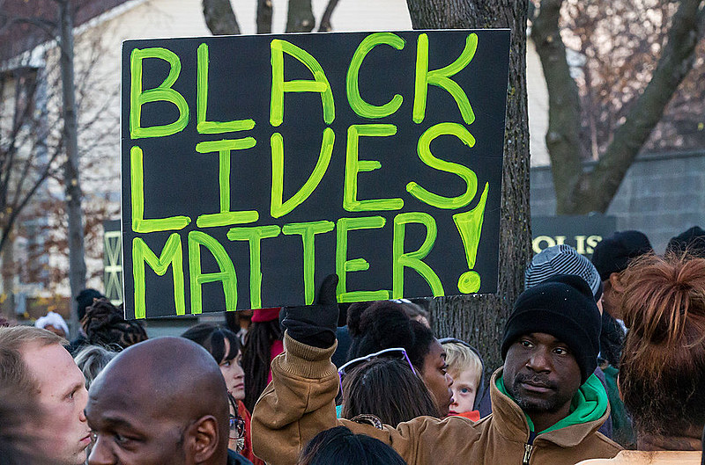


Black Lives Matter
This is a social movement that speaks against police violence, racism and general social justice
Previous campaigns addressed the issue of police violence, indiscriminate killings of young unarmed black men and general racism against the African Americans
The new campaigns shine a light on the divisiveness of the violent protests that are said to be divisive and not a representation of what the movement stands for (Richardson, 2019).
Notes:
Black lives matter is a social justice movement that emerged in the US in 2013. This was after the acquittal of George Zimmerman, who was charged with killing Trayvon Martin. The movement gained momentum with demonstrations occurring in most cities in the US and high-profile incidents of police brutality occurring.
The previous campaigns addressed the issue of police brutality, but there have been criticisms of the movement and its violent protests. The social justice movement is supposed to provide awareness to both the victims and the perpetrators on the importance of unity, non-partisanship, and following the Constitution in allowing people their right to life. Blatant racism is unacceptable, and further pushing it with violence and not being remorseful is a mockery of the constitution and the civil rights order that fought for the equality of minorities in the United States of America (Richardson, 2019).
The new campaigns, however, are meant to cite the failures of the previous movement and shine a light on new ways to ensure that the movement is well organized and passes on the exact message but with a less violent and pragmatic approach that will lead to further loss of lives. The new campaigns push for inclusivity since the minority population does not consist of only blacks but other minorities that fit within the category,

Slide 3
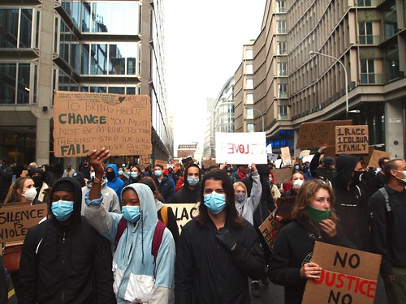
BLM: The New Campaign
Promoting non-violent campaigns in resolving issue with the police
Advocating for all lives since the brutality does not only target black lives
All lives, just like the black lives matter since it shows more care and sympathy for humanity without isolating the issue of only black suffering from the indiscriminate brutality when everyone can suffer from the hands of uncivilized and unlawful police officers.
Notes:
The new campaign shares the aim of having a new way of handling the social movement. This is the tangent between how Malcolm and Martin Luther King Jr dealt with the protests during the civil rights movement. The violent demonstrations are cited to be unrealistic if only more people die while advocating for the rights of Americans. The new campaign is keen on promoting the issue of stopping systemic racism towards minorities and, specifically, the black community (Szetela, 2020). In addition, the movement sought to increase public awareness of the problem through non-violent protests, inclusivity in the marches, and promoting policy change to address these issues. Also, through the sensitization, the campaign hopes to reduce the incidents of police brutality by creating awareness and communities to report any incidents that might be deemed to be unfair on any unarmed black person caught in a scuffle with the police and in danger of any uninformed and unnecessary violence.

Slide 4
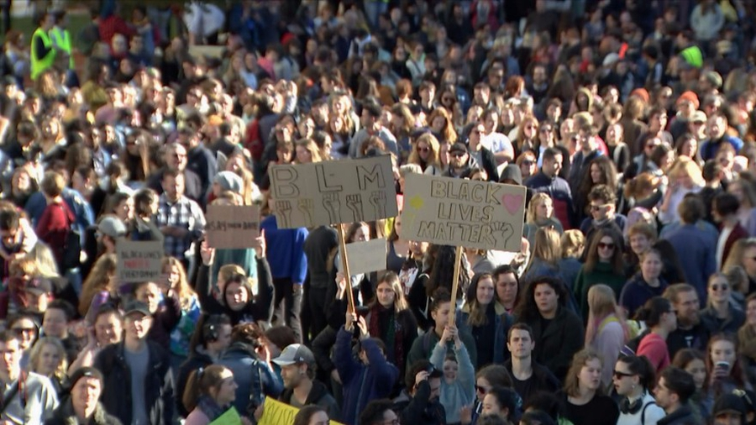
BLM: The New Campaign (Cont..)
Target audience should be young people with a passion for social justice
Social media campaigns to help gather as many young and active people as possible
Preaching the message of peace and firmness in standing for social justice and what is right which is the stopping systemic racism and policy brutality against black people (Richardson, 2019).
Notes:
The new campaign targets young people who are active on social media and passionate about social justice. Statistics show that young people, especially in developed countries, are at the forefront of wanting change to occur for them. They are the vulnerable group since they are the most exposed to police incidents, and them being black, they are supposed to be consciously aware of the consequences of interactions with the police (Richardson, 2019).
The new campaign also aims to educate young people on responsibility, cooperation, and being good citizens. It is not an easy conversation to have with a police officer whose mental health, social status, and general work environment is also a factor in having such an attitude when dealing with civilians. The social movement should create a meeting point that does not necessarily have to be an antagonistic relationship but an interaction whereby less violence is expected and more cordial conversations are made to help further promote peace. A timeline for the campaign will be developed, with regular updates on the campaign's progress.

Slide 5
Measurement of Effectiveness of the Campaign
The audience engagement will be measured to show the progress of the campaigns
Surveys on various social media platforms and chatrooms will be done to help know the reach and how the conversation is going (Szetela, 2020)
The measurement of the effectiveness of the campaign is crucial in knowing if the new approach is impactful to the conversation and new ways to change it.
Notes:
The measurement metrics for the new campaign are crucial since it helps with the general gauging of the direction of the conversation. Social media is the best place to start since most conversations make their way to these platforms. If the conversation provides positive analytics, the social movement can be curated further to help push the exact positive message that guarantees a more realistic outcome when the campaign continues to grow (Szetela, 2020).
Any feedback is necessary since the new campaign aims to push nonviolence, inclusivity, young people, and the general policies review that will help push the message forward. It is prudent for the overall outcome to be realistic and work within the confines of the law to help guide the new campaign slogan on the suitable non-violent tactic that will help with the overall outcome of the process.

Slide 6

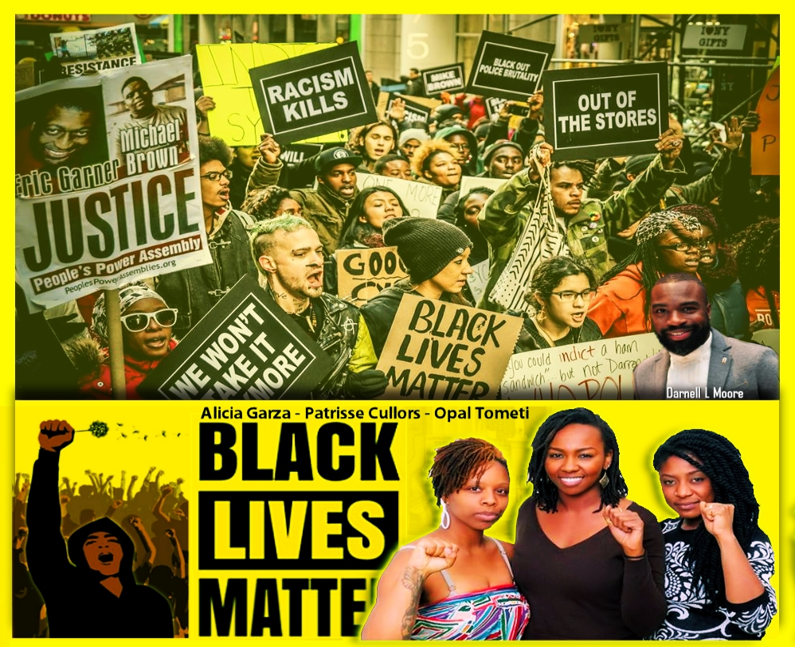



Conclusion
Notes:
Call to Action:
We encourage everyone to join the movement since this is a new campaign of inclusivity and it helps people have a voice on the right way to advocate for policy and effective change in the society that we live in,

Slide 7
References
Richardson, A. V. (2019). Dismantling Respectability: The Rise of New Womanist Communication Models in the Era of Black Lives Matter. Journal of Communication, 69(2), 193–213. https://doi.org/10.1093/joc/jqz005
Szetela, A. (2020). Black Lives Matter at five: limits and possibilities. Ethnic and Racial Studies, 43(8), 1358–1383. https://doi.org/10.1080/01419870.2019.1638955

