Slide 1
ST. PAUL’S SR. SEC. SCHOOL
ENGLISH HOLIDAY ASSIGNMENT
TOPIC- PPT on Social Evils
PRESENTED BY- AYAN ANWAR 10th ‘C’
PRESENTED TO- MRS. RUCHI MA’AM

Slide 2
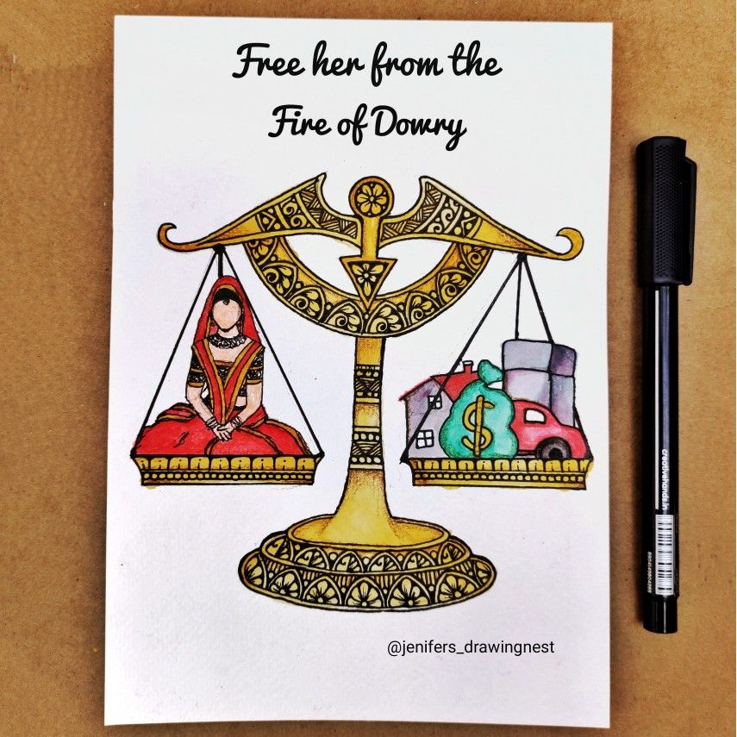

SAY NO TO DOWRY
DOWRY is a SOCIAL EVIL
in the society , that has
tortured many women in
unimaginable manner…
The evil has taken lives of women from all stratas of society - be it POOR
be it MIDDLE CLASS
or the RICH...

Slide 3

DOWRY-THROUGH
THE GLASS OF ECONOMICS
In India around 20 women die every day as a consequence of harassment over dowry.
In the marriage market , dowry is the price paid by the bride in exchange of utilities.
Even after marriage , a women’s parents continue to fulfill the ever increasing demand for dowry.

Slide 4

DOWRY IS A CRIME
DOWRY SYSTEM HAS RESULTED IN OTHER SOCIAL EVILS LIKE FEMALE INFANTICIDE , DOMESTIC VIOLENCE , SEXUAL HARASSMENT , ETC…
DOWRY HAS LEAD TO INJUSTICE PRACTICES WITH WOMEN AND FORBIDS EQUAL STATUS IN SOCIETY…

Slide 5

…….DOMESTIC………….
..…..…..VIOLENCE……..
When one talks about
DOMESTIC VIOLENCE laws in India , two major legislations appear :
PROTECTION OF WOMEN FROM DOMESTIC VIOLENCE ACT, 2005
and SECTION 498-A of the penal code…

Slide 6

WHAT IS DOMESTIC VIOLENCE?
When one talks about DOMESTIC VIOLENCE, it is a systematic method to instill fear and subservience in an individual in a domestic setting like a household.
DOMESTIC VIOLENCE IN INDIA TYPICALLY MEANS VIOLENCE SUFFERED BY WOMEN FROM THE MALE MEMBERS OR RELATIVES IN HER FAMILY…

Slide 7

EVEN MALES CAN BE VICTIMS OF DOMESTIC VIOLENCE
Besides women, men also experience gender-based violence in India. Most women experience violence so there is a stereotypical assumption among people that domestic violence is gender-specific which is not correct…
India is a patriarchal or male dominated society, it is often hard to believe that even males can be victims of
DOMESTIC
VIOLENCE..

Slide 8
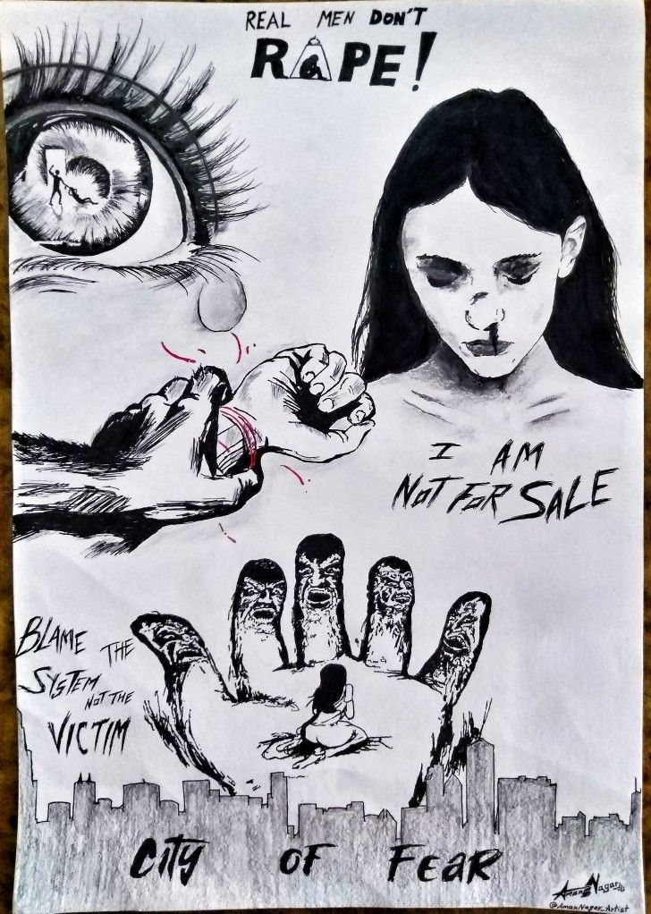
......RAPES IN INDIA......
RAPE, generally known as balatkar is a terrifying word in itself. In India, it is one of the most common criminal activities. So petrifying, humiliating, traumatic and terrifying the word rape is that it destroys the entire psychology and effects the deepest emotions of the person being RAPED. No single definition can define the word rape because of its exhaustive nature. Only the person who suffers it, knows it. Hence, rape can be termed as a sex crime…

Slide 9
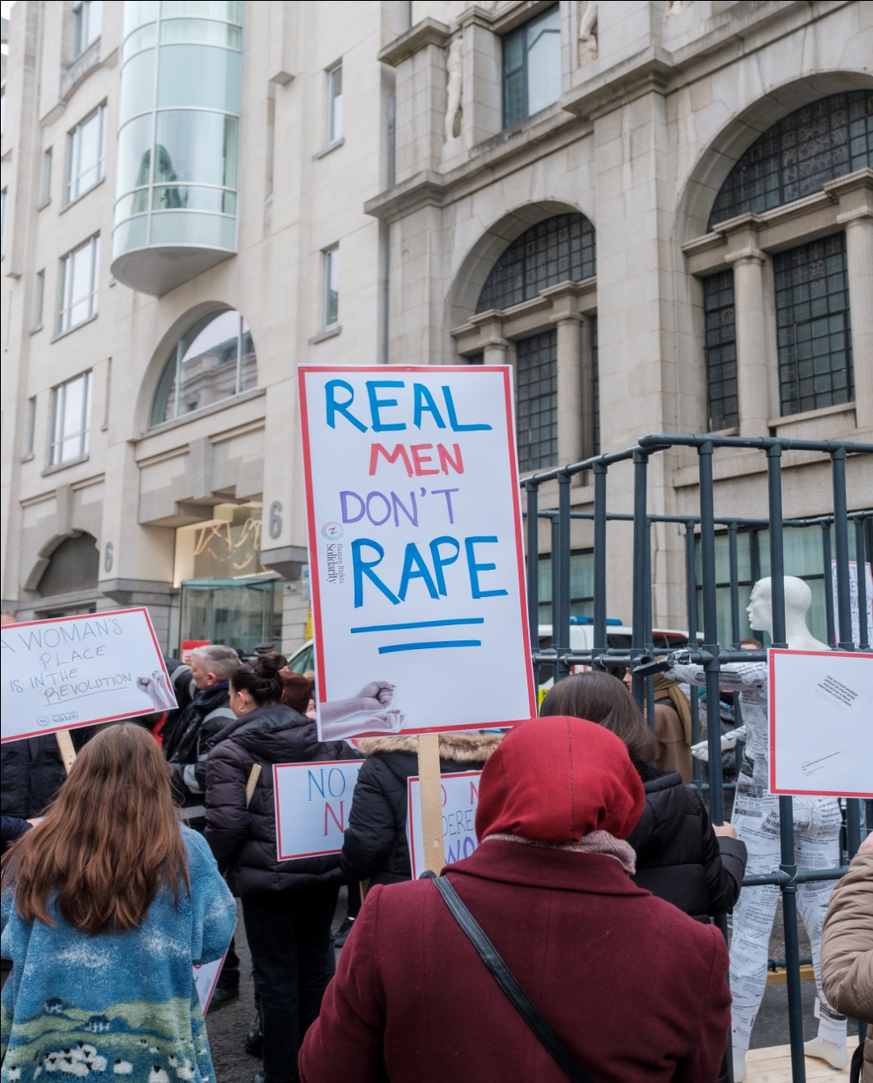
PROVISIONS REGARDING RAPE LAWS IN INDIA
RAPE is a cognizable offence in India. There are so many provisions in different Acts for rape.
Section 375,376A,376B,376C and 376D of Indian Penal Code 1860.
Section 53(1)[4], 164A[5],327(2)6 of Code of Criminal Procedure. Section 114-A[3] of Indian Evidence Act
The term RAPE has been legally defined under section 375 of Indian Penal Code…

Slide 10

….Corruption in India….
Corruption in India is an issue which affects economy of central, state and local government agencies in many ways. Corruption is blamed for stunting the economy of India…
The causes of corruption in India include excessive regulations, complicated tax and licensing systems, numerous government departments etc…

Slide 11
thank you
and
have a nice
day!

