Slide 1

Environmental studies
Bs psychology 2nd

Slide 2

Group 1
Participants :
Samia Batool (7)
Hira Abrar (11)
Kainat Rauf (23)
Ayesha Fayyaz (10)
Sidra Mehmood (14)
Saima Ashraf (28)

Slide 3
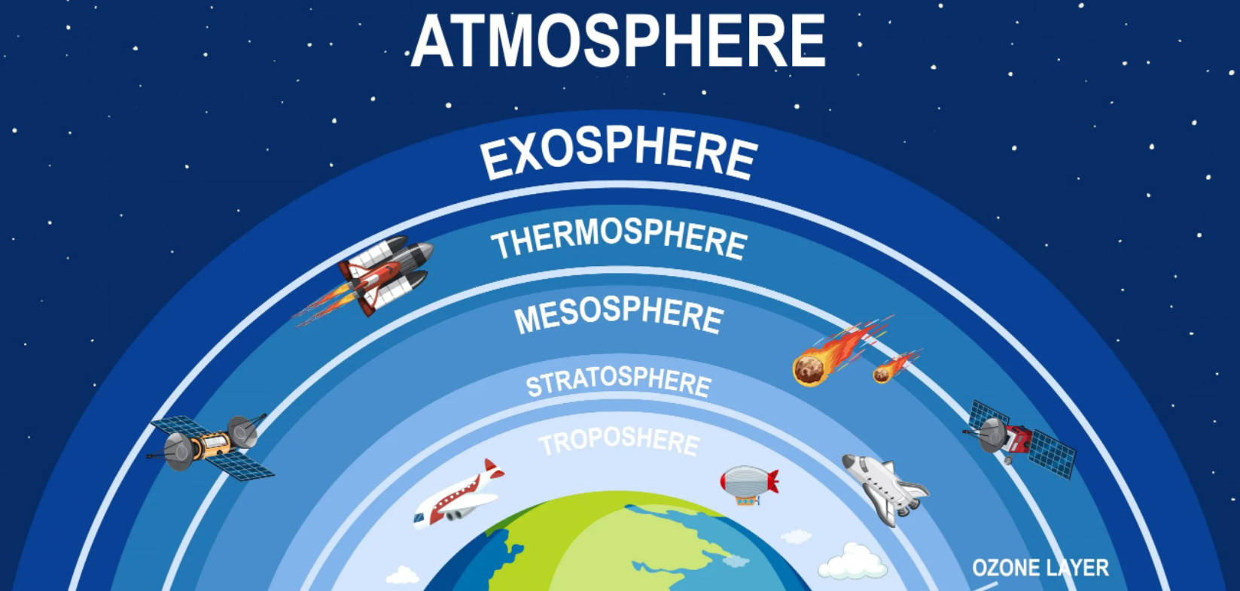
OZONE :​

Slide 4
Ozone or trioxygen is an inorganic molecule with the chemical formula O3.
It is an important pale blue gas with a strong smell in the stratosphere.
Ozone layer:
The ozone layer was discovered in 1913 by the French physicists Charles Fabry and Henri Buisson.
Ozone layer, also called ozonosphere, region of the upper atmosphere, between roughly 15 and 35 km (9 and 22 miles) above Earth’s surface, containing relatively high concentrations of ozone molecules (O3).
The ozone layer or ozone shield is a region of Earth's stratosphere that absorbs most of the Sun's ultraviolet radiation.

Slide 5
Formation of ozone Layer in stratosphere:
Ozone in the Earth's stratosphere is created by ultraviolet light striking ordinary oxygen molecules containing two oxygen atoms (O2), splitting them into individual oxygen atoms (atomic oxygen); the atomic oxygen then combines with unbroken O2 to create ozone, O3. The ozone molecule is unstable (although, in the stratosphere, long-lived) and when ultraviolet light hits ozone it splits into a molecule of O2 and an individual atom of oxygen, a continuing process called the ozone-oxygen cycle.

Slide 6
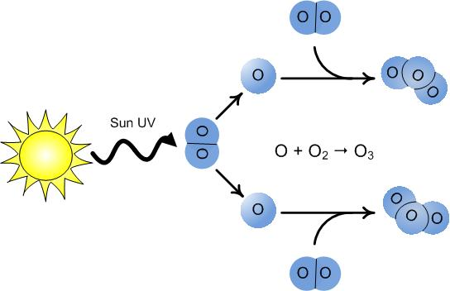
Chemically, this can be described as:
O₂ + UV 2O
O + O₂ O₃

Slide 7
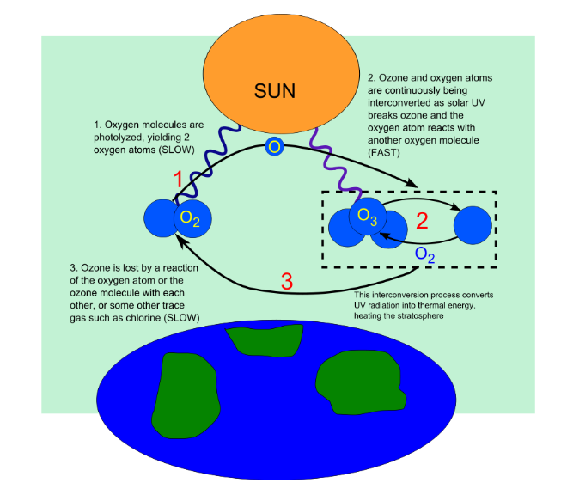

Slide 8
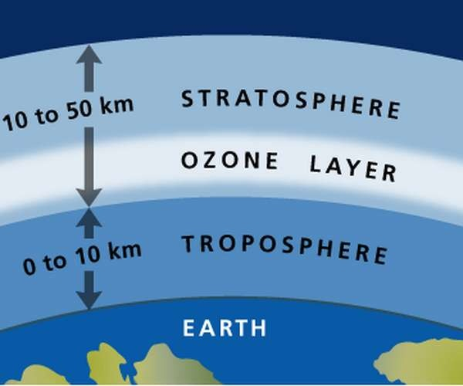
Ozone composition:
The ozone layer, also called the stratosphere, is composed of the ozone gas (90% of the total ozone in the atmosphere). The ozone has three oxygen atoms, and it is the result of the action of Ultra Violet (UV) radiation on oxygen molecules, composed of two oxygen atoms.
The production of ozone in the stratosphere results primarily from the breaking of the chemical bonds within oxygen molecules (O2) by high-energy solar photons. This process, called photodissociation.
In results the release of single oxygen atoms, which later join with intact oxygen molecules to form ozone.
Rising atmospheric oxygen concentrations some two billion years ago allowed ozone to build up in Earth’s atmosphere, a process that gradually led to the formation of the stratosphere.

Slide 9
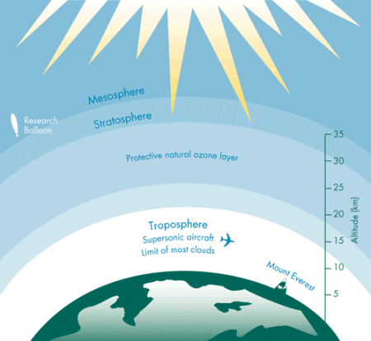
OZONE THICKNESS:
The thickness of the ozone layer varies worldwide and is generally thinner near the equator and thicker near the poles.
Thickness refers to how much ozone is in a column over a given area and varies from season to season. The reasons for these variations are due to atmospheric circulation patterns and solar intensity.
The majority of ozone is produced over the tropics and is transported towards the poles by stratospheric wind patterns.
In the northern hemisphere these patterns, make the ozone layer thickest in the spring and thinnest in the fall.

Slide 10
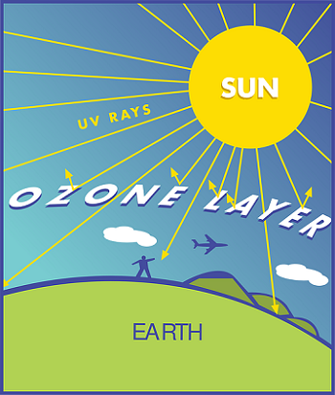
Role of ozone layer:
All life on Earth is protected by the ozone layer. This layer of gas acts as an invisible filter that protects all life forms from over-exposure to the sun’s harmful UV rays.
The ozone layer effectively blocks almost all solar radiation of wavelengths less than 290 nm from reaching Earth’s surface, including certain types of ultraviolet (UV) and other forms of radiation that could injure or kill most living things.
Without the protective effect of ozone life on Earth would not have evolved the way it has.
​

Slide 11
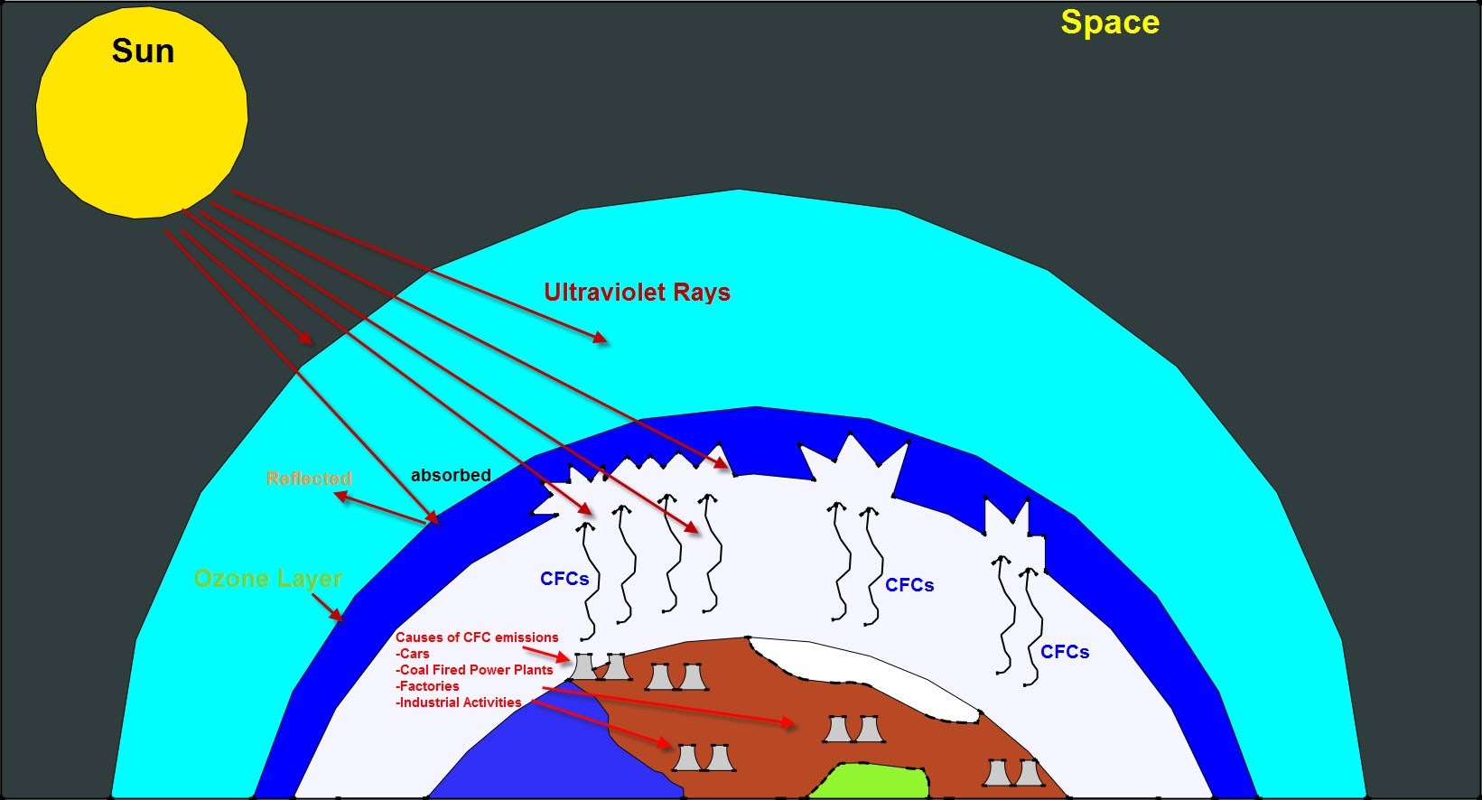
OZONE DEPLETION:
Ozone depletion is the gradual thinning of earth’s ozone layer in the upper atmosphere caused by the release of chemical compounds containing gaseous chlorine or bromine from industry and other human activities.
Ozone depletion, the global decrease in stratospheric ozone observed since the 1970s, is most pronounced in polar regions.

Slide 12
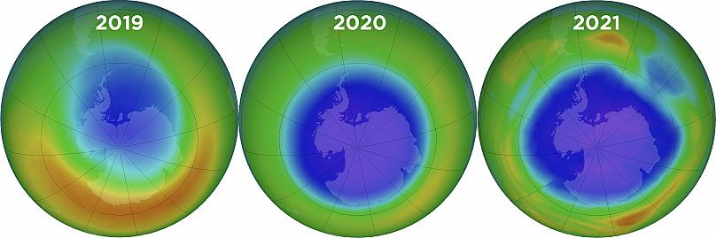
Ozone hole:
Depletion is so extensive that so-called ozone holes (regions of severely reduced ozone coverage) form over the poles during the onset of their respective spring seasons.
The largest such hole—which has spanned more than 20.7 million square km (8 million square miles) on a consistent basis since 1992—appears annually over Antarctica.

Slide 13
Causes:
The global decrease in stratospheric ozone is well correlated with rising levels of chlorine and bromine in the stratosphere from the manufacture and release of CFCs and other halocarbons.
Halocarbons are produced by industry for a variety of uses, such as refrigerants (in refrigerators, air conditioners, and large chillers), propellants for aerosol cans, blowing agents for making plastic foams, firefighting agents, and solvents for dry cleaning and degreasing.
Chlorine could destroy extensive amounts of ozone after it was liberated from CFCs by UV radiation. Free chlorine atoms and chlorine-containing gases, such as chlorine monoxide (ClO), could then break ozone molecules apart by stripping away one of the three oxygen atoms.
Certain bromine-containing compounds are even more effective at destroying ozone than were chlorine and its reactive compounds.

Slide 14
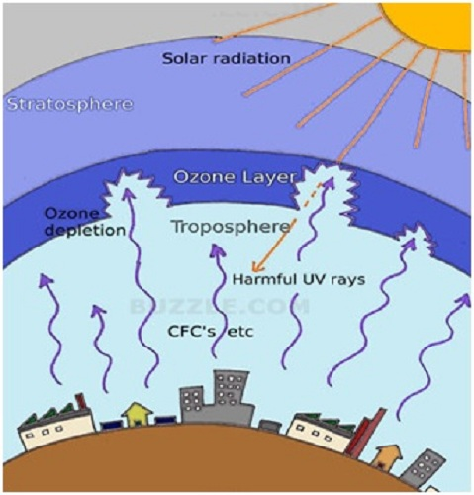

Slide 15
Ozone layer depletion effects:
Effect ​ | Explanation ​
Humans​ | Can cause skin cancer and damage eye’s,​genetic and immune system damage.
Plants​ | Directly affect the growth .
Marine life​ | cause damage to early developmental stages , decrease reproductive capacity .​
Biopolymer​ ​ | Can accelerate the breakdown of biopolymers by decreasing their life time.​ ​
Global warming​ | Kill planktons that absorb carbon dioxide and thus increase in global warming​.

Slide 16
Ozone layer regulation:
Scientists announced that the global depletion of the ozone layer may be slowing down because of the international regulation of ozone-depleting substances.
The United States, Canada and Norway enacted bans on CFC-containing aerosol sprays that damage the ozone layer.
Only recycled and stockpiled CFCs were available for use in developed countries. The treaty was amended to ban CFC production in the developed countries, and in developing countries. Today, world's 197 countries have signed the treaty.

Slide 17
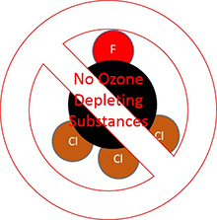
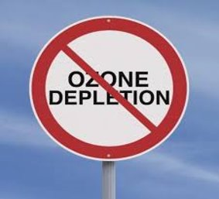
Compounds containing C–H bonds (such HCFCs) have been designed to replace CFCs in certain applications. These replacement compounds are more reactive and less likely to survive long enough in the atmosphere to reach the stratosphere where they could affect the ozone layer.
While being less damaging than CFCs, HCFCs can have a negative impact on the ozone layer, so they are also being phased out.
These in turn are being replaced by hydrofluorocarbons (HFCs) and other compounds that do not destroy stratospheric ozone at all.

Slide 18
thankyou

