Slide 1

The Principles of Resilience: Supporting Learners in the Classroom
Resilience is crucial for success in any classroom. This presentation explores the principles of resilience and how to apply them to support the learning environment of learners, including specific strategies and case studies.

Slide 2

What is Resilience?
Resilience is the ability to adapt and thrive despite adversity. In the classroom, it means the ability to overcome obstacles, overcome failure, and keep learning even under challenging circumstances.

Slide 3

The Importance of Resilience in the Classroom
When learners are resilient, they can handle setbacks better, are more motivated, take more risks, and are more creative in their problem-solving.

Slide 4

Characteristics of a Resilient Learner
Positive Mindset
Adaptability
Resilient learners have a positive outlook and see challenges as opportunities for growth.
Resilient learners are adaptable and can respond to changing circumstances.
Grit
Self-Regulation
Resilient learners have grit and determination to overcome obstacles and setbacks.
Resilient learners can regulate their emotions and behaviors during difficult situations.

Slide 5
Factors That Promote Resilience in the Classroom
1
Positive Relationships
Establishing positive relationships between students and with the teacher fosters a sense of belonging, safety, and trust, which is vital for resilience.
Culture of Inclusivity
2
Cultivating a culture of inclusivity promotes a sense of belonging, respect, and acceptance for students of different backgrounds and abilities.
3
Engaging learning environment
Creating a positive, stimulating, and challenging learning environment sparks learners' interest and helps them stay motivated and engaged.
Effective Teaching Strategies
4
Using effective teaching strategies that promote questioning, curiosity, and critical thinking promote learners' self-confidence and resilience.

Slide 6
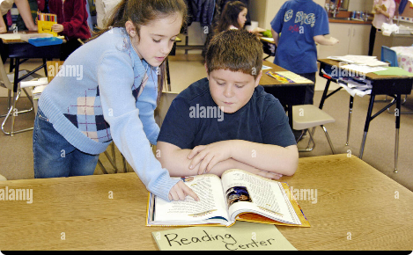

Applying the Principles of Resilience in the Classroom
Cultivate a Positive and Inclusive Classroom Culture
Teach and Model a Growth Mindset
Encourage positive habits like kindness, empathy, and collaboration to build a positive community and reduce stress.
Help learners develop a growth mindset where failure is seen as an opportunity for growth and learning.

Slide 7

Conquering Negative Effects of Risk Experiences
Risk experiences such as trauma, social isolation, or other adversities can have negative effects on learning. Resilience principles can help learners thrive despite such experiences.

Slide 8
Strategies to Foster Resilience Among Learners
1
Promote Self-Regulation
2
Encourage Social Support
Teach learners self-regulation skills like self-awareness, self-control, and self-motivation to help them manage their emotions and behaviors.
Provide learners with social support like counseling, mentoring, peer support, or parent involvement to help them cope with risk experiences.
3
Foster Healthy Habits and Mindset
4
Provide a Safe Learning Environment
Promote healthy habits such as exercise, good sleep, and nutrition to help learners develop a healthy mindset.
Create a safe and supportive learning environment where learners feel safe to take risks, learn from mistakes, and seek help without fear of negative consequences.

Slide 9

Coping Effectively with Traumatic Experiences
Students who have experienced significant adversities need special support to help them cope with their experiences and succeed in learning.
Expression of Positive Adaptation Despite Significant Life Adversity.
Resilient learners can overcome significant life adversity and emerge stronger, more adaptable, and more optimistic. Resilience principles can help learners cope and adapt positively to such experiences.

Slide 10
Case Studies Showcasing Successful Implementation of Resilience Principles
Case Study 1: Baltimore's ExCEL program
Case Study 2: Project Rise
This initiative provides academic and social support to over 2000 children in homeless and domestic violence shelters in Ohio, helping them stay engaged and resilient in school.
This program promotes resilience among learners by supporting their social and emotional development, academic achievement, and life preparation through a range of interventions and support services.

Slide 11

Conclusion and Key Takeaways
Resilience is a critical skill that learners need to succeed in school and life. By fostering a positive and inclusive learning environment, promoting resilient habits and mindset, teaching coping skills, and providing special support to at-risk learners, educators can help learners develop resilience and overcome obstacles and adversity with confidence and optimism.

