Slide 1
Notes:
Welcome to supreme supply and services

Slide 2

HSE Induction
Notes:
This is a short HSE induction

Slide 3

Ground Rules
Don’t use mobile phones during training, keep in silent mode
Know your nearest muster point
Aware of trip hazards while going to muster point
Know where the fire extinguisher located
Know where the first aid kit located
Know where the washroom located
Notes:
Ground Rules
Don’t use mobile phones during training, keep in silent mode
Know your nearest muster point
Aware of trip hazards while going to muster point
Know where the fire extinguisher located
Know where the first aid kit located
Know where the washroom located

Slide 4

















Supreme – Organization Overview
Established in 2003
Supplying multiple Quality Products for Oil & Gas Industry
Bolting & Machining Service Provider
Agents for reputed brands & products in Qatar
Our Certification
ISO 9001: 2015 (Quality)
ISO 14001: 2015 (Environment)
ISO 45001: 2018 (Safety)
Notes:
Supreme supply and services was Established in 2003
Supplying multiple Quality Products for Oil & Gas Industry
Bolting & Machining Service Provider
Agents for reputed brands & products in Qatar
Supreme supply and services is a ISO certified company

Slide 5
10 Golden Rules
ALWAYS NEVER
WORKING AT HEIGHT
Protect yourself and loose objects against a fall
PERMIT TO WORK
Work with a valid permit
ENERGY ISOLATION
Verify isolation and zero energy before work begins
DRIVING SAFETY
Follow safe driving rules
PPE
Wear designated (PPE) for the area and task
SUSPENDED LOAD
Do not walk or stand under a suspended load
PINCH POINT
Keep hands and body clear from pinch points
ALCOHOL & DRUGS
Prohibited to work under influence of alcohol / drugs
SMOKING POLICY
Do not smoke outside designated smoking areas
LINE OF FIRE
Keep yourself and others out of the line of fire
Notes:
There are 10 life saving golden rules to be followed while working with supreme supply and services
Protect yourself and loose objects against a fall
Always work with a valid work permit
Always verify isolation and zero energy before work begins
Follow safe driving rules
Wear designated (PPE) for the area and task
Do not walk or stand under a suspended load
Keep hands and body clear from pinch points
Keep yourself and others out of the line of fire
Prohibited to work under influence of alcohol / drugs
Do not smoke outside designated smoking areas

Slide 6


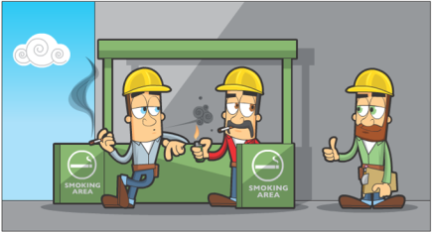
Smoking Policy
Smoking is not permitted in any company building, accommodation room, vehicle (including hired vehicles) or client premises / site.
Designated smoking areas have been provided for use, and strictly to be followed
Notes:
Smoking Policy
Smoking is not permitted in any company building, accommodation room, vehicle (including hired vehicles) or client premises / site.
Designated smoking areas have been provided for use, and strictly to be followed

Slide 7

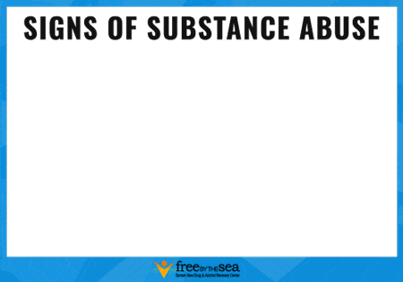
Alcohol & Drugs Abuse Policy
Do not report to work under the influence of alcohol, drugs or any other substance!!
Make your supervisor is aware if you are taking prescription drugs that could affect your ability to work safely.
You may be subject to screening by the company and by clients on their sites.
Consequences of violation detailing the disciplinary actions that will be taken if the policy is breached.
Notes:
Alcohol & Drugs Abuse Policy
Do not report to work under the influence of alcohol, drugs or any other substance!!
Make your supervisor is aware if you are taking prescription drugs that could affect your ability to work safely.
You may be subject to screening by the company and by clients on their sites.
Consequences of violation detailing the disciplinary actions that will be taken if the policy is breached.

Slide 8


First Aid
First aid is the first and immediate assistance given to any person with a medical emergency, with care provided to preserve life, prevent the condition from worsening, or to promote recovery until medical services arrive.
First aiders’ contact details are on the company & site notice board
First aid boxes are maintained, and their location is stated on the notice board
In the event of an incident:
Call for help (first aider)
Ensure your own safety as you approach the casualty.
If safe to do so, remove the hazard from the casualty
If appropriate, send someone to phone for an ambulance
Do not move the casualty unless they are in immediate danger
Ensure you know where the first aid kit is kept. Know who the first aiders or appointed persons are
Do not attempt to provide First Aid, if you are not trained and confident
Notes:
First Aid
First aid is the first and immediate assistance given to any person with a medical emergency, with care provided to preserve life, prevent the condition from worsening, or to promote recovery until medical services arrive.
First aiders’ contact details are on the company & site notice board
First aid boxes are maintained, and their location is stated on the notice board
Do not attempt to provide First Aid, if you are not trained and confident
In the event of an incident:
Call for help (first aider)
Ensure your own safety as you approach the casualty.
If safe to do so, remove the hazard from the casualty
If appropriate, send someone to phone for an ambulance
Do not move the casualty unless they are in immediate danger

Slide 9
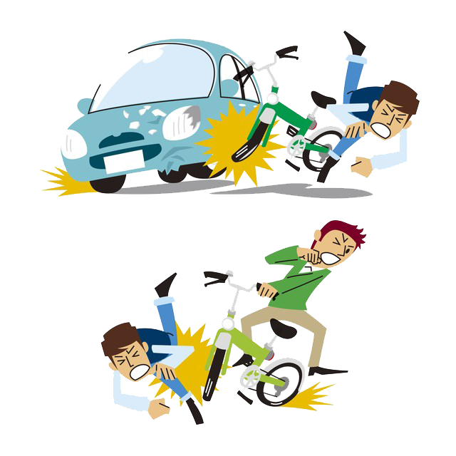
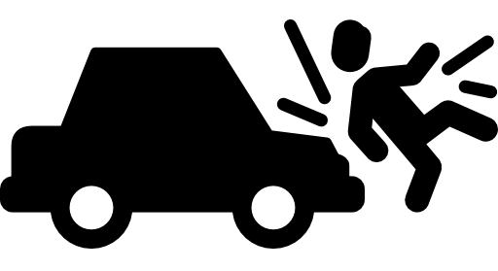
Vehicle Movements
People are most often involved in accidents as they walk around the workplace or when they encounter vehicles in or around the workplace.
It is therefore important to understand the various common accident. More serious accidents between pedestrians and vehicles can often be traced back to excessive speed or other unsafe vehicle practices, such as lack of driver training.
Overturning
Machinery hazards
Objects falling from vehicles
Slips, trips, and falls
Collisions
Creating noise
Driving too fast
Road conditions
Unsafe vehicle loading/unloading
Notes:
Vehicle Movements
People are most often involved in accidents as they walk around the workplace or when they encounter vehicles in or around the workplace.
It is therefore important to understand the various common accident. More serious accidents between pedestrians and vehicles can often be traced back to excessive speed or other unsafe vehicle practices, such as lack of driver training.
Overturning
Machinery hazards
Objects falling from vehicles
Slips, trips, and falls
Collisions
Creating noise
Driving too fast
Road conditions
Unsafe vehicle loading/unloading

Slide 10

Vehicle Movements
Always alert for vehicle movements when you walk.
Cross a road via marked cross walk.
Always maintain situational awareness while walking or working near vehicles.
Follow the rules of the road and obey signs and signals.
Walk on sidewalks whenever they are available.
If there is no sidewalk, walk facing traffic and as far from traffic as possible.
Cross streets at crosswalks or intersections. Look for cars in all directions, including those turning left or right.
If a crosswalk or intersection is not available, locate a well-lit area where you have the best view of traffic. Wait for a gap in traffic that allows enough time to cross safely; continue watching for traffic as you cross.
Watch for cars entering or exiting driveways or backing up in parking lots.
Avoid alcohol and drugs when walking; they impair your abilities and your judgment.
Embrace walking as a healthy form of transportation - get up, get out and get moving
Notes:
Always alert for vehicle movements when you walk.
Cross a road via marked cross walk.
Always maintain situational awareness while walking or working near vehicles.
Follow the rules of the road and obey signs and signals.
Walk on sidewalks whenever they are available.
If there is no sidewalk, walk facing traffic and as far from traffic as possible.
Cross streets at crosswalks or intersections. Look for cars in all directions, including those turning left or right.
If a crosswalk or intersection is not available, locate a well-lit area where you have the best view of traffic. Wait for a gap in traffic that allows enough time to cross safely; continue watching for traffic as you cross.
Watch for cars entering or exiting driveways or backing up in parking lots.
Avoid alcohol and drugs when walking; they impair your abilities and your judgment.
Embrace walking as a healthy form of transportation - get up, get out and get moving

Slide 11
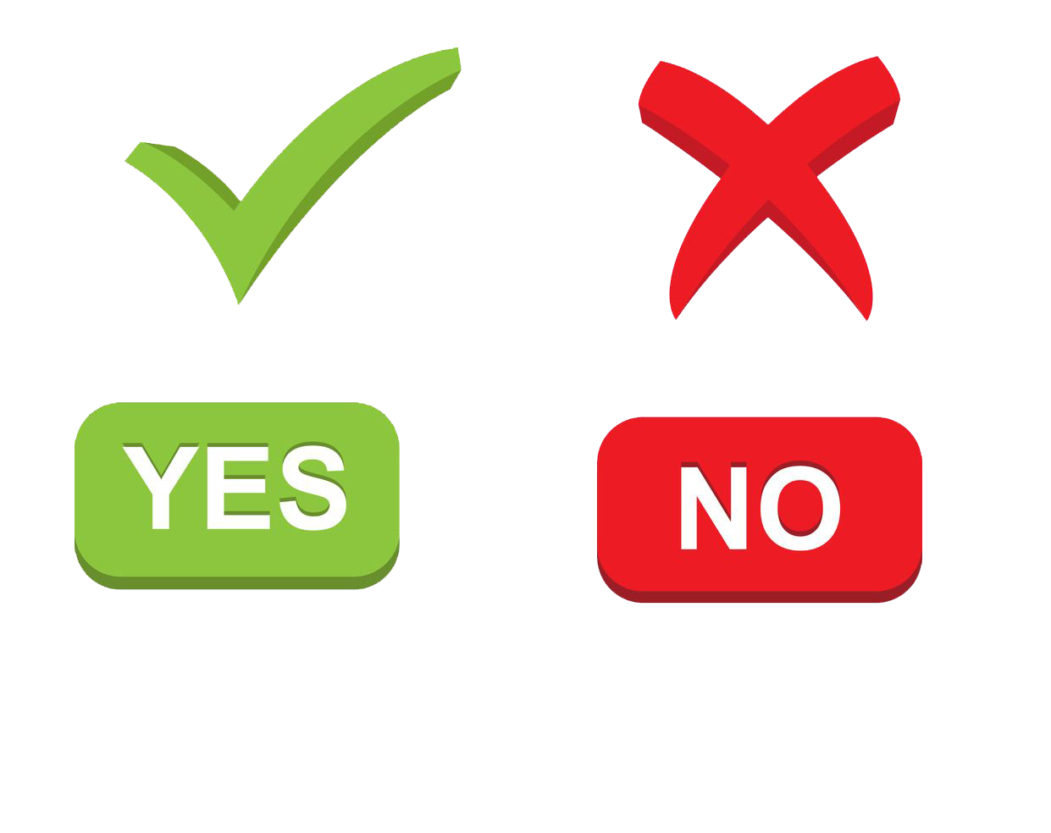
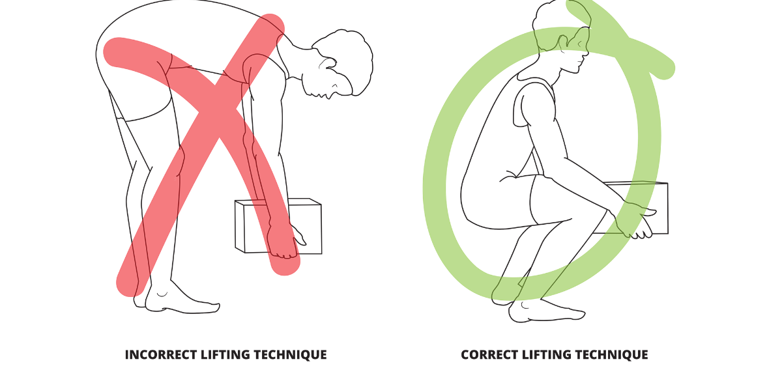
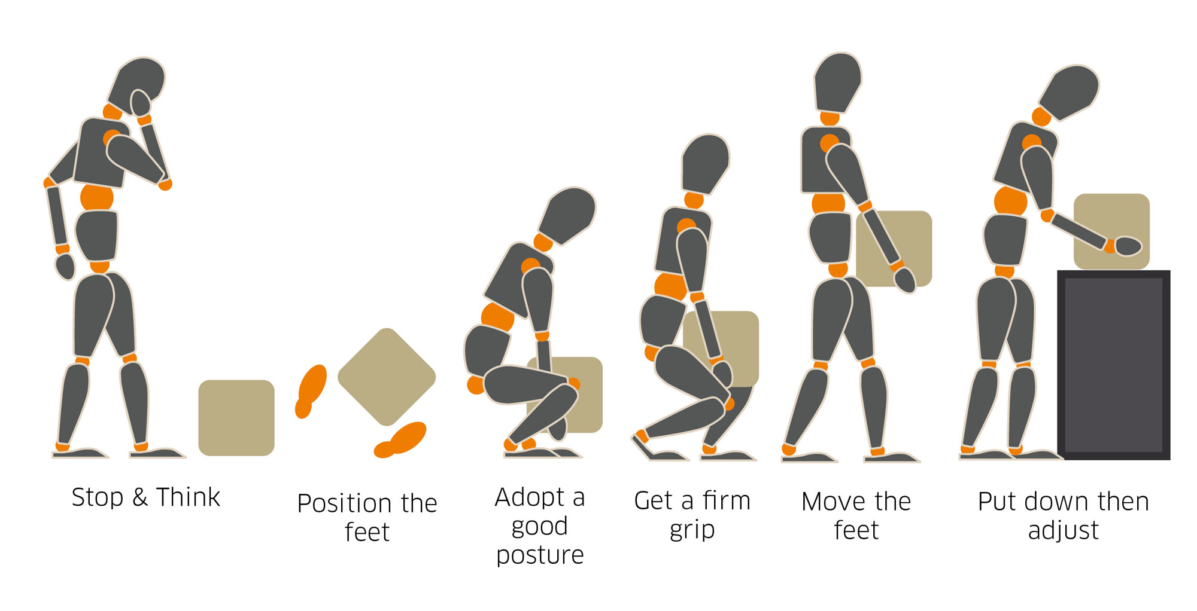
Manual Handling
The term manual handling is defined as the movement of a load by human effort alone
This effort may be applied directly or indirectly using a rope or a lever.
Hazards in Manual Handling.
Heavy Loads
Awkward or Unstable Loads
Repetitive Movements
Poor Posture
Unstable or Slippery Surfaces
Injuries associated with manual handling
Back Injuries
Shoulder Injuries
Knee Injuries
Wrist and Hand Injuries
Muscle Strains
Notes:
Manual Handling
The term manual handling is defined as the movement of a load by human effort alone
This effort may be applied directly or indirectly using a rope or a lever.
Hazards in Manual Handling.
Heavy Loads
Awkward or Unstable Loads
Repetitive Movements
Poor Posture
Unstable or Slippery Surfaces
Injuries associated with manual handling
Back Injuries
Shoulder Injuries
Knee Injuries
Wrist and Hand Injuries
Muscle Strains

Slide 12
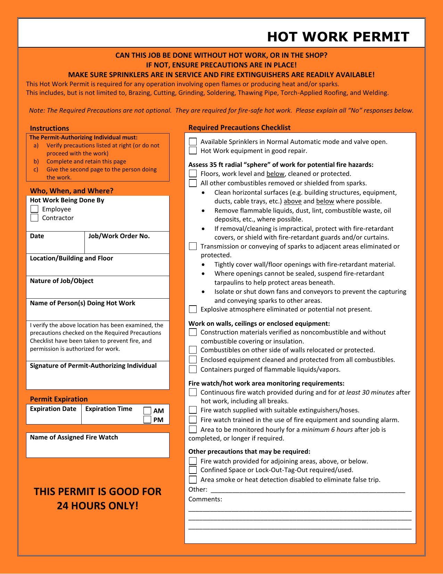
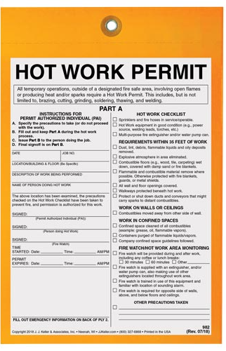

Permit to Work
A permit to work is a document that controls the undertaking of a task involving sufficient hazards to require a written record of hazard identification, control measure verification, authorization to start, acceptance, return and cancellation
DO NOT START ANY WORK WITHOUT A VALID PERMIT
There are different types of work permits based on the operation performed and it differs based on client site regulations
Notes:
Permit to Work
A permit to work is a document that controls the undertaking of a task involving sufficient hazards to require a written record of hazard identification, control measure verification, authorization to start, acceptance, return and cancellation
DO NOT START ANY WORK WITHOUT A VALID PERMIT
There are different types of work permits based on the operation performed and it differs based on client site regulations

Slide 13
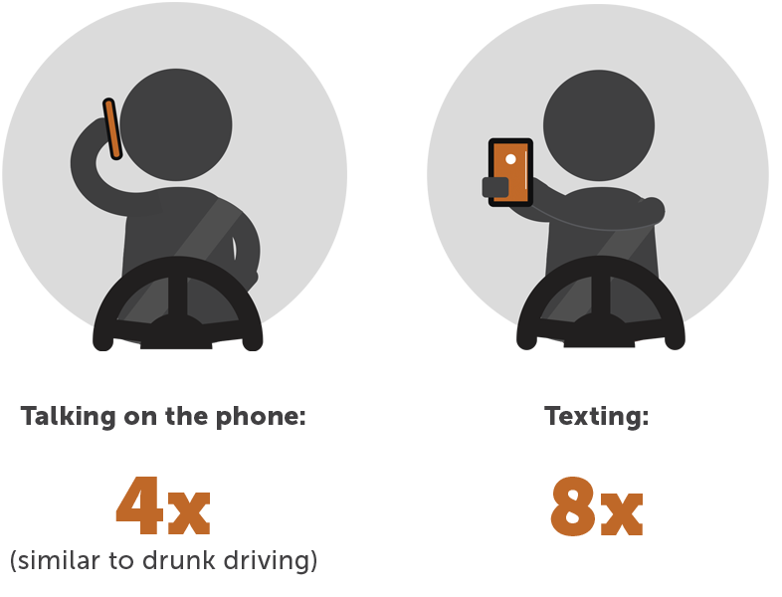

Driving
Always wear seat belt
Don’t drive if you are tired
Don’t use cell phone while driving
Follow the speed limit specified by the road/ Site
Maintain a safe driving distance
Don’t use a cell phone while driving, pull off the road in a safe place then use.
Don’t drive under the influence of alcoholic beverages as well as some prescription drugs.
Maintain your vehicle in good condition. Check that the tires, brakes, headlights, taillights, and turn signals all work properly.
Notes:
Driving
Always wear seat belt
Don’t drive if you are tired
Don’t use cell phone while driving
Follow the speed limit specified by the road/ Site
Maintain a safe driving distance
Don’t use a cell phone while driving, pull off the road in a safe place then use.
Don’t drive under the influence of alcoholic beverages as well as some prescription drugs.
Maintain your vehicle in good condition. Check that the tires, brakes, headlights, taillights, and turn signals all work properly.

Slide 14
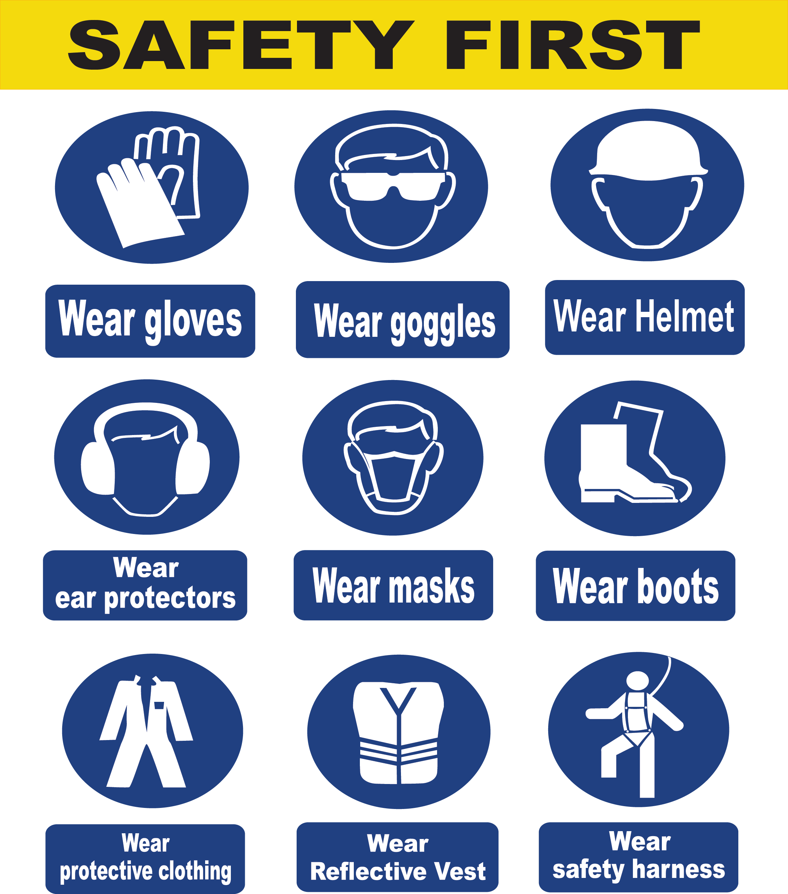
PPE
Personal protective equipment (PPE) is safety equipment that is designed to protect employees by reducing their exposure to chemical, biological, and physical hazards while working.
Company will issue all work-related PPE’s.
Working without PPE is considered as a violation.
PPE must be worn correctly in required areas as specified in the risk assessments.
If you found the PPE is damaged, report to your supervisor immediately and get a replacement .
Notes:
PPE
Personal protective equipment (PPE) is safety equipment that is designed to protect employees by reducing their exposure to chemical, biological, and physical hazards while working.
Company will issue all work-related PPE’s.
Working without PPE is considered as a violation.
PPE must be worn correctly in required areas as specified in the risk assessments.
If you found the PPE is damaged, report to your supervisor immediately and get a replacement

Slide 15


Slips, Trip's and Falls
Clear up waste materials as you create them.
Do housekeeping before and after the work.
Do not leave tools, equipment or unused materials lying around
Ensure materials are stacked correctly and in the right storage area.
When using substances which may spill, ensure that you have the means for clearing up any spillages correctly.
Ensure that routes for cables for power tools are routed in the most appropriate manner
A fall occurs when a person is too far off balance.
        People slip on water or oil spills; they trip over small objects and electrical cords; and they fall off ladders, chairs or down stairways.
A slip occurs when there is too little traction or friction between the shoe and walking surface.
A trip occurs when a person’s foot contacts an object or drops to
a lower level unexpectedly, causing them to be thrown off-balance
Notes:
Slips, Trip's and Falls
Clear up waste materials as you create them.
Do housekeeping before and after the work.
Do not leave tools, equipment or unused materials lying around
Ensure materials are stacked correctly and in the right storage area.
When using substances which may spill, ensure that you have the means for clearing up any spillages correctly.
Ensure that routes for cables for power tools are routed in the most appropriate manner
A slip occurs when there is too little traction or friction between the shoe and walking surface.
A trip occurs when a person’s foot contacts an object or drops to
a lower level unexpectedly, causing them to be thrown off-balance
A fall occurs when a person is too far off balance.
People slip on water or oil spills; they trip over small objects and electrical cords; and they fall off ladders, chairs or down stairways.

Slide 16
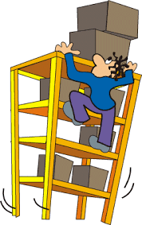
Unsafe Work
Unsafe working conditions are conditions that are dangerous or hazardous to any person expected to be on the premises of place of work.
Workers have the right to refuse dangerous work and are protected from reprisal for exercising this right.
Employers cannot take or threaten disciplinary action against a worker for exercising their rights and duties under the legislation.
Our management supports and encourages any employee who observes and stops unsafe working conditions
Notes:
Unsafe Work
Unsafe working conditions are conditions that are dangerous or hazardous to any person expected to be on the premises of place of work.
Workers have the right to refuse dangerous work and are protected from reprisal for exercising this right.
Employers cannot take or threaten disciplinary action against a worker for exercising their rights and duties under the legislation.
Our management supports and encourages any employee who observes and stops unsafe working conditions

Slide 17
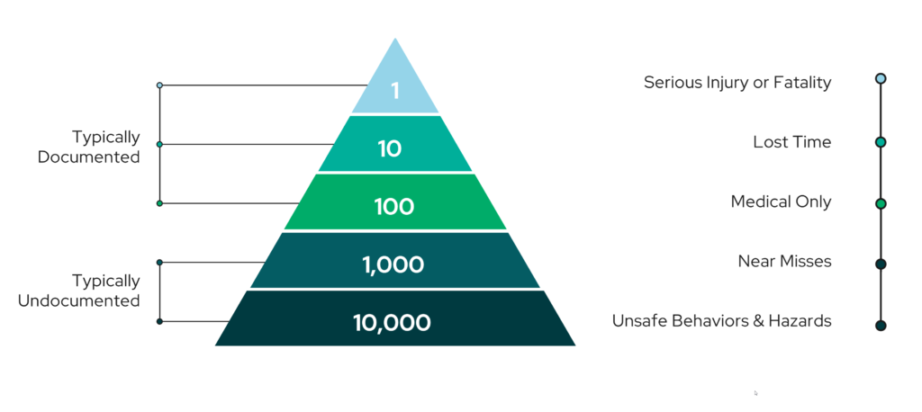
Near Miss
A near miss is an event or hazard that does not result in injury, illness or damage, but had the potential to do so.
Near misses must be reported, regardless of how severe, in order to ensure that the appropriate steps are taken to prevent a recurrence in which serious injury or loss may occur.
Near Misses are Warnings
Notes:
Near Miss
A near miss is an event or hazard that does not result in injury, illness or damage, but had the potential to do so.
Near misses must be reported, regardless of how severe, in order to ensure that the appropriate steps are taken to prevent a recurrence in which serious injury or loss may occur.
Near Misses are Warnings

Slide 18
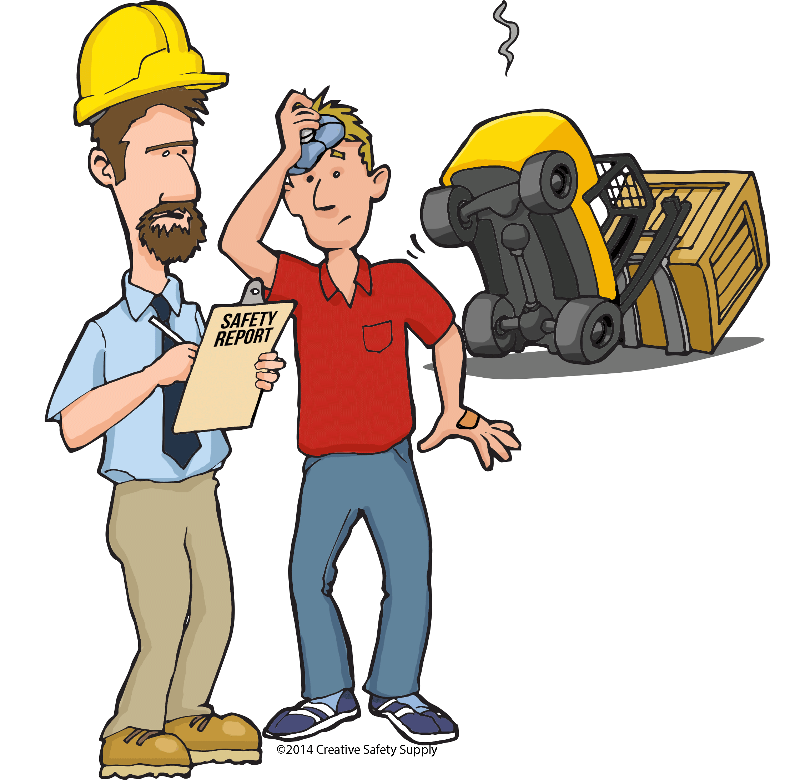
Incident Reporting
An accident/incident investigation identifies any unsafe conditions, acts, or procedures that may have contributed to the injury/illness to the worker and prevents others from being injured in the same manner.
Report any incident to your supervisor or safety officer immediately.
Company will conduct incident investigation to find out root causes and will implement preventive measures to avoid reoccurrence
Notes:
Incident Reporting
An accident/incident investigation identifies any unsafe conditions, acts, or procedures that may have contributed to the injury/illness to the worker and prevents others from being injured in the same manner.
Report any incident to your supervisor or safety officer immediately.
Company will conduct incident investigation to find out root causes and will implement preventive measures to avoid reoccurrence

Slide 19
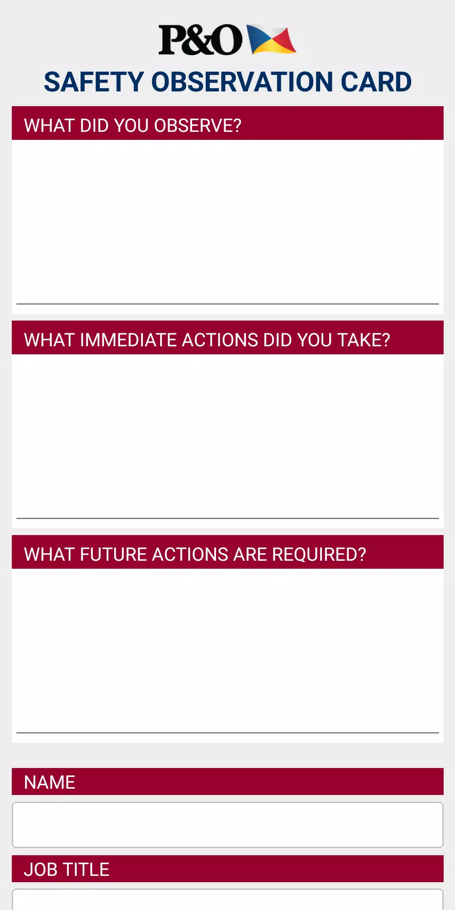

Safety Observation Card
A safety observation card is a very quick form where employees identify a potential hazard and report it to their leadership group
You can report positive observations and negative observations
Anyone can submit a Safety Observation Card
Notes:
Safety Observation Card
A safety observation card is a very quick form where employees identify a potential hazard and report it to their leadership group
You can report positive observations and negative observations
Anyone can submit a Safety Observation Card

Slide 20

Code of Conduct
It is a set of rules about how employees can and can’t behave during and after work hours while employed.
Few topics are,
Respect (including harassment, discrimination, and more)
Use of company property
Personal appearance (including cleanliness and dress code)
Absenteeism and lateness
Conflicts of interest
Communication and collaboration
Your behavior has an impact in company reputation in front of client
Notes:
Code of Conduct
It is a set of rules about how employees can and can’t behave during and after work hours while employed.
Few topics are,
Respect (including harassment, discrimination, and more)
Use of company property
Personal appearance (including cleanliness and dress code)
Absenteeism and lateness
Conflicts of interest
Communication and collaboration
Your behavior has an impact in company reputation in front of client

Slide 21



Environmental Management
3 R’s
Reduce: Reduction of waste generation 〈Don't be wasteful. Reduce garbage.〉
Reuse: Reuse of products and parts 〈Use things again and again.〉
Recycle: Use of recycled resources 〈Recycle resources for reuse.〉
Notes:
Environmental Management
3 R’s
Reduce: Reduction of waste generation 〈Don't be wasteful. Reduce garbage.〉
Reuse: Reuse of products and parts 〈Use things again and again.〉
Recycle: Use of recycled resources 〈Recycle resources for reuse.〉

Slide 22

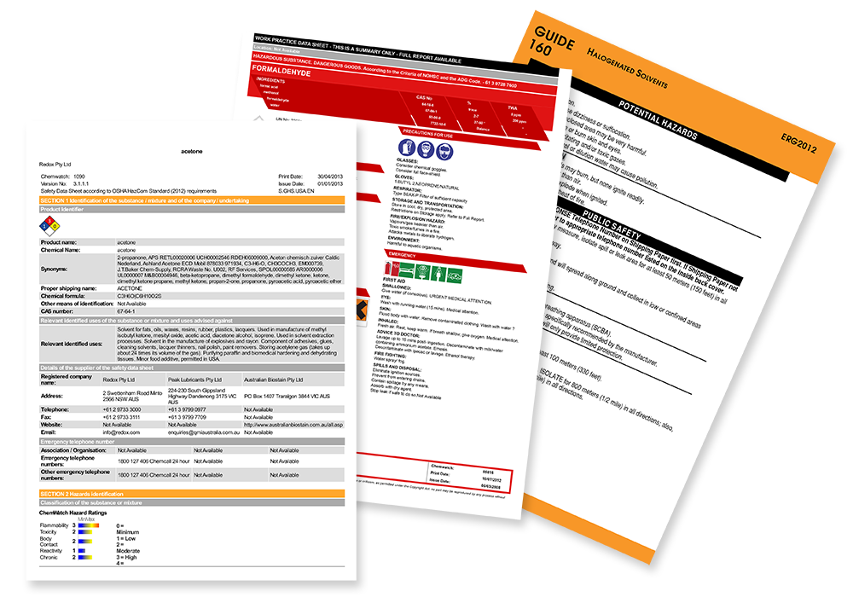
Chemical Management (COSHH)
Working with Hazardous Substances
All chemicals will contain SDS (Safety Data Sheet), read before handling.
Store all hazardous materials properly, separate incompatibles, and store in ventilated, dry, cool areas.
Employees must keep themselves and the work area clean from chemical spill
After handling any hazardous material, wash thoroughly with soap and water.
Conduct risk assessment before handling chemicals
Notes:
Chemical Management (COSHH)
Working with Hazardous Substances
All chemicals will contain SDS (Safety Data Sheet), read before handling.
Store all hazardous materials properly, separate incompatibles, and store in ventilated, dry, cool areas.
Employees must keep themselves and the work area clean from chemical spill
After handling any hazardous material, wash thoroughly with soap and water.
Conduct risk assessment before handling chemicals

Slide 23
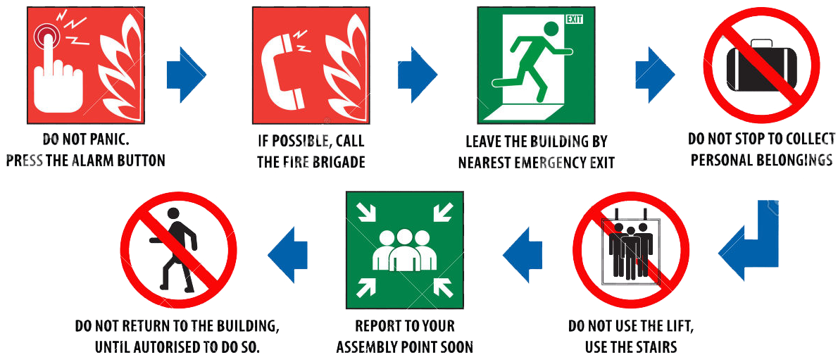
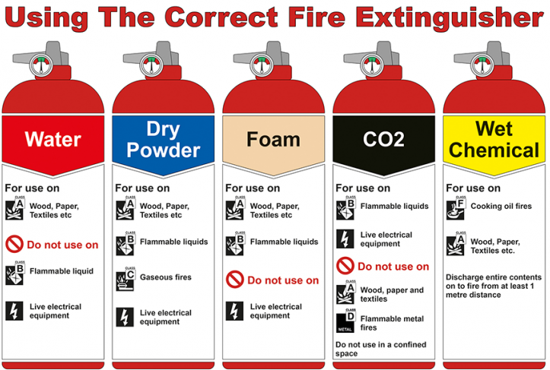
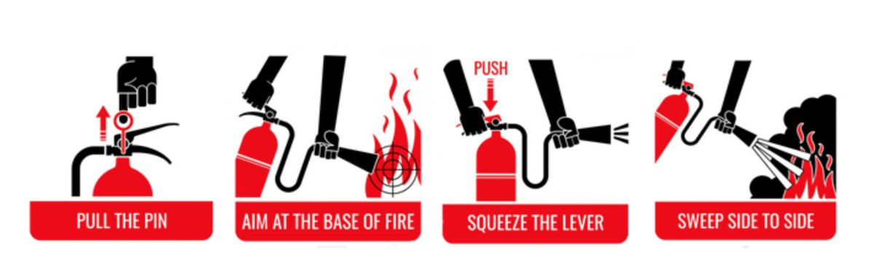
Fire Safety Awareness

Slide 24
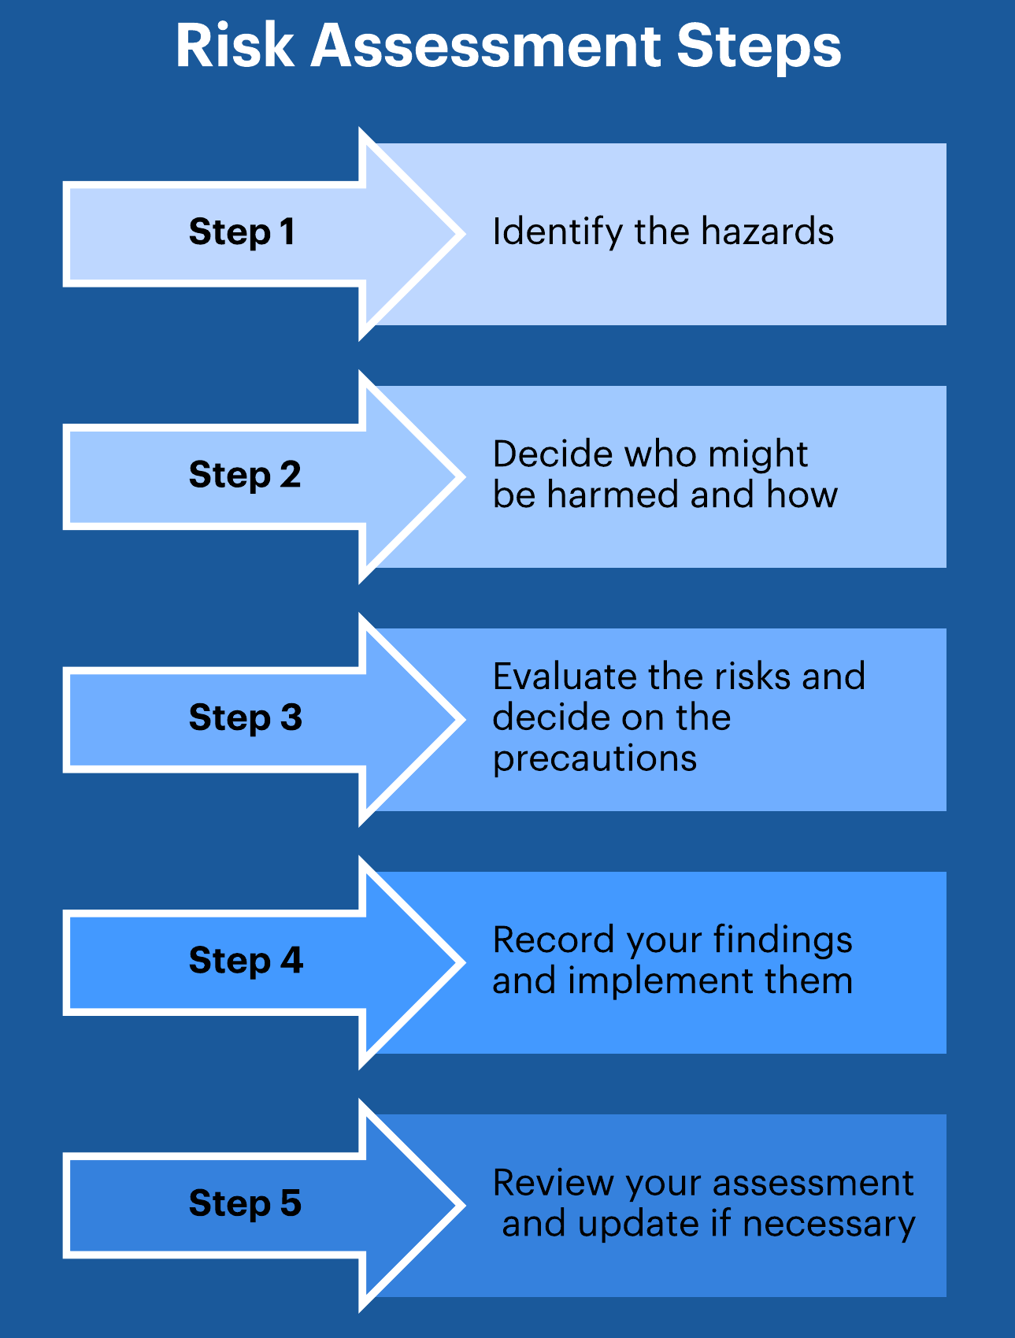
Risk Assessment
All activities performed at site has a generic risk assessment in place, always read and understand the risk and mitigations before start
Use the LMRA checklist to identify hazards around you which is not covered in the job specific RA
Do not start any work without the identified mitigation of risk is implemented
Notes:
Risk Assessment
All activities performed at site has a generic risk assessment in place, always read and understand the risk and mitigations before start
Use the LMRA checklist to identify hazards around you which is not covered in the job specific RA
Do not start any work without the identified mitigation of risk is implemented

Slide 25
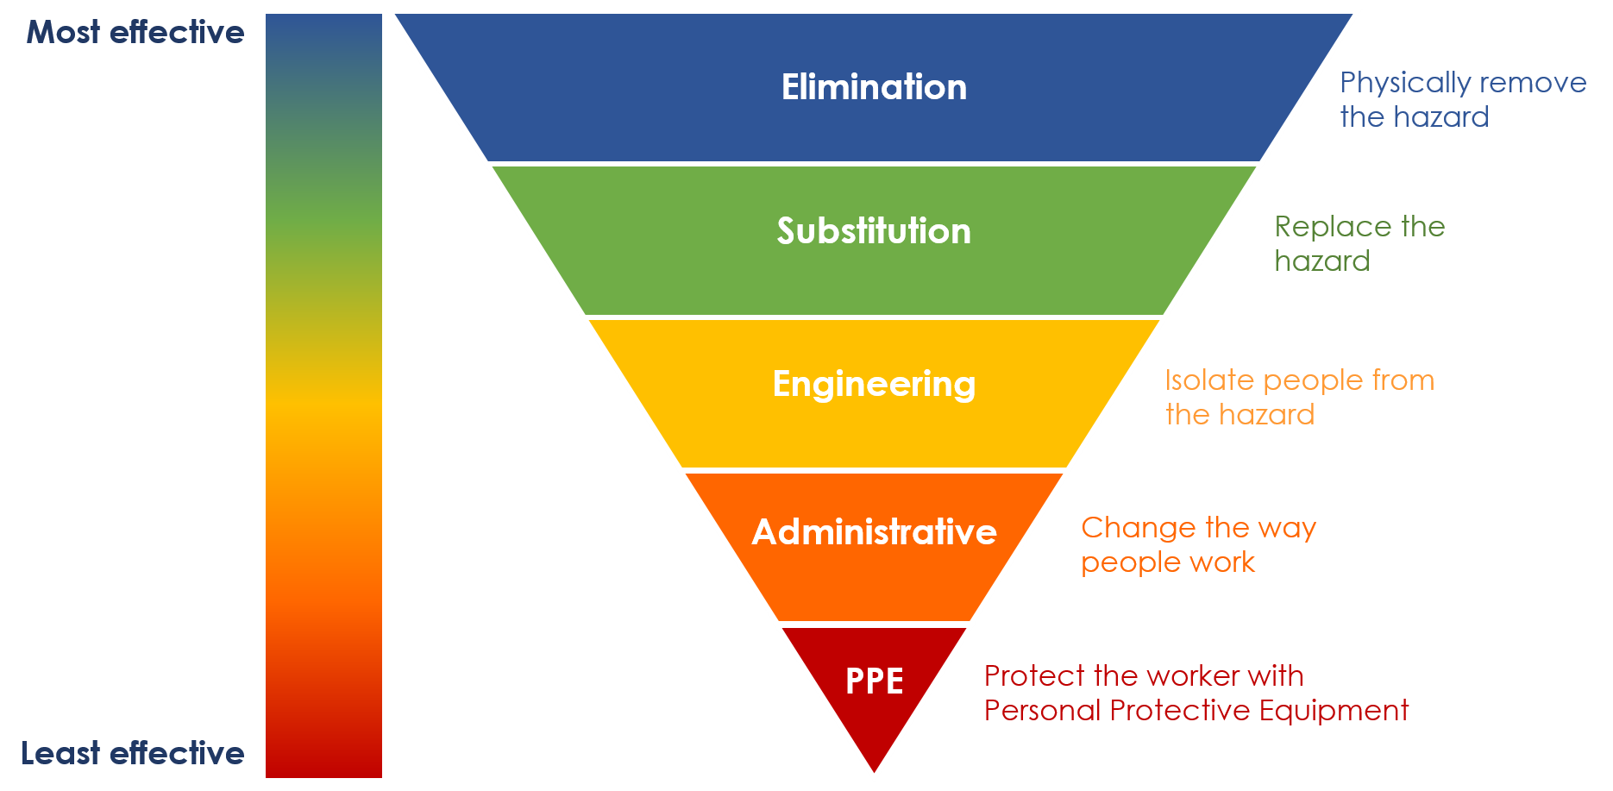
Risk Assessment

Slide 26
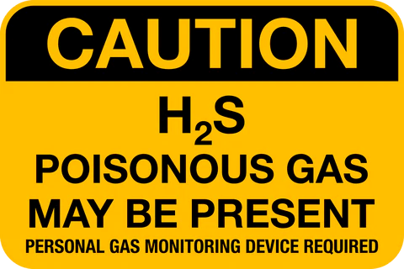

H2S Awareness
Hydrogen sulfide (H2S) presents a potential hazard to workers at many work sites.
Highly toxic, poisonous gas deadly to humans has no visible color.
When ignited, H2S produces Sulfur Dioxide (SO2) which is extremely hazardous
It is 20% heavier than air, and can be dispersed great distances with only a slight breeze
Can be easily detected due to a strong odor of rotten eggs
Can irritate the eyes and respiratory tract at low concentrations
A concentration greater than 700 ppm, inhalation may cause coma and/or death after a single breath
If you should smell the presence of H2S or hear warnings from monitor alarms, then immediately evacuate this area.
The exposure limit should be set to alarm at a concentration of 10 ppm.
Notes:
H2S Awareness
Hydrogen sulfide (H2S) presents a potential hazard to workers at many work sites.
Highly toxic, poisonous gas deadly to humans has no visible color.
When ignited, H2S produces Sulfur Dioxide (SO2) which is extremely hazardous
It is 20% heavier than air, and can be dispersed great distances with only a slight breeze
Can be easily detected due to a strong odor of rotten eggs
Can irritate the eyes and respiratory tract at low concentrations
A concentration greater than 700 ppm, inhalation may cause coma and/or death after a single breath
If you should smell the presence of H2S or hear warnings from monitor alarms, then immediately evacuate this area.
The exposure limit should be set to alarm at a concentration of 10 ppm.

Slide 27


Notes:
Supreme team thank you for participating the HSE induction , if you have any questions please contact the supervisor or concerned person..

