Slide 1



Slide 2
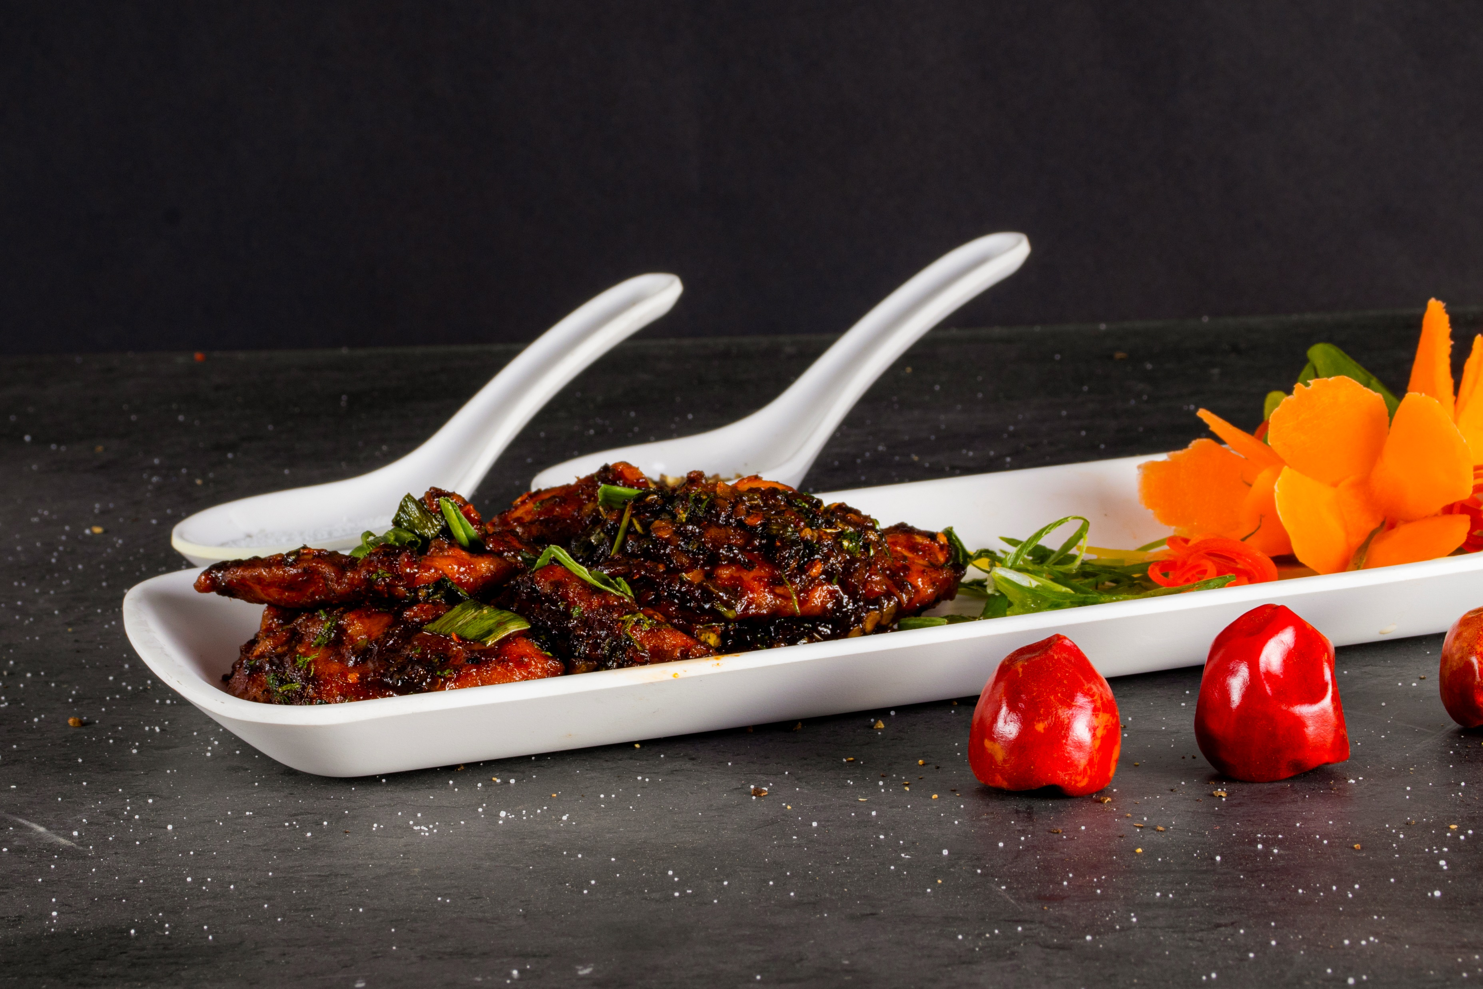
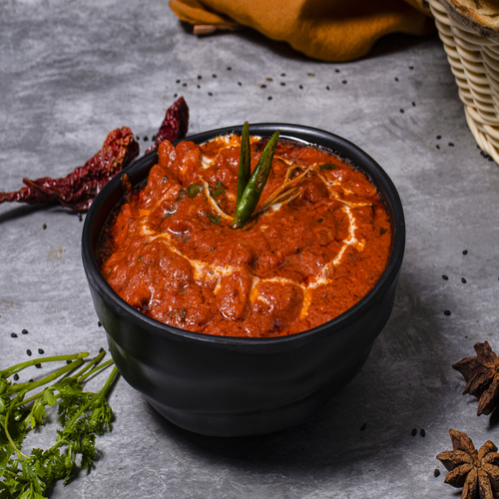
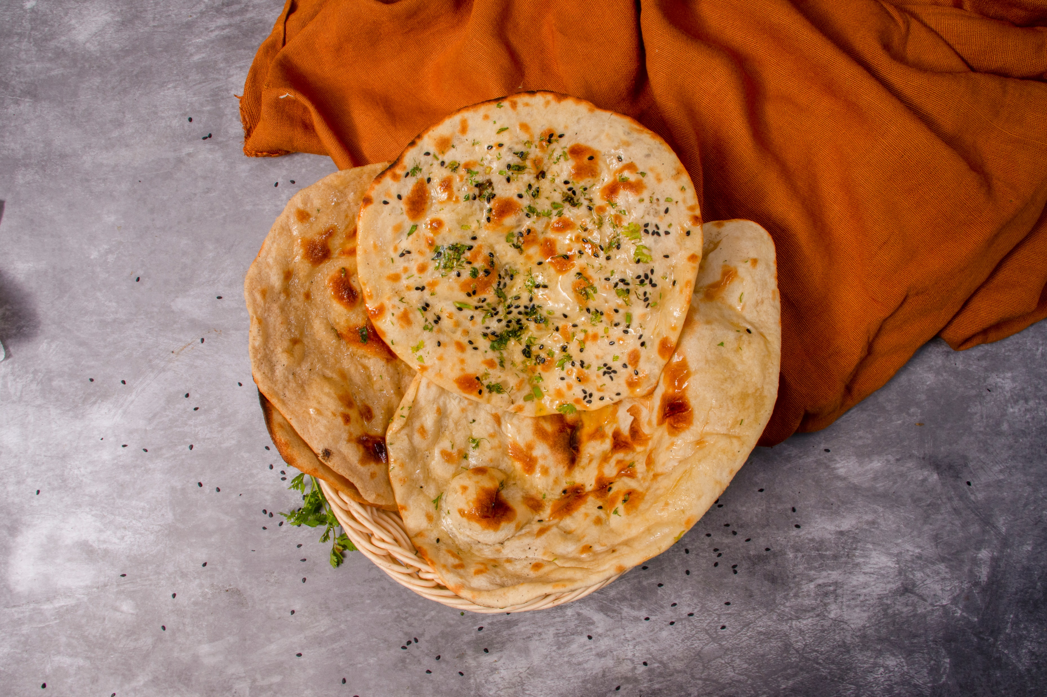
Chicken
Teriyaki Dry
Delhi Da
Murg Makhni
Roti, Naan,
Paratha, Kulcha

Slide 3
We Cater for You!
Birthday Parties
Events
Family functions
Get Togethers
Corporate Parties
Office Parties
Indian Cuisine
Tandoor
Chinese Cuisines
Mughlai Food
Veg & Non Veg
Soups
Starters
Main Course
Dal
Rice
Biriyani
Roti/Naan

Slide 4
Flat 30% OFF!
on orders above 3000*

Slide 5
9004590057
myriaadfoods@gmail.com
Free Delivery
All over Mumbai

Slide 6
Celebrate your Happy Moments
with Myriaad Foods!
Give us a chance to serve you
the food With Best Quality
and a handsome quantity

