Slide 1
COURSE CODE: 102
Dr. Muhammad Umair
SEMESTER:1 (Fall 2021)
REFERENCE TEXT BOOK:
TEXTBOOK OF MEDICAL PHYSIOLOGY
GYTON & HALL

Slide 2
OVERVIEW
Environment
Fluid and its compartments
Homeostasis
Factors that are homeostatically regulated
Systems regulating homeostasis
Feed back mechanisms

Slide 3
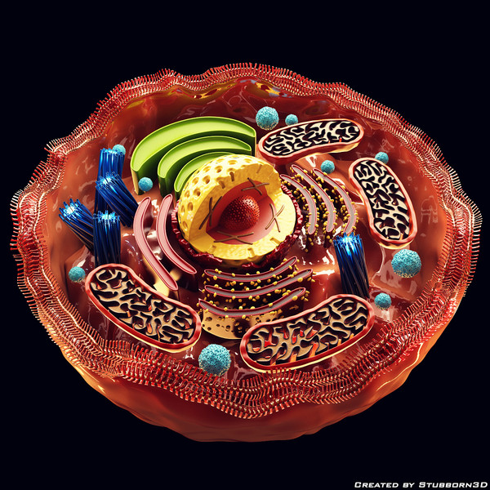
TODAY’S TOPIC
CELL ORGANIZATION,CELL MEMBRANE,CELL ADHESION MOLECULES,CELL OGRANELLES,PHAGOCYTOSIS ,ENDOCYTOSIS AND PINOCYTOSIS

Slide 4
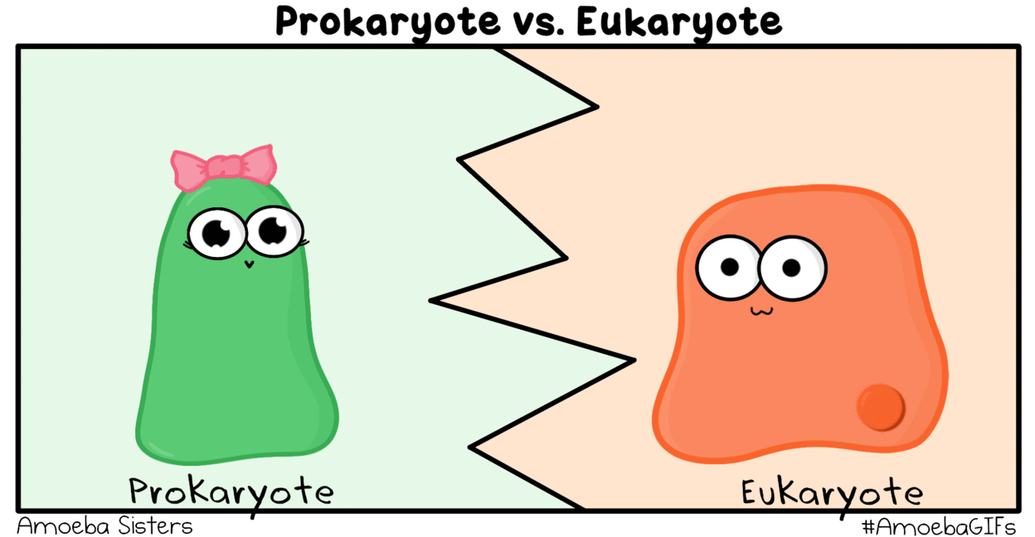
OUTLINE
Cell Organization
Cell Membrane
Cell adhesion molecules
Cell Organelles
Phagocytosis
Endocytosis
Pinocytosis

Slide 5
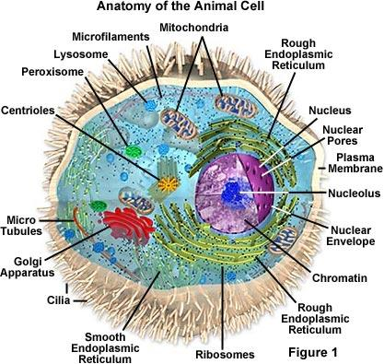
CELL PHYSIOLOGY
Basic living unit of body
Entire body contains almost 100 trillions cells

Slide 6
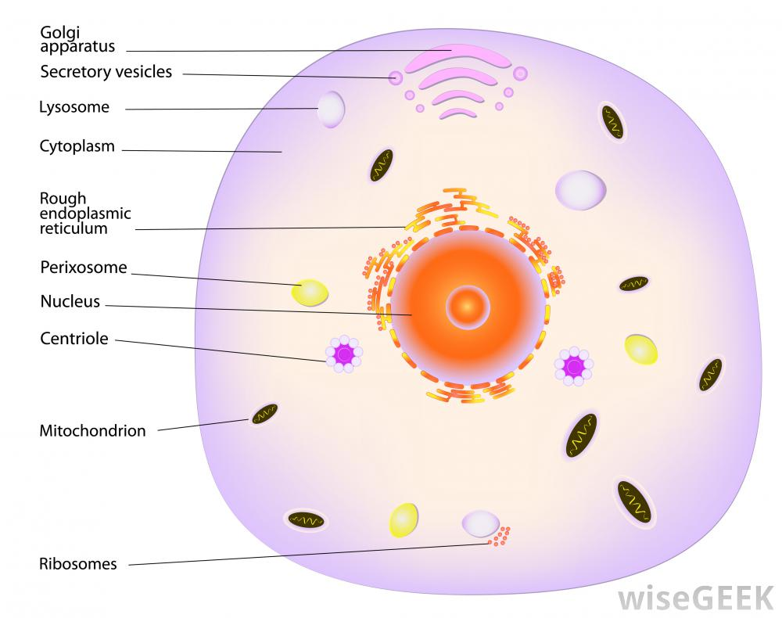
ORGANIZATION OF CELL
2 major components of cell.
Nucelus
Cytoplasm

Slide 7
ORGANIZATION OF CELL
Different substances that makeup cell collectively called protoplasm
Protoplasm is composed of:
  Water
  Electrolytes
  Proteins
  Lipids
  Carbohydrates

Slide 8
CELL MEMBRANE
Outermost limit of a cell
More than a simple boundary surrounding the cellular contents
Many metabolic reactions take place on its surfaces

Slide 9
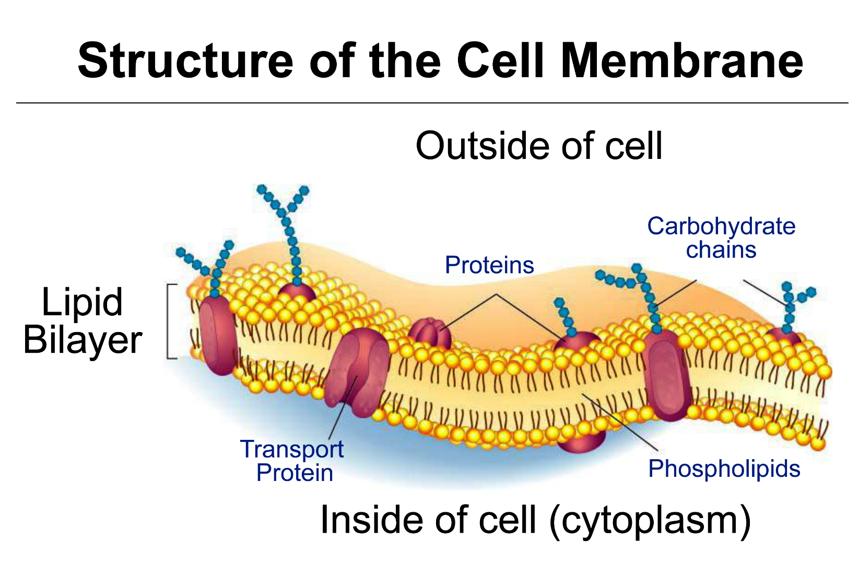

Slide 10
GENERAL CHARACTERISTICS
Extremely thin
Flexible and elastic
Complex surface features with
  Outpouchings and
  Infoldings
  Increase surface area

Slide 11
GENERAL CHARACTERISTICS
If damaged
  Cell membrane quickly seals tiny breaks
If damage is extensive
  Cell contents escape
  The cell dies
Act as selectively permeable membrane
  Allowing some in while excluding others

Slide 12
CELL MEMBRANE STRUCTURE
Composed of lipids and proteins, with some carbohydrate
Phospholipid bilayer
Heads contain phosphate groups
  Form the surfaces of the membrane
  Water-soluble (hydrophilic or “water-loving”)

Slide 13
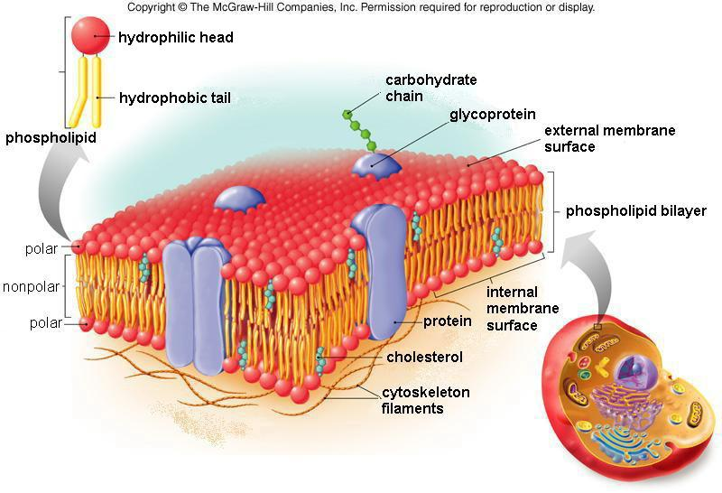

Slide 14
CELL MEMBRANE STRUCTURE
Tails consisting of fatty acid chains,
  Make up the interior of the membrane
  Water insoluble (hydrophobic or “water-fearing”)

Slide 15
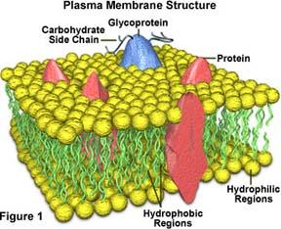

Slide 16
INTERIOR OF CELL MEMBRANE
Consists of the fatty acid portions
Lipids soluble molecules can pass through this layer
  Oxygen
  Carbon dioxide
Steroid hormones Impermeable to water-soluble molecules
  Amino acids
  Sugars
  Proteins
  Nucleic acids
  Various ions

Slide 17
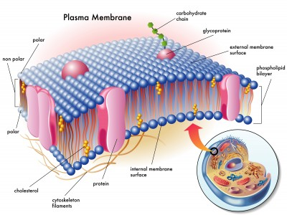

Slide 18
SPECIALIZED PROTEINS
Cell membrane includes many kinds of specialized proteins
globular proteins
fibrous proteins

Slide 19
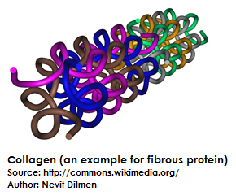
FIBROUS PROTEINS
Extend outward from its surface on one end
They are water insoluble.
They have supporting functions.

Slide 20
INTEGRAL PROTEINS
Form “pores” in the membrane
Allow water molecules to pass through
Other are highly selective
  Form channels that allow only particular ions to enter

Slide 21
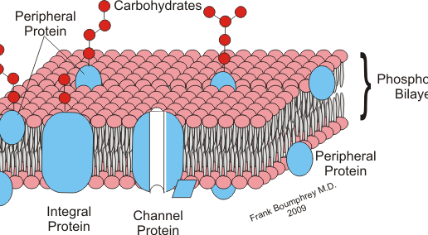
INTEGRAL PROTEINS

Slide 22
PERIPHERAL PROTEINS
Function as enzymes
Many are part of signal transduction
Associated carbohydrate groups form glycoproteins
  Help cells to recognize and bind to each other
  Mark the cells of an individual as self

Slide 23
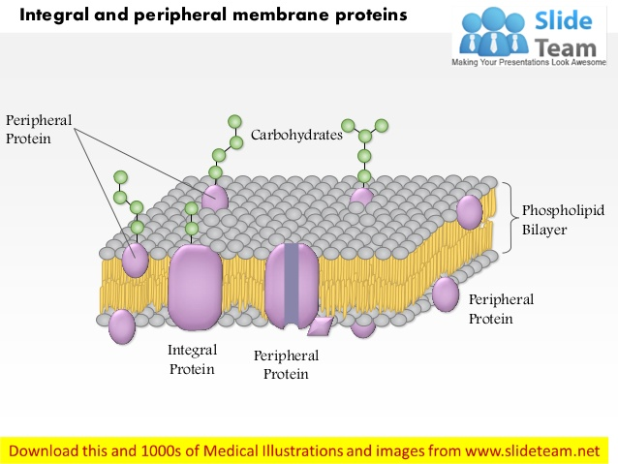
PERIPHERAL PROTEINS

Slide 24
CELLULAR ADHESION MOLECULES
Proteins located on the cell surface
Involved in binding
  With other cells or
  With the extracellular matrix (ECM)
Process called cell adhesion
Selectin
Integrin

Slide 25
INTERCELLULAR JUNCTIONS
Cells are tightly packed by
  Structures called intercellular junctions
Connecting their cell membranes

Slide 26
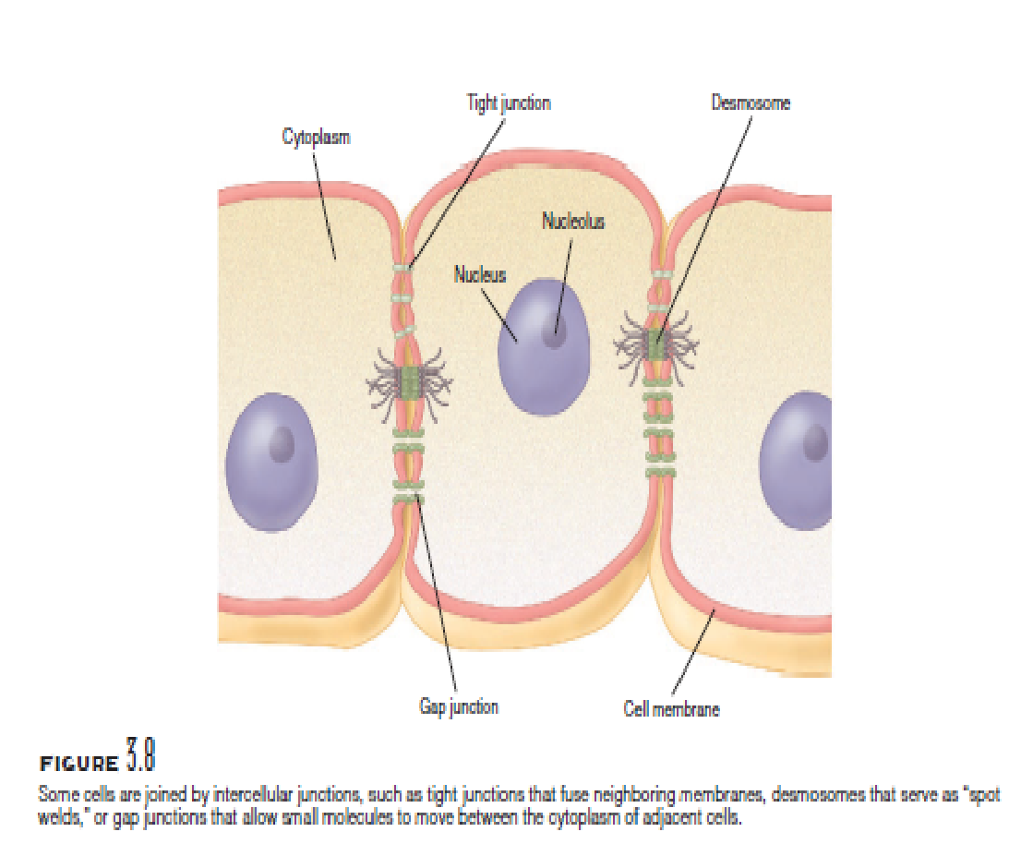
TYPES OF JUNCTIONS
Tight junction
Desmosome
Gap junctions

Slide 27
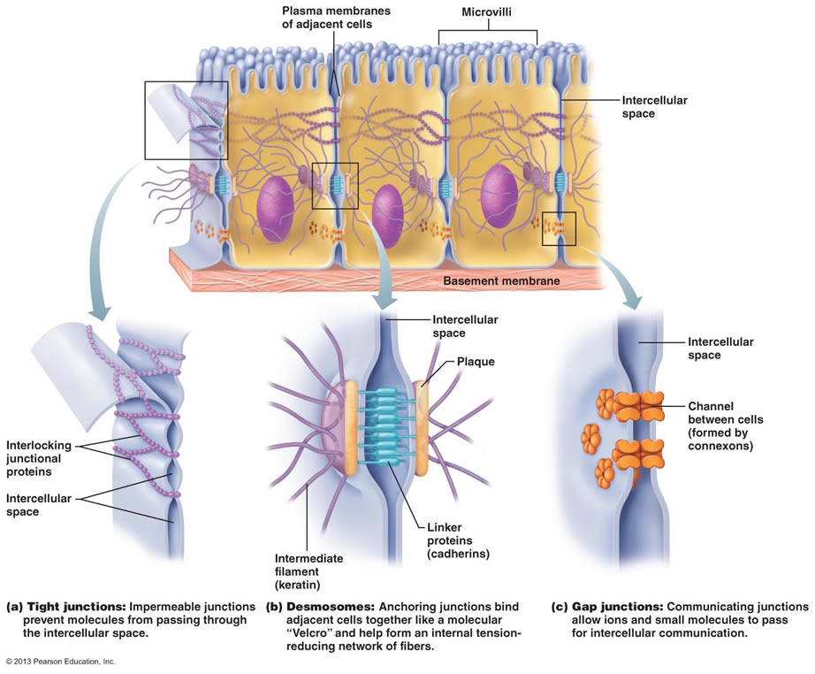

Slide 28
TIGHT JUNCTIONS
The membranes of adjacent cells
  Converge and
  Fuse
Junction closes the space between the cells
Cells that form sheet like layers joined by tight junctions
  Digestive tract

Slide 29
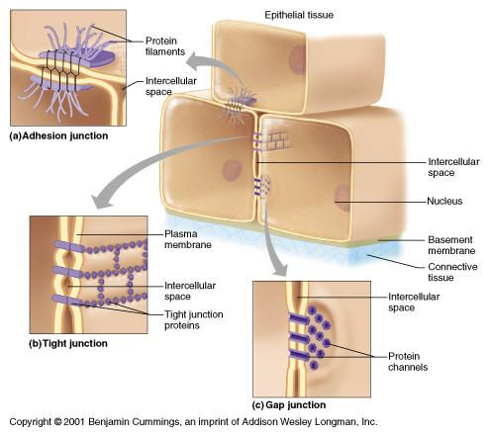
TIGHT JUNCTIONS

Slide 30
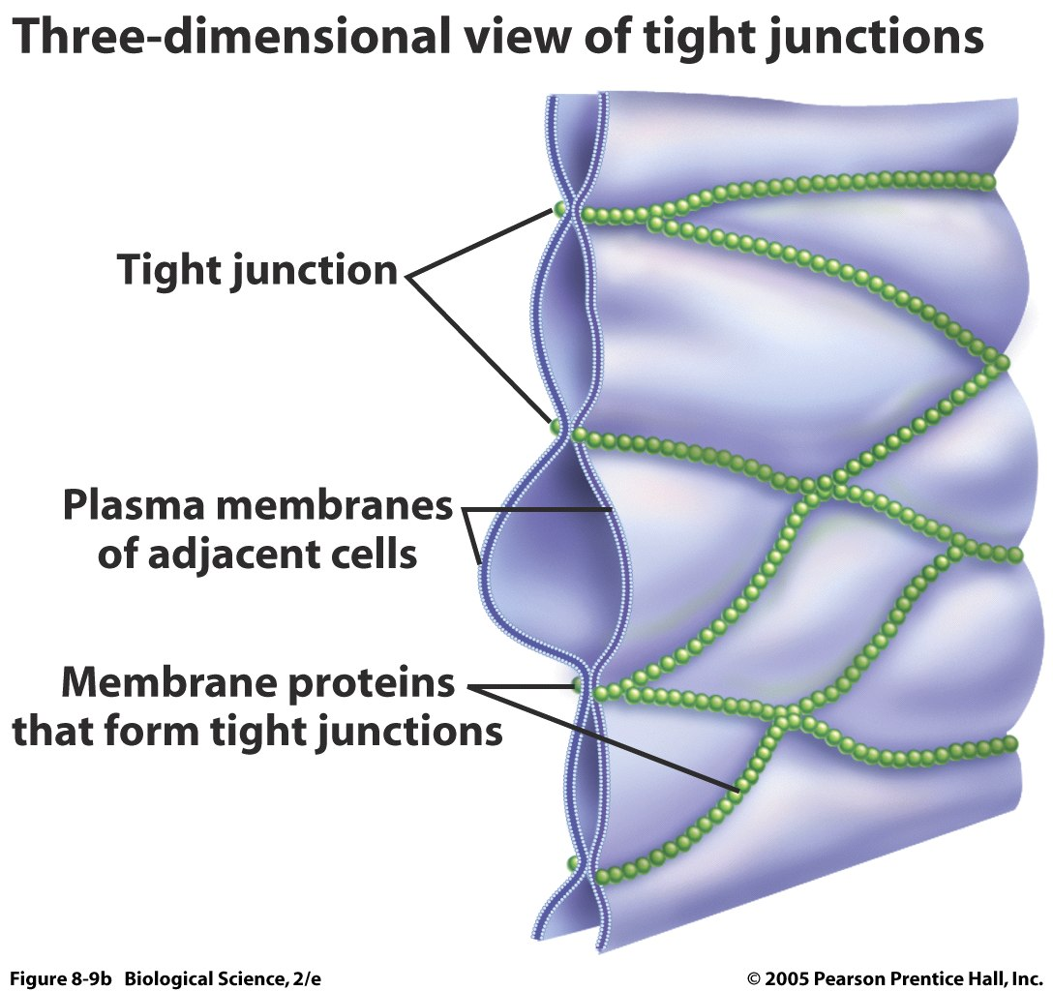

Slide 31
DESMOSOME
Circular, dense body
Attachment between certain epithelial cells
  Stratified epithelium of the epidermis
“Spot welds” adjacent skin cells

Slide 32
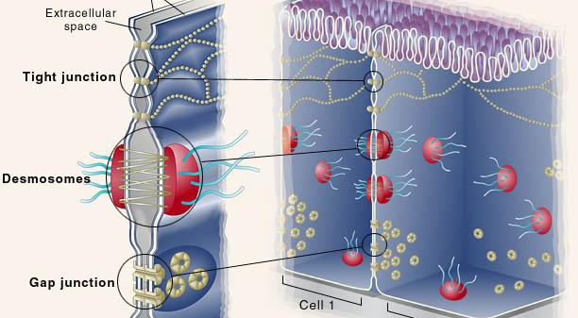
DESMOSOME

Slide 33
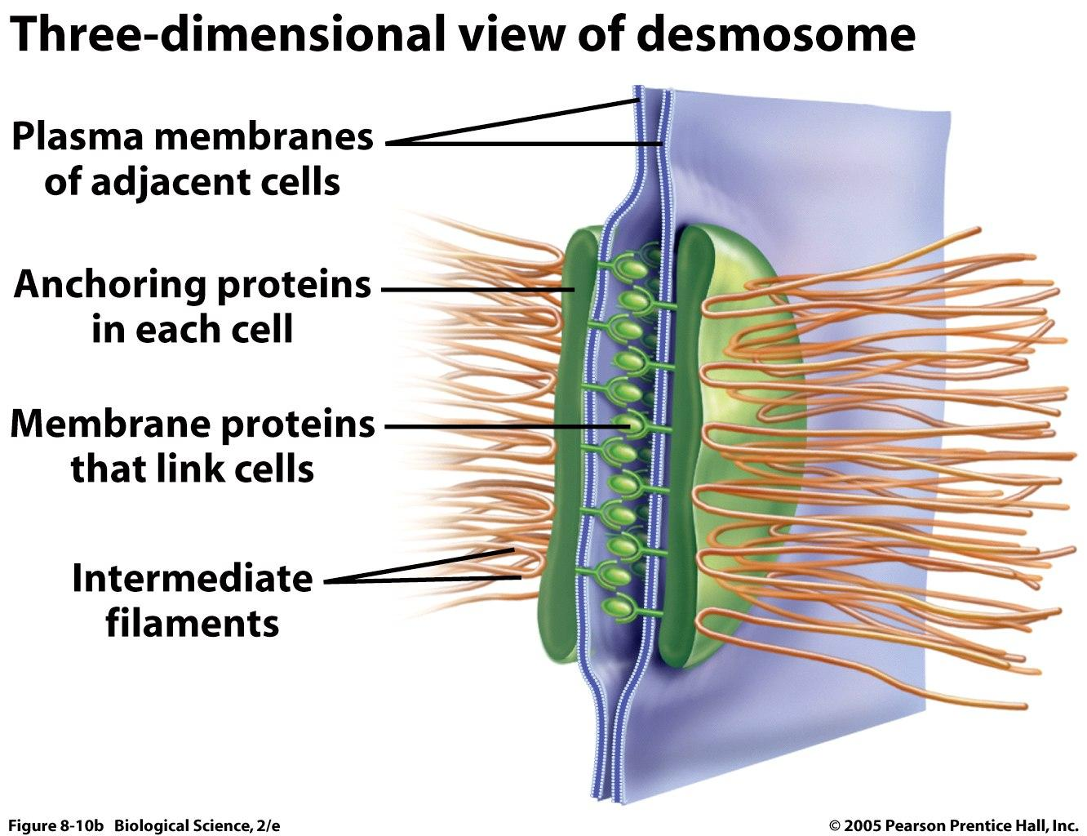

Slide 34
GAP JUNCTIONS
Link the cytoplasm of adjacent cells
Form tubular channels
Present in heart muscle and muscle of the digestive tract
Allow movement of
  Ions
  Nutrients (such as sugars, amino acids, and nucleotides)
  Other small molecules

Slide 35
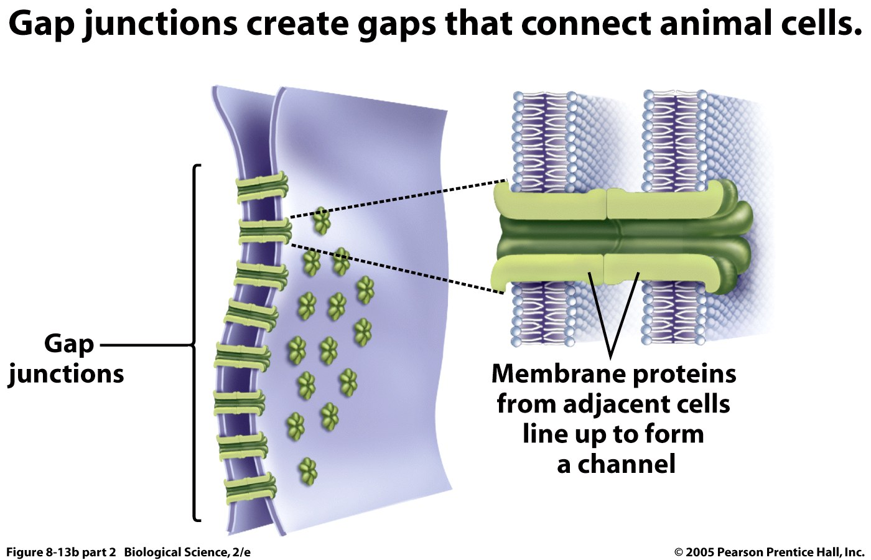

Slide 36
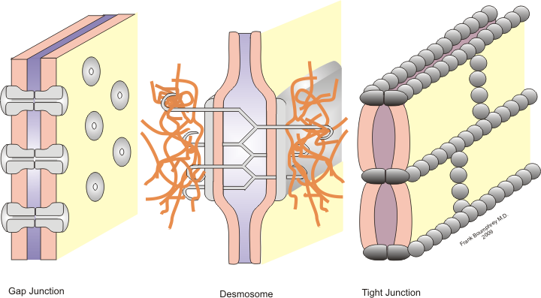
JUNCTIONS

Slide 37
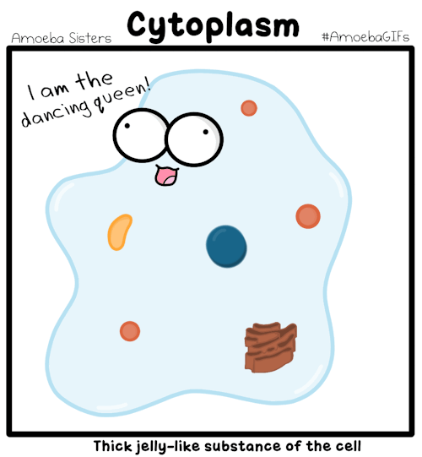
CYTOPLASM
Appears as clear jelly
Contains networks of membranes and organelles suspended in a clear liquid called cytosol
Activities of a cell mostly occur in cytoplasm

Slide 38
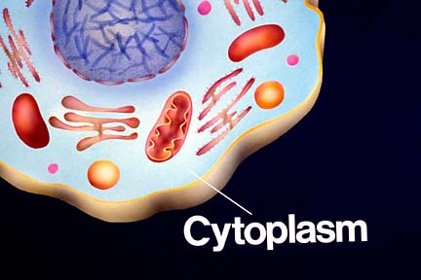

Slide 39
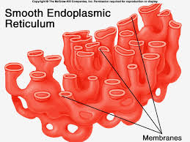
ENDOPLASMIC RETICULUM
Composed of membrane-bound
  Flattened sacs
  Elongated canals
  Fluid-filled vesicles
These are interconnected

Slide 40
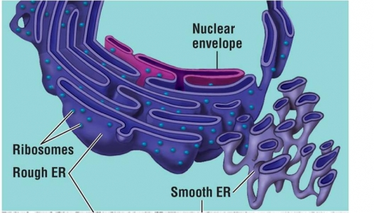
ENDOPLASMIC RETICULUM
Also communicate with
  Cell membrane
  Nuclear envelope
  Certain cytoplasmic organelles

Slide 41
FUNCTION OF ER
Widely distributed through the cytoplasm
Provide a tubular transport system for molecules
Participates in the synthesis of
  Proteins
  Lipid molecules

Slide 42
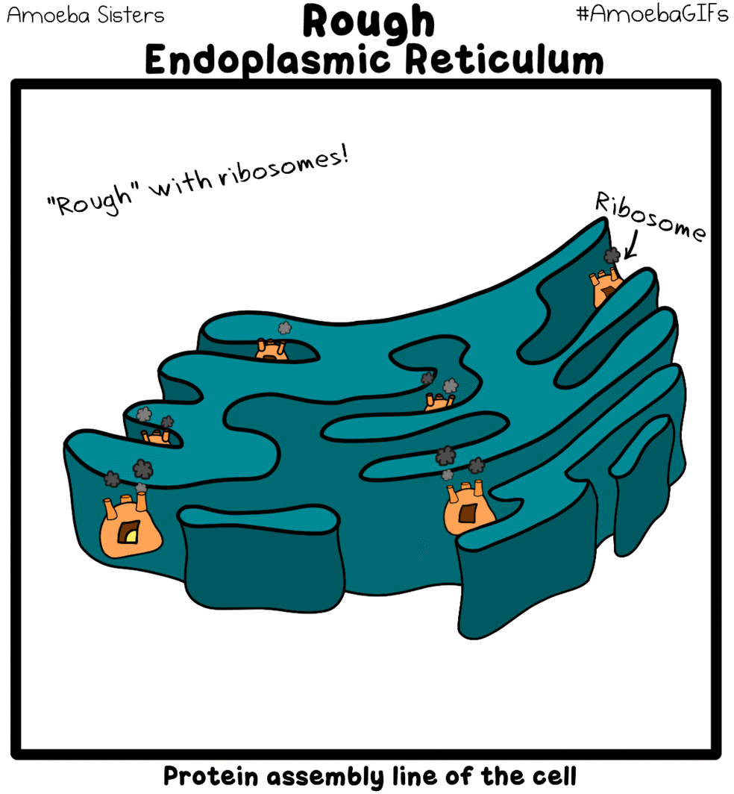
TYPES OF ER
Rough ER
Studded with many tiny, spherical organelles
  Called ribosomes
The ribosomes of rough ER are
  Sites of protein synthesis

Slide 43
TYPES OF ER
Smooth ER
Lacks ribosomes
Contains enzymes
  Important in lipid synthesis

Slide 44
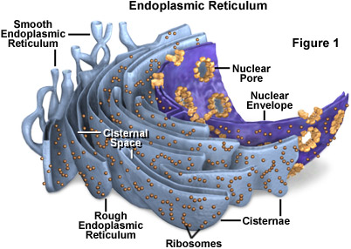
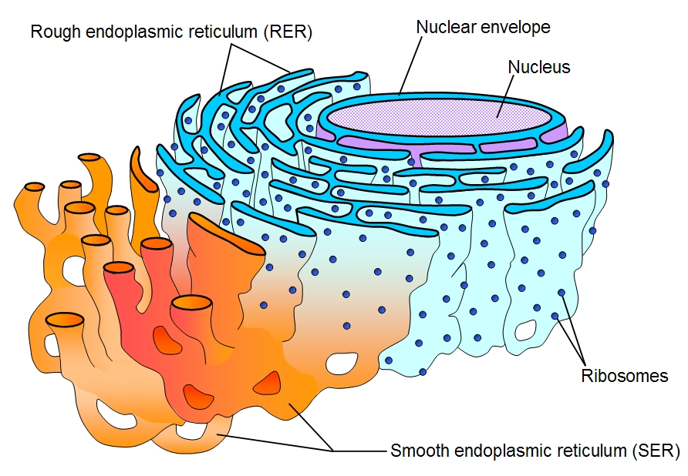

Slide 45
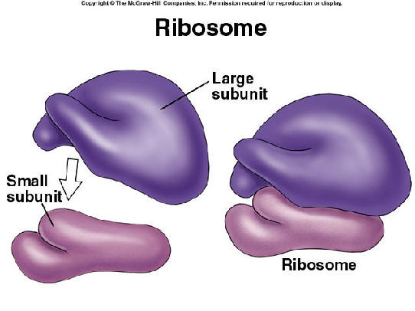
RIBOSOMES
Scattered freely throughout the cytoplasm
Composed of protein and RNA
Provide a structural support to cell
Serves as the primary site of biological protein synthesis

Slide 46
FUNCTIONAL SYSTEMS OF CELL
Nutrients pass through cell membrane by
Diffusion
Active transport

Slide 47
DIFFUSION
Simple movement through
Cell membrane
Lipid matrix of cell membrane

Slide 48
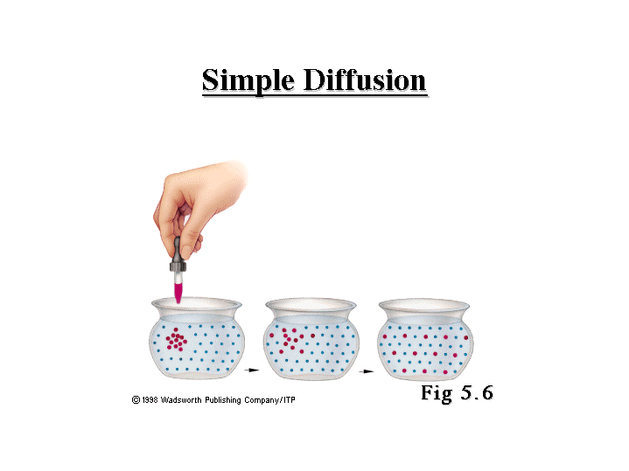
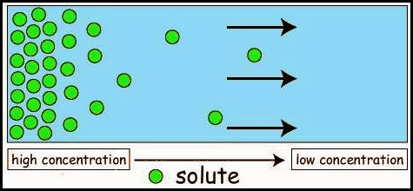
Simple Diffusion: The movement of particles or molecules from a region of higher concentration to a region of a lower concentration is called diffusion.

Slide 49
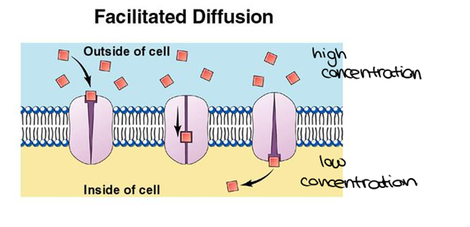
FACILITATED DIFFUSION
Facilitated diffusion is the process of spontaneous passive transport of molecules or ions across a cell's membrane via specific transmembrane integral proteins.

Slide 50
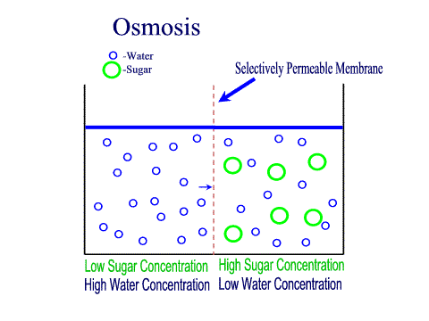
OSMOSIS
Movement of a solvent (as water) through a semipermeable membrane (as of a living cell) into a solution of higher solute concentration that tends to equalize the concentrations of solute on the two sides of the membrane.

Slide 51
ACTIVE TRANSPORT
Uptake of substances through
  Protein structure of cell membrane
  By using energy

Slide 52
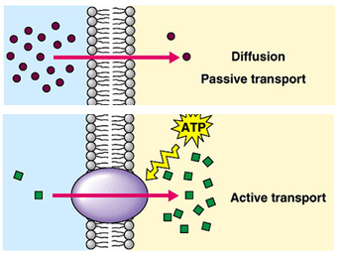

Slide 53
ENDOCYTOSIS
Very large substances enter cell
  By endocytosis
Two forms of endocytosis
  Pinocytosis
  Phagocytosis

Slide 54
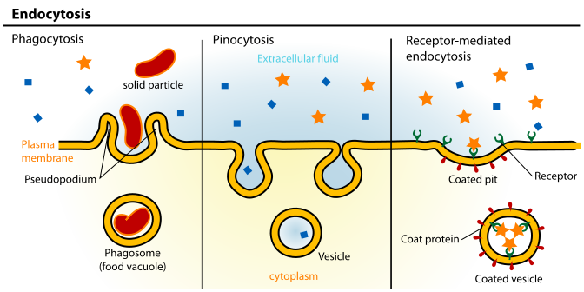

Slide 55
PINOCYTOSIS
Known as fluid endocytosis
Small particles are brought into the cell by
  Forming an invagination
  Then suspended within small vesicles

Slide 56
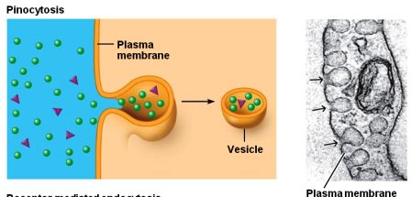
PINOCYTOSIS

Slide 57
PHAGOCYTOSIS
Occurs in same way as pinocytosis
Ingestion of large particles, as
  Bacteria
  Whole cells
  Portion of degenerating tissue

Slide 58
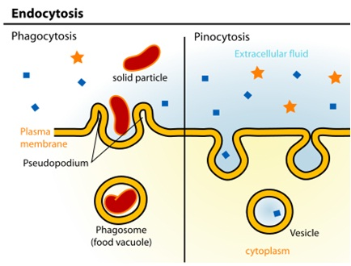

Slide 59
REVIEW OF CELLULAR ORGANELLES

Slide 60
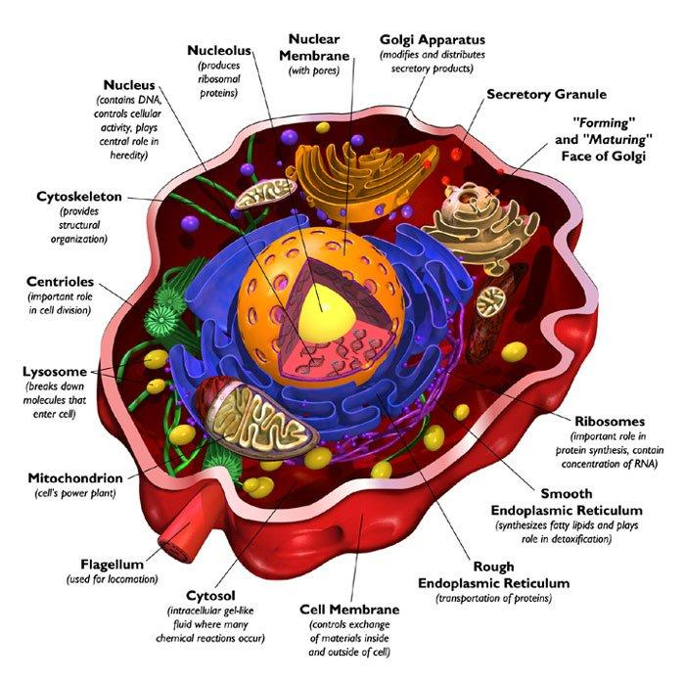

Slide 61
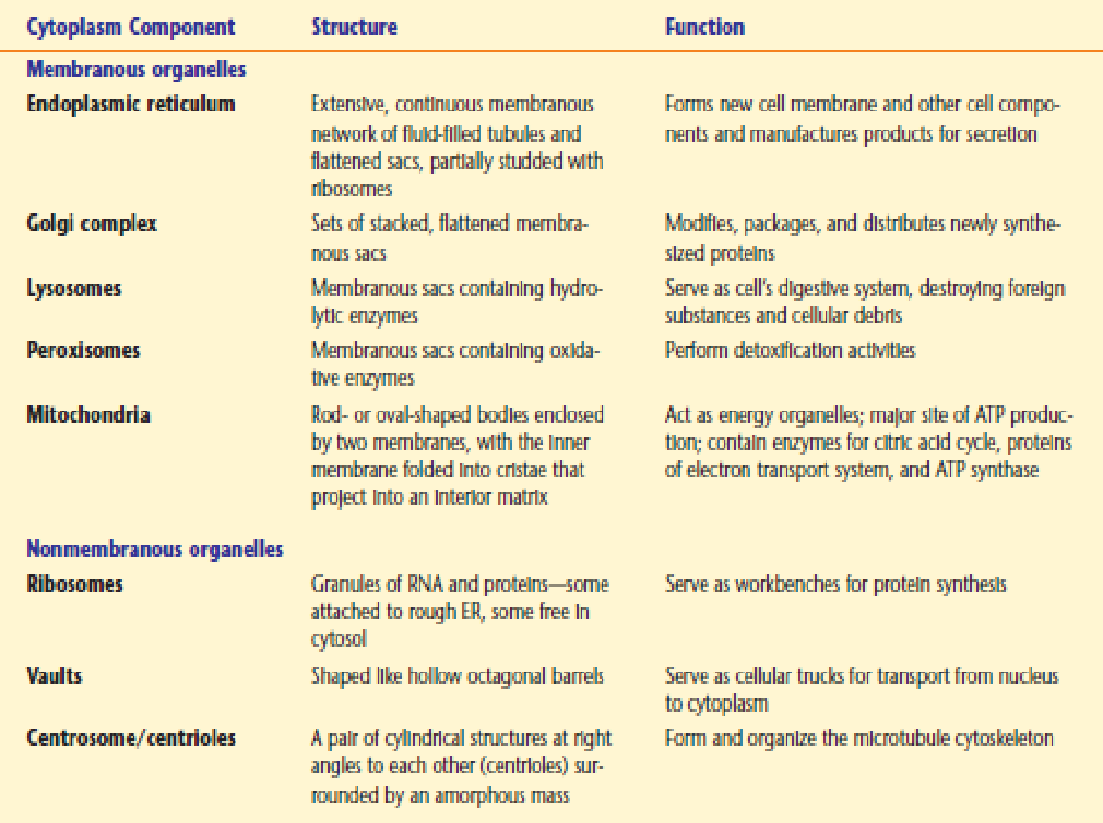

Slide 62
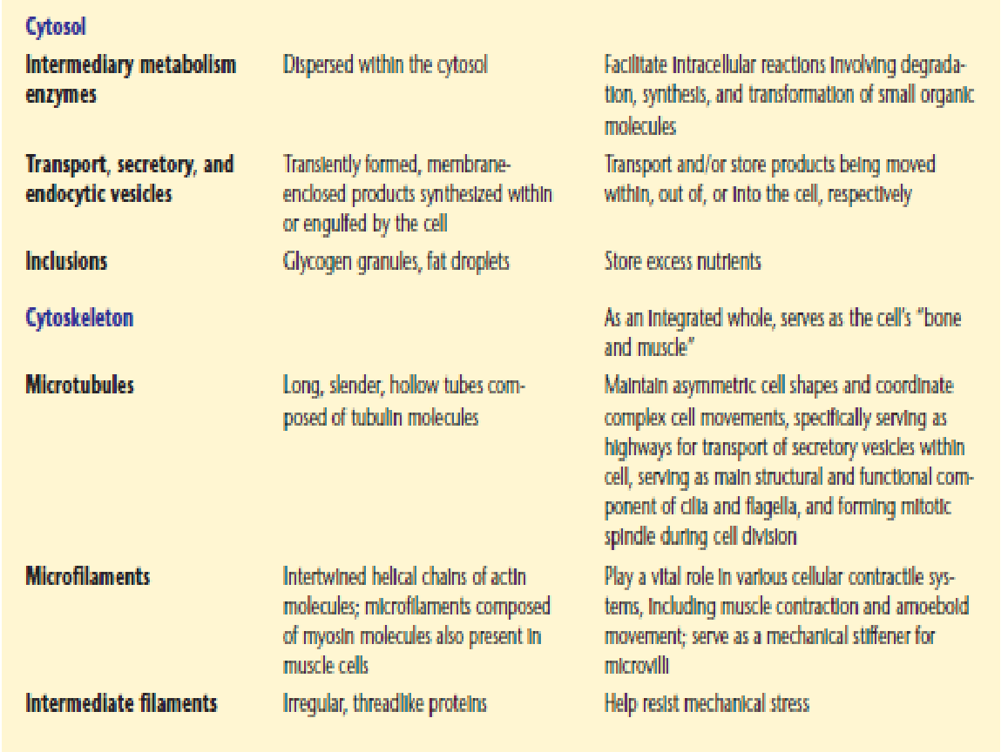

Slide 63


Slide 64
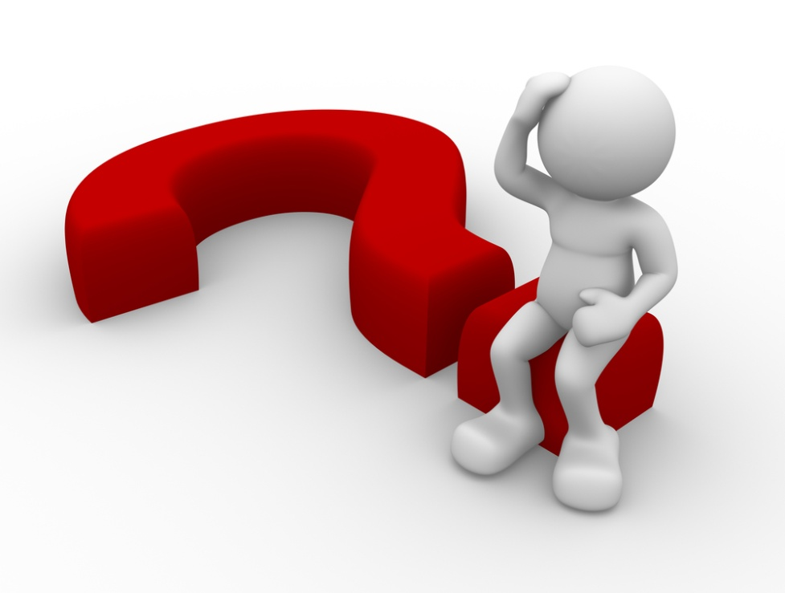
Circular proteins interconnecting various cells are known as:
Tight junction
Gap junction
Desmosomes
None of the above

Slide 65
Circular proteins interconnecting various cells are known as
Tight junction
Gap junction
Desmosomes
None of the above

Slide 66
Eukaryotic ribosomes are of:
70 S
50 S
60 S
80 S

Slide 67
Eukaryotic ribosomes are of
70 S
50 S
60 S
80 S

Slide 68
Rough ER is involved in synthesis of
Lipids
Carbohydrates
Proteins
Fatty acids

Slide 69
Rough ER is involved in synthesis of
Lipids
Carbohydrates
Proteins
Fatty acids

Slide 70
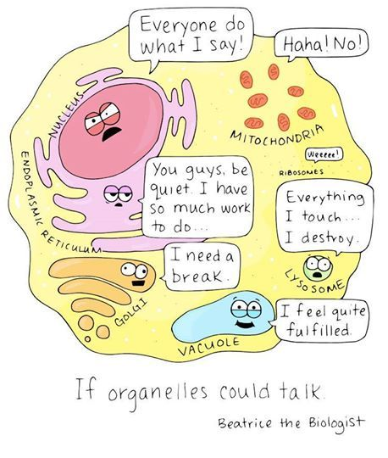
Any Questions??

Slide 71

QUOTE OF THE DAY

