Slide 1
Human Physiology II
Introduction to Reproductive system
Nusrat Hossain

Slide 2
REPRODUCTIVE SYSTEM
The reproductive system is a group of organs that allow procreation (the process which allows two living beings to produce a third, separate being).
Reproductive system allows genetic material to pass from one generation to another. Unlike any other system in the human body, the male and female reproductive systems are complementary to one another.
Reproduction is the biological process by which new "offspring" individual organisms are produced from their "parents". It is a fundamental feature of all known life; each individual organism exists as the result of reproduction. The methods of reproduction are grouped into: sexual and asexual.
Asexual-an individual can reproduce without involvement with another individual of that species such as by budding, binary fission, fragmentation.
Sexual- requires the involvement of two individuals or gametes, one each from opposite type of sex.

Slide 3
Reproduction is the creation of new individuals of the same species. In human, it is sexual; that is, it requires both a male and a female parent who produce gamates (sex cells: ova in female ovaries and sperm in male testes) that can meet and
combine their genes in a zygote (fertilized egg).
Each reproductive system has also
ducts that transport gamates and
glands that secrete hormones.

Slide 4
Components of Reproductive System
Primary sex organs- testes & ovaries (to produce sex cells-sperms & ova)
Secondary sex organs- ducts (to transport sex cells for fertilization of sperm & ova)
gland (to secrete hormones)
Sexual reproduction contributes to species survival by increasing genetic variability by
(i) creating many possible combination of chromosomes in ova & sperms,
(ii) Varying genetic information on a given combination and
(iii) Mixing information from two parents in the union of ova and sperms.
Possible combination of 23 pairs of chromosomes in ova and sperms is more than 8 millions.

Slide 5
FUNCTIONS OF REPRODUCTIVE SYSTEM
The male reproductive system performs the functions-
(i) production of sperm cells in the testes
(ii) sustaining & transfer of sperm cells to the female duct system to provide
  nutrients to sperm cells,
  environment to mature sex cells,
  secretions to form semen to be transferred to the female
  to transport sex cells through penis to deposit in the female reproductive system
(iii) production of male sex hormones : that control and develop the male reproductive system & behavior and male body.

Slide 6
The female reproductive system performs the functions-
(i) production of female sex cells in the ovaries
(ii) reception of sperm cells from the male, and to transport the sperm cells to the site of fertilization
(iii) nurturing the development of and providing nutrients for the fetus via placenta and infant as milk
(iv) production of female sex hormone that control and develop the female reproductive system & behavior and female body.

Slide 7
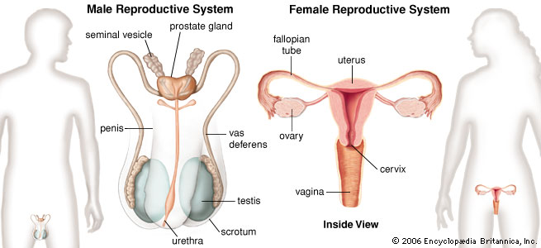
Human Reproductive System

Slide 8
SEX DETERMINATION: ROLE OF SEX CHROMOSOMES
Male or female sex is determined upon fertilization of an ovum by a sperm cell containing an X or a Y chromosome.
Human cells have 23 pairs of chromosomes- 22 pairs of autosomes and 1 pair sex chromosomes.
A sex chromosome may be either a large X-chromosomes or a small Y-chromosome.
An ova/egg contains an X-chromosome, but half of male sperm carry an X-chromosome and other half carry a Y chromosome.
Therefore, If an ovum is fertilized with an X-chromosome bearing sperm, it produces an XX zygote that gives a female baby.
If is fertilized with a Y-chromosome bearing sperm, it gives an XY zygote that a male baby.

Slide 9
DEVELOPMENT OF SEX ORGANS (Hormones and sex differentiation)
A fetus is sexually undifferentiated, or 'noncommittal' as to which sex it will be.
Gonads (the primary reproductive organs- ovaries and testes) begin to develop at 5 to 6 weeks as gonadal ridges near the kidneys. Two ducts adjacent to gonadal ridges are:
mesophrenic ducts (wolffian ducts) and
paramesophrenic ducts (mullerian ducts)
In male, mesophrenic ducts develop into the male reproductive tract & the para-mesophrenic ducts degenerate. In female, it is opposite. It is because of
(i) first, the Y-chromosome has a gene for testis determining factor (TDF), which codes for hormone receptor in the embryonic gonad (testes), and
(ii) second, the placenta (a disc of tissue that attach the fetus to mother's uterus) secretes a hormone called human chorionic gonadotropin (HCG).

Slide 10
If the fetus is XX,
its gonad has no HCG receptors and does not respond to the hormone.
In such case, para-mesophrenic ducts develop into the female reproductive tract and the mesophrenic ducts degenerate
If the fetus is XY,
its gonad has HCG receptors that respond to the hormone.
By 8 to 10 weeks, it begins to secretes mullaerian-inhibiting factor (MIF) and androgen (mainly testosterone and less dihydrortestosterone).
Androgens stimulate the mesophrenic duct to develop into male reproductive tract, while MIF causes the para-mesophrenic duct to regress, which is opposite in female.

Slide 11
In female embryo, the cortex of gonads becomes ovaries and
In male embryo, medulla of gonads becomes the testes.
As female development proceeds, paramesophrenic ducts become uterine ducts which fuse in the middle to form the uterus and vagina.
As male development proceeds, mesophrenic ducts become male genital ducts.
Gonadotropin and Y chromosome causes testes development to secretes testosterone.
Female embryo without testosterone develops female ducts.

Slide 12
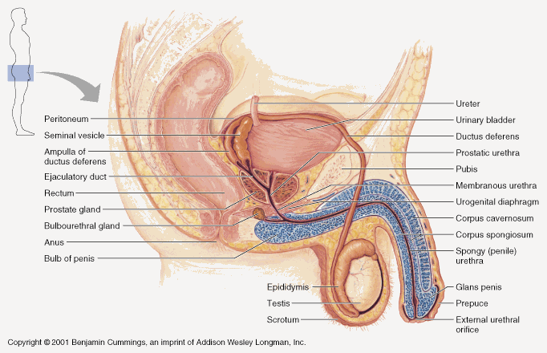
Physiologic Anatomy of Male Sexual Organs

Slide 13
Reproductive System
Four processes execute the function of the reproductive system
  Production of egg or sperm
  Transport and maintenance of egg or sperm
  Nurturing of the developing offspring
  Secretion of male and female sex hormones

Slide 14
Anatomy of the Male Reproductive System
Testis
Scrotum
Penis
Seminal vesicles, prostate gland, bulbourethral glands
Epididymus, vas deferens, urethra

Slide 15
Parts of Male Reproductive Organ
Testis: Composed of upto 900 coiled seminiferous tubules in which the sperm are formed.
Epididymis: Sperm empty into epididymis from seminiferous tubules. It is another coiled tube.
Vas deferens: Epididymis leads to vas deferens which enlarges to form Ampulla.
Prostate gland: Vas deferens leads to the prostate gland.
Prostatic duct: Contents from the prostate gland are carried to the ejuculatory duct by this duct.
Seminal vesicle: Located on the side of Prostate gland. It empties into the prostatic end of the ampulla.
Ejaculatory duct: Contents of the seminal vesicle, ampulla and prostatic duct empty into the ejaculatory duct.
Urethra: Last connecting link from the testis to the exterior.
Bulbourethral glands (Cowper’s gland): Located near the origin of urethra.
For more information: Textbook of Medical Physiology– Guyton & Hall

Slide 16
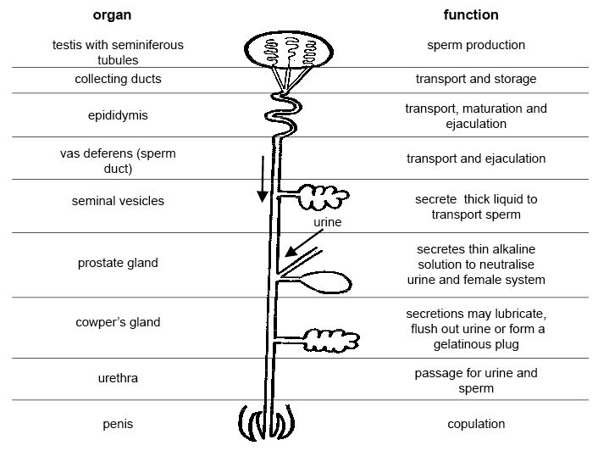
Functions of Male reproductive Organs

Slide 17
Male Reproductive System
The male reproductive system consists of
Paired glands- the TESTES
Accessory glands- seminal vesicles, prostrate glands, bulbourethral glands
System of ducts- rete testis, efferent ductules, epididymis, Vas deference, ejaculatory duct

Slide 18
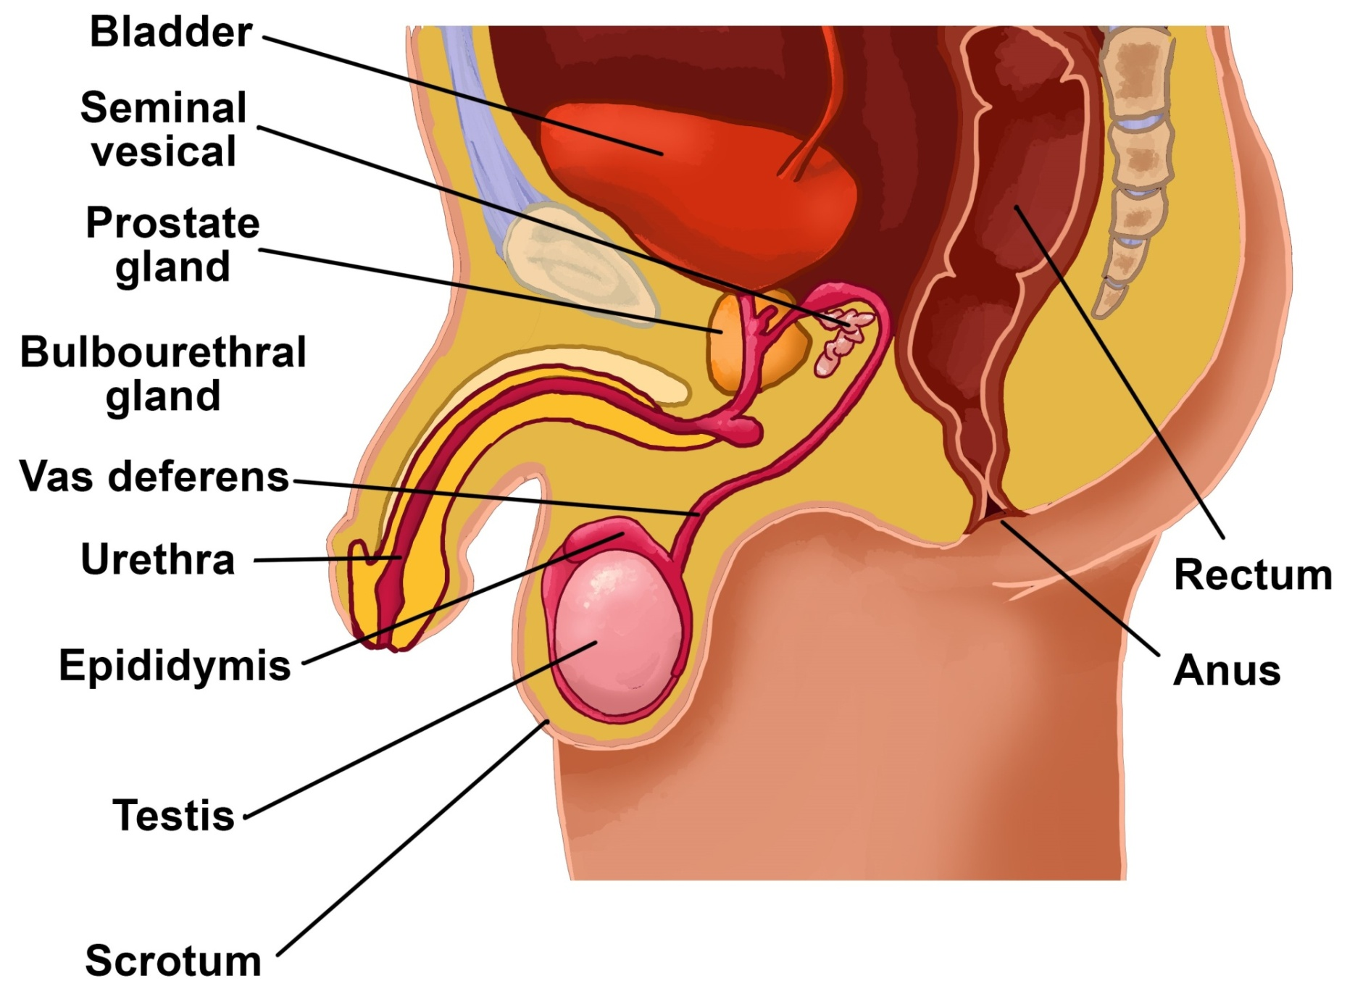
Male reproductive system

Slide 19
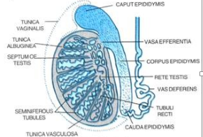
Primary Gland
TESTES
Structure: oval organ of about 5 cm long & 2.5 cm diameter
covered by connective tissue called tunica albugineae.
inside, testis is separated by speta into several hundred lobules that
contain 1-4 convulated seminiferous tubules.
Contains: testicular tunicae (external coverings)
testicular lobules containing seminiferous tubules
(Each testis has 250 testicular lobules.
(Each lobule contains 1 to 4 seminiferous tubules)
Each testis is suspended within the scrotum
and is covered by testicular capsule.
The capsule is made of three layers
tunica vaginalis
tunical albugineae
tunica vascularis

Slide 20
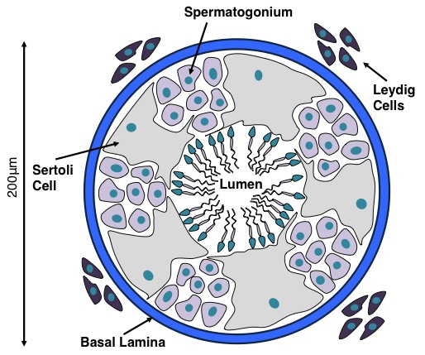
Primary Gland
Cells of the Testes
1. Sertoli Cells
are tall pyramidal cells adhere to basal lamina & end to apical ends of seminiferous tubules,
contain abundant smooth ER, Golgi apparatus, mitochordira & lysome, elongated triangular nuceus
Functions of Sertoli cells
support, protect & supply nutrients to developing spermatozoa
secrete fluid into seminiferous tubules
2. Leydig Cells
3. Smooth Muscle Cells

Slide 21
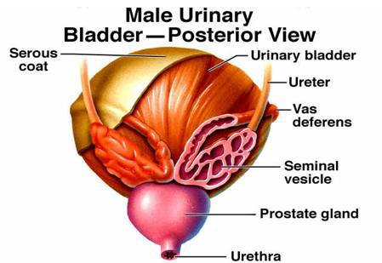
Accessory Glands
1. Seminal vesicles
Structure:
are paired vesicles, each consisting of two highly coiled 15 cm long tubes
Wall of seminal vesicle has 3 layers:
adentitia: external coating of connective tissue with elastic fibres
middle smooth muscle coat: consists of inner circular & outer longitudinal layers
internal mucosa: consists of lining of epithelium & fibroblastic connective tissues
Contains: fructose, enzyme, prostaglandins
Function:

Slide 22
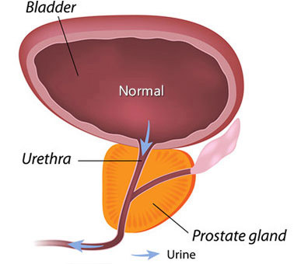
2. Prostrate Gland
The prostrate lies immediately below the urinary bladder and surrounds the beginning portion of the urethra
is about 2x4x3 cm in size &
is an aggregate of 30 to 50 compound tubuloacinar glands enclosed in a single fibrous capsule.
the glands empty through about 20 pores in the urethral wall.
pH is about 6 to 6.5
Functions
secretes serous milky white fluid that contains- lipids, proteolytic enzymes, acid phosphate,
Citrate
helps sperm motility as a liquefying agent.

Slide 23
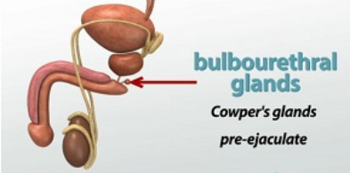
3. Bulvourethral Gland
Also known as Cowper’s Gland
Secret mucus to serve as a lubricant

Slide 24
Ducts
Ducts: rete testis, efferent ductules, epididymis, Vas deference and ejaculatory duct
Rete testis is an highly anastomotic network of channels within the medastinium testis. It is lined by simple cuboidal epithelium.
It conducts spermatozoa from the tubuli tecti to the ductuli efferens.
Efferent Ductules are collection of 10 to 20 tubules originating from the rete testis to epididymis, lined by an epithelium of alternating ciliated & nonciliated cuboidal cells having a thin circular layer of smooth muscle beneath the basal lamina of the epithelium. It reabsorbs the fluid from semen.
Ductus epididymis is a single coiled tube of about 4 -6 m length. It is surrounded by connective tissues and blood vessels and forms the body and tail of the epididymis It is lined by pseudostratified columner epithelium of basal & columner cells that are supported by a basal lamina of smooth muscle cells. Peristaltic contractions of the smooth muscle layer assist to move sperm along the duct.
Ductus (vas) deferens . Each vas deferens is a thick-walled muscular tube with a narrow irregular lumen that coveys spermatozoa from the tail of epididymis to the ejaculalory duct. It consists of mucoa, middle circular layer and fibrous adventia-covers the muscular coat.
Ejaculatory duct. It is the continuation of vas deferens, beyond where it receives the duct of seminal vesicles. It enters the prostrate gland.

Slide 25
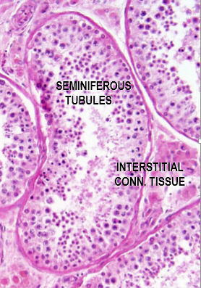
Other Important Structure
Seminiferous tubules
are embedded in a meshwork loose connective tissue containing blood vessels, lymphatics, nerves & interstitial cells of Leydig (secrete testosterone)
are highly convoluted & close-ended in the testicular lobule
Each testis has 250-1000 seminiferous tubules
Each seminiferous tubule is about 150 - 250 µm diameter & 30-70 cm long
The combined length of seminiferous tubules of one testis is about 250 m
Seminiferous tubules are enveloped by tunica propria
Each seminiferous tubules is lined by 4-8 layers of seminiferous or germinal epithelium that contains spermatogenic cells & sertoli cells
Seminiferous tubules form twisting pathways through testicular lobules and then narrow into short tubuli recti that connect the seminiferous tubules with rete testis

Slide 26
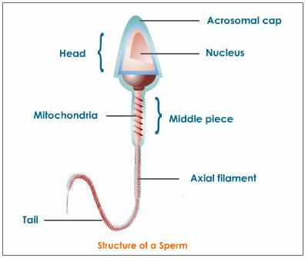
Sperm

Slide 27
For more information visit this link
https://www.youtube.com/watch?v=k60M1h-DKVY

Slide 28
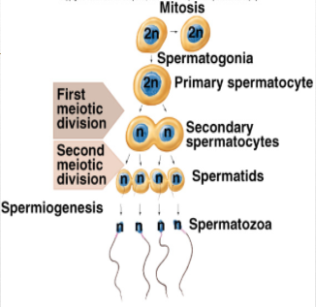
Steps of Spermatogenesis
Spermatogonia:
  Replicate initially by mitosis.
One of the 2 primary spermatocytes undergoes meiosis:
  2 nuclear divisions:
    1st meiotic division produces 2 secondary spermatocytes.
    2nd meiotic division produces 4 spermatids.

Slide 29
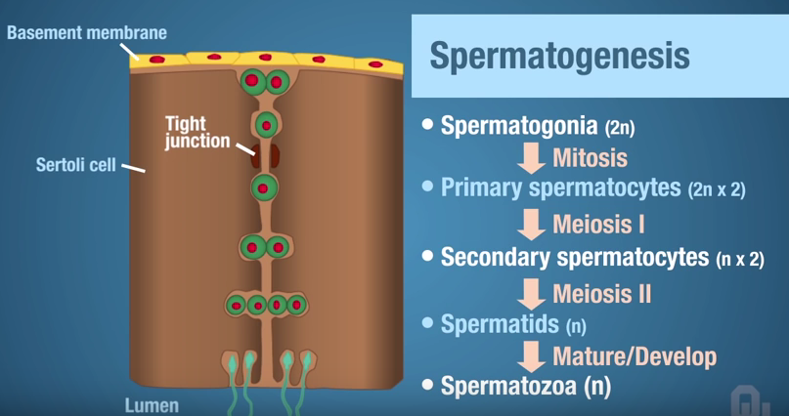
Spermatogenosis

Slide 30
Hormonal Factors that Stimulate Spermatogenesis
Testosterone:
  Secreted by Leydig cells located in the interstitium of testis.
  Essential for growth and division of germinal cells in forming sperm.
Luteinizing Hormone (LH):
  Secreted by the anterior pitutary gland
  Stimulate Leydig cells to secrete testosterone
Follicle stimulating hormone (FSH):
  Secreted by the anterior pitutary gland
  Stimulate sertoli cells for which the conversion of spermatids to sperm occur.
Estrogens:
  After stimulation by FSH, the sertoli cells produce estrogen from testosterone.
  Probably essential for spermatogenesis
Growth Hormone:
  Secreted by the anterior pitutary gland
  Necessary for controlling background metabolic functions of the testes.
  Promotes early division of spermatogonia

Slide 31
Storage of Sperm
The 2 testes can form about 120 million sperm each day.
Small quantity stored in the epididymis.
Most of the sperm are stored in the vas deferens and ampulla of the epididymis.
They can remain fertile in the genital duct for about a month. They remain in inactive form in the duct.

Slide 32
Semen
Semen is ejaculated during the male sexual act.
Composition of semen:
pH of semen is approximately 7.5
Fluid | Source | Percentage
Sperm | Vas Deferens | 10%
Fluid | Seminal Vesicles | 60%
Fluid | Prostate gland | 30
Fluid | Bulbourethral gland

Slide 33
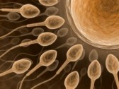

Why does only 1 sperm enter the oocyte?
Facts:
  Only a few sperm make it upto the zona pellucida (thick covering of the ovum).
  Within a few minutes after the first sperm binds to the ovum, calcium ions diffuse through the oocyte and causes it to release granules that permeate the zona pellucida and prevent binding of additional sperms. It even causes other bound sperms to fall off.
  Changes in the oocyte membrane after fusion with sperm are believed to cause depolarization which prevents the attachment of other sperms.

Slide 34
Abnormal Spermatogenesis
Different diseases can cause the destruction seminiferous tubuluar epithelium. E.g: bilateral orchitis resulting from mumps can cause sterility.
Effect of temperature on spermatogenesis:
Higher temperature is unfavorable for spermatogenesis.
Cryptorchidism: absence of one of both testes from the scortum.

Slide 35
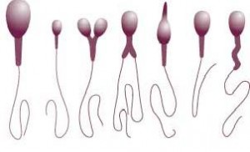
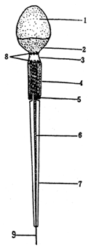
Male fertility
Semen normally contains 35 to 200 million sperm per milliliter. When the number of sperm in each ml is below 20 million, the person is likely to be infertile.
Sperm motility and morphology plays important role in male fertility
  Morphologically abnormal sperm
  Non-motile sperm
Abnormal infertile sperm compared to normal sperm

Slide 36
For more information, go to this link:
https://www.youtube.com/watch?v=krSMZDsjLuU
Textbook of Medical Physiology– Guyton & Hall

Slide 37
Thanks

