Slide 1
BDS Year 1 Regular batch
Academic Year 2023-2024
Subject: Dental Materials
Topic: PROVISIONAL RESTORATION
Dr. Vaibhavi Hathi
Senior Lecturer
Dept. of Prosthodontics and Crown & Bridge
Notes:
%%TTS_FEMALE %

Slide 2
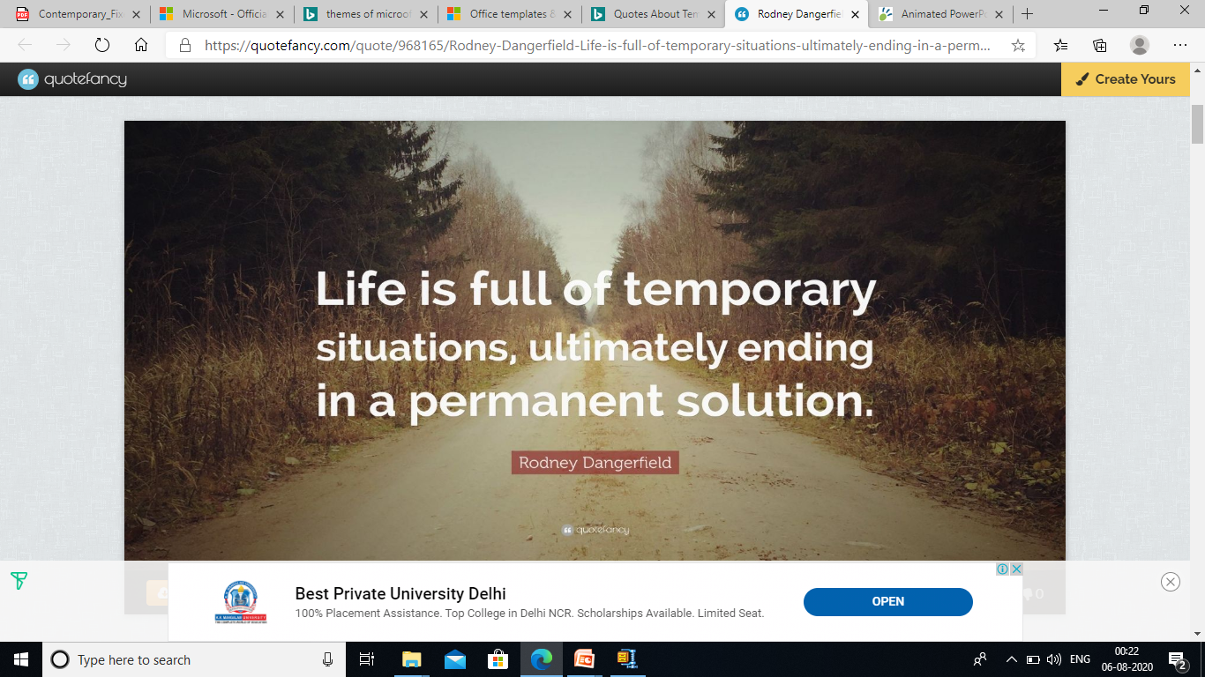

Slide 3
CONTENTS
Synonyms
Introductcion
Definitions
History
Requirements for fixed provisional restorations
Types of provisional restorations
Various techniques of fabrication

Slide 4
.
Limitations of provisional restorations
Recent advances in provisionalization
Conclusion
References

Slide 5
SYNONYMS
Provisional restoration
Treatment restoration (Temporization)
Interim prosthesis
• Provisional prosthesis
The word provisional means established for the time being pending a permanent arrangement

Slide 6
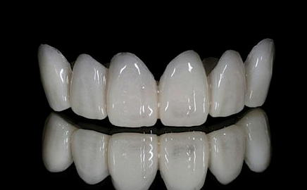
INTRODUCTION
Provisional crowns or fixed partial dentures are essential to prosthodontic therapy.
Though a definitive restoration may be placed as quickly as 2 weeks after tooth preparation.

Slide 7
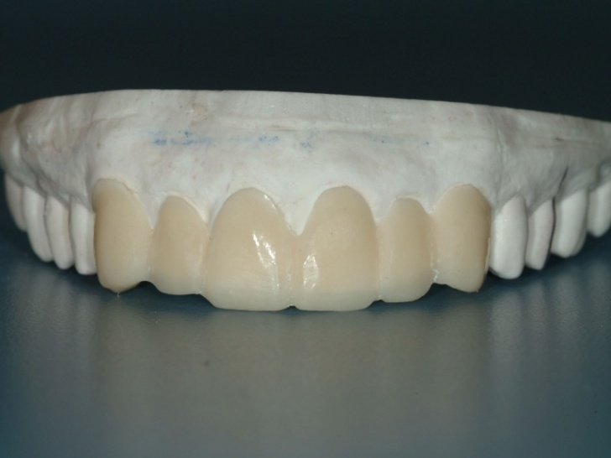
DEFINITION
.
A fixed or removable prosthesis designed to enhance esthetics, stabilization and function for a limited period of time after which it is to be replaced by definitive prosthesis.(GPT-9)

Slide 8

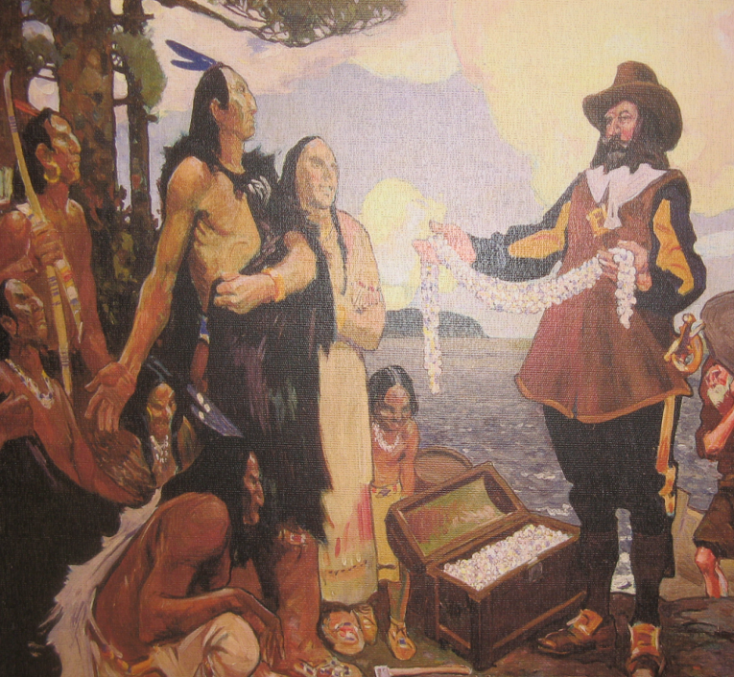
HISTORY

Slide 9
1937 ---- Heat cured acrylic resin
1947 ---- Auto polymerizing acrylic resin
1952 ---- Brotman introduced prefabricated aluminum or celluloid crown form
1959 ---- Amsterdam et al suggested use of copper band splint

Slide 10
1960s ---- Vinyl poly-ethyl methacrylate (Snap and Trim)
1969 ---- Ethyl imine derivatives ( Suctan)
1972 -technique for a modified “shell” type temporary acrylic resin fixed partial denture
1973 ---- Charles et al described the use of polycarbonate resin

Slide 11
1980 ---- Composite (Protemp, Visio Gem and Triad)
1983 -Technique that use silicone putty impression material in provisional restoration fabrication.

Slide 12
Rationale for Provisional Restoration
(Fredrick and Krug)
Protect pulpal tissue and sedate prepared abutments
2. Protect teeth from dental caries
3. Provide comfort and function
4. Evaluate parallelism of abutments
5. Provide method for immediately replacing missing teeth
6. Prevent migration of abutments
7. Improve esthetics

Slide 13
8. Evaluate and reinforce the patient’s oral home care
9. Provide a matrix for the retention of periodontal surgical dressings
10. Stabilize mobile teeth
11.Provide anchorage for orthodontic brackets during tooth movement
12. Aid in developing and evaluating an occlusal
13. Allow evaluation of vertical dimension, phonetics, and masticatory function
14. Assist in determining the prognosis of questionable abutments during prosthodontic treatment planning

Slide 14
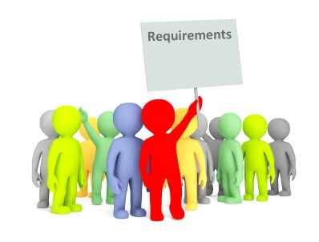
REQUIREMENTS

Slide 15

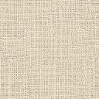

BIOLOGIC
Pulp protection
Periodontal health
Occlusal compatibility
Tooth position
Protect against fracture
MECHANICAL
Resist Functional load
Resist Removal forces
Inter-abutment alingment
ESTHETIC
Contourable
Colour stability
Translucent
Texture

Slide 16
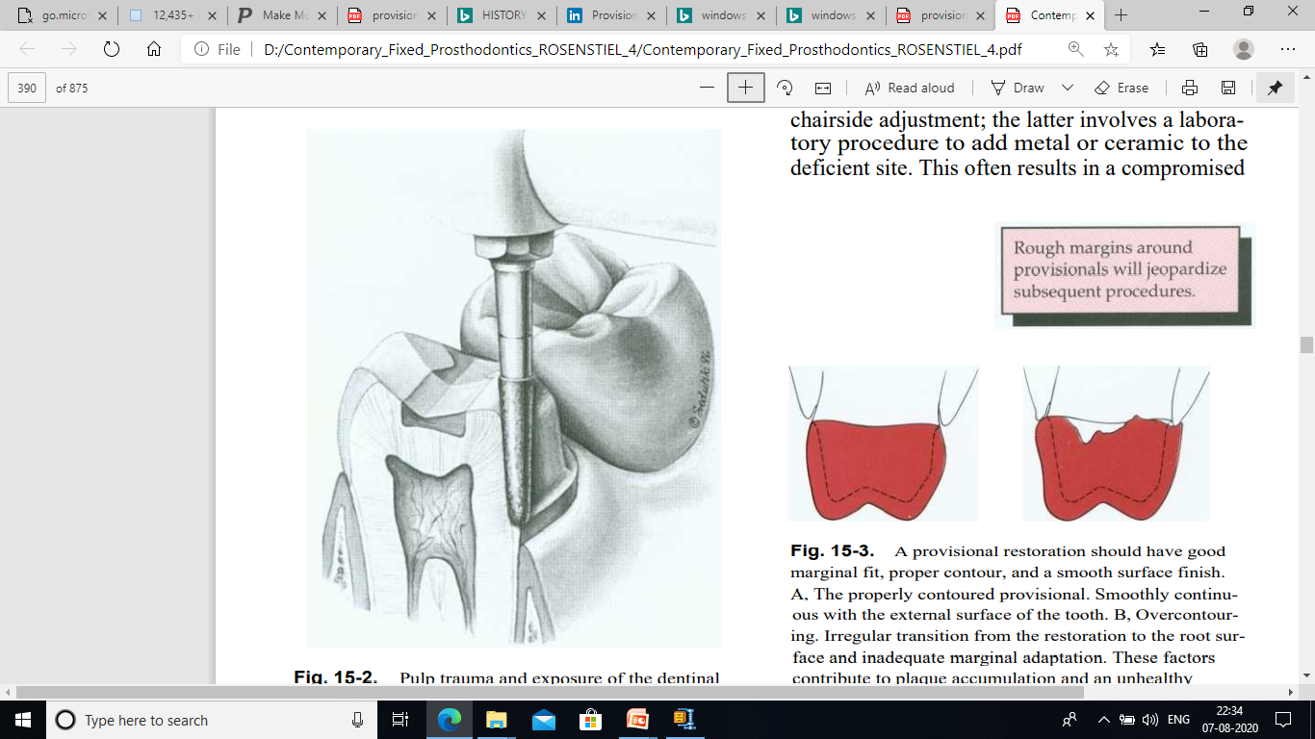
BIOLOGIC REQUIREMENTS
Pulp Protection.

Slide 17
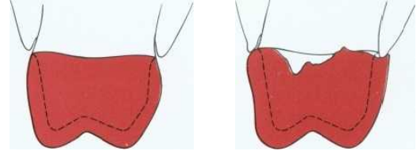
Periodontal Health

Slide 18
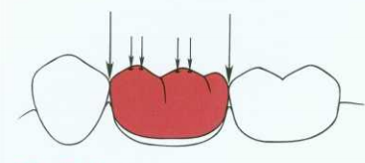
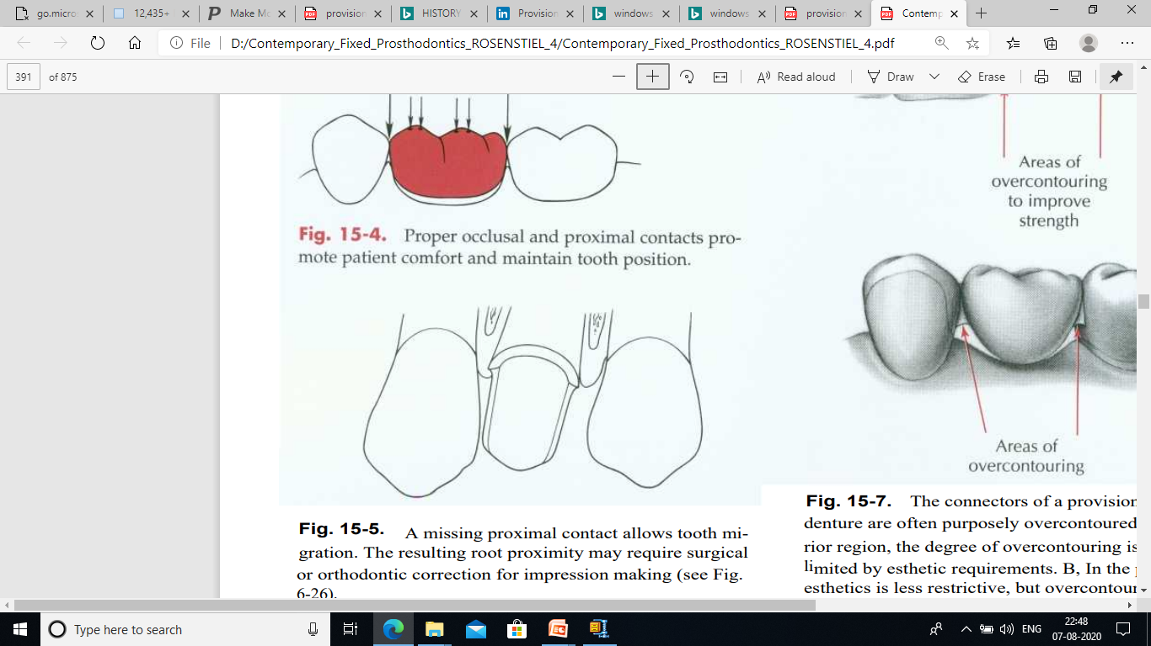
3. Occlusal Compatibility and Tooth Position.
Maintain proper contacts with adjacent and opposing teeth
A missing proximal contact allows tooth migration

Slide 19
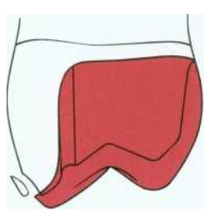
4. Prevention of Enamel Fracture
Fracture of a tooth after the impression phase delays treatment and jeopardizes restorability. proximal contour.

Slide 20
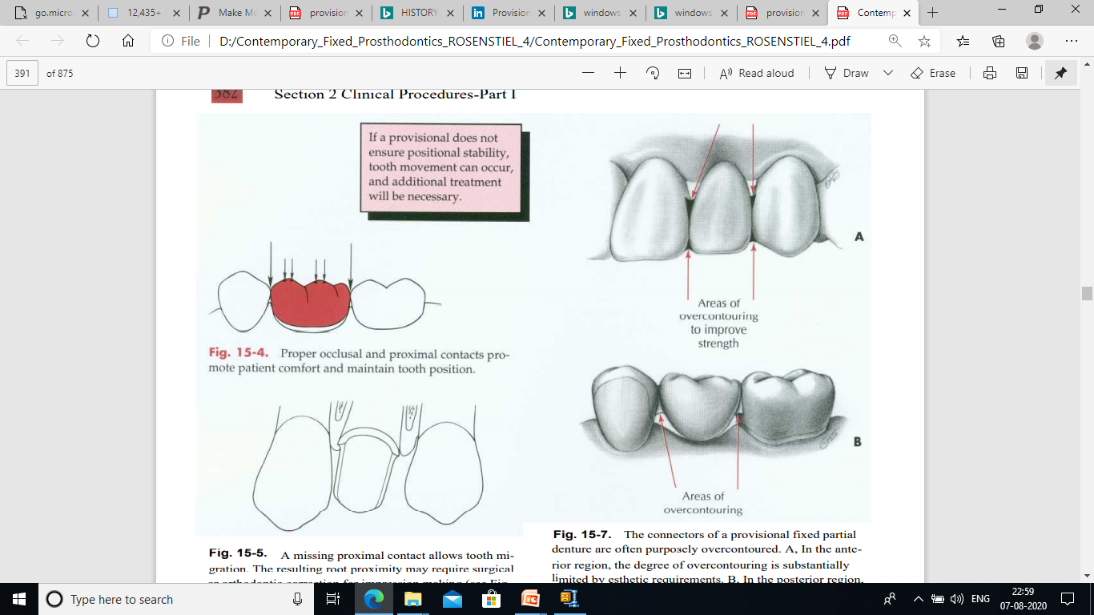
MECHANICAL REQUIREMENTS
Function.

Slide 21
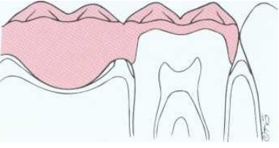
In this mesiodistal section, an overcontoured connector crowds the gingiva. Pressure ischemia and poor access for plaque removal promote gingivitis.

Slide 22
Need of high-strength provisionals
A long span posterior fpd
Prolonged treatment plan
Avoid excess forces
Above average masticatory muscle strength
History of frequent breakage

Slide 23
2. Displacement.
For this and for biologic reasons, unlined preformed crowns should be avoided.
3. Removal for Reuse.
Provisional restorations often need to be reused and therefore should not be damaged when removed from the teeth.

Slide 24
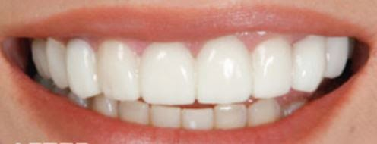
ESTHETIC REQUIREMENTS
Color compatibility
Translucency
Color stability

Slide 25
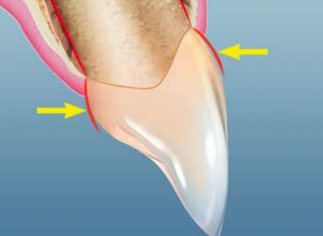
Proper contours
The emergence profile must be the same as the original tooth to facilitate plaque removal.
Embrasure areas must be contoured to allow for the interdental papilla.
The pontic must be contoured so that it is as self cleansing as possible.

Slide 26
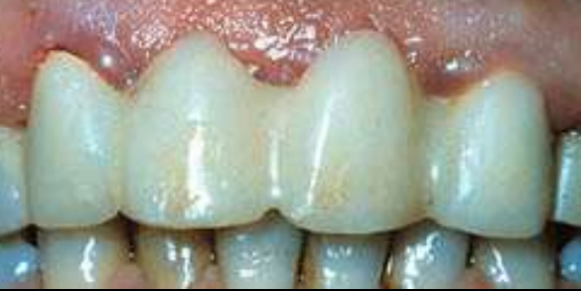
In this improperly contoured fixed partial denture, There is not enough embrasure space. The dental papilla are impinged upon and signs of gingival inflammation are present

Slide 27

CLASSIFICATION

Slide 28
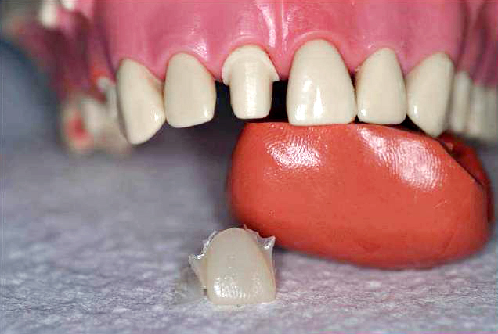
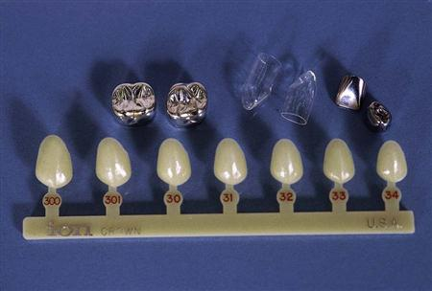
1.DEPENDING ON THE METHOD OF FABRICATION
CUSTOM MADE PROVISIONAL RESTORATION
PREFABRICATED PROVISIONAL RESTORATION

Slide 29
2. DEPENDING ON THE MATERIAL AVAILABLE IN PREFORMED CROWNSAVAILABLE
Polycarbonate
Cellulose acetate
Aluminium and tin-silver
Nickel-chromium

Slide 30
DEPENDING ON THE TYPE OF MATERIAL USED
Resin based provisional restoration
Cellulose acetate
Polycarbonate resin
Poly-methyl methacrylate
Poly-ethyl methacrylate
Microfilled composite
Urethane dimethacrylate
Bis -acryl composite
Metal provisional restoration
Aluminium
Nickel-chromium
Tin-silver

Slide 31
DEPENDING ON THE DURATION OF USE
-SHORT TERM -for few days (upto 2 weeks)
( e.g. ---- Polycarbonate or aluminum crowns )
-MEDIUM TERM ---- for few weeks ( > 2 weeks)
( e.g. ---- resin based provisionals)
-LONG TERM ---- for months
( e.g. ---- mostly cast metal crowns)

Slide 32
DEPENDING ON TECHNIQUE OF FABRICATION
INDIRECT TECHNIQUE
DIRECT-INDIRECT TECHNIQUE
DIRECT TECHNIQUE

Slide 33
DEPENDING ON LOCATION OF FABRICATION
CHAIR- SIDE FABRICATED
LABORATORY FABRICATED

Slide 34

MATERIALS AND PROCEDURES

Slide 35
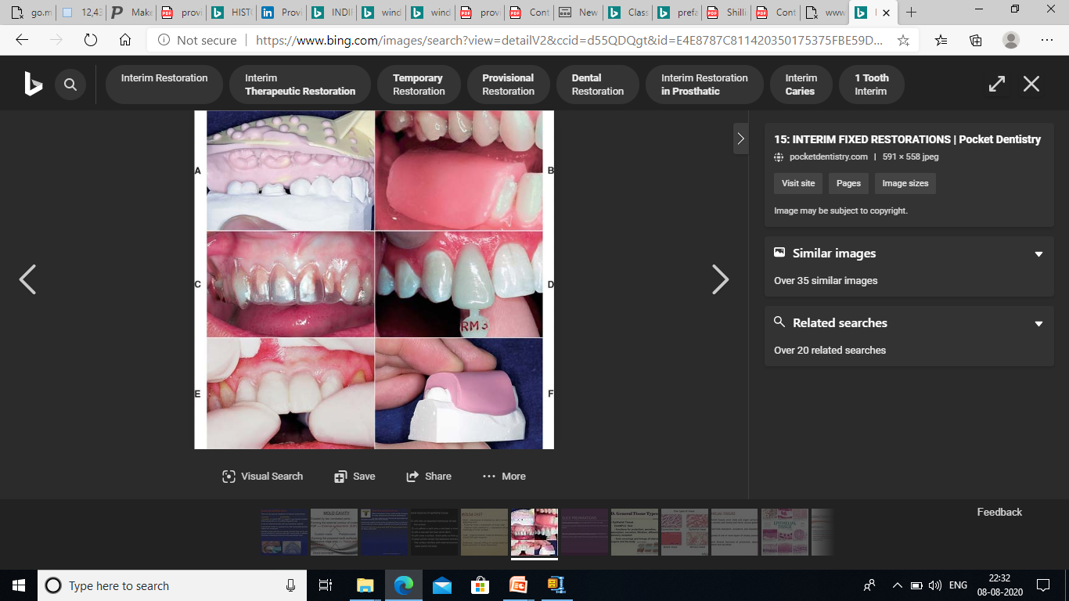
Many procedures using a wide variety of materials are available to make satisfactory provisional restorations
An alginate impression
Baseplate wax impression
vacuum-formed acetate sheet
A polycarbonate preformed shell
Three-unit FPD shell
A silicone putty impression

Slide 36
MOLD CAVITY
Created by two correlated parts:-
1.Forming the external contour of crown or FDP External surface form (ESF)
Custom made
Prefabricated
2. Forming the prepared tooth surfaces and edentulous ridge area -Tissue surface form ( TSF)
Direct technique
Indirect technique
Indirect-direct, results from the sequential application of these two forms

Slide 37
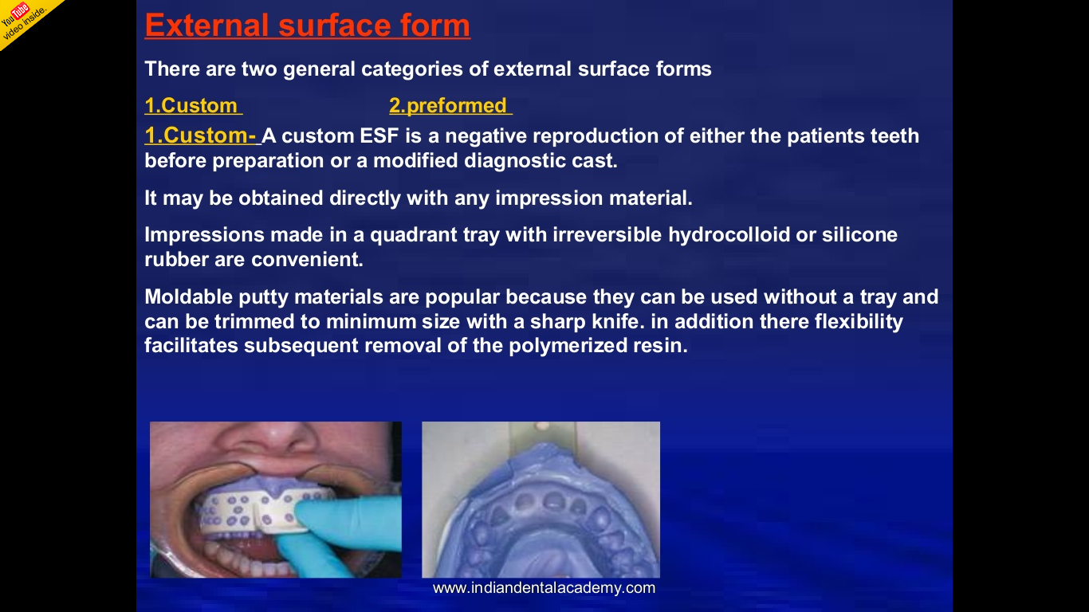
EXTERNAL SURFACE FORM
CUSTOM MADE
A custom ESF is a negative reproduction of either the patient's teeth before preparation or a modified diagnostic cast.
It may be obtained directly with any impression material.

Slide 38

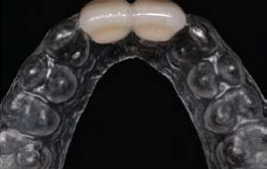
Moldable putty materials are popular because they can be used without a tray and can be easily trimmed to minimum size
A custom ESF can be produced from thermoplastic sheets, which are heated and adapted to a stone cast with vacuum or air pressure while the material is still pliable

Slide 39
Prefabricated
They can be thought of as ESFs rather than as finished restorations and therefore must be lined with autopolymerizing resin
Materials from which preformed ESFs are made include polycarbonate, cellulose acetate, aluminum, tin-silver, and nickel-chromium. These are available in a variety of tooth types and sizes

Slide 40

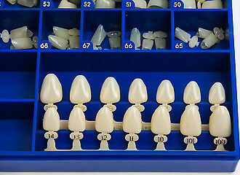
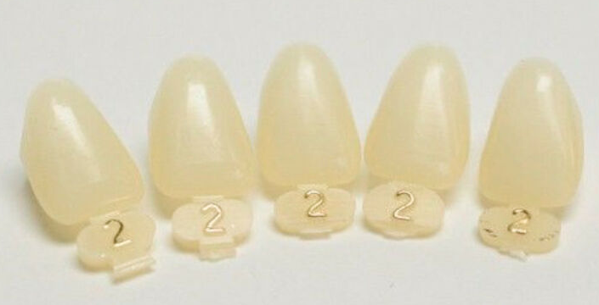
Polycarbonate.
Polycarbonate has the most natural appearance of all the preformed materials

Slide 41
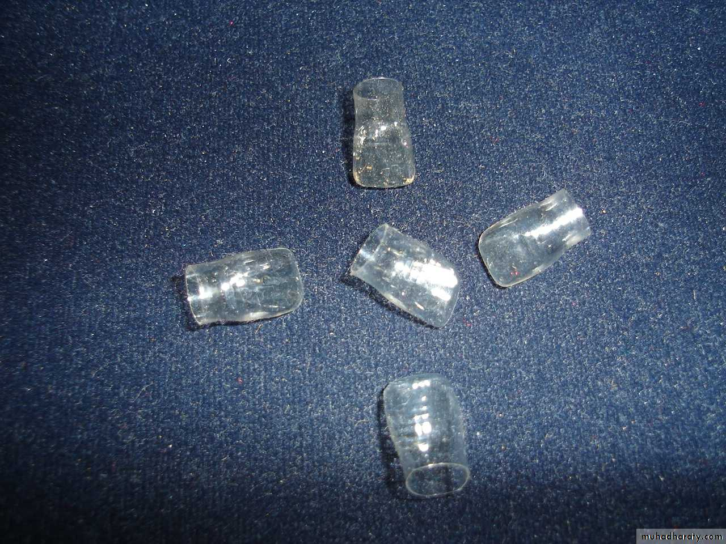
Cellulose Acetate
Cellulose acetate is a thin (02 to 0.3 mm) transparent material available in all tooth types and a range of sizes.Shades are entirely dependent on the autopolymerizing resin

Slide 42
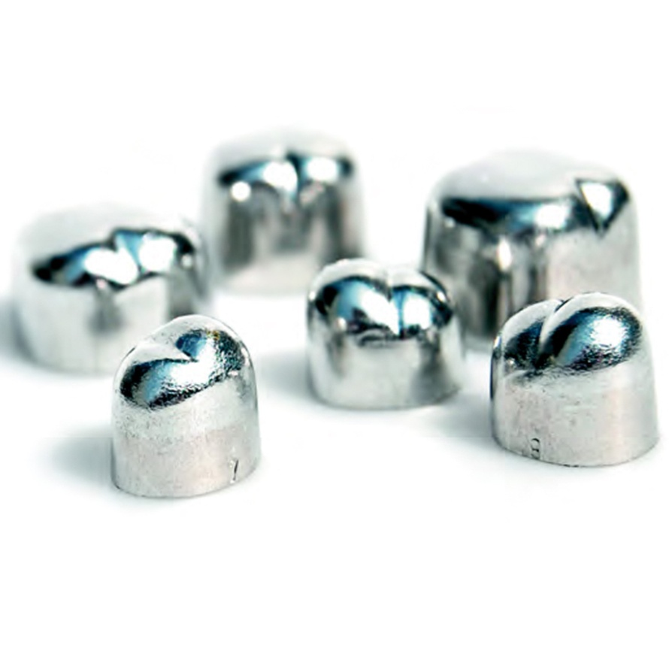
Aluminum and Tin-silver
Aluminum and tin-silver are suitable for posterior teeth.

Slide 43
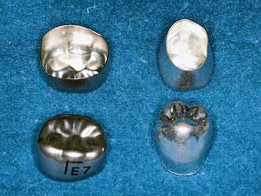
Nickel-chromium
Nickel-chromium shells are used primarily for children with extensively damaged primary teeth

Slide 44
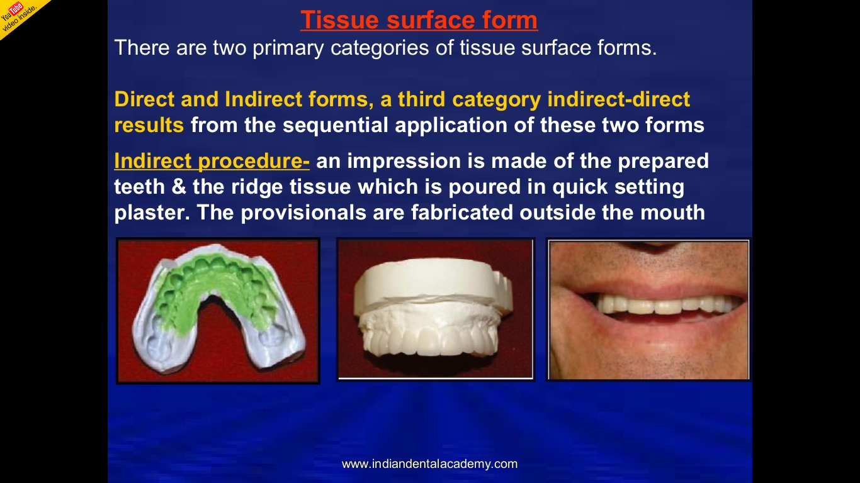
TISSUE SURFACE FORM
Indirect Procedure.

Slide 45
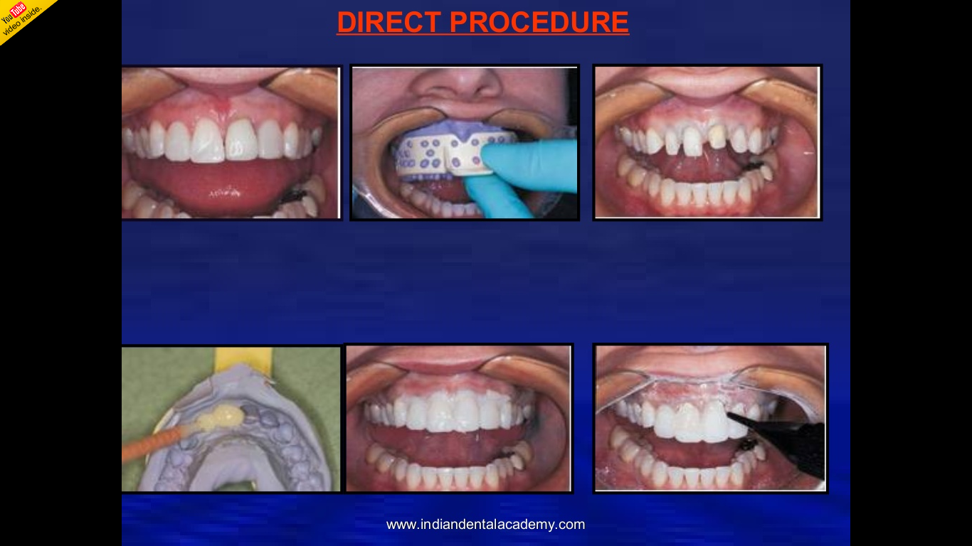
Direct Procedure

Slide 46
Indirect-direct Procedure
In this technique, the indirect component produces a "custom-made preformed ESF" similar to a preformed polycarbonate crown.
Another method of creating the shell eliminates the need for an indirect TSF

Slide 47
PROVISIONAL RESTORATIVE MATERIALS
Ideal Properties
An ideal provisional material has the following characteristics
Convenient handling-adequate working time, easy moldability, rapid setting time
Biocompatibility-nontoxic, nonallergenic, nonexothermic • Dimensional stability during solidification
Ease of contouring and polishing
Adequate strength and abrasion resistance

Slide 48
Good appearance-translucent, color controllable, color stable
Good patient acceptance-nonirritating, odorless
Ease of adding to or repairing
Chemical compatibility with provisional luting agents

Slide 49
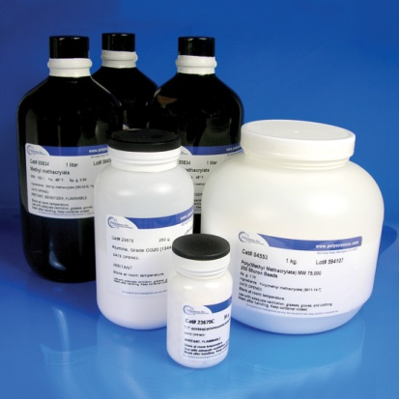
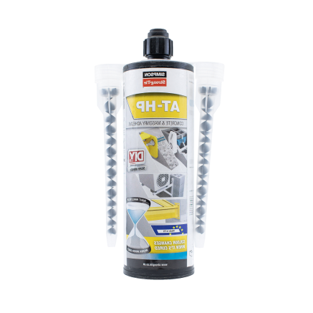
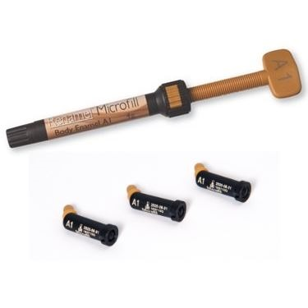
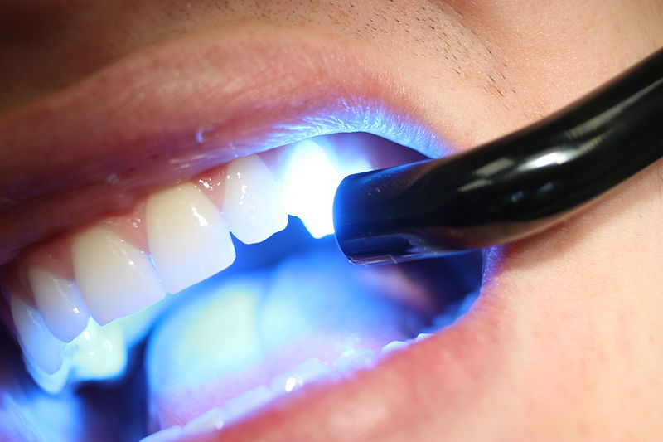
Currently Available Materials
The materials can be divided into four resin groups
Poly(methyl methacrylate)
Poly(R' methacrylate)
Microfilled composite
Light-cured

Slide 50
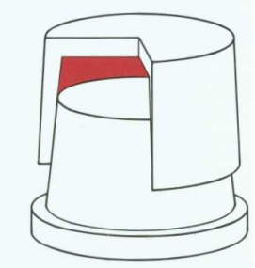
These materials shrink during polymerization, which causes marginal discrepancy

Slide 51
MATERIALS SCIENCE
William M. Johnston
The material used for fabrication of a provisional restoration consists of pigments, monomers, filler, and an initiator, which combine to form an esthetic restorative substance
The pigments are incorporated by the manufacturer, so the set material will resemble a natural tooth structure as much as possible, with a variety of shades available

Slide 52
Most commonly used monomers are methyl methacrylate, ethyl methacrylate, isobutyl methacrylate, bis-GMA, and urethane dimethacrylate.
The monomer's ability to convert to a polymer allows the material (after it has been formed as desired) to set into a solid that is durable enough to withstand the oral environment for the necessary interim period

Slide 53

PROCEDURES
As a rule of thumb
“The time taken to temporise a tooth should be similar to the time taken to prepare it.”

Slide 54
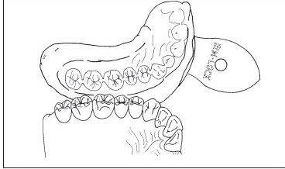
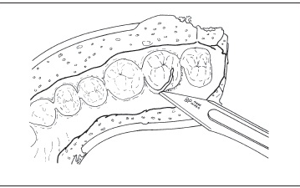
Overimpression-fabricated provisional crown
Overimpression is made from the diagnostic cast
Thin edges in the gingival areas of the overimpression are cut away.

Slide 55
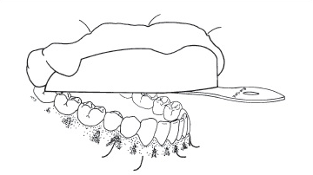
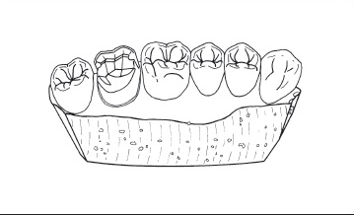
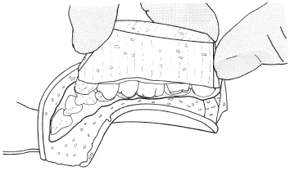
An alginate impression is made of the prepared tooth.
Properly trimmed plaster cast.
The cast is tried in the overimpression before proceeding

Slide 56

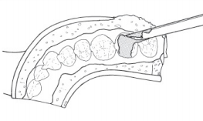
Separating medium is painted on the plaster cast.
Acrylic resin is mixed in a dappen dish
Resin is placed into the overimpression.

Slide 57
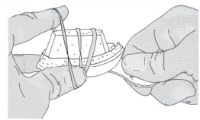
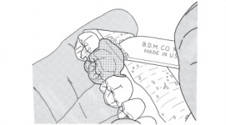
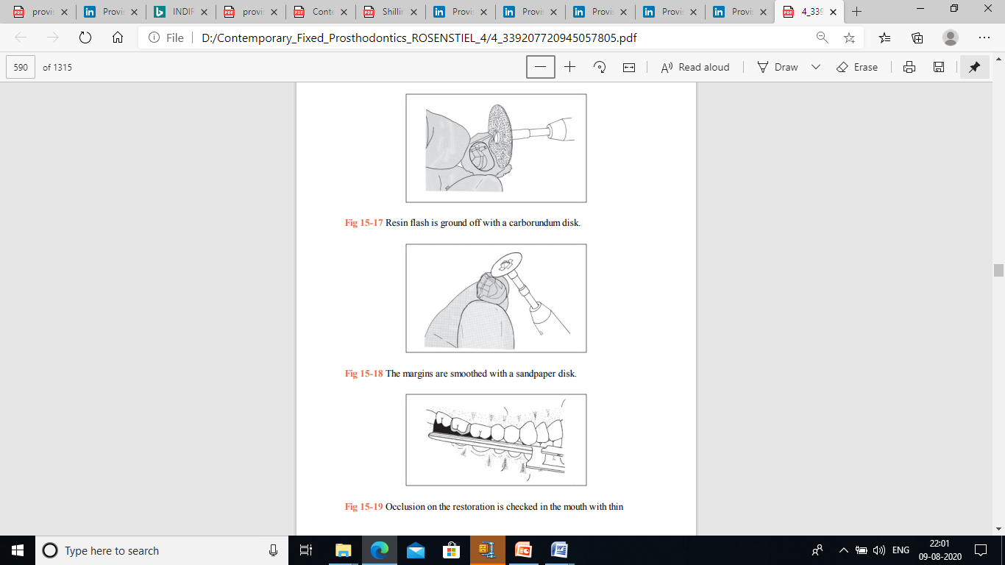
The cast is held in place with a rubber band.
The cast can be broken to remove the provisional restoration.
Resin flash is ground off with a carborundum disk.
Smoothed with a sandpaper disk.

Slide 58
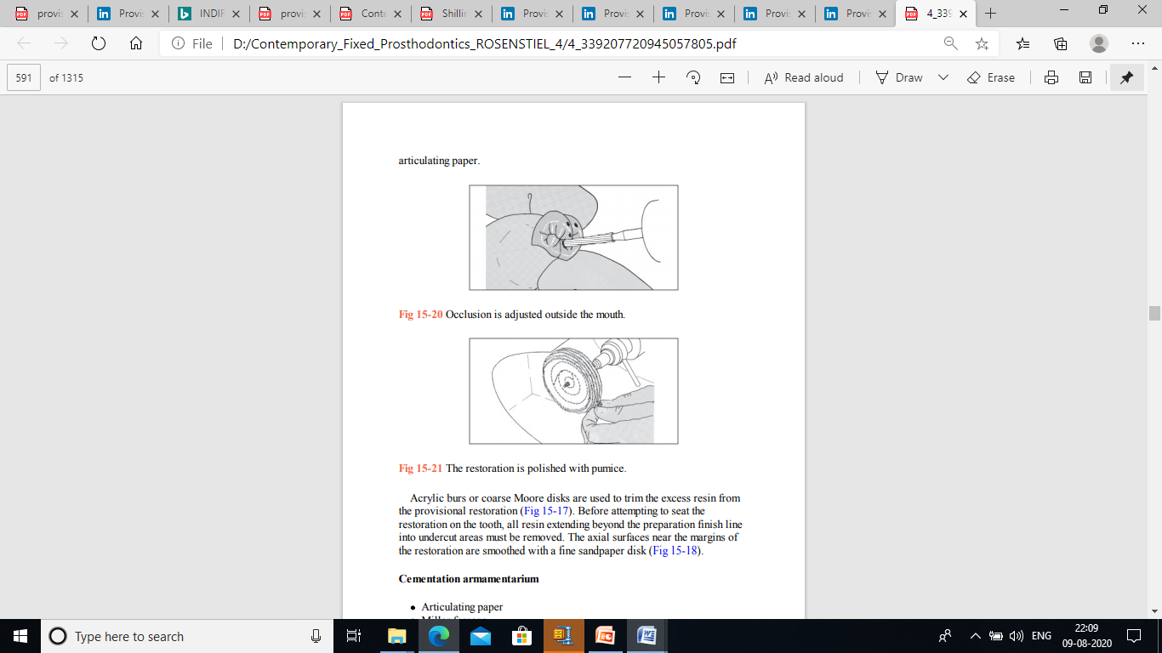
Checked in the mouth
Occlusion is adjusted outside the mouth
The restoration is polished with pumice

Slide 59
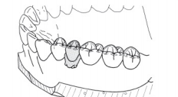
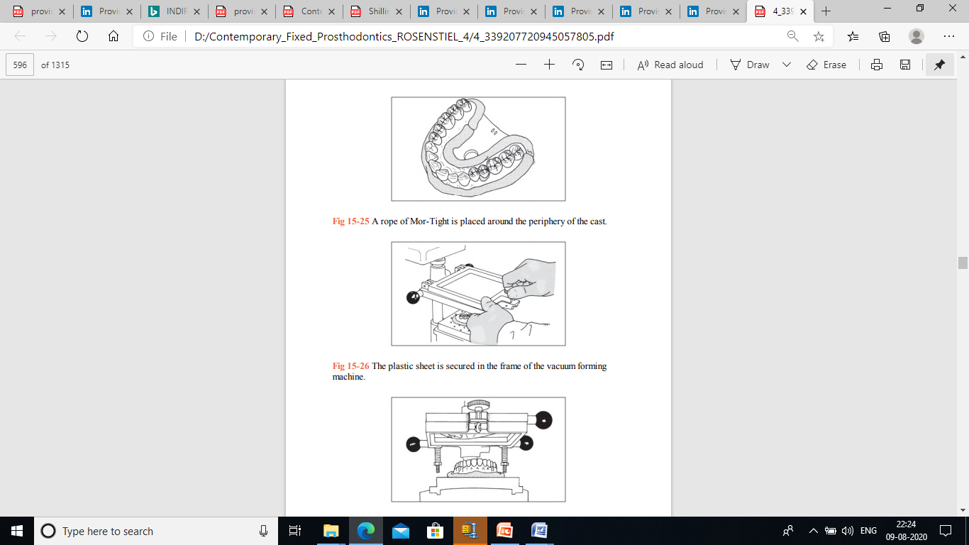
Template-fabricated provisional fixed partial denture
A denture tooth is placed in the edentulous space
Rope of Mor-Tight is placed
Plastic sheet is secured
plastic sags as it is heated

Slide 60
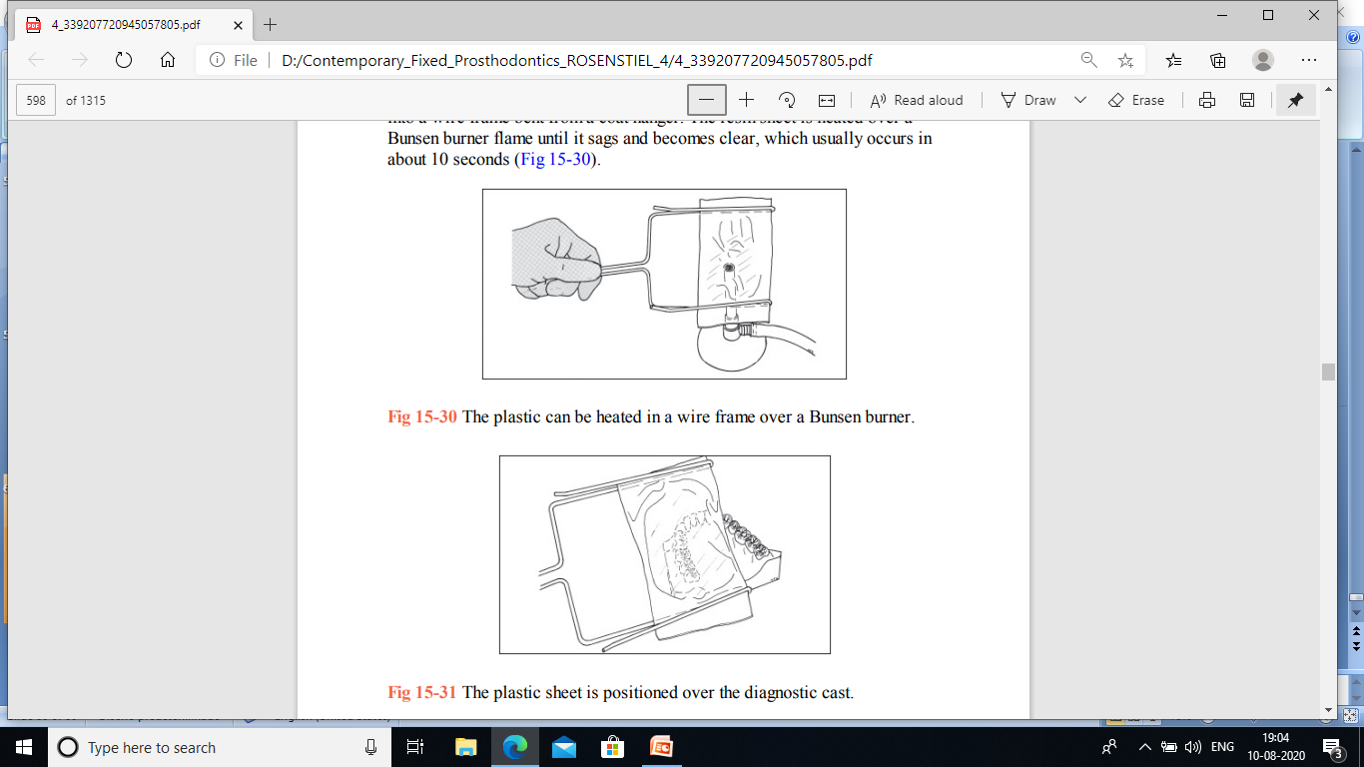
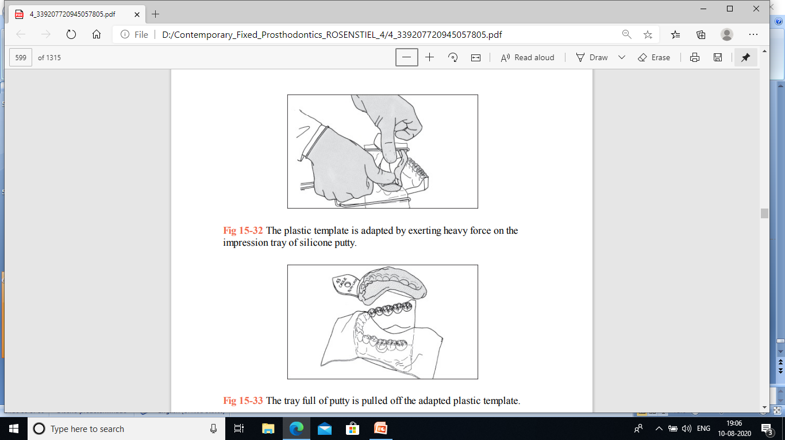
Plastic can be heated in a wire frame
Plastic sheet is positioned over the diagnostic cast.
heavy force on the impression tray of silicone putty
adapted plastic template

Slide 61
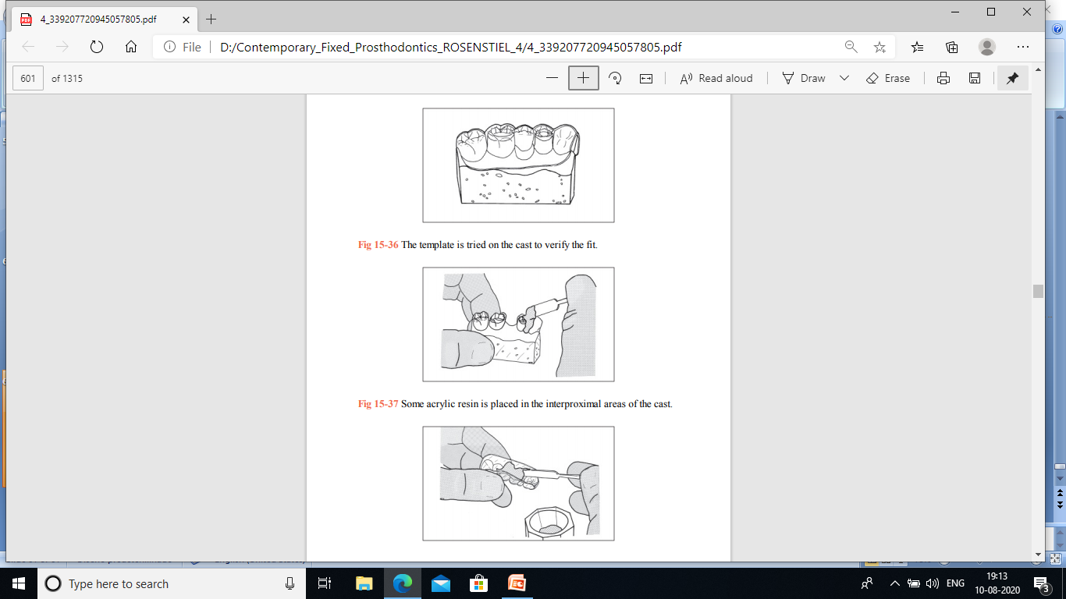
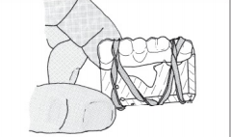
The template is tried on the cast to verify the fit
Resin is placed in the template.
The template is held in position with rubber bands.

Slide 62
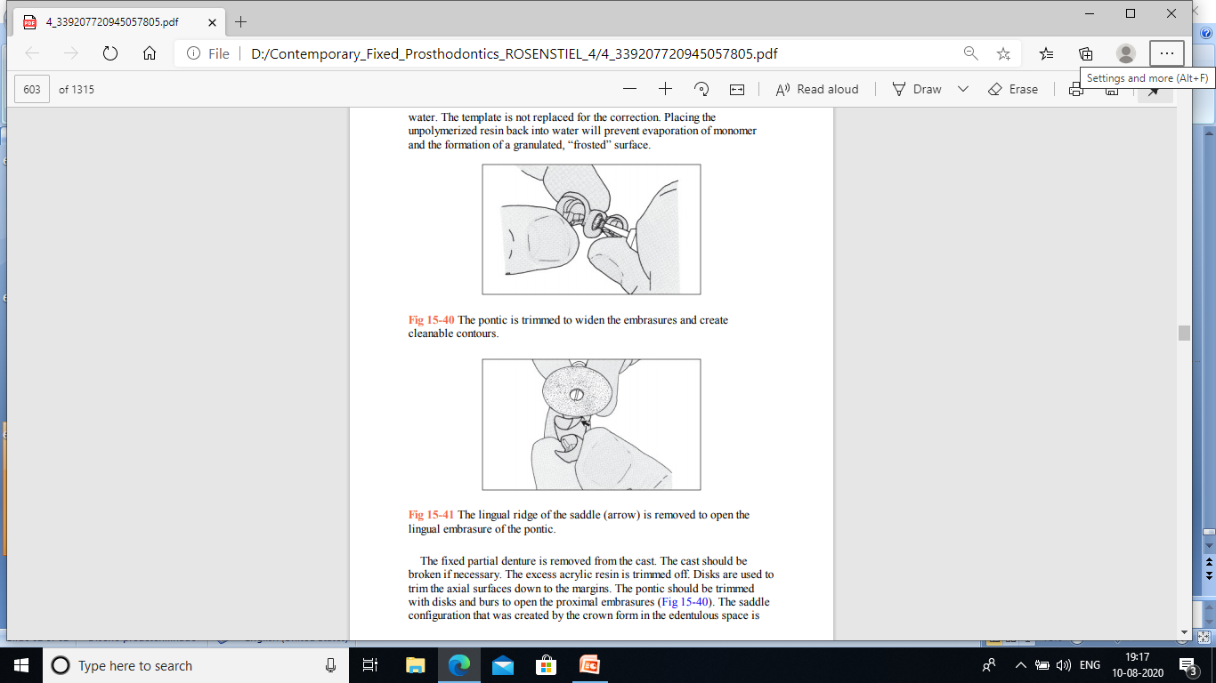
Template-fabricated provisional fixed partial denture technique
The pontic is trimmed to widen the embrasures and create cleanable contours
The lingual ridge of the saddle (arrow) is removed

Slide 63


Template-fabricated VLC provisional restoration
Putty index is formed over the template
VLC resin is placed in the clear template.
The resin-loaded template is forcefully seated on the quick-set plaster cast.
putty index is seated over the template.

Slide 64
THANK YOU

