Slide 1


Cabalantian National High School
STRATEGIES
OF READING
COMPREHENSION
in Grade 7 Students
Researchers:
Zapanta, Christian Jay Q.
Garcia, Jay U.
Lestones , Jinky G.
Bajao, April Rose V.
Jamis, Ellen Mae A.
Notes:
This is the data Information Drive of our research entitled strategies of reading comprehension in Grade 7 students

Slide 2

WHAT IS READING COMPREHENSION ?
Notes:
Reading is a variable skill for acquiring knowledge, but it has a many other
important benefits. In some studies, reading is said to be the process of
looking at a series of written symbols and getting meaning from them.
Understanding written language is known as comprehension.
Recognizing words on a page without understanding their falls short of
the intended objective or aim of reading which is comprehension.
Reading difficulties negatively impact different aspects of students,
including their educational progress, self-esteem, attitudes about reading
and learning, motivation to read, career choices, social-economic status
and expectation for future reading success(Sloat,Beswick,and Wilks,
2007;Wooly,2011)

Slide 3

Welcome to our
Data Information Drive
Notes:
Welcome to our Data Information Drive

Slide 4
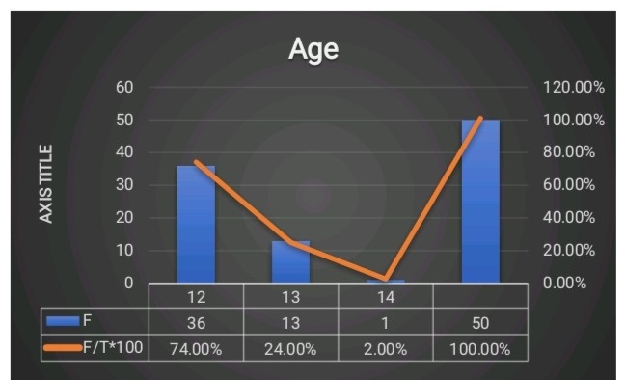
Profile of the students: Age
Notes:
This figure shows the participants profiles in terms of Age who are between 12, 13, and 14 have responded.

Slide 5
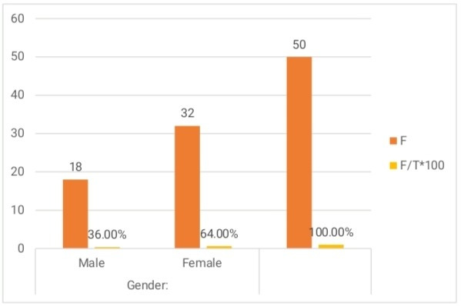
Gender
Notes:
This figures show participants profile in terms of Gender that there are 32 females and 18 males respondents.

Slide 6
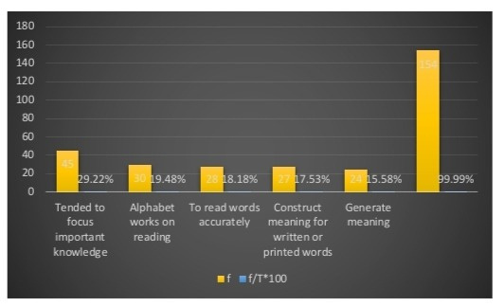
The importance of reading comprehension
Notes:
According to our survey questionnaires that the researchers tabulated these percentage indicated in students are tended to focus important knowledge ( 29.22%), alphabet works in reading (19.48%), to read words accurately (18. 18%), construct meaning for written or printed words ( 17.53%), and generate meaning(15.58%).
It is an important and timely contribution to securing high-quality teaching of the range of attributes children need to become fully-ﬂedged readers.

Slide 7
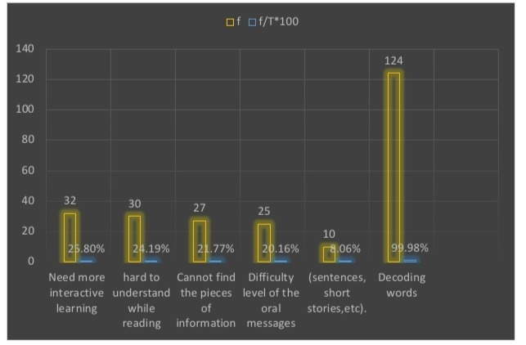
The main problem of the students in reading comprehension
Notes:
According to our survey questionnaires that the researchers tabulated these percentage indicated in students are need more interactive learning (25.80%), hard to understand while reading (24.19%), cannot find the pieces of information ( 21.77%), difficulty level of the oral messages (sentences, short stories, etc) (20.16%), and decoding words (8.06%). These are the major problems faced by the students in reading comprehension.
These problems are related to poor habit of reading and less interesting reading comprehension course they have in the classroom. Students need more interactive learning activities to be applied in the classroom such as games, or audio visual media to keep them interested in the lecture or reduce the anxiety.

Slide 8
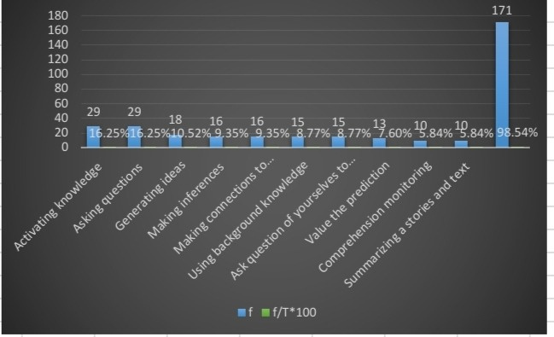
The Strategies for reading comprehension
Notes:
According to our survey questionnaires that the researchers tabulated these percentage indicated in students are activating knowledge (16.25), asking questions(16.25), generating ideas(10.52%), making inference(9.35%), making connections to connect ideas(9.35%), using background knowledge(8.77%), ask questions of yourself to construct meaning(8.77%), valuate the prediction(7.60%), comprehension monitoring(5.84%), summarizing a stories and text, etc(5.84). These strategies are often used by the students based on the survey questionnaires checklist.
Ahmadi and Pourhossein (2012) stated that learners who learn reading strategies try to
recognize the main point of a paragraph, to elaborate unclear words, phrases, or sentences,
and to summarize their reading. These strategies aid readers to solve their problems when
reading texts and assess their planning and its result.

Slide 9
CONCLUSION
Upon analyzing the data, the researchers found out the importance, main problems and strategies
are identity to them that they different strategies when it comes to reading. The purpose of these
study is to know how students deals with reading comprehension. Using the tabulated data used by
the researchers students have many difficulties when it comes to reading comprehension. Based on
the data and the responses of the Students in their importants are tended to focus important
knowledge, alphabet works on reading, to read words accurately, construct meaning for written or
printed words, and generate meaning. The main problem of the students in reading comprehension
are need more interactive learning, hard to understand while reading, cannot find the pieces of information, the difficulty level of the oral messages (sentences, short stories, etc.) and decoding words.
The strategies for improving reading comprehension are activating knowledge, asking questions,
generating ideas, making inference, making connections to connect ideas, using background
knowledge, ask question of yourselves to construct meaning, valuate the prediction, comprehension
monitoring, and summarizing a stories and text.
Notes:
Conclusions
Upon analyzing the data, the researchers found out the importance, main problems and strategies
are identity to them that they different strategies when it comes to reading. The purpose of these
study is to know how students deals with reading comprehension. Using the tabulated data used by
the researchers students have many difficulties when it comes to reading comprehension. Based on
the data and the responses of the Students in their importants are tended to focus important
knowledge, alphabet works on reading, to read words accurately, construct meaning for written or
printed words, and generate meaning. The main problem of the students in reading comprehension
are need more interactive learning, hard to understand while reading, cannot find the pieces of
information, the difficulty level of the oral messages (sentences, short stories, etc.) and decoding words.
The strategies for improving reading comprehension are activating knowledge, asking questions,
generating ideas, making inference, making connections to connect ideas, using background
knowledge, ask question of yourselves to construct meaning, valuate the prediction, comprehension
monitoring, and summarizing a stories and text.

Slide 10
RECOMMENDATIONS
Based on the conclusions cited in here, the following are hereby recommended :
1. A further qualitative study investigating the research questions of this study through using additional data collection methods, such as observation would be interesting.
2.Conducting another study or to dig deeper why does the does students have problems in reading.
3 Conducting a study that explore the strategies that encourages student with learning disabilities increasing their reading practice outside the school setting.
4. This will benefit the school, parents, and teacher to help the students with regards in reading.
5. Students should be guided by their parents to assists their children to read more to enhance the learnings of them.
Notes:
Recommendations
Based on the conclusions cited in here, the following are hereby recommended :
1. A further qualitative study investigating the research questions of this study through using additional data collection methods, such as observation would be interesting.
2. Conducting another study or to dig deeper why does the does students have problems in reading.
3. Conducting a study that explore the strategies that encourages student with learning disabilities increasing their reading practice outside the school setting.
4. This will benefit the school, parents, and teacher to help the students with regards in reading.
5. Students should be guided by their parents to assists their children to read more to enhance the learnings of them.

