Slide 1

Newborn Neonatal Resuscitation: Saving Lives in the First Minute
Every second counts when a newborn needs help breathing. Skilled, immediate intervention can mean the difference between life and death, between disability and a healthy future.
By Dr.M.Alkawati

Slide 2

Why Neonatal Resuscitation Matters
10%
<1%
Need breathing support
Need advanced care
Approximately 10% of newborns require assistance to initiate breathing at birth
Less than 1% require comprehensive resuscitation with advanced interventions
23%
Preventable deaths
Birth asphyxia accounts for nearly a quarter of neonatal deaths in some regions
Prompt, skilled intervention during those critical first moments can prevent death and long-term neurological disability. Every healthcare provider attending births must be prepared to act swiftly and effectively.

Slide 3





Anticipation & Preparation: The Foundation of Success
Identify High-Risk Deliveries
Prepare Equipment
Screen for prematurity, foetal distress, maternal complications such as pre-eclampsia, meconium-stained fluid, or multiple gestations that may require immediate intervention
Ensure readiness of radiant warmer, suction devices, bag-mask ventilation system, oxygen source, intubation tools, and emergency medications before delivery
Assign Roles & Rehearse
Designate clear team roles, establish communication protocols, and conduct briefings to ensure seamless coordination during resuscitation efforts

Slide 4

Initial Assessment: The Three Critical Questions
Within seconds of birth, assess these three vital parameters to determine the need for resuscitation:
01
02
03
Is the infant full term?
Does the infant have good muscle tone?
Is the infant breathing or crying?
Gestational age affects thermoregulation and respiratory maturity, influencing resuscitation approach
Spontaneous respirations or vigorous crying demonstrate effective air exchange and transition
Active movement and flexed posture indicate neurological function and adequate oxygenation
✓ All "Yes"
✗ Any "No"
Provide routine care with skin-to-skin contact, continuous monitoring, and support for breastfeeding initiation
Move immediately to resuscitation under radiant warmer for warmth and complete assessment

Slide 5

The Golden Minute: First Steps of Resuscitation
The first 60 seconds after birth are crucial. These rapid, sequential interventions can restore breathing and heart rate:
Provide Warmth
Dry infant thoroughly, remove wet linens, cover with warm blankets, and maintain temperature under radiant warmer to prevent hypothermia
Position Airway
Place infant in "sniffing position" with neck slightly extended to open airway and facilitate spontaneous breathing
Clear Airway
Gently suction mouth then nose if secretions present, limiting to 5 seconds maximum to avoid vagal stimulation
Stimulate Breathing
Provide tactile stimulation by rubbing back or flicking soles of feet to encourage spontaneous respirations
Reassess Continuously
Monitor breathing effort, heart rate, and colour throughout, adjusting interventions based on infant's response

Slide 6
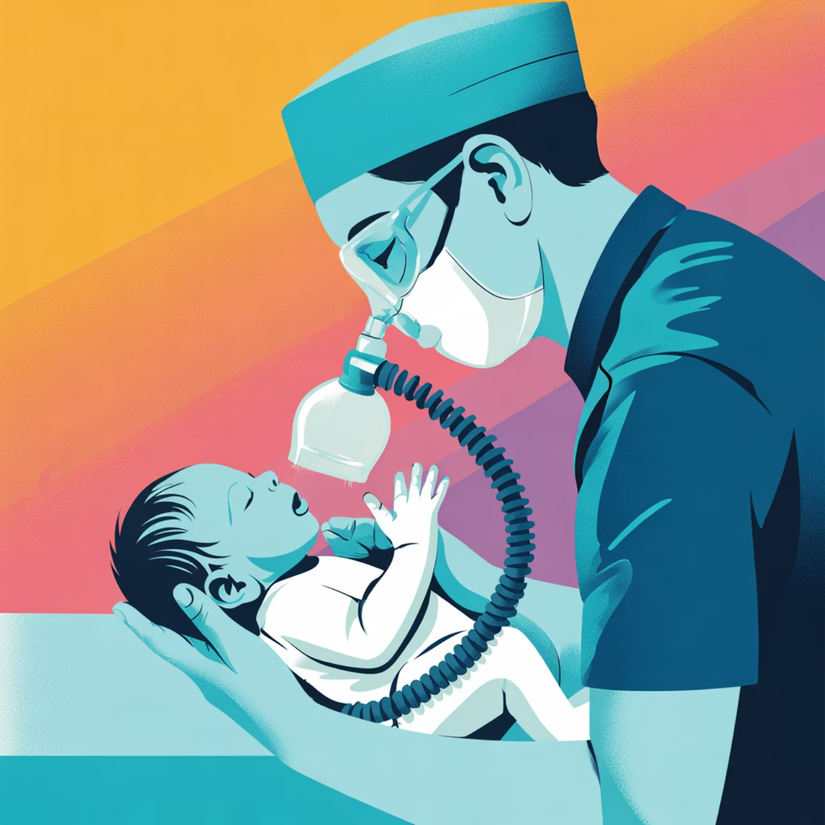
Positive Pressure Ventilation (PPV)
When to Initiate PPV
Begin positive pressure ventilation immediately if the infant is apnoeic, gasping, or has a heart rate below 100 beats per minute after completing initial resuscitation steps.
Technique
Critical Importance
Troubleshooting
Use bag-mask device at 40-60 breaths per minute, delivering sufficient pressure to achieve visible chest rise with each breath
Effective ventilation is the single most crucial intervention to improve heart rate and establish adequate oxygenation
If ventilation proves ineffective, systematically check mask seal, head position, airway patency, and consider need for airway adjuncts

Slide 7

Advanced Interventions: Chest Compressions & Medications
Chest Compressions Indication
1
Initiate if heart rate remains below 60 bpm despite 30 seconds of effective positive pressure ventilation with good chest rise
2
Compression Technique
Use 3:1 ratio—three chest compressions to one ventilation—delivering 90 compressions per minute coordinated with 30 breaths per minute
Medication Administration
3
Epinephrine (adrenaline) rarely needed; reserved for cases where heart rate remains below 60 bpm after adequate ventilation and compressions
4
Volume Expansion
Consider isotonic crystalloid or blood products if significant blood loss suspected or infant appears pale with poor perfusion despite resuscitation

Slide 8



Umbilical Cord Management & Oxygen Use
Delayed Cord Clamping
Strategic Oxygen Management
Waiting at least 60 seconds before clamping benefits preterm infants by reducing intraventricular haemorrhage, improving blood volume, and enhancing iron stores.
Begin ventilation with room air (21% oxygen) for term infants. For preterm babies, titrate oxygen carefully based on pulse oximetry readings to meet target saturations whilst avoiding hyperoxia-related injury.
Clinical Guidance: Use pulse oximetry from the first minute to guide oxygen delivery decisions. Target saturations increase progressively: 60-65% at 1 minute, 70-75% at 3 minutes, 80-85% at 5 minutes, and 85-95% at 10 minutes.

Slide 9

Apgar Score: Monitoring Progress, Not Guiding Resuscitation
Appearance
Pulse
Grimace
Skin colour assessment: pink, acrocyanotic, or completely blue/pale
Heart rate evaluation: absent, below 100, or above 100 beats per minute
Reflex irritability response to stimulation: none, grimace, or cry
Activity
Respiration
Muscle tone observation: limp, some flexion, or active movement
Respiratory effort: absent, slow/irregular, or good crying
Score 7-10
Score 4-6
Score 0-3
Normal range indicating good condition
Moderately abnormal, requires monitoring
Critically low, immediate intervention essential
Assessed at 1 and 5 minutes (and every 5 minutes thereafter if low), the Apgar score guides continuation of resuscitation efforts and need for neonatal intensive care transfer, but never dictates initial resuscitation decisions.

Slide 10

Conclusion: Key to Saving Newborn Lives
The Golden Minute
Early recognition, meticulous preparation, and prompt action within the first 60 seconds are the cornerstones of successful neonatal resuscitation
Team Excellence
Comprehensive team training, equipment readiness, and strict adherence to evidence-based algorithms ensure optimal outcomes
Family-Centred Care
Keeping mother and baby together whenever safely possible supports crucial bonding, breastfeeding initiation, and emotional recovery
Continuous Improvement
Ongoing education, simulation training, and quality improvement initiatives progressively enhance neonatal outcomes worldwide
"Every newborn deserves the best possible start in life. With knowledge, preparation, and swift action, we can ensure that every baby has the chance to thrive."

