Slide 1

Significance of the PAN Card
The PAN Card, or Permanent Account Number Card, is a crucial document in India that serves as a unique identifier for taxpayers and plays a vital role in financial transactions. Its significance stems from its ability to streamline tax collection, curb tax evasion, and facilitate transparent financial transactions.
am
by agnes mithila

Slide 2
What is a PAN Card?
Issued by the Income Tax Department, the PAN Card is a 10-digit alphanumeric card containing a unique identifier. This card functions as a primary identification document for individuals and entities in India, acting as a bridge between the taxpayer and the government for all financial transactions.
PAN Cards are mandatory for individuals who:
The PAN Card is a mandatory document for a variety of financial and legal activities, including:
File income tax returns
Engage in financial transactions exceeding certain thresholds
Opening bank accounts
Investing in stocks and mutual funds
Purchase or sell property
Applying for loans
Operate a business or profession
Paying utility bills

Slide 3
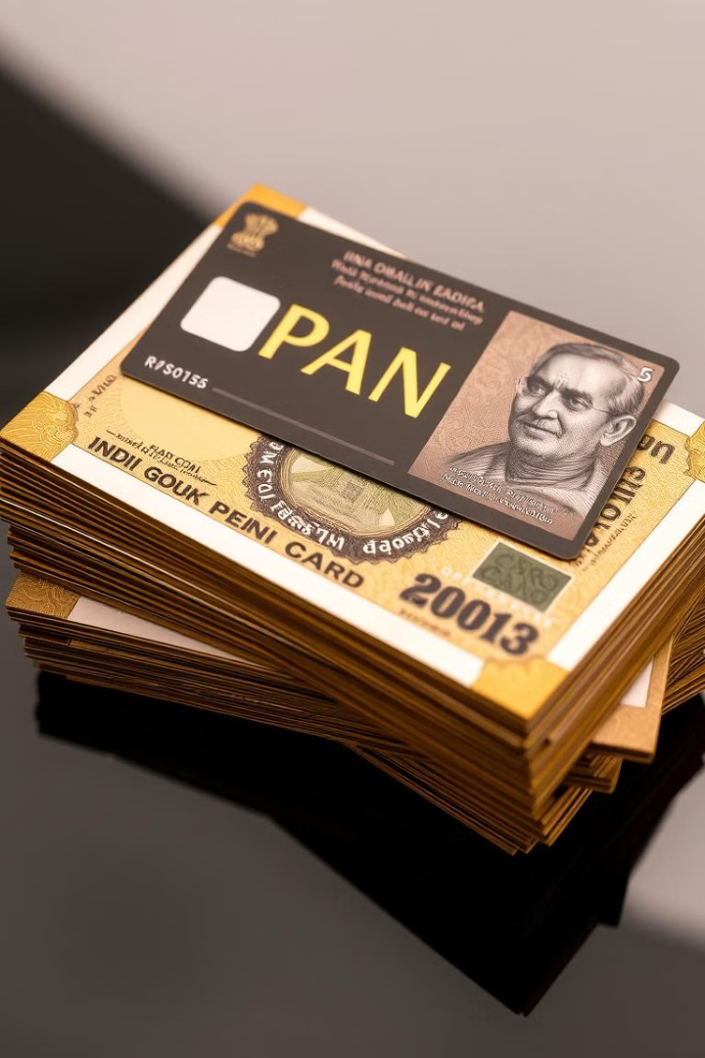
Importance of the PAN Card
The PAN Card holds immense importance for both individuals and the Indian economy. It plays a pivotal role in ensuring tax compliance and facilitating transparent financial transactions.
1
Tax Compliance
2
Financial Transparency
It helps the government track income and taxes paid, promoting fairness and accountability in the tax system.
It enhances transparency in financial transactions, preventing money laundering and black market activities.
3
Financial Inclusion
It facilitates access to financial services for all citizens, promoting financial inclusion and economic growth.

Slide 4
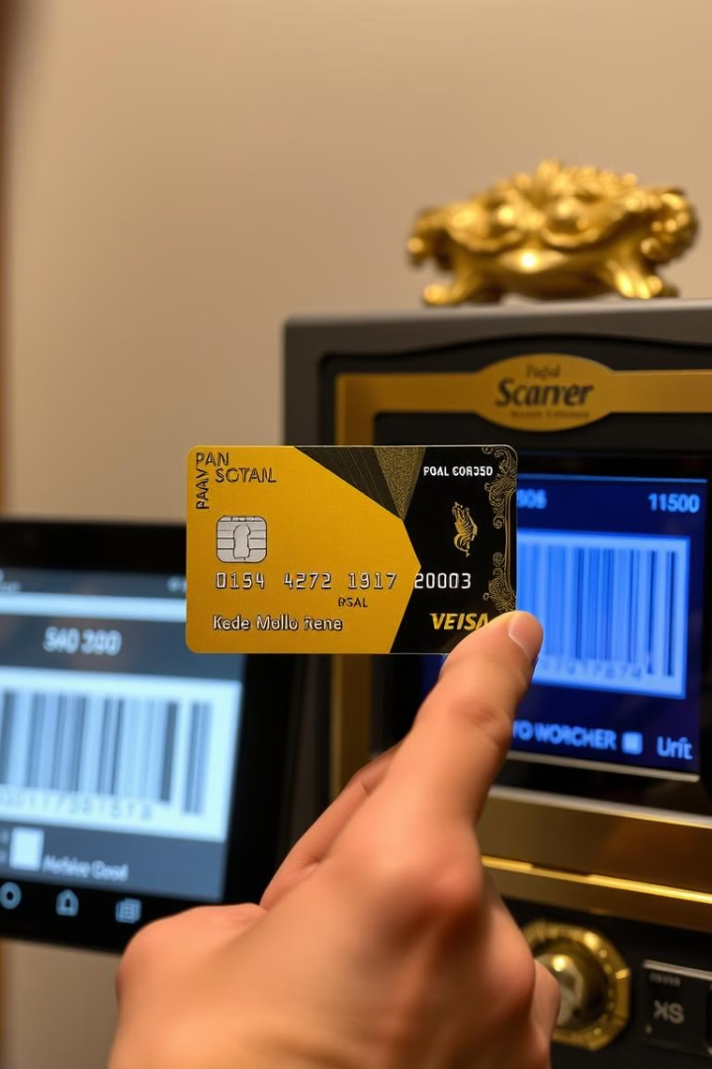



PAN Card as a Unique Identifier
The PAN Card serves as a unique identifier for all individuals and entities in India. It is a primary document for verification and identification in various financial and legal transactions, ensuring authenticity and preventing fraudulent activities.
Identification
Security
It acts as a reliable and verifiable identifier for individuals and businesses.
It helps mitigate risks associated with identity theft and fraudulent activities.
Access
It grants access to essential financial services and other legal requirements.

Slide 5

PAN Card and Tax Compliance
The PAN Card is integral to tax compliance in India. It allows the government to efficiently track taxpayers and their income, leading to a fairer and more transparent tax system.
1
Taxpayers use their PAN Card to file income tax returns, ensuring accurate reporting of income and taxes paid.
2
The government uses PAN Card data to identify potential tax evasion and enforce tax regulations.
3
The PAN Card contributes to a robust and efficient tax system that fuels economic development and social welfare programs.

Slide 6





PAN Card and Financial Transactions
The PAN Card plays a crucial role in various financial transactions, ensuring transparency and accountability. It is essential for a range of activities, from opening bank accounts to investing in financial instruments.
Bank Accounts
Individuals need a PAN Card to open a bank account, enabling access to a range of financial services.
Financial Investments
A PAN Card is mandatory for investments in stocks, mutual funds, and other financial instruments.
Property Transactions
The PAN Card is required for buying, selling, or renting properties, ensuring proper documentation.
Insurance Policies
PAN Card details are required for purchasing insurance policies, enabling accurate recordkeeping and claims processing.

