Slide 1
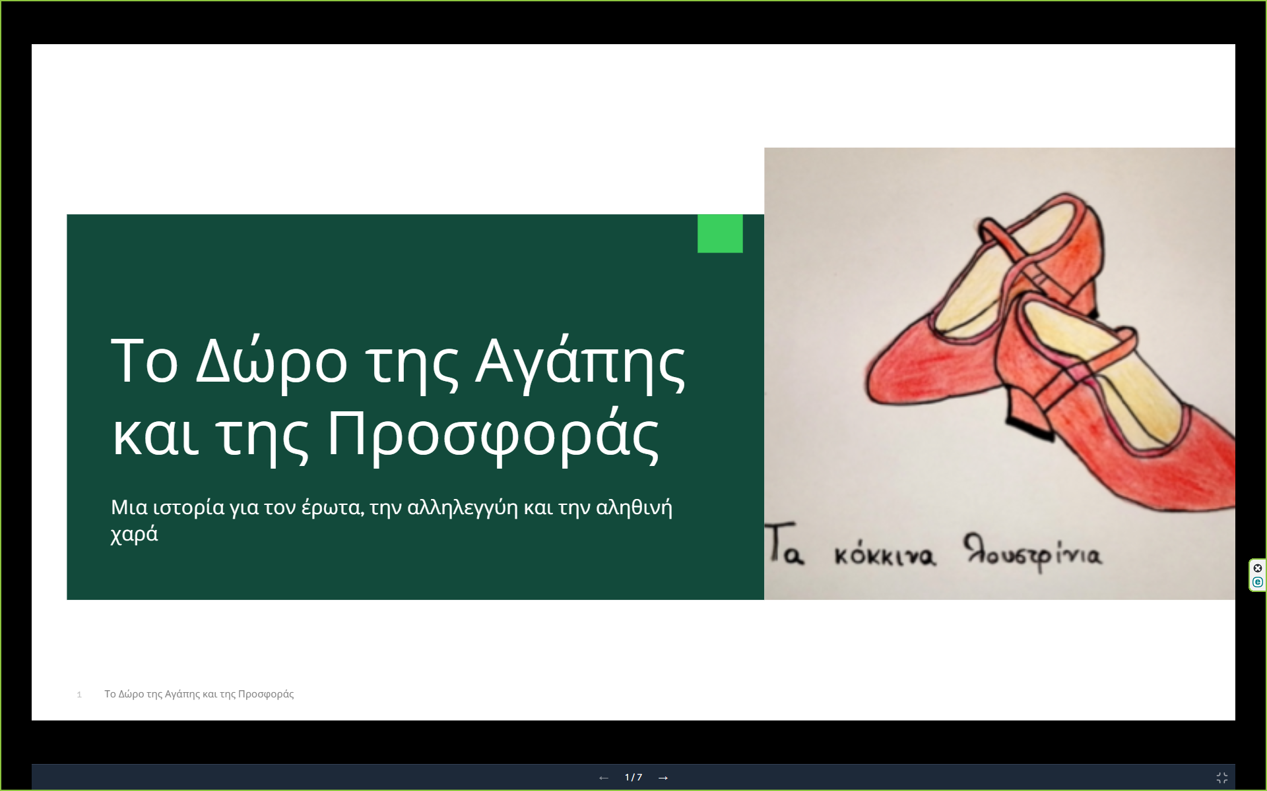
https://app.slidespeak.co/presentation/cmje8mq0m000rjvqtv8ikyehz?openPanel=ASSISTANT/share

Slide 2
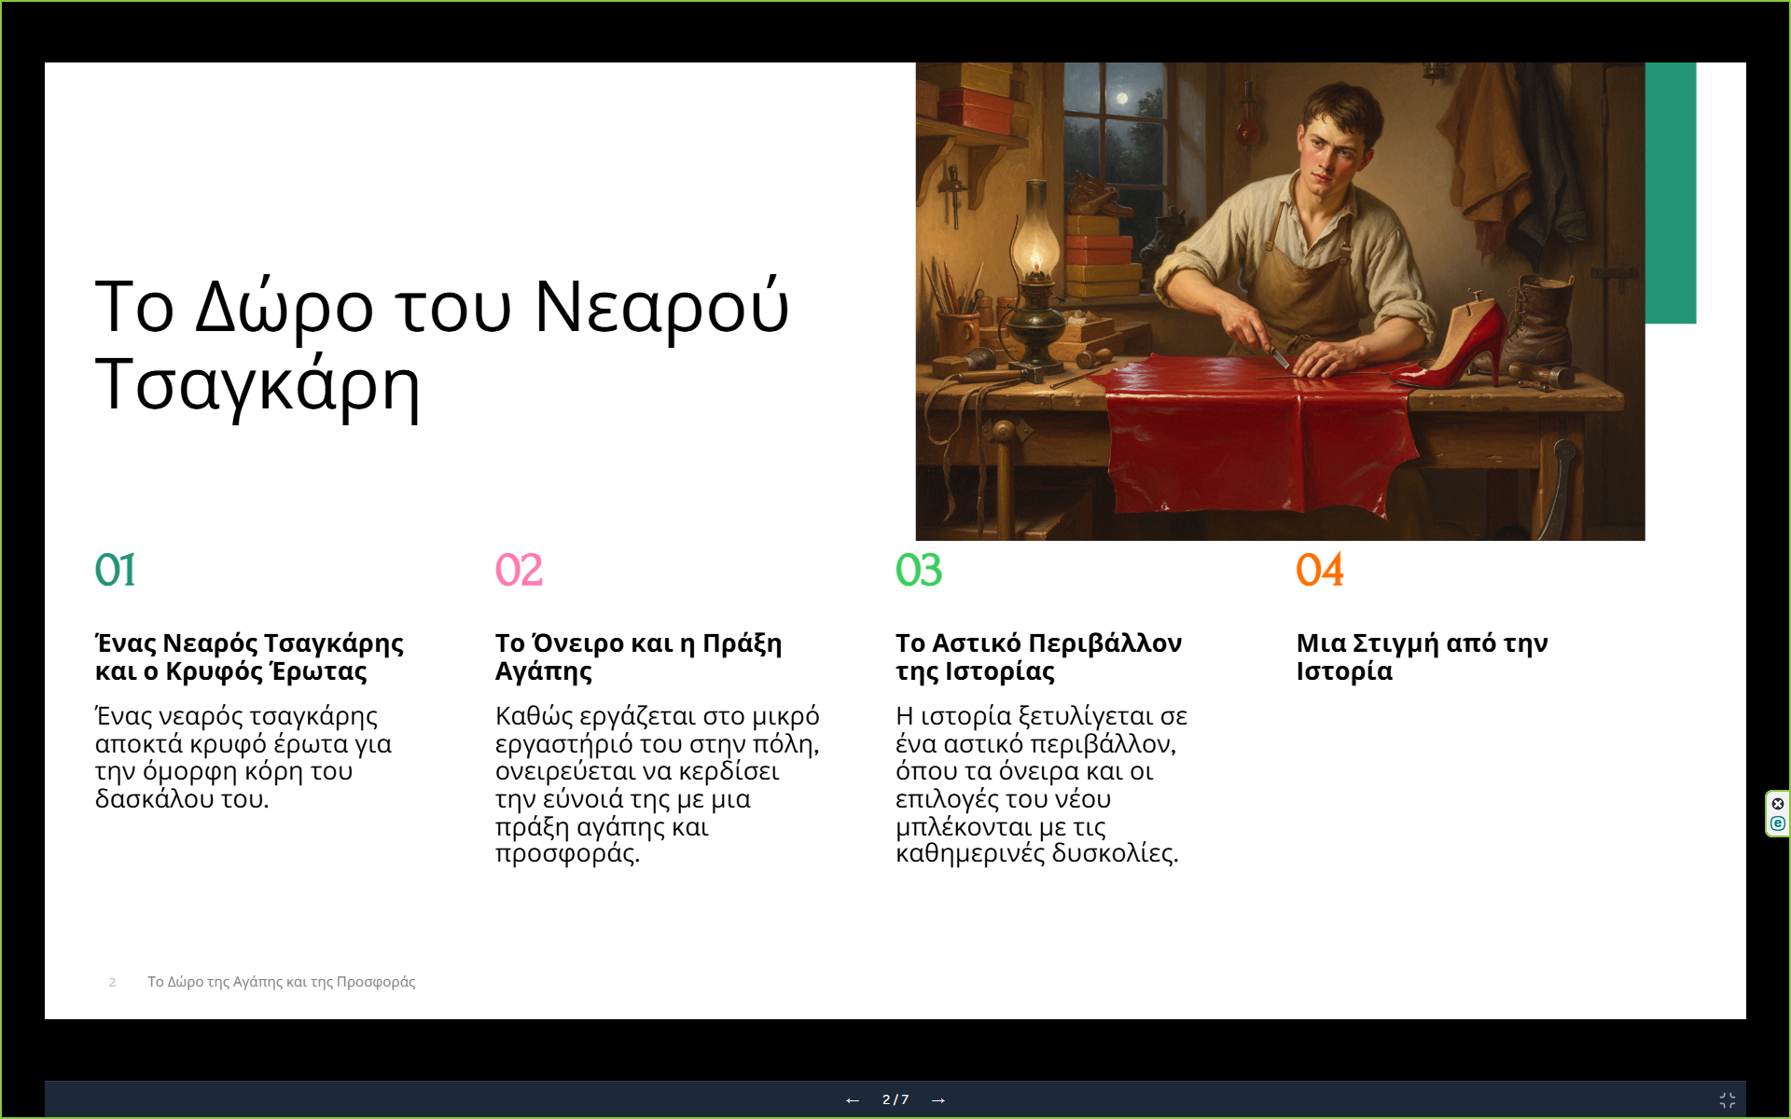

Slide 3
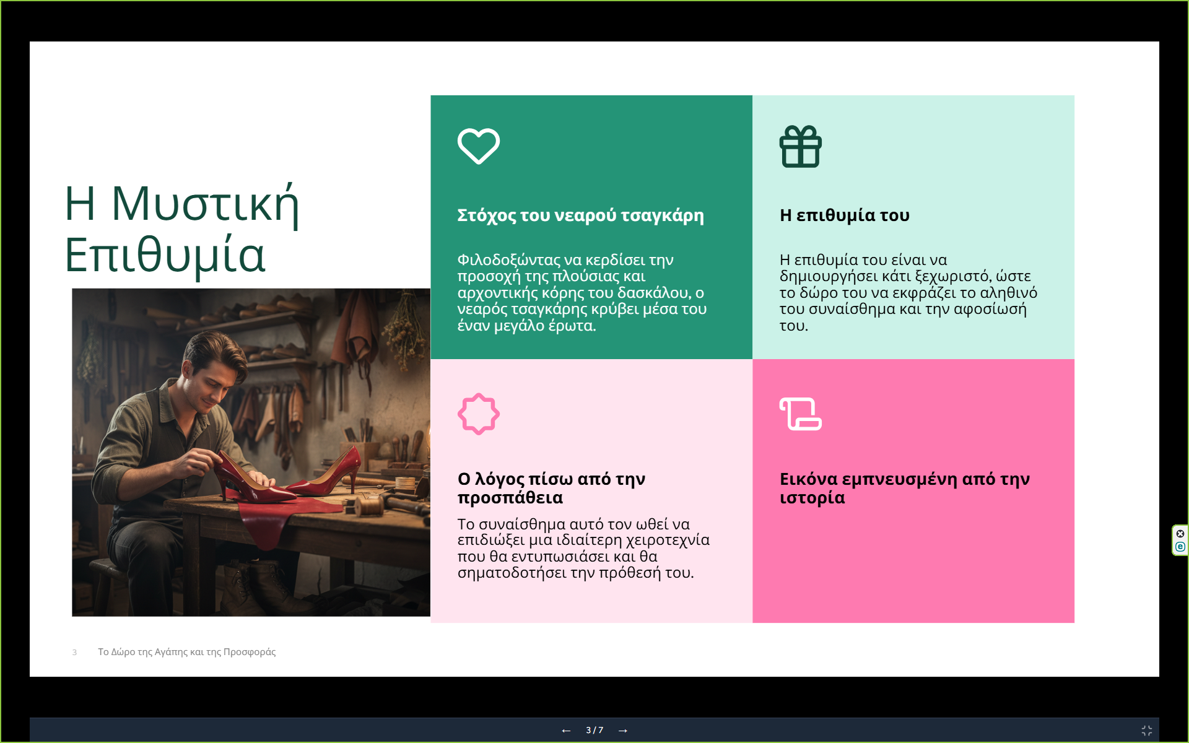

Slide 4
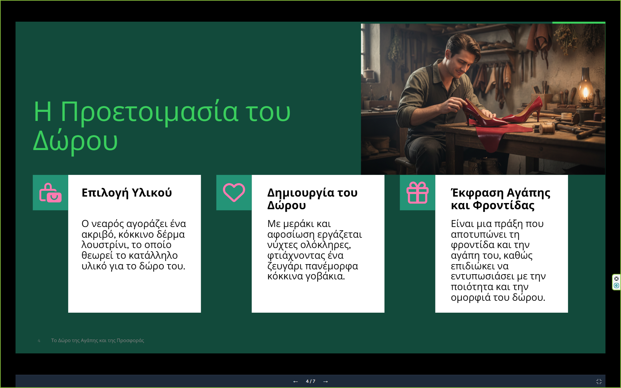

Slide 5
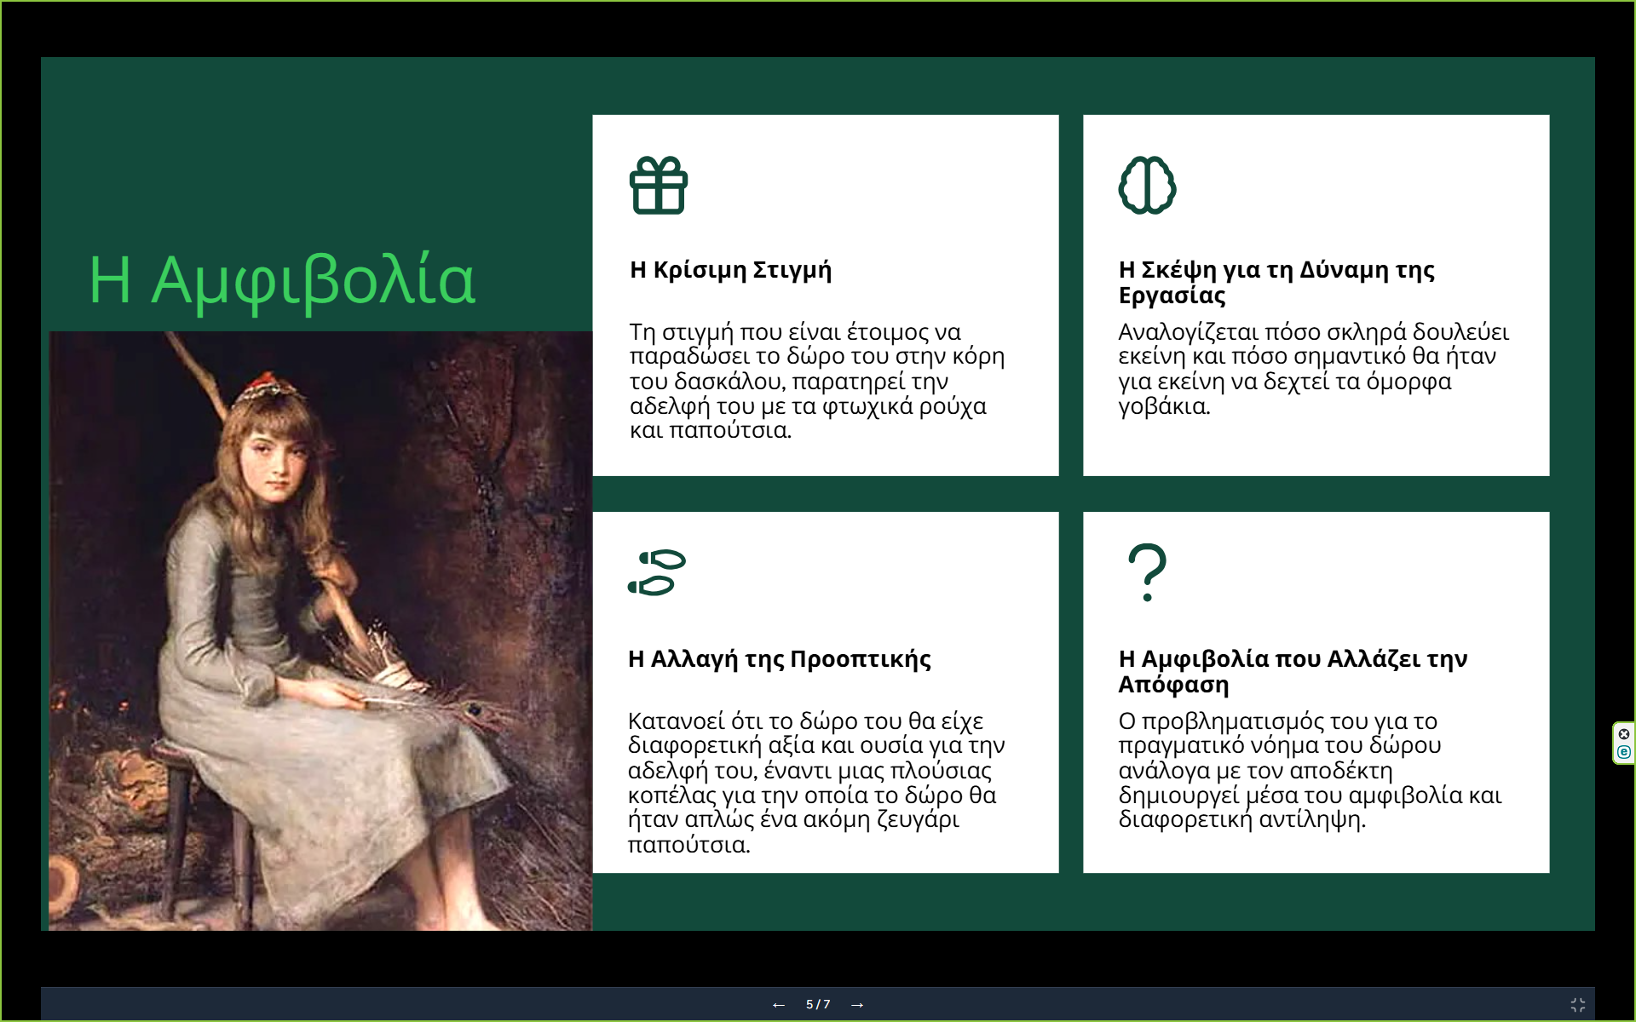

Slide 6
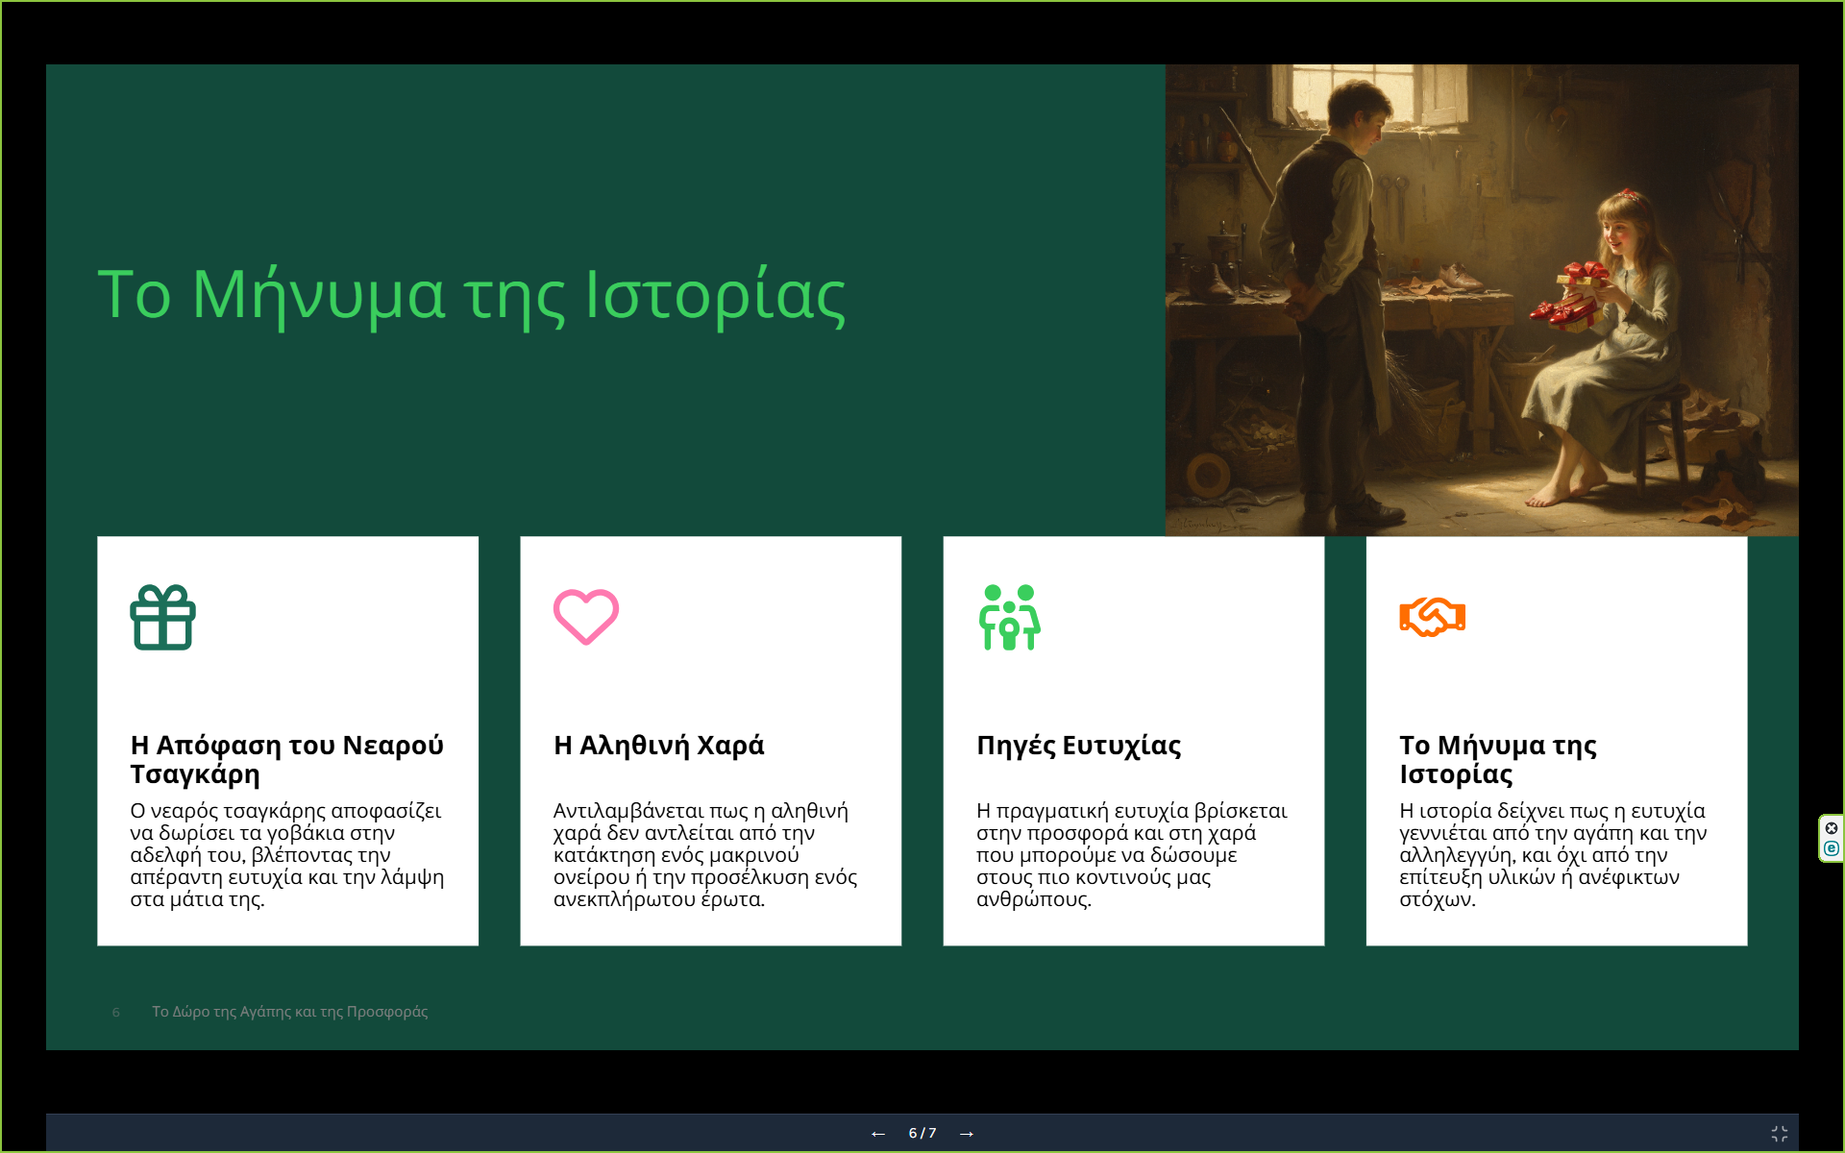

Slide 7


