Slide 1
Page 1
IT Skills
Topic: Crypto Currency Submitted By: Sujal Srivastva MBA HR Roll Number: 2410019025695 Submitted To: Sanjeev Verma

Slide 2

Page 2
Introduction to
Crypto Curreny
Crypto Currency is a digital form of currency that operates independently of traditional banking systems. It is built on blockchain technology, a decentralized and transparent ledger that records all transactions. Crypto currencies, like Bitcoin and Ethereum, have gained significant traction in recent years, transforming the way we think about money and financial transactions. This comprehensive introduction will explore the fundamentals of cryptocurrency, its underlying technology, the major players in the market, and the potential benefits and challenges it presents.

Slide 3
Page 3
What is Crypto Currency?
1
Digital Currency
2
Decentralized System
Crypto currency is a digital asset designed to work as a medium of exchange. It utilizes cryptography to secure and verify transactions, as well as to control the creation of new units of a particular cryptocurrency.
Crypto Currencies operate on a decentralized network, meaning they are not controlled by any single entity, such as a government or financial institution. This decentralization is a key feature that sets cryptocurrencies apart from traditional fiat currencies.
3
Blockchain Technology
4
Pseudonymous Transactions
Crypto currencies are built on blockchain technology, which is a distributed, digital ledger that records all transactions in a secure, transparent, and permanent manner.
Crypto Currency transactions are recorded on the blockchain using unique digital identifiers, allowing for pseudonymous transactions where the identity of the parties involved is not directly revealed.

Slide 4

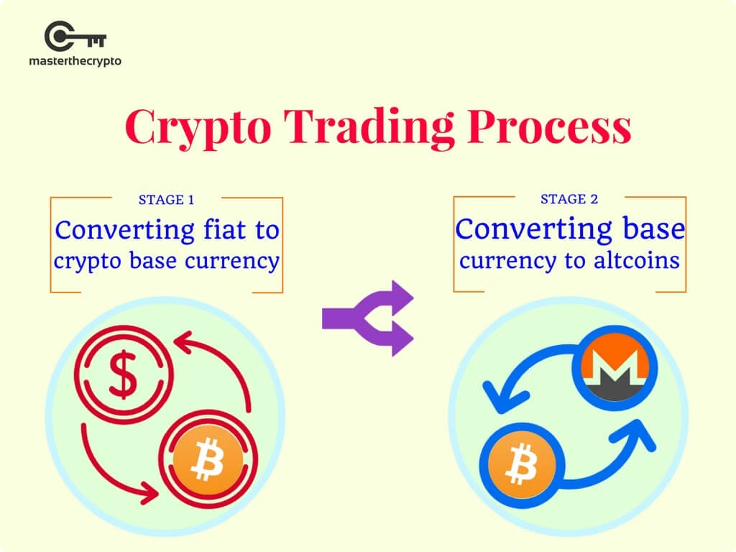
Page 4
How Crypto Currency Works
1
Transaction Initiation
A user initiates a crypto currency transaction by sending digital coins from their digital wallet to another user's wallet address.
2
Transaction Verification
The transaction is broadcasted to the decentralized network of computers, known as nodes, which verify the transaction and ensure it is valid.
3
Block Creation
Once verified, the transaction is added to a block, which is then added to the blockchain, creating an immutable record of the transaction.

Slide 5
Page 5
Blockchain Technology
Distributed Ledger
Cryptographic Security
Decentralized Consensus
The blockchain is a distributed, digital ledger that records all crypto currency transactions in a secure, transparent, and permanent manner. This ledger is shared across the entire network of computers, known as nodes, which maintain and update the ledger.
Blockchain technology utilizes advanced cryptography to secure the network and prevent unauthorized modifications to the ledger. Each block in the chain is linked to the previous block, creating an immutable record of all transactions.
The decentralized nature of the blockchain means that there is no single point of control or failure. Transactions are validated and added to the ledger through a consensus process, ensuring the network's security and reliability.

Slide 6


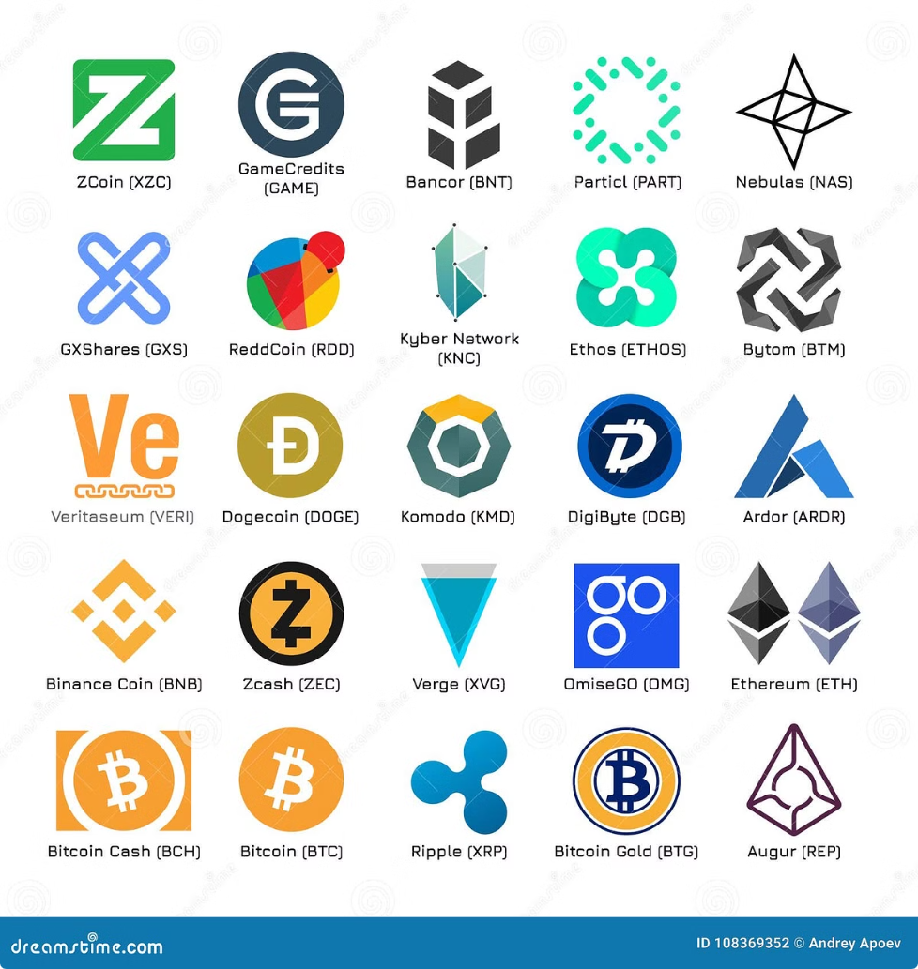



Page 6
Major Crypto Currencies: Bitcoin, Ethereum, and More
Bitcoin
The first and most well-known crypto currency, Bitcoin was introduced in 2009 and has since become the largest cryptocurrency by market capitalization.
Ethereum
Ethereum is a decentralized, open-source blockchain platform that enables the development and deployment of smart contracts and decentralized applications (dApps).
Litecoin
Litecoin is a peer-to-peer crypto currency that was created as a faster and more efficient alternative to Bitcoin, with reduced transaction confirmation times.
Ripple
Ripple is a digital payment network and protocol that enables fast and secure cross-border transactions, with a focus on facilitating international money transfers.

Slide 7


Page 7
Benefits of Crypto Currency
Decentralization
Crypto currencies operate on a decentralized network, which eliminates the need for intermediaries and centralized control, providing users with greater control and autonomy over their finances.
Transparency
The blockchain technology underlying crypto currencies ensures that all transactions are recorded in a transparent and immutable manner, promoting trust and accountability.
Accessibility
Crypto currencies offer global accessibility, as they can be accessed and used by anyone with an internet connection, making them particularly beneficial for the unbanked and underbanked populations.
Speed and Efficiency
Crypto currency transactions are typically faster and more efficient than traditional banking and payment systems, with reduced fees and settlement times.

Slide 8
Page 8
Risks and Challenges of Crypto Currency
Volatility
Regulatory Uncertainty
Security Concerns
Crypto currencies are known for their high volatility, with significant price fluctuations that can make them risky investments. This volatility can also hinder their adoption as a stable medium of exchange.
The regulatory landscape surrounding crypto currencies is constantly evolving, with varying approaches and policies across different jurisdictions. This uncertainty can create challenges for both users and businesses operating in the crypto currency space.
Crypto Currency wallets and exchanges are vulnerable to hacking, theft, and other security breaches, which can result in the loss of digital assets. Maintaining the security of one's crypto currency holdings is a significant challenge for users.

Slide 9


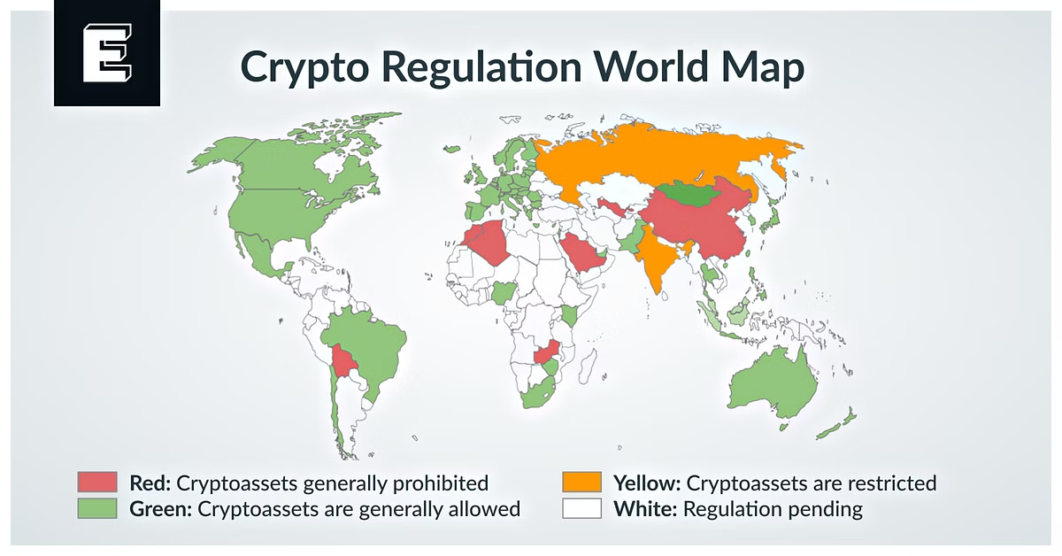


Page 9
Regulatory Landscape and
Crypto Currency
Varying Approaches
Different countries and regions have adopted varying regulatory approaches to crypto currencies, ranging from complete bans to more lenient frameworks that seek to foster innovation.
Compliance Challenges
The lack of global regulatory consensus creates compliance challenges for businesses and individuals operating in the crypto currency space, as they must navigate a complex patchwork of regulations.
Ongoing Developments
Regulatory authorities continue to monitor the evolution of crypto currencies and are actively working to develop appropriate frameworks to address the unique challenges posed by this emerging technology.

Slide 10


Page 10
Investing and Trading in Crypto Currency
Investment Strategies
Risks and Considerations
- Long-term holding (HODLing) - Day trading - Margin trading - Diversification
- Volatility - Security risks - Regulatory changes - Technical analysis and market knowledge
Investing and trading in crypto currencies can be a complex and risky endeavor, requiring a deep understanding of the market dynamics, security best practices, and regulatory frameworks. Investors should carefully consider their risk tolerance, investment strategies, and the potential rewards and challenges before entering the cryptocurrency market.

Slide 11


Page 11
Conclusion
Crypto Currency represents a transformative shift in the way we think about and interact with money. While the technology is still evolving, and the regulatory landscape remains uncertain, the potential benefits of crypto currencies, such as decentralization, transparency, and accessibility, have captured the attention of individuals, businesses, and governments worldwide. As the crypto currency ecosystem continues to mature, it will be crucial for stakeholders to navigate the risks and challenges, foster innovation, and ensure the responsible development of this disruptive technology.

Slide 12
Page 12
Thank You

