Slide 1

Lathe presentation
By Guardxavier

Slide 2
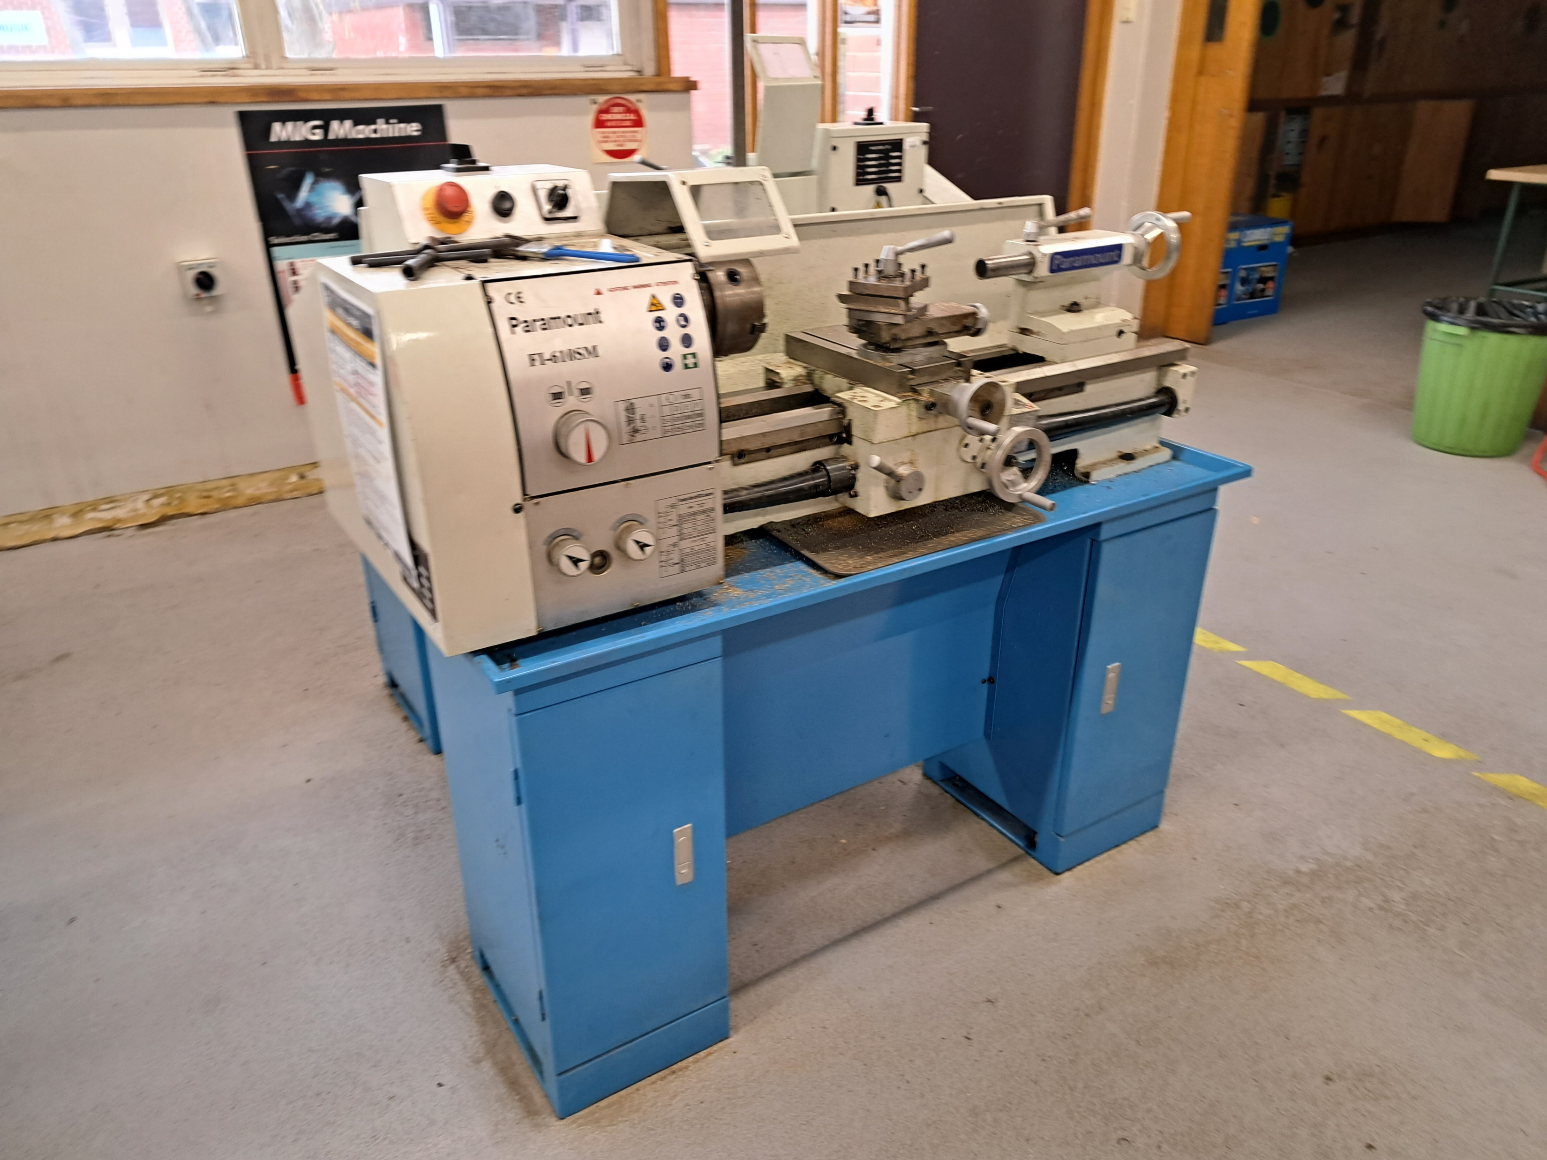
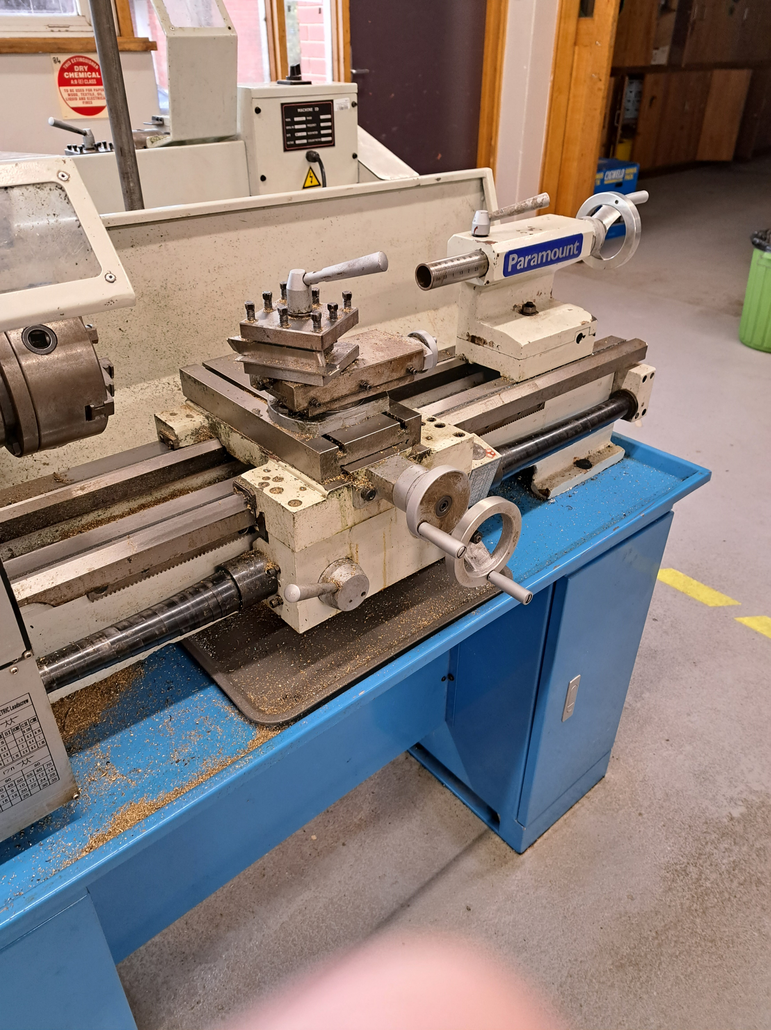
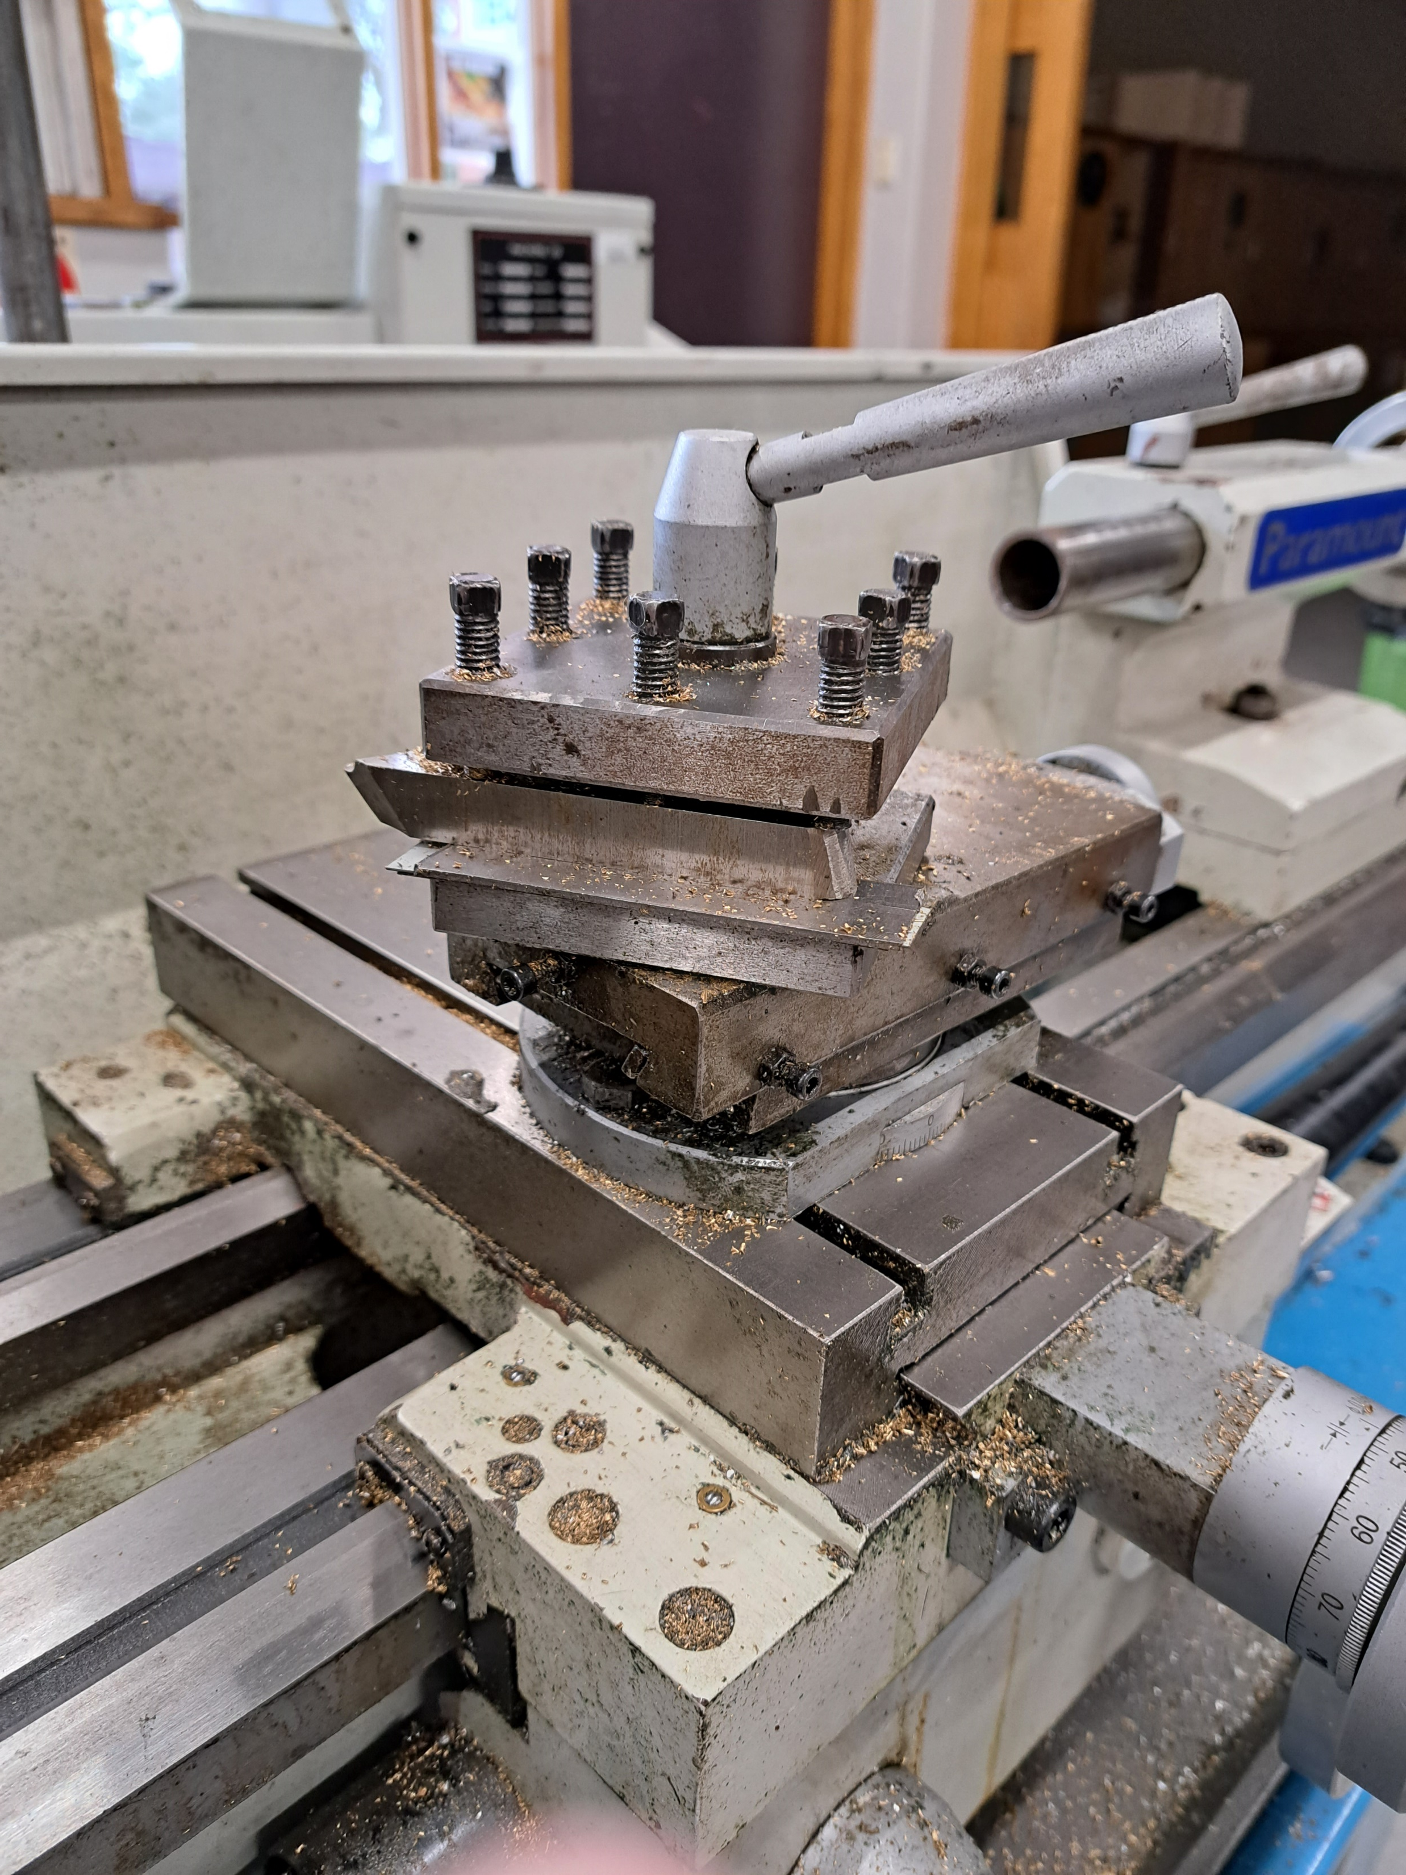
What is a lathe and how does it work?
A lathe is a type of machining tool that is usually used to shape metal or wood. The workpiece is rotated around a fixed cutting tool. By exposing workpieces to a cutting tool, lathes are used to remove material. The workpiece is clamped to the lathe and rotated while being pressed onto a cutting tool. Material can be removed quickly, efficiently, and precisely thanks to the circular movement of the work piece. Lathes have been used to create parts for other machines as well as unique things such as bowls and musical instruments. This basic gripping and rotating mechanism is used by all of them, regardless of their type or purpose.
By Weasley
By Weasley
By Weasley
Notes:
A lathe is a type of machining tool that is usually used to shape metal or wood. The workpiece is rotated around a fixed cutting tool. By exposing workpieces to a cutting tool, lathes are used to remove material. The workpiece is clamped to the lathe and rotated while being pressed onto a cutting tool. Material can be removed quickly, efficiently, and precisely thanks to the circular movement of the work piece. Lathes have been used to create parts for other machines as well as unique things such as bowls and musical instruments. This basic gripping and rotating mechanism is used by all of them, regardless of their type or purpose.

Slide 3
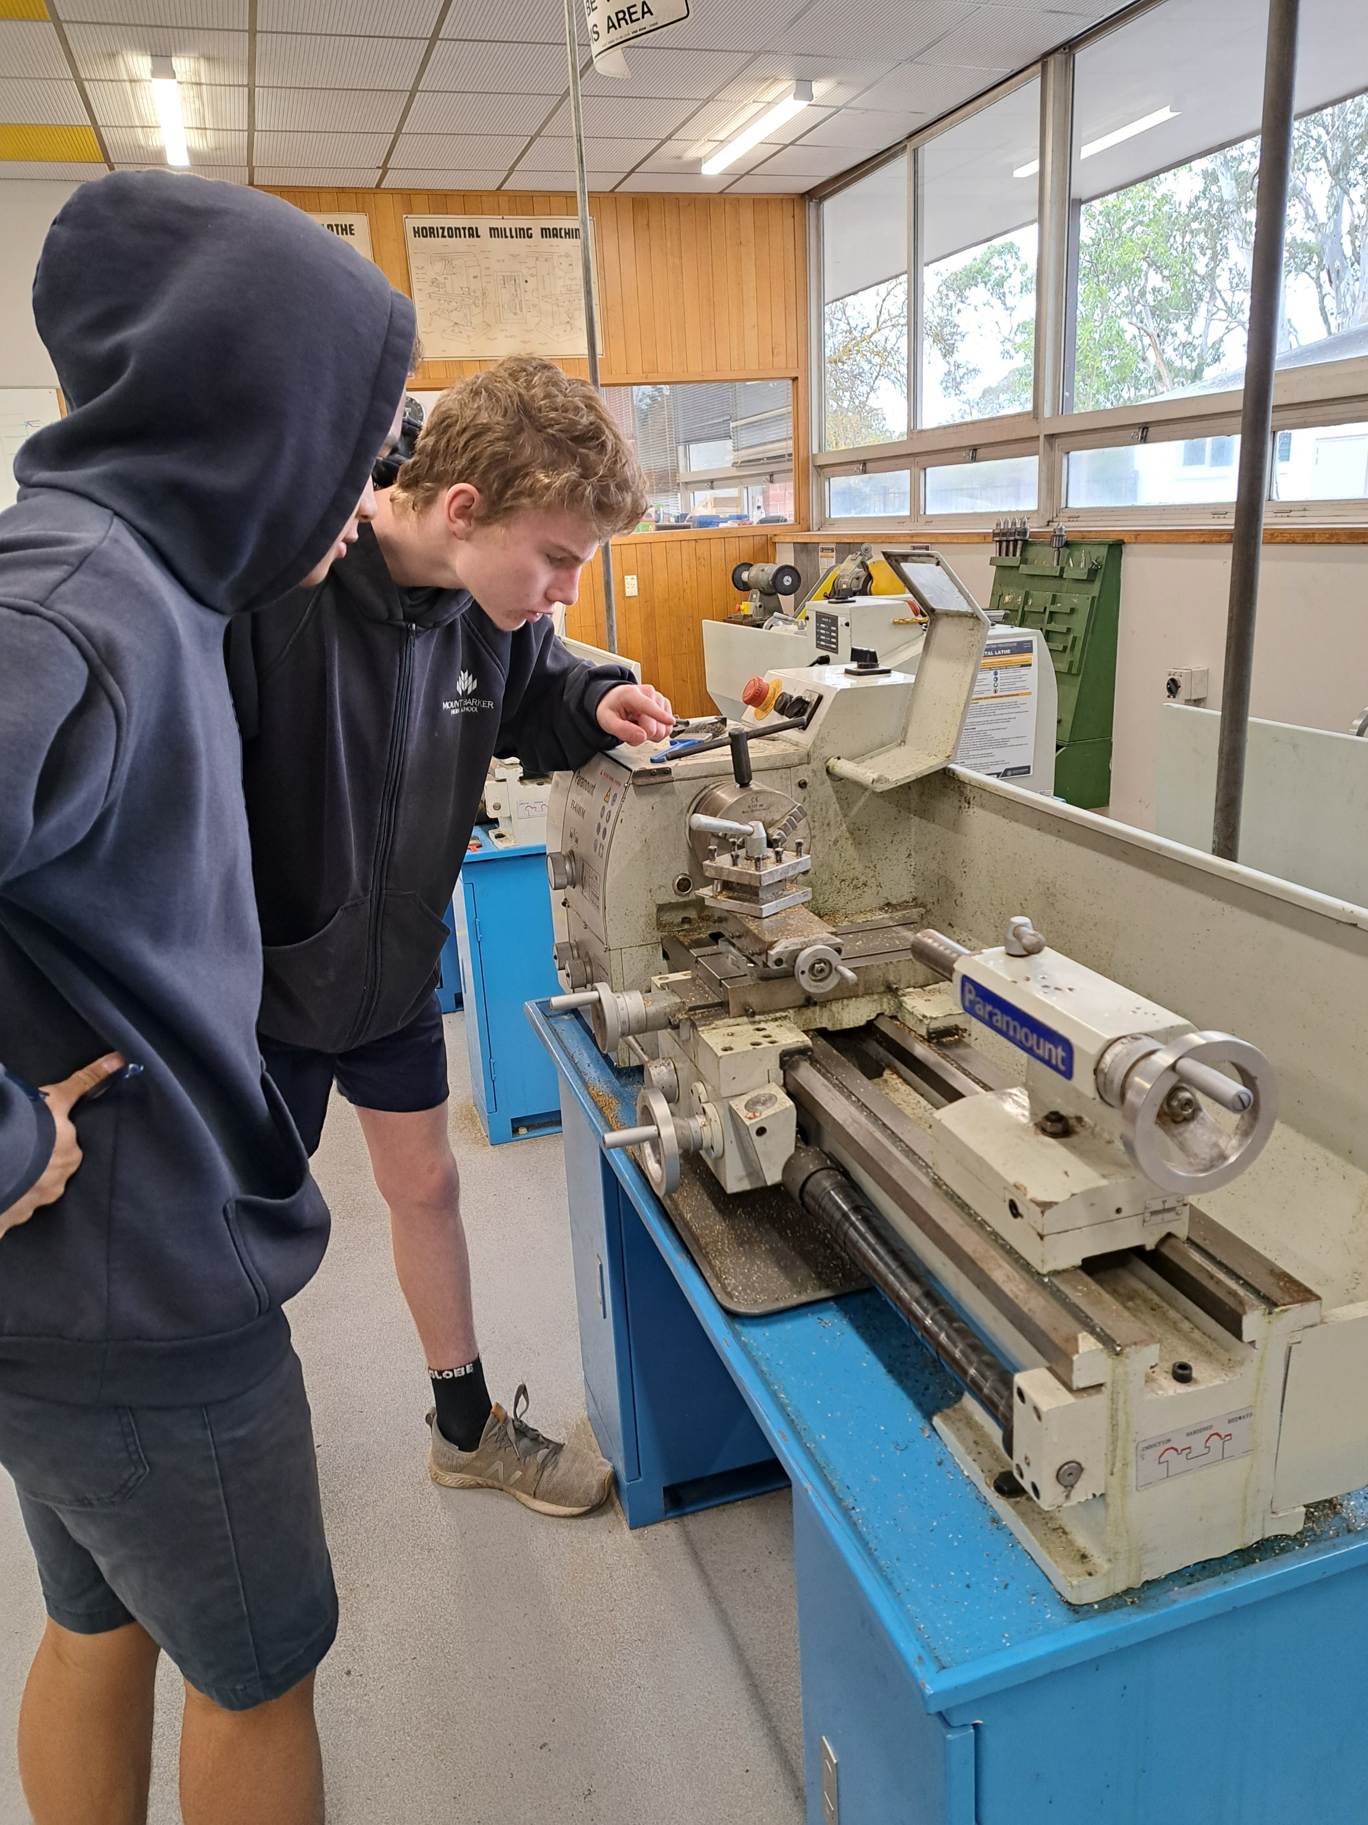
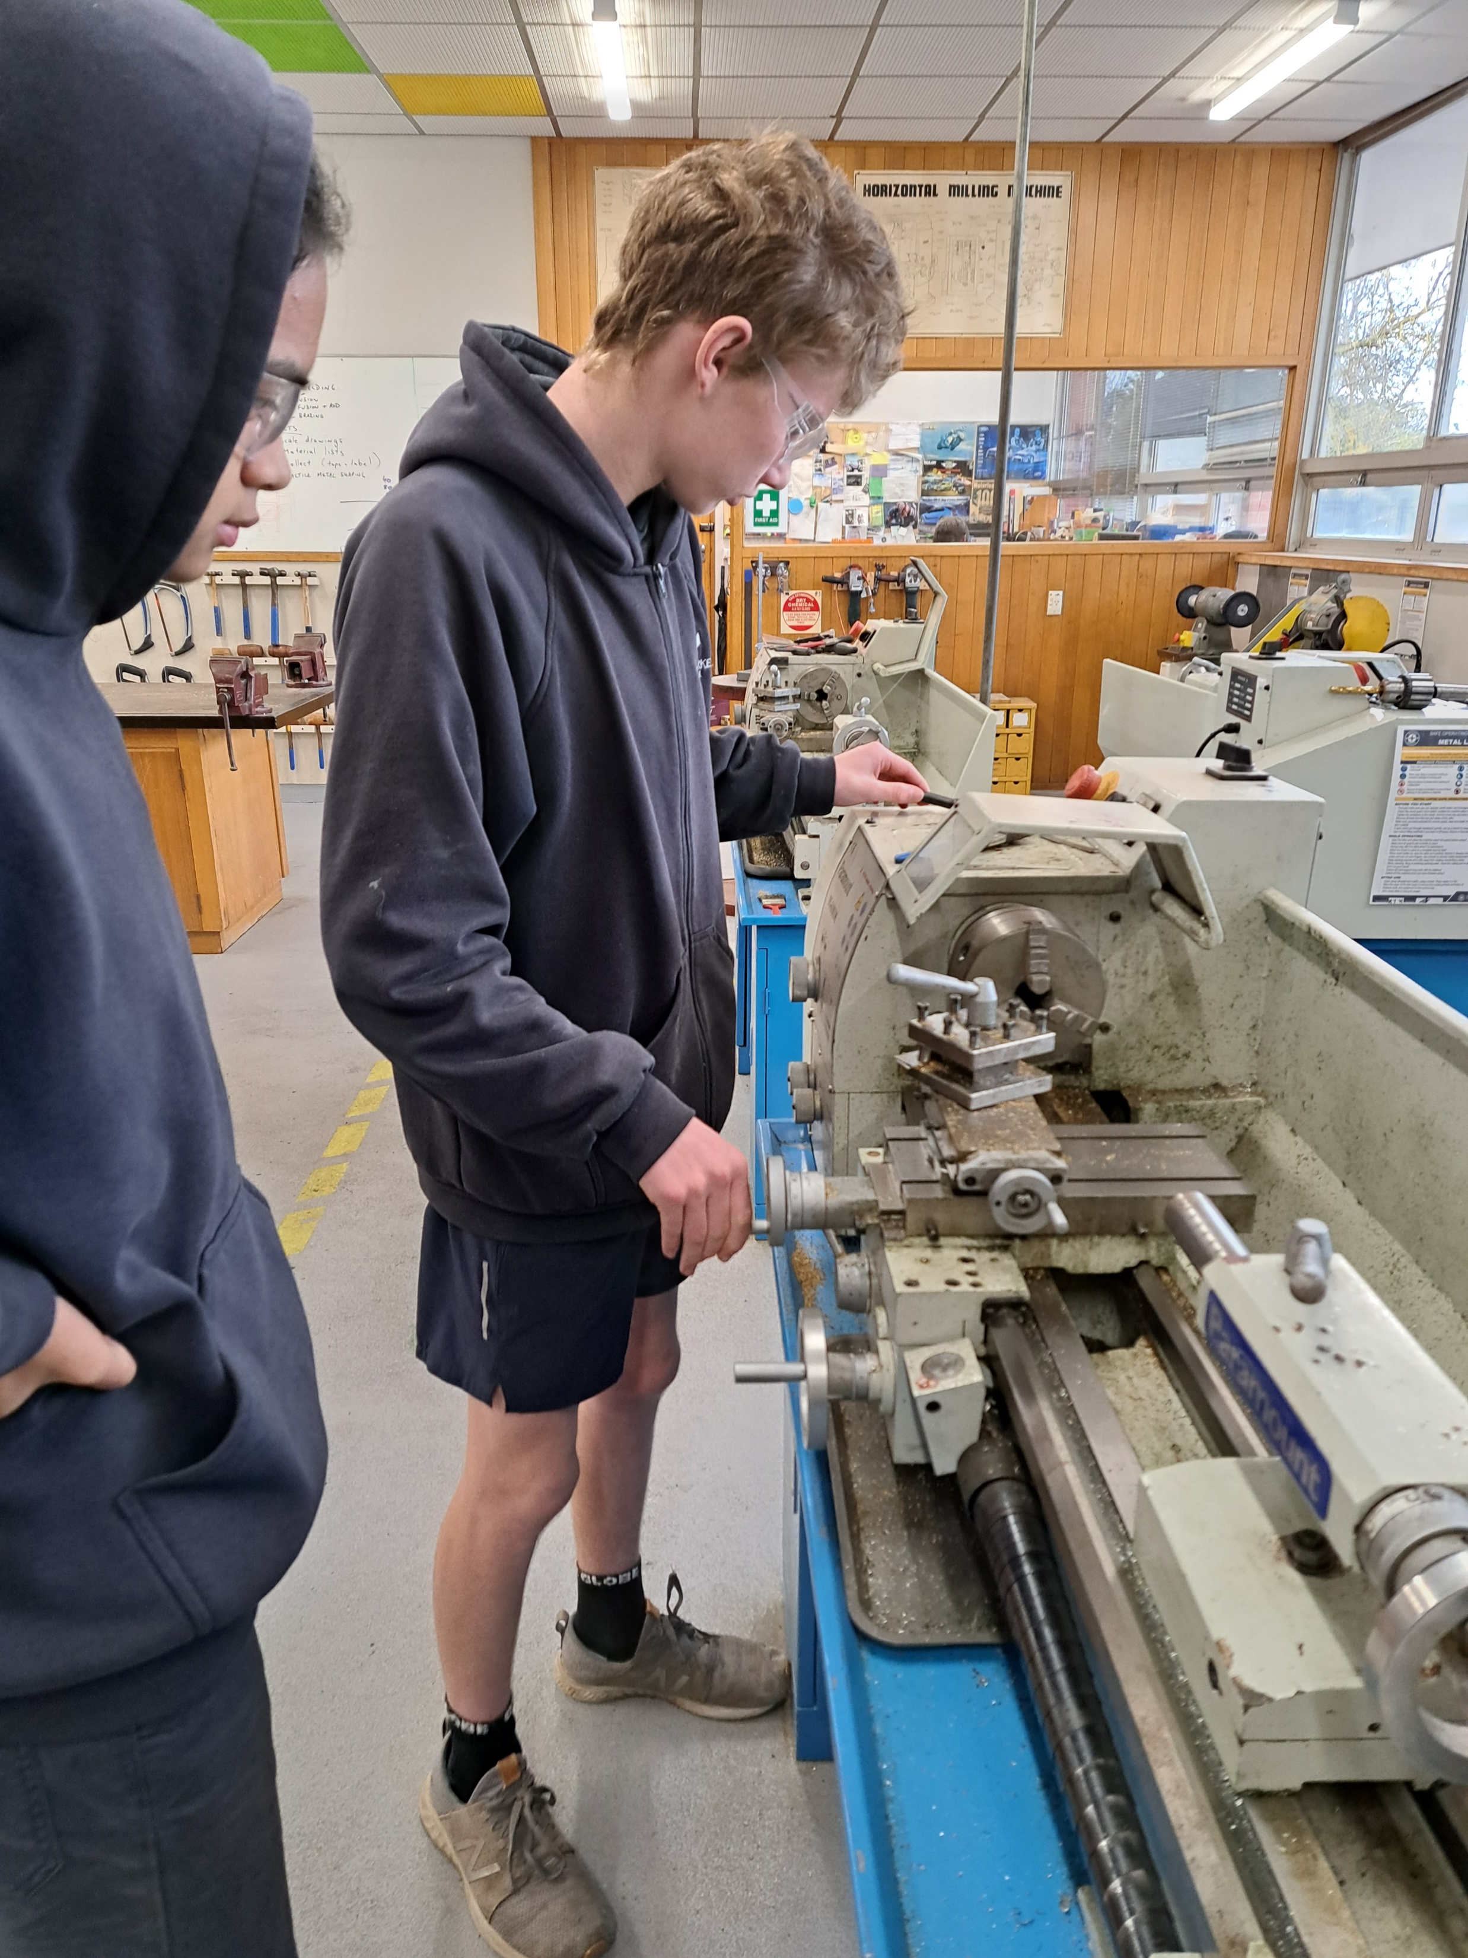
Safety procedures for lathes
Not Safe
Safe
When operating lathes, remember to take the following safety precautions:
It's important to dress properly; take off your jewelry and watches, and roll your sleeves over your elbows.
Before making any modifications, always turn off the lathe.
Wait until the lathe has come to a complete stop before changing spindle speeds.
Wear safety glasses always.
Laying tools directly on the lathe ways is never a good idea. If a separate table is not available, arrange the ways on a broad board with a cleat on each side.
When sanding the workpiece, use two hands. Sandpaper or emery cloth should not be wrapped around the workpiece.
Long hair must be tied and worn back to avoid hair getting stuck in the machine
Notes:
When operating lathes, remember to take the following safety precautions:
It's important to dress properly; take off your jewelry and watches, and roll your sleeves over your elbows.
Before making any modifications, always turn off the lathe.
Wait until the lathe has come to a complete stop before changing spindle speeds.
Wear safety glasses always.
Laying tools directly on the lathe ways is never a good idea. If a separate table is not available, arrange the ways on a broad board with a cleat on each side.
When sanding the workpiece, use two hands. Sandpaper or emery cloth should not be wrapped around the workpiece.
Long hair must be tied and worn back to avoid hair getting stuck in the machine

Slide 4
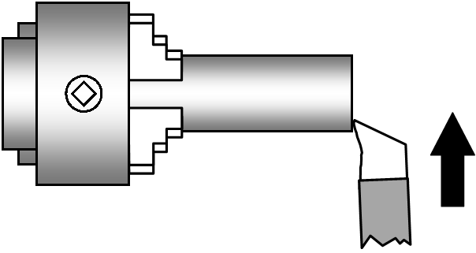
Facing
What is Facing? On the lathe, a facing tool is used to carve a flat surface perpendicular to the rotational axis of the workpiece. A facing tool is installed in a tool holder that is attached to the lathe carriage. As the component rotates in the chuck's jaws, the tool will feed perpendicularly across the part's rotational axis.
Set up the tool by securing it, levelling it, and screwing it in. Place the component you're working on away from the chuck in a place where it won't be struck by the tool. Then, as directed by the safety instructions, examine all the equipment.
Making a tiny incision around the object to indicate when to stop facing and using a sharpie to make the mark stand out more. Facing to a length: Roughly measure out a length and set up the machine. Undo the chunk and place the object into the jaws after marking and setting up the machine, then tighten using the given tool.
With the machine on, slowly spin the carriage handler which moves horizontally and removes the desired amount of metal, slowly go in and out until you managed to achieve a finished and smooth cut without any bumps or uneven levelling
Notes:
What is Facing? On the lathe, a facing tool is used to carve a flat surface perpendicular to the rotational axis of the workpiece. A facing tool is installed in a tool holder that is attached to the lathe carriage. As the component rotates in the chuck's jaws, the tool will feed perpendicularly across the part's rotational axis.
Set up the tool by securing it, levelling it, and screwing it in. Place the component you're working on away from the chuck in a place where it won't be struck by the tool. Then, as directed by the safety instructions, examine all the equipment.
Making a tiny incision around the object to indicate when to stop facing and using a sharpie to make the mark stand out more. Facing to a length: Roughly measure out a length and set up the machine. Undo the chunk and place the object into the jaws after marking and setting up the machine, then tighten using the given tool.
With the machine on, slowly spin the carriage handler which moves horizontally and removes the desired amount of metal, slowly go in and out until you managed to achieve a finished and smooth cut without any bumps or uneven levelling

Slide 5
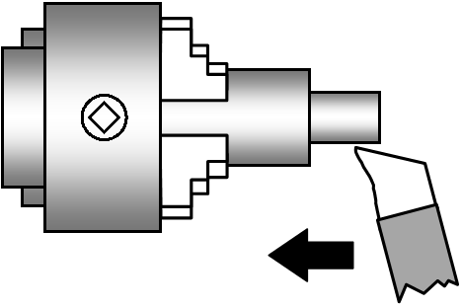
Parallel turning
What is Parallel turning? Parallel turning is a cutting technique used on a center lathe to reduce the diameter of a workpiece. If a long length needs to be cut, the automated feed can help ensure a smooth, even cut, while the live center can help support the material and keep it from bending away from the tool.
Just like facing you must secure the tool, levelling it, and screwing it in are all steps in the setup process. Place the component you're working on far enough away from the chuck, so it won't be hit by the tool. Examine all the equipment as directed by the safety regulations.
With the object secured you can now start shaving off the objects, it is advised to turn the compound rest travel handle slowly to get an even and smooth finish
Notes:
What is Parallel turning? Parallel turning is a cutting technique used on a center lathe to reduce the diameter of a workpiece. If a long length needs to be cut, the automated feed can help ensure a smooth, even cut, while the live center can help support the material and keep it from bending away from the tool.
Just like facing you must secure the tool, levelling it, and screwing it in are all steps in the setup process. Place the component you're working on far enough away from the chuck, so it won't be hit by the tool. Examine all the equipment as directed by the safety regulations.
With the object secured you can now start shaving off the objects, it is advised to turn the compound rest travel handle slowly to get an even and smooth finish

