Slide 1

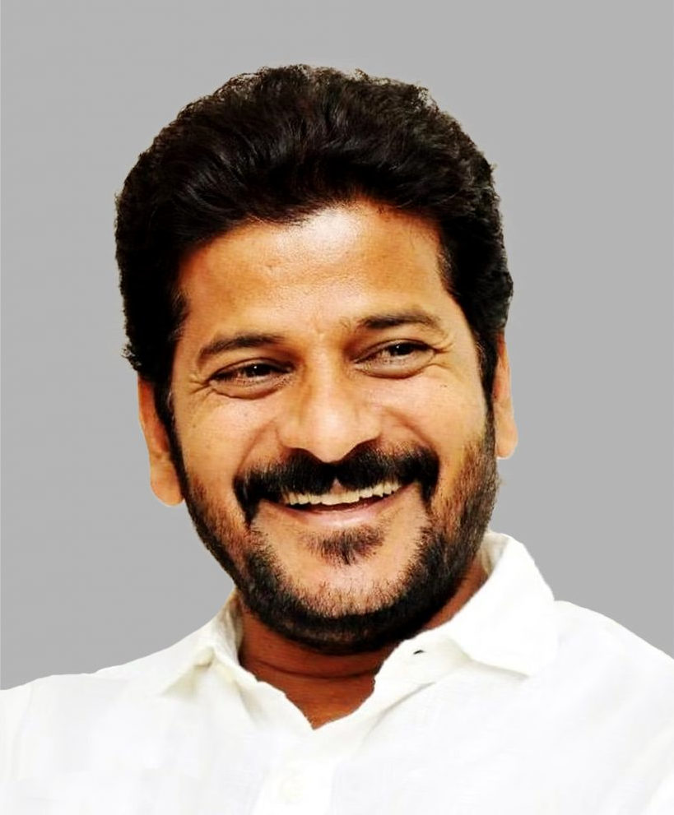
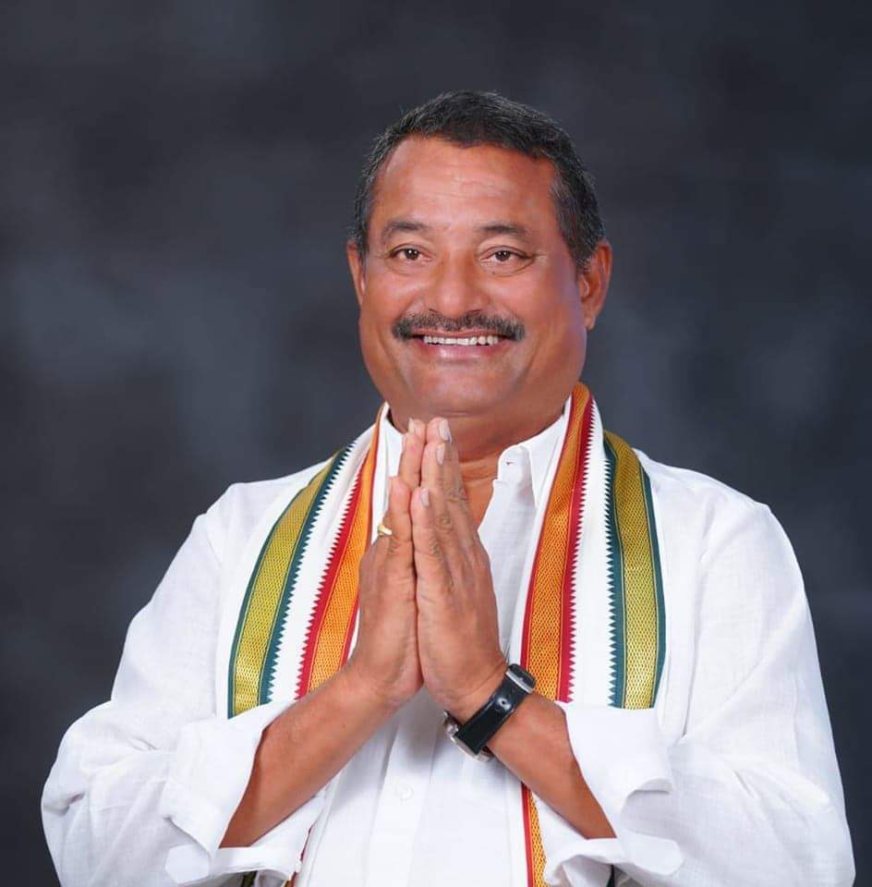

Developmental Work Proposals
MIRYALAGUDA MUNICIPALITY
Shri Revanth Reddy
Hon’ble Chief Minister,
Government of Telangana
Shri Bathula Laxma Reddy
Hon’ble MLA
Miryalaguda Assembly Constituency
Technical Associate
NCPE Infrastructure India Private Ltd.
Infrastructure Designers, Urban Planners and Project Management Consultants
Notes:
Namaste, my dear brothers and sisters of Miryalguda Assembly Constituency.
At the outset, I wish to put on record, my immense gratitude for electing me as your representative in the Legislative Assembly. As you are aware, our Hon’ble Chief Minister has used the platform of ‘Telangana Rising Global Summit 2025’ to unveil the government’s vision for a $3 trillion economy by 2047.

Slide 2
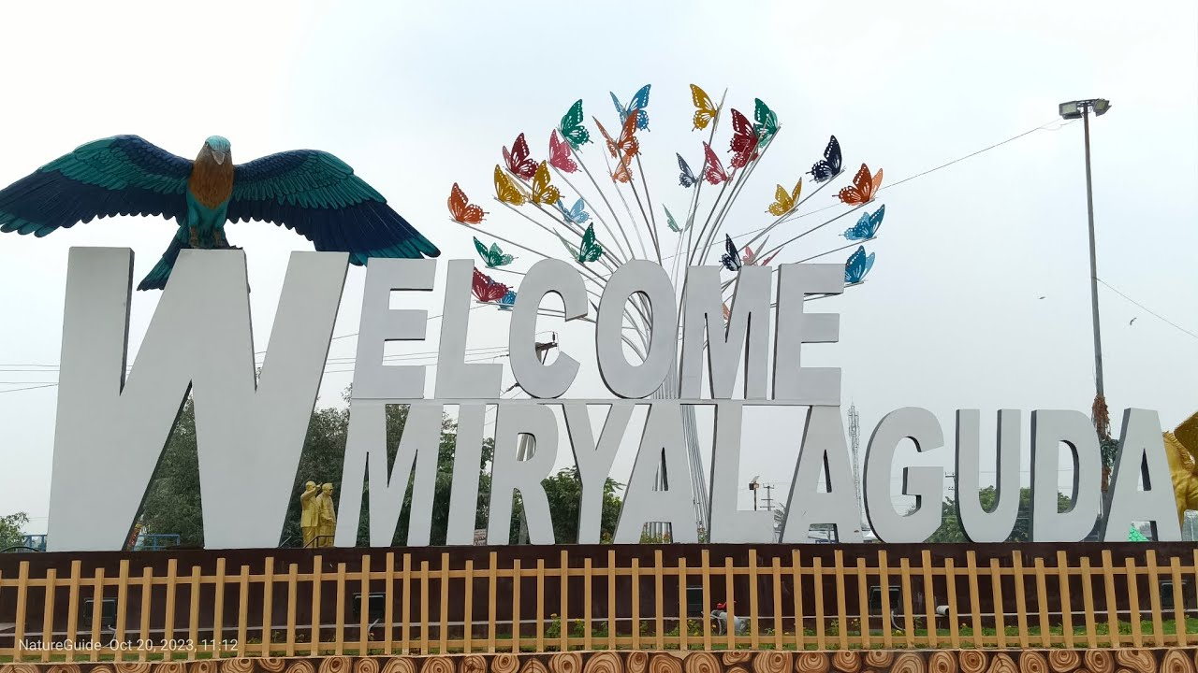
Notes:
It is of immense pleasure for me to state that, I, along with the public of my constituency, extend unwavering support to our beloved Chief Minister in realizing the vision of economic prosperity and all round development of the state of Telangana.

Slide 3
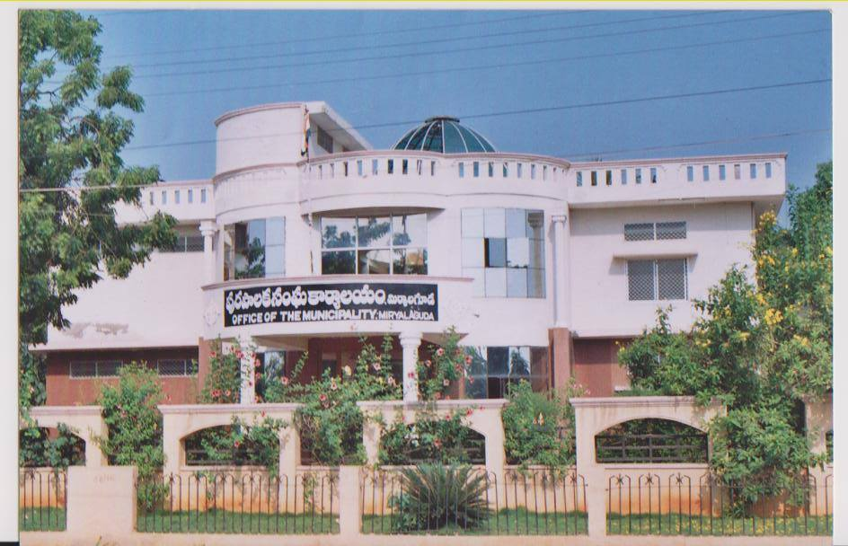
Notes:
Let me take this opportunity to state that our state's rise is the rise of all its villages, towns and cities put together.
This is the time for hard work – a time to conceive and implement developmental works which make Miryalguda constituency more prosperous and self-reliant in the times ahead.

