Slide 1

Smart Slimming Blueprint

Slide 2


01.
Why We Gain
02.
Science of Fat Loss
CONTENTS
03.
05.
Five-Meal Framework
Hydration & Exercise
04.
06.
Food Choices Matrix
Coaching Toolkit

Slide 3



01
Why We Gain

Slide 4

The Energy Surplus Trap
Modern eating patterns often create an unintentional daily calorie surplus. This excess energy, beyond what the body immediately needs, is efficiently stored as adipose tissue (fat), leading to gradual weight gain over time.
Meal Spacing: Long gaps between meals can lead to overeating later.
Hidden Fats: Oils, dressings, and processed foods add calories quickly.
Oversized Dinners: Large evening meals contribute to fat storage during sleep.

Slide 5
The Hidden Cost of Extra Weight
Carrying excess weight isn't just about appearance; it creates significant mechanical and metabolic stress on the body.
Joint Strain
Cardiac Stress
Respiratory Issues
Hip load triples, accelerating cartilage wear.
Heart works harder, increasing disease risk.
Breathing becomes labored, reducing stamina.
Chronic Fatigue
Cellulite Formation
Compounding Risk
Daily energy levels plummet.
Stubborn fat deposits develop.
Problems worsen over time.

Slide 6
02
Science of Fat Loss

Slide 7
The Calorie Balance Law
Weight loss is governed by a simple, unbreakable law of physics. To lose fat, you must create a sustained energy deficit, forcing your body to use stored fat for fuel while preserving vital muscle tissue.
Daily Calorie Intake
-
Daily Calorie Expenditure
=
Energy Balance
(Food & Drinks)
(Basal Metabolic Rate + Activity)
Must be NEGATIVE for fat loss
⚠️ Crash diets fail because they create too large a deficit, forcing the body to burn muscle for energy instead of fat.

Slide 8
Understanding Your Macros
Protein
Carbohydrates
Fats
4 kcal/g
4 kcal/g
9 kcal/g
Builds and repairs tissues. Essential for preserving muscle during weight loss. Choose lean sources.
Body's primary energy source. Choose slow carbs (whole grains, legumes) for sustained energy and satiety.
Most calorie-dense. Essential for hormones and vitamins. Focus on unsaturated fats from fish, nuts, and oils.

Slide 9
03
Five-Meal Framework

Slide 10
The Five-Meal Framework
Transform your eating pattern by dividing your daily calories into five balanced meals. This strategy is a game-changer for sustainable fat loss.
3 Meals/Day
5 Meals/Day
Long fasting windows lead to extreme hunger and overeating.
Steady energy, reduced cravings, and a higher metabolic burn.
6:00 AM
9:30 AM
1:00 PM
4:30 PM
8:00 PM
Breakfast
Snack
Lunch
Snack
Dinner

Slide 11

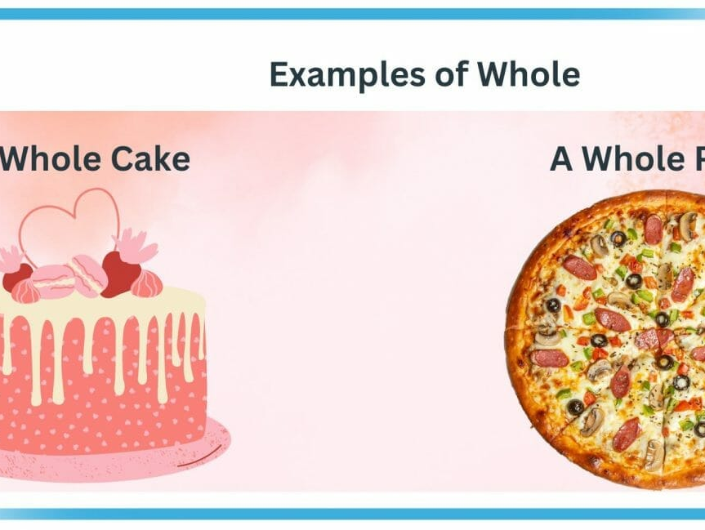

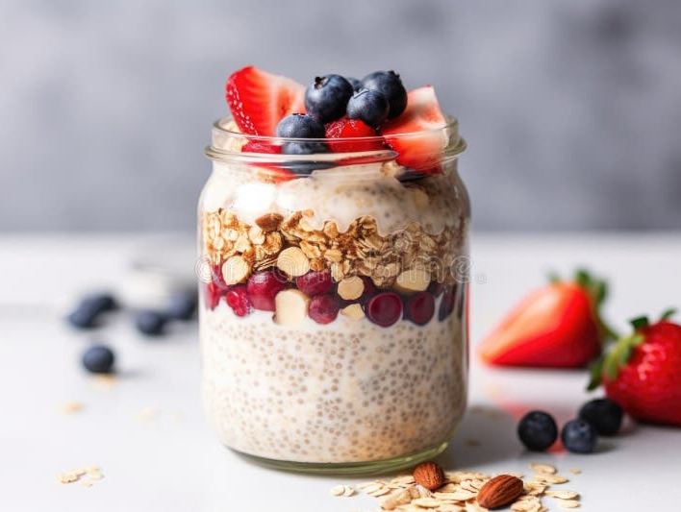
Breakfast Re-engineered
A protein-rich breakfast is non-negotiable. It prevents muscle loss, curbs mid-morning crashes, and sets a positive metabolic tone for the day.
Aim for 20% of your daily protein intake.
Prep the night before to save time.

Slide 12
Smart Snack Swaps
Vending Machine Traps
Smart & Portable
Pastries & Candy Bars (~300 kcal)
Hard-Boiled Egg + Fruit (~150 kcal)
Sugary Drinks (~150 kcal)
Canned Fish + Veggies (~200 kcal)
Cookies & Chips (~200 kcal)
Cheese + Whole-Wheat Crackers (~200 kcal)
Pro-Tip: Pre-portion snacks at home to avoid mindless overeating.

Slide 13
04
Food Choices Matrix

Slide 14
Prioritize Your Protein
Tier 1: Super Lean
Chicken breast, white fish, egg whites, lentils
Tier 2: Lean
Tuna, turkey, low-fat cottage cheese, Greek yogurt
Aim for 1g of protein per kg of body weight daily. Rotate through lean sources to cover your needs without excess calories from fat.
Tier 3: Moderate Fat
Salmon, eggs, lean beef, tofu
Use the list to guide your shopping and meal planning. Focus on the top two tiers for the leanest options.
Tier 4: Higher Fat
Regular cheese, nuts, fatty cuts of meat (eat sparingly)

Slide 15
Choose Slow-Burning Carbs
400
Slow-digesting carbs provide sustained energy and keep you fuller for longer. Combine them with protein and fibre for the best results.
360
255
90
Potatoes
(per 100g)
Whole-Wheat Bread
(per 100g)
Brown Rice
(per 100g)
Sugar / Pastries
(per 100g)

Slide 16
Master Your Fat Budget
Dry-Fry or Grill: Use non-stick pans to cook meat and veg without oil.
Limit total daily fat intake to 30-40g from all sources. Be mindful of "hidden" fats in meats, dairy, and processed foods.
Yoghurt Dressings: Swap oil for low-fat yoghurt in salads and marinades.
1 Tablespoon of Oil = 90 kcal
That's a significant portion of your daily budget! Use these tactics to preserve flavor without the excess.
Spice Rubs: Use herbs, spices, and citrus to add flavor without calories.

Slide 17
05
Hydration & Exercise

Slide 18

Water: The Fat Exit Strategy
Adequate hydration is non-negotiable for fat loss. Water is the vehicle your body uses to flush out the byproducts of fat metabolism.
Minimum 4 Pints Daily
Essential for kidney function and waste removal.
Flushes Protein Waste
A high-protein diet requires more water to eliminate byproducts like urea.
Controls Appetite
Thirst is often mistaken for hunger. Stay ahead of the signal.

Slide 19
Move to Mobilise Fat
Exercise's primary role is to increase your total daily energy expenditure and protect lean muscle mass. It's not about "earning" food, but about creating a larger calorie deficit healthily.
Daily Steps
Cardio
Resistance
Active Hobbies
The foundation of activity.
Burns calories efficiently.
Critical to protect muscle.
Make it enjoyable.
Goal: Aim for a mix of activities that you enjoy and can sustain. Focus on building a healthy, capable body, not just a smaller number on the scale.

Slide 20
06
Coaching Toolkit

Slide 21
Quick Portion Estimates
Use these visual cues to estimate 100 kcal portions without a scale. An essential skill for real-world application.
Protein
Carbs
Fats
Palm-sized piece of cooked chicken, fish, or lean meat.
A cupped handful of cooked rice, pasta, or a small potato.
A thumb-sized portion of cheese, nuts, or 1 tsp of oil.

Slide 22

Track Your Journey
A simple weekly diary is a powerful tool. It builds self-awareness, reveals patterns, and helps you make informed adjustments.
Meal Times & Hunger Levels
Daily Fluid Intake
Weight Trend (2x/week)
Notes on Challenges & Wins
Review weekly to identify high-risk moments and plan strategies.

Slide 23
Stalled Progress? Run This Checklist.
Weight loss plateaus are normal. Use this systematic approach to identify the cause and get back on track without resorting to drastic measures.
1
Verify Calorie Totals
Are you accurately tracking everything? Portion sizes creeping up?
2
Tighten Fat Grams
Reduce added oils, dressings, and high-fat snacks by 10-15g.
3
Add 10 Mins Daily Walk
A small increase in activity can reignite progress.
4
Review Sleep & Stress
Both can significantly impact hormones that control weight.

Slide 24
The 48-Hour Reset
A lapse is not a collapse. Overeating happens. The key is to get back on track immediately with a structured plan, not guilt.
Return to 5 Meals
Immediately resume your structured eating plan. Do not skip meals to "compensate."
Extra Water
Drink an extra 1-2 glasses of water to help with digestion and satiety.
Light Activity
Go for a 20-30 minute walk to boost mood and metabolism.

Slide 25
Special Populations: Safety First
This program is designed for generally healthy adults. Certain groups require special consideration and medical supervision.
Adolescents
Seniors (55+)
Nutritional needs are different; focus on healthy habits, not restriction.
Muscle preservation is critical; protein needs may be higher. Monitor closely.
Pregnancy & Breastfeeding
Medical Conditions & Medications
Absolutely contraindicated. Nutritional needs are significantly increased.
Hypertension, diabetes, etc. require a doctor's clearance and supervision.
When in doubt, refer to a registered dietitian or qualified medical professional.

Slide 26


THANK YOU
ScaLearn
November 2025

