Slide 1
Project : Reduction of VDD3_ACC_DIG Failure Rate
DMAIC - Story Board
Ams Calamba
Joseph B. Josafat
Test Product Engineer

Slide 2
Project “Reduction of VDD3_ACC_DIG Failure Rate“
Define Phase
Define
Measure
Analyze
Improve
Control
Notes:
This phase entails precisely describing the problem or opportunity for improvement, establishing project objectives, and understanding customer requirements.

Slide 3
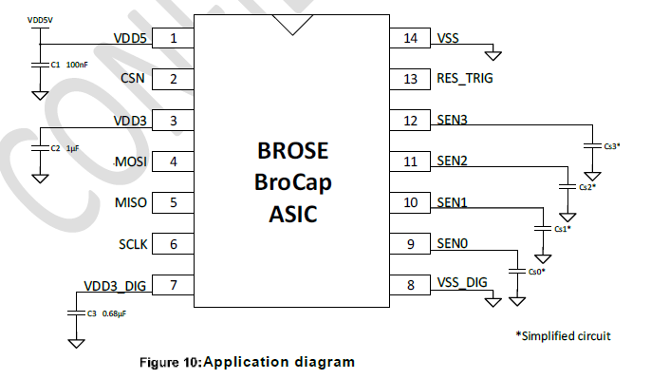
Project “Reduction of VDD3_ACC_DIG Failure Rate“
A brief overview of the VDD3_ACC_DIG__ test parameter
Terminal Pins VDD3 and VDD3_DIG are two independent voltage regulators that are used to supply the digital and analog blocks with 3.3V.
This refers to the voltage level present at the VDD3 pin and is crucial for proper trimming of the device.
An external capacitor is required to ensure stability of each regulator.
During final testing, the voltage regulators were trimmed to 3.3 Volts to supply voltage VDD3 pins while maintaining a constant voltage.
Notes:
Terminal Pins VDD3 and VDD3_DIG are two independent voltage regulators that are used to supply the digital and analog blocks with 3.3V.This refers to the voltage level present at the VDD3 pin and is crucial for proper trimming of the device.
An external capacitor is required to ensure stability of each regulator.During final testing, the voltage regulators were trimmed to 3.3 Volts to supply voltage VDD3 pins while maintaining a constant voltage.

Slide 4
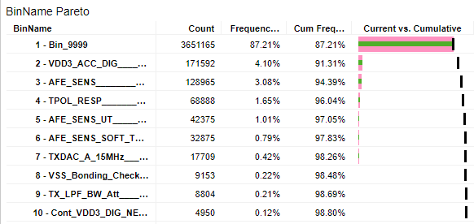

Project “Reduction of VDD3_ACC_DIG Failure Rate“
Business Case
On the year 2023:
For the year 2024:
The projected is volume is 4,971,436 units
4.1% of the total volume for 2023 or 171, 000 units were scrapped due to this failure
4.10% to 2.00%
Project aims to reduce the scrapped units into half from 204,000 units to 99,000 units
Which result to 21,000 Euros revenue lost
Which result to 12,000 Euros Cost savings
Notes:
Business Case
On the year 2023
It demonstrates that the VDD3_ACC_DIG regularly ranks as one of the top failing parameter in 50424-Brocap, resulting in a 4.10% yield loss on the first pass test.
Which result to 21,000 Euros revenue lost
For the year 2024
The projected is volume for the whole year for 50424-Brocap device is 4,971,436 units
This project aims to reduced the failure rate from 4.10% or 204k units to 2.0% or 99k units that will result to 12k euros savings . This initiative is both a strategic imperative for our company and a chance to strengthen our market position, as it aims to increase production output while enhancing overall final test yield.

Slide 5
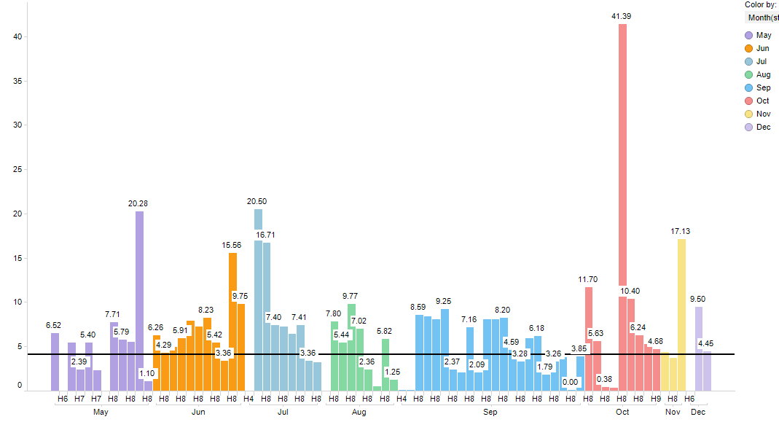

DEFINE: Supporting Data for Project Charter
VDD3_ACC_DIG__ rejection rate per lot for the year 2023
Average rejection rate 4.10%
Define
Measure
Analyse
Improve
Control
Notes:
Bar graph shows the failure rate of all the lots that run on the year 2023 averaging 4.10% failure rate.

Slide 6
DEFINE: Supporting Data for Project Charter
Final Test Yield does not met due to the over rejection on VDD3_ACC_DIG__ averaging 95.5% on the year 2023
Define
Measure
Analyse
Improve
Control
Notes:
Line chart shows that the monthly Final Test yield for 2023 does not met the target FTY for production on 50424-Brocap.
Final Test Yield does not met due to the over rejection on VDD3_ACC_DIG__ averaging 95.5% on the year 2023

Slide 7






Project “Reduction of VDD3_ACC_DIG Failure Rate“
Project Team
Project Sponsor
Peter Paul Carada
Test Product Engineering
Leader
Joseph Josafat
Test Product Engineering
Member
Test Development Engineering
Member
Product Engineering
Member
Preventive Maintenance Engineering
Member
Define
Measure
Analyse
Improve
Control
Notes:
Project Sponsor
Peter Paul Carada
Test Product Engineering
Leader
Joseph Josafat
Test Product Engineering
Member
Regie Denal
Test Development Engineering
Member
Diane Cristine Cabrera
Product Engineering
Member
Brenda Ruba
Preventive Maintenance Engineering
Member
Richard Mercado

