Slide 1
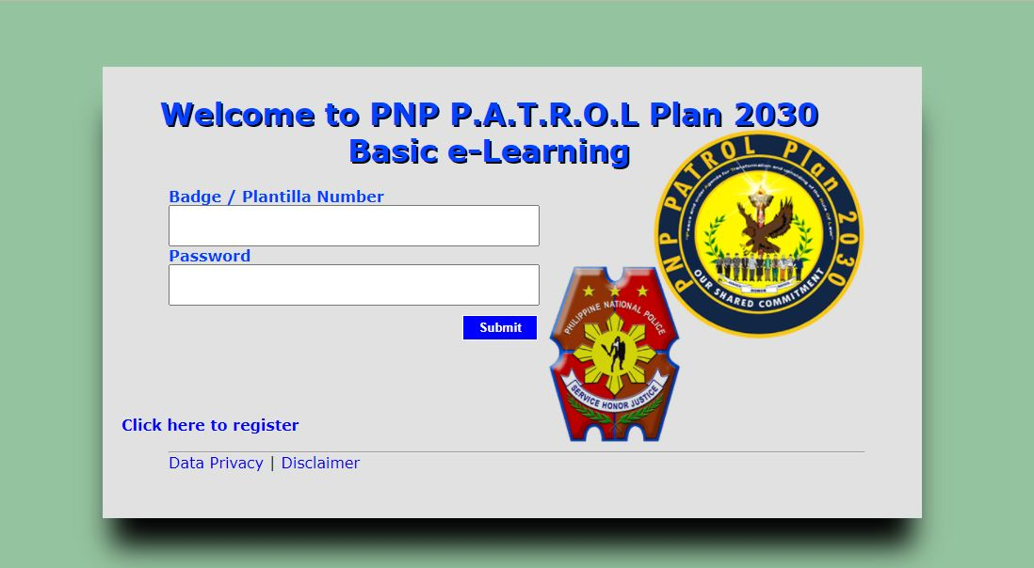

1. Go to your mobile/computer browser and search on the following link:
ebasic.cpsm.ph (Basic e-learning)
ela.cpsm.ph (Advance e-Learning)
2. Click the “Click here to register.”

Slide 2
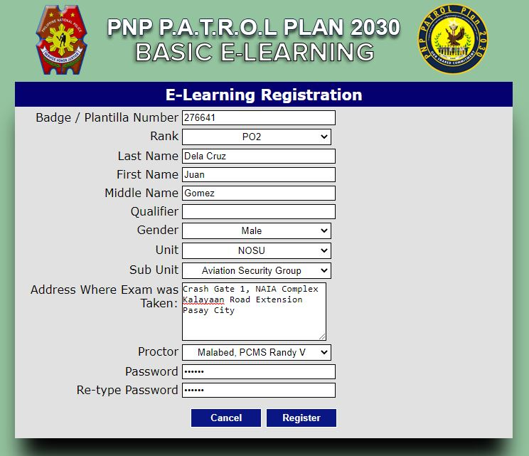
3. Kindly fill out all the information needed for registration.

Slide 3
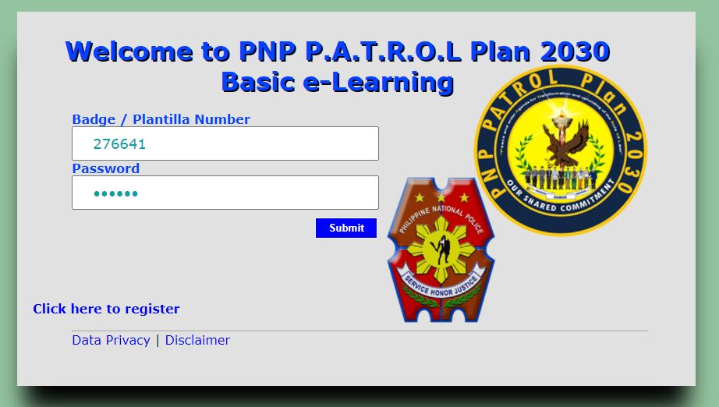
3. Log in your account and take the examination.

