Slide 1
The Philippine Government Development Science and Technology Agenda and Major Projects Program
Group 2
Notes:
how are you

Slide 2
OBJECTIVES
Encourage research and development to produce fresh ideas and innovations.
Encourage the adoption and commercialization of new solutions.
Boost scientific and technological capabilities across a range of industries.
Boost communication between the government, universities, businesses, and other interested parties.
By using scientific and technology-based solutions, you may improve the quality of life for Filipinos while addressing major societal issues.

Slide 3
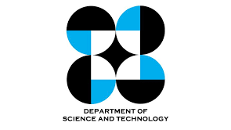
The Department of science and technology is a government organization in charge of fostering the advancement of science, technology, and innovation in several nations, including India and the Philippines. Utilizing scientific and technological developments for the nation's socioeconomic development is its main goal

Slide 4
The Department of Science and technology
Research projects in a variety of disciplines, including agriculture, health, information technology, engineering, and environmental sciences, are supported and funded by the DOST. It strives to promote creativity and scientific advancements that can advance the growth of the country.
Technology Transfer and Commercialization: The DOST supports the dissemination of knowledge and technology from academic and research organizations to businesses for use in the production of goods and services. This facilitates the transition from academic research to commercial applications, promoting economic growth and generating new business prospects.

Slide 5
HISTORY

Slide 6
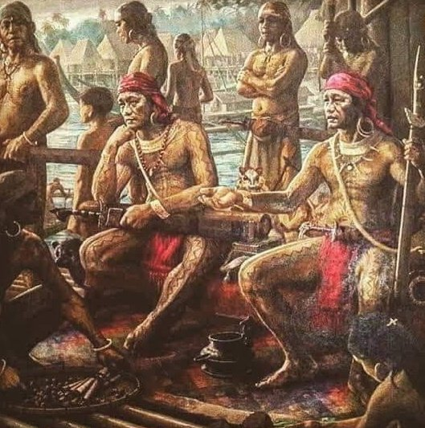
Pre Spanish Period
- The pre-Spanish period in the Philippines refers to the time before the arrival of the Spanish colonizers in the 16th century. During this era, the indigenous people of the Philippines had their own rich traditions, knowledge systems, and advancements in science and technology. Here is an introduction to the pre-Spanish period of science and technology in the Philippines

Slide 7

The forefathers of the Igorot people carved terraces into the mountains of Banaue, Ifugao, in the Philippines. These terraces are known as the Banaue Rice Terraces. The terraces have been referred to be the "Eighth Wonder of the World" on occasion. Most people believe that the terraces were mostly constructed by hand and with very little equipment.

Slide 8
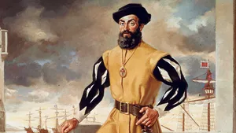
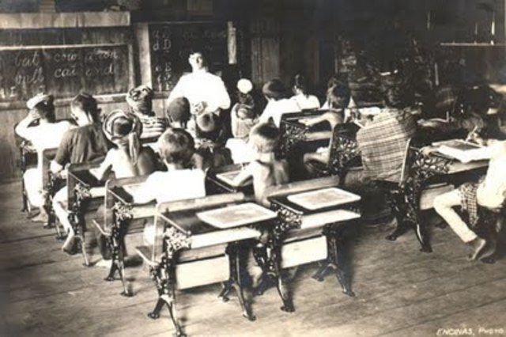
Spanish Colonial Period
Significant advancements in science and technology occurred throughout the more than 300-year span of Spanish colonial rule in the Philippines, from the 16th to the late 19th century. The scientific and technological innovations brought by the Spanish invaders had an impact on the archipelago in both beneficial and harmful ways.
Christian beliefs, humanities, and languages, with an emphasis on Latin and Spanish, were taught in institutions called "colegios" and "universities" that were established by religious orders like the Dominicans, Jesuits, and Augustinians. These institutions were only open to the elite, primarily the privileged natives or the offspring of the ruling class who could afford an education.

Slide 9
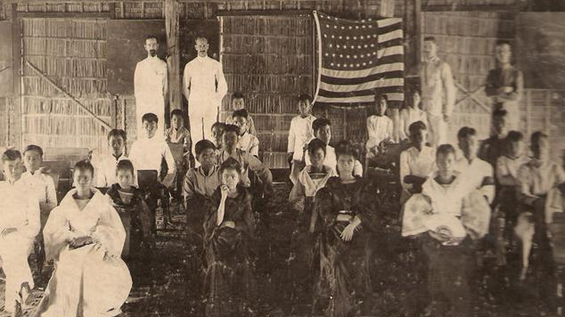
American period and Post Commonwealth Era
- Following the United States' victory in the Spanish-American War, Spanish colonial sovereignty over the Philippines ended in 1898, marking the start of the American era. With the signing of the Treaty of Paris, the United States took over administration of the Philippines from Spain. The Philippines changed from being a colony of Spain to a territory of the United States while being governed by Americans.
-

Slide 10
American Period
- Significant advances in science and technology occurred in the Philippines between 1898 and 1946, when the United States occupied the country. The Philippines underwent modernization initiatives during the United States' colonial rule, including improvements in numerous scientific fields.
- To tackle contagious diseases, Americans created public health measures. The Department of Health, which was later renamed the Bureau of Health, was founded in 1901 and worked to promote cleanliness, carry out vaccination drives, and control diseases including tuberculosis and malaria.
- The Bureau of Government Laboratories was founded by the Philippine Commission on July 1, 1901, and it was housed inside the Department of Interior. The Laboratorio Municipal, which was founded during the Spanish colonial era, was succeeded by the Bureau.

Slide 11
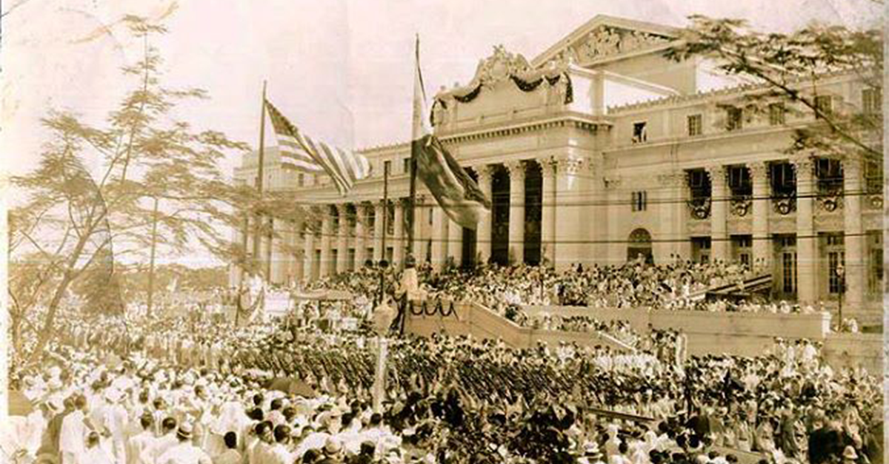
Commonwealth Era
- In the Philippines, the term "Commonwealth era" refers to the years that the nation was a commonwealth of the United States, from 1935 to 1946. This time period was a pivotal turning point in Philippine history since it was a step toward eventual independence and self-government.
Significant advancements in science and technology occurred in the Philippines during the Commonwealth period (1935–1946).

Slide 12
Philippine Institute of Tropical Medicine
- The PITM, which was founded in 1935, was instrumental in identifying and eradicating the country's tropical diseases. It concentrated on researching ailments like tuberculosis, leprosy, dengue, and malaria.
National Research Council of the Philippines (NRCP)
- The NRCP was established in 1933 as a government organization to support and organize scientific research across a range of disciplines. It promoted scientific cooperation among Filipino researchers and funded their research endeavors.
University of the Philippines (UP)
- The UP, being the top university in the nation, made a considerable contribution to scientific progress during this time. It offered courses in a range of scientific specialties and carried out investigations in areas like chemistry, engineering, agriculture, and medicine.
Infrastructure Development
- Infrastructure projects were built throughout the Commonwealth era, facilitating scientific research and technological development. Examples worth mentioning include the opening of the Philippine General Hospital (PGH), the Jones Bridge, and the Carabao Dam.

Slide 13
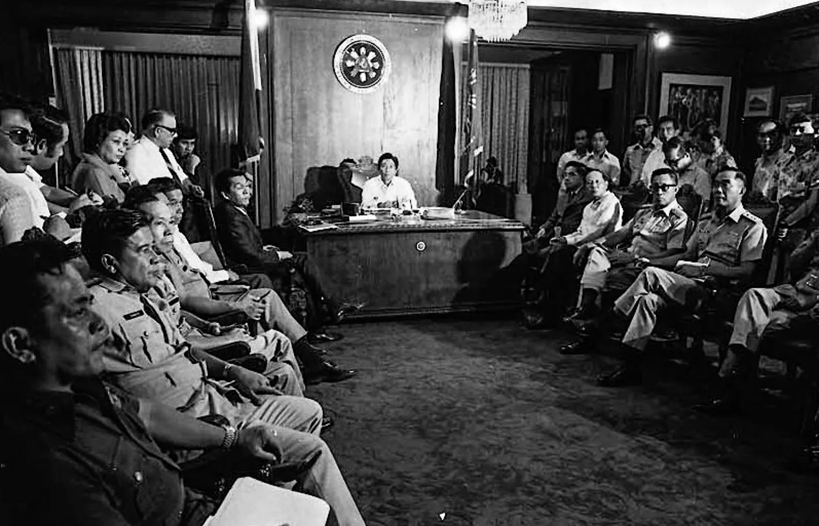
Marcos era and Martial Law
- The Marcos era is the time frame during which Ferdinand Marcos presided over the Philippines from 1965 to 1986. After winning a democratic election to take office, Marcos eventually imposed martial law in 1972, which was a pivotal moment in Philippine history.
- During the Marcos era and Martial Law in the Philippines (1972-1986), there were several notable developments in science and technology. While the regime was known for its political controversies and human rights violations, it also implemented various initiatives and projects in the field of science and technology.

Slide 14
The Philippine Nuclear Research Institute (PNRI) and the Philippine Atmospheric, Geophysical and Astronomical Services Administration (PAGASA) are just two of the scientific and technology organizations that the Marcos administration founded. These institutes concentrated on scientific pursuits including weather forecasting and nuclear research.
Telecommunications and broadcasting: During the Marcos administration, these fields experienced tremendous advancements. The creation of the Philippine Long Distance Telephone Company (PLDT) satellite station in Antipolo is one of the initiatives the government launched to upgrade and expand the communications infrastructure. The first government-owned television station in the nation, Television Malacanang, was also unveiled by the government.
Infrastructure for medicine and health: The nation's infrastructure for medicine and health has been improved. To improve access to healthcare, the Marcos administration built hospitals, clinics, and rural health facilities. To fight diseases and enhance public health, it also developed a number of health programs, including the Expanded Program on Immunization (EPI).

