Slide 1


Surgical safety checklist
Notes:
HELLO EVERYONE. WELCOME TO NURSEPREP GURU. TODAY IM GOING TO TALK ABOUT SURGICAL SAFETY CHECKLIST. SO LETS START.

Slide 2


Surgical safety checklist
A surgical checklist is a standardized list of crucial tasks and safety measures followed by surgical teams to enhance patient safety and minimize errors during surgical procedures.
Notes:
A surgical checklist is like a to-do list for doctors and nurses in the operating room. Just like how you might use a checklist before going on a trip to make sure you packed everything you need, surgeons and their team use this checklist before and during surgery to make sure they're doing everything right and keeping the patient safe.
The checklist is like a set of important questions and tasks that the surgical team goes through. They check things like the patient's name and what surgery they're having, making sure all the needed tools are ready, and that everyone knows what they're supposed to do. It helps them avoid making mistakes and ensures they're all on the same page.
So, a surgical checklist is a simple but very important tool that helps doctors and nurses work together smoothly and safely during surgery. The aim of a surgical checklist is to enhance patient safety during surgical procedures by ensuring that important tasks and safety measures are consistently followed. It helps reduce errors, improve communication among the surgical team, and prevent avoidable complications. The checklist aims to create a standardized and systematic approach to surgical care, reducing the risk of mistakes and enhancing overall surgical outcomes.

Slide 3

COMPONENTS OF SURGICAL SAFETY CHECKLIST:
SIGN IN
TIME OUT
SIGN OUT
Notes:
The surgical safety checklist consists of three components: sign-in, performed before the induction of anesthesia; time-out, performed before skin incision; and sign-out, performed immediately after skin closure or before the patient leaves the operating theatre.

Slide 4
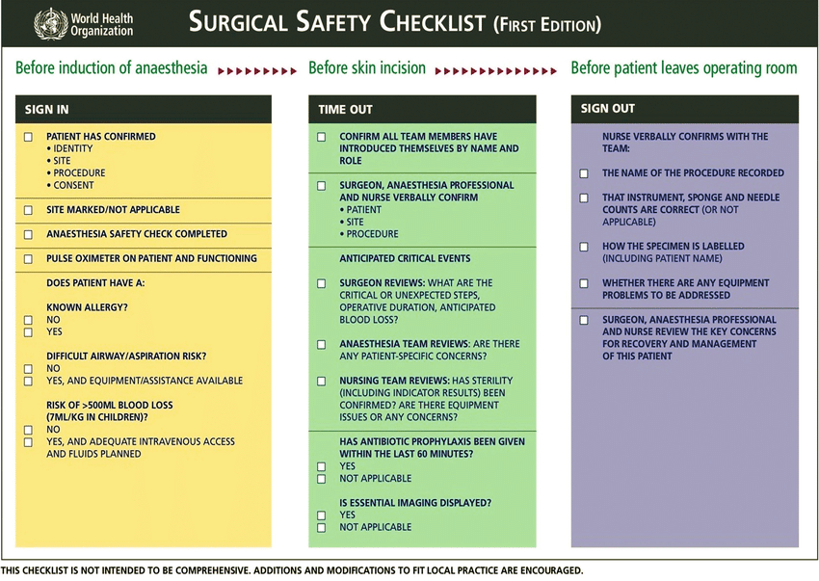
Notes:
This is the Surgical Safety Checklist by WHO. As you can see 3 components are there. First one Is sign in. Second time out. And the third one is sign out. So lets discuss all the three components one by one.

Slide 5

1.sign in
Before Induction of Anesthesia:
Notes:
The "Sign In" phase serves as a critical initial checkpoint before surgery. It ensures that the correct patient and procedure are identified, critical information is available, and the entire team is acquainted with each other's roles. By following this phase meticulously, surgical teams contribute to patient safety and reduce the chances of preventable errors during surgery.
First we are going to Confirm Patient Identity, the site by checking the patient's identification band and asking the patient to state their name and date of birth. This step ensures that the correct patient is undergoing the intended surgery. And also going to the Confirm Planned Procedure and surgical consent form with medical records to confirm the planned procedure. This prevents any errors or misunderstandings regarding the type of surgery to be performed.
Next is Marked the Surgical Site: In this we are going to check for surgical site clearly marked on the patient's body or not .This marking ensures that everyone is aware of the correct area for the surgery, reducing the risk of operating on the wrong site.
Next is anesthesia plan is discussed, ensuring that the patient's specific needs are considered during the surgery.. Than the equipments like pulse oximeter is checked on the patient whether its functioning or not.
Verification of Essential Documents and Imaging is also done in this phase only. The team ensures that all necessary documents, test results, and imaging studies (such as X-rays or scans) are available and reviewed. This step prevents delays or interruptions during surgery due to missing information or equipment.
Next step is to Confirm Allergies and Anesthesia Plan. The team confirms if the patient has any allergies or adverse reactions to medications. Also the airway and aspiration risk is assessed so that equipments made accessible. Also we estimate about the blood loss during the surgery so that blood can be arranged on time.
Few more points are included in this which are not mentioned in this picture that are
Team Introduction . Each member of the surgical team introduces themselves by name and role. This introduction establishes clear communication channels and fosters a collaborative environment.
Briefing and Discussion: The team engages in a brief discussion to address any concerns, potential challenges, or unique aspects of the upcoming surgery. This communication helps ensure that everyone is on the same page and prepared for the procedure.

Slide 6
2.time out
Before Skin Incision:
Notes:
The "Time Out" phase is like that last-minute check before starting a journey. It's a time to make sure everyone is on the same page, that all concerns are addressed, and that the team is fully prepared for a safe and successful surgery.
The "Time Out" phase of the WHO Surgical Safety Checklist is like a final check before starting surgery. First, the team reconfirms all the team members are introduced by name and their role. . They check that they have the right patient and procedure. If anyone has concerns, they speak up. They talk about important things, like special tools or challenges. The whole team agrees they're ready to start. They also make prophylaxis dose of antibiotic is given within last 6omin of surgery. They make sure they have all the needed papers and pictures like X-rays and the essential imaging is displayed over the display board. This ensures everything is ready and nothing is missing.
If the patient needs something special, they get it ready. They confirm everyone and everything is set for the surgery. The "Time Out" ends with a last pause for clarity before they begin. It's like a final look before starting something important. This way, the surgical team makes sure everything is set, and the surgery goes well.

Slide 7
3.sign out
Before the Patient Leaves the Operating Room:
Notes:
The "Sign Out" phase is like saying goodbye at the end of a story. It's when the surgical team makes sure the surgery is finished well, any problems are taken care of, and the patient is ready for the next steps. By doing this, the surgical team makes sure everything is done right as the surgery ends. After the surgery, the surgical team goes over the important things that happened. They make sure everyone understands what was done. They check that all the planned steps in the surgery are finished and the name of the procedure done is recorded. Nursing officer carefully count all the tools and sponges to make sure nothing is left inside the patient. If there are any worries or extra things needed, they talk about them. They also talk about what care the patient needs right after the surgery. Each team member says that the surgery is done and everything needed is done. They write down everything in the checklist. If the patient needs to be taken care of by another team, they make sure it happens smoothly. They have a quick talk about the surgery to see what went well and what could be better. The "Sign Out" phase ends with a final check that everything is done, and the patient is ready to move on.

Slide 8
thankyou
Notes:
thankyou

