Slide 1

MRP BHEL
Engineering Exploration Course Project
MOHAMMEDASIM BAGE | 02FE21BCS048
PRIYA J SIDDASAMUDRA | 02FE21BEC066
ROHAN V ANVEKAR | 02FE21BEC074
Under the guidance of
Prof. Sachidananda T G
2021-2022, Even Semester
Engineering Exploration, KLE Dr. MSSCET, Belagavi
Notes:
Hello everyone this is team MRP BHEL. The members of the team are MOHAMMEDASIM BAGE, PRIYA J SIDDASAMUDRA and ROHAN V ANVEKAR. Under the guidance of Prof. Sachidananda T G.

Slide 2
Problem Definition
Build a Mixer which is automatics which has a lid of transparent material which is of cylindrical shape and also user-friendly. The weight of the machine should be with in 3kg, the rotor must have at least 3 blades. It Size and dimension of machine must be 2 cubic feet and built with in 3500Rs. The dish must be ready in 2-3 mins. It should be self serving and should give a beep alert Indication after task completion.
Notes:
Our problem definition is Build a Mixer which is automatics which has a lid of transparent material which is of cylindrical shape and also user-friendly. The weight of the machine should be with in 3kg, the rotor must have at least 3 blades. It Size and dimension of machine must be 2 cubic feet and built with in 3500Rs. The dish must be ready in 2-3 mins. It should be self serving and should give a beep alert Indication after task completion.

Slide 3
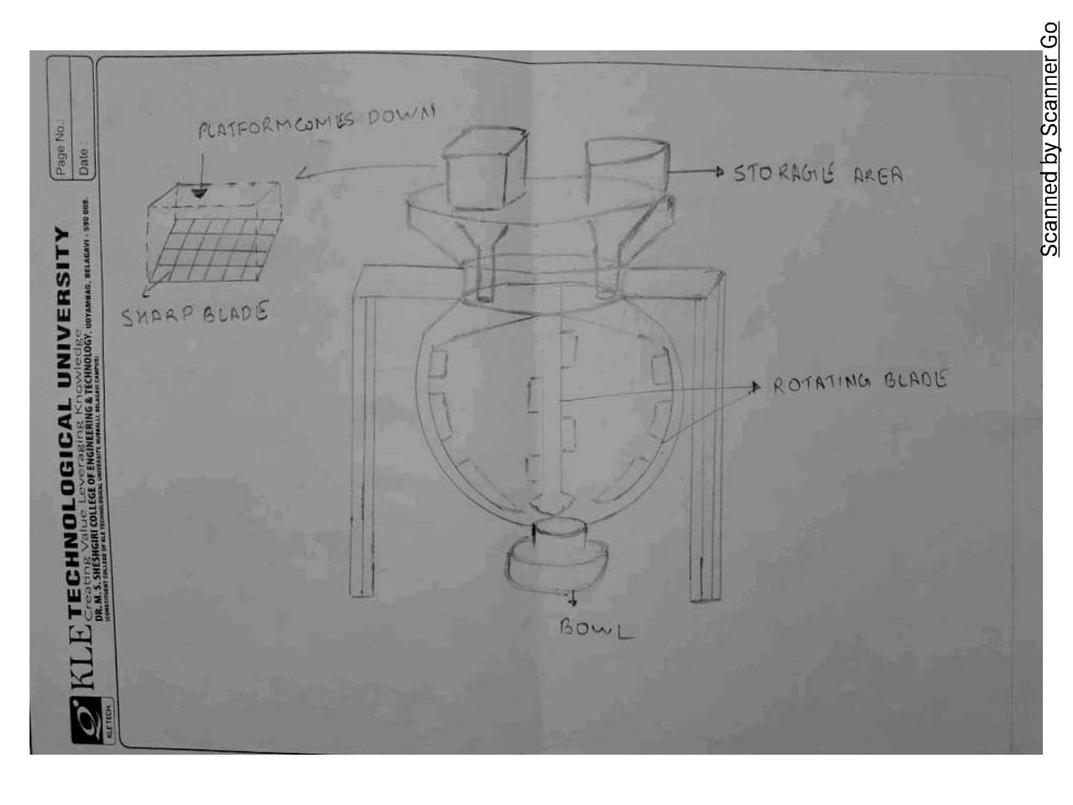
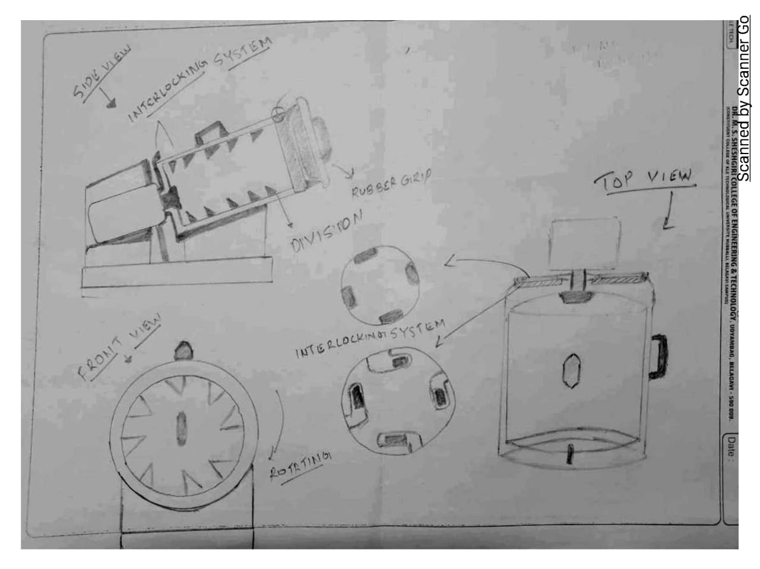
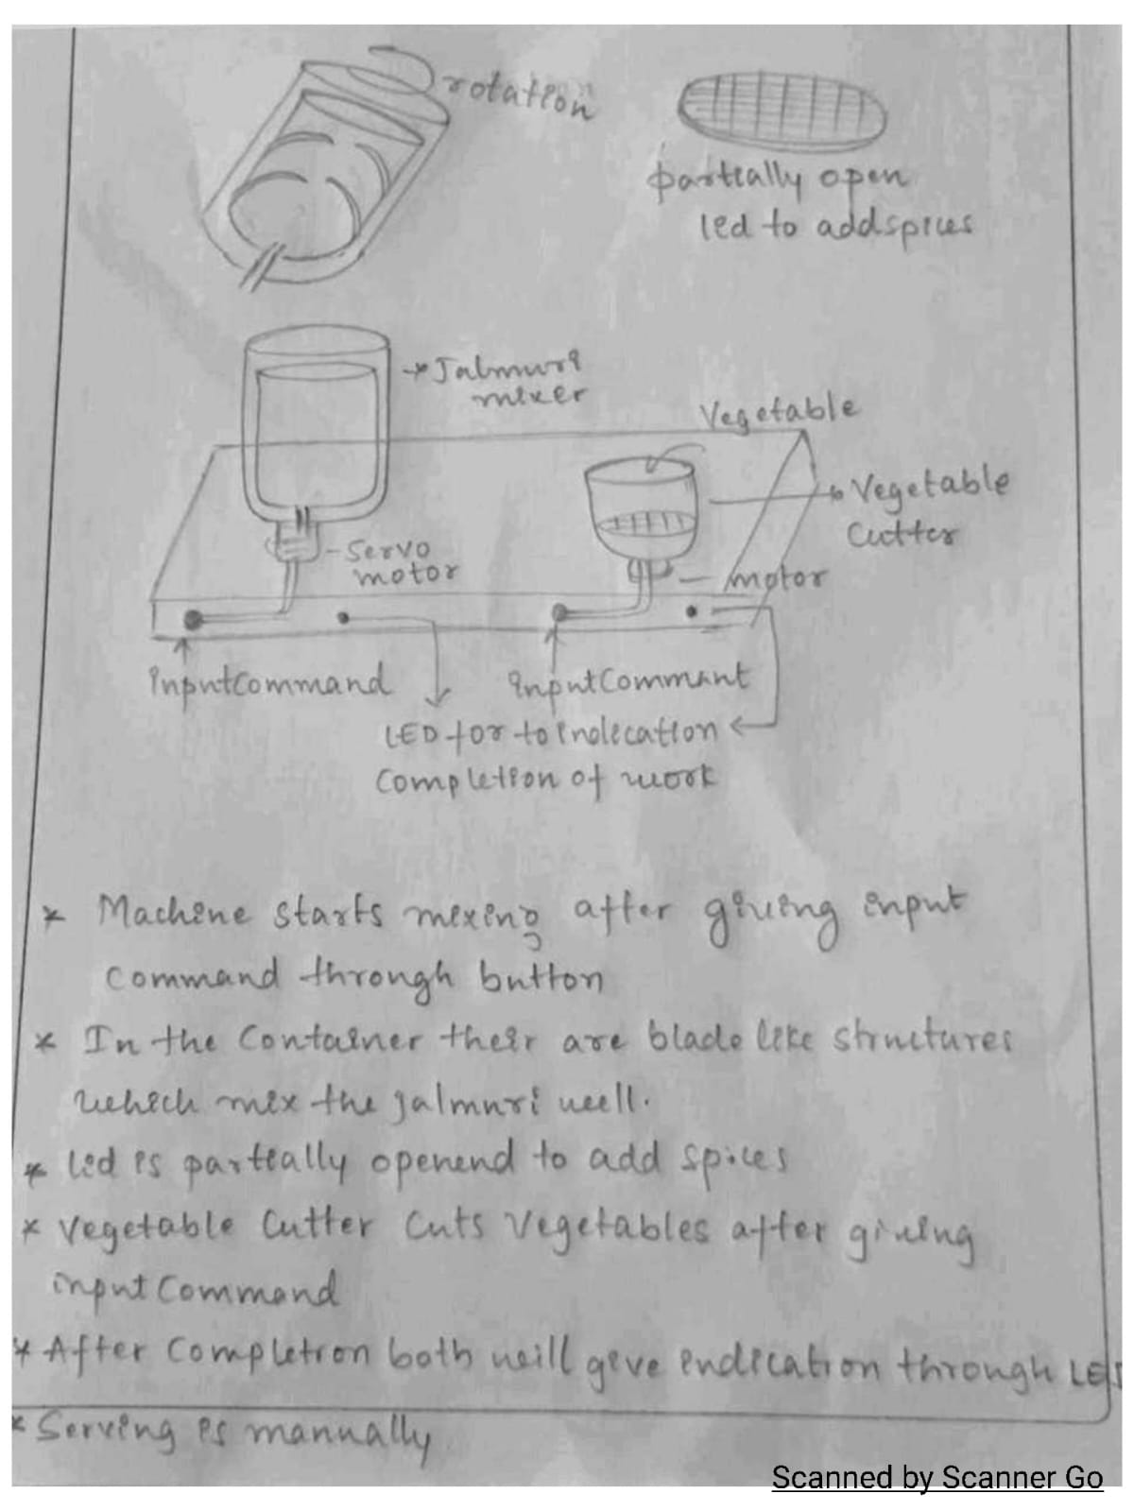
Generated Concepts
Notes:
These are 3 engineering design Generated Concepts

Slide 4
Selected Concept
Notes:
We have selected this design concept for the implementation

Slide 5
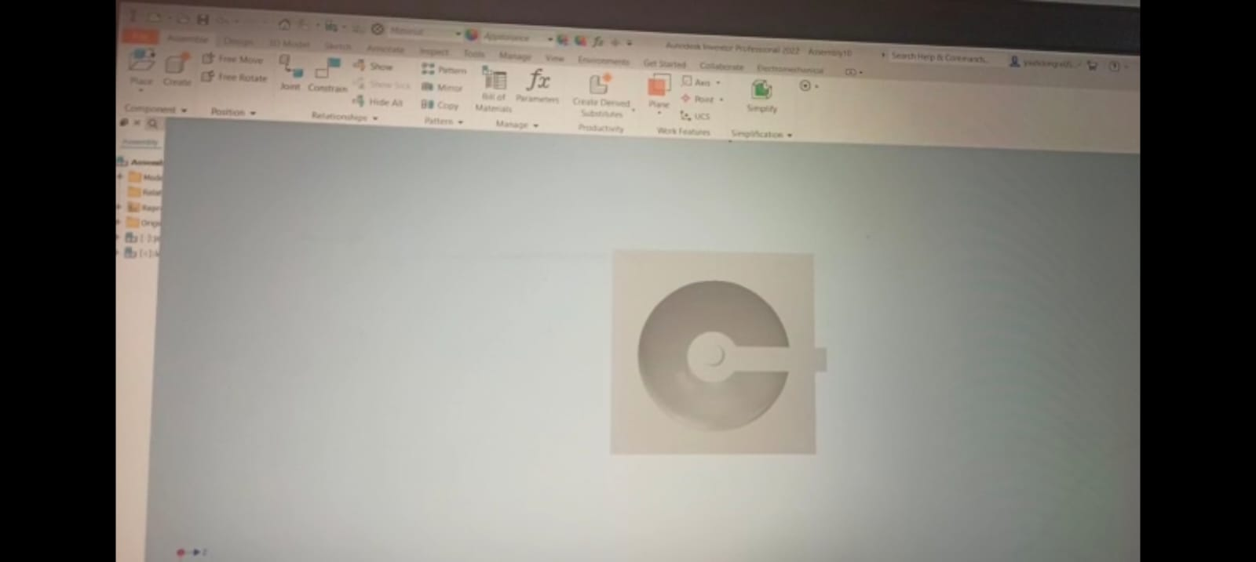
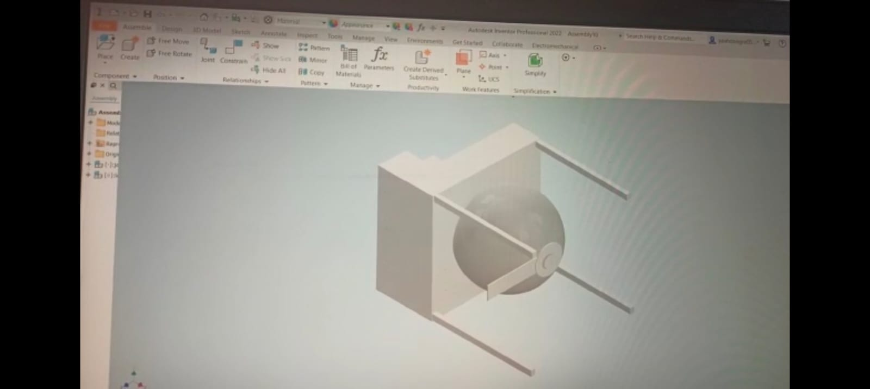
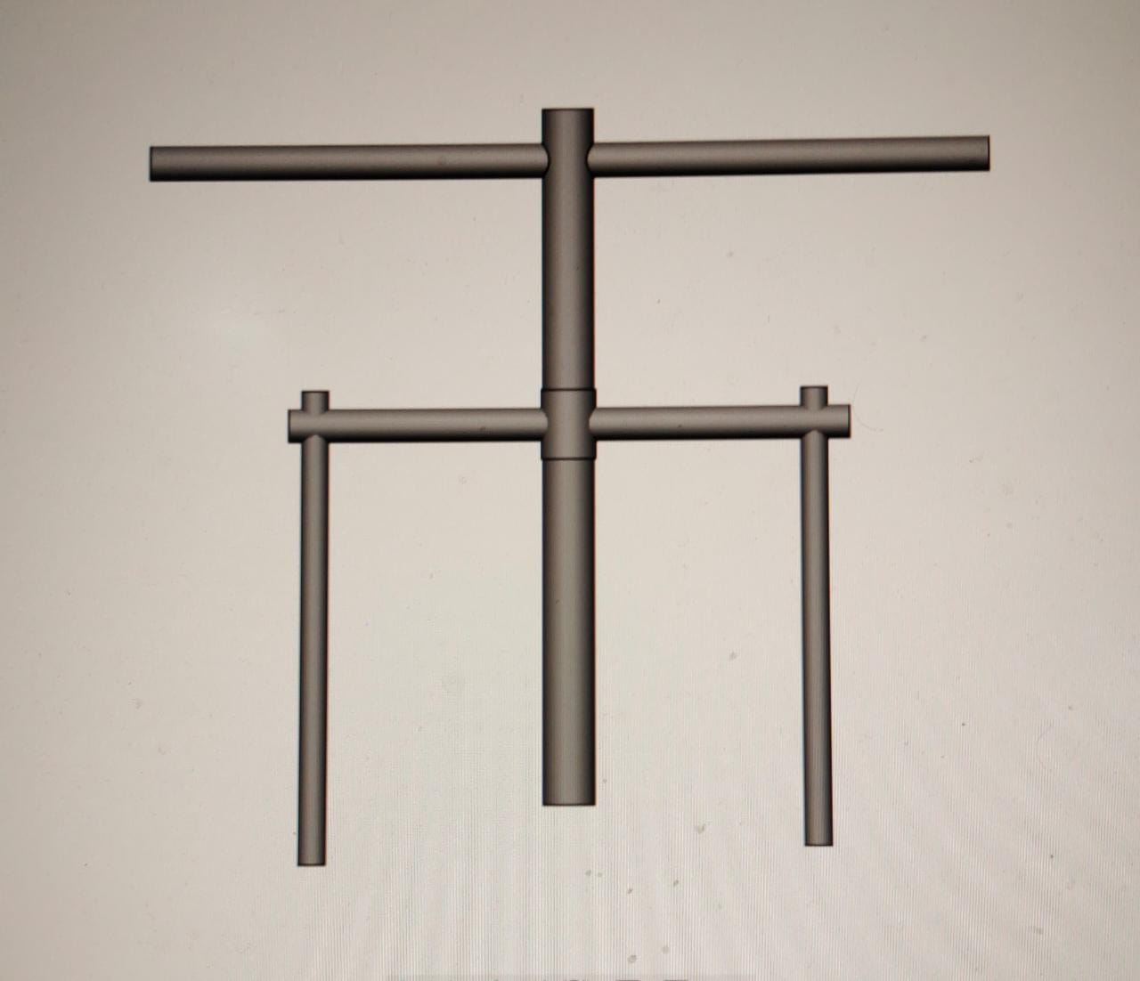
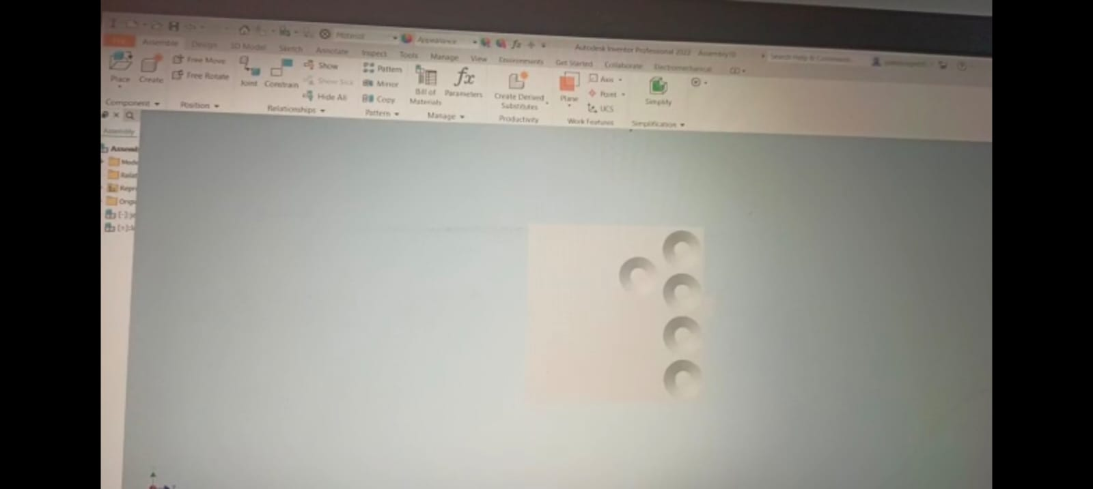
Virtual Implementation
Notes:
Virtual Implementation using Autodesk inventor .

Slide 6
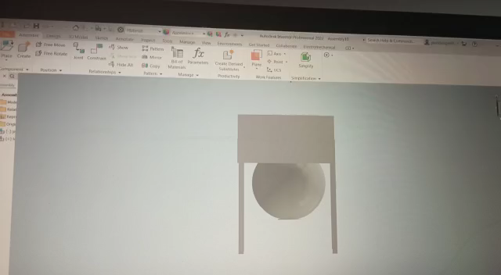
3D model of the entire system
Notes:
3D model of the entire system

Slide 7
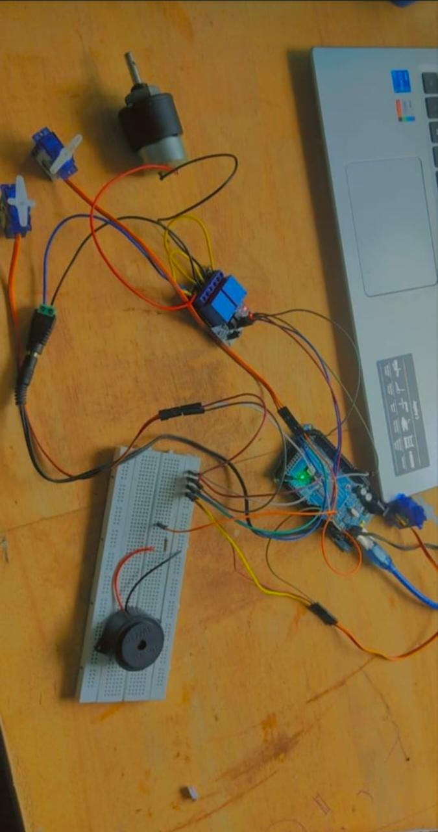
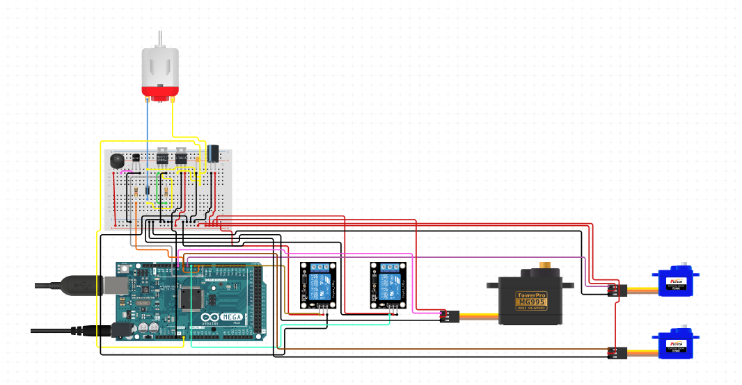
Circuit diagram of the entire system
Notes:
Circuit diagram of the entire system

Slide 8
Physical Implementation
Notes:
Physical Implementation

Slide 9
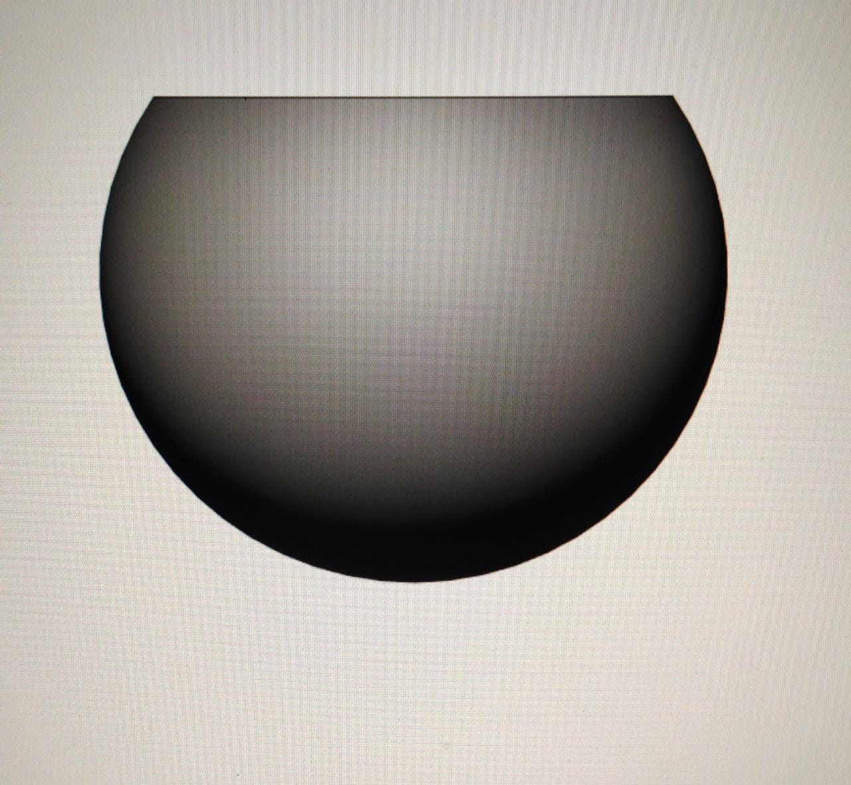
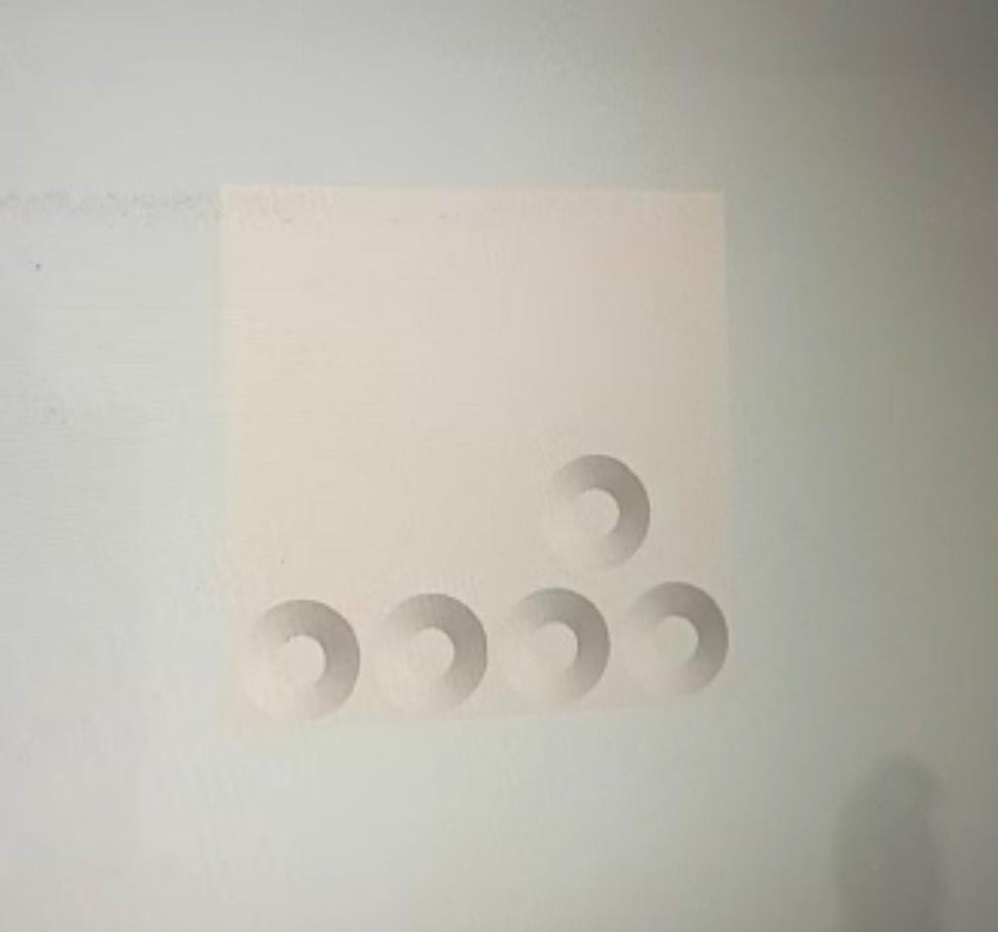
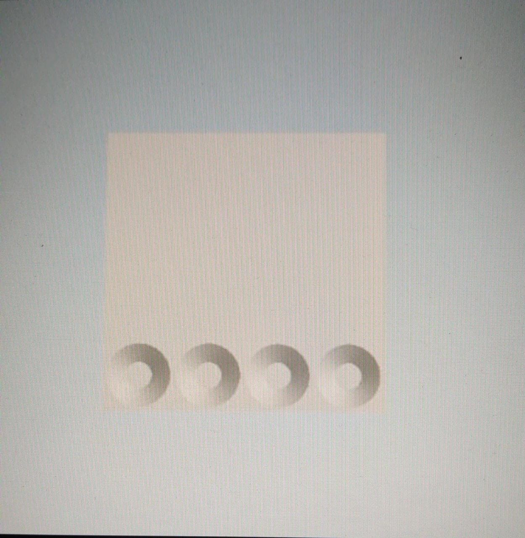
SPRINT 1: (3D MODELING)
BLADE STRUCTURE MIXING CONTAINER STORING CONTAINERS
Notes:
In sprint one first image shown gives the idea about the blade structure present in mixer. Image two shows the mixing container and third image gives us the idea about how the storing containers will be present in our model.

Slide 10
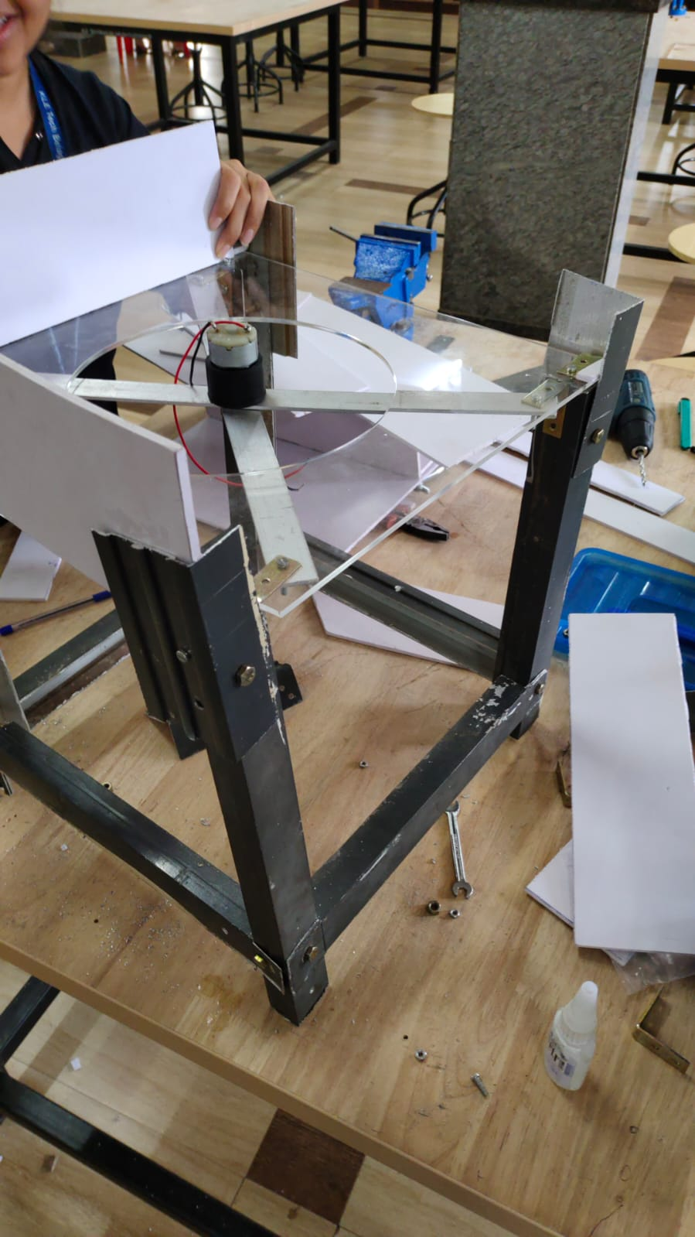
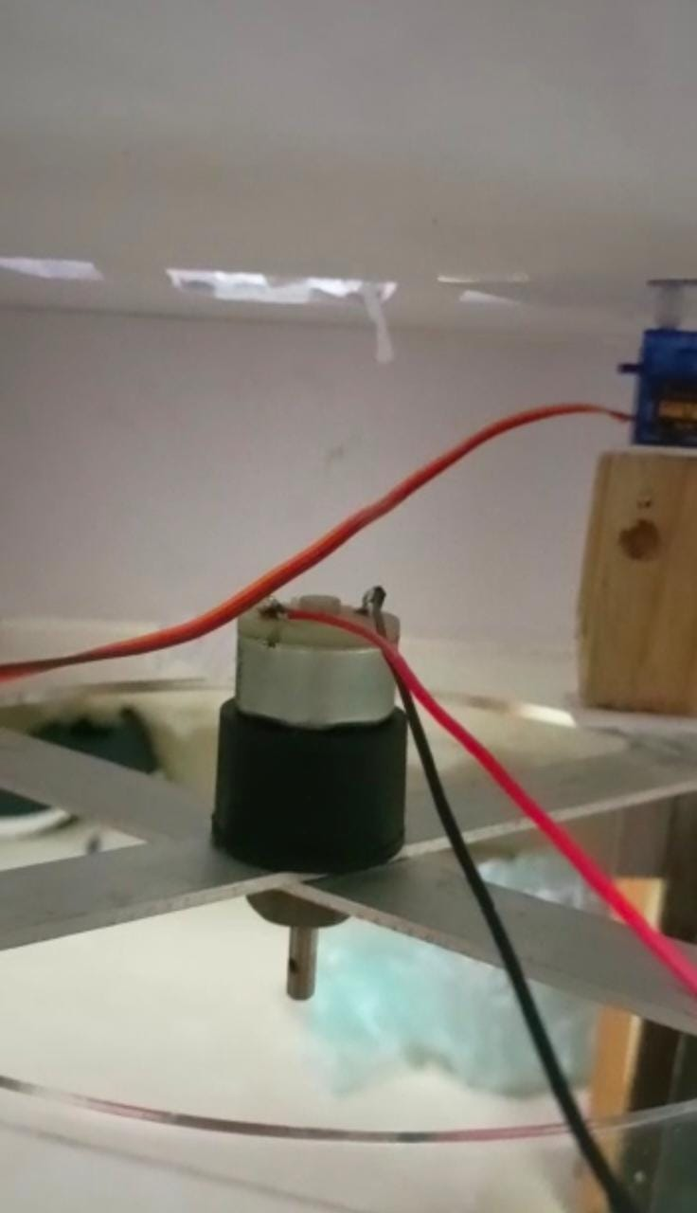
SPRINT 2: ( Circuit connections)
Notes:
Sprint two talks about the circuit connections .Here we have used two micro servo and a servo MG995 with a sixty rpm DC motor connected to a relay . A DC power jack , a piezo buzzer, a resistor, a bread board and Arduino mega .

Slide 11
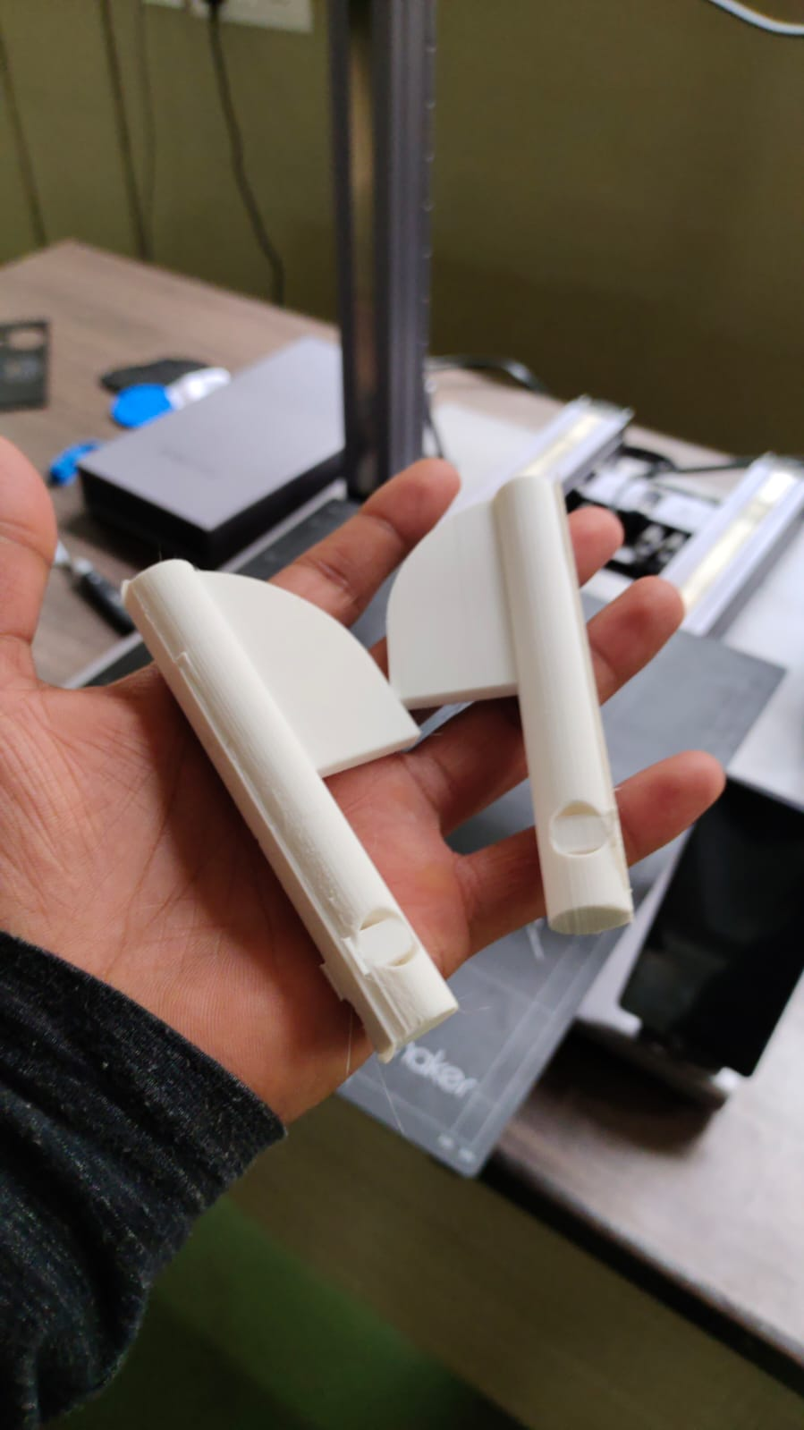
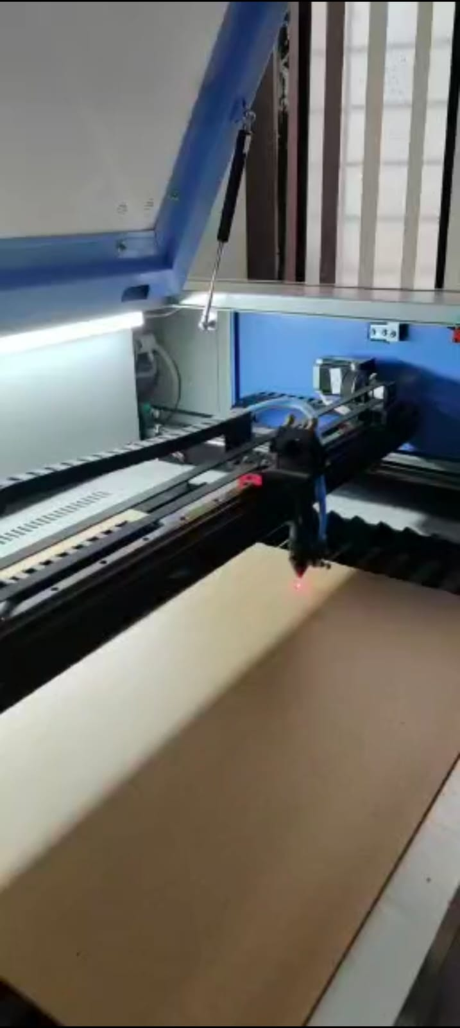
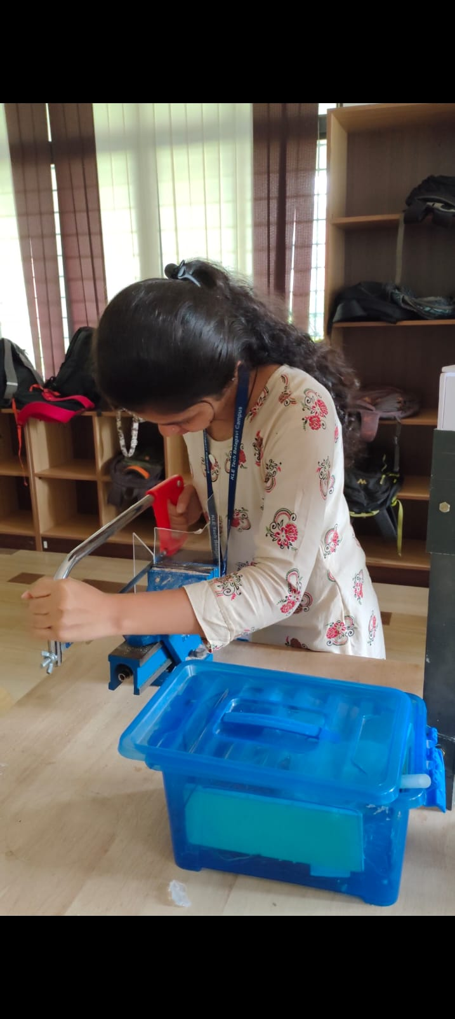
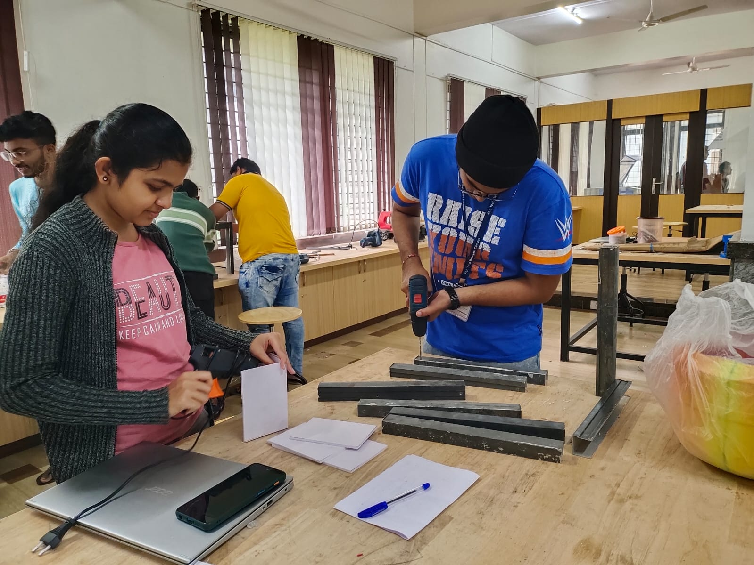
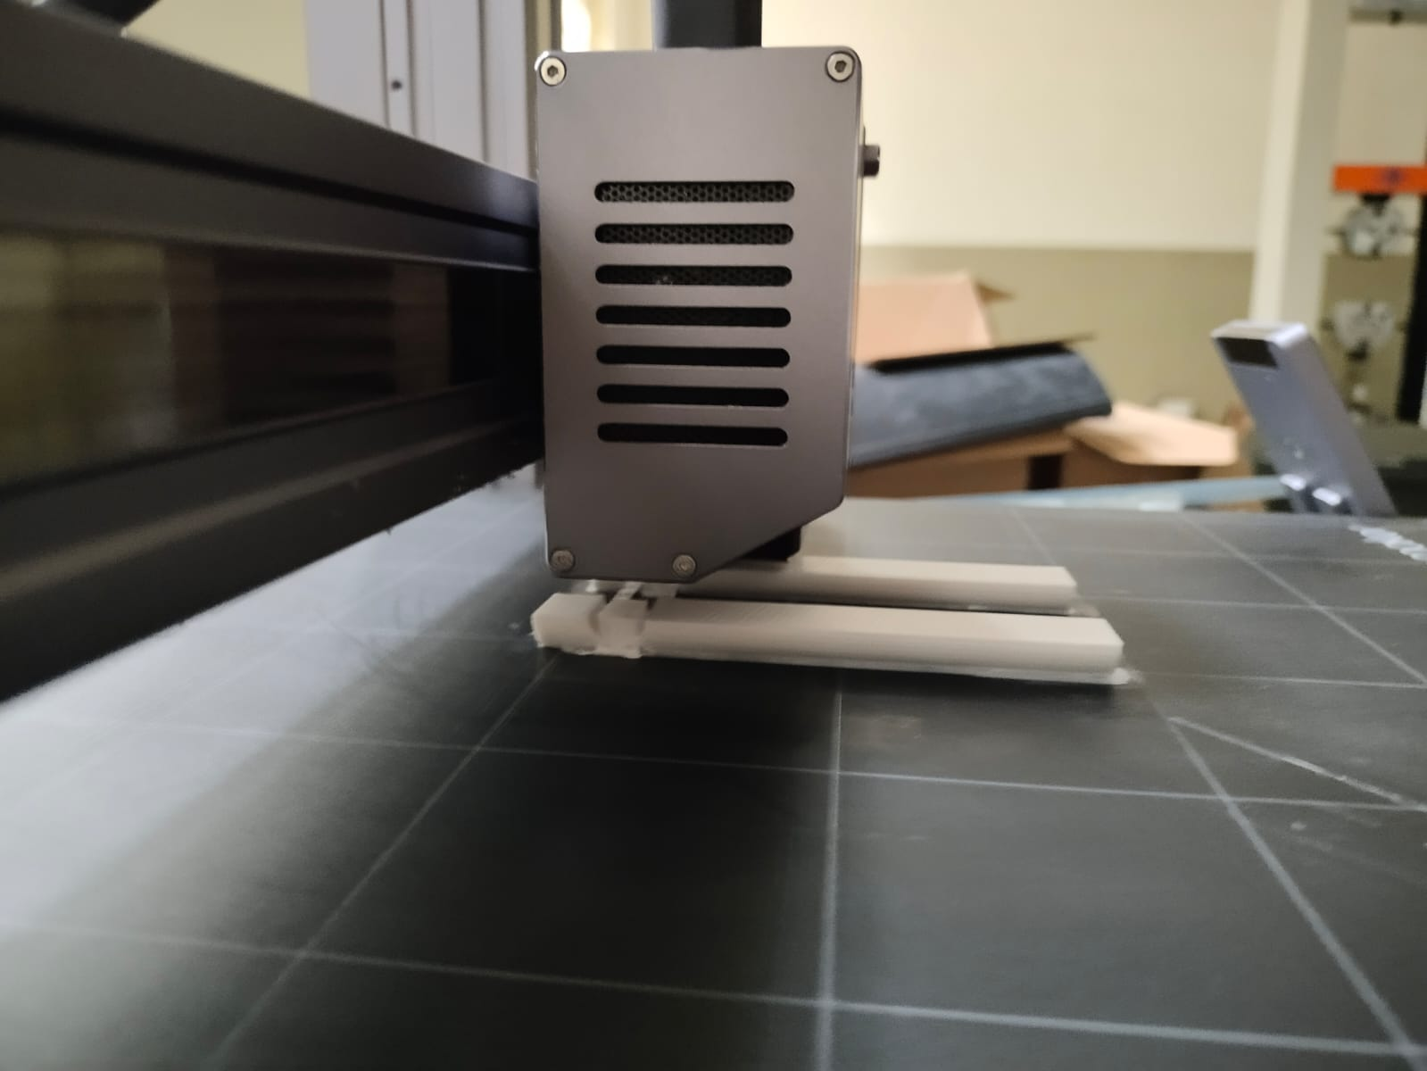
SPRINT 3: (Physical implementation)
Notes:
We used acrylic sheet to make the base for all the components . Got the required dimension of cutting using laser cutting tool. We got the 3D printed blades using the PLA material. It took around 7hr to get it printed. The structure is made of aluminium. We used form sheet to cover the components. Used multiple other tool from tinkering lab to complete the model.

Slide 12
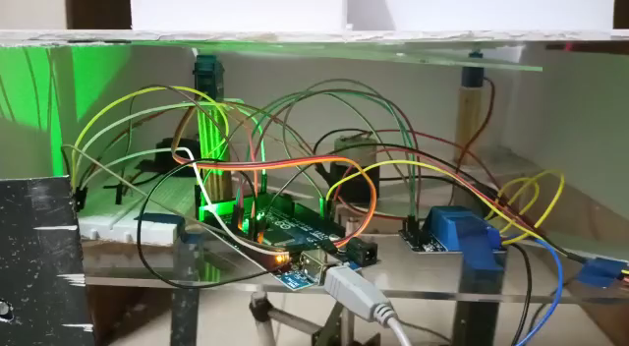
Performance testing
Notes:
First we dumped the code to Arduino, ones the power supply is given to model first the two micro servo opens the channel to outflow the food ingredient’s into the rotating container. Then signal is sent to DC motor through Arduino and it starts rotating for the given amount of time. After this the buzzer gives a beep sound indicating that the mixing is done. After this the servo MG995 opens the bottom plate and closes in a given amount of time.

Slide 13
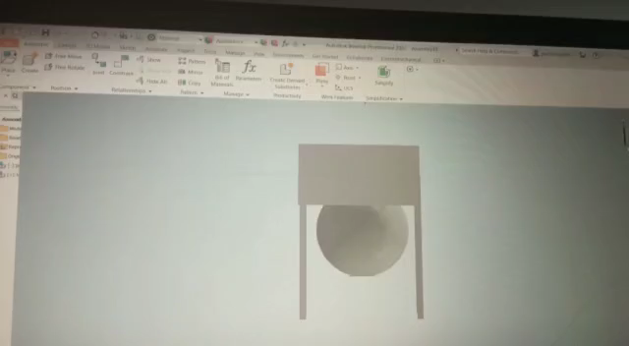

Slide 14
Learning from course project/exploration course
1. This is one of the best course I have ever witnessed. The Learning from course project is just endless. Got an in hand experience working on most device like drill gun, hacksaw blade, laser cutting tool and the list goes on and on….
We got to use the 3D printer for the first time . Learnt how to use one, what are the key points to keep in mind while using this printer, material used in such printer and mainly as fancy it looks to get it printed, the complex the print the longer is the time durations.
We also learnt how to use the sensors, actuators and Arduino. Coding was the hard part but as a team we managed it all well.
Mainly got an insights how does a final year project looks like, why team formations and communications is key to any successful project.

Slide 15
Thank You

