Slide 1
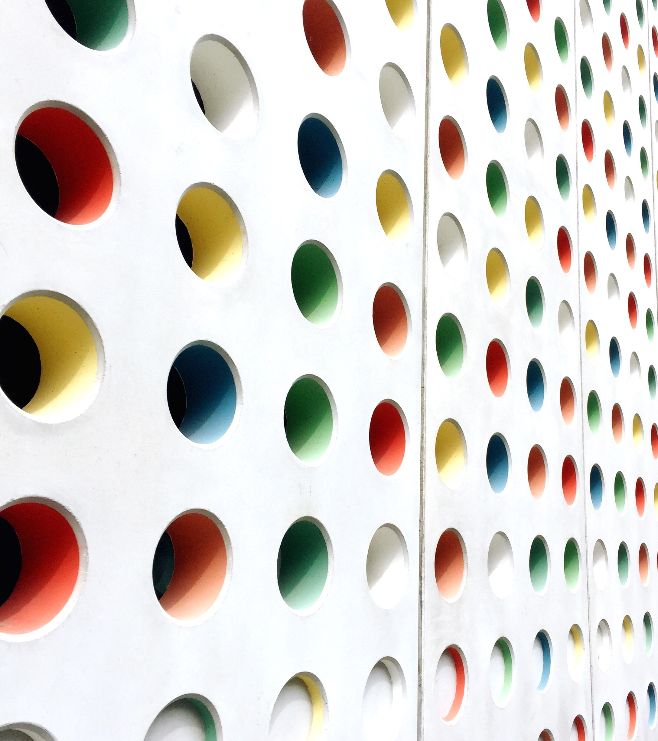
BELLA VITA ORGANIC

Slide 2

NATURAL SKIN CARE

Slide 3
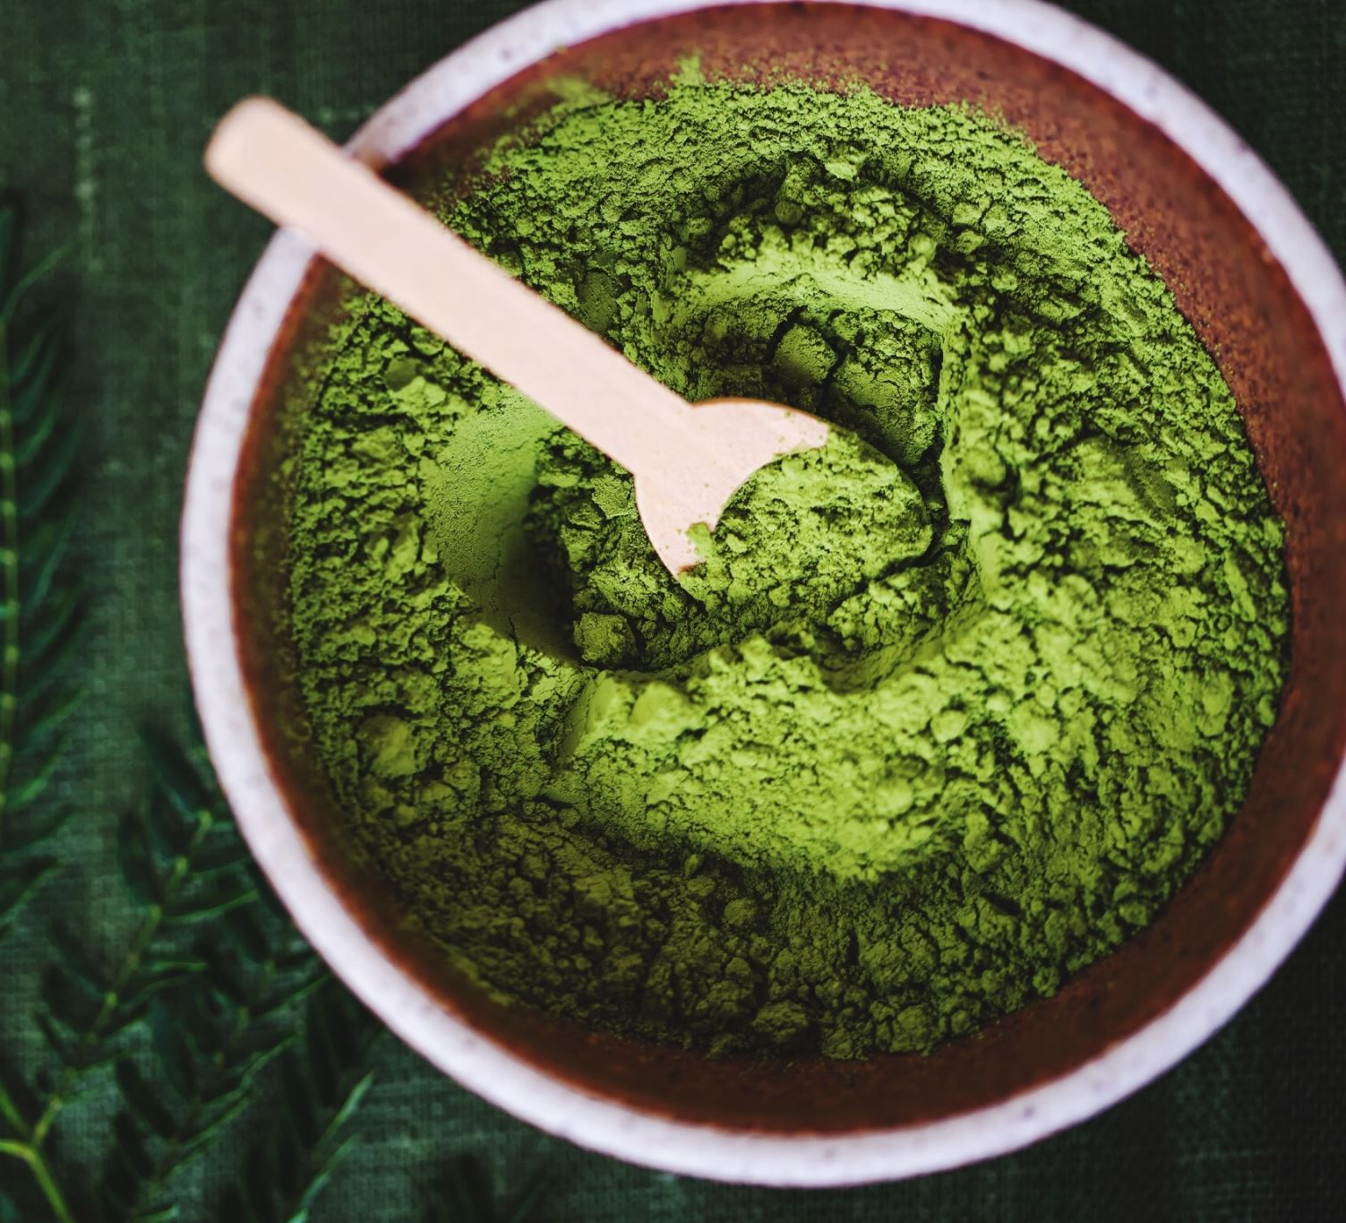
WHY BELLA VITA????
ORGANIC
CRUELITY FREE
AYURVEDIC
NO CHEMICALS

Slide 4
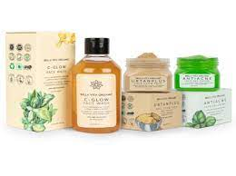
GREEN PRODUCTS

Slide 5

SPECIAL OFFERS
FREE GIFTING SAMPLES AFTER SPENDING OVER $35

