Slide 1
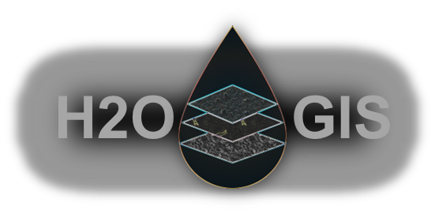




INTRODUCTION TO GPS FOR WATER INDUSTRY
Sam Shamsi, PhD, PE
sam.shamsi@GIS-Training.com
www.linkedin.com/in/samshamsi
© A1 APPLICATIONS 2025
Notes:
%%AVATAR_BOTTOMRIGHT%
%%SLIDETTSVOICE%en-US-Wavenet-J%%SLIDETTSVOICE-END%
%%TTSPROSODYRATE%0.7%%TTSPROSODYRATE-END%
Hello folks, this is your instructor, Sam Shamsi.
Welcome to this course!!!
I am joining you from Pittsburgh, Pennsylvania—one of the most beautiful and livable cities in the United States.
It’s a pleasure to be with you today.
If you have any questions, feel free to reach out by email anytime.

Slide 2
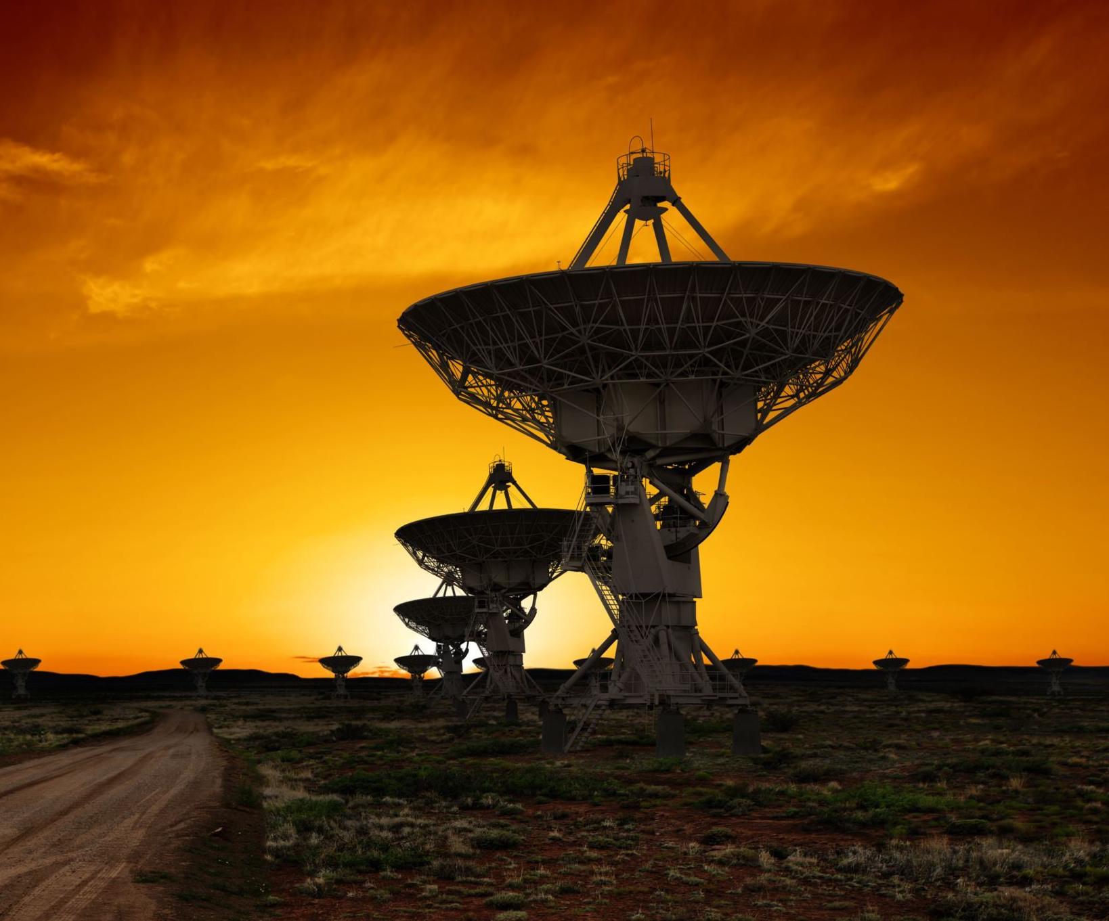

Outline
Basics and history of the Global Positioning System (GPS)
Differences between GPS and Global Navigation Satellite Systems (GNSS)
Key satellite generations and their features
How GPS works including trilateration
GPS Accuracy
Practical applications and classroom activities related to GPS
Notes:
%%AVATAR_BOTTOMRIGHT%
%%SLIDETTSVOICE%en-US-Wavenet-J%%SLIDETTSVOICE-END%
%%TTSPROSODYRATE%0.7%%TTSPROSODYRATE-END%
Let's start with the course outline. <break time=”2s”/> <break strength=”medium”/>
This course provides a comprehensive overview of the Global Positioning System, starting with its fundamental concepts and historical development. We'll explore how GPS differs from other Global Navigation Satellite Systems, highlighting unique features and capabilities. The discussion includes an examination of key satellite generations, emphasizing technological advancements and their impact on accuracy and reliability. We'll also delve into the core mechanism of GPS focusing on trilateration and how it enables precise location determination. Finally, practical applications will be covered, along with suggested classroom activities to help learners engage with, and understand, GPS technology in real-world context.. <break time=”5s”/>

Slide 3
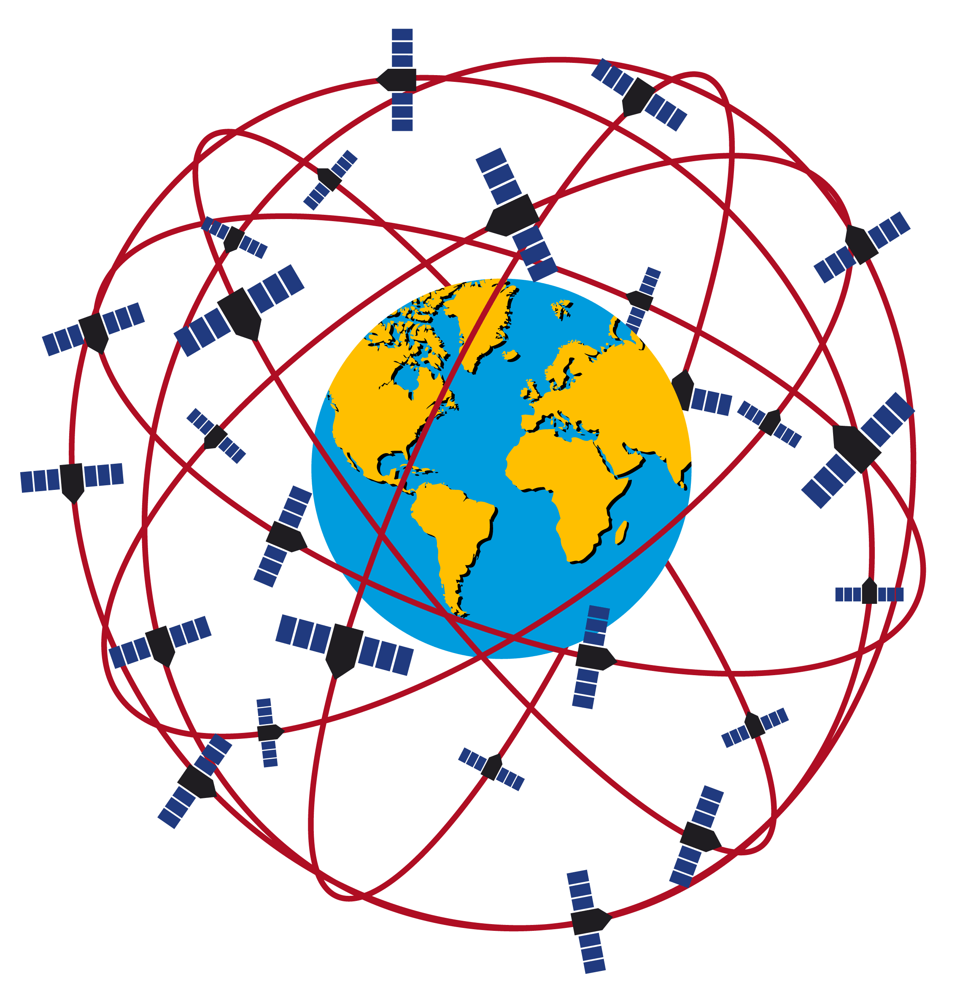

Global Positioning System (GPS)
A U.S. satellite navigation system
Launched in 1978, operational by 1980
Has 31 active satellites (as of this writing)
12,500 miles above the earth
Satellites orbit the earth twice daily
  i.e. pass over approximately the same world location every 12 hours
6 orbits (4 to 6 satellites per orbit)
This Photo by Unknown Author is licensed under CC BY-SA-NC
Notes:
%%AVATAR_BOTTOMRIGHT%
%%SLIDETTSVOICE%en-US-Wavenet-J%%SLIDETTSVOICE-END%
%%TTSPROSODYRATE%0.7%%TTSPROSODYRATE-END%
Global Positioning System. <break time=”2s”/> <break strength=”medium”/>
Let’s begin with GPS overview and satellite technology.
GPS is a U.S. satellite navigation system launched in 1978 with 31 active satellites orbiting 12 thousand 500 miles above earth, completing two orbits daily.

Slide 4
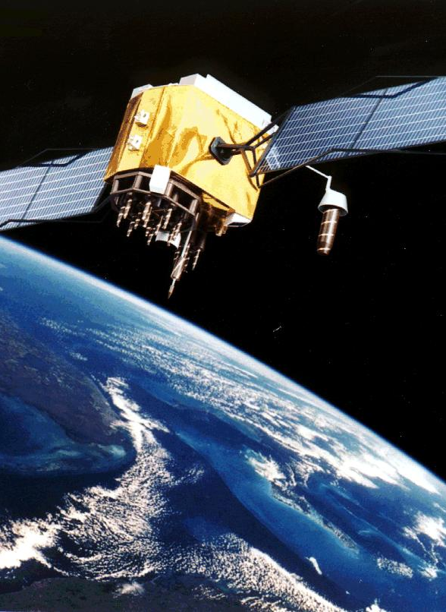
Global Positioning System (GPS)
GPS receivers read radio signals from orbiting satellites to calculate the exact spot of the receiver on the Earth by comparing the time taken by signals from 4 different GPS satellites to reach the receiver.
Notes:
%%AVATAR_BOTTOMRIGHT%
%%TTSPROSODYRATE%0.7%%TTSPROSODYRATE-END%
This diagram is true to scale. <break time=”2s”/> <break strength=”medium”/>
GPS receivers determine location by measuring signal travel time from satellites, requiring signals from at least 4 satellites.
GPS provides latitude, longitude, elevation, and time with accuracy ranging from meters on smartphones to centimeters with survey-grade GPS equipment..

Slide 5
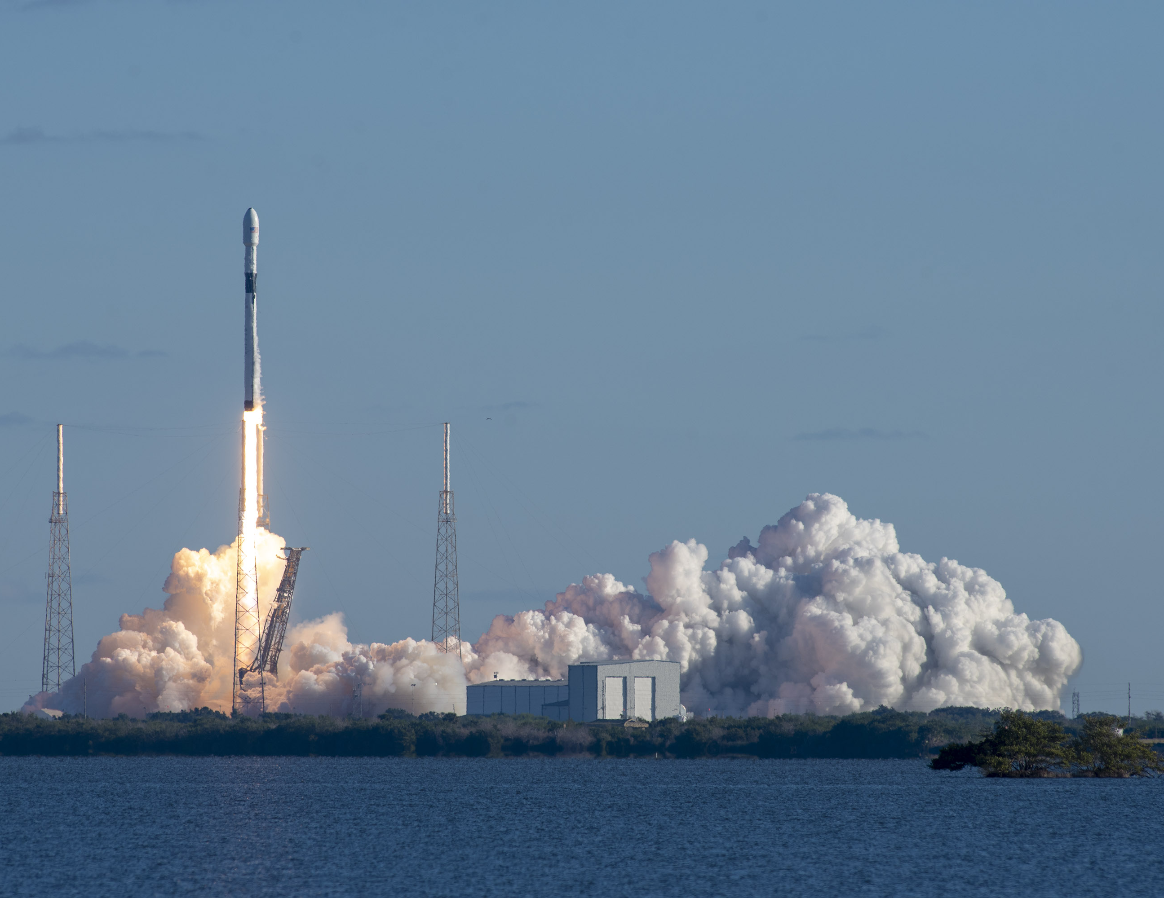
Satellite Launch
Falcon 9 rocket launching the first GPS III satellite, December 2018
Photo courtesy of SpaceX (founded by Elon Musk in 2002)
Notes:
%%AVATAR_BOTTOMRIGHT%
%%TTSPROSODYRATE%0.7%%TTSPROSODYRATE-END%
Satellite Launch. <break time=”2s”/> <break strength=”medium”/>
This slide highlights the significant milestone of the Falcon 9 rocket launching the first GPS three satellite in December 2018. The image captures the moment of liftoff, showcasing advanced rocket technology from SpaceX. <break time=”2s”/>
Founded by Elon Musk in 2002, SpaceX has revolutionized space travel with reusable rockets and ambitious missions. The GPS three satellite represents a major upgrade in global positioning technology, offering improved accuracy, enhanced security, and better resistance to jamming. This launch marked a key step in modernizing the GPS constellation, which is critical for navigation, timing, and various military and civilian applications worldwide. The clear sky and water backdrop emphasize the precision and power of this launch event..
Note that SpaceX stands for Space Exploration Technologies Corporation..<break time=”2s”/>
SpaceX performs the following functions. <break time=”2s”/>
Launches rockets for satellites, cargo, and people (e.g., Falcon 9, Falcon Heavy).
Transports astronauts to the International Space Station for NASA.
Develops reusable rockets to reduce the cost of space travel.
Builds spacecraft like Dragon and Starship for future Mars missions. <break time=”2s”/>

Slide 6

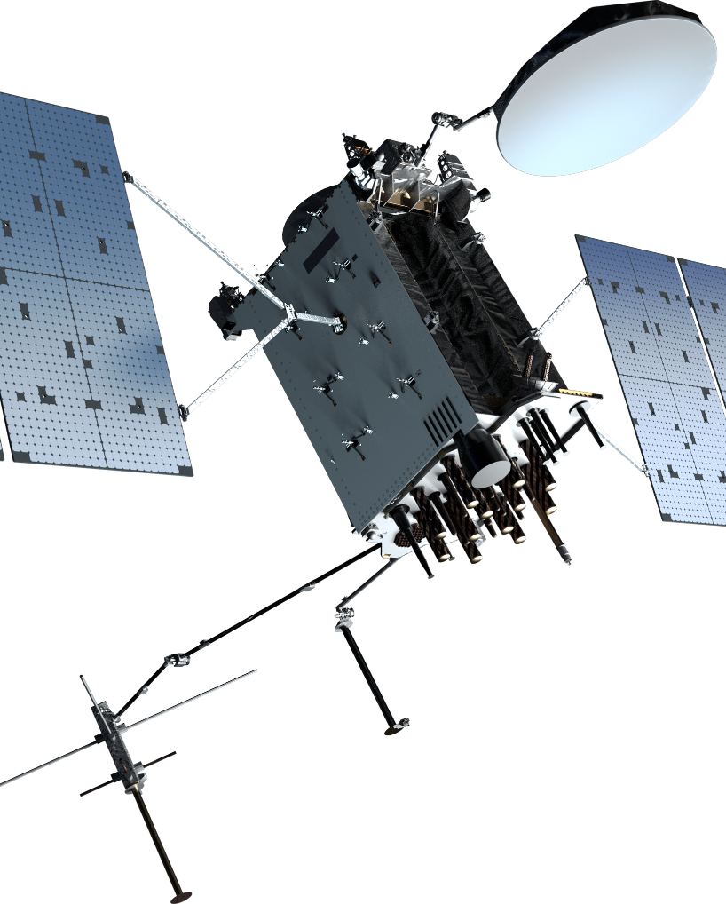
GPS IIIF Satellite
Manufacturer: Lockheed Martin
To be launched in 2026.
60X greater anti-jamming to ensure U.S. and allied forces cannot be denied access to GPS in hostile environments
Notes:
%%AVATAR_BOTTOMRIGHT%
%%TTSPROSODYRATE%0.7%%TTSPROSODYRATE-END%
GPS Three F Satellite. <break time=”2s”/> <break strength=”medium”/>
This slide highlights the GPS Three F satellite, a critical advancement in satellite navigation technology developed by Lockheed Martin, set for launch in 2026. The key feature of this satellite is its enhanced anti-jamming capability, which is 60 times greater than previous models. This improvement is vital for maintaining uninterrupted GPS access for U.S. and allied forces, especially in hostile or contested environments where signal interference or denial attempts are common. The satellite's robust design ensures operational reliability and security, reinforcing strategic advantages in military and defense operations. The image on the slide visually represents the satellite, emphasizing its technological sophistication and the importance of this upgrade in global positioning systems..

Slide 7
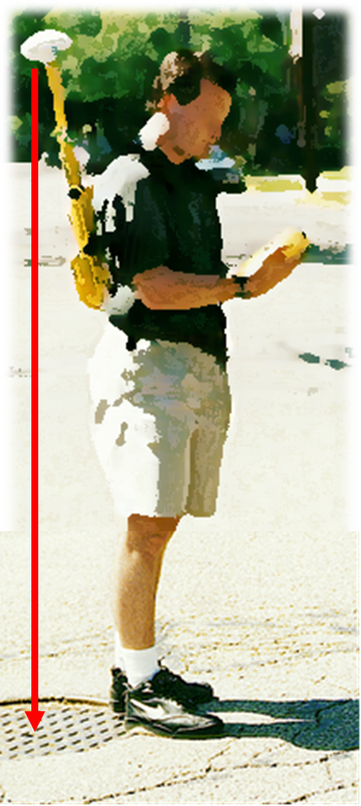
How GPS Works
A GPS receiver calculates its position comparing signals received from at least 4 satellites.
GPS accuracy
  1-5 meter horizontal on smartphones
  centimeter-level horizontal and vertical with survey-grade GPS equipment.
Notes:
%%AVATAR_BOTTOMRIGHT%
%%TTSPROSODYRATE%0.7%%TTSPROSODYRATE-END%
How GPS Works?. <break time=”2s”/> <break strength=”medium”/>
A GPS receiver calculates its exact location by measuring the distance from at least four satellites, which allows it to determine latitude, longitude, elevation, and precise time. The accuracy varies depending on the device: smartphones typically achieve horizontal accuracy within 1 to 5 meters, while specialized survey-grade GPS equipment can pinpoint locations with centimeter-level accuracy both horizontally and vertically. <break time=”2s”/>

Slide 8
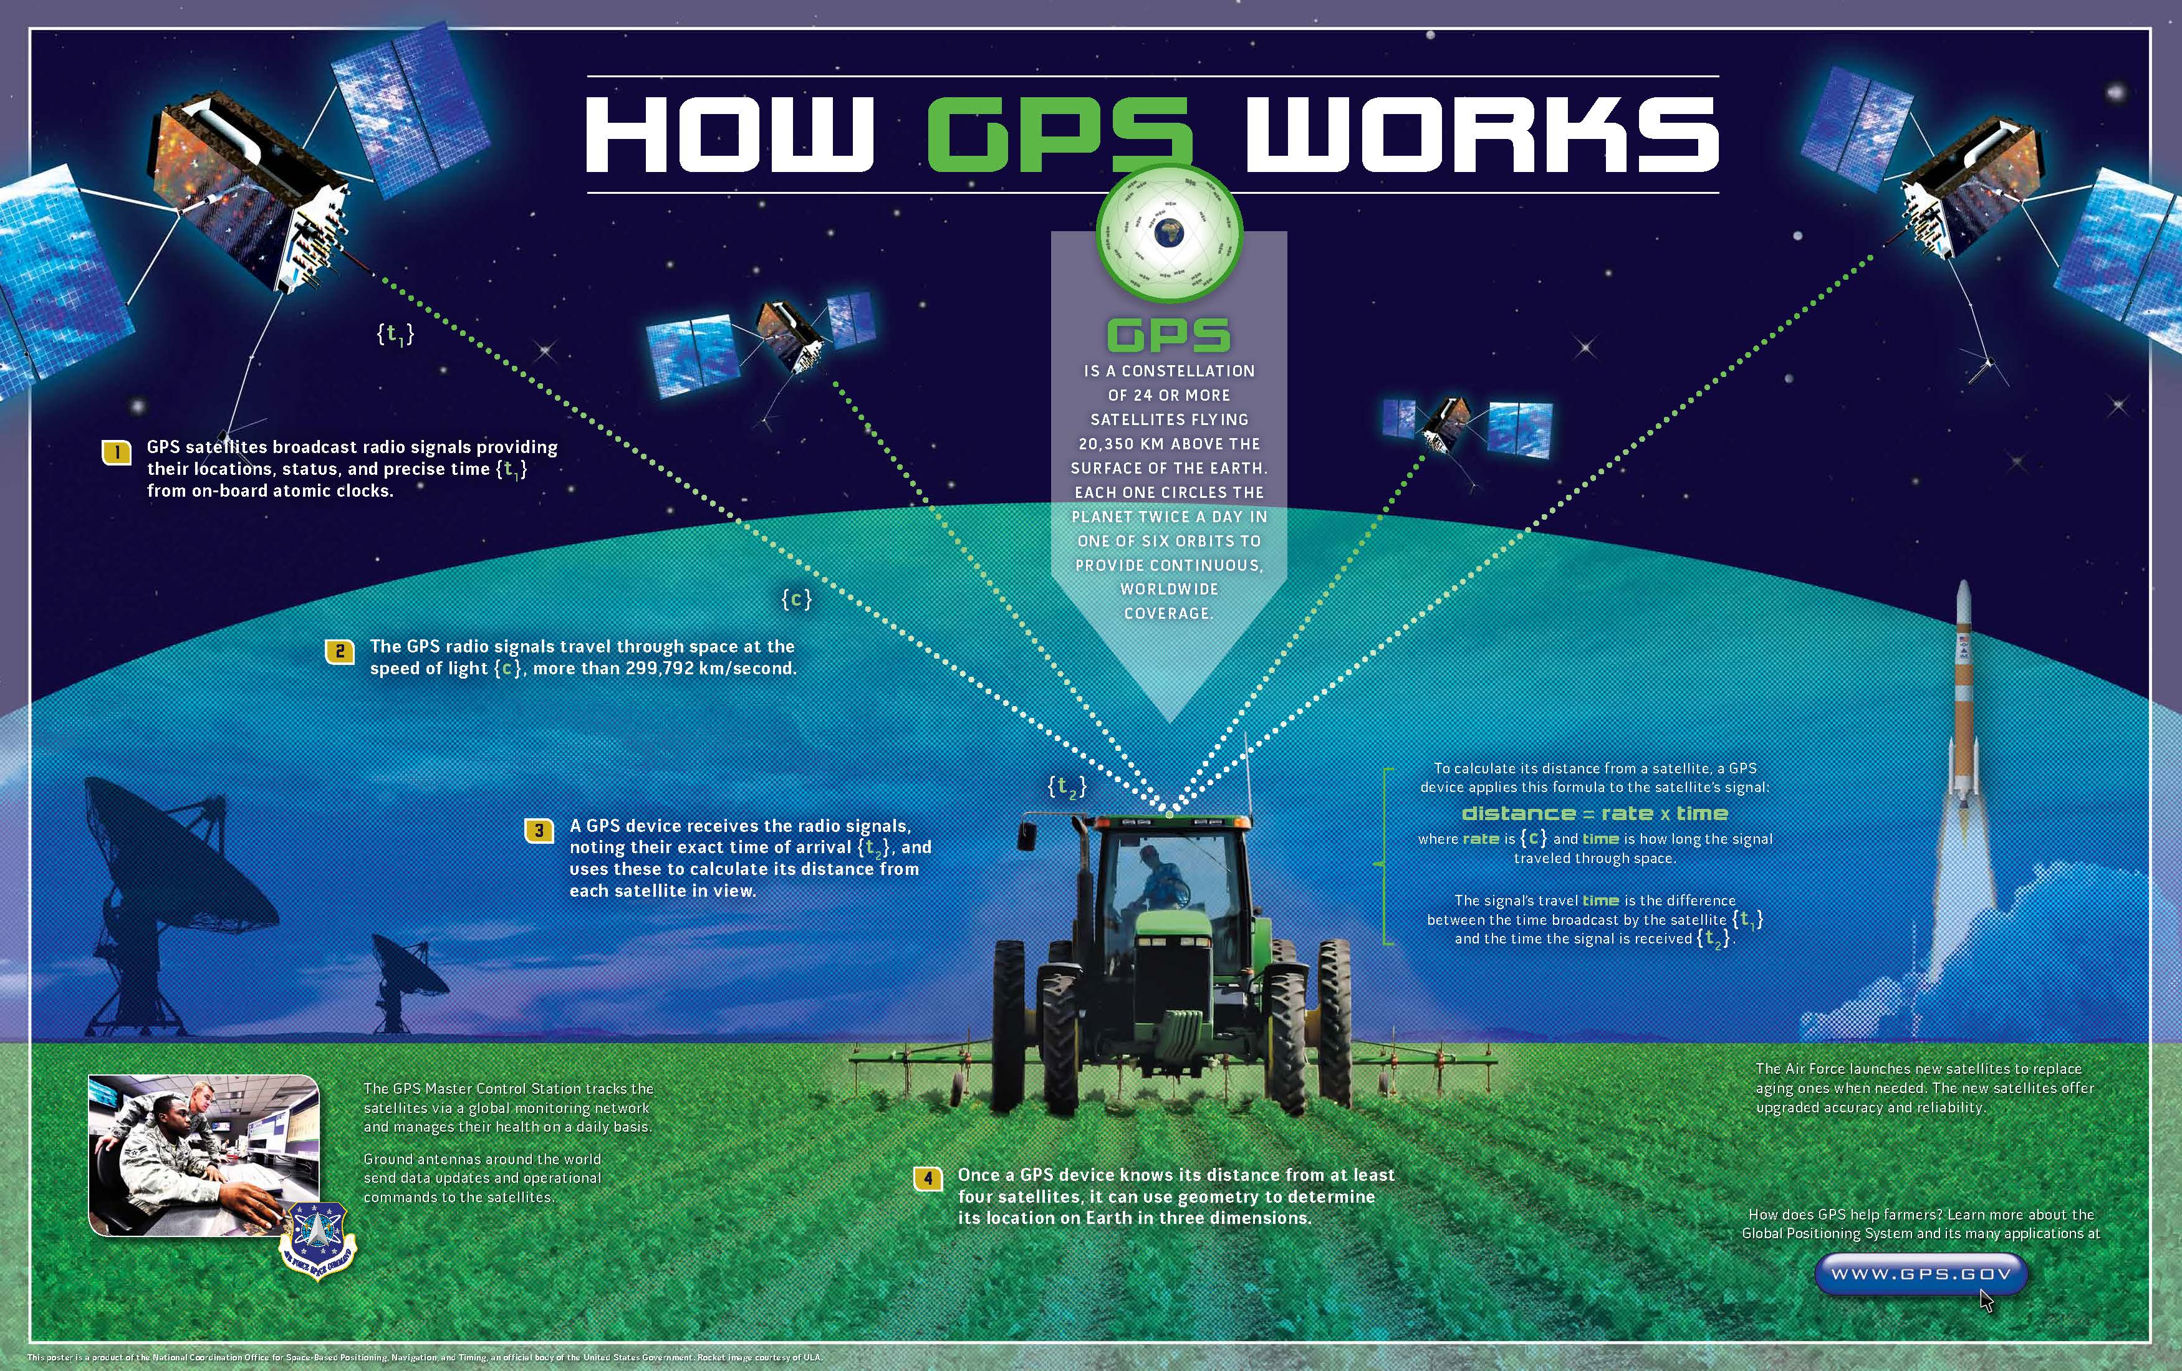
How GPS Determines Position
Like this? Need PDH? Contact me for my GPS course. sam.shamsi@GIS-Training.com
Notes:
%%AVATAR_BOTTOMRIGHT%
How GPS Determines Position. <break time=”2s”/> <break strength=”medium”/>
This diagram is from www.gps.gov
It breaks down the process of how GPS determines your exact position on Earth. It starts with GPS satellites continuously broadcasting radio signals. These signals travel at the speed of light, and the GPS receiver measures how long it takes for each signal to arrive. By calculating the distance from multiple satellites using this travel time, the receiver uses trilateration to pinpoint its precise location..

Slide 9

Class Activity: Trilateration
Use Google Chrome (or another browser) to find the difference between triangulation and trilateration.
Time: 15 minutes
Video Course
  Virtual teaching assistant
  Pause video for the activity; resume after completing the activity.
Notes:
%%AVATAR_BOTTOMRIGHT%
%%SLIDETTSVOICE%en-US-Wavenet-H%%SLIDETTSVOICE-END%
Class Activity. <break time=”2s”/> <break strength=”medium”/>
Hello, This is your Teaching Assistant.
Let’s take a short break for a quick class activity.
Please open Google Chrome—or any other browser you prefer—and search for the difference between triangulation and trilateration.
You’ll have 15 minutes for this activity. Once you're done, we’ll regroup and discuss what you found.
Take your time and have fun exploring. <break time=”5s”/>

Slide 10

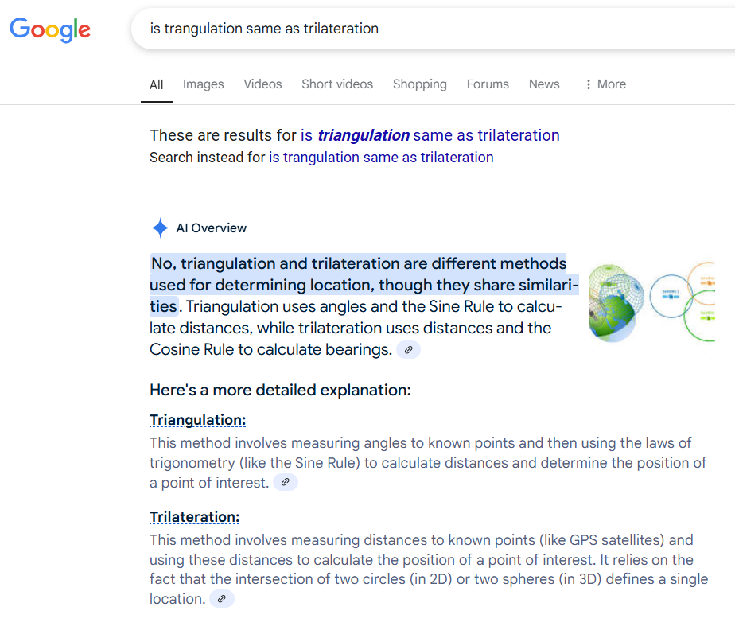
Class Activity: Results
Conventional (theodolite, total station) survey uses triangulation
  Measures angles
GPS uses trilateration
  Measures distances
Misconception: GPS uses triangulation.
Survey
GPS
Notes:
%%AVATAR_BOTTOMLEFT%
%%SLIDETTSVOICE%en-US-Wavenet-H%%SLIDETTSVOICE-END%
Class Activity Results. <break time=”2s”/> <break strength=”medium”/>
Here is the desired outcome of this activity.
This activity should clarify a common misunderstanding about positioning methods. It should contrast conventional surveying, which relies on triangulation, with GPS technology that uses trilateration. Triangulation involves measuring angles from known points to determine a location, whereas trilateration calculates position based on distances from multiple satellites. The slide highlights that many people mistakenly believe GPS uses triangulation, as shown by the Google search screenshot.. <break time=”2s”/>

Slide 11
Quiz: Section 2
char
1) To function properly, a GPS receiver must receive signals from at least:
  A) 1 satellite
  B) 2 satellites
  C) 3 satellites
  D) 4 satellites
Notes:
%%AVATAR_BOTTOMRIGHT%
%%SLIDETTSVOICE%en-US-Wavenet-H%%SLIDETTSVOICE-END%
Section 2 Quiz. <break time=”2s”/> <break strength=”medium”/>
Hello again. This is your Teaching Assistant. It’s time for a quick quiz.
Question number 1:
To function properly, GPS receiver must receive signals from at least:
A..
One satellite..
B..
Two satellites..
C..
Three satellites..
Or D..
Four satellites..
Take a moment to think about your answer..
I’ll reveal the correct choice in just a bit..
All the best!!!
The correct answer is D: 4 satellites

Slide 12
INTRODUCTION TO GPS FOR WATER INDUSTRY
Sam Shamsi, PhD, PE
sam.shamsi@GIS-Training.com
www.linkedin.com/in/samshamsi
© A1 APPLICATIONS 2025
Notes:
%%AVATAR_BOTTOMRIGHT%
%%SLIDETTSVOICE%en-US-Wavenet-H%%SLIDETTSVOICE-END%
So long folks! Thanks for your time and attention.

