Slide 1




ESP32-CAM: Embedded Imaging Solution
The ESP32-CAM is designed for compact embedded applications requiring image or video capture capabilities. It features the ESP32-S module, with a dual-core processor running at up to 240 MHz, Wi-Fi, Bluetooth, and rich peripheral interfaces.
by gedivya 0508

Slide 2
Powerful Dual-Core Processor
High Performance
Efficient Connectivity
Rich Peripheral Interfaces
The ESP32-S module is equipped with a dual-core processor running at up to 240 MHz, ensuring rapid data processing for image and video capture applications.
It provides Wi-Fi and Bluetooth connectivity, allowing seamless communication with other devices and networks.
The module offers a wide range of peripheral interfaces, enhancing its compatibility with various external components and sensors.

Slide 3
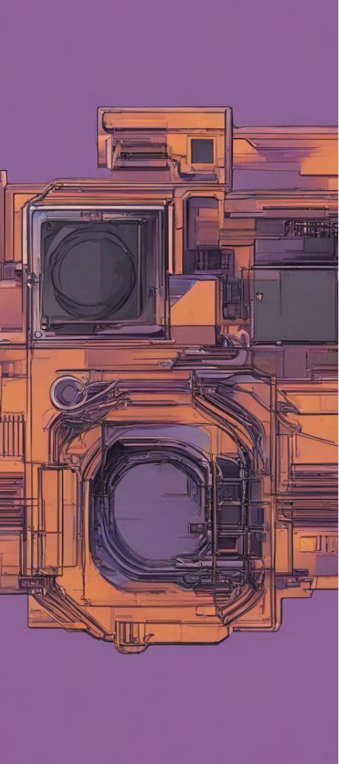
Integrated Camera for Versatile Applications
1
Image and Video Capture
2
Compact Form Factor
The on-board camera allows for both image and video capture, making it suitable for surveillance, monitoring, and visual recognition applications.
The module's small size and integrated camera make it ideal for embedded systems with space constraints.
3
Enhanced Functionality
Integrating the camera on the module reduces the need for additional hardware, simplifying the design process for developers.

Slide 4




Remote Monitoring and Surveillance
24/7 Surveillance
Real-time Alerts
Flexible Deployment
Enables continuous monitoring of indoor or outdoor spaces for security and safety purposes.
Instantly notifies users of any detected motion, ensuring prompt response to potential security threats.
Adaptable for remote monitoring applications in varied environments, providing comprehensive coverage.

Slide 5

Visual Recognition and Edge Computing
Edge Computing Capabilities
Object Detection
Empowers on-device image processing and analysis, minimizing latency and enhancing real-time decision-making.
Facilitates the identification and tracking of objects, enabling a wide range of visual recognition applications.
AI Integration
Supports the integration of AI algorithms for advanced image analysis and classification directly on the module.

Slide 6
IoT Connectivity and Smart Devices
10K
5
IoT Devices Connected
Multi-Protocol Support
Enables the connection of up to 10,000 IoT devices for scalable and extensive smart system integration.
Supports a diverse range of communication protocols for seamless connectivity with various IoT devices and platforms.

Slide 7

Customizable Development and Prototyping
1
Flexible Development Environment
Provides diverse development tools and resources to support custom applications and prototyping needs.
2
Efficient Prototyping Process
Enables rapid ideation, testing, and refinement of embedded imaging solutions for diverse use cases.
3
Community Support
Access to a robust online community for sharing knowledge, troubleshooting, and collaborative development efforts.

Slide 8
Security and Data Integrity
Secure Transmission
Facilitates encrypted data transmission for secure communication and data integrity.
Embedded Security Features
Integrated security measures to protect against unauthorized access and ensure system integrity.
Versatile Encryption Support
Supports various encryption algorithms to safeguard sensitive data and maintain privacy.

