Slide 1


Dr. Savita Shegavi
(Dental Surgeon)

Slide 2


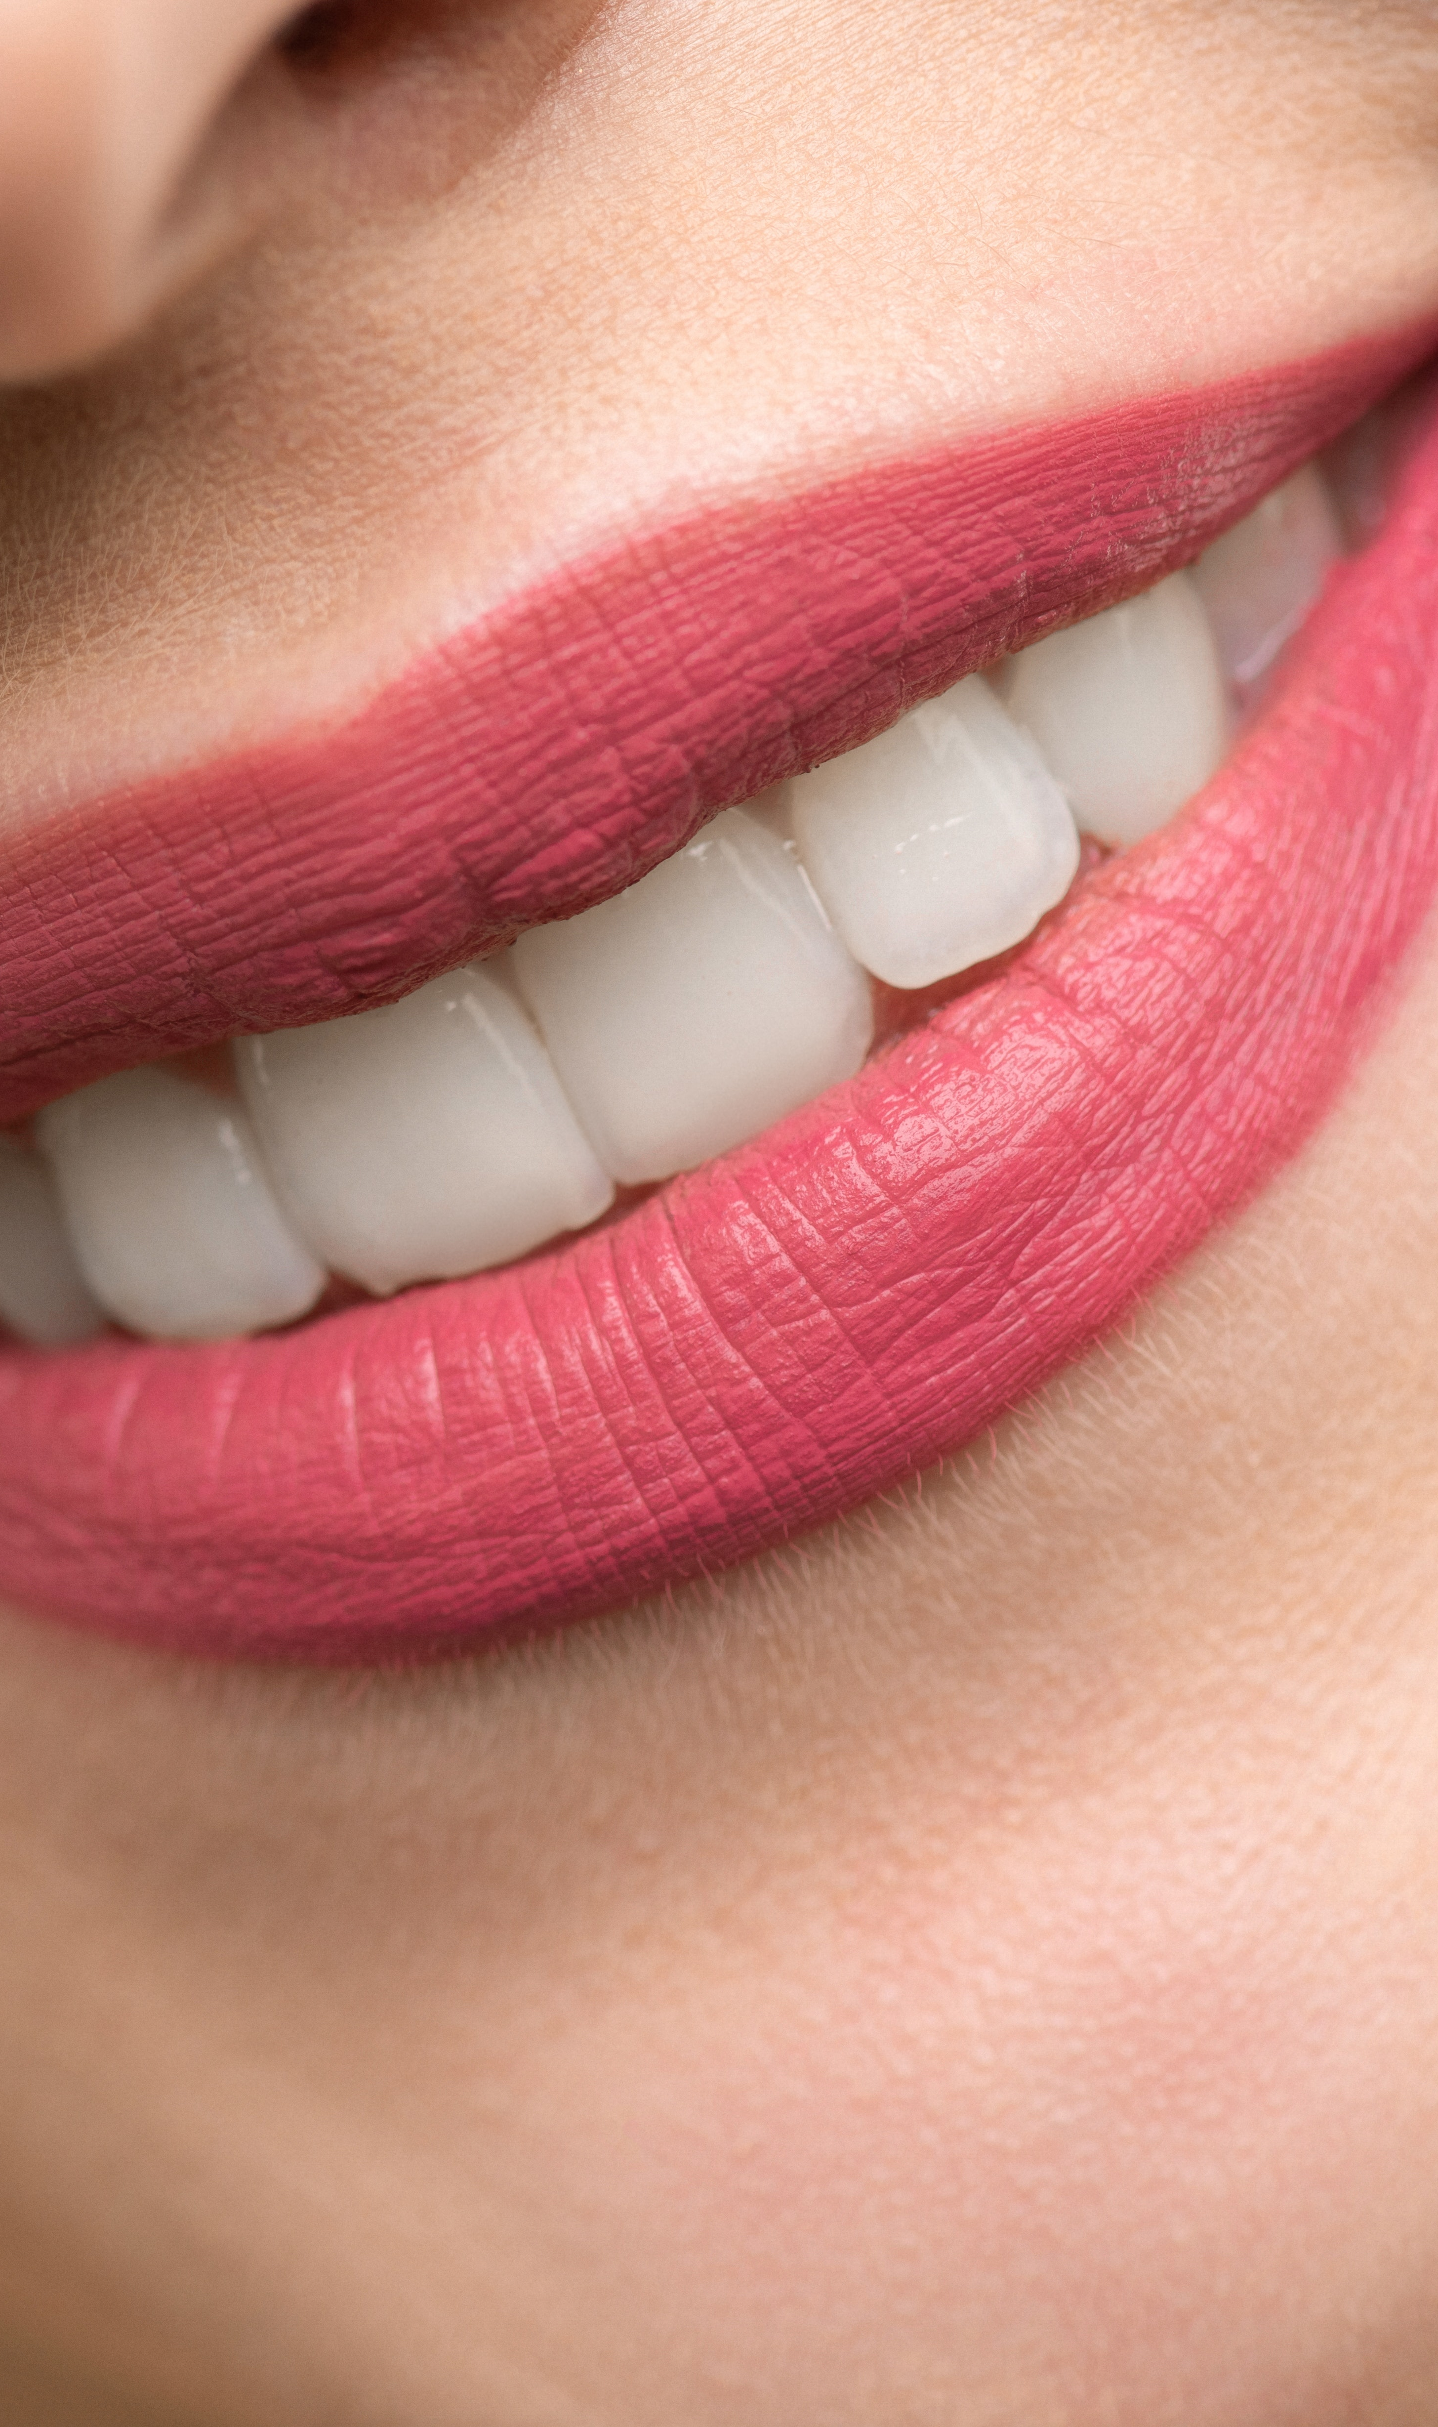
“If you’ve put a smile on someone’s face today, you’ve done more good than you know.”

Slide 3
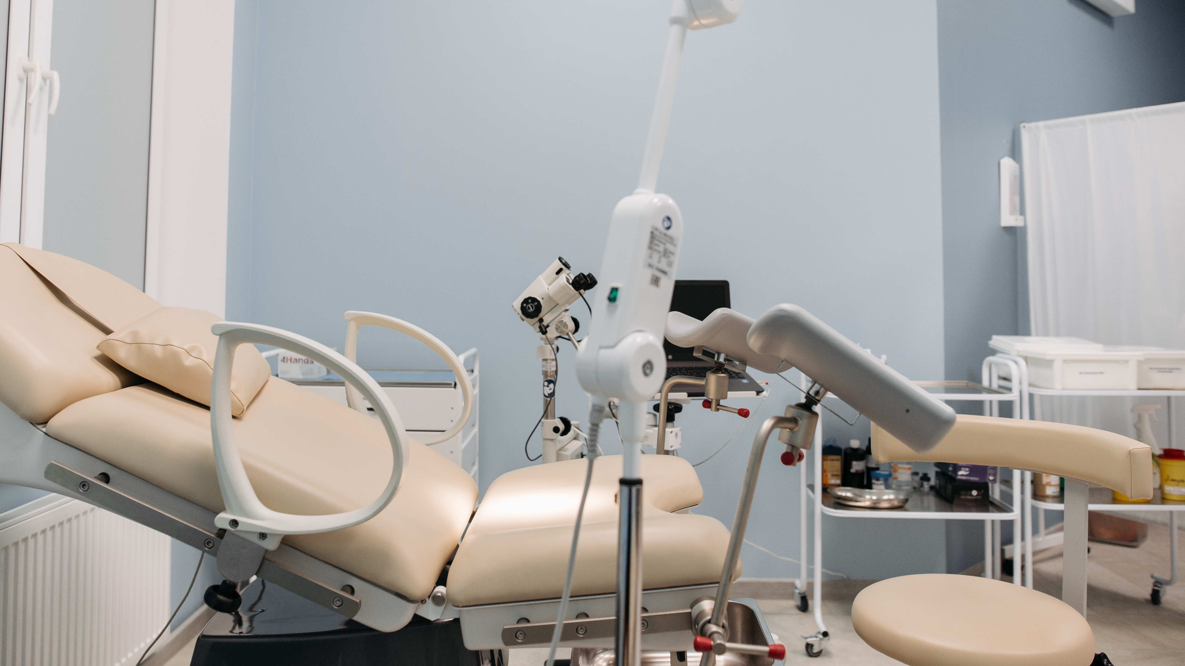
Dental Equipements
Dental instruments are tools that dental professionals use to provide dental treatment. They include tools to examine, manipulate, treat, restore, and remove teeth and surrounding oral structures.

Slide 4
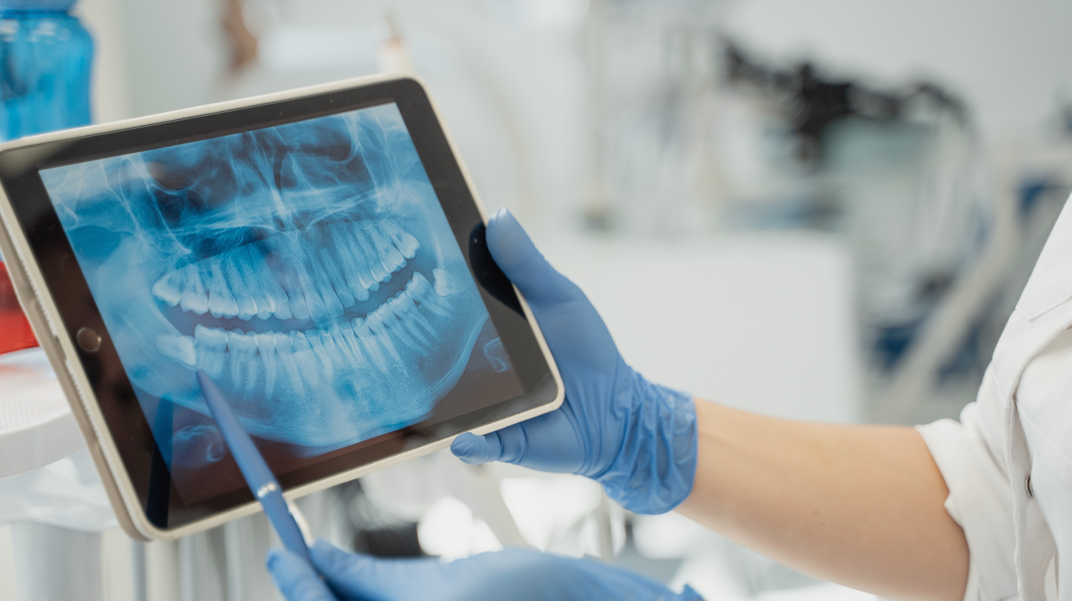
Dental XRAY
Dental X-rays help dentists visualize diseases of the teeth and surrounding tissue that cannot be seen with a simple oral exam.
They also help the dentist find and treat dental problems early on, which can help save you money, unnecessary discomfort, and maybe even your life.

Slide 5

Timings
Monday - Saturday Opened 10.30AM - 01.30 PM
05.30PM - 08.30 PM
Sunday Closed -

