Slide 1

Counselor and Supervisor Development
Notes:
Hello. Let’s talk about counselor and supervisor development.

Slide 2

Developmental Stages of Counselors
Counselors are at different stages of professional development. Thus, regardless of the model of supervision you choose, you must consider the supervisee’s level of training, experience, and proficiency.
Notes:
It’s imperative that you take note and remain aware of your associate’s development. Likewise, especially in the beginning of your LPC supervisor career, you should continually self-assess your development as well.

Slide 3
Different supervisory approaches are appropriate for counselors at different stages of development.
An understanding of the supervisee’s (and supervisor’s) developmental needs is an essential ingredient for any model of supervision.
Notes:
As you decide upon your model of supervision, ensure you take into account your associate’s stage of development and that you tailor your supervision activities accordingly.

Slide 4

Developmental Stages of Counselors
Various paradigms or classifications of developmental stages of clinicians have been developed (Ivey, 1997; Rigazio-DiGilio, 1997; Skolvolt & Ronnestrand, 1992; Todd and Storn, 1997).
This reading focuses on the Integrated Developmental Model (IDM) of Stoltenberg, McNeill, and Delworth (1998) (see figure 2, p. 10). This schema uses a three-stage approach. The three stages of development have different characteristics and appropriate supervisory methods.
Notes:
Let’s take some time to briefly look into the Integrated Developmental Model of supervision.

Slide 5
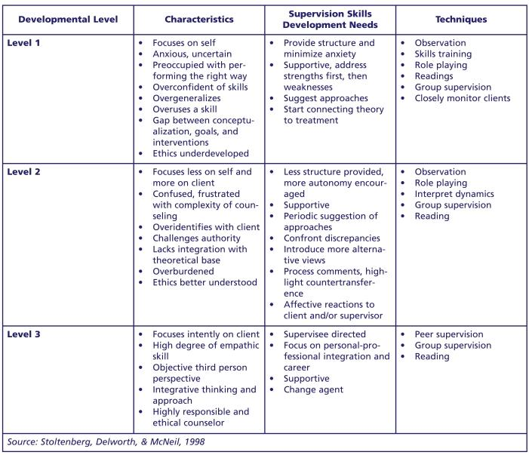
Figure 1
Counselor Developmental Model
Notes:
Please note the various levels of development, the characteristics expected during each level and how to address the associated needs. This chart is available for download in the curriculum. It’s recommended you print it or save it for reference.

Slide 6

It is important to keep in mind several general cautions and principles about counselor development
There is a beginning
but not an end point for learning clinical skills~
be careful of counselors who think they “know it all”
Notes:
Remember- there is a beginning but not an end point for learning clinical skills. And always be wary of any counselor thinks he or she knows it all.

Slide 7

Consider the individual learning styles and personalities of your supervisees and fit the supervisory approach to the developmental stage of each counselor.
Notes:
In addition to the developmental stage, be aware of learning styles and personalities of your associates so you can better tailor your supervision. Your relationship with your associate is tantamount to a healthy supervisory relationship.

Slide 8

There is a logical sequence to development, although it is not always predictable or rigid~
some counselors may have been in the field for years but remain at an early stage of professional development, whereas others may progress quickly through the stages.
Notes:
Know any colleagues that still seem pretty green even though they’ve been in the field for quite awhile? This is common and you need to be aware of this with each of your associates. Some are quick learners, some are not. Stay on top of assessing their development.

Slide 9

Counselors at an advanced developmental level have different learning needs and require different supervisory approaches from those at Level 1.
Notes:
Obviously, as your associate develops into level 2 and 3, their needs will be different from those associates at level 1.

Slide 10

The developmental level can be applied for different aspects of a counselor’s overall competence (e.g., Level 2 mastery for individual counseling and Level 1 for couples counseling).
Notes:
And be sure to stay aware of specific skills development. For instance, you associate may be approaching Level 3 development overall, but still may be at level 1 regarding crisis interventions. Staying aware of these variations in development will help to strengthen your supervisory relationship as you manage the development of your associate’s specific skills.

Slide 11

Developmental Stages of Supervisors
Just as counselors go through stages of development, so do supervisors.
The developmental model presented in figure 2 provides a framework to explain why supervisors act as they do, depending on their developmental stage.
Notes:
So, you too will embark on a new developmental journey as an LPC supervisor. Take a look at the levels of development, the similarities with the associate’s development, and how you as the supervisor can help yourself to become a more competent supervisor.

Slide 12
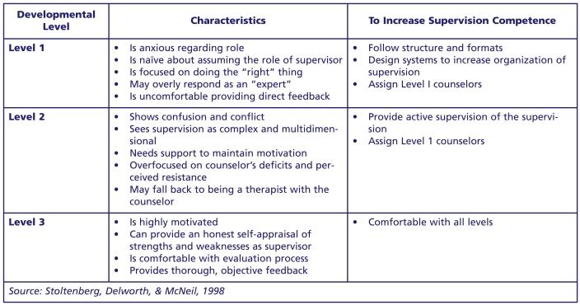
Figure 2
Supervisor Developmental Model
Notes:
Remember, staying self-aware is key to mastering competency in supervision. Never hesitate to seek guidance from your supervisor colleagues.

Slide 13
It would be expected that someone new to supervision would be at a Level 1 as a supervisor.
However, supervisors should be at least at Level 2 or Level 3 of counselor development.
If a newly appointed supervisor is still at Level 1 as a counselor, he or she will have little to offer to more seasoned supervisees.
Notes:
Some new supervisors have plenty of management and supervision skills already developed, but what about those counseling skills? Be diligent with keeping abreast of the most up-to-date best practice techniques, ethics, laws, and theories. Your counseling experience and knowledge is vital to ensuring your competency as an LPC Supevisor.

Slide 14
To summarize:
The Integrated Developmental Model of Clinical Supervision is a framework used to guide the supervision of therapists and counselors. It combines several supervision models, emphasizing the importance of both the supervisee's developmental stage and the supervisory relationship. Key features of this model include:
Notes:
In summary, The Integrated Developmental Model of Clinical Supervision is a framework used to guide the supervision of therapists and counselors. It combines several supervision models, emphasizing the importance of both the supervisee's developmental stage and the supervisory relationship. Key features of this model include:

Slide 15
Key features
Focus on Stages of Development:
It recognizes that therapists progress through various developmental stages in their professional growth and tailors supervision to meet their evolving needs.
Notes:
A focus on the stages of development. It recognizes that therapists progress through various developmental stages in their professional growth and tailors supervision to meet their evolving needs.

Slide 16
Key features
Reflective Practice:
Encourages supervisees to engage in self-reflection, exploring their feelings, thoughts, and reactions to better understand their clients and themselves.
Notes:
Reflective practice. It encourages supervisees to engage in self-reflection, exploring their feelings, thoughts, and reactions to better understand their clients and themselves.

Slide 17
Key features
Parallel Process:
Acknowledges the interconnectedness of the therapist-client relationship and the supervisor-supervisee relationship, with dynamics in one often mirroring those in the other.
Notes:
Another key feature is the parallel process. It acknowledges the interconnectedness of the therapist-client relationship and the supervisor-supervisee relationship, with dynamics in one often mirroring those in the other.

Slide 18

Key features
Supervisory Working Alliance:
Emphasizes the importance of a strong working relationship between the supervisor and supervisee, characterized by trust, respect, and collaboration.
Notes:
The supervisory working alliance:
Emphasizes the importance of a strong working relationship between the supervisor and supervisee, characterized by trust, respect, and collaboration.

Slide 19

Key features
Multiple Perspectives:
Integrates various theoretical and practical perspectives to offer a holistic approach to supervision.
Notes:
Lastly, there are multiple perspectives. The model Integrates various theoretical and practical perspectives to offer a holistic approach to supervision.

Slide 20

In summary:
The Integrated Developmental Model of Clinical Supervision combines a developmental focus, reflective practice, parallel process awareness, a strong supervisory alliance, and a multifaceted perspective to guide and enhance the supervision process for therapists and counselors.
Notes:
So, The Integrated Developmental Model of Clinical Supervision combines a developmental focus, reflective practice, parallel process awareness, a strong supervisory alliance, and a multifaceted perspective to guide and enhance the supervision process for therapists and counselors. Always remember that the supervisory relationship is key to a healthy and positive supervisory experience.

