Slide 1
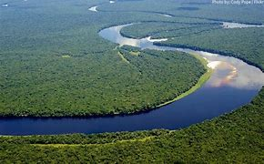
Congo River
Made by: Ethan, Jayden Jong
Notes:
Hello, my name is Ethan today me and Jayden will present Congo river &&TTS_MALE&

Slide 2
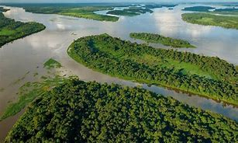
Facts about The Congo River
The Congo River is the second-longest river in Africa, shorter only than the Nile.
It is the third largest river in the world by discharge volume, following the Amazon and the Ganges rivers.
The Congo River is also the world’s deepest recorded river, with measured depths of around 220 m (720 ft).
The Congo River has a length of 2,900 miles (4,700 km) and rises in the highlands of northeastern Zambia between Lakes Tanganyika and Nyasa (Malawi) as the Chambeshi River at an elevation of 5,760 feet (1,760 metres) above sea level.
The Congo Basin has a total area of about 4,000,000 km2 (1,500,000 sq mi), or 13% of the entire African landmass.
Notes:
The Congo River is the second-longest river in Africa, shorter only than the Nile.
It is the third largest river in the world by discharge volume, following the Amazon and the Ganges rivers.
The Congo River is also the world’s deepest recorded river, with measured depths of around 220 m (720 ft).
The Congo River has a length of 2,900 miles (4,700 km) and rises in the highlands of northeastern Zambia between Lakes Tanganyika and Nyasa (Malawi) as the Chambeshi River at an elevation of 5,760 feet (1,760 metres) above sea level.
The Congo Basin has a total area of about 4,000,000 km2 (1,500,000 sq mi), or 13% of the entire African landmass.

Slide 3
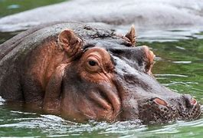
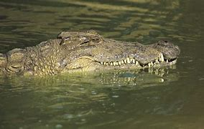
What kind of animal lives in the Congo river
Crocodiles
Hippopotami
River otters
Manatees
Water snakes
Semi-aquatic tortoises
Forest elephants
Some of the endangered species that can be found in the Congo Basin include bonobos, forest elephants, western lowland gorillas, eastern lowland gorillas, chimpanzees, mountain gorillas, and cross river gorillas.
Notes:
What kind of animal lives in the Congo river. Many animals live in the Congo river such as Crocodiles,
Hippopotami,
River otters,
Manatees,
Water snakes,
Semi-aquatic tortoises,
Forest elephants,
And Some of the endangered species that can be found in the Congo Basin include bonobos, forest elephants, western lowland gorillas, eastern lowland gorillas, chimpanzees, mountain gorillas, and cross river gorillas.

Slide 4
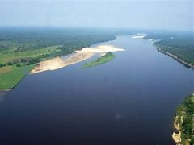
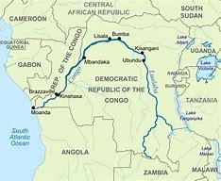
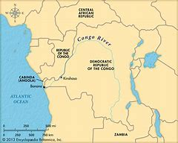
Where is Congo River located
The Congo River, formerly known as the Zaire River, is located in west-central Africa. It flows through 11 countries, including the Democratic Republic of the Congo, the Republic of the Congo, Angola, Zambia, Tanzania, Cameroon, Central African Republic, Burundi, Rwanda, Uganda and South Sudan.
Notes:
Where is Congo River located. The Congo River, formerly known as the Zaire River, is located in west-central Africa. It flows through 11 countries, including the Democratic Republic of the Congo, the Republic of the Congo, Angola, Zambia, Tanzania, Cameroon, Central African Republic, Burundi, Rwanda, Uganda and South Sudan.

Slide 5
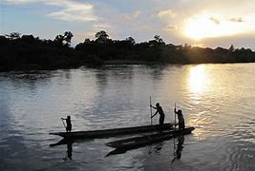
What will we see along the Congo river
The sunset over the water and the two countries on its banks
The fishermen, crossing boats, and local villages that reflect the culture and livelihood of the people
The rain forests and wildlife that are home to many endangered species, such as lowland gorillas, forest elephants, and chimpanzees
The historical sights, such as the Livingstone Falls, named after the explorer David Livingstone, and the colonial capitals of Kinshasa and Brazzaville
Notes:
What will we see along the Congo river. The sunset over the water and the two countries on its banks
The fishermen, crossing boats, and local villages that reflect the culture and livelihood of the people
The rain forests and wildlife that are home to many endangered species, such as lowland gorillas, forest elephants, and chimpanzees
The historical sights, such as the Livingstone Falls, named after the explorer David Livingstone, and the colonial capitals of Kinshasa and Brazzaville

Slide 6
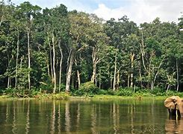
What will we stop to visit
Visit the Parc National Nouabale-Ndoki, a pristine tropical rainforest park in the north of Congo.
See the Les Rapides, roaring rapids near the city of Brazzaville.
Explore the Diosso Gorge, a stunning landscape that was once the capital of the Loango Kingdom.
Experience the biodiversity of the Parc National Conkouati-Douli, a park that covers various ecosystems from mangroves to savannahs.
Relax in Pointe-Noire, the largest city and the main port of Congo.
Visit Pointe Indienne, a scenic spot where the Atlantic Ocean meets the Congo River.
Notes:
What will we stop to visit. We Visit the Parc National Nouabale-Ndoki, a pristine tropical rainforest park in the north of Congo.
See the Les Rapides, roaring rapids near the city of Brazzaville.
Explore the Diosso Gorge, a stunning landscape that was once the capital of the Loango Kingdom.
Experience the biodiversity of the Parc National Conkouati-Douli, a park that covers various ecosystems from mangroves to savannahs.
Relax in Pointe-Noire, the largest city and the main port of Congo.
Visit Pointe Indienne, a scenic spot where the Atlantic Ocean meets the Congo River.

Slide 7
How long will the journey take
The total flight duration from Brazzaville, Congo to Kuala Lumpur, Malaysia is 12 hours, 29 minutes. This assumes an average flight speed for a commercial airliner of 500 mph, which is equivalent to 805 km/h or 434 knots. It also adds an extra 30 minutes for take-off and landing
Notes:
How long will the journey take. The total flight duration from Brazzaville, Congo to Kuala Lumpur, Malaysia is 12 hours, 29 minutes. This assumes an average flight speed for a commercial airliner of 500 mph, which is equivalent to 805 km/h or 434 knots. It also adds an extra 30 minutes for take-off and landing

Slide 8
Thank You For Listening
Made By: Ethan and Jayden Jong
Notes:
Thank You For Listening

