Slide 1


Notes:
Introduce the topic: communication is the most important skill everyone should learn.

Slide 2

Notes:
Explain that while technical skills are important, communication makes everything effective.

Slide 3

Notes:
Explain that Among all skills, communication is the most powerful because it connects people and opens doors.

Slide 4

Notes:
Explain communication is not just speaking but also listening and understanding.

Slide 5
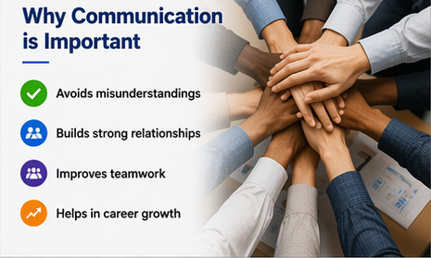
Notes:
Explain how communication helps avoid confusion and improves teamwork and growth.

Slide 6

Notes:
Give your OLI example: fixing issues is technical, explaining completes the task.

Slide 7
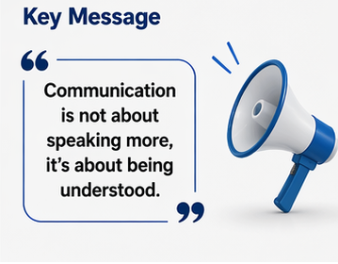
Notes:
Summarize: communication makes your skills visible and helps growth.

Slide 8
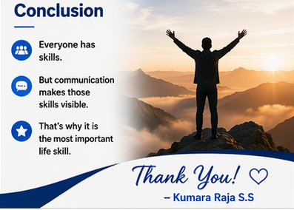
Notes:
Summarize: communication makes your skills visible and helps growth.

