Slide 1




MetanzaNite
Revolutionizing Tanzanite Industry with Blockchain Technology
ETHICAL MINING, TRANSPARENCY, AND SECURITY

Slide 2
INTRODUCTION
01
Ladies and gentlemen,
Meet Azizi Chamani, the visionary founder of MetanzaNite. With a solid academic background in Business Administration and Blockchain Management, holding a Master's Degree from Guglielmo Marconi University in Italy, Azizi is uniquely positioned at the intersection of tradition and cutting-edge technology.
As the CEO and owner of TopNotch Co. Ltd, Azizi's unwavering dedication to innovation and preserving Tanzanite's legacy has ignited a transformative journey. His expertise and collaborative spirit have birthed MetanzaNite, where Tanzanite's timeless elegance converges with blockchain technology’s limitless potential.
Azizi Chamani aligns MetanzaNite's mission with Madam President Hassan’s vision to safeguard Tanzanite's legacy. In her speech, Tanzanite, a gemstone exclusive to Tanzania, holds a unique place in our nation's heart. Its significance, however, faces challenges, including global proliferation and depleting resources.
Azizi recognizes the need for a controlled system, an organization to regulate Tanzanite, and Madam President call to have all Tanzanite mined in our country purchased by one umbrella organization resonates deeply. MetanzaNite emerges as the vehicle to realize these aspirations. By embracing blockchain technology, the project is positioned to enhance Tanzanite's value, ensuring that our Tanzanite stays in our hands, as she envisioned.
MetanzaNite represents the innovation and collaboration needed to elevate the status of Tanzanite in the global market. Azizi Chamani envisions a future where tradition and technology coexist to protect our unique treasure
Notes:
Ladies and gentlemen,
Meet Azizi Chamani, the visionary founder of MetanzaNite. With a solid academic background in Business Administration and Blockchain Management, holding a Master's Degree from Guglielmo Marconi University in Italy, Azizi is uniquely positioned at the intersection of tradition and cutting-edge technology.
As the CEO and owner of Top Notch Co. Ltd, Azizi's unwavering dedication to innovation and preserving Tanzanite's legacy has ignited a transformative journey. His expertise and collaborative spirit have birthed MetanzaNite, where Tanzanite’s timeless elegance converges with blockchain technology’s limitless potential.
Azizi Chamani aligns MetanzaNite’s mission with Madam President Hassan’s vision to safeguard Tanzanite’s legacy. In her speech, Tanzanite, a gemstone exclusive to Tanzania, holds a unique place in our nation’s heart. Its significance, however, faces challenges, including global proliferation and depleting resources.
Azizi recognizes the need for a controlled system, and an organization to regulate Tanzanite, and Madam President’s call to have all Tanzanite mined in our country purchased by one umbrella organization resonates deeply. MetanzaNite emerges as the vehicle to realize these aspirations. By embracing blockchain technology, the project is positioned to enhance Tanzanite's value, ensuring that our Tanzanite stays in our hands, as she envisioned.
MetanzaNite represents the innovation and collaboration needed to elevate the status of Tanzanite in the global market. Azizi Chamani envisions a future where tradition and technology coexist to protect our unique treasure

Slide 3
Introduction continues,
Ladies and gentlemen, distinguished guests, and fellow enthusiasts of Tanzanite's timeless beauty, I extend to you a warm welcome.”
Tanzanite, a gemstone born beneath the African sky, possesses an otherworldly charm. Its deep blue hues mirror the depths of the oceans, making it one of nature's most captivating creations.”
Today, we gather to embark on a journey of transformation. We introduce you to MetanzaNite, a groundbreaking project designed to revolutionize the Tanzanite industry.

Slide 4
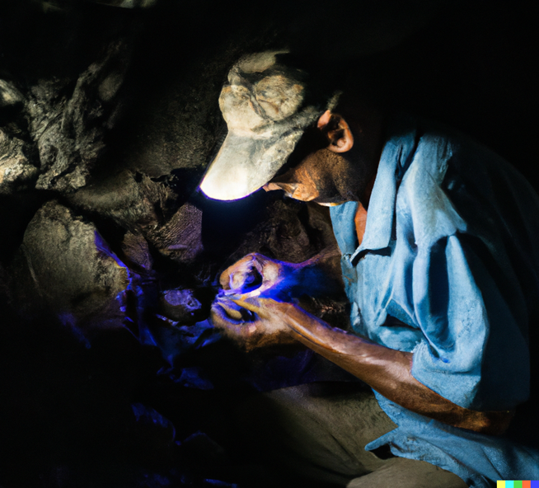
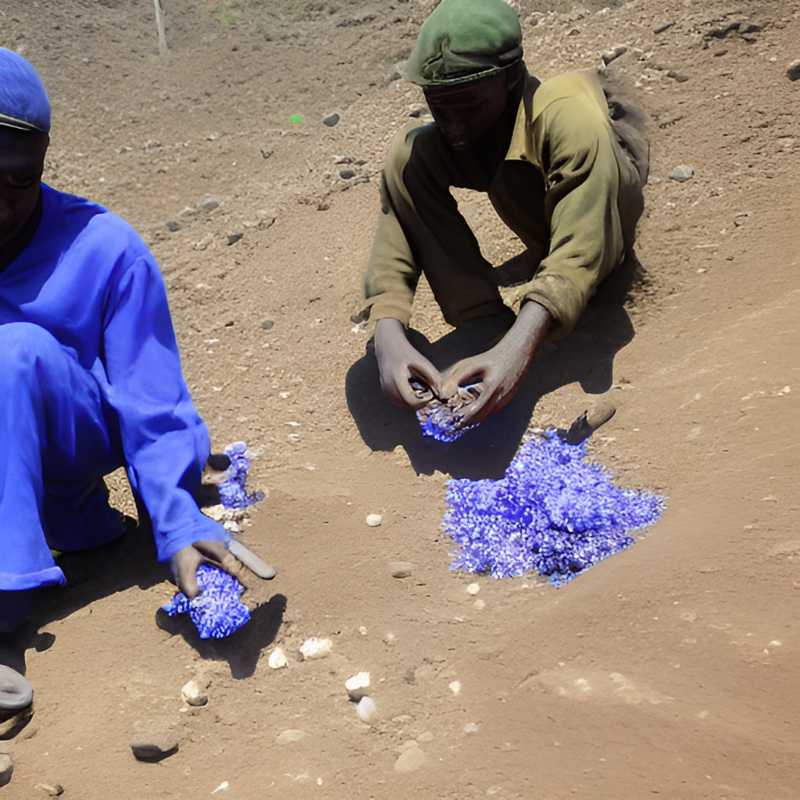
The Tanzanite Industry Today
"As we delve into the world of Tanzanite, it's crucial to confront the challenges that currently plague this industry.”
"Smuggling, unethical mining practices, and a pervasive lack of transparency have cast shadows over Tanzanite's brilliance."

Slide 5
The Vision of MetanzaNite
01
OUR MISSION
In response to these pressing issues, MetanzaNite emerges with a bold vision.
02
OUR GOALS
To reshape the Tanzanite industry, infusing it with ethics, transparency, and authenticity.
Our goals are ambitious yet attainable, aiming to not only combat these challenges but to set new standards of excellence."

Slide 6
Blockchain Technology
Central to our endeavor is blockchain technology.
Blockchain, the decentralized ledger, forms the bedrock of MetanzaNite.
Blockchain is more than a buzzword; it's the key to unparalleled transparency.
This technology enables us to trace every Tanzanite's journey, ensuring its authenticity.

Slide 7
Key Components
$TzNITE Crypto Token:
The native currency for transactions.
Let's delve into the heart of MetanzaNite, the $TzNITE crypto token.
This token powers our ecosystem, facilitating secure and transparent transactions.
NFT Marketplace:
A platform for buying and selling Tanzanite-based NFTs.
Explore the MetanzaNite NFT Marketplace, where Tanzanite's digital future begins.
Here, unique NFTs representing precious Tanzanite are bought and sold.

Slide 8
Key Components…
GameFi:
An educational and entertaining gaming experience.
MetanzaNite GameFi: Where education meets entertainment.
Experience the joy of learning about Tanzanite through engaging gameplay.
eCertificate:
A solution for certifying Tanzanite's authenticity.
Our eCertificate ensures the legitimacy and origin of every Tanzanite.
Say goodbye to doubts and embrace the assurance of authenticity.

Slide 9
Key Components…
Escrow Solution:
A trust and security mechanism for transactions.
Trust is paramount, and our Escrow Solution guarantees it.
Experience secure and dispute-free transactions with MetanzaNite's Escrow.

Slide 10

$TzNITE Crypto Token
Let's dive into the lifeblood of MetanzaNite – the $TzNITE crypto token.”
This digital currency powers transactions, ensuring trust and security within our ecosystem.
$TzNITE tokens are your gateway to participating in MetanzaNite's vibrant ecosystem.
Hold $TzNITE to make transactions, gain access to unique features, and even have a say in governance decisions.

Slide 11
NFT Marketplace
Next, we step into the world of our NFT Marketplace.
Imagine a virtual store where you can own unique Tanzanite-based NFTs.
Experience the future of jewelry shopping with our virtual try-on feature.
Try before you buy, all in the digital realm.

Slide 12

GameFi
Now, let's dive into our GameFi platform.
It's not just fun; it's education gamified.
GameFi fosters a vibrant community where learning and entertainment go hand in hand.
Join the adventure, learn, and grow with us.

Slide 13
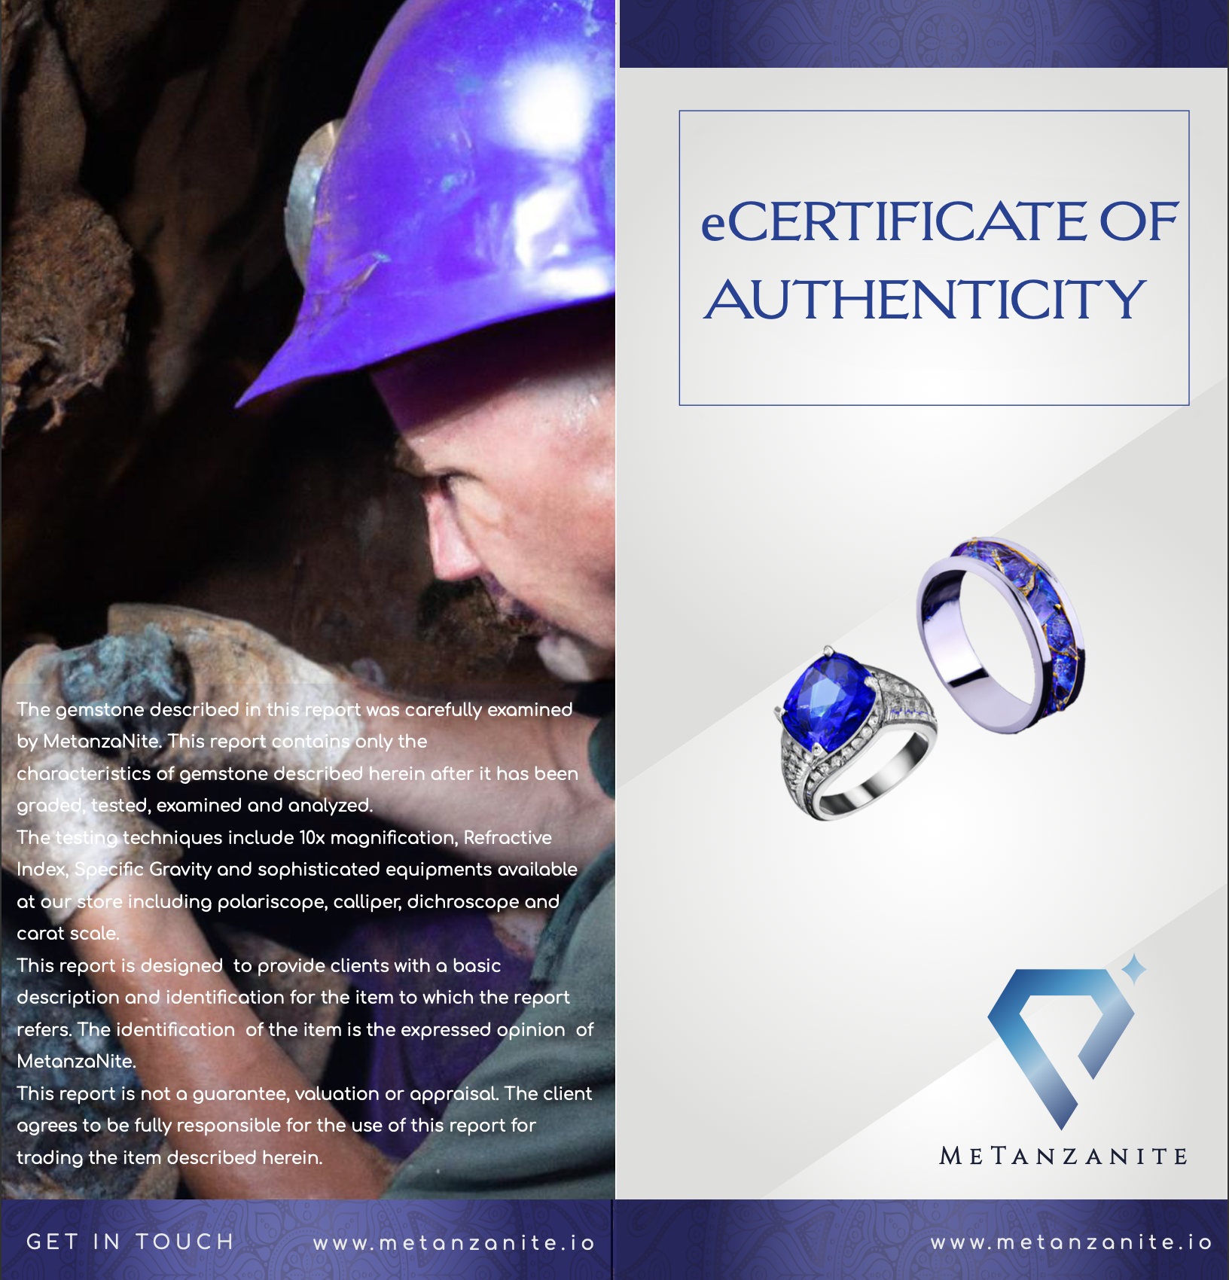
eCertificate
Now, let's talk about our Tanzanite eCertificate.
It's your guarantee of authenticity and origin.”
Say goodbye to fraud; say hello to trust.
Protecting Tanzanite's legacy, one certificate at a time.

Slide 14

Escrow Solution
Now, let's dive into our Escrow Solution.
The trust and security behind every transaction.
Fraud-proof transactions: That's our promise.
Ensuring trust, one transaction at a time.

Slide 15
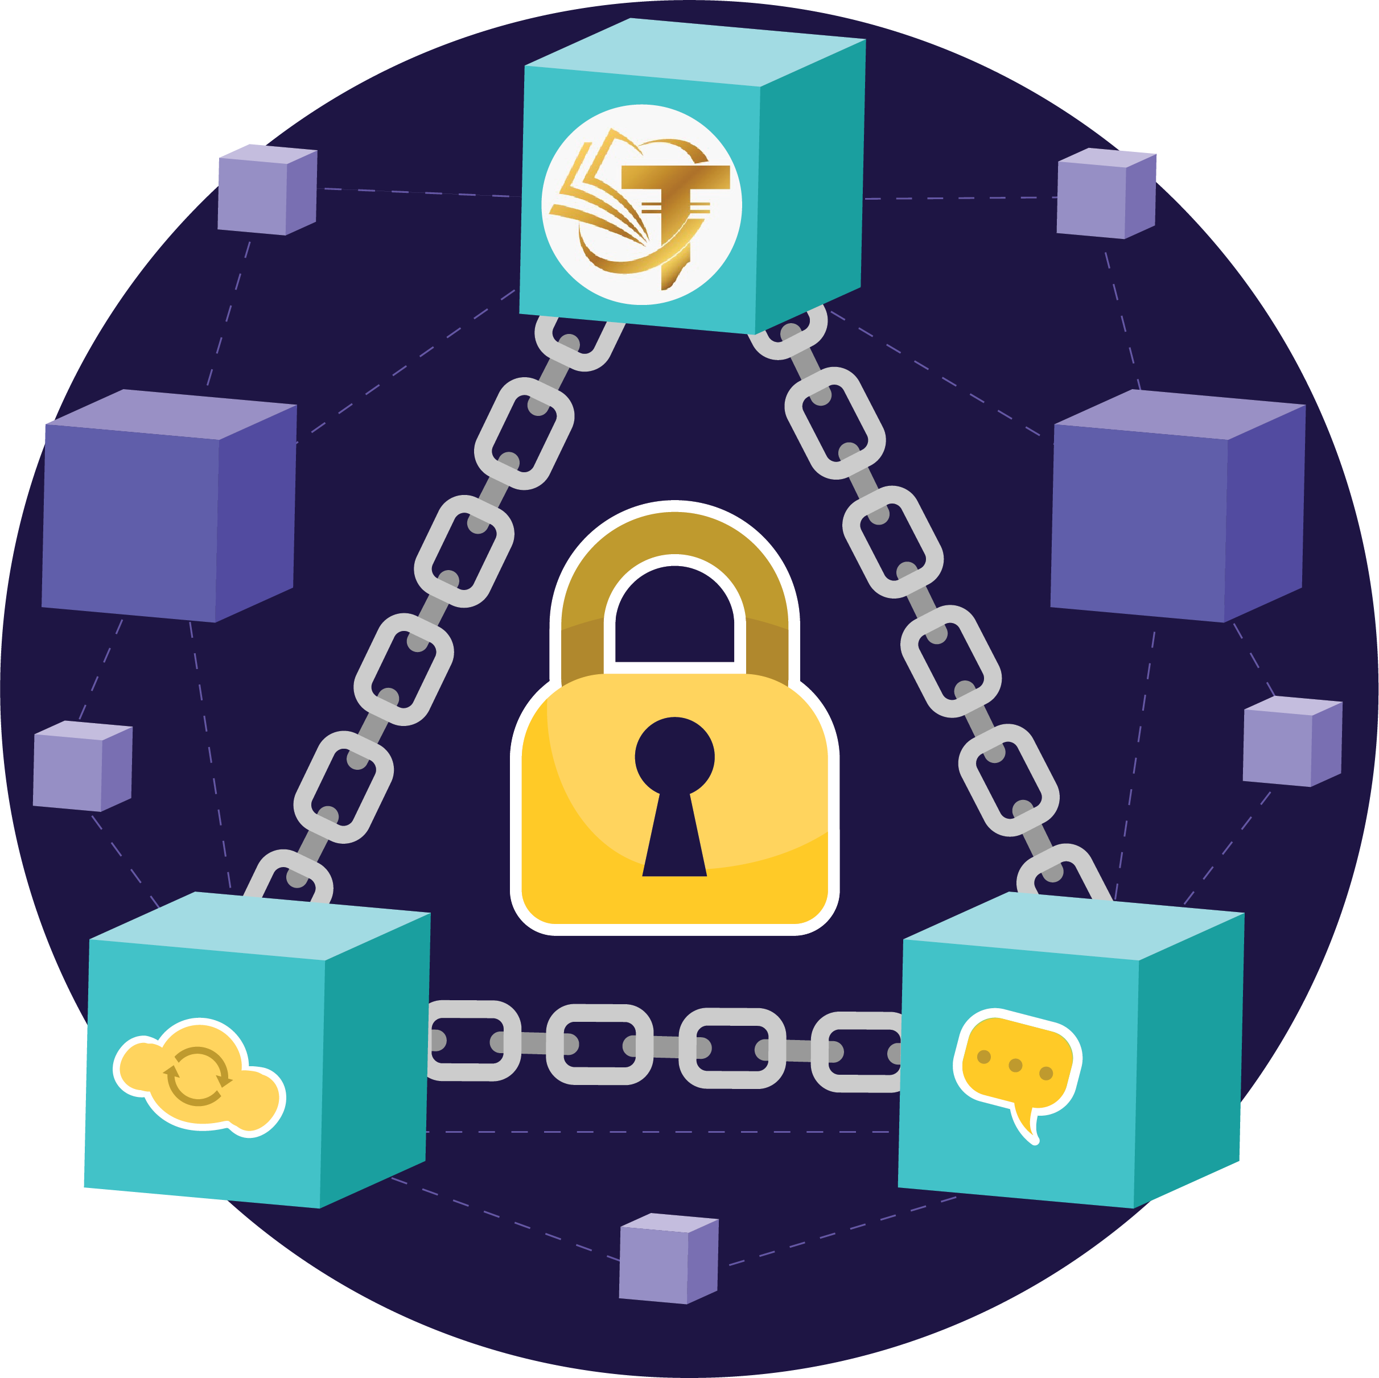
Transparency & Security
Blockchain:
Our cornerstone for transparency and security.
Changing the game with blockchain technology.
Transparent supply chain from mining to market.
Security that safeguards your Tanzanite investments.

Slide 16
Benefits for Stakeholders
Miners:
Ethical mining and fair compensation.
Empowering miners with ethical practices.
Fair wages, brighter futures.
Brokers & Dealers:
Streamlined transactions with security.
Seamless and secure transactions for dealers.
Trustworthy deals, every time.

Slide 17
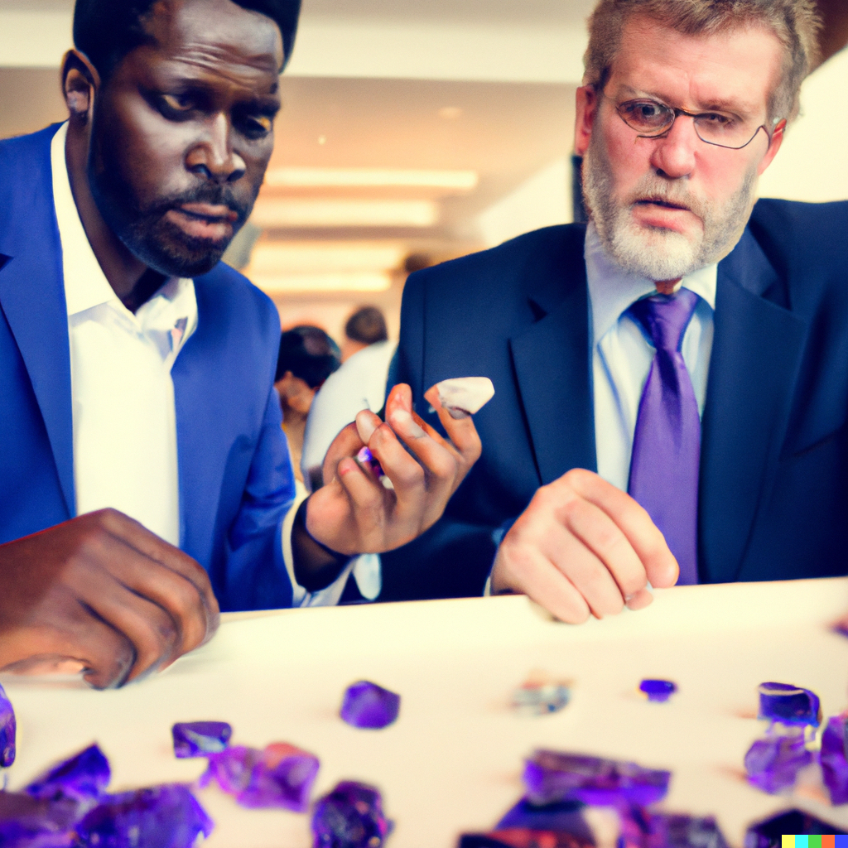
Benefits for Stakeholders…
Buyers:
Confidence in Tanzanite's authenticity.
Confident purchases with certified Tanzanite.
The assurance of authenticity.

Slide 18

Roadmap & Future
Our journey towards revolutionizing Tanzanite.
Milestones that lead to our global vision.
Our vision: Leading the global gemstone industry.
MetanzaNite's commitment to a sparkling future.

Slide 19
Get Involved
Join us in reshaping the Tanzanite industry.
Your involvement makes a difference.
Own TzNITE tokens for a stake in our success.
Discover unique Tanzanite treasures in our NFT Marketplace.

Slide 20




Q&A
Your questions, our answers.
Let's engage in a meaningful discussion.

Slide 21
Conclusion
MetanzaNite: Shaping Tanzanite's future.
Thank you for joining us on this revolutionary journey.
Your support means the world to us.
Together, we'll change the face of Tanzanite.

Slide 22
THANKS!
Do you have any questions?
Reach out to us. Let's connect.
Website https://metanzanite.io
@metanzanite
Thank you for being part of MetanzaNite's story.
Stay connected with us online.

