Slide 1

Climate Action
General Orientation
Notes:
Welcome to the Parker climate action general orientation video.

Slide 2
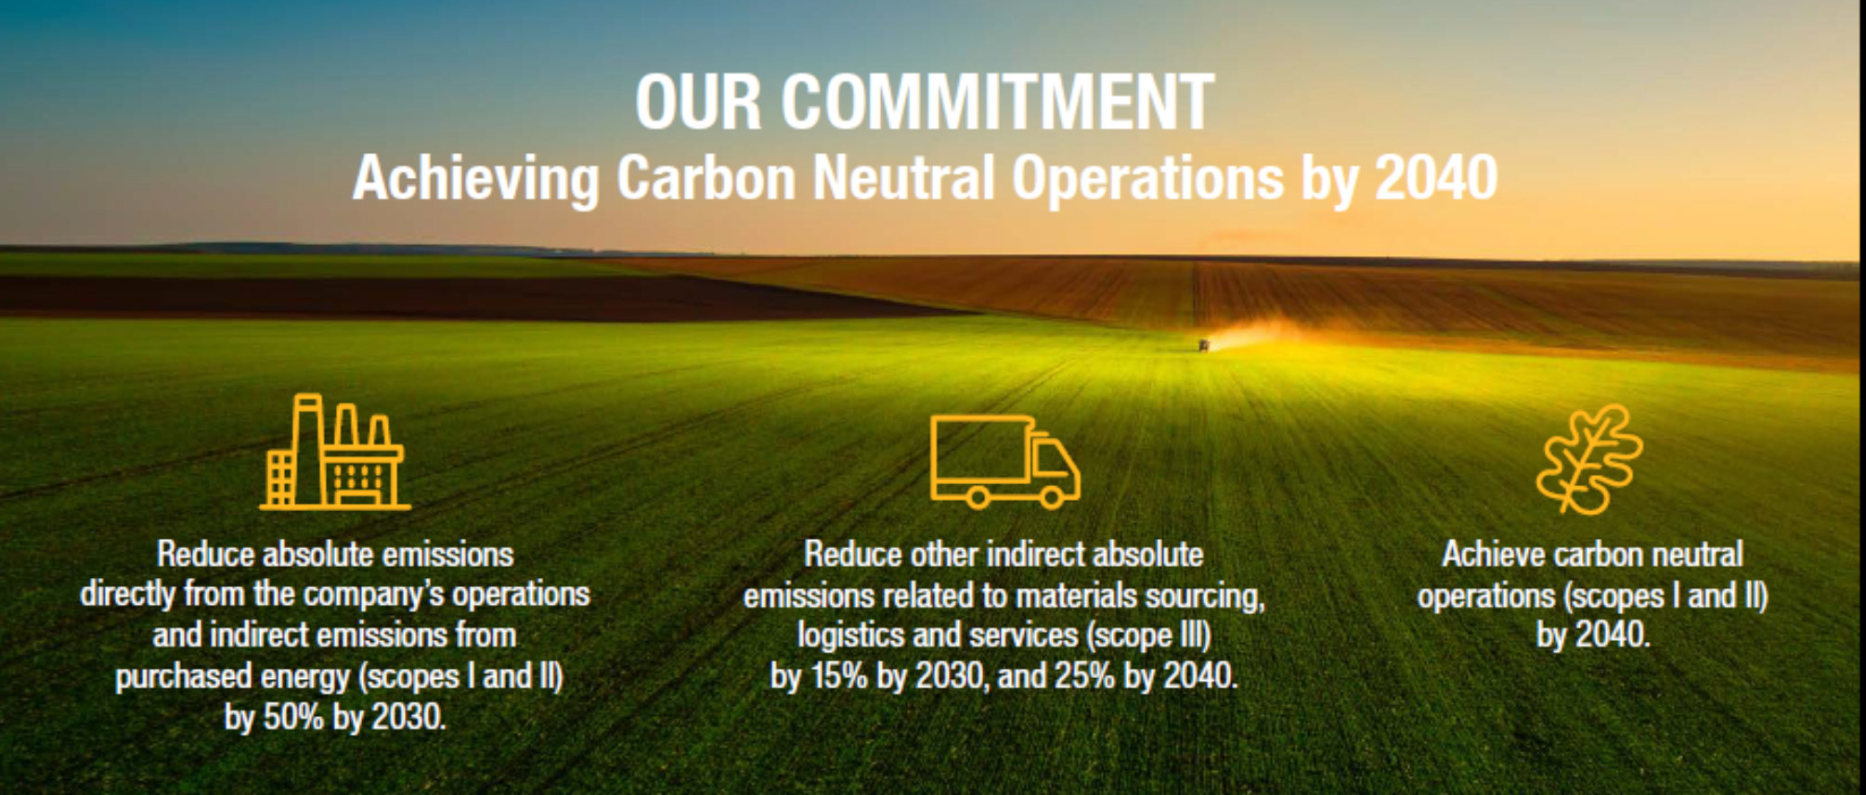
Notes:
In 2021, Parker Hannifin announced it's 2030 and 2040 climate reduction ambitions.
By 2030 , Parker intends to reduce its scope one and scope two emissions from operations by fifty percent and intends to reduce its scope three carbon emissions from logistics and supply chain by 15%.
Parker's long-term 2040 climate ambition is to be carbon neutral for scope one and two emissions and reduce our scope three footprint by twenty five percent.
All of Parker's science-based climate goals are based on emission totals from fiscal year 2019..

Slide 3
Parker’s Climate Action 2030 & 2040 Enterprise Goals
Business Segment | Targets
 | 2030 | 2040
Operations (Scope I&II) | 50% | 100% (Carbon Neutral)
Supply Chain (Scope III) | 15% | 25%
Products | Enable our customers’ Sustainability Programs
3
Notes:
You can see Parker’s Climate Goals represented here in table format along with an additional goal to produce more products that enable our customers to reduce their carbon emissions from their products or services.

Slide 4





Parker’s Climate Action Strategy - Functional Overview
What Will We Do? | How Will We Do It?
Public Commitment: Carbon Neutral by 2040 for Operations (Scopes I&II) Emissions. 25% reduction for Scope III Emissions. Public Metric: Metric Tons Absolute Carbon Emissions. Improved: Data management, Energy Efficiency |  | Operations | Facility Emissions On & Off-site Renewables Energy Efficiency Data Management
 |  | Supply Chain | Supplier Emissions Logistics Footprint Supplier Engagement Data Management
 |  | Products | Market Opportunity Product Marketing Design for Environment
 |  | Business Strategy | Climate M&A Due Diligence Stitching into Strategy
 |  | Engagement | Green HPTs Commuting Community Projects
Notes:
Parker’s climate strategy will require commitments from many functions at parker including:
Operations for facility emissions reductions by improving energy efficiency and installing on-site renewables.
Supply chain emission reductions through supplier engagement, logistics emissions reductions from transport of our products.
Engineering for new market opportunities to create more sustainable products. Parker clean tech products will help our customers meet their carbon reduction goals.
Business strategy for engaging in new low carbon markets through future mergers and acquisitions.
Employee engagement for site level community projects that lead to improved environmental outcomes.

Slide 5
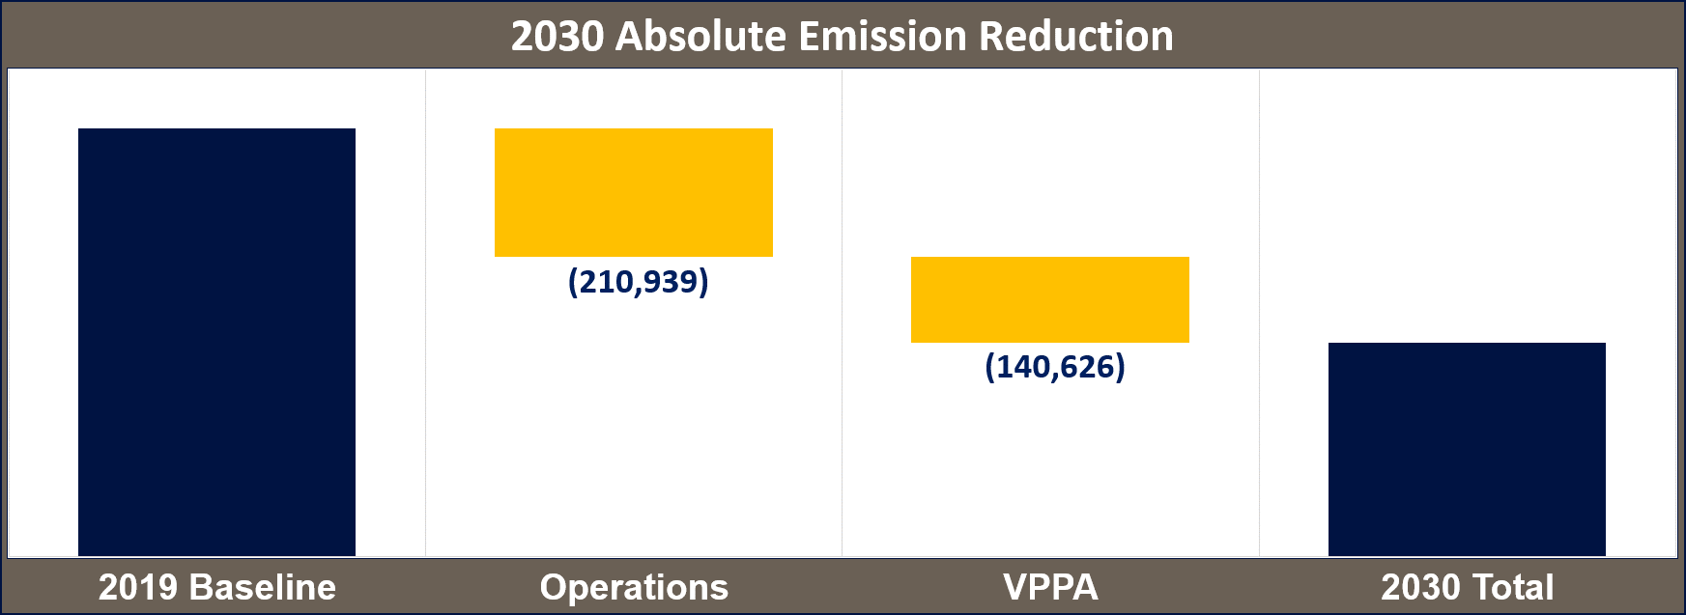
2030 Reduction Journey (Operations Scopes I&II)
Absolute Emission Reduction
We will balance the remainder of our footprint with our carbon footprint with renewable energy and RECs
703,129
We will reduce this portion or our carbon footprint with on-site action like efficiency and renewables.
351,565
Notes:
Parker is switching from using an intensity carbon target to an absolute reduction target.
An Intensity target is a number that is normalized by dividing Parker’s carbon emissions by business metrics like net sales or parts shipped. This is how Parker has always measured our carbon emissions because it compensates for growth of the business.
Now Parker is using absolute targets to measure our carbon reduction progress. An absolute target is direct measurement of our carbon emissions without normalization.
This means Parker will report the actual emissions by three hundred and fifty thousand metric tons by the year 2030 regardless of our manufacturing output.
To achieve this reduction target, Parker will reduce roughly two hundred and ten thousand metric tons or 30% of the target by making efficiency improvements to our operations
An additional 20% or approximately one hundred forty thousand metric tons will come from renewable solutions and renewable energy credits.

Slide 6
What does Carbon Neutral mean?
Understanding Parker’s Carbon Neutral Goal
Scope I Emissions
Scope II Emissions
Renewable Credits
Renewable Energy
Current State
Notes:
The term carbon neutral means that any carbon dioxide released into the atmosphere from Parker’s operations is balanced by an equivalent amount being removed. This can be achieved by an actual reduction in carbon emissions or by purchasing Renewable Energy Certificates or RECs from renewable energy generation projects.
We will have more discussion about Renewable Energy Certificates during this orientation.
Parker’s operations create emissions of greenhouse gases (GHGs) that accumulate in the atmosphere.
These emissions need to be offset or balanced using renewable energy or renewable energy credits.

Slide 7
What does Carbon Neutral mean?
Understanding Parker’s Carbon Neutral Goal
Scope I Emissions
Renewable Energy Credits (RECs)
Scope II Emissions
Shrink Footprint
Increase Renewables
Renewable Energy
Carbon Neutral
Future State
Notes:
Parker will shrink its carbon footprint through efficiency efforts at each manufacturing location.
Then use renewable energy and renewable energy certificates to off set the remainder of our footprint.
Parker will be considered carbon neutral once we obtain this balance of our carbon footprint.

Slide 8
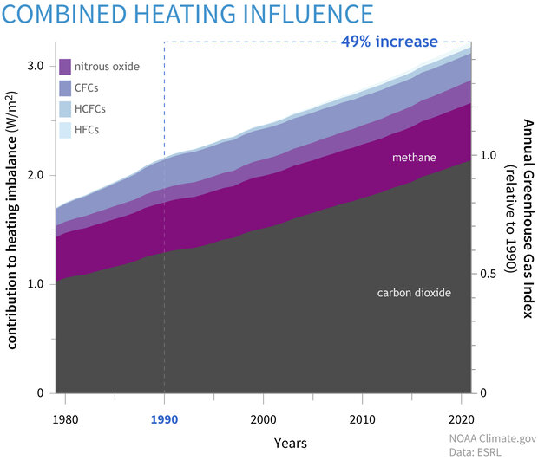
Greenhouse Gasses (GHG)
Greenhouse Gas (GHGs)
  Carbon Dioxide
  Methane
  Nitrous Oxide
  Fluorinated Gases
CO₂ Equivalent
  Converting all gases to equivalent amounts of CO₂ emissions
Parker: GHGs = CO₂ = CO₂ Equivalent or CO2e
Notes:
Carbon dioxide is Earth’s most important greenhouse gas or GHG.
Unlike oxygen or nitrogen (which make up most of our atmosphere), greenhouse gases absorb heat radiating from the Earth’s surface and re-release it in all directions—including back toward Earth’s surface. Without carbon dioxide, Earth’s natural greenhouse effect would be too weak to keep the average global surface temperature above freezing.
By adding more carbon dioxide to the atmosphere, we are supercharging the natural greenhouse effect, causing global temperature to rise.
Carbon dioxide accounts for about seventy nine percent of all greenhouse gas emissions from human activities and remains in the climate for thousands of years.
Thus, CO2 has become to poster child for global climate change and as such, we represent all other greenhouse gases by converting them to carbon dioxide equivalents or C O 2 E.

Slide 9















CO₂
CH₄
SF₆
CH₄
N₂O
CO₂
N₂O
PFC
CH₄
HFC
CO₂
Leased Assets
Employee Commuting
Business Travel
Waste Generated
Transportation
Distribution
Capital Goods
Purchased Goods
Services
Purchased:
Electricity
Steam
Heating
Cooling
Investments
Franchises
Leased Assets
End of Life Products
Use of Sold Products
Processing of Products
Transportation
Distribution
Company Facilities
Company Vehicles
Process Emissions
Scope II
Indirect Emission
Scope III
Indirect Emission
Scope I
Direct Emission
Scope III
Indirect Emission
Upstream Activities
Reporting Company - Parker
Downstream Activities
Notes:
Scope one emissions are emissions from fuel burned onsite in assets controlled by Parker. All fuels used on-site that produce greenhouse gas emissions must be included in scope one totals.
Scope two emissions are emissions generated offsite from purchased energy including electricity, steam, heating, and cooling.
Scope three emissions are all other emissions – not included in scopes one and two – that occur at Parker, including both upstream and downstream emissions.
Upstream emission include everything required to produce our products. The most significant of these upstream activities are related to purchased supplies or the supply chain.
Downstream emissions are emitted after a product or service leaves the company’s control/ownership. The most significant of these downstream activities are emissions from our products and logistics for transporting our products.
Scope three emissions are 80% of Parker’s total emissions

Slide 10
Mechanisms for Carbon Footprint Reduction
Notes:
The next section will cover mechanisms Parker will use to reduce its carbon footprint.

Slide 11
Energy Efficiency
Energy efficiency - Energy efficiency is simply the use of less energy to perform the same task or produce the same result.
Mechanisms
Lean Kaizen
Energy/Climate Efficiency Assessment
Energy Treasure Hunt
Life Cycle Approach to Capital Purchases
Digital Transformation
Design for the Environment (Simplification)
Equipment
Chilled Water
Lighting
Compressed Air
Fans and Pumps
Motors
Steam
HVAC
Notes:
Energy efficiency is simply the use of less energy to perform the same task or produce the same result. Efficiency is the number one way for Parker to lower its carbon emissions and operational costs.
Some of the mechanisms Parker will use to achieve energy efficient operations include, lean kaizen, Energy or Climate Efficiency Assessments, energy treasure hunts, Life Cycle Approach to Capital Purchases, Digital Transformation and Design for the Environment or Simplification.
Some of the key equipment includes Chilled Water, Lighting, Compressed Air, Motors, Steam, HVAC, Fans and Pumps.

Slide 12





Energy/Climate Reduction Resources
Climate & Energy Reduction Tools
Training Resources
Assessment Guidance
Best Practices
https://parkercorp.sharepoint.com/sites/ClimateActionParker
Notes:
Parker has developed a toolbox to help our divisions obtain their carbon reduction goals.
This toolbox is available on the companies SharePoint site under the EHS page.
The toolbox contains useful guidance on many different energy and carbon reduction topics.
The toolbox also contains training resources, Climate & Energy Reduction Tools, best practices and guidance documents to help identify reduction opportunities.

Slide 13
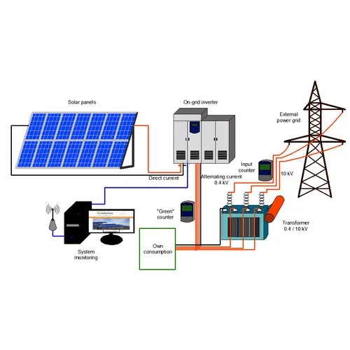

On-site Solar
On-site Solar and other Renewables
Capital Purchase or PPA
Guidance and Standards
Notes:
Parker can also reduce emissions by placing solar systems on our sites. These systems produce clean power to run Parker’s manufacturing processes.
The panels are made of silicon, a semi-conductive element that generates electricity when sunlight touches the panels.
These solar systems can be purchased directly with Parker capital or contracted through a third party that will own and maintain the systems as sell Parker the power at an agreed upon price. This contracted arrangement is called a power purchase agreement.
A Power Purchase Agreement, or PPA is an agreement between a solar project developer and Parker where the buyer pays the developer an agreed upon price for each unit of energy the system produces.
Parker has published guidance on solar equipment and power purchase agreements. This material is available in the Parker Climate Action SharePoint site.

Slide 14







How Off-site Renewable VPPAs Work
RECs Sent to Parker
Energy Provider
Payment from Market
Payment to Utility
Energy to Grid
Energy from Grid
Energy Off-taker
Settlement Based on Strike Price
Notes:
A virtual power purchase agreement is another mechanism that Parker can use to leverage renewable energy to reduce our carbon footprint.
A virtual power purchase agreements or VPPA is a purely financial contract that provides Renewable Energy Credits or Certificates (RECs) from a specific renewable energy project located off Parker’s property and is not owned by Parker.
The contract is “virtual” because it is not tied to any specific facility consuming physical electricity, which provides enormous flexibility. Physical electricity is not delivered to Parker under a virtual power purchase agreement. Rather, the electricity from the renewable generation facility is delivered to the grid and not to Parker. However, Parker receives renewable energy certificates or RECs, and can claim credit for the use of renewable energy to offset our carbon footprint.
The purchase of VPPAs and renewable energy certificates will be done as a center led process by Parker’s Corporate team.

Slide 15

Carbon Offset Overview
Used to off-set scope I & III Emissions
One Metric Ton Carbon Sequestered
One Carbon Offset
Plant Trees to Sequester Carbon
Notes:
Carbon Offsets are used to address and GHG emissions such as scope one and scope two emissions.
A carbon offset broadly refers to a reduction in GHG emissions or an increase in carbon storage through land restoration or the planting of trees that is used to compensate for emissions that occur elsewhere.
Remember! One Carbon Offset equals one metric ton of carbon

Slide 16
Renewable Energy Credit (REC) Overview
Used to off-set scope II Emissions
One Megawatt Hour of Energy
One Renewable
Energy
Credit
Generate Renewable Power
Notes:
A renewable energy certificate is a market-based instrument that represents the property rights to the environmental, social, and other non-power attributes of renewable electricity generation. Renewable energy certificates are issued when one megawatt-hour of electricity is generated and delivered to the energy grid from a renewable energy resource.
Renewable energy certificates, or RECs play an important role in accounting, tracking, and assigning ownership to renewable electricity generation and use.
Remember! One renewable energy certificate equals 1 Megawatt hour of electrical power

Slide 17
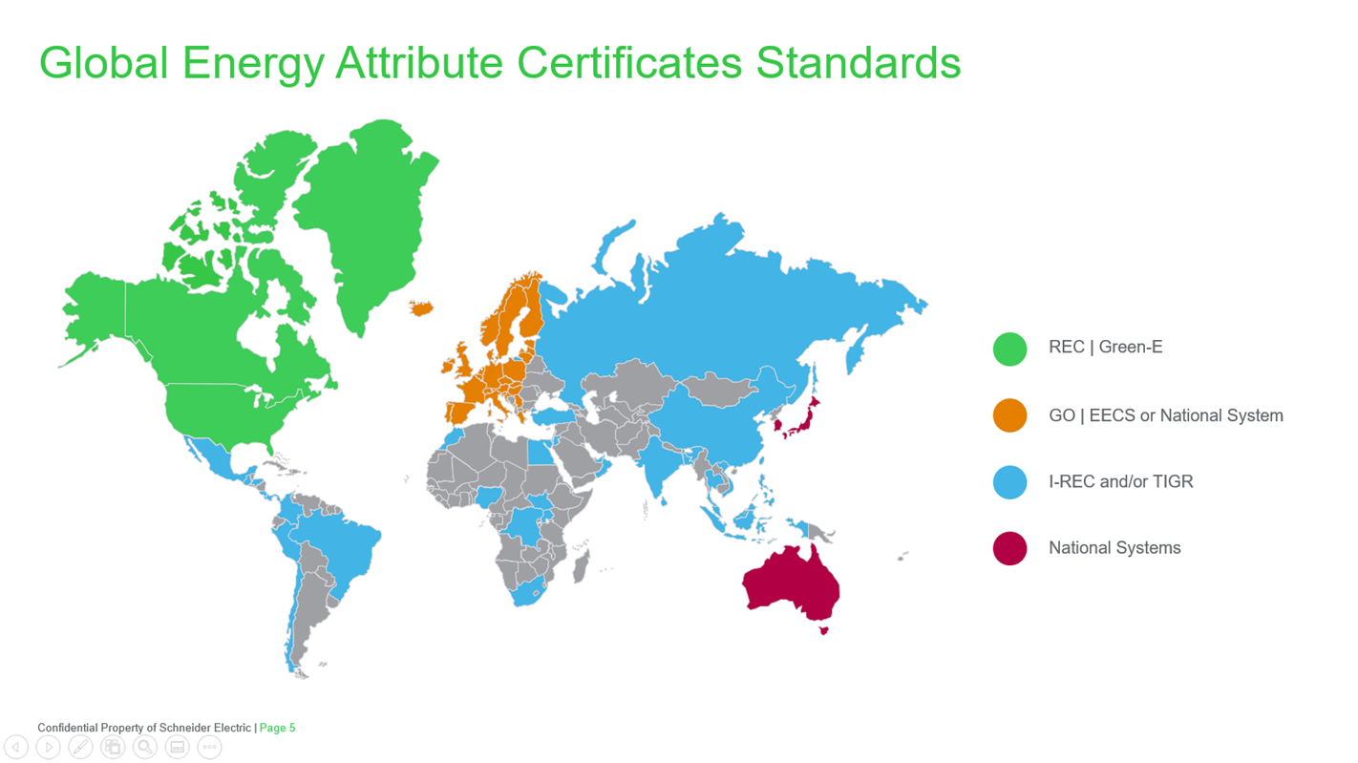
Global Energy Attribute Certificates Standards
REC | Green-E
GO | EECS or National System
I-REC and/or TIGR
National Systems
Notes:
Energy Attribute Certificates or EAC Standards are available for many different markets and countries around the world.
Renewable Energy Certificate or REC issues under the Green-e standard is the most common EAC standard in North America.
In Continental Europe, Guarantees of Origin are like Renewable Energy Certificates in North America. All European member states use the Guarantees of Origin scheme.
In Great Britain, Renewable Energy Guarantees of Origin are the main evidence for licensed electricity suppliers to prove the proportion of renewable electricity supplied to their customers.
The International Renewable Energy Certificate scheme or I-REC is used in other parts of the world along with Tradable Instrument for Global Renewables or TIGR.

Slide 18
Operational Overview
Notes:
The next section will cover Parker’s plan to operationalize the carbon reduction AIP.

Slide 19
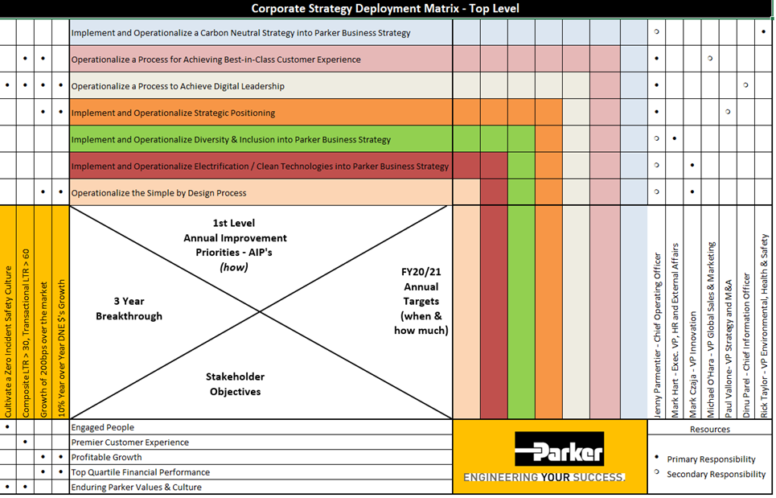
Corporate AIP Strategy Deployment Matrix
Breakthrough Objective
50% Absolute Reduction in Operations Carbon Footprint (FY19 Basis)
15% Absolute Reduction in Supply Chain Footprint (FY19 Basis)
1st Level AIP
Implement and Operationalize a Carbon Neutral Strategy into Parker Business Strategy
FY23 Annual Operations Target (Scopes I&II)
3% Absolute Carbon Reduction from JOP, Aggregate 12% from FY19 Baseline
Notes:
Parker Strategy Deployment Matrix
Parker has added climate action to the top level strategic Deployment matrix for fiscal year 2023.
Strategy Deployment is Parker’s management process that aligns all of parker’s functions and activities with Parker’s strategic objectives.
The annual plan is a top down and bottom up process involving a dialogue between senior managers and project teams about the resources and time both available and needed to achieve the targets.

Slide 20
Carbon Reduction Process Overview
Action Planning
Process
Plan
Action Plan
Execution
Do
Process Review & Corrective Actions
Act
Data & Performance Management
Check
Notes:
Here is a brief description Parker’s Carbon Action Planning Process.
An Action Planning Process Includes:
Ownership and accountability at each level of the organization.
Assigning clear roles and responsibilities.
Setting of annual short-term targets calibrated to meet Parker’s long-term reduction.
The Action Plan execution includes:
Participating in energy climate action training.
Performing energy slash climate assessments, or treasure hunts designed to identify reduction opportunities
Each division should identify energy slash carbon reduction opportunities.
Having a list of shovel ready projects that can be chosen to meet the annual reduction goals.
Data and Performance management will include visual tools that are available for the team improvement boards that will track your annual progress toward your reduction goal. This data should be reported to your staff and reviewed on a normal cadence and corrective actions should be issued if the division gets off target.
The Process should be reviewed annually or more often if needed, the division should review the entire climate process for strengths and weaknesses and take corrective actions when appropriate.
Climate BARNS should be created to communicate a successful completion of a reduction opportunity. Division success should be celebrated.

Slide 21
Site Climate Leader Accountability
Metric
  Carbon Reduction Target
    3% year/year
Tasks
  Manage Site TIB & Activities Tracking
  Identify & Submit Reduction Opportunities
  Execute Projects
  Data & Invoice Reporting
  Celebrate success
  Execute Corrective Actions
Team Members
  EHS Leaders
  Facility Managers
  Environmental HPT Members “Green Team”
Group Leader
Division Leader
Site Leader
Notes:
Site Climate Leader Accountability
Each division should have an annual reduction goal and enough projects to achieve this goal.
The Division Carbon Reduction Target should be at least 3% annually but can be adjusted based on the group and division plan. This reduction goal should be tied to efficiency projects that have been planed for completion in the current fiscal year.
A Climate leaders' task should be linked to achieving the Divisions carbon reduction goals and should include but are not limited to:
Managing site team improvement board and activities tracking.
Identifying and submit reduction opportunities into the project tracking system.
Making sure the projects assigned to the division are being completed.
Overseeing the utility data collection and submittal into the Parker tools
Executing corrective actions and or celebrate division successes.
The team members should Include EHS Leaders, Facility Managers Environmental HPT or Green Team Members.

Slide 22

Climate Action Toolbox
Climate & Energy Reduction Tools
Best Practices
Training Resources
Guidance Documents
https://parkercorp.sharepoint.com/sites/ClimateActionParker
Notes:
Parker has developed a toolbox to help parker divisions obtain their carbon reduction goals.
This toolbox is available on the companies SharePoint site under the EHS page.
The toolbox has useful guidance on many different energy and carbon reduction topics.
The toolbox contains training resources, Climate & Energy Reduction Tools, best practices and guidance documents to help identify reduction opportunities.

Slide 23



Climate Action Training and Awareness
Climate Action Orientation
Climate Leaders Presentation
Climate Action Bootcamp
30 Minutes
Talent Central LMS
All Team Members
60 Minutes
Talent Central LMS
Business & Climate Leader
20 hours
Live or Recorded
Climate Leaders
Notes:
Climate Action Training and Awareness
Parker currently has orientation training for all employees. The objective of the employee orientation is to make all Parker team members aware of Parker’s climate action ambitions and actions that are being implemented.
Parker also has a leadership training module that is geared towards Parker carbon and energy leaders as well as Parker’s business leaders. This would include Group Staff, Division Staff, EHS Leaders and Energy Leaders.
The most comprehensive training resource is our Climate slash Energy Bootcamp. This Bootcamp is a recorded course that can be accessed anytime but is also scheduled for two annual live sessions. One in the fall and another in the spring.
The content of the bootcamp is geared towards the team members working on the division carbon reductions. This would include Facility Managers, EHS Leaders, Environmental HPT members and others directly involved with the division’s carbon and energy reduction.

Slide 24
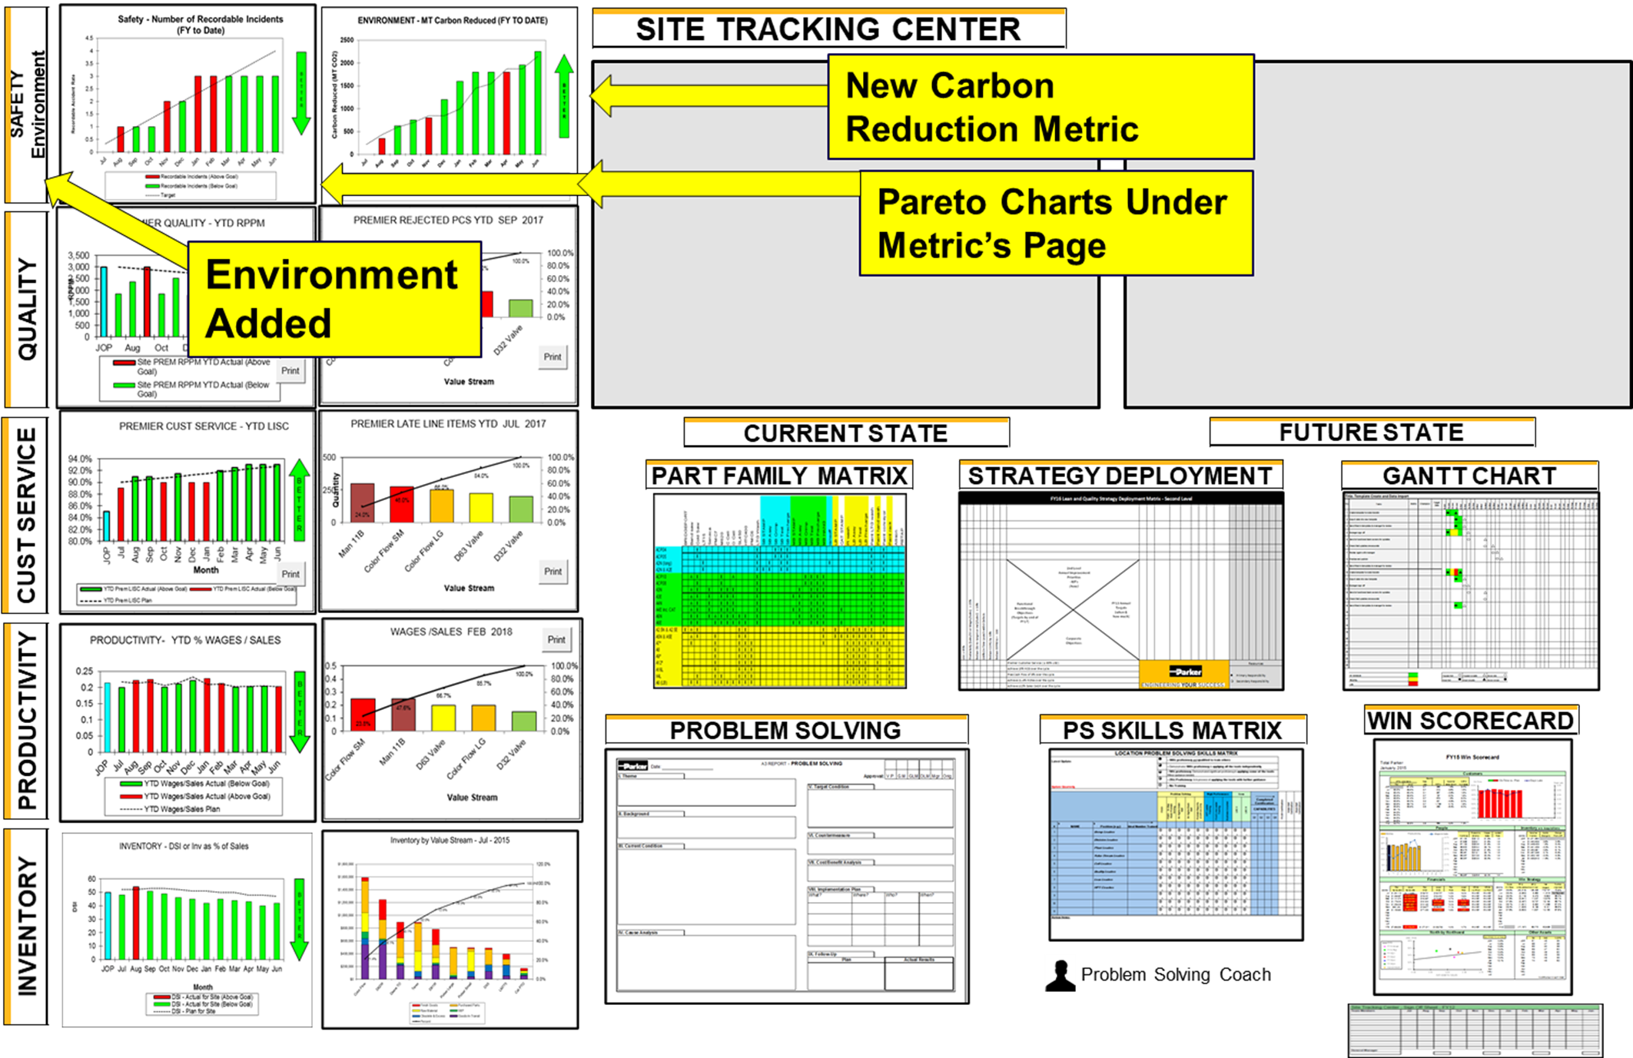
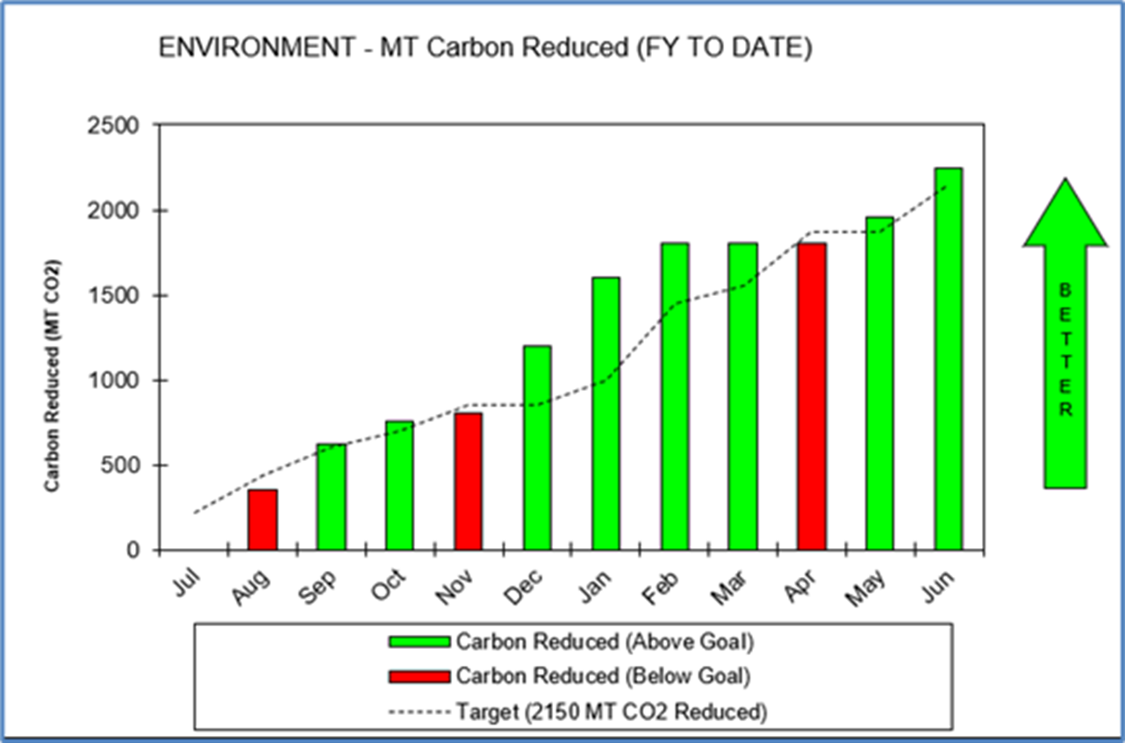
Visual Management
Site Tracking Center
Added Environmental Metric to the Site Tracking Center
Track Carbon Reduction from Completed Projects vs the Annual Goal.
Notes:
Carbon reduction tracking has been added as an Environmental Metric to the Site Tracking Center.
The chart tracks carbon reduction from completed efficiency projects vs the annual reduction goal.

Slide 25
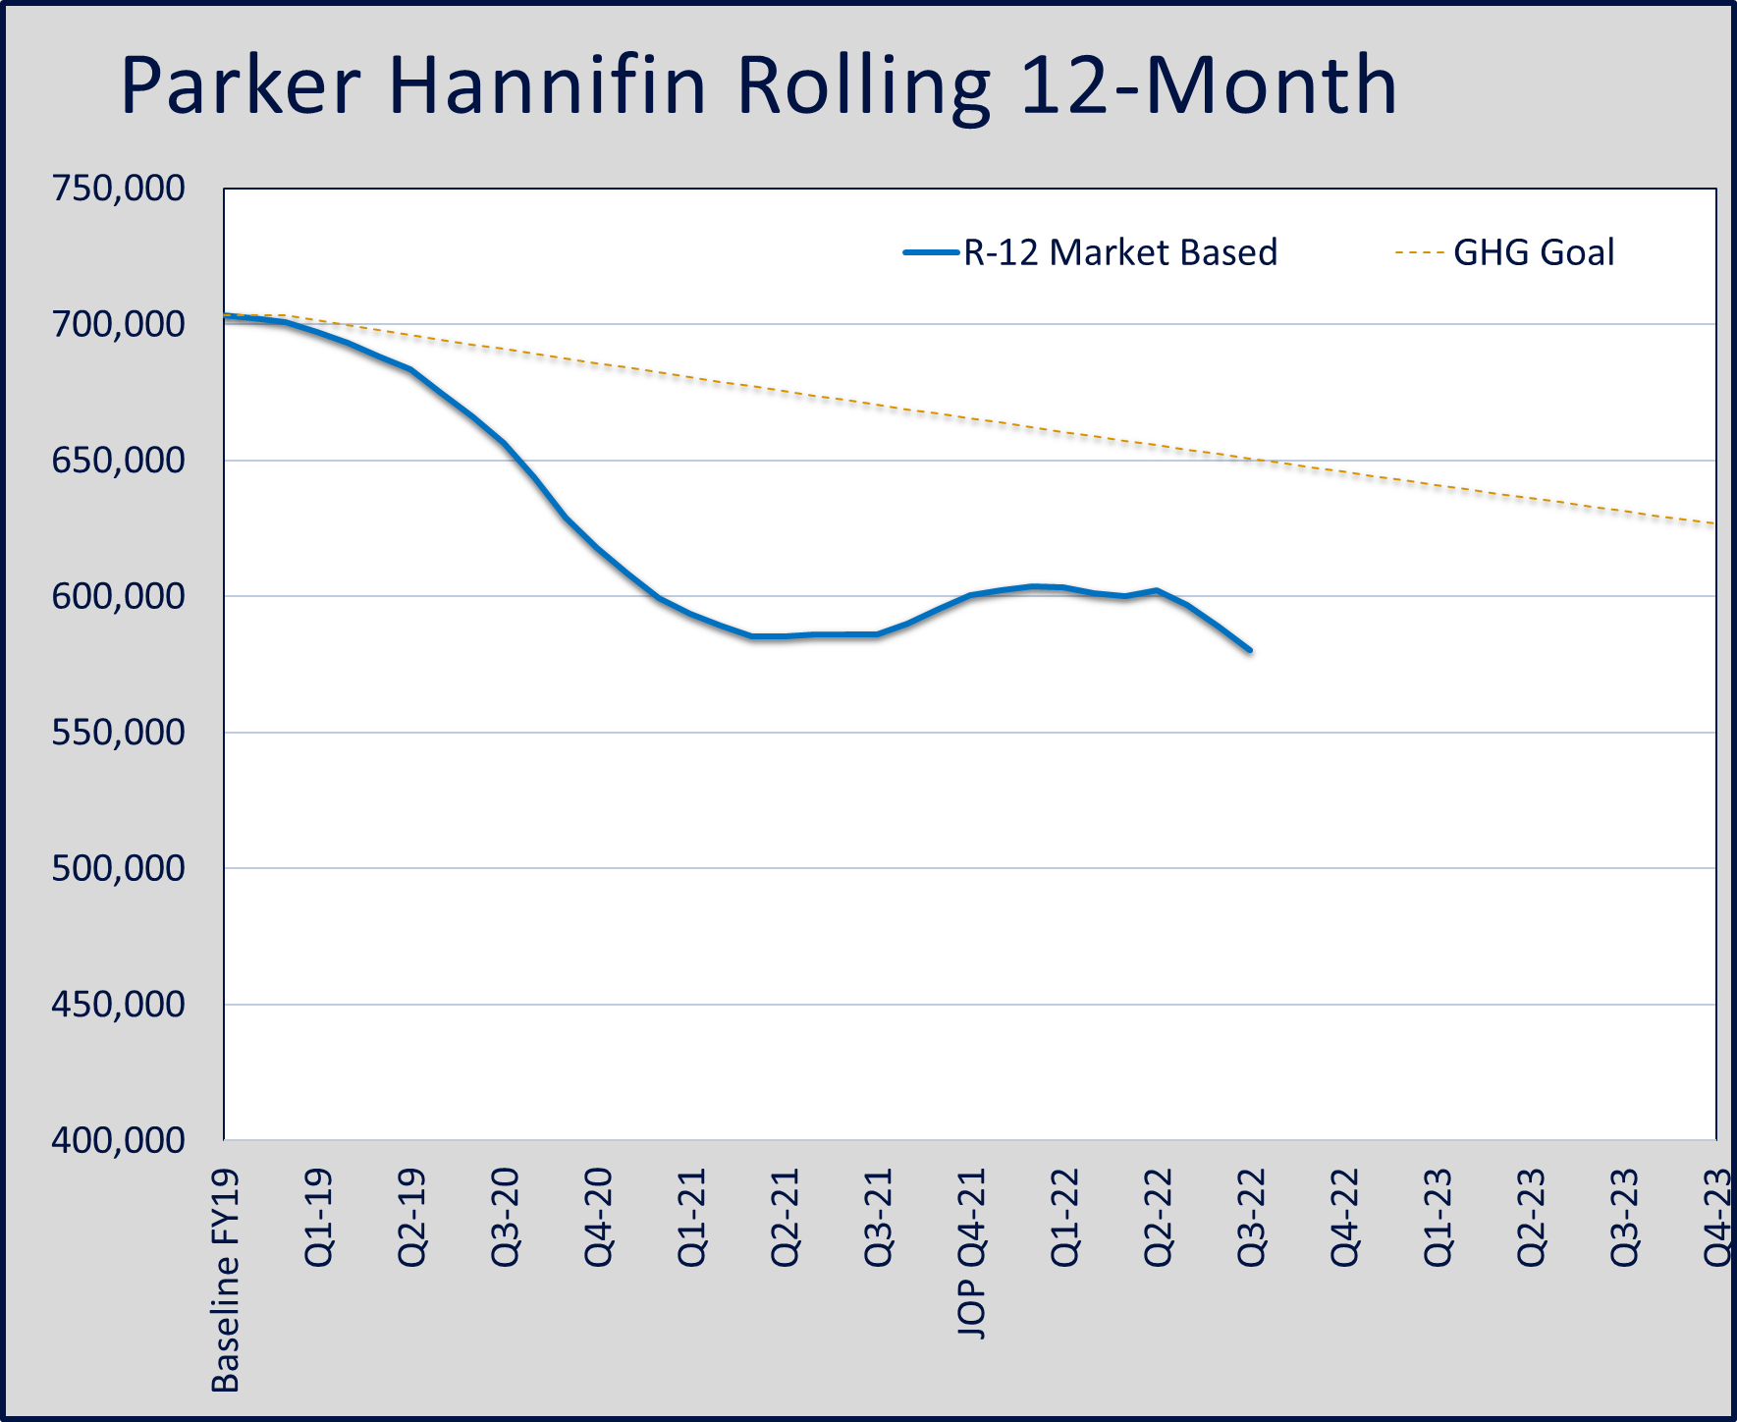
Climate Scoreboard
Climate Scorecard
Parker measures climate reduction progress by using a rolling 12-month total.
This Scorecard is updated every quarter
Data lags one quarter.
Notes:
The Parker Climate Scorecard
Parker measures climate reduction progress at the enterprise level by using a rolling 12-month total.
This Scorecard is updated every quarter.
Data lags one quarter to give us time to collect the utility invoices.

Slide 26
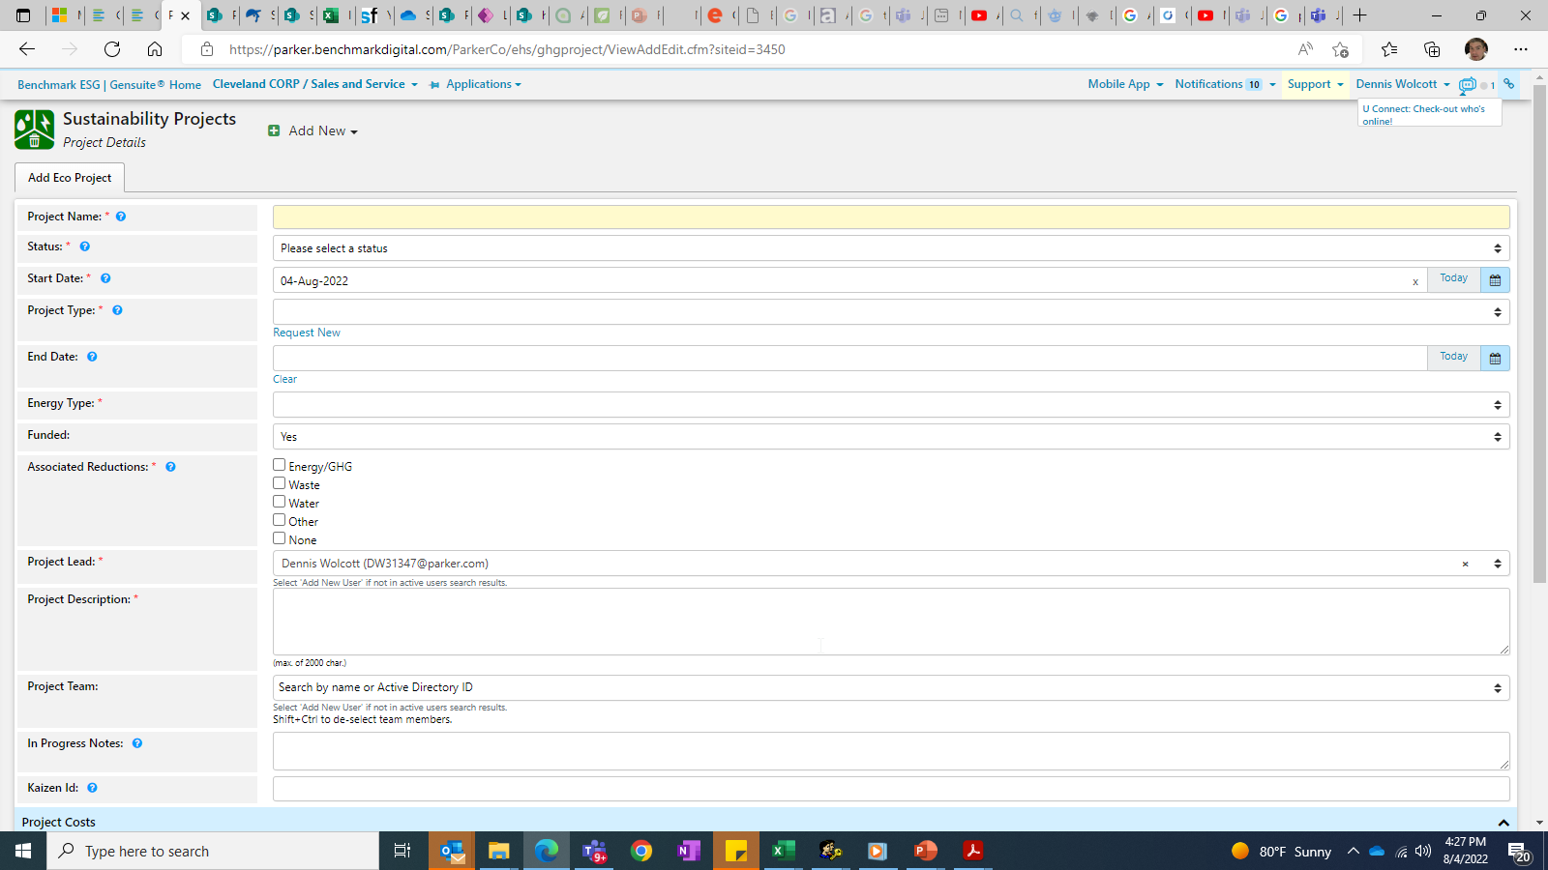
Project Tracking
Project Tracker Tool
All Climate & Energy projects should be entered into the tracker as soon as they have been identified.
Tracked until project is completed.
Notes:
Project Tracking at Parker
All Climate & Energy projects should be entered into the tracker as soon as they have been identified.
Each climate project will be tracked until the project is completed.

Slide 27
What Can You Do to Help?
Notes:
The next section will cover what you can do to help Parker reduce its carbon footprint.

Slide 28

Join a Climate HPT
Notes:
Join a climate HPT and help your site and division reduce their carbon footprint through collaboration with other Parker team members.

Slide 29




Turn Out the Lights
Notes:
Turn Out the Lights
Make use of natural light from windows and skylights. Don’t rely on artificial light when it’s bright outside – save it for gloomy days and dark evenings.
Don’t leave lights on in unoccupied rooms. It should go without saying but remind fellow team members to do their part.
Alternatively, ask your maintenance teams to install occupancy monitoring sensors and automate lighting controls in conference rooms, offices and common areas.

Slide 30
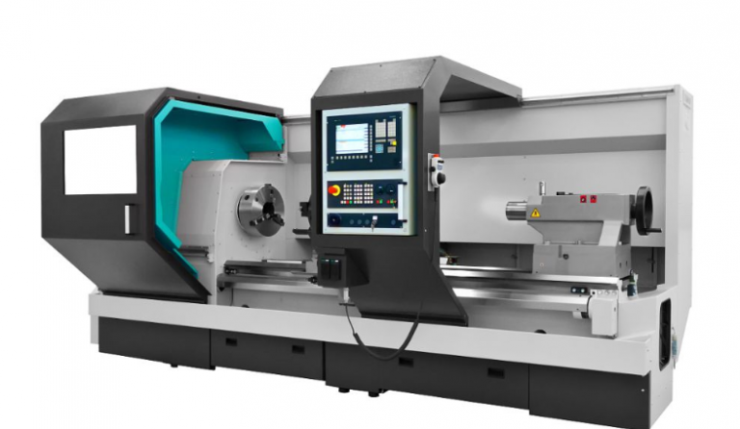

Switch OFF Equipment When Not in Use
Notes:
Switch OFF Equipment When Not in Use
Just like with lights, make sure that you switch off and un- plug all equipment when not in use.

Slide 31

Report Compressor Air Leaks to Maintenance
Notes:
Report Compressor Air Leaks to Maintenance
Leaks can be a significant source of wasted energy in an industrial compressed air system, sometimes wasting 20-30% of a compressor's output. A typical plant that has not been well maintained will likely have a leak rate equal to 20% of total compressed air production capacity.

Slide 32


Choose Laptops Over Desktops
Notes:
Choose Laptops Over Desktops
Laptops typically consume less energy compared to desktops, so keep this in mind when choosing your workplace equipment. Opt for laptops whenever possible.

Slide 33

Use Hibernation Mode on all Computers
Notes:
Advise everyone to put their computers in hibernation mode if they take a break or go to a meeting. This applies to any situation when a team member won’t be using it for a long period of time.
The hibernation feature in computers allows users to save existing work as it is and continue working at the exact same point upon return.

Slide 34
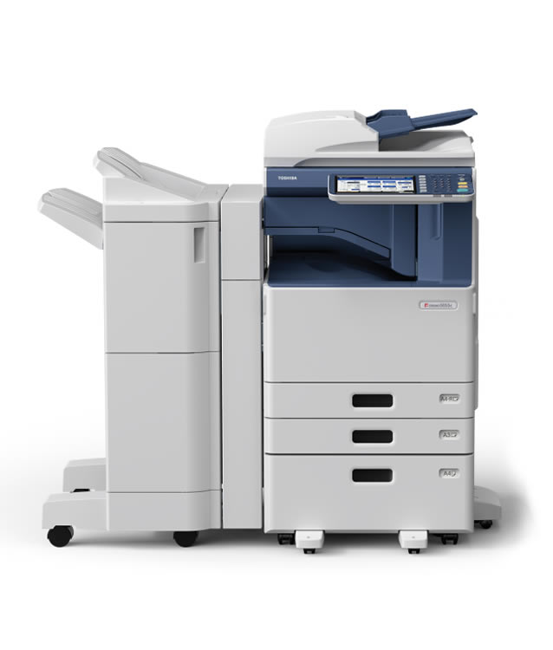
Print Only When Necessary
Notes:
Print Only When Necessary
Avoid printing files that can be sent via email. There are many ways you can share or store important files today.
Modern technology gives you a ton of options, including cloud storage, email clients and even ped drives if you insist.
Aside from reducing paper wastage, this also helps cut the total amount of energy consumed by the printer.

Slide 35

Control your Heating and Cooling
Notes:
Control your Heating and Cooling
Meet with staff to set acceptable temperature set points for your thermostats and enforce its use.
Simple things like keeping doors and windows closed while heating is on also helps prevent wasting energy because open doors and windows allow heated air to escape and cold air to come in.
Also, make sure that your ventilation ducts are not being blocked as this affects the device efficiency.
There is no need to heat or cool down corridors and storerooms since they are not being used all day. Focus on the areas that are frequented by Parker team members and areas where they spend the most of their time.

Slide 36
End
Notes:
This is the end of the presentation.
Thank you for your attention.

