Slide 1
SAAI Sure
E. faecalis Multiplex PCR detection kit

Slide 2
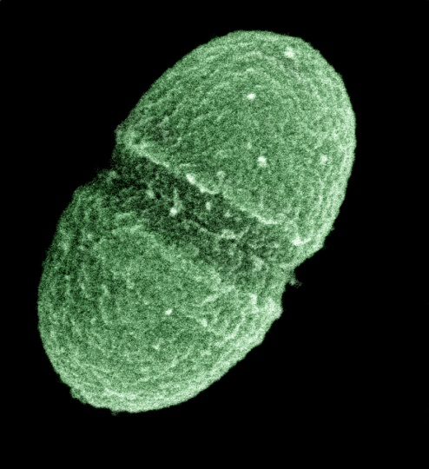
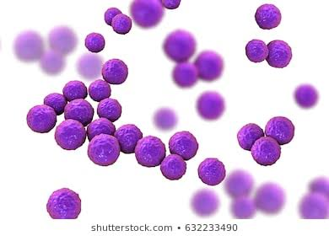
Enterococcus faecalis
  E. faecalis is an aerobic, non motile, gram positive coccus (0.5-1 µm in diameter).
  Cells are arranged in pairs or as short chains.
  Responsible for approximately 80% of cases of human infection.
  Cause many serious human infections, including Urinary Tract Infections, Endocarditis, Bacteremia, and wound infections

Slide 3
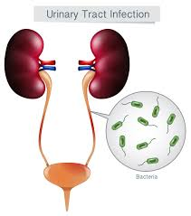
Enterococcus faecalis
  Commensal , commonly present in the gastrointestinal tracts of humans and other mammals.
  Urinary Tract Infections are the most common, responsible for approximately 110,000 cases yearly, many of which are nosocomial.
  Infections with E. faecalis can be especially troublesome to treat because of their frequent resistance to multiple antibiotics.

Slide 4
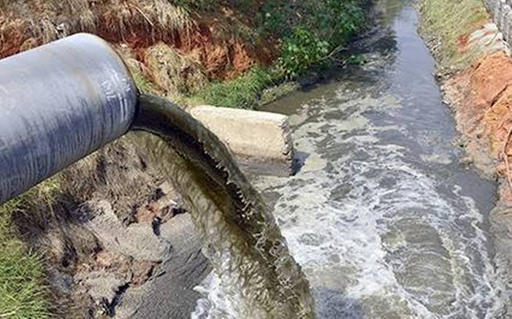
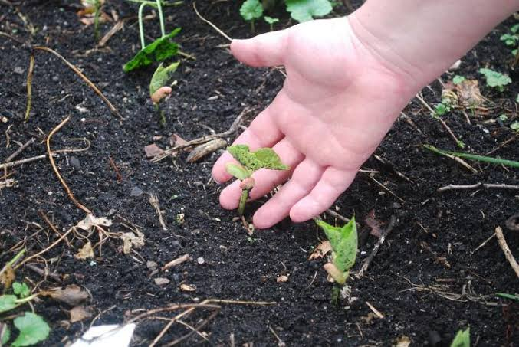
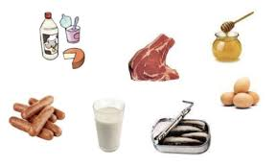
Sources of E. faecalis
E. faecalis are common in environments, contaminated by human and animal faecal materials.
Everyday objects such as telephones, doorknobs, towels, and soaps can also contain E. faecalis.
Urban sewage, recipient water, and soil receiving fertilizers of animal origin as well as in food products derived from animals.

Slide 5
Ecology of E. faecalis
Capable of survival at 60 degree celsius for 30 minutes.
Able to grow in high pH, salts and acidic condition.
Having large amount of natural antibiotic resistant.
Alter the nature of the water leads to various kinds of infections.

Slide 6
Impacts
E. faecalis contaminated water is not fit for Human consumption.
Cannot be used for healthcare and food processing Industries.

Slide 7
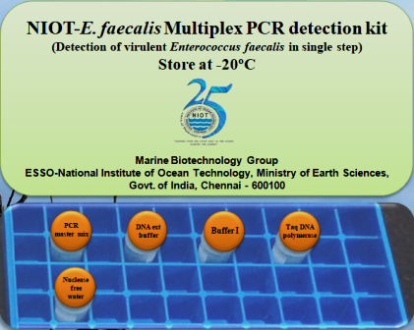
SAAI Sure E. faecalis Multiplex PCR detection Kit
E. faecalis Multiplex PCR detection Kit.
Rapid detection for pathogenic E. faecalis and its virulent genes in single step from water, food and other samples

Slide 8
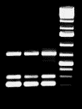
Description
  NIOT- E. faecalis kit is an all inclusive, ready to use kit which simplifies and expedite the process of detection of virulent genes in pathogenic E. faecalis (gelE-213 bp, asa1-713 bp, hyl-276 bp ) within 6 hours.
713 bp
276 bp
213 bp

Slide 9
  SAAI Sure - E. faecalis kit contains
    SAAI Sure - E. faecalis enrichment medium
  To attain sufficient cell growth within 3 hours
  Digestion Buffer
  To extract the crude DNA from the pure and enriched cultures
  SAAI Sure - E. faecalis Multiplex PCR master mix
  For specified amplification and detection of virulent genes.
  Positive and Negative controls
  To identify and interpret the virulence range of the pathogen

Slide 10




Applications
Agriculture Industries Food Processing Industries
Water Industries Healthcare Industries

Slide 11
Advantages of SAAI Sure
First kit to identify the E. faecalis contamination from water, food and other samples.
One step detection.
Reduced operation handling
Increased sensitivity and specificity.
Achieve results within 6 hours.
Eliminate unintended contamination.
Simplified standard operating procedure.
Also detect 1-5 CFU/mL

Slide 12
Prospect Cost Summary
Production cost = 8000/Kit
Market Price = 15000/Kit
Total No. companies in India = 12000
Total turnover of kit = 12000*15000
= 18 crores
Total Profit = 8.4 crores
(Approximate projection exclusive of all taxes)

Slide 13
Investment
Facility
Machinery
Manpower
Raw materials
Regulatory & Statutory Compliance
Marketing

Slide 14


