Slide 1

How the Site Engineers submit inspection notification requests to the Contractor Quality Department
Site Engineer
Notes:
How the Site Engineers submit inspection notification requests to the Contractor Quality Department

Slide 2

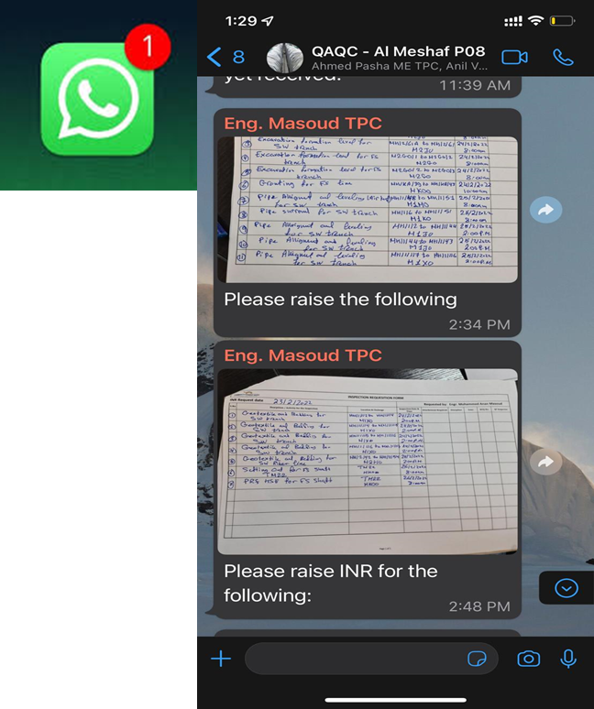



Site Engineers will send their request for inspection with a handwritten form which will be send via WatsApp group
Notes:
Site Engineers will send their request for inspection with a handwritten form which will be send via WatsApp group

Slide 3

Quality Engineer will do the Pre-Inspection and confirms it with Document Controller to proceed with the submission of INR to consultant
Quality Engineer
Notes:
Quality Engineer will do the Pre-Inspection and confirms it with Document Controller to proceed with the submission of INR to consultant

Slide 4

Document Controller will generate INR reference from APMS then log the INR in software Named Monday.com for tracking and sends Electronic INR for GEC inspection
Document Controller
Notes:
Document Controller will generate INR reference from APMS then log the INR in software Named Monday.com for tracking and sends Electronic INR for GEC inspection

