Slide 1
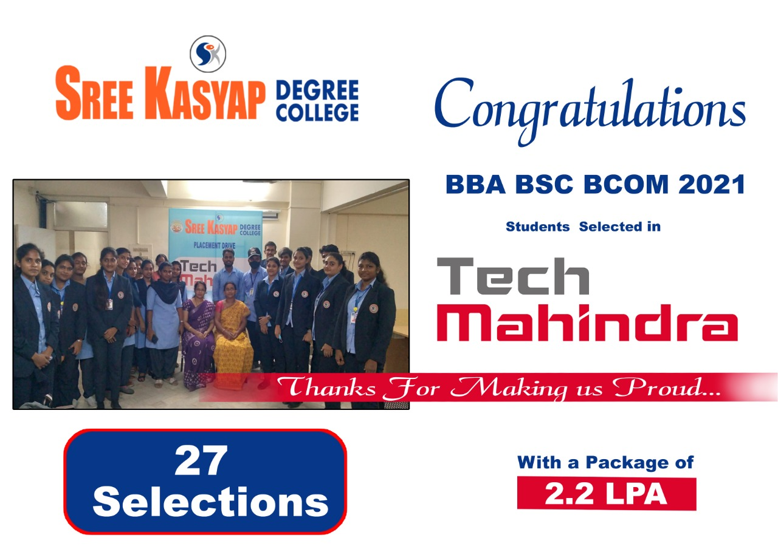

Slide 2
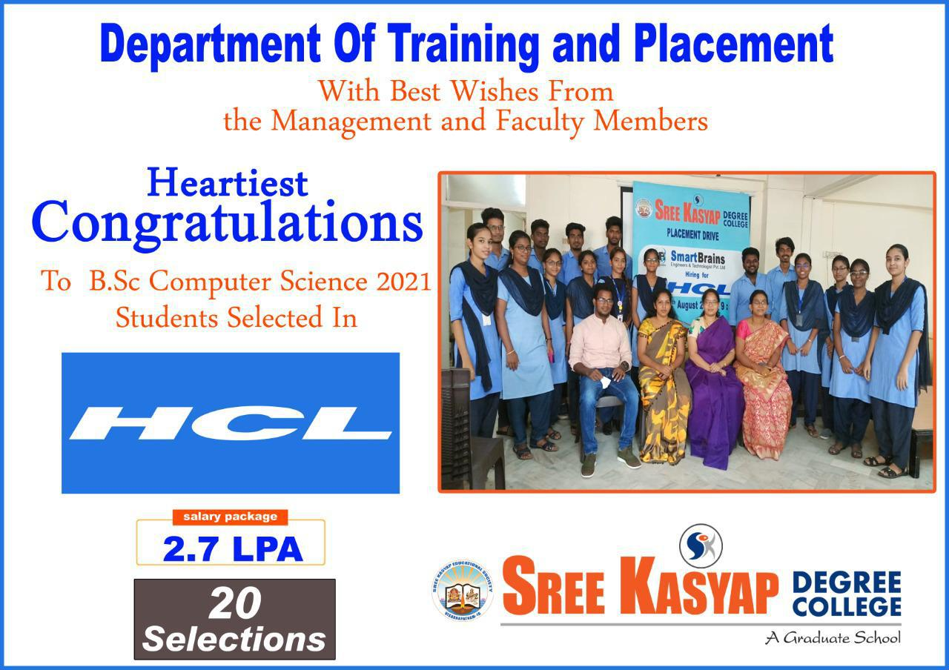

Slide 3
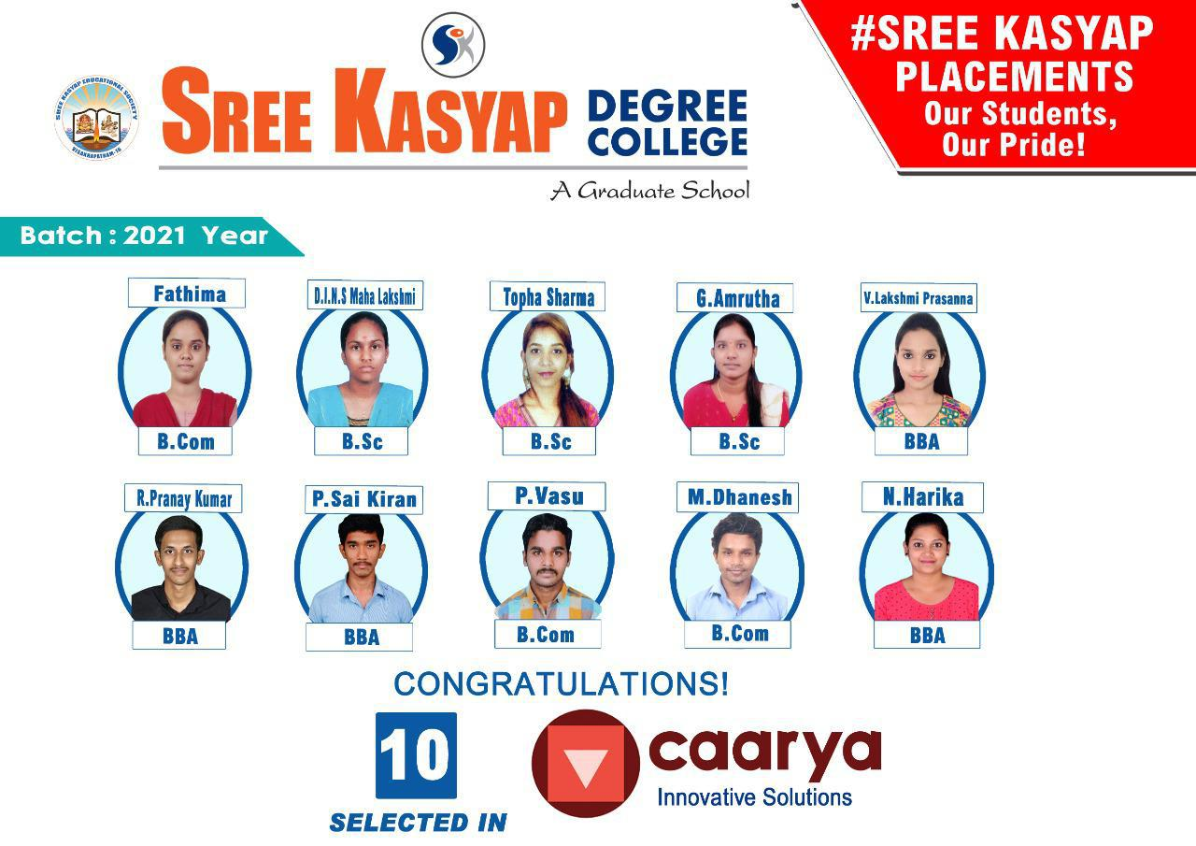

Slide 4
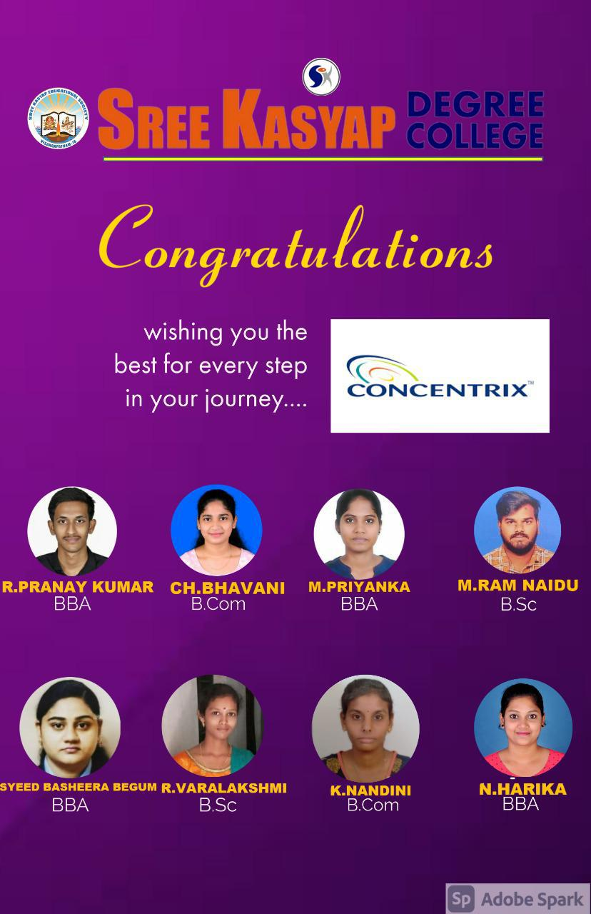

Slide 5
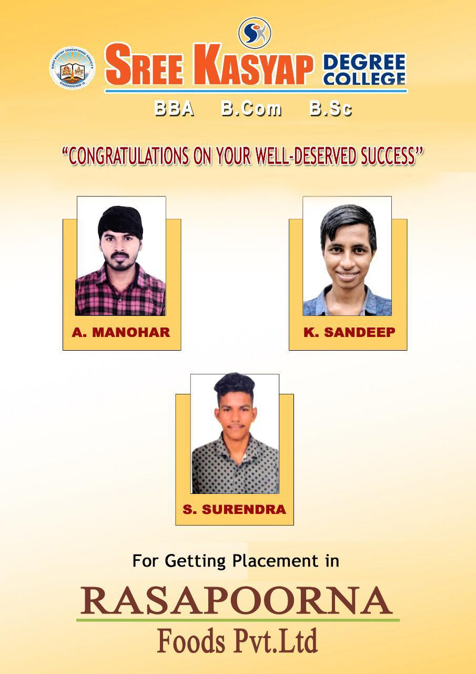

Slide 6
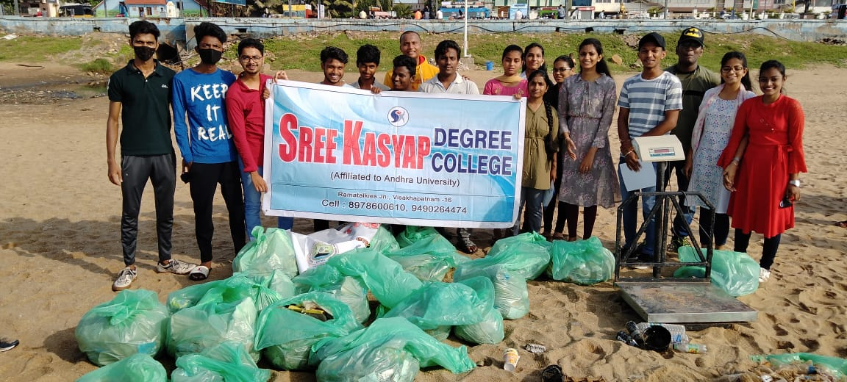
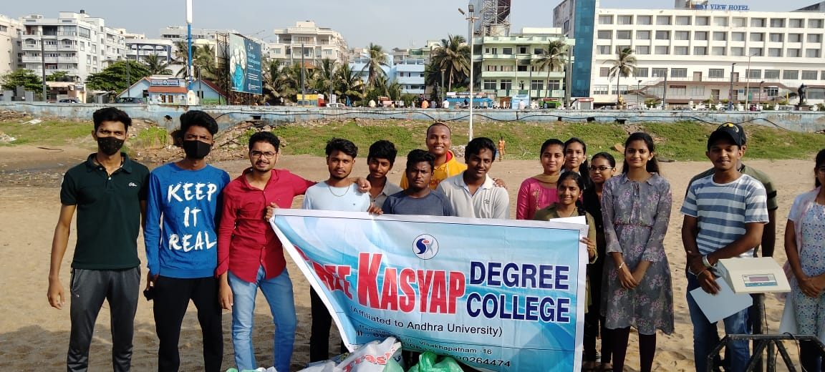

Slide 7
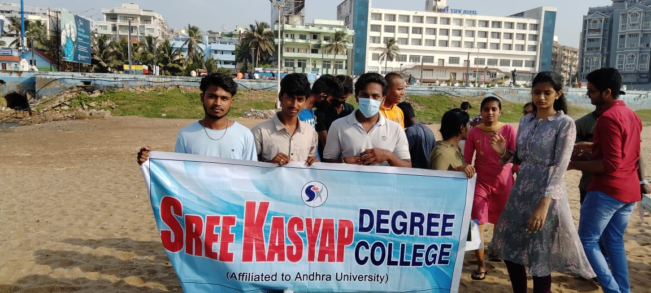
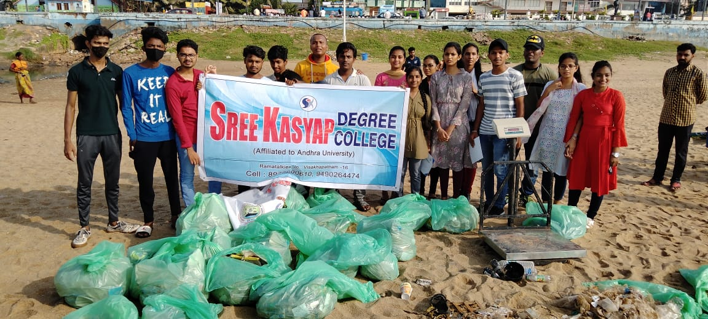

Slide 8
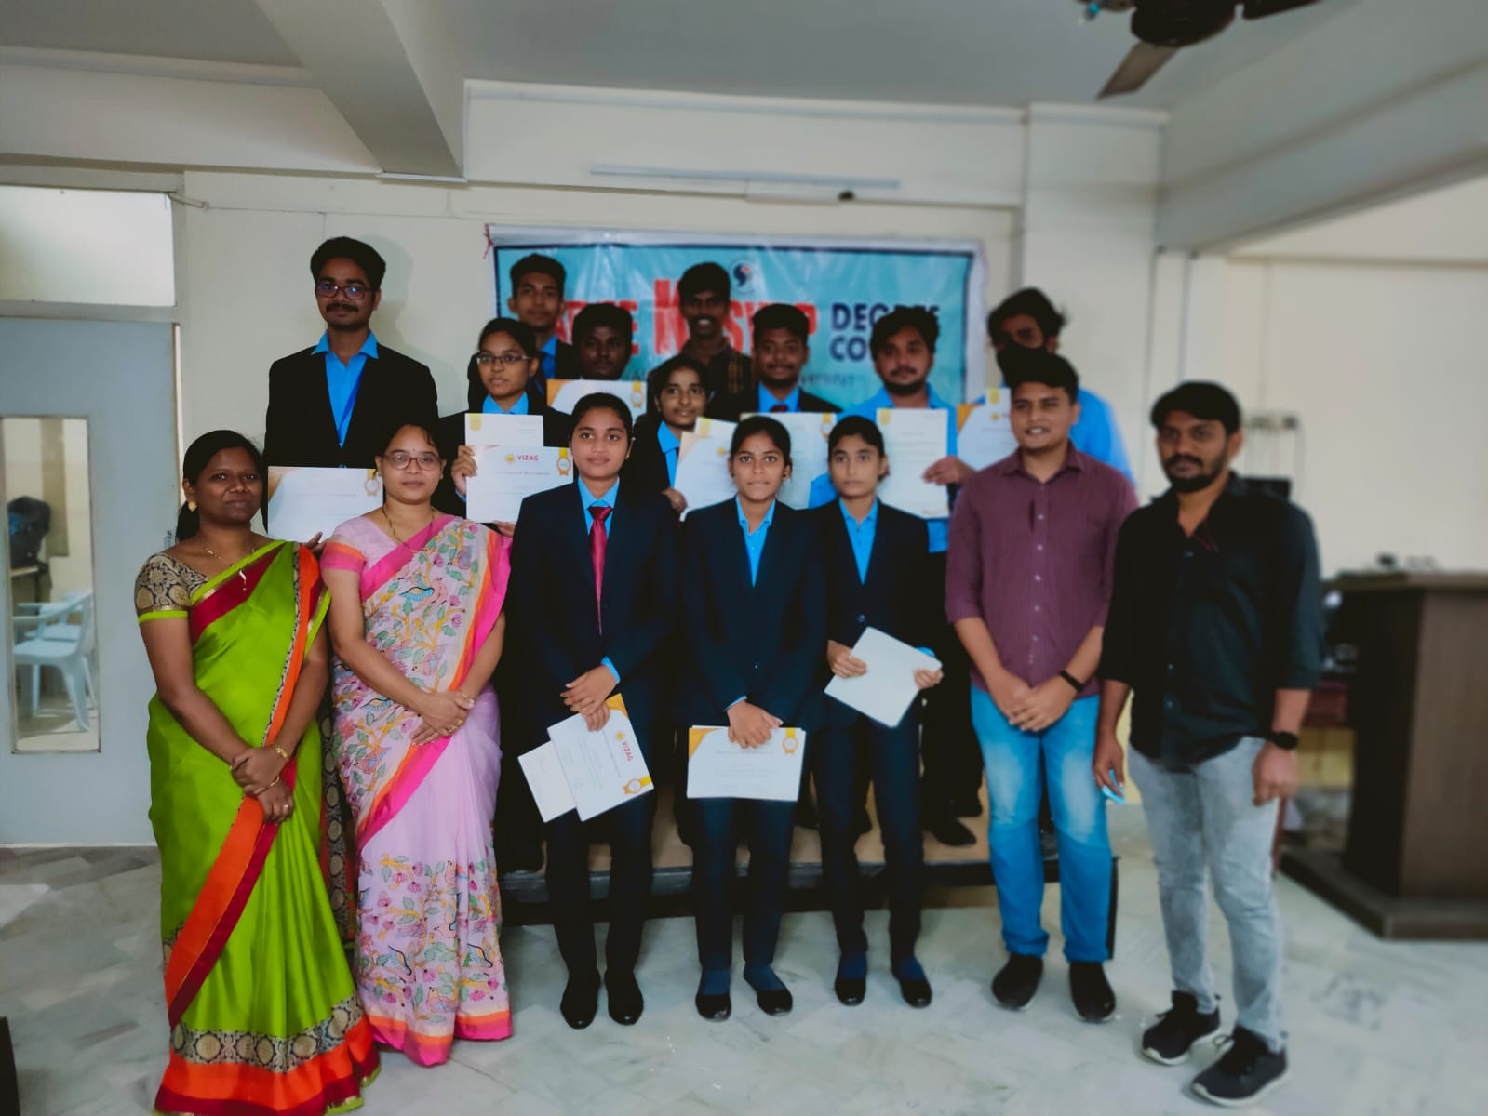
1st BBA students successfully completed two months Social Immersion Internship in Vizag Volunteers NGO and received Certificates.

Slide 9
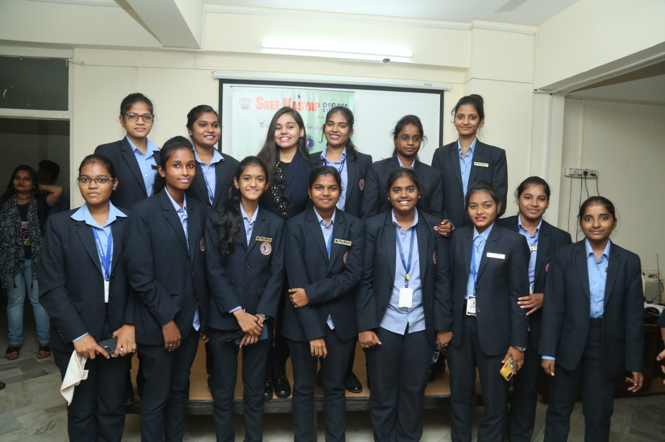

Slide 10
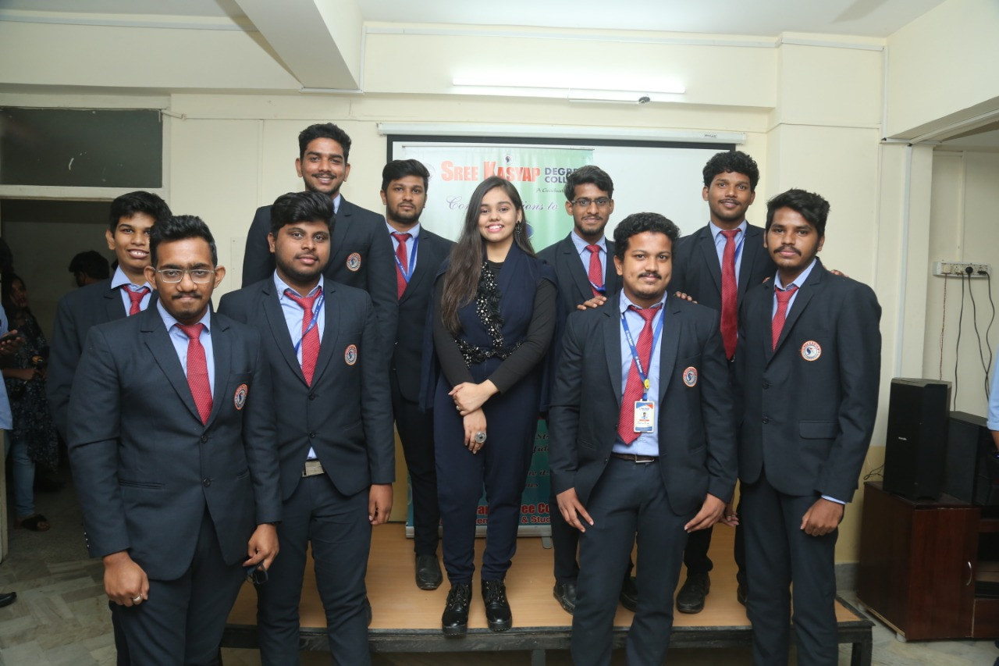

Slide 11
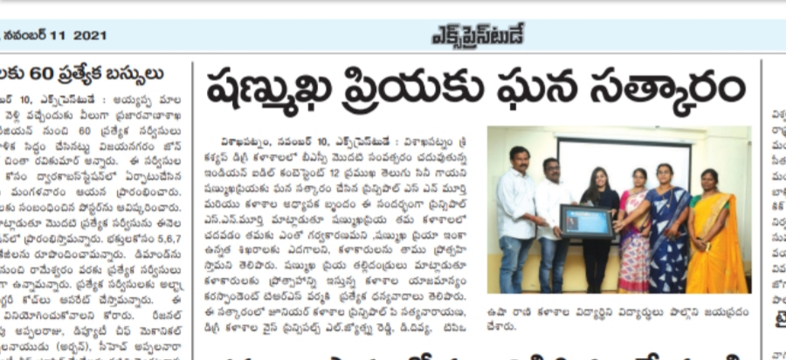
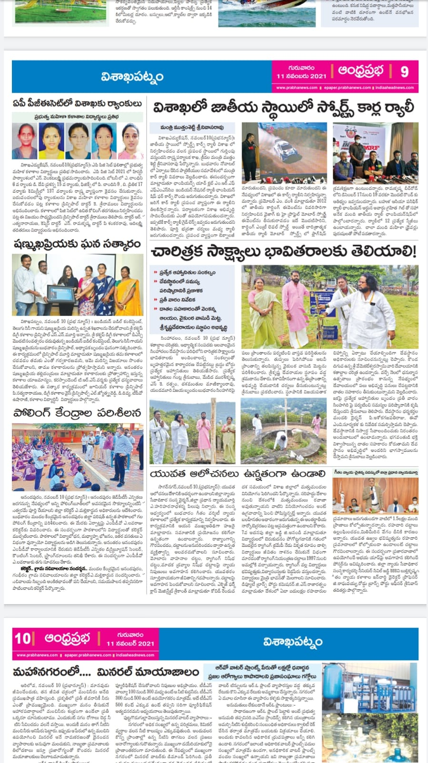

Slide 12
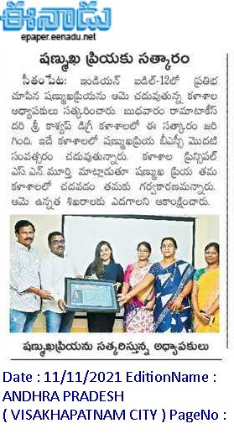

Slide 13
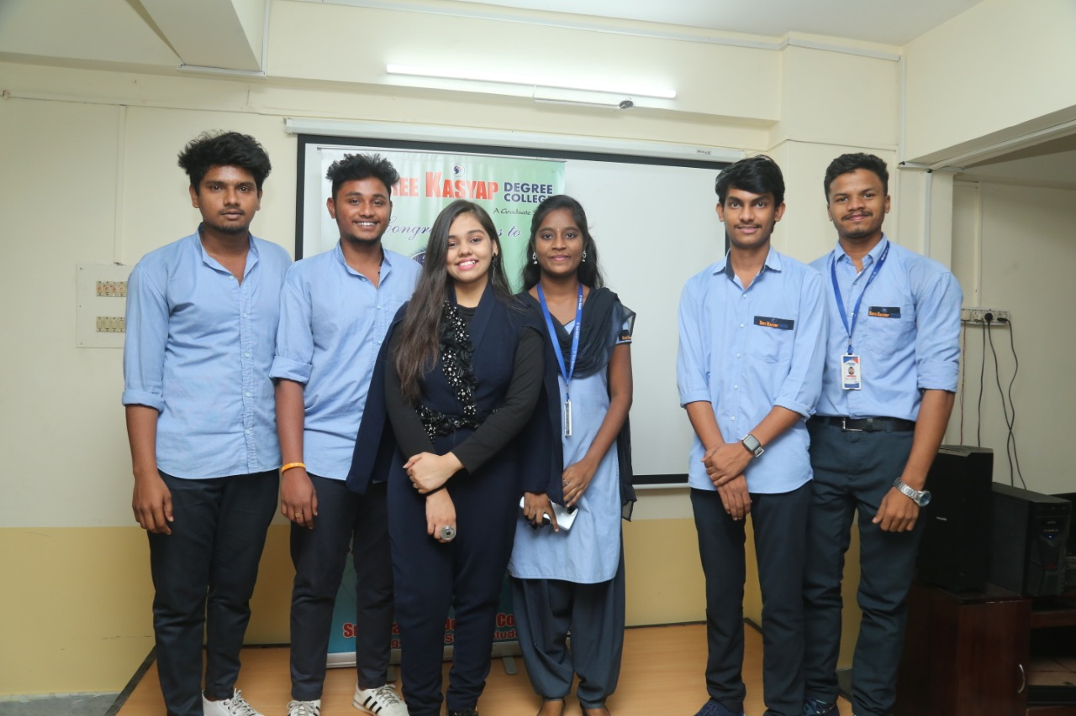

Slide 14
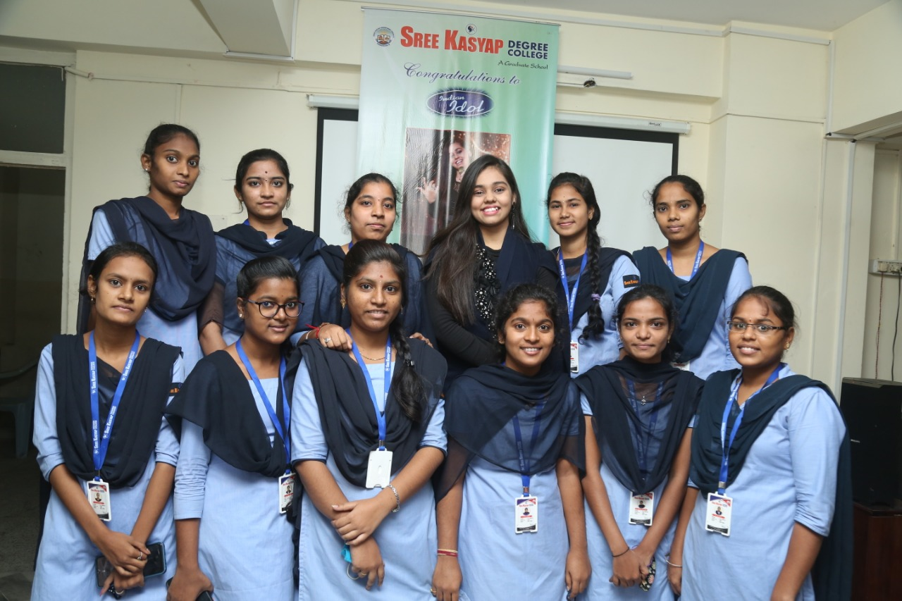

Slide 15
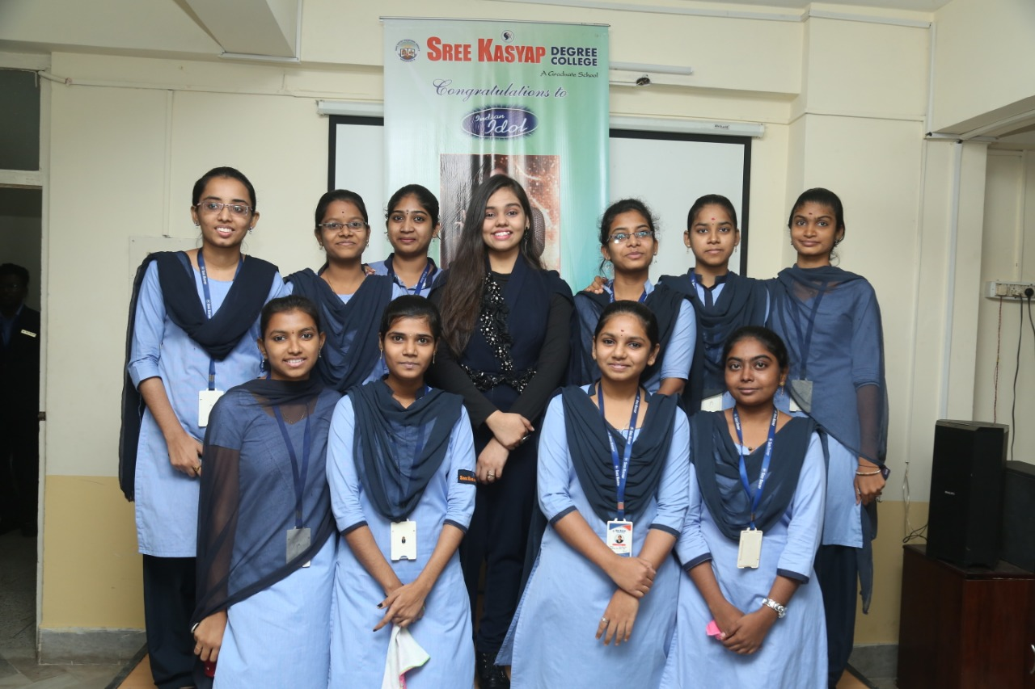

Slide 16
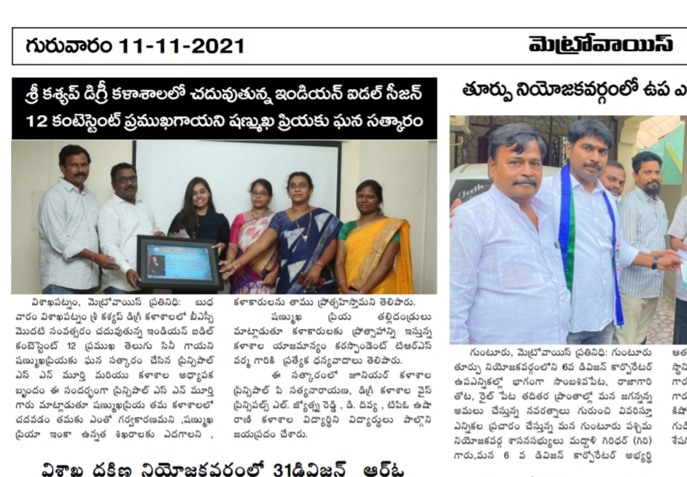

Slide 17
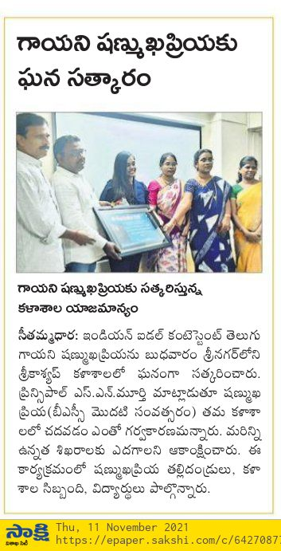

Slide 18
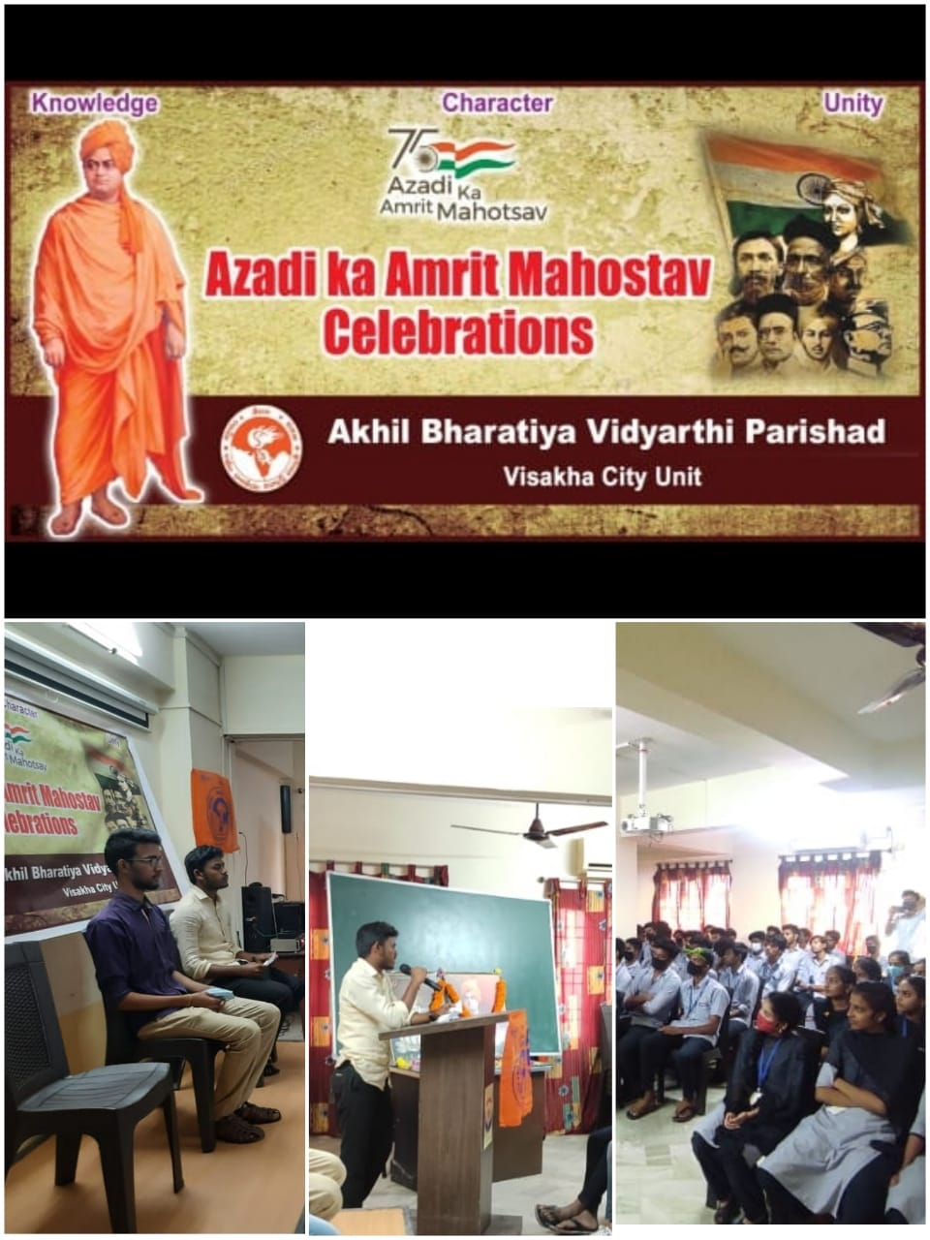
75th Azadi ka Amrit Mahostav Celebrations in our College and Intermediate Students Participated in it....

Slide 19
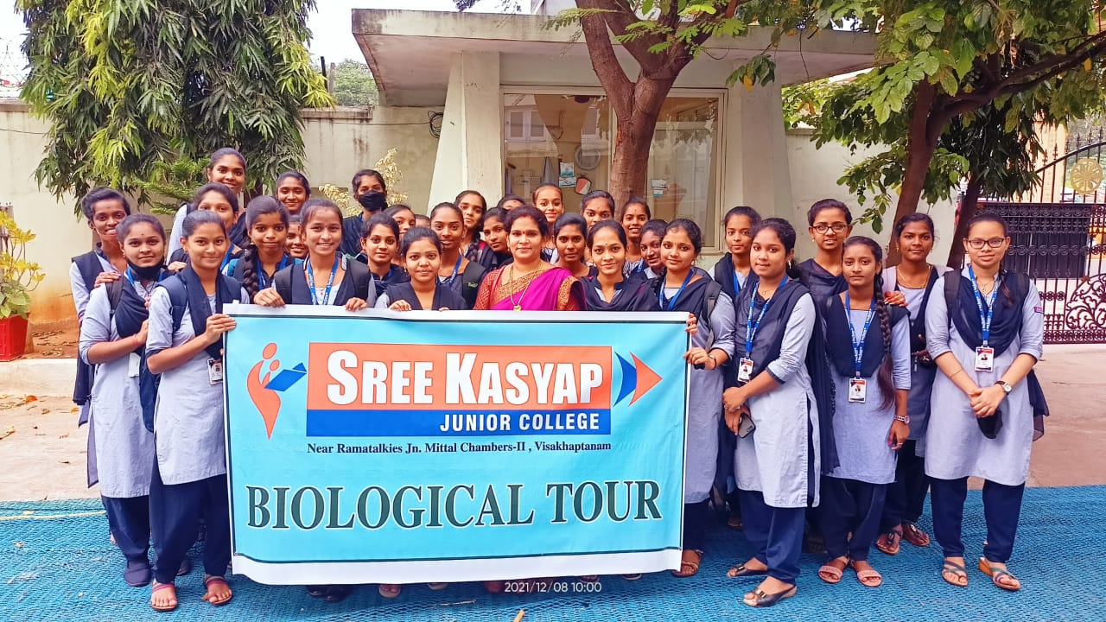

Slide 20
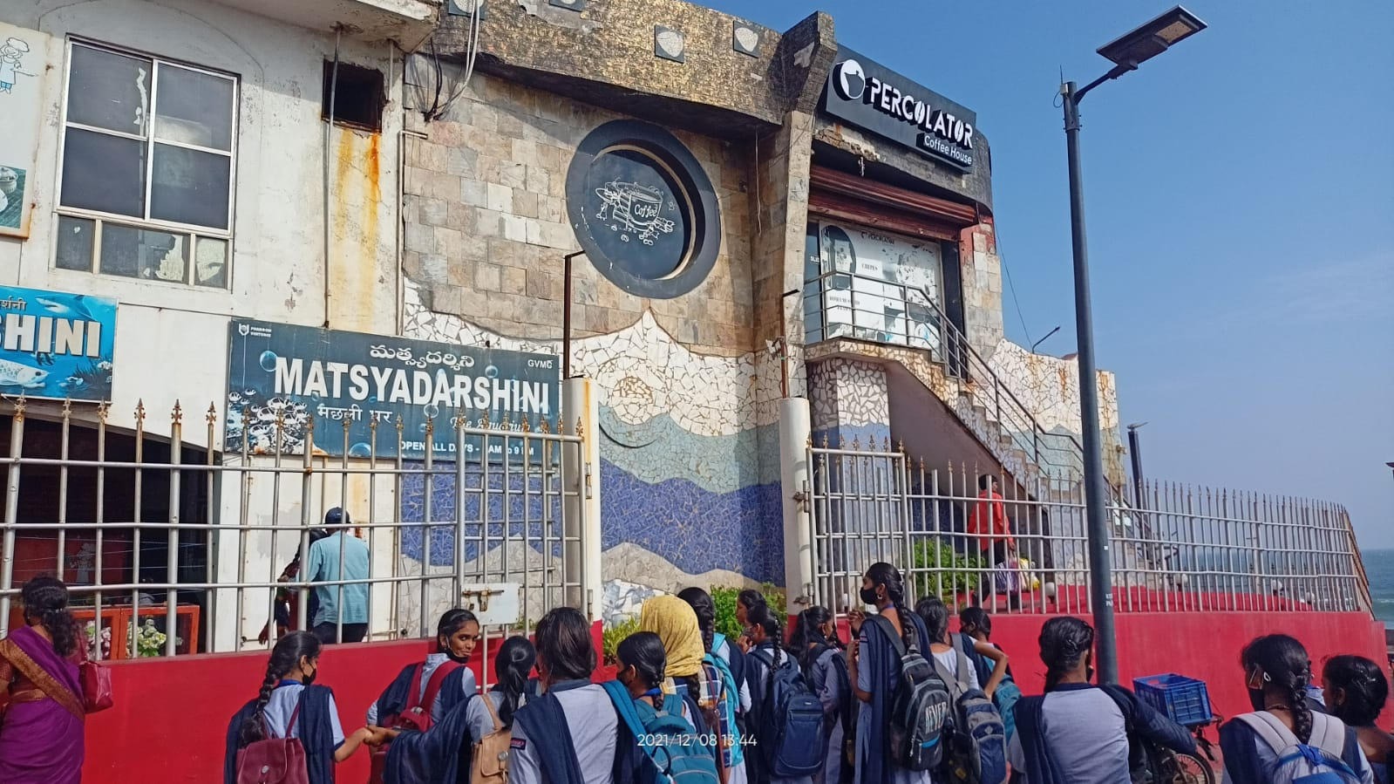

Slide 21
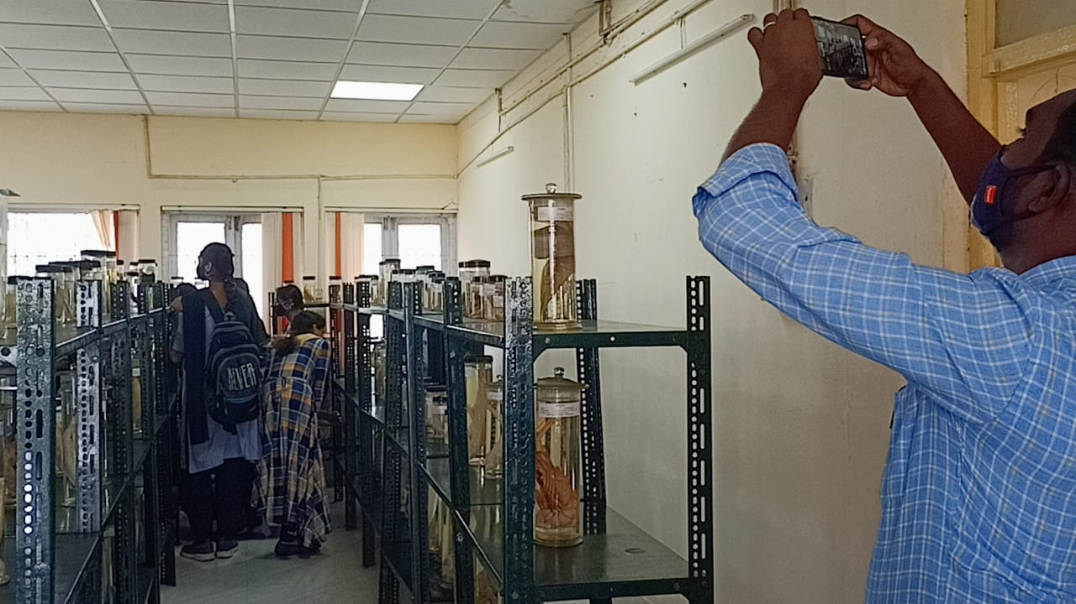

Slide 22
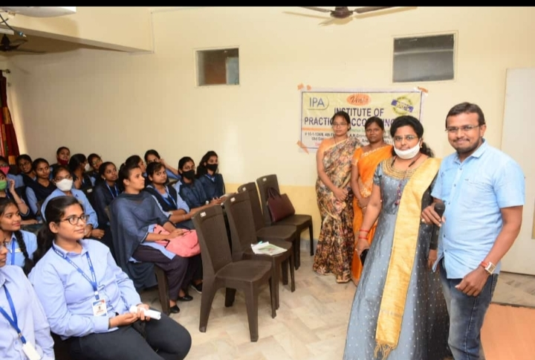
A Guest Lecture on GST by Institute of Practical Accounting Team Members.

Slide 23
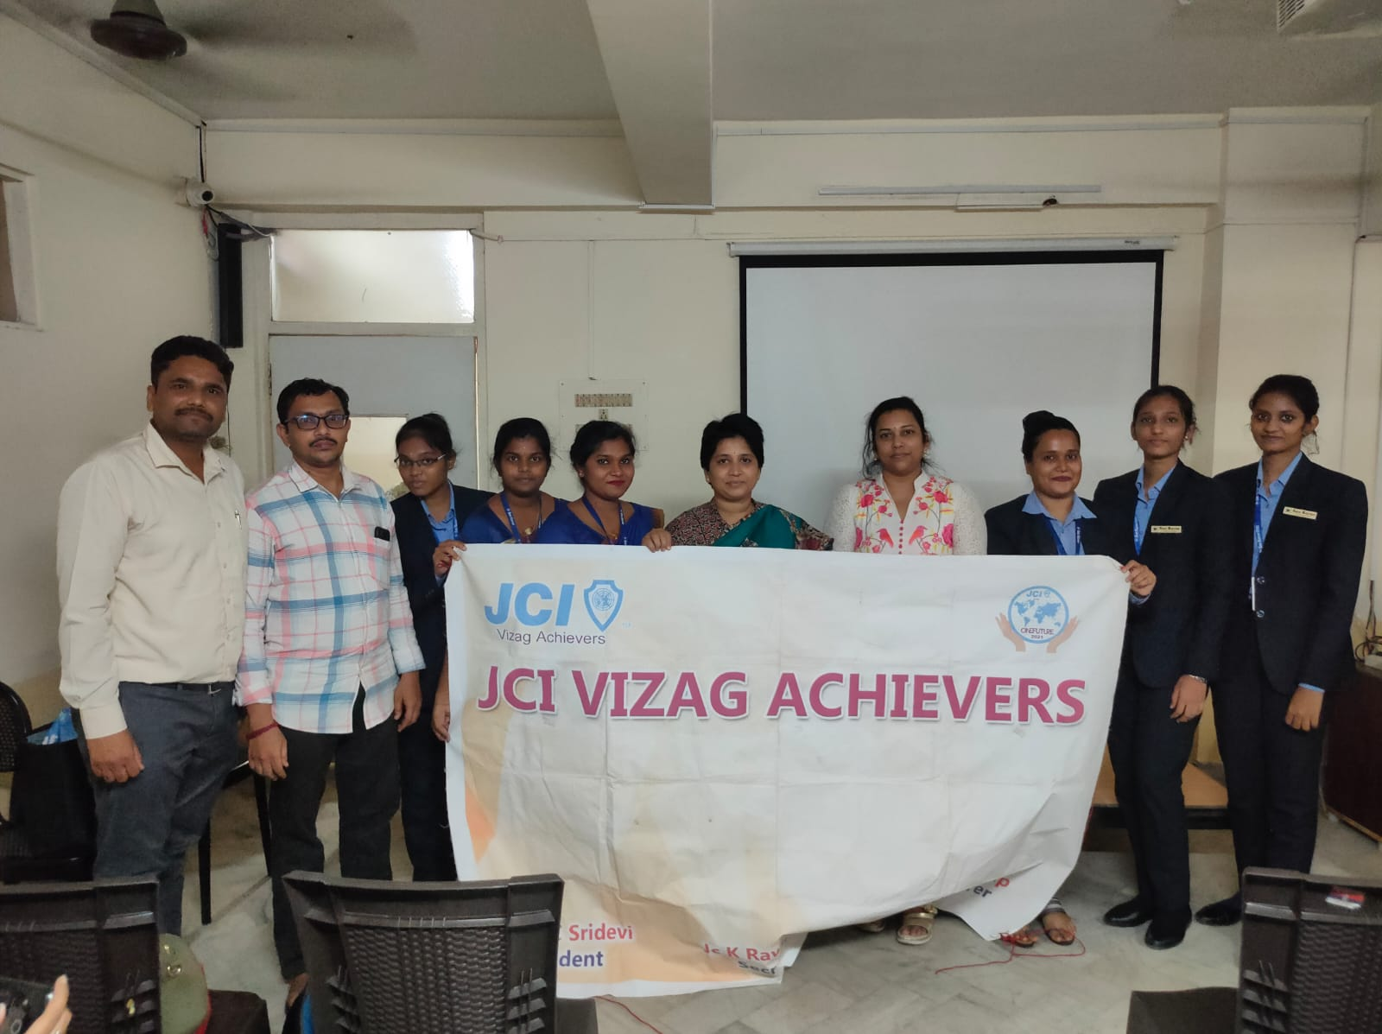

Slide 24
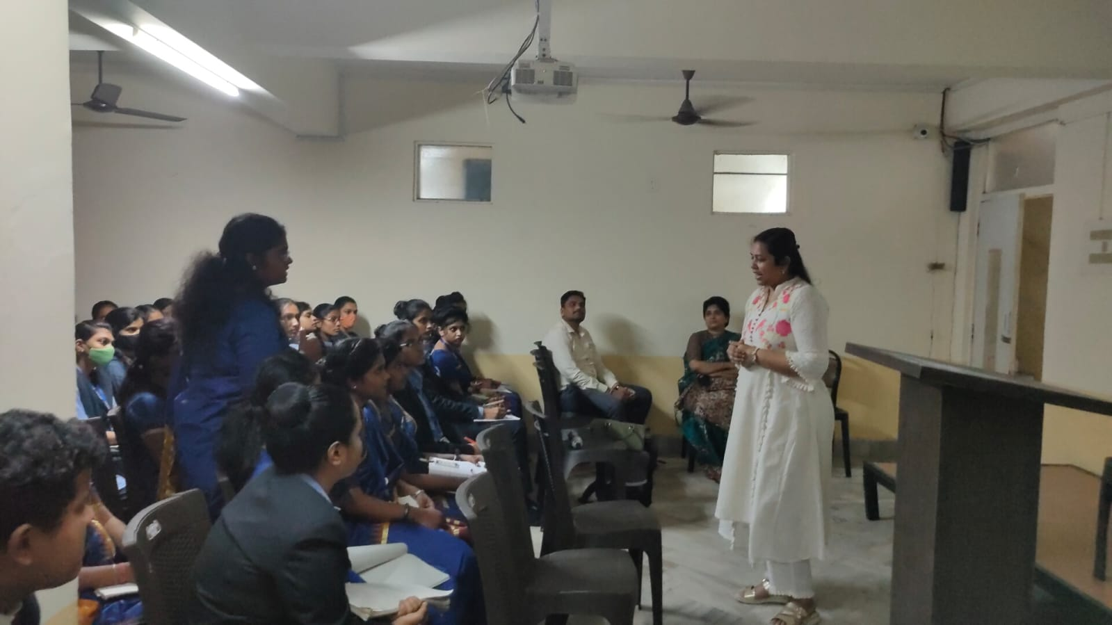

Slide 25
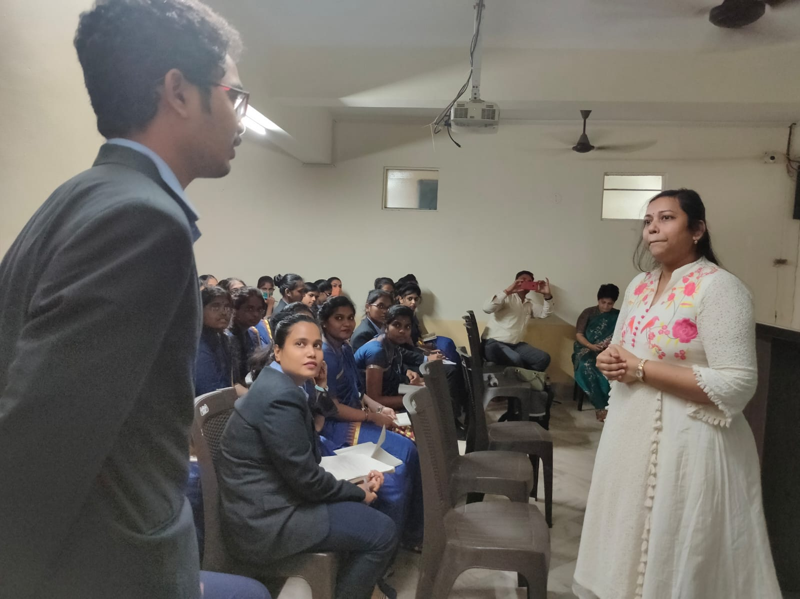

Slide 26
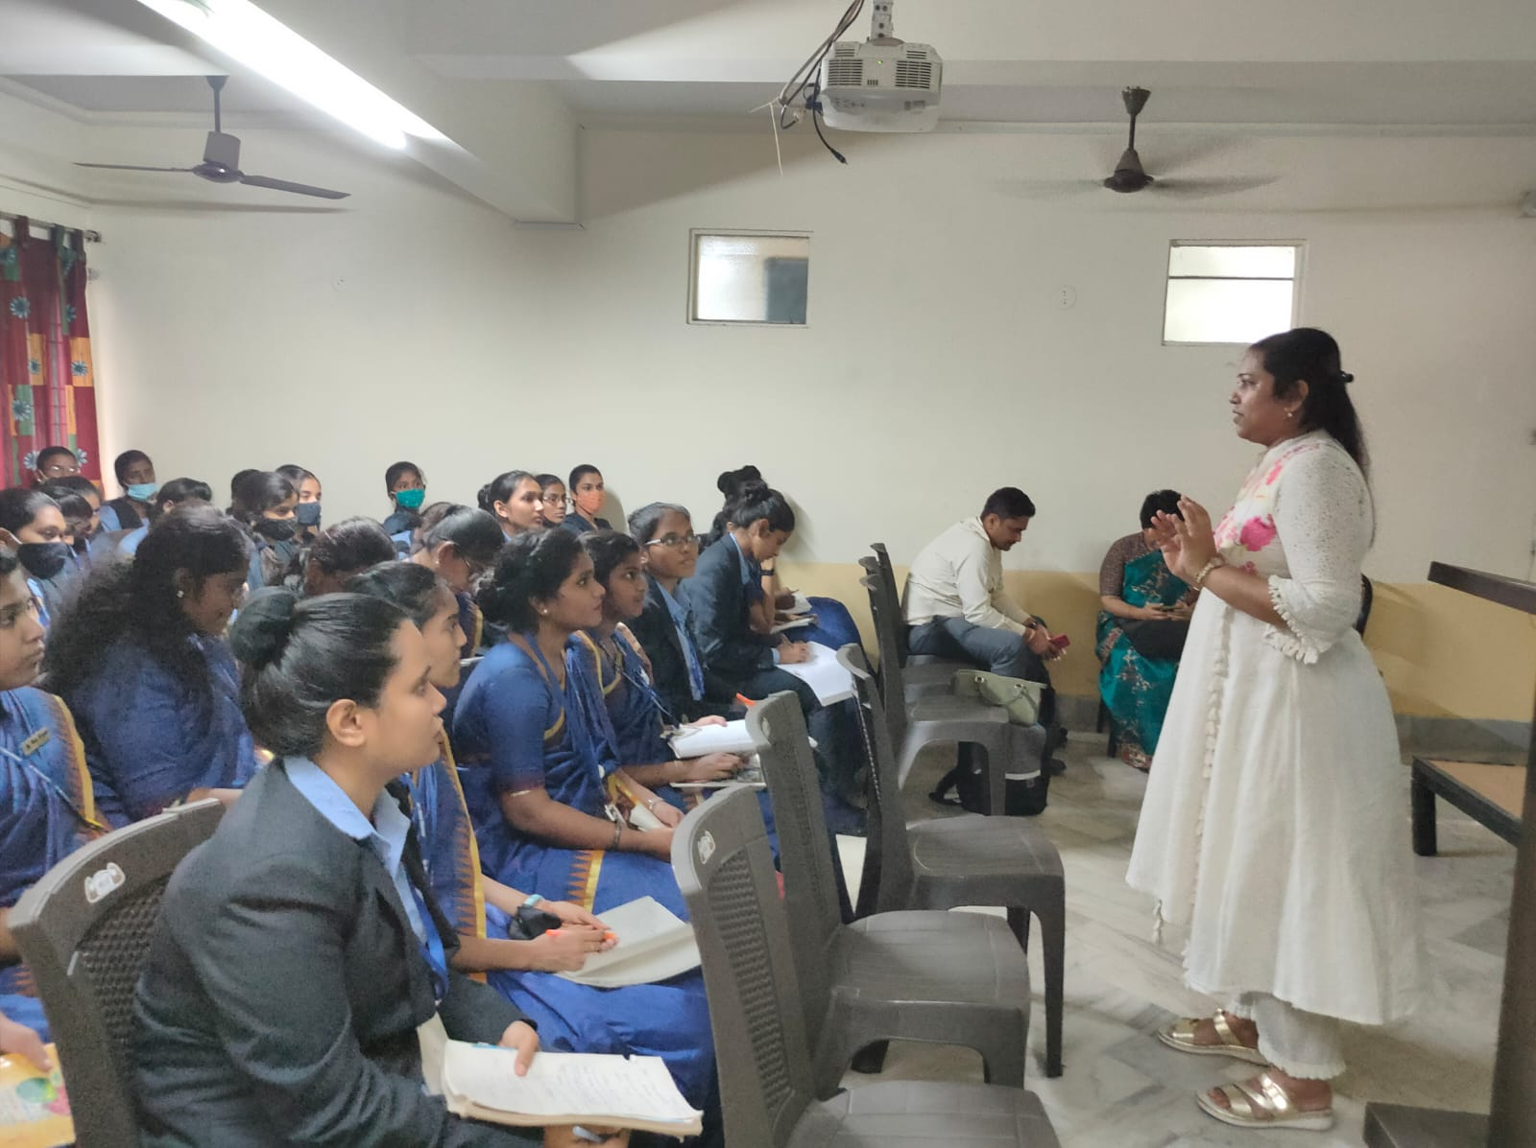

Slide 27
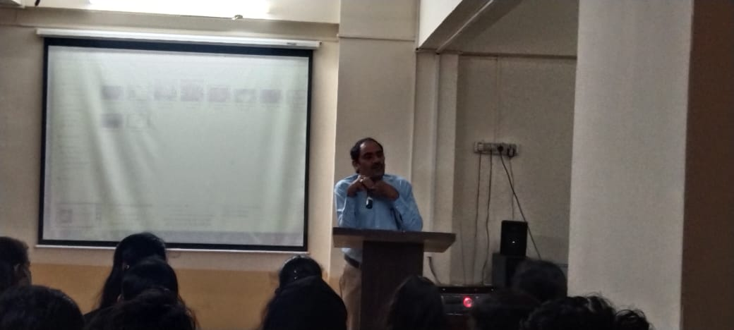
Academic Coordinator Mr.Venkatesh sir addressing the Fresher's..

Slide 28
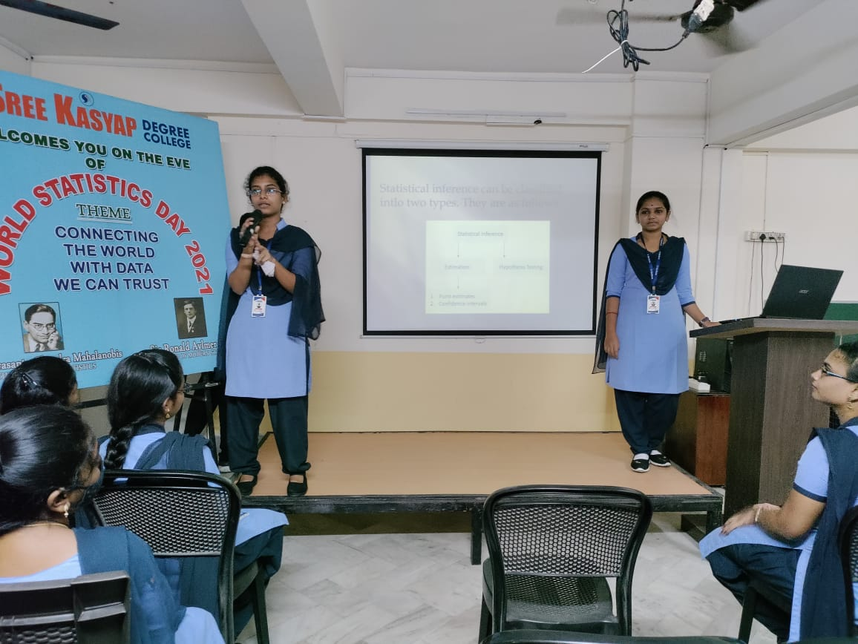
As a part of World Statistics Day Celebration

Slide 29
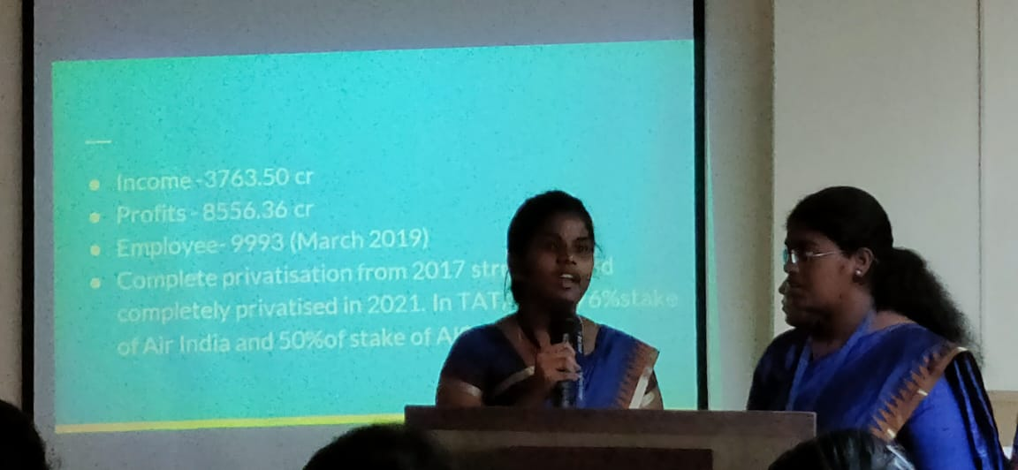
BBA final year students participated in Case Study Presentation...

Slide 30
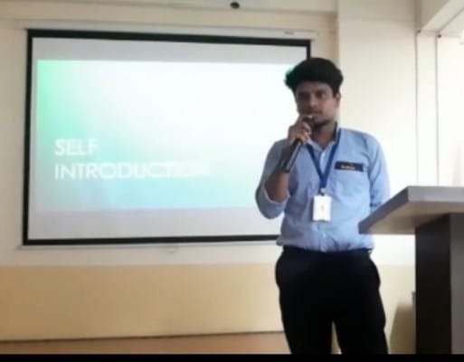
Self Introduction by B.Sc Statistics and Electronics Students

Slide 31
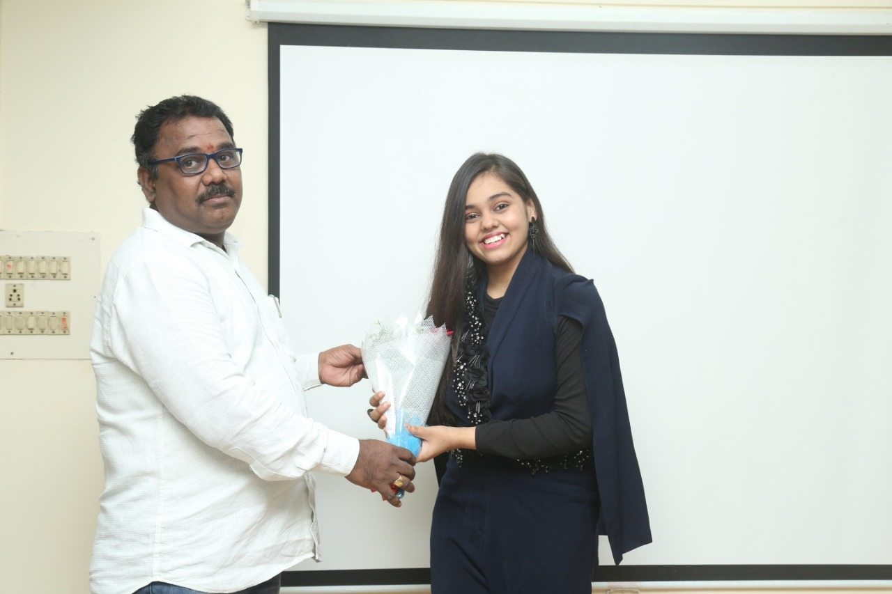
As a token of love and encouraging for her achievement Mr.S.N.Murthy Sir ,Mr.P.Sathyanaraya Sir has Felicitated our Indian Idol Season 12 Finalist.

Slide 32
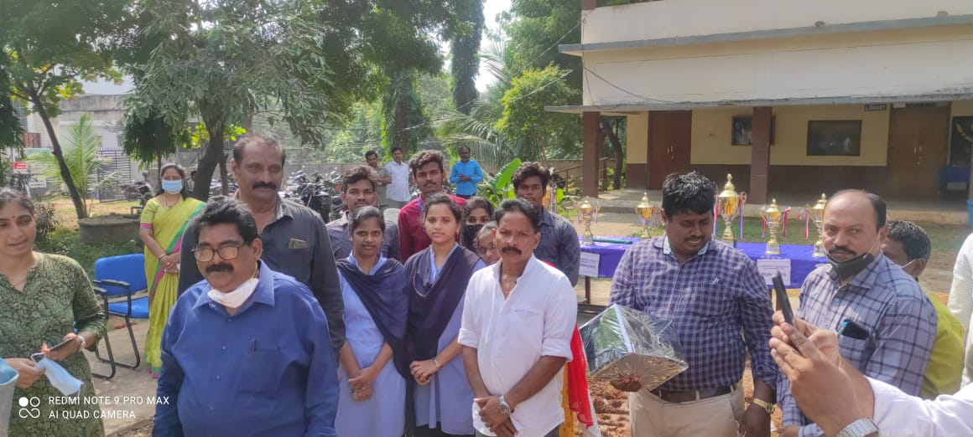
AU Physical Director Vijaya Mohan Gari tho SREE KASYAP DEGREE COLLEGE Students Boys & Girls

Slide 33
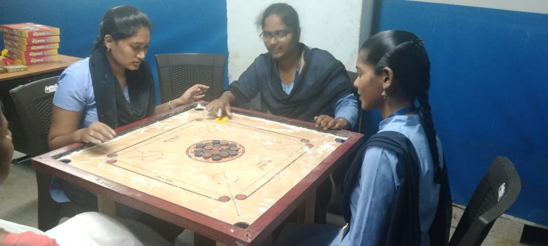
B.Com and BBA students playing indoor games in our college Cellar space designed for Indoor Games

Slide 34
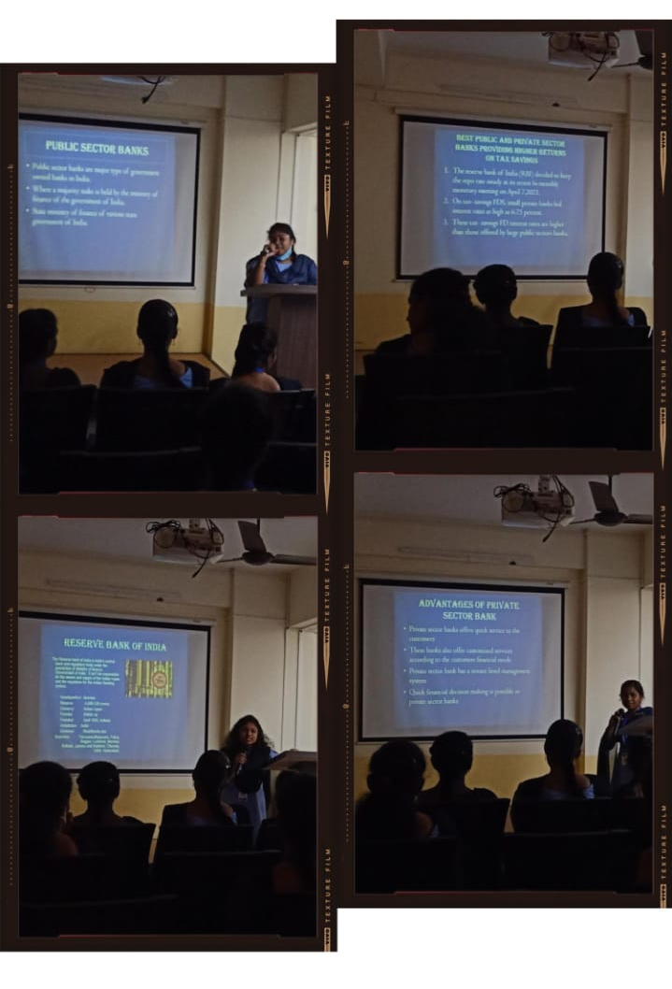
B.Com Final year first year students participated in PPT Presentation on Rural Banking...

Slide 35
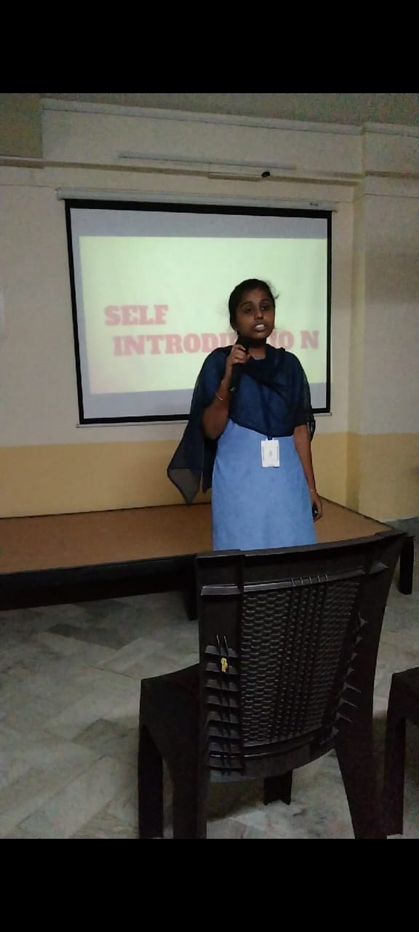
B.Com Final year students were trained on Self Introduction and then participated in the practical activity also.

Slide 36
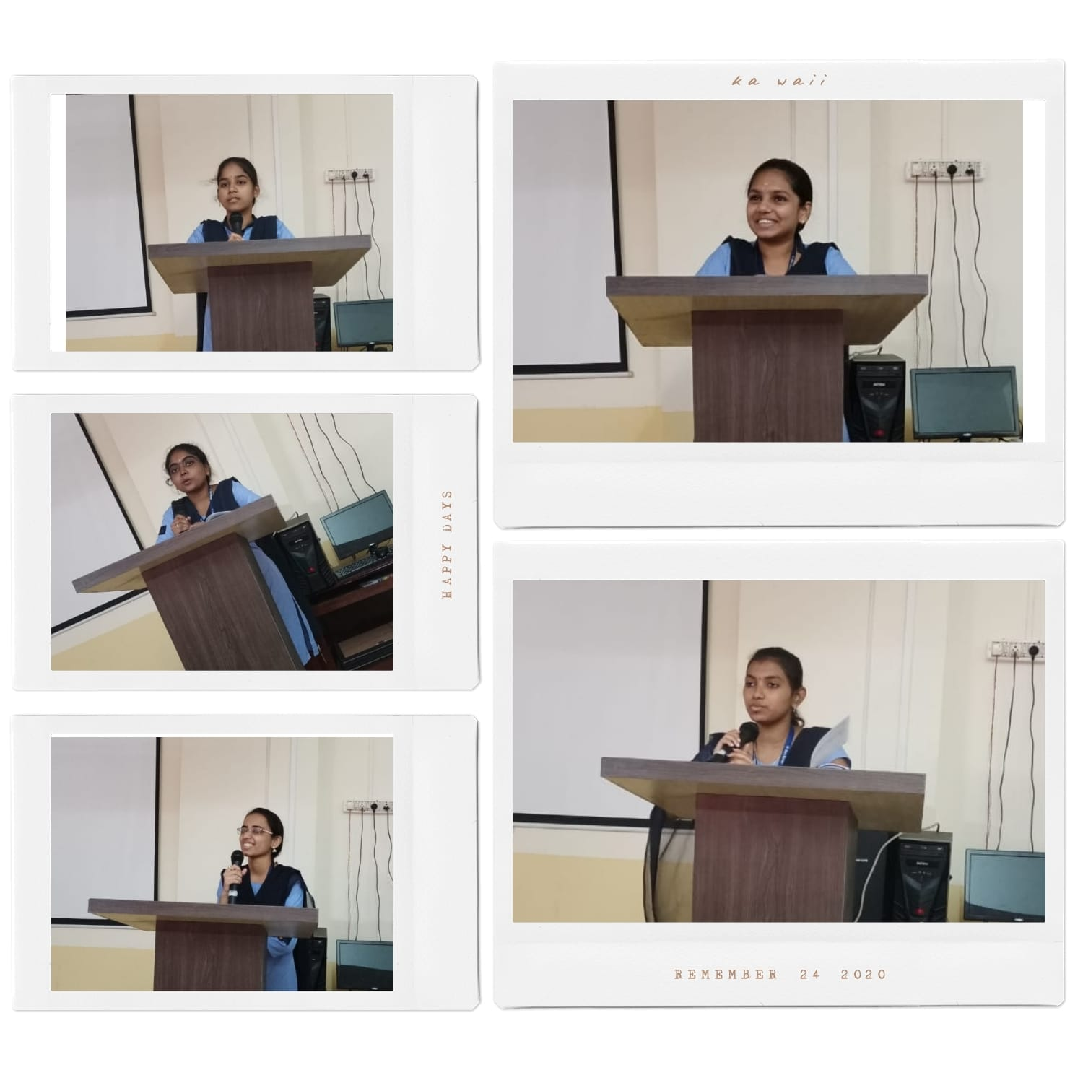
B.Sc Electronics students participated in the JAM session today...

Slide 37
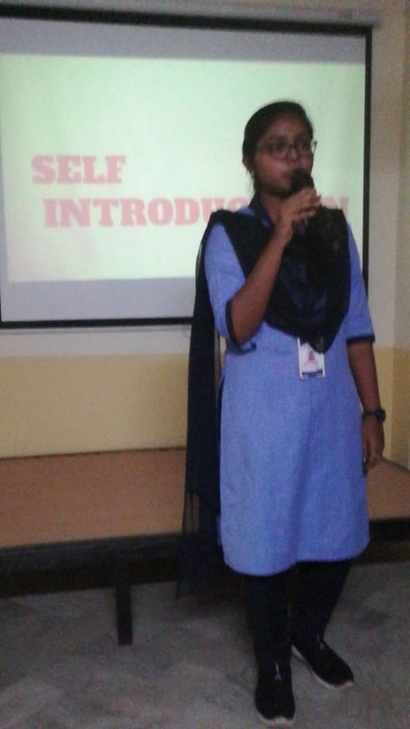
B.Sc Final year Chemistry and Physics students were trained on Self Introduction and post to that participated in Self Introduction Session..

Slide 38
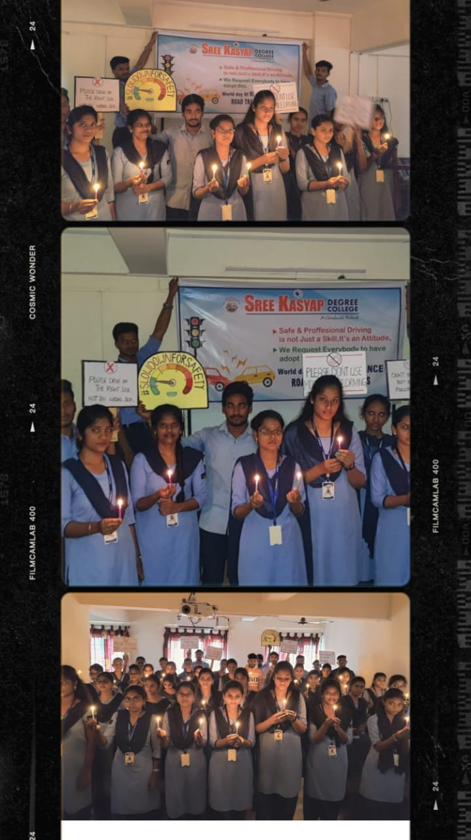
B.Sc Final year Students observed the National Day for Remembrance of Traffic Victims..

Slide 39
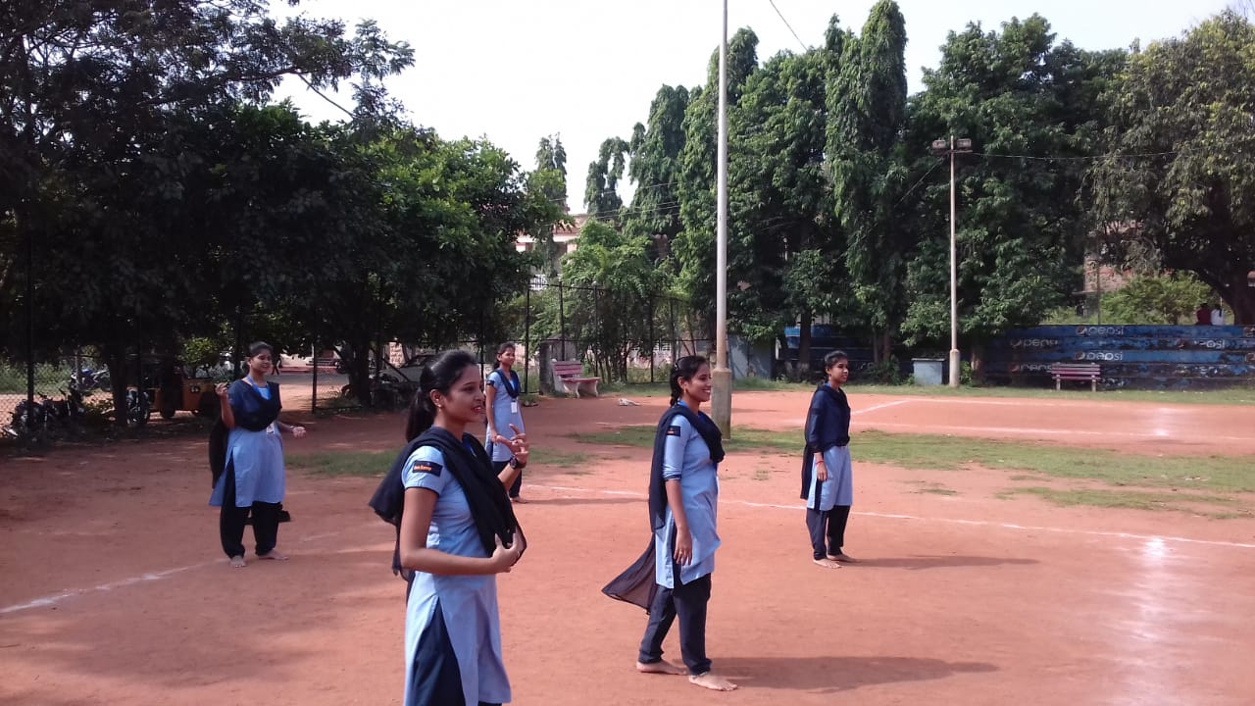
B.sc girls playing Outdoor games....

Slide 40
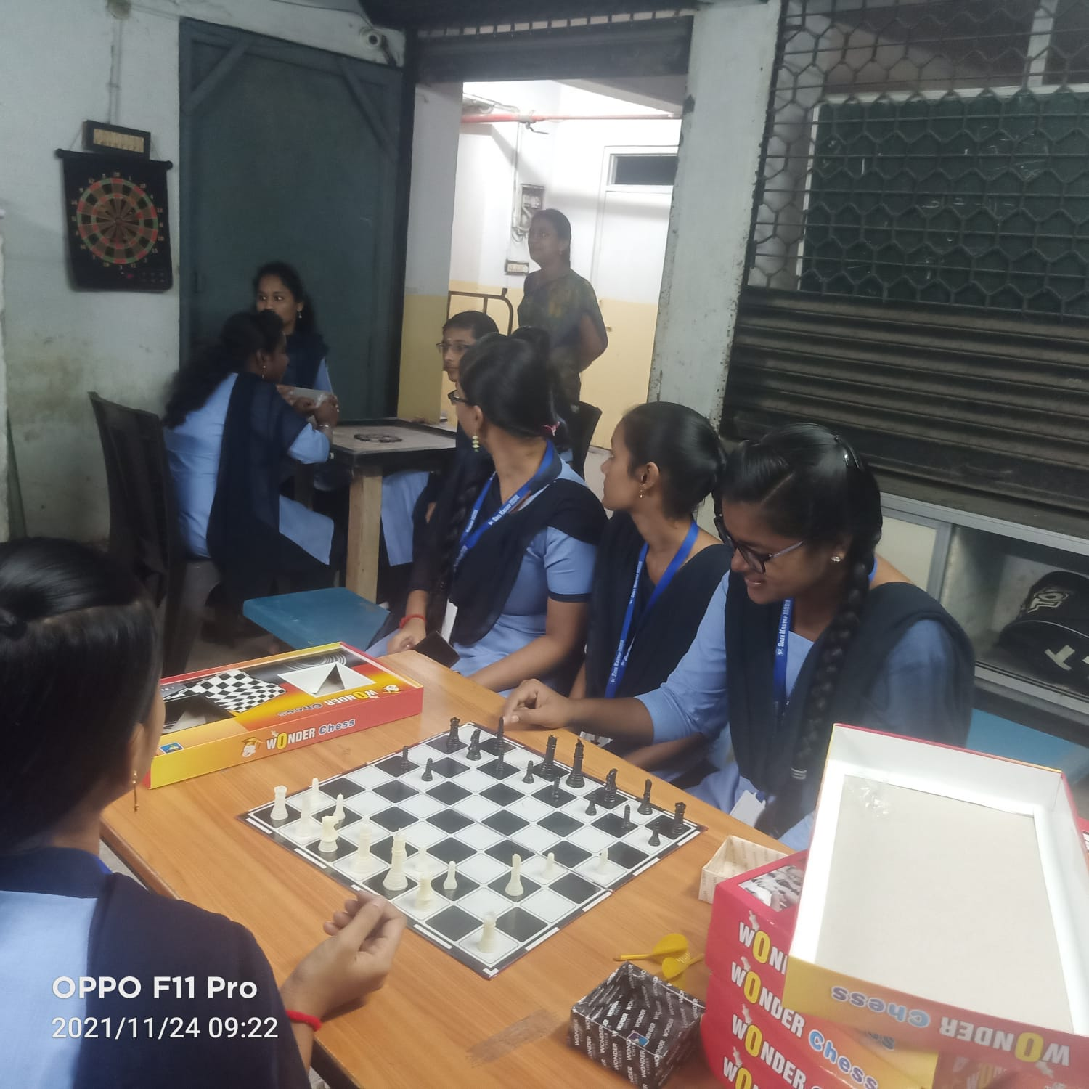
B.Sc Students playing indoor games....

Slide 41
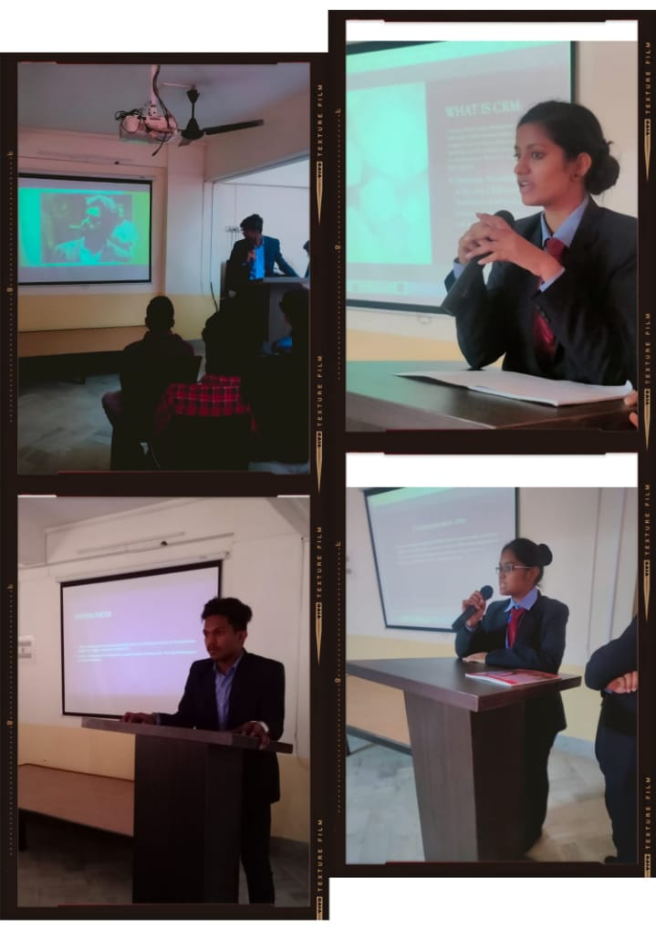
BBA First year Power Point Presentation on Advertisement and
E-Commerce Subject...

Slide 42
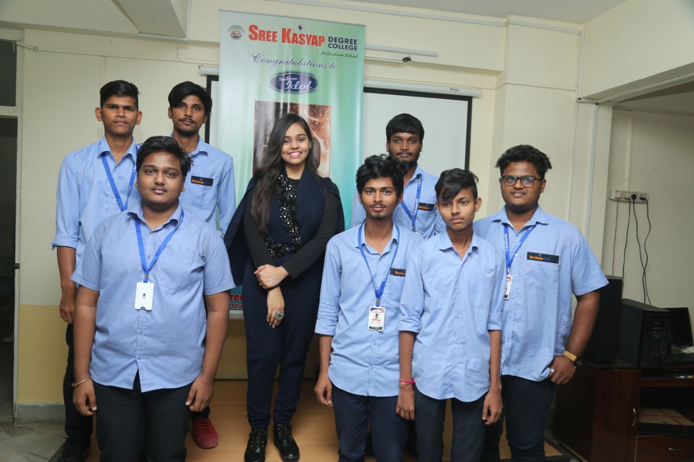

Slide 43
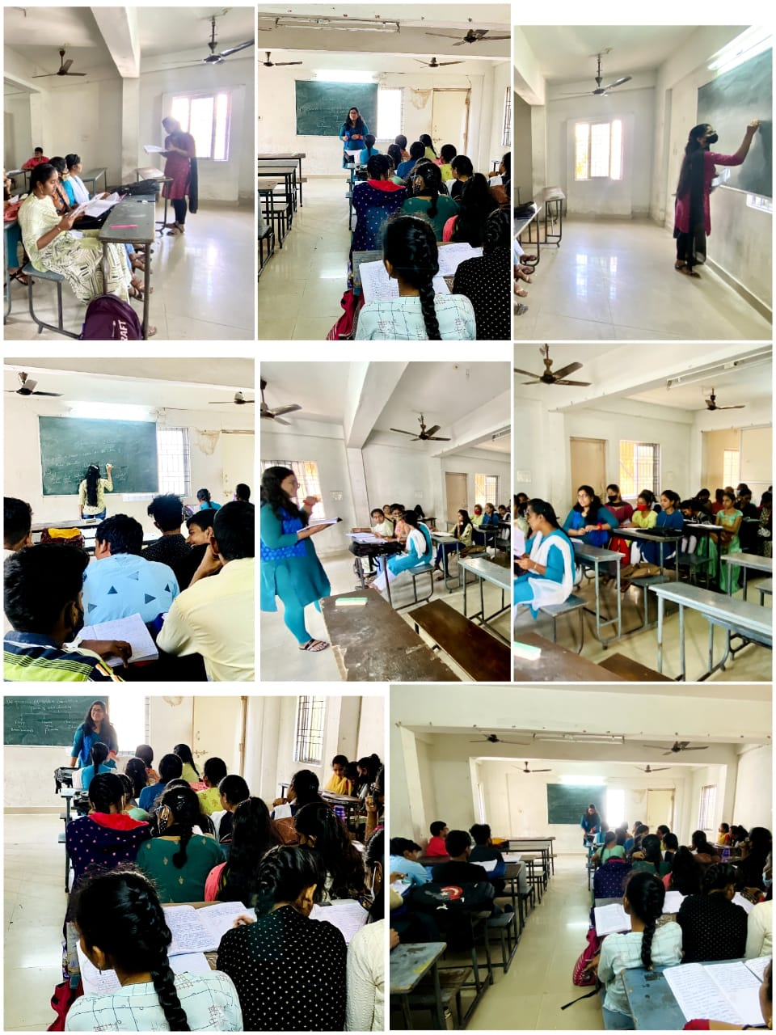
Class Room Seminars by First Year BBA students on Human Values and Professional Ethics...

Slide 44
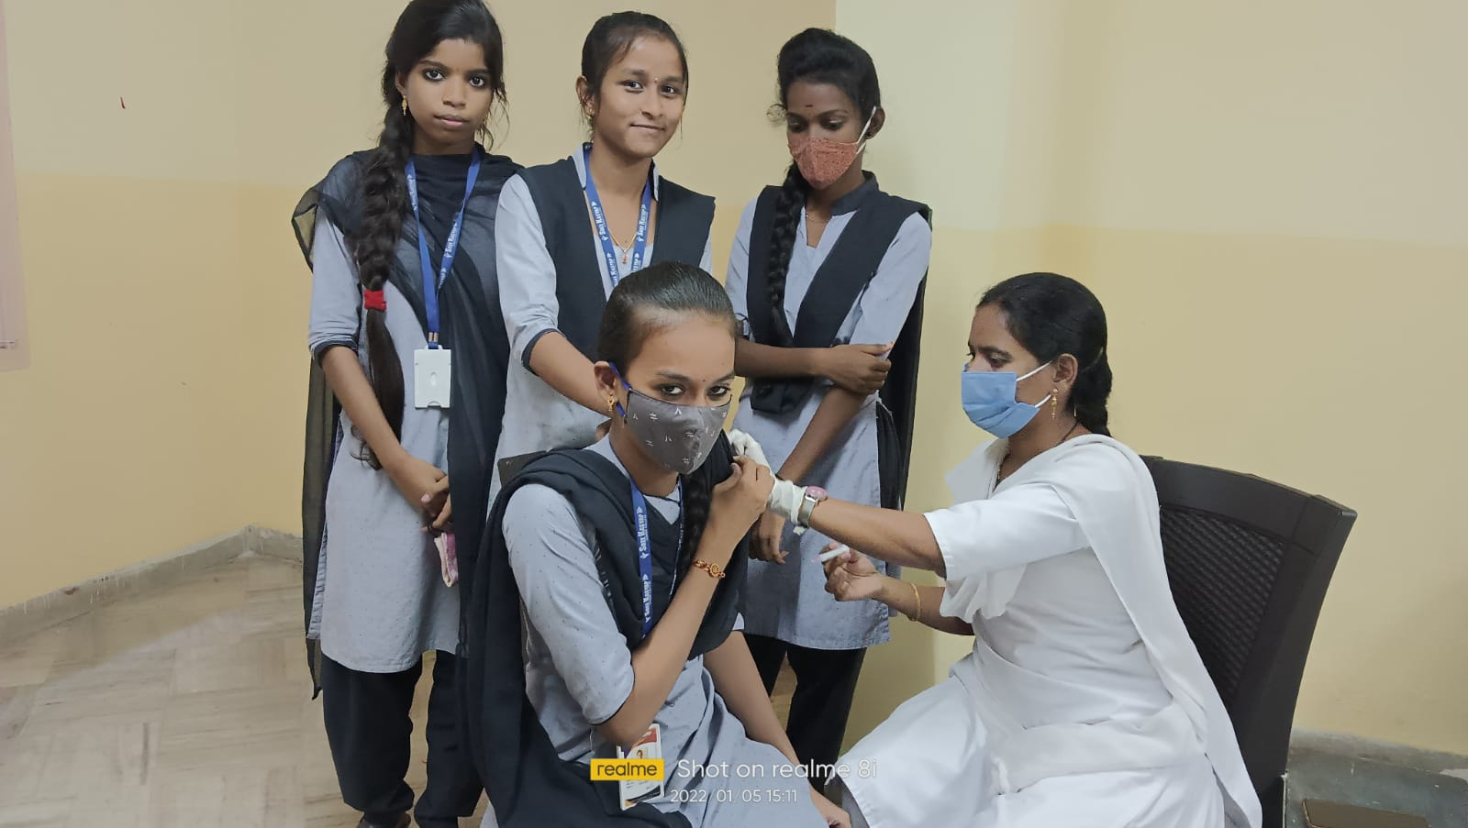
COVID Vaccination Drive in our Sree Kasyap College for Intermediate Students.....

Slide 45
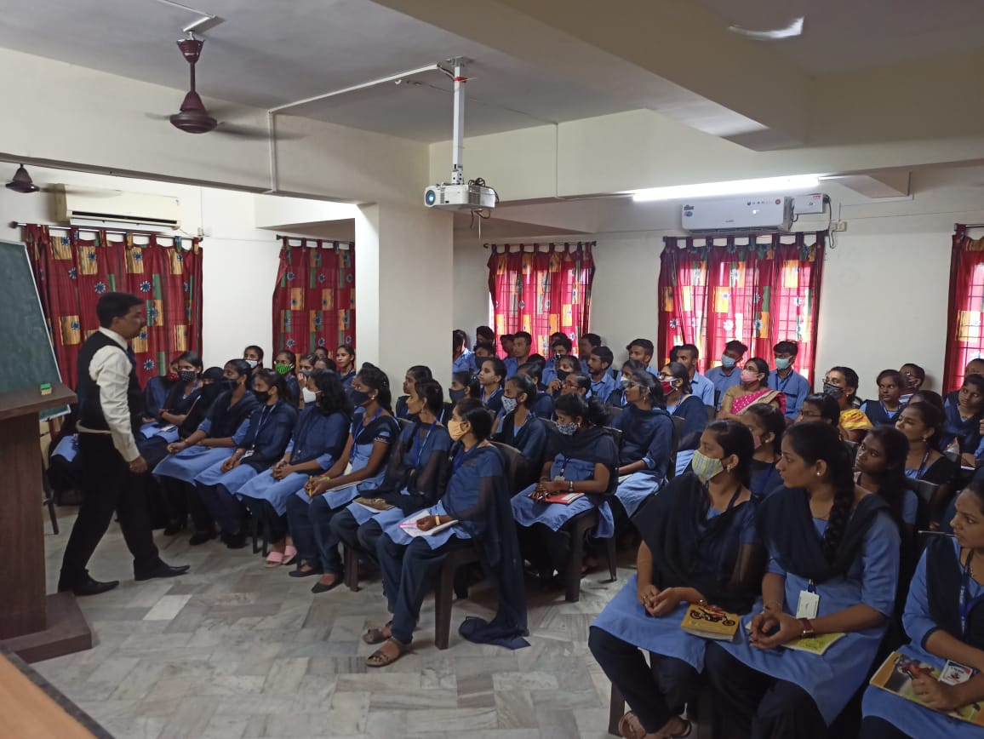
CRT demo Sessions on Verbal and Arthematic Skills by Urban Club Academy for B.Sc,BBA and B.Com final year students.

Slide 46
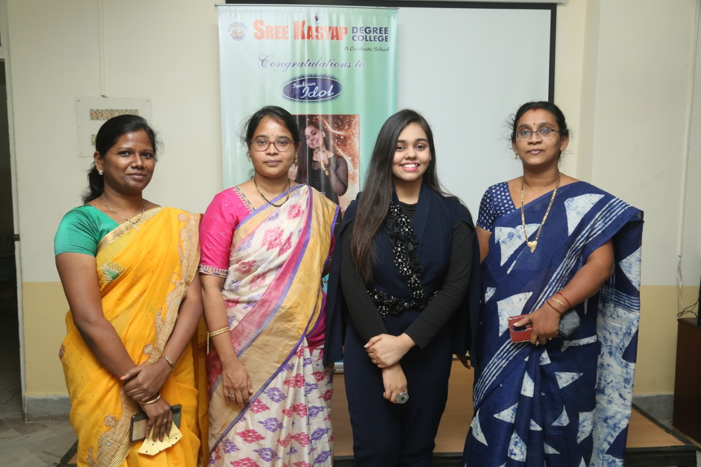

Slide 47
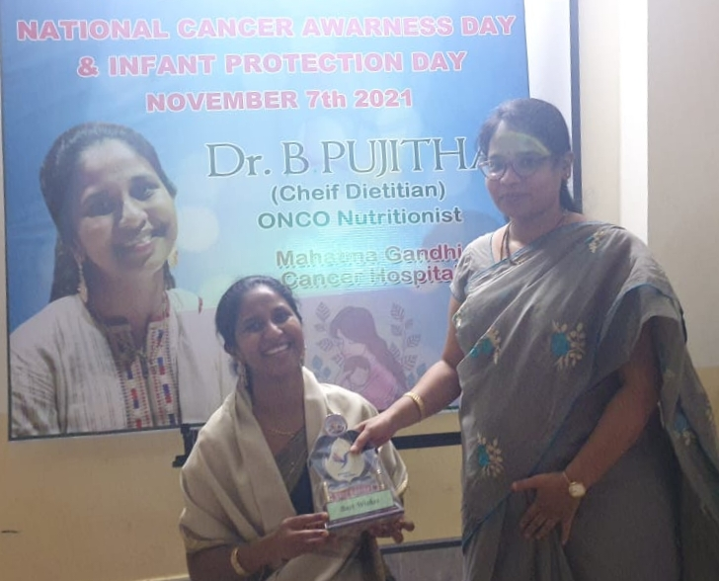
Felicitation to Dr.Pujitha mam by our Vice Principal Arts,Mrs.Jyosthna Reddy...

Slide 48

Field Trip to Explore More Practical Knowledge for all the senior Intermediate Students @FSI

Slide 49

First step ahead towards Placement, Conducted Train and Hire program in association with Ramer Software Solutions & Rasapoorna Foods Pvt Ltd.

Slide 50

Fisheries survey of india (FSI) and MATSYADARSHINI

Slide 51

Fisheries survey of india (FSI) and MATSYADARSHINI

Slide 52

Geeky Round and Self Introduction round Conducted for B.Com and BBA First Years

Slide 53

Group Activity Concept Analysis by First year Students.

Slide 54

First year BBA Student Mr.Sandeep Dhoni has bagged Silver Medal in DRM Boxing Competition

Slide 55

In remberance of Traffic Victims.... students and faculty joined in a road rally

Slide 56

Inauguration of Art Gallery .... The ideas and views of students on the themes Cancer Awareness and Infant Protection were placed....

Slide 57

Interactive Session on Linkedin Learning and Resume preparation by Mr.SivaKumar Raju Data Scientist at TCS

Slide 58

Intermediate Boys and Girls Playing Outdoor Games.....

Slide 59
Joined for a photo session with students and faculty.....

Slide 60

Junior Bi.P.C. girls playing outdoor games

Slide 61

Junior Intermediate Girl's having Personality Development Session...

Slide 62

Live Execution of SQL Commands on ORAClE -10G EXPRESS EDITION by Final Physics and Statistics Students.

Slide 63

Magic show done by our Second B.Com student.

Slide 64

Miss.Shanmukha Priya Performing in front of her classmates upon their request and mesmerized everybody.

Slide 65

Mr.Jagadesh garu Imparting knowledge on Importance of National Mole Day..

Slide 66

Mrs.Subamma Garu Inaugurated Today's Crafts Exhibition Conducted by First BBA student as a part of Fund Raising for helping Indian Youth....

Slide 67

National level Quiz Prelims on Indian Geography and History Is conducted in our college today.....

Slide 68

November 9th JAM Session activity for B.Sc Electronics Students..

Slide 69

Our Correspondent Sir Interacting with the students to know how the things are going on and what could be the possible things that could be done for the betterment of students....

Slide 70

Participated students received Certificates also after completing the Session....

Slide 71

Personality and Career Development Session by Sakshi Media in association with Gillet....

Slide 72

Personality Development Session for Intermediate Students....

Slide 73

Post to Gesture Identification Group Discussion also conducted for the students.

Slide 74

Power Point Presentation on Customer Relationship Management and E-CRM by final BBA Final Year Students...

Slide 75

Power Point Presentation on Data Base Management System by B.Sc Final year Students.

Slide 76

Practical session on MS EXCEL by siva kumar Raju Data scientist at TCS

Slide 77

Presentation of Charts on the topic Relational Database Management System and E.F.CODD rules.

Slide 78

Principal Sir Graced the Exhibition to support the students with Inter College Principal Mr.Satyanaraya garu and Administration Department....

Slide 79

Principal Sir, Vice Principals also visited the Art Gallery....

Slide 80

Product Desiging and PPT's by 1st,2nd,3rd BBA students.Today i.e Thursday promptly Management Activity Day is well organized by 3rd BBA students.

Slide 81

Proud to inform you all that our First Year BBA student Md. Adnan who won Silver Medal in Boxing in state level and going to Play for Nationals on December 22nd at LPU ,Gujarat ...

Slide 82

First Year BBA student Mr.Sandeep Dhoni has been selected for Boxing Nationals to be held In Lovely Professional University , Punjab.

Slide 83

Role Play Activity by Third Year BBA students

Slide 84

Self Introduction Activity for the Final year B.Com students

Slide 85

Senior and Junior Intermediate Bi.PC students visited departments of Biology and Zoology in our Andhra University..

Slide 86

Senior Bi.PC students visited Bio Diversity Park at Rani Chandramathi Hospital VSP.

Slide 87

Senior Boys Session On Goal Setting and Personality Development....

Slide 88

Senior inter students biological tour

Slide 89

Senior MEC and CEC students having Personality Development Session...

Slide 90

Senior SG-2 Girls having Outdoor Games Today.....

Slide 91

SG-1 Girls outdoors Games

Slide 92

Students participated in Just A Minute Activity..

Slide 93

Students participated in Just A Minute Activity..

Slide 94

Students Participated in Painting Competition on two themes National Cancer Awareness Day and Infant Protection Day...

Slide 95

Students participated in the activity.

Slide 96

Subject oriented seminar by 1st BBA students.

Slide 97

Industrial Visit

Slide 98

Today Conducted Extempore Activity for all first year B.Sc students....

Slide 99

Industrial trip to Etikoppaka with 2nd and 3rd BBA students.

Slide 100

Cancer Awareness Programme by Dr.Pujitha ,Chief Dietitian , Mahatma Gandhi Cancer Hospital.

Slide 101

Today's Gesture Identification Activity for BBA students

Slide 102

Today's Gesture Identification Activity for BBA students

Slide 103

Today's session in association with JCI Vizag on Goal Setting by JC Saranya garu and Ranjith Sha sir. Knowledge gaining orientation to BBA and Bcom students.

Slide 104

Total Members participated in the activity..

Slide 105

V.Tanusha, B.Sc First Year participated in inter college Chess Competition and Selected to play for Andhra University in South Zone Indoor Games Competition.

Slide 106

We are happy to inform you all Mr. Sasibushan Inter 2nd year MPC student, Secured 1st prize in Kata in Karate, and Kumito 3rd prize conducted by South India Karate Championship.

Slide 107


Slide 108


Slide 109


Slide 110


Slide 111


Slide 112


Slide 113


Slide 114


Slide 115

Winners were given Momentos by the Chief guest...

