Slide 1
Recreational drugs
By:Markia Knight

Slide 2

Introduction
What is a recreational drug?
According to Merriam-Webster, a recreational drug is "a drug (such as cocaine, marijuana, or methamphetamine) used without medical justification for its psychoactive effects often in the belief that occasional use of such a substance is not habit-forming or addictive."

Slide 3

Lysergic Acid Diethylamide

Slide 4
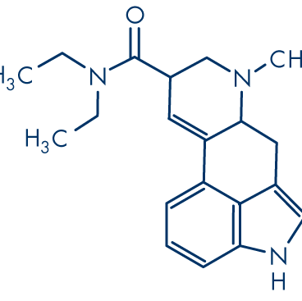
Chemistry (LSD)
Lysergic Acid Diethylamide (LSD) is a psychedelic drug known for its profound effects on perception, mood, and consciousness. From a chemistry perspective:
Chemical Structure: LSD's chemical structure includes a core indole ring system, which is common in many hallucinogenic compounds. The diethylamide group attached to this core structure is crucial for its activity.
Synthesis: LSD is synthesized from lysergic acid, which itself is derived from ergot alkaloids found in ergot fungi that grow on rye. The synthesis of LSD involves several chemical steps, typically starting with the extraction of lysergic acid from ergot alkaloids.
Pharmacodynamics: LSD acts primarily as a serotonin receptor agonist, particularly at the 5-HT2A receptors. This action alters neurotransmitter function in the brain, leading to its psychedelic effects.
Physical and Chemical Properties: LSD is usually synthesized as a colorless, odorless crystalline solid. It is sensitive to light, air, and moisture, which can degrade its potency over time.
Analytical Chemistry: Detecting LSD in biological samples or illicit substances requires specialized analytical techniques such as gas chromatography-mass spectrometry (GC-MS) or liquid chromatography-mass spectrometry (LC-MS) due to its low concentrations in bodily fluids and small doses typically consumed.
Legal and Regulatory Aspects: Due to its potent effects and potential for misuse, LSD is classified as a Schedule I controlled substance in many countries, meaning it is illegal to manufacture, possess, or distribute without proper authorization.
Understanding the chemistry of LSD is crucial for both scientific research into its potential therapeutic uses and for law enforcement in detecting and regulating its presence in society.

Slide 5

Effects on Health
Physical effects:
Increases temperature, blood pressure, and heart rate
Weakness and numbness of muscles
Dryness of mouth
Profuse sweating
Dilation of pupils
Nausea
Effects on perception:
Visual effects
Impaired thinking
Changes in mood

Slide 6
Application to Nursing
Overdose of LSD has the effects of increased paranoia, psychotic episodes, panic attacks, delusions, and seizures
People overdosed on LSD or having long term effects must be transported to an ER, a detox center, or a substance abuse clinic.
If a person is having a bad trip, healthcare staff are trained to calm these people down, medically assist them, and make sure they can't hurt themselves

Slide 7
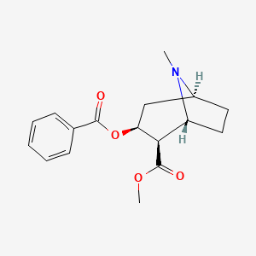
Cocaine
Cocaine is a powerful stimulant drug derived from the leaves of the coca plant (Erythroxylum coca). From a chemistry standpoint, here are some key aspects related to cocaine:
Chemical Structure: Cocaine has a relatively simple chemical structure but is potent in its effects. It is an alkaloid compound with a tropane ring structure. The chemical formula of cocaine is C17H21NO4.
Cocaine consists of a benzene ring fused to a seven-membered ring, which includes a nitrogen atom. This structure is responsible for its pharmacological activity.

Slide 8
Effects on Health
CNS effects similar to Amphetamines
﻿﻿Increases levels of dopamine in brain circuits related to control of movement and reward.
Application to Nursing
Treatment Priorities:
﻿﻿Restoring Blood flow to the heart
﻿﻿Restoring oxygen rich blood supply to the affected part of the brain
﻿﻿Stop the seizure

Slide 9

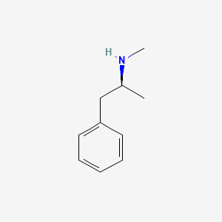
Methamphetamine

Slide 10
Chemistry
Methamphetamine, commonly referred to as meth, is a powerful central nervous system stimulant and a highly addictive drug.
Chemical Structure: Methamphetamine belongs to the phenethylamine class of compounds and is structurally related to amphetamine. Its chemical structure consists of a phenethylamine core with a methyl substituent at the alpha carbon and a methyl group attached to the nitrogen atom. The chemical formula of methamphetamine is C10H15N.
This structure is responsible for its pharmacological activity as a potent stimulant.

Slide 11
Application to Nursing
In nursing we will most likely encounter a patient with meth related problems in all healthcare environments. It is important to understand the chemical affecting the patients mental and physical state and to know the signs of overdosing.
Effects on Health
Meth is an amphetamine that controls the central nervous system and inhibits the uptake of some catecholamines such as nonadrenaline, dopamine and serotonin.
﻿highly addictive substance that affects the brain.
﻿can lead to violent behavior, anxiety, confusion, insomnia, cardiovascular problems and psychotic symptoms.

Slide 12
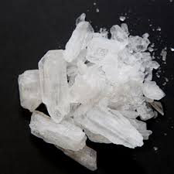
Amphetamines
Amphetamines are a group of synthetic stimulant drugs that share a common chemical structure and pharmacological effects. Here’s an overview of their chemistry:
Chemical Structure: Amphetamines are derivatives of the compound phenethylamine. They typically have a phenethylamine core with an alpha-methyl group (methyl group attached to the alpha carbon) and a side chain consisting of an ethyl group linked to an amine group. This structure is responsible for their stimulant effects on the central nervous system.
Amphetamine's chemical formula is C9H13N.

Slide 13
Effects on Health
﻿a stimulant drug that increase alertness, speeds mental processes, and generally elevates mood.
﻿amphetamine is a handmade salt chemical derived from ephedrine is an amino group mix with methyl and alkyl fuctinal groups.

Slide 14
Application to Nursing
As nurses we will be administrating amphetamine to treat
ADHD disorder in adults and children. brand name drug adderall

Slide 15
Conclusion
All these drugs apply to the healthcare field.
As a nurse it is important to be informed of these substances and how they can affect our bodies.

Slide 16

References
Mind Over Matter: The Brain's Response to Methamphetamine. (n.d.). Retrieved from https://teens.drugabuse.gov/teachers/mind-
matters/methamphetamine
Methamphetamine. (n.d.). Retrieved from
https://pubchem.ncbi.nlm.nih.gov/compound/Methamphetam
National Institute on Drug Abuse. (n.d.). Cocaine. Retrieved from
https://www.drugabuse.gov/publications/drugfacts/cocaine
Anderson, L. (2018, August). LSD. Retrieved June 16, 2019, from https://www.drugs.com/illicit/lsd.html
Davis, K. (2017, June). LSD: Effects and hazards. Retrieved June 16, 2019, from
https://www.medicalnewstoday.com/articles/295966.php
Drug Enforcement Agency. (N.d.). Drug Scheduling. Retrieved June 16, 2019, from https://www.dea.gov/drug-scheduling

