Slide 1
Information Technology
Notes:
%%TTS_FEMALE% Welcome to Halma.

Slide 2
Introduction
Password Management
Importance of locking the system
Do’s and Don'ts on Company System
Notes:
%%TTS_FEMALE% Here we are going to cover the topics on Password management, OneDrive management, importance of locking the system and do’s and don'ts of company system.

Slide 3
Password Management
Notes:
%%TTS_FEMALE% Password Management

Slide 4
What is password?
A password is a string of characters used to verify the identity of a user during the authentication process.
Best Practices:
A minimum length of eight characters and a maximum between 8 to 16 characters.
Include both uppercase and lowercase letters with case sensitivity.
Use at least one number and one special character.
Avoiding common or predictable passwords, such as names, dates, phrases or keyboard patterns
Changing passwords regularly and avoiding reusing old passwords
Notes:
%%TTS_FEMALE% What is password?
A password is a string of characters used to verify the identity of a user during the authentication process.
Passwords are typically designed to be known only to the user and allow that user to gain access to a device, application or website.
So let us understand how to create a secure password.
Passwords, when carefully created and protected, increase safe and secure interactions online and in the workplace and can prevent password cracking.
To maximize the strength and efficacy of passwords, organizations often establish password policies.
These policies are designed to help users create strong passwords and adopt best practices for managing login credentials.
Below are a few examples of the best practices that contribute to effective password management and creation.
They are:
A password must be a minimum length of eight characters and a maximum between 8 to 16 characters.
Always Include both uppercase and lowercase letters with case sensitivity.
Use at least one number and one special character.
Try to avoid common or predictable passwords, such as names, dates, phrases or keyboard patterns.
Change passwords regularly and avoid reusing old passwords.

Slide 5
How to avoid weak password
Use of the word "password"
Sequential numbers starting from one, such as "12345678"
Inclusion of accessible information: birthdates, names of relatives, home addresses and names of pets or children
How often should passwords be changed?
Corporate password policies often place an expiration date on their users' passcodes, forcing users to replace old passwords with new ones. Password time periods commonly span 90 to 180 days.
Notes:
%%TTS_FEMALE% Now let us see how to avoid weak password.
Avoid using the word password.
Don’t give the Sequential numbers starting from one, such as 12345678.
Do not include your birthdates, names of relatives, home addresses and names of pets or children.
Now you have question how often should passwords be changed?
Corporate password policies often place an expiration date on their users' passcodes, forcing users to replace old passwords with new ones.
Password time periods commonly span 90 to 180 days.
Do not use old passwords again.

Slide 6
Alternative methods to passwords
Password less authentication has emerged to help eliminate the complexities and vulnerabilities of traditional passwords. This method is especially beneficial for users on mobile devices or social platforms. Instead of creating a unique password, users receive a one-time authentication code via a text message, email or other messaging alert or service.
Types of authentication methods include:
Two-factor authentication –Password/PIN,ID card
Multifactor authentication – It is a multi-step account login process that requires users to enter more information than just a password.
Biometrics – Fingerprints, retinal scan.
One-time password(OTP) - These passwords change for every use and are typically stored on security tokens.
Notes:
%%TTS_FEMALE% There are alternative methods to passwords.
Password less authentication has emerged to help eliminate the complexities and vulnerabilities of traditional passwords.
This method is especially beneficial for users on mobile devices or social platforms. Instead of creating a unique password, users receive a one-time authentication code via a text message, email or other messaging alert or service.
The code allows users to log in automatically.
There are Other authentication methods which can also be combined with or in place of passwords.
They are:
Two-factor authentication – Two factor authentication requires users to provide two authentication factors that include a combination of something the user knows like a password or PIN.
Next is
Multifactor authentication – It is a multi-step account login process that requires users to enter more information than just a password.
For example, along with the password, users might be asked to enter a code sent to their email, answer a secret question, or scan a fingerprint.
Next is
Biometrics – A Biometric methods authenticates users based on physiological characteristics such as fingerprints or retinal scans or behavioural characteristics such as typing patterns and voice recognition.
And the last one is
One-time passwords - An OTP is an automatically generated password that only authenticates a user for a single transaction or session.
These passwords change for every use and are typically stored on security token.
Next we will move on to our next topic and that is

Slide 7
Importance of Locking your system
Notes:
%%TTS_FEMALE% Importance of locking the system
If you walk away from your computer and do not lock it or log off, it poses a security risk to you and for the organisation.
Someone can use your computer in an unauthorized way even if you are away for few minutes, like: Sending an email from your account or Tampering the files and can deleting confidential files.

Slide 8
Importance of locking your PC
One of the best practices for ensuring the security of your system is to lock it when you are not using it.
Locking the system prevents unauthorized access to your files, applications, and settings.
Locking the system also protects your privacy and prevents others from viewing your personal or confidential information.
By locking the system, you can reduce the risk of data breaches, identity theft, and malware infections.
Notes:
%%TTS_FEMALE% One of the best practices for ensuring the security of your system is to lock it when you are not using it.
By locking the system prevents unauthorized access to your files, applications, and settings.
Locking the system also protects your privacy and prevents others from viewing your personal or confidential information.
By locking the system, you can reduce the risk of data breaches, identity theft, and malware infections.
When it comes to cybersecurity, it’s every employee’s responsibility. You may not see the direct role you play in the protection of your organization and its data, but consider this fact: as an employee, you have access to your organization’s data and network.

Slide 9
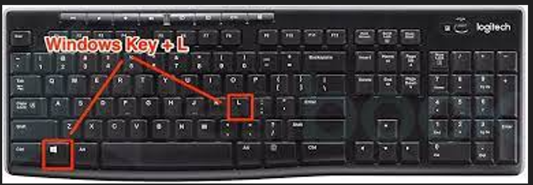
Shortkeys for locking the system
You can also use Windows key + L to lock the system.
You can also set the system to lock automatically after a certain period of inactivity.
Notes:
%%TTS_FEMALE% Let us see some shortcuts for locking the system.
You can use Windows key plus L button to lock the PC as shown in the picture below.
Second one, you can lock the system automatically after a certain period of time by setting screen saver timings.
Let us now look into the steps for setting the screen saver.

Slide 10
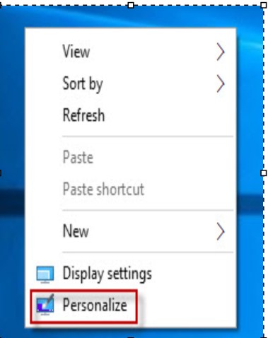
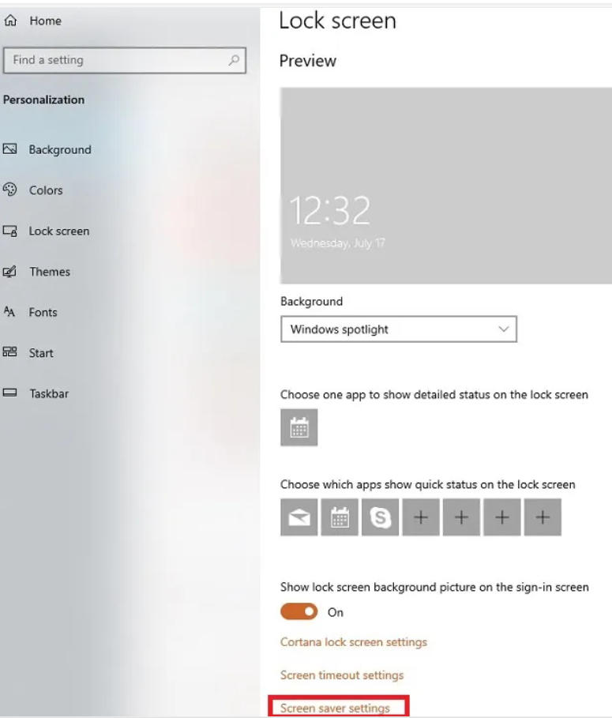
Step 1: Right-click on the desktop empty area and click on “personalize.” A control panel will be open up.
Step 2: Click on Lock Screen from the left side pane.
Step 3: Click on the “Screen saver settings” from the right-side pane.
Notes:
%%TTS_FEMALE% Right-click on the desktop empty area and click on “personalize.” A control panel will be open up as shown in the picture.
Click on Lock Screen from the left side pane.
Click on the “Screen saver settings” from the right-side pane.
Once you have clicked on Screen saver setting option. Screen saver tab will open as shown.

Slide 11
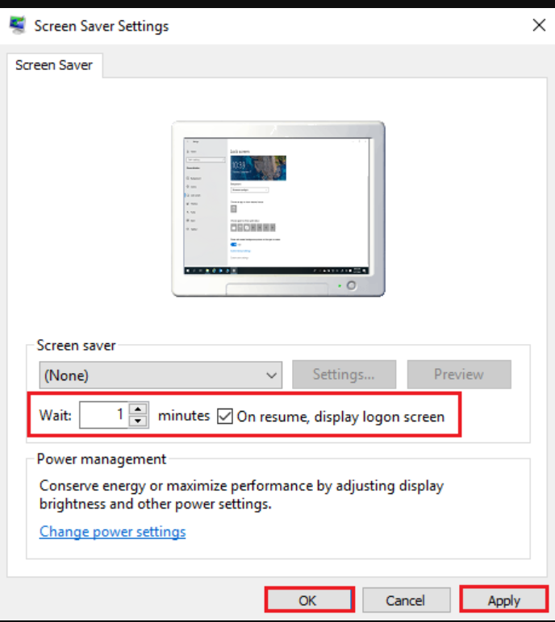
Step 4: Under screen saver section, put a particular time in the “wait” field and tick the check box of “on resume, display logon screen”.
Step 5: Click on Apply and OK.
Notes:
%%TTS_FEMALE% Under screen saver section, put a particular time in the “wait” field and tick the check box of “on resume, display logon screen”.
Click on Apply and OK.
By setting this option, if your system is idle for specific minutes what you have mentioned in the wait field the system gets automatically get locked.
You need to provide password when you attempt to login next time.
Will be moving onto text topic that is.

Slide 12
Do’s and Don'ts on Company Assets
Notes:
Do’s and don’ts on Company Assets.

Slide 13
Do’s
Safeguard your laptop by putting a password/lock on it so that nobody else can access it except you.
Make sure you shut down/put your laptop to sleep when you’re done with work.
Try to keep your laptop/desktop in good physical condition.
Ensure to close the browser while exiting your remote desktop access session
Try working on a desk/table so that you don’t damage any of the parts.
Shutdown your laptops at the end of your day.
Keep the laptop clean. Wipe the screen and keypad often.
Keep running security updates frequently.
Notes:
%%TTS_FEMALE% Some general rules of Do’s are as follows.
Always Safeguard your laptop by putting a password/lock on it so that nobody else can access it except you.
Make sure you shut down/put your laptop to sleep when you’re done with work.
Try to keep your laptop/desktop in good physical condition.
Always ensure to close the browser while exiting your remote desktop access session.
Try to work on a desk/table so that you don’t damage any of the parts.
Shutdown your laptops at the end of your day.
Keep the laptop clean. Wipe the screen and keypad often.
Keep running security updates frequently.

Slide 14
Dont’s
Do not forward company or client-related emails even to your own personal email address.
Don’t log in with your private email account/Gmail/Facebook or any other social media accounts
Don’t utilize browsers/websites that aren’t trustworthy.
Avoid opening e-mail(s) or e-mail attachments from an unknown sender.
Don’t try to eat or drink around your laptop so that you don’t accidentally spill anything on it.
Avoid over heating by keeping away your laptop from bed sofa or pillows.
Do not upload/download/print confidential information of your organization anywhere.
Do not open any social media site on company laptop.
Do not download any new software on your own.
Don’t connect to public Wi-Fi without connecting to VPN.
Notes:
%%TTS_FEMALE% Next is don’ts
Do not forward company or client-related emails even to your own personal email address.
Don’t log in with your private email account/Gmail/Facebook or any other social media accounts
Don’t utilize browsers/websites that aren’t trustworthy.
Avoid opening e-mails or e-mail attachments from an unknown sender.
Don’t try to eat or drink around your laptop so that you don’t accidentally spill anything on it.
Avoid over heating by keeping away your laptop from bed sofa or pillows.
Do not upload/download/print confidential information of your organization anywhere.
Do not open any social media site on company laptop.
Do not download any new software on your own.
Don’t connect to public Wi-Fi without connecting to VPN.
This completes the basic training of IT. If you have any queries kindly reach out to the IT team.
We are happy to help you.

Slide 15
You can raise ticket by dropping an E-mail to helpdesk@halma.com
Notes:
%%TTS_FEMALE% You can also raise ticket by dropping an E-mail to helpdesk@halma.com.

Slide 16
Thank You
Notes:
%%TTS_FEMALE% Thank you

