Slide 1
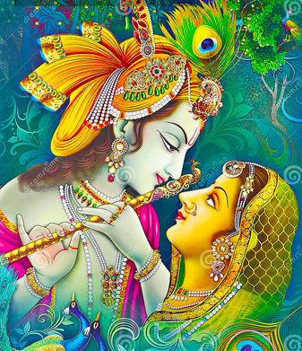
12th APRIL
8.00 P.M:- BUSES WILL GO FROM RAMSHARNAM LUDHIANA
6.30 A.M:-REACH VRINDAVAN (TEA WILL BE SERVED)

Slide 2
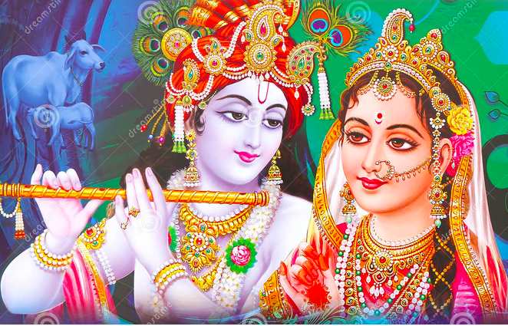
13th APRIL(MORNING)
8.30 TO 10.00 A.M :-BFAST TIME
10 .00 A.M:- E RICKSHAW WILL BE PROVIDED ON SHARING OF 5 FOR
TEMPLES
1) BANKE BIHARI
2) RADHA VALLABH
3) RADHA DAMODAR
4) RADHA SHAM SUNDER
5) RADHA RAMAN 6) NIDHI VAN
1.30 P.M TO 4.30 P.M:- LUNCH AND REST TIME

Slide 3
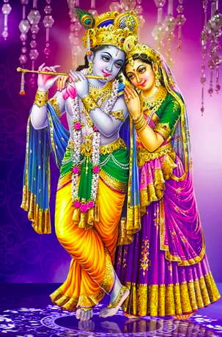
13th APRIL
(EVENING)
4.30 P.M :- TEA AND SNACKS
5.00 P.M TO 8.00 P.M :- AGAIN
E-RIKSHAW WILL BE PROVIDED FOR TEMPLES
1) VAISHNO DEVI
2) PRIYA KANTA ZOO
3) ISKON TEMPLE
4) PREM MANDIR
8.30 P.M :- BACK TO ROOMS
DINNER AND REST

Slide 4
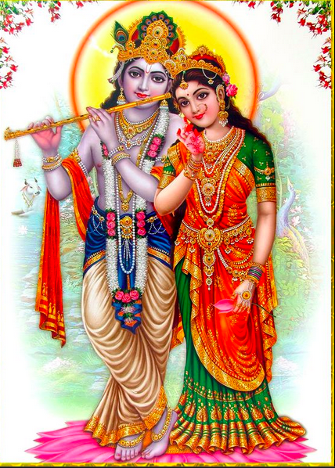
14th APRIL (MORNING)
6.30 to 7.30 a.M:- TEA TIME
9.00 A.M:- BFAST AND READY
9.00 A.M:- BUS WILL PLY FOR
1) MANSAROVER MAHADEV TEMPLE
2) BEL VAN
3) GOKUL
4) RAMAN RETI
5) BHARMAND GHAT
1.30 TO 2.30 P.M :- LUNCH WILL BE PROVIDED

Slide 5
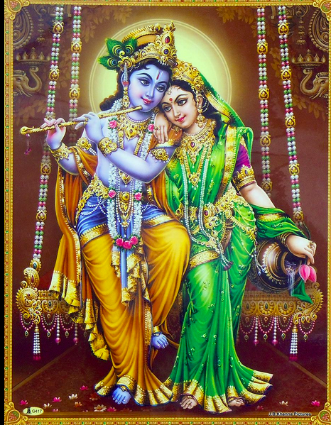
14th APRIL (EVENING)
3.00 P.M :- .BUSES WILL MOVE FOR
1) MATHURA
2) DWARKA DHEESH
3) VISHRAM GHAT
4) janam bhoomi
6.00 p.m:- BACK TO DHARAMSHALA
Tea and snacks
BHAJAN SANDHYA AT DHARAMSHALA
9.30 p.m:- DINNER AND GO FOR REST

Slide 6
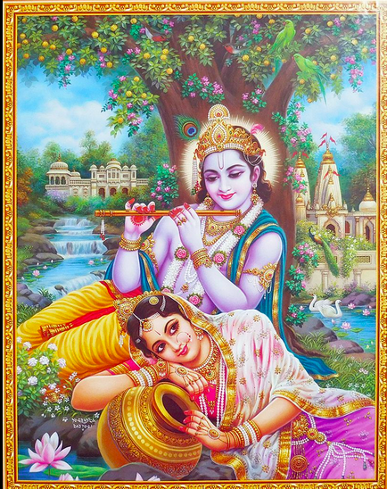
15th APRIL (morning)
6.30 to 7.30 A.M:- TEA TIME
8.30 TO 10.00 A.M:- B FAST
10.00 A.M TO 12.00 P.M :- FREE TIME FOR SHOPPING
12.P.M :- BUSES WILL MOVE FOR GOWARDHAN
2.00 P.M :- LUNCH AT GOWARDHAN

Slide 7
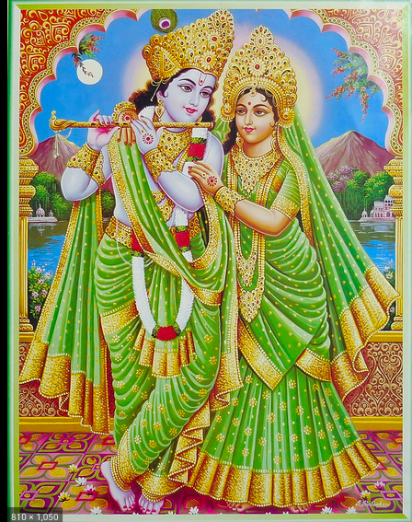
15th APRIL (EVENING)
5.40 P.M:- BUSES WILL MOVE FOR KOKILA VAN (SHANI MANDIR)
8.00 P.M :- DINNER AT KOKILA VAN
AFTER DINNER BUSES WILL MOVE
FOR LUDHIANA
16th APRIL
7.00 A.M :- REACH LUDHIANA

