Slide 1
PL Fin Yr. 2021-22 0-180 DPD PORTFOLIO Collection PERFORM Report
 | LIVE ZERO |  |  |  |  |  |  |  | BUCKET B
DIVISION | Agmt. | MTBC. | Auto Clr. Count% | Non Clr TBC Coll.% | Effi Coll% | BCODC Coll% | NOT COLLECT. | Arr Incr/Decr. | Agmt. | MTBC. | Auto Clr. Count% | Non Clr TBC Coll.% | Arr Collect | Effi Coll% | BCODC Coll% | NOT COLLECT. | Arr Incr/Decr. | Total MTBC COLL% | 2021-22 RANK
GONDIA | 20221 | 78.30 | 73% | 90% | 97% | 18% | 639 | 22.42 | 8309 | 25.56 | 12% | 83% | 74.9 | 19% | 4% | 3903 | 35.98 | 94% | 1
AKOLA | 27617 | 104.56 | 78% | 85% | 97% | 12% | 927 | 31.52 | 11080 | 32.23 | 21% | 79% | 80.4 | 20% | 4% | 5021 | 49.53 | 94% | 2
AMRAVATI | 39776 | 151.46 | 76% | 87% | 97% | 14% | 1315 | 45.65 | 16402 | 50.10 | 19% | 75% | 119.6 | 18% | 4% | 7522 | 94.24 | 93% | 3
CHANDRAPUR | 22839 | 83.63 | 74% | 84% | 96% | 19% | 936 | 31.77 | 10884 | 33.17 | 17% | 79% | 91.9 | 18% | 5% | 5080 | 54.96 | 93% | 4
NAGPUR | 29111 | 108.77 | 76% | 88% | 97% | 12% | 906 | 31.79 | 12803 | 41.28 | 18% | 74% | 90.0 | 18% | 3% | 5524 | 81.22 | 92% | 5
NASIK | 25747 | 97.05 | 79% | 83% | 97% | 13% | 960 | 32.53 | 12653 | 39.18 | 19% | 73% | 94.9 | 18% | 5% | 6053 | 79.13 | 92% | 6
JALGAON | 37399 | 144.14 | 78% | 86% | 97% | 13% | 1306 | 46.20 | 15654 | 48.46 | 18% | 70% | 106.3 | 17% | 3% | 7785 | 113.39 | 92% | 7
Grand Total | 202710 | 767.90 | 76% | 86% | 97% | 14% | 6989 | 241.87 | 87785 | 269.98 | 18% | 75% | 658.0 | 18% | 4% | 40888 | 508.45 | 93%
SME Fin Yr. 2021-22 0-180 DPD PORTFOLIO Collection PERFORM Report
 | LIVE ZERO |  |  |  |  |  |  |  | BUCKET B
DIVISION | Agmt. | MTBC. | Auto Clr. Count% | Non Clr TBC Coll.% | Effi Coll% | BCODC Coll% | NOT COLLECT. | Arr Incr/Decr. | Agmt. | MTBC. | Auto Clr. Count% | Non Clr TBC Coll.% | Arr Collect | Effi Coll% | BCODC Coll% | NOT COLLECT. | Arr Incr/Decr. | Total MTBC COLL% | 2021-22 RANK
AMRAVATI | 4673 | 88.39 | 75% | 79% | 96% | 5% | 180 | 34.64 | 2536 | 75.47 | 23% | 86% | 131.6 | 22% | 1% | 917 | 77.30 | 93% | 1
CHANDRAPUR | 3062 | 56.25 | 71% | 88% | 97% | 9% | 119 | 16.42 | 1603 | 28.95 | 16% | 81% | 48.9 | 22% | 3% | 638 | 45.84 | 93% | 2
JALGAON | 6059 | 120.51 | 75% | 86% | 97% | 8% | 217 | 40.66 | 2040 | 53.51 | 15% | 70% | 88.2 | 19% | 2% | 938 | 124.94 | 91% | 3
AKOLA | 4503 | 82.07 | 78% | 85% | 97% | 6% | 177 | 28.97 | 2097 | 46.42 | 18% | 72% | 83.4 | 18% | 2% | 888 | 100.09 | 90% | 4
NASIK | 4517 | 109.70 | 76% | 85% | 96% | 8% | 233 | 46.74 | 2864 | 65.47 | 16% | 77% | 109.1 | 20% | 3% | 1198 | 129.26 | 90% | 5
GONDIA | 2761 | 48.78 | 69% | 90% | 97% | 11% | 129 | 16.89 | 2095 | 36.50 | 13% | 74% | 72.0 | 18% | 2% | 983 | 79.52 | 89% | 6
NAGPUR | 3665 | 80.47 | 75% | 79% | 97% | 7% | 149 | 26.78 | 2417 | 45.51 | 16% | 66% | 53.5 | 17% | 2% | 1002 | 127.58 | 88% | 7
Grand Total | 29240 | 586.17 | 75% | 84% | 97% | 7% | 1204 | 211.11 | 15652 | 351.83 | 17% | 76% | 586.7 | 20% | 2% | 6564 | 684.52 | 91%

Slide 2
PL 1st TO 8th PDC Fin Yr. 2021-22 0-180 DPD PORTFOLIO Collection PERFORM Report
 | LIVE ZERO |  |  |  |  |  |  |  | BUCKET B
DIVISION | Agmt. | MTBC. | Auto Clr. Count% | Non Clr TBC Coll.% | Effi Coll% | BCODC Coll% | NOT COLLECT. | Arr Incr/Decr. | Agmt. | MTBC. | Auto Clr. Count% | Non Clr TBC Coll.% | Arr Collect | Effi Coll% | BCODC Coll% | NOT COLLECT. | Arr Incr/Decr. | Total Effi Coll% | Total MTBC COLL% | 2021-22 RANK
GONDIA | 11842 | 45.89 | 74% | 92% | 98% | 60% | 259 | 9.14 | 764 | 2.98 | 15% | 68% | 5.7 | 27% | 12% | 354 | 8.17 | 88% | 96% | 1
AKOLA | 16004 | 61.22 | 78% | 86% | 97% | 33% | 475 | 17.10 | 1378 | 5.14 | 25% | 65% | 7.8 | 29% | 10% | 564 | 13.58 | 85% | 95% | 2
AMRAVATI | 23162 | 89.34 | 77% | 86% | 97% | 40% | 686 | 25.10 | 2072 | 7.95 | 21% | 62% | 9.8 | 27% | 9% | 846 | 23.31 | 84% | 95% | 3
NAGPUR | 15948 | 59.79 | 77% | 88% | 97% | 39% | 435 | 16.02 | 1471 | 5.64 | 20% | 57% | 6.5 | 24% | 9% | 645 | 18.93 | 82% | 95% | 4
CHANDRAPUR | 12829 | 46.13 | 75% | 86% | 97% | 64% | 453 | 15.37 | 1319 | 4.69 | 21% | 64% | 7.2 | 27% | 15% | 573 | 13.41 | 82% | 94% | 5
NASIK | 12951 | 49.49 | 82% | 84% | 97% | 37% | 415 | 14.48 | 1355 | 5.16 | 22% | 52% | 5.6 | 23% | 11% | 631 | 19.08 | 81% | 94% | 6
JALGAON | 20442 | 79.31 | 78% | 85% | 97% | 43% | 694 | 25.23 | 2241 | 8.51 | 22% | 55% | 10.9 | 23% | 7% | 1058 | 30.18 | 80% | 94% | 7
Grand Total | 113178 | 431.16 | 77% | 87% | 97% | 44% | 3417 | 122.44 | 10600 | 40.06 | 21% | 60% | 53.5 | 26% | 10% | 4671 | 126.67 | 83% | 95%
SME 1st TO 8th PDC Fin Yr. 2021-22 0-180 DPD PORTFOLIO Collection PERFORM Report
 | LIVE ZERO |  |  |  |  |  |  |  | BUCKET B
DIVISION | Agmt. | MTBC. | Auto Clr. Count% | Non Clr TBC Coll.% | Effi Coll% | BCODC Coll% | NOT COLLECT. | Arr Incr/Decr. | Agmt. | MTBC. | Auto Clr. Count% | Non Clr TBC Coll.% | Arr Collect | Effi Coll% | BCODC Coll% | NOT COLLECT. | Arr Incr/Decr. | Total Effi Coll% | Total MTBC COLL% | 2021-22 RANK
CHANDRAPUR | 1806 | 28.03 | 73% | 92% | 97% | 61% | 59 | 7.25 | 160 | 2.16 | 11% | 70% | 2.5 | 28% | 15% | 60 | 5.66 | 86% | 96% | 1
GONDIA | 1507 | 26.29 | 69% | 93% | 98% | 50% | 48 | 6.30 | 138 | 2.17 | 15% | 66% | 3.3 | 27% | 9% | 57 | 5.69 | 85% | 96% | 2
AMRAVATI | 2550 | 39.98 | 75% | 88% | 97% | 42% | 94 | 11.73 | 265 | 3.56 | 16% | 60% | 4.3 | 27% | 12% | 108 | 12.29 | 84% | 94% | 3
JALGAON | 3636 | 57.90 | 75% | 88% | 97% | 49% | 131 | 17.55 | 399 | 6.32 | 12% | 58% | 7.5 | 24% | 7% | 208 | 22.98 | 81% | 94% | 4
AKOLA | 2553 | 37.92 | 79% | 84% | 96% | 44% | 101 | 13.34 | 293 | 4.33 | 16% | 45% | 2.9 | 22% | 7% | 136 | 18.84 | 79% | 92% | 5
NAGPUR | 2236 | 36.59 | 75% | 85% | 97% | 41% | 96 | 11.50 | 336 | 4.69 | 12% | 46% | 3.0 | 19% | 7% | 163 | 22.19 | 77% | 92% | 6
NASIK | 2503 | 43.24 | 75% | 84% | 96% | 65% | 130 | 15.98 | 398 | 5.65 | 13% | 53% | 5.6 | 20% | 14% | 188 | 23.79 | 76% | 92% | 7
Grand Total | 16791 | 269.95 | 75% | 88% | 97% | 50% | 659 | 83.66 | 1989 | 28.88 | 14% | 55% | 29.0 | 23% | 10% | 920 | 111.42 | 80% | 93%

Slide 3


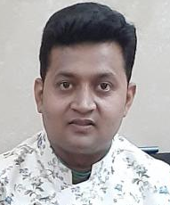
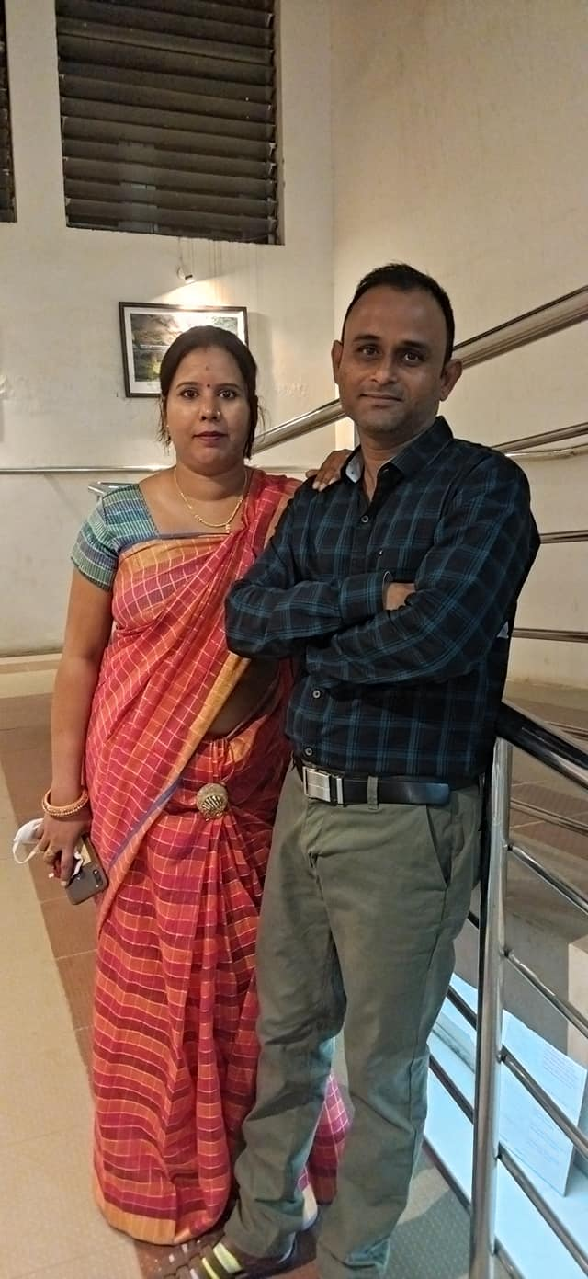
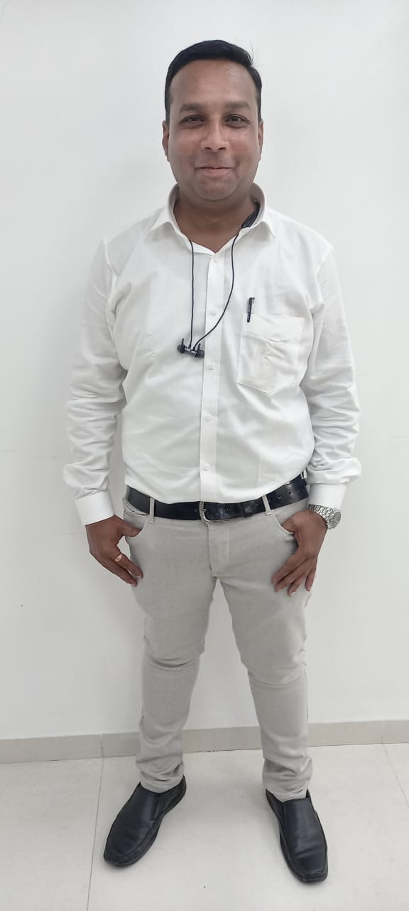
 | PL Fin Yr 2021-22 0-180 DPD |  |  |  |  | SME Fin Yr 2021-22 0-180 DPD
BRANCH | Auto Clr. Count% | Non Clr TBC Coll.% | Arr Collect | MTBC COLL% | BCODC Coll% | Auto Clr. Count% | Non Clr TBC Coll.% | Arr Collect | MTBC COLL% | BCODC Coll% | Total Auto Clr. Count% | Total Non Clr TBC Coll.% | Total MTBC COLL% | Total BCODC Coll%
WASHIM | 60% | 88% | 28.5 | 96% | 7% | 61% | 90% | 36.0 | 96% | 3% | 60% | 90% | 96% | 5%
NASIK ROAD | 65% | 78% | 11.5 | 93% | 7% | 50% | 89% | 30.3 | 95% | 5% | 62% | 86% | 94% | 6%
KATOL | 60% | 89% | 13.5 | 96% | 6% | 54% | 86% | 10.6 | 93% | 5% | 60% | 88% | 95% | 6%
UMRED | 56% | 89% | 10.9 | 96% | 6% | 62% | 87% | 10.8 | 94% | 6% | 57% | 88% | 95% | 6%
PUSAD | 56% | 83% | 28.2 | 93% | 4% | 54% | 97% | 53.7 | 101% | 1% | 55% | 90% | 97% | 2%

Slide 4





 | PL Fin Yr 2021-22 0-180 DPD |  |  |  |  | SME Fin Yr 2021-22 0-180 DPD
BRANCH | Auto Clr. Count% | Non Clr TBC Coll.% | Arr Collect | MTBC COLL% | BCODC Coll% | Auto Clr. Count% | Non Clr TBC Coll.% | Arr Collect | MTBC COLL% | BCODC Coll% | Total Auto Clr. Count% | Total Non Clr TBC Coll.% | Total MTBC COLL% | Total BCODC Coll%
WARORA | 54% | 86% | 23.5 | 95% | 8% | 55% | 80% | 5.0 | 92% | 5% | 54% | 84% | 94% | 7%
CHANDRAPUR | 57% | 82% | 24.6 | 93% | 8% | 52% | 82% | 16.9 | 92% | 3% | 57% | 82% | 92% | 5%
AMRAVATI | 62% | 80% | 33.1 | 93% | 4% | 63% | 74% | 20.5 | 91% | 2% | 62% | 77% | 92% | 3%
CHALISGAON | 55% | 85% | 29.1 | 94% | 5% | 63% | 77% | 17.9 | 90% | 3% | 56% | 80% | 92% | 4%
MALEGAON | 58% | 84% | 13.6 | 95% | 4% | 65% | 84% | 13.1 | 94% | 3% | 60% | 84% | 94% | 3%

Slide 5


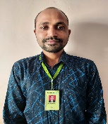

Fin Year TOP RE in 97% Avg MTBC Collection in Allocation
 |  | PL Fin Year 2021-22 0-180 DPD |  |  |  |  |  | SME Fin Year 2021-22 0-180 DPD |  |  |  |  |  | 2021-22
ALLOCATION NAME | Branch | Auto Clr. Count% | Non Clr TBC Coll.% | Arr Collect | MTBC COLL% | BCODC Coll% | Arr Incr/Decr. | Auto Clr. Count% | Non Clr TBC Coll.% | Arr Collect | MTBC COLL% | BCODC Coll% | Arr Incr/Decr. | Total MTBC COLL%
PRAVIN CHAVHAN | WASHIM | 56% | 104% | 8.9 | 101% | 8% | -1.05 | 54% | 118% | 11.2 | 107% | 4% | -6.21 | 104%
VIJAY CHILGAR | PUSAD | 52% | 84% | 8.5 | 92% | 4% | 8.80 | 48% | 106% | 20.7 | 106% | 1% | -6.71 | 99%
RAVINDRA BAIRAGI | NASIK RD | 63% | 86% | 10.4 | 95% | 7% | 7.08 | 47% | 92% | 27.4 | 98% | 4% | 5.18 | 97%
SANJAY TANDULKAR | RAMTEK | 59% | 86% | 5.7 | 95% | 7% | 4.12 | 50% | 95% | 6.4 | 98% | 5% | 1.77 | 97%

Slide 6
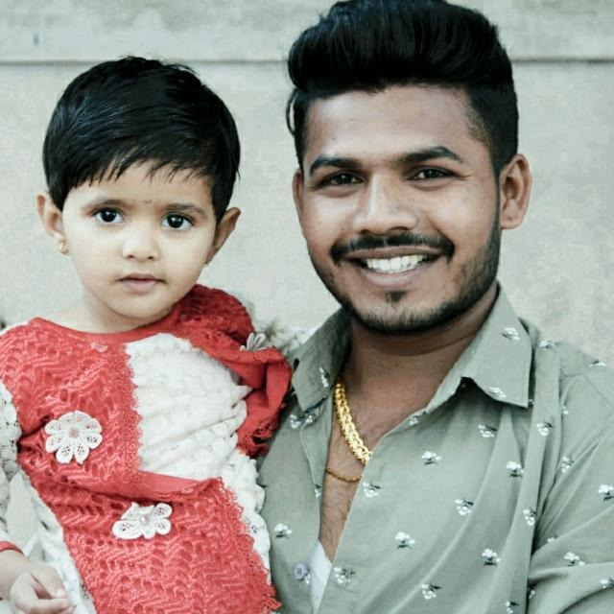

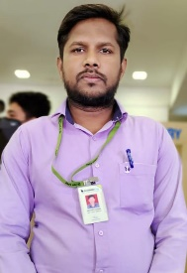
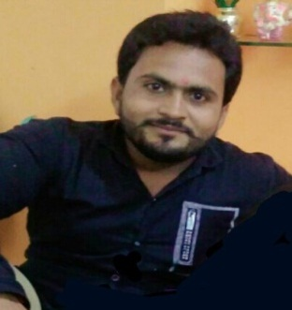
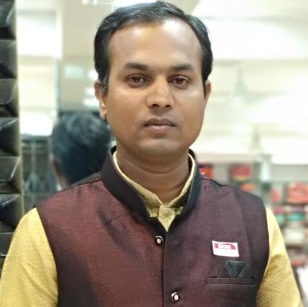
Fin Year TOP RE in 95% Avg MTBC Collection in Allocation
 |  | PL Fin Year 2021-22 0-180 DPD |  |  |  |  |  | SME Fin Year 2021-22 0-180 DPD |  |  |  |  |  | 2021-22
ALLOCATION NAME | Branch | Auto Clr. Count% | Non Clr TBC Coll.% | Arr Collect | MTBC COLL% | BCODC Coll% | Arr Incr/Decr. | Auto Clr. Count% | Non Clr TBC Coll.% | Arr Collect | MTBC COLL% | BCODC Coll% | Arr Incr/Decr. | Total MTBC COLL%
SAGAR RAUT | AKOLA | 56% | 106% | 4.3 | 102% | 6% | -0.71 | 47% | 93% | 1.7 | 91% | 1% | 3.21 | 96%
SUCHIL KSHIRSAGAR | YAVATMAL | 60% | 90% | 8.6 | 96% | 6% | 3.46 | 50% | 92% | 25.7 | 95% | 1% | 11.33 | 95%
BAPURAO TIKANDE | CHALISGAON | 52% | 85% | 10.8 | 94% | 6% | 6.32 | 62% | 90% | 5.0 | 96% | 5% | 5.57 | 95%
PRADEEP POHOKAR | WASHIM | 56% | 94% | 6.8 | 99% | 7% | 0.48 | 58% | 77% | 3.8 | 93% | 3% | 7.71 | 95%
RAVINDRA DHAWAS | RAJURA | 50% | 83% | 12.4 | 93% | 6% | 7.77 | 50% | 95% | 4.1 | 99% | 4% | 1.24 | 95%

Slide 7


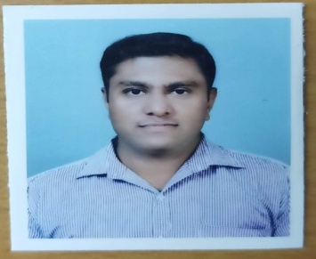


Fin Year TOP RE in 95% Avg MTBC Collection in Allocation
 |  | PL Fin Year 2021-22 0-180 DPD |  |  |  |  |  | SME Fin Year 2021-22 0-180 DPD |  |  |  |  |  | 2021-22
ALLOCATION NAME | Branch | Auto Clr. Count% | Non Clr TBC Coll.% | Arr Collect | MTBC COLL% | BCODC Coll% | Arr Incr/Decr. | Auto Clr. Count% | Non Clr TBC Coll.% | Arr Collect | MTBC COLL% | BCODC Coll% | Arr Incr/Decr. | Total MTBC COLL%
RAKESH DEVIKAR | UMRED | 55% | 89% | 5.1 | 96% | 6% | 2.55 | 74% | 78% | 0.4 | 94% | 4% | 2.90 | 95%
GAMLSEH CHITRIW | GONDIA | 52% | 91% | 8.5 | 96% | 5% | 4.57 | 51% | 76% | 1.2 | 93% | 1% | 2.94 | 95%
ROHAN DESHMUKH | AMRAVATI | 59% | 81% | 6.8 | 94% | 3% | 6.03 | 50% | 92% | 10.3 | 96% | 1% | 4.23 | 95%
SANDESH FANSE | PARATWADA | 56% | 89% | 6.2 | 96% | 8% | 3.48 | 52% | 80% | 3.3 | 91% | 6% | 2.98 | 95%
DEEPAK PATIL | JALGAON | 58% | 82% | 11.8 | 93% | 4% | 10.82 | 52% | 97% | 5.5 | 98% | 4% | 0.91 | 95%

Slide 8
Fin Year New RE in Frame 97% Avg MTBC Collection in Allocation
 |  | PL Fin Year 2021-22 0-180 DPD |  |  |  |  |  | SME Fin Year 2021-22 0-180 DPD |  |  |  |  |  | 2021-22
ALLOCATION NAME | Branch | Auto Clr. Count% | Non Clr TBC Coll.% | Arr Collect | MTBC COLL% | BCODC Coll% | Arr Incr/Decr. | Auto Clr. Count% | Non Clr TBC Coll.% | Arr Collect | MTBC COLL% | BCODC Coll% | Arr Incr/Decr. | Total MTBC COLL%
SHESHRAO JADHAO | BULDHANA | 57% | 128% | 1.7 | 109% | 5% | -1.14 | 76% | 94% | 0.1 | 99% | 10% | 0.06 | 107%
NILESH GIRASE | BHUSAWAL | 57% | 114% | 2.8 | 105% | 7% | -0.95 | 48% | 91% | 1.3 | 104% | 2% | -0.45 | 104%
AKSHAY CHOUDHARI | NAGPUR | 79% | 205% | 0.2 | 104% | 1% | -0.17 | 0% | 0% | 0.0 | 0% | 0% | 0.00 | 104%
ASHISH FULE | BHRAMHAPURI | 58% | 133% | 2.8 | 108% | 10% | -1.64 | 56% | 103% | 2.8 | 101% | 3% | -0.36 | 104%
TANVIR SHEIKH | RAJURA | 59% | 119% | 1.8 | 107% | 16% | -0.90 | 70% | 100% | 0.4 | 100% | 15% | 0.00 | 104%
SHUBHAM DHTRAK | NASIK RD | 70% | 116% | 1.2 | 103% | 11% | -0.46 | 57% | 178% | 1.9 | 101% | 5% | -0.21 | 102%
VAIBHAV BHAT | WARORA | 67% | 110% | 2.0 | 102% | 12% | -0.61 | 91% | 100% | 0.0 | 100% | 23% | 0.00 | 102%
GANESH GHODE | YAVATAMAL | 72% | 124% | 0.2 | 101% | 6% | -0.04 | 0% | 0% | 0.0 | 0% | 0% | 0.00 | 101%
TUSHAR KILWANT | KATOL | 62% | 97% | 0.5 | 99% | 24% | 0.47 | 100% | 0% | 0.0 | 100% | 0% | 0.00 | 99%
PRASSANA SABALE | WARDHA | 72% | 97% | 0.6 | 99% | 13% | 0.22 | 67% | 100% | 0.0 | 100% | 111% | 0.00 | 99%
NARENDRA NIMJE | NAGPUR | 65% | 107% | 2.0 | 102% | 4% | -0.52 | 66% | 63% | 0.3 | 89% | 2% | 1.57 | 97%
NIKHIL NARWADE | BHUSAWAL | 48% | 93% | 2.8 | 96% | 3% | 1.28 | 70% | 116% | 0.3 | 98% | 3% | 0.22 | 97%
Excellent
performance
Since
joining

