Slide 1

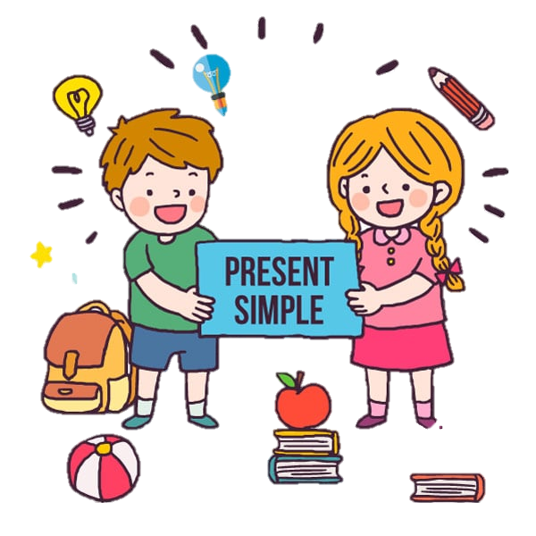



MEMBERS:
Guayama Herrera Jenny Elizabeth.
Ortiz Vega Felipe.
Yuto Huarancca Lucia Isabel.
TEACHER :
Muñoz Hilares Juan Carlos .
CICLE: I

Slide 2

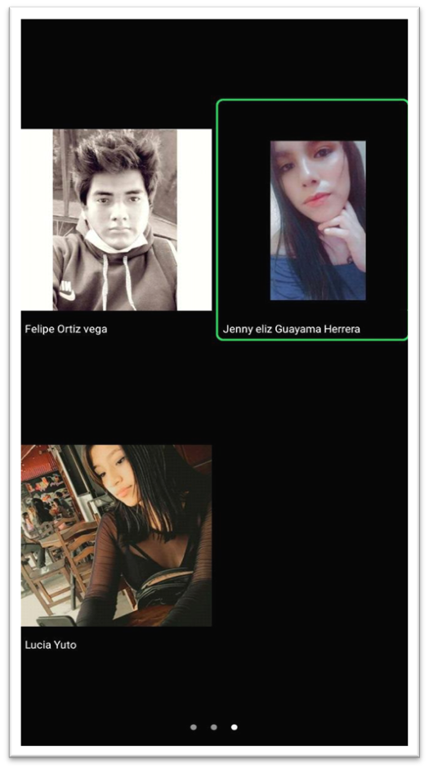
PRESENTS:

Slide 3
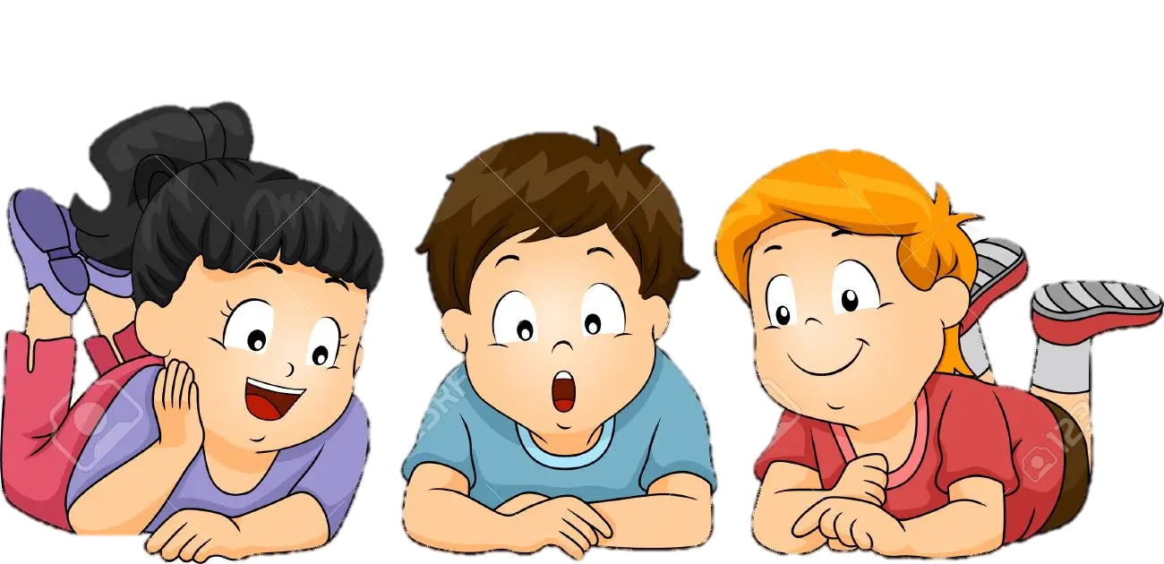
S –ES –IES
AFFIRMATIVE

Slide 4

EXAMPLES:
-I go to class twice a week.
-She reads the newspaper every day.
-Mr. Green works with my uncle.
-S

Slide 5
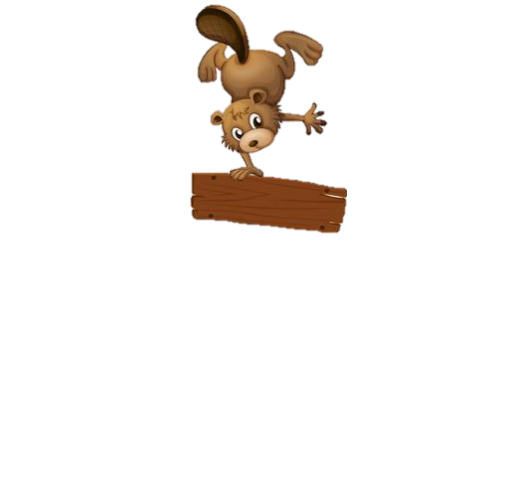
-She does not accept my decision.
-My mother never watches TV in her room.
-Paul never does his homework
-ES

Slide 6
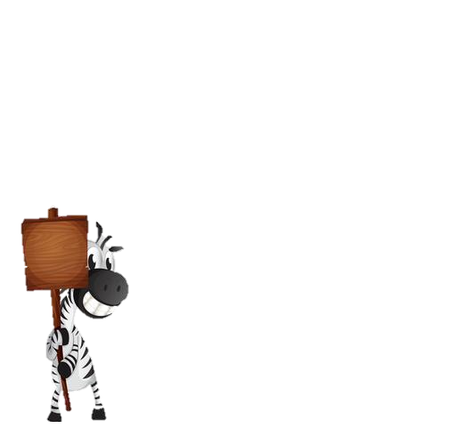
-María studies medicine.
-My sister cries every day
-Francisco cries for his ex-girlfriend.
-IES

Slide 7


DON´T
DOESN´T
NEGATIVE

Slide 8

-The students don´t the homework. They is lazy.
-My father don´t reads the newspaper at morning.
-Oscar don´t correct mistakes , is very easy.
DON´T

Slide 9

-He doesn´t study.
-The children doesn´t watches tv everyday.
-He doesn´t sing in public.
DOESN´T

Slide 10
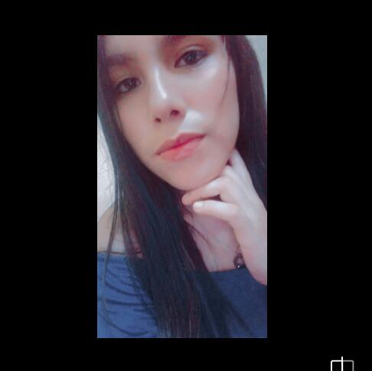

DO - DOES
INTERROGATIVE

Slide 11

DO
-Do you cook every day?
-Do they read at night?
-Do we like cheese pizza?

Slide 12

Does he cook every day ?
Does she read at night?
- Does he want a Little puppy?
DOES

Slide 13
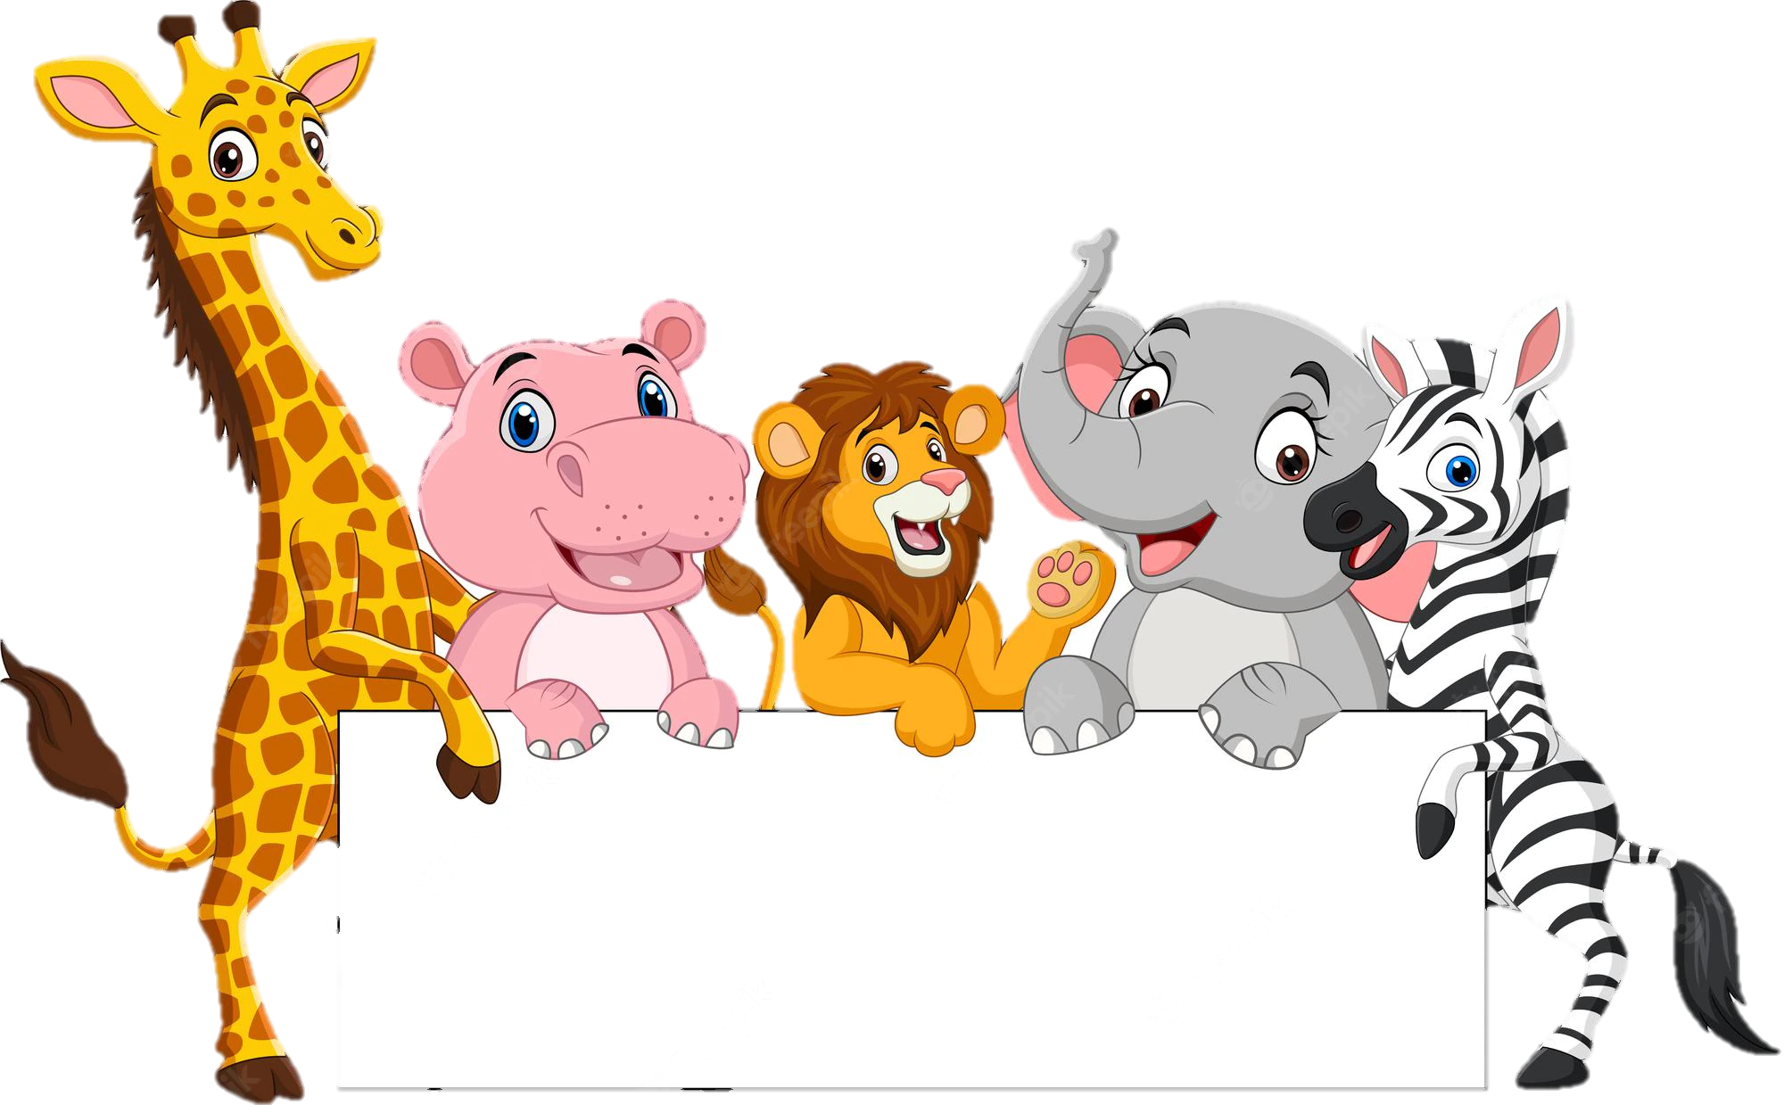
THANK YOU

