Slide 1
SEL Group Head HR(CHRO) :- Manjusha Raulkar Mam Visited To
Site: Nanisindhodi Site
Area:- Nanisindhodi
State:- Kutch (Gujarat)
Date:- 19-May-2022

Slide 2
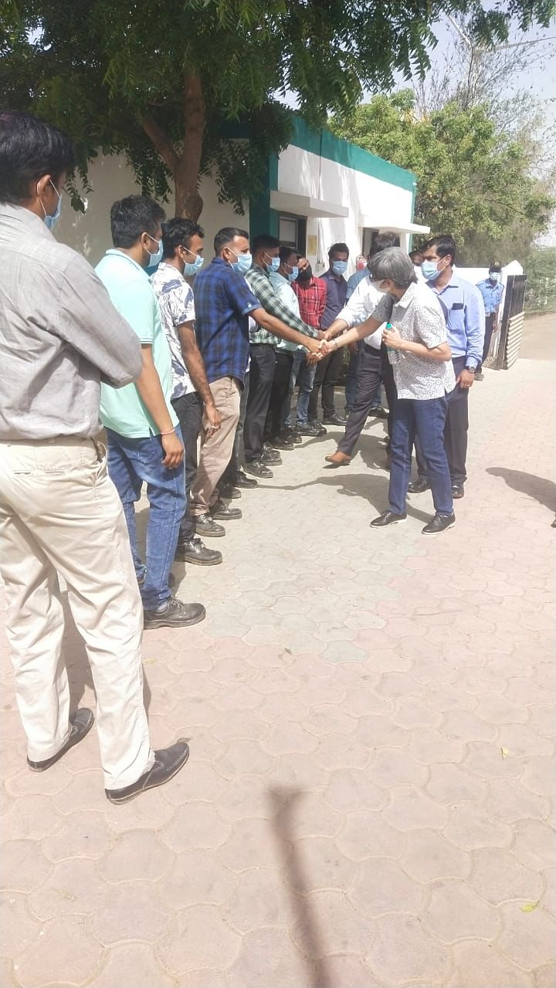
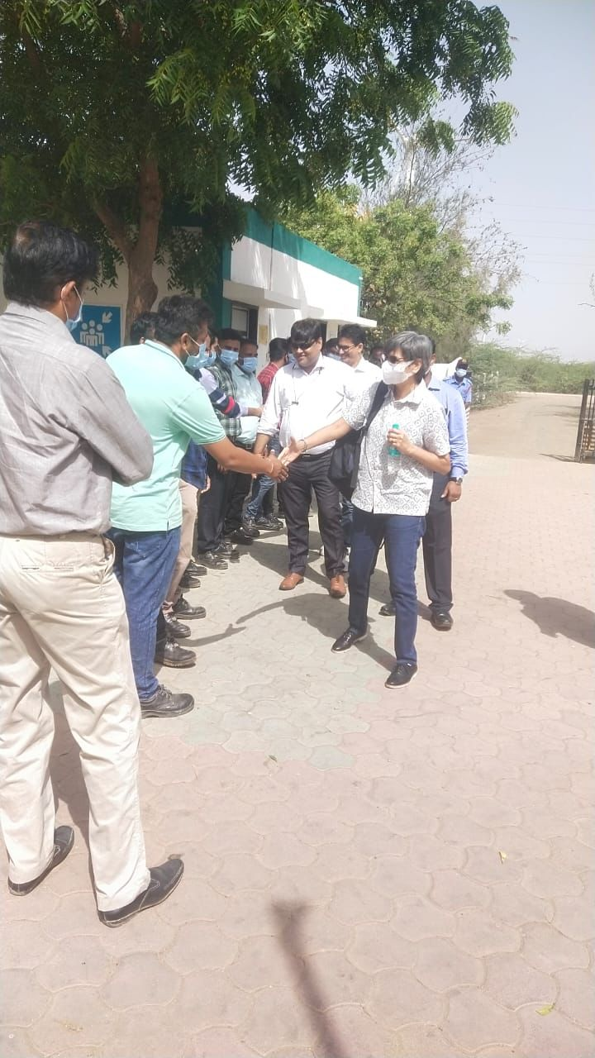
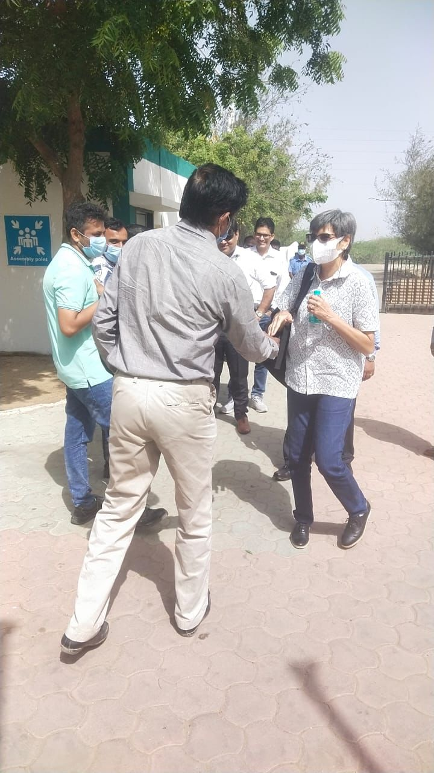
Interacted with all employees

Slide 3
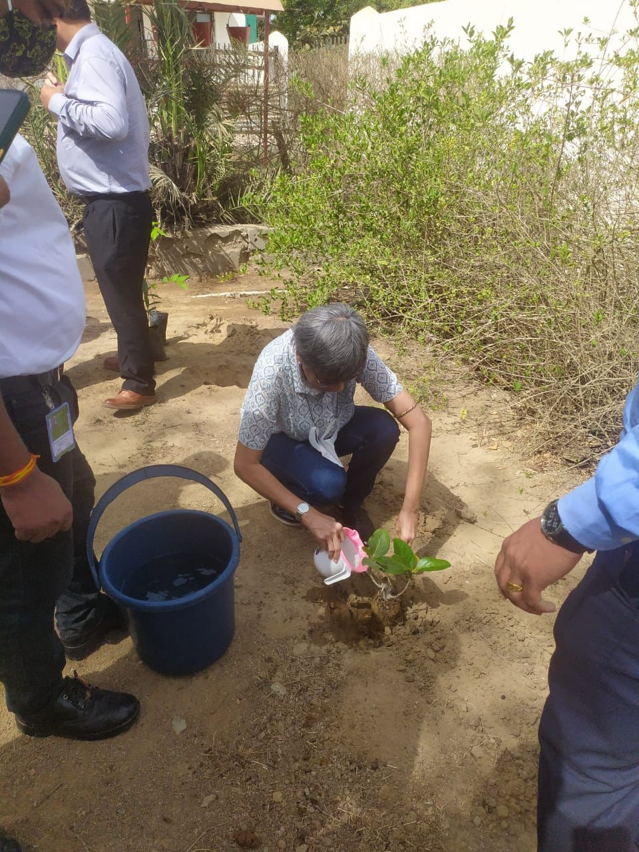
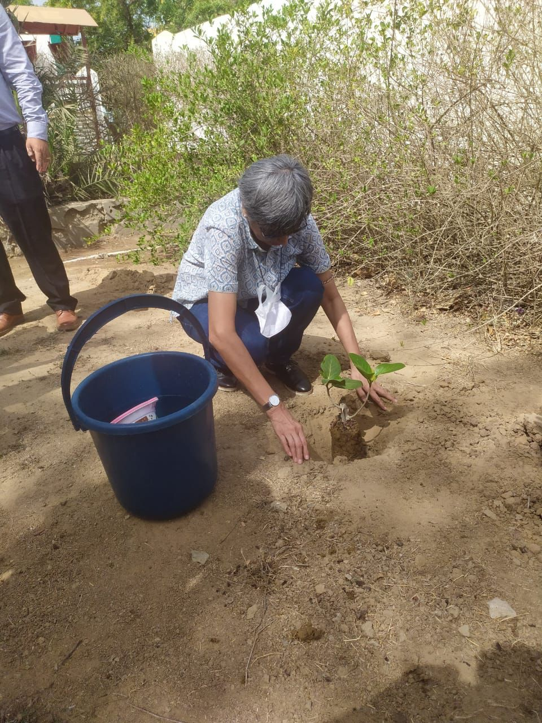
Tree
Plantation
Program

Slide 4
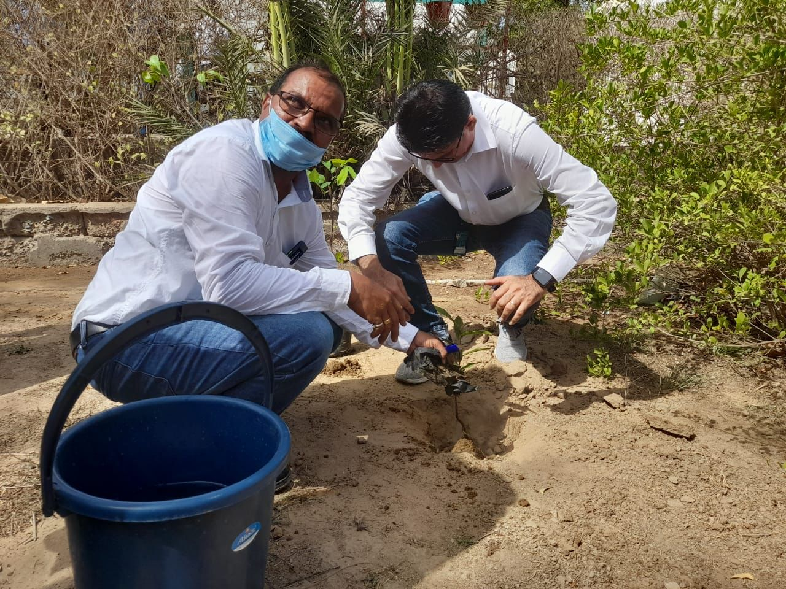
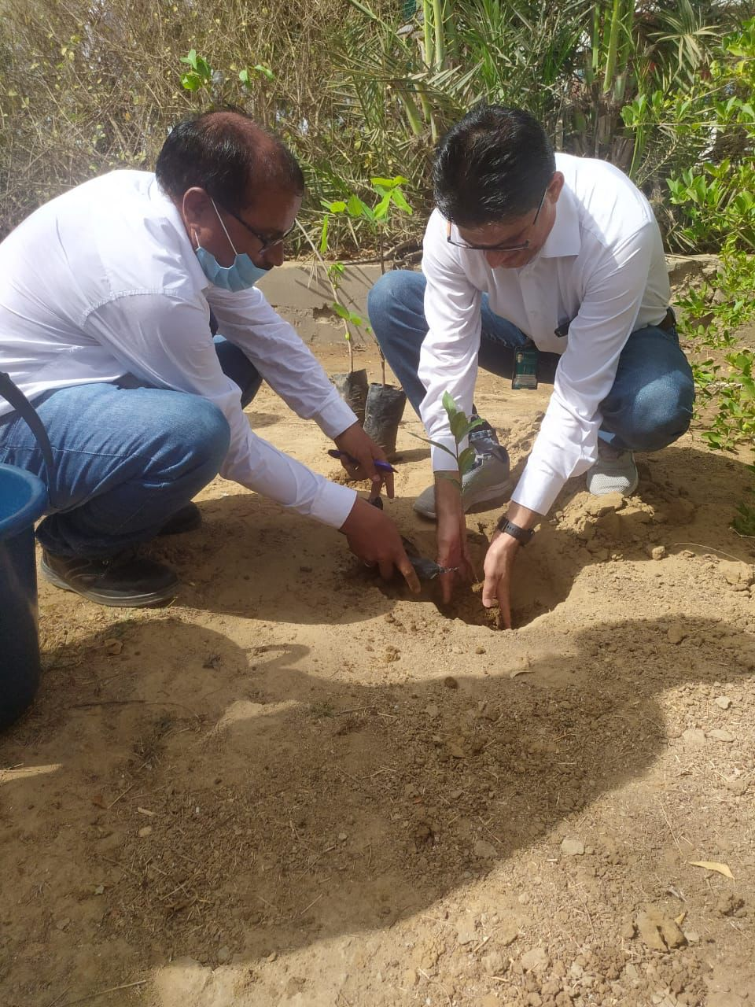
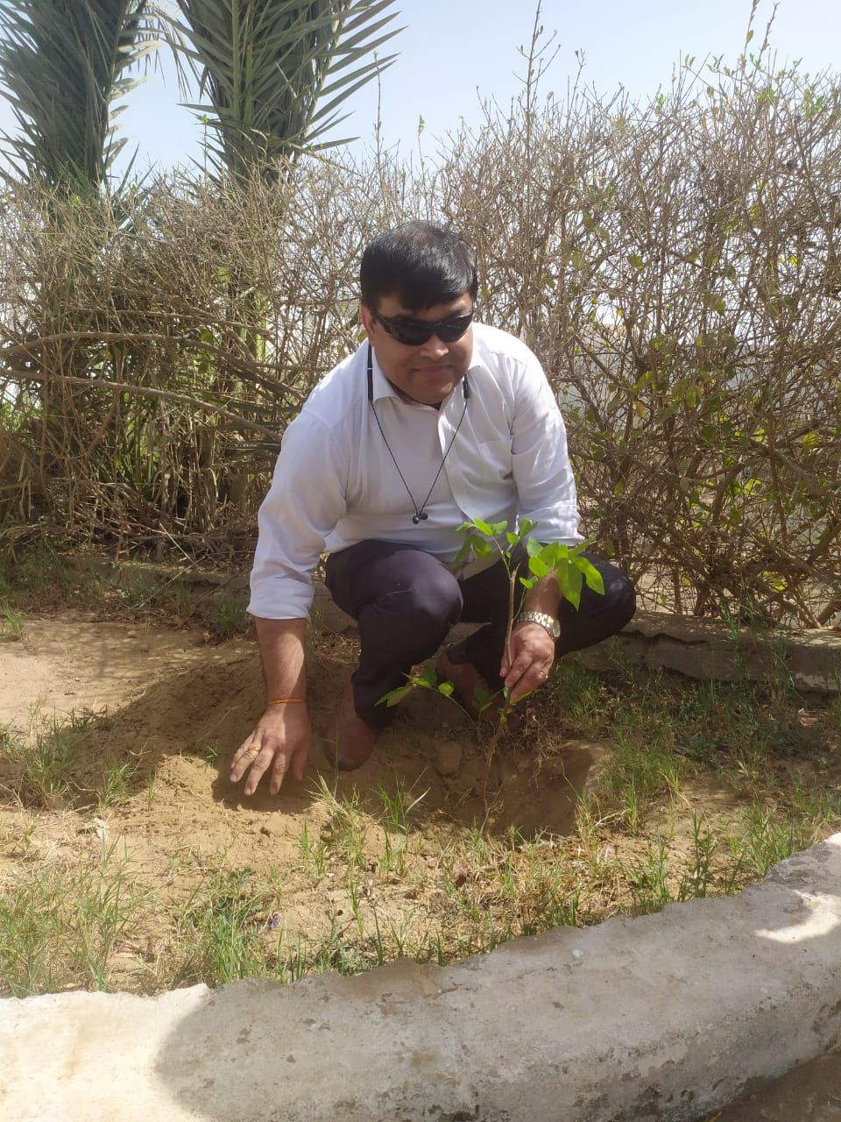

Slide 5
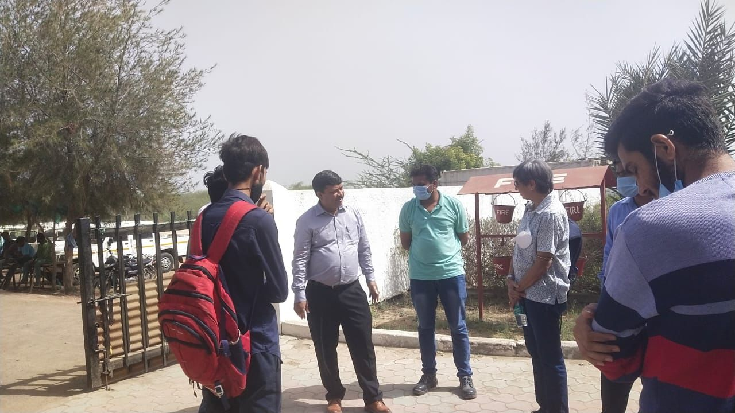
Interacted with Site employee about there day to day life activities and problem which they are facing

Slide 6
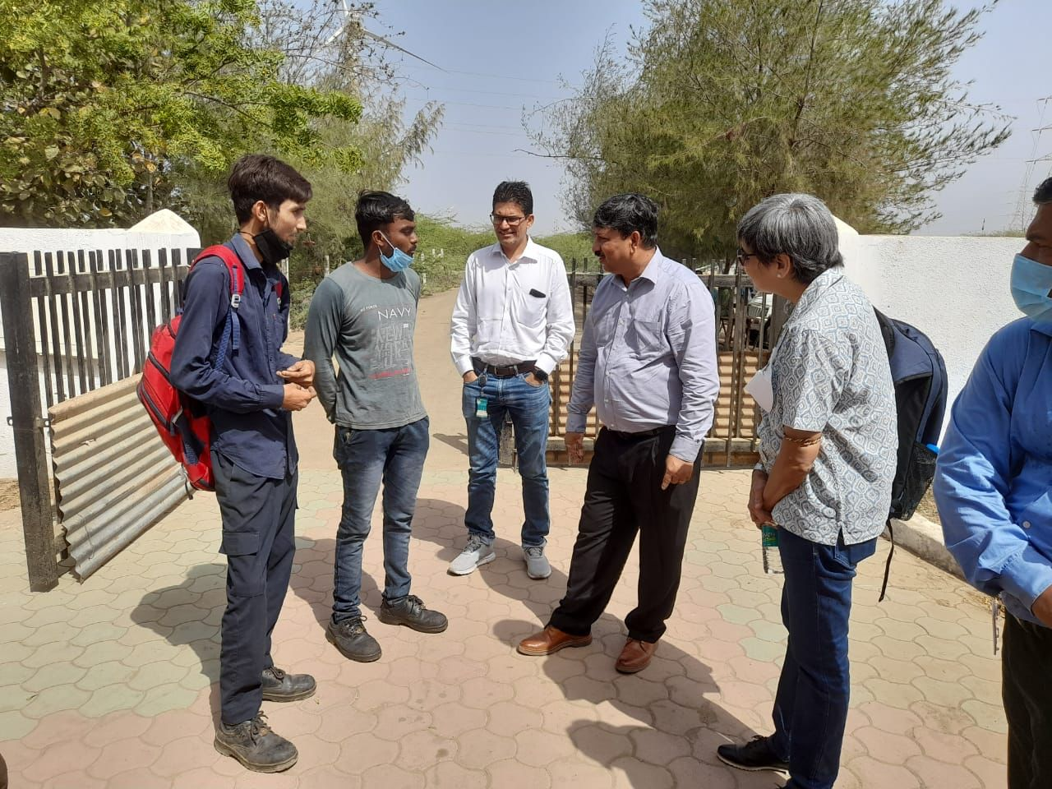
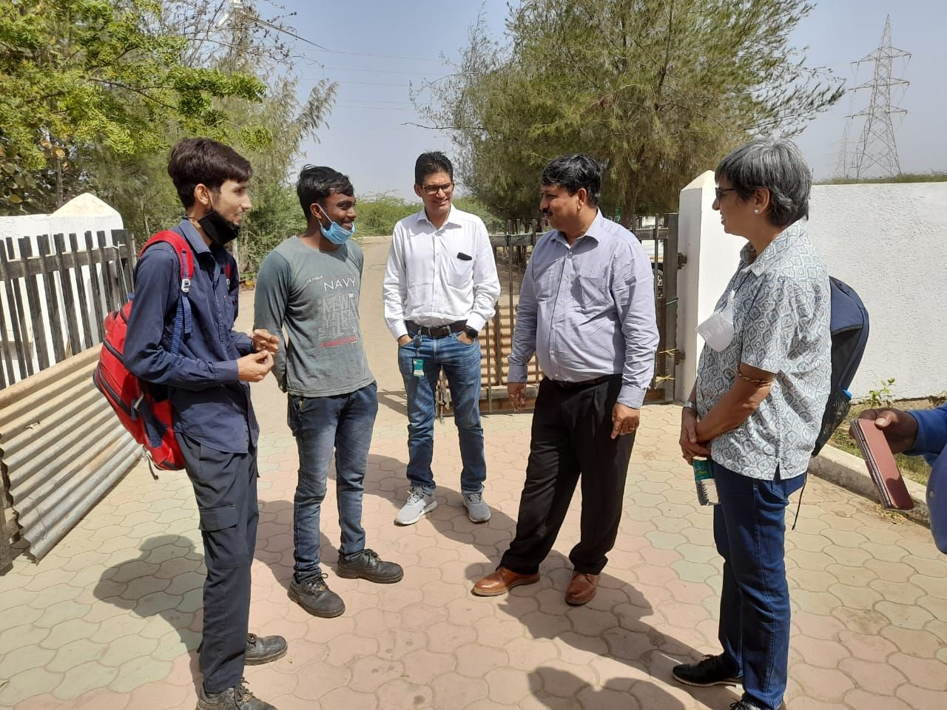

Slide 7
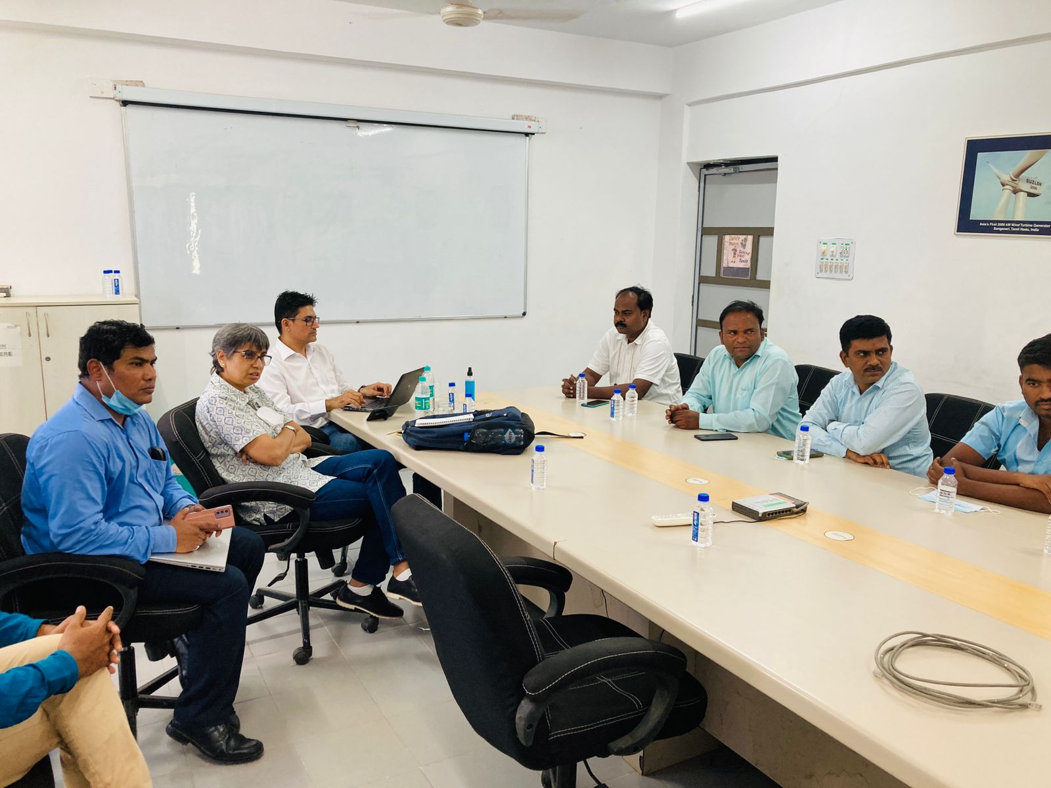
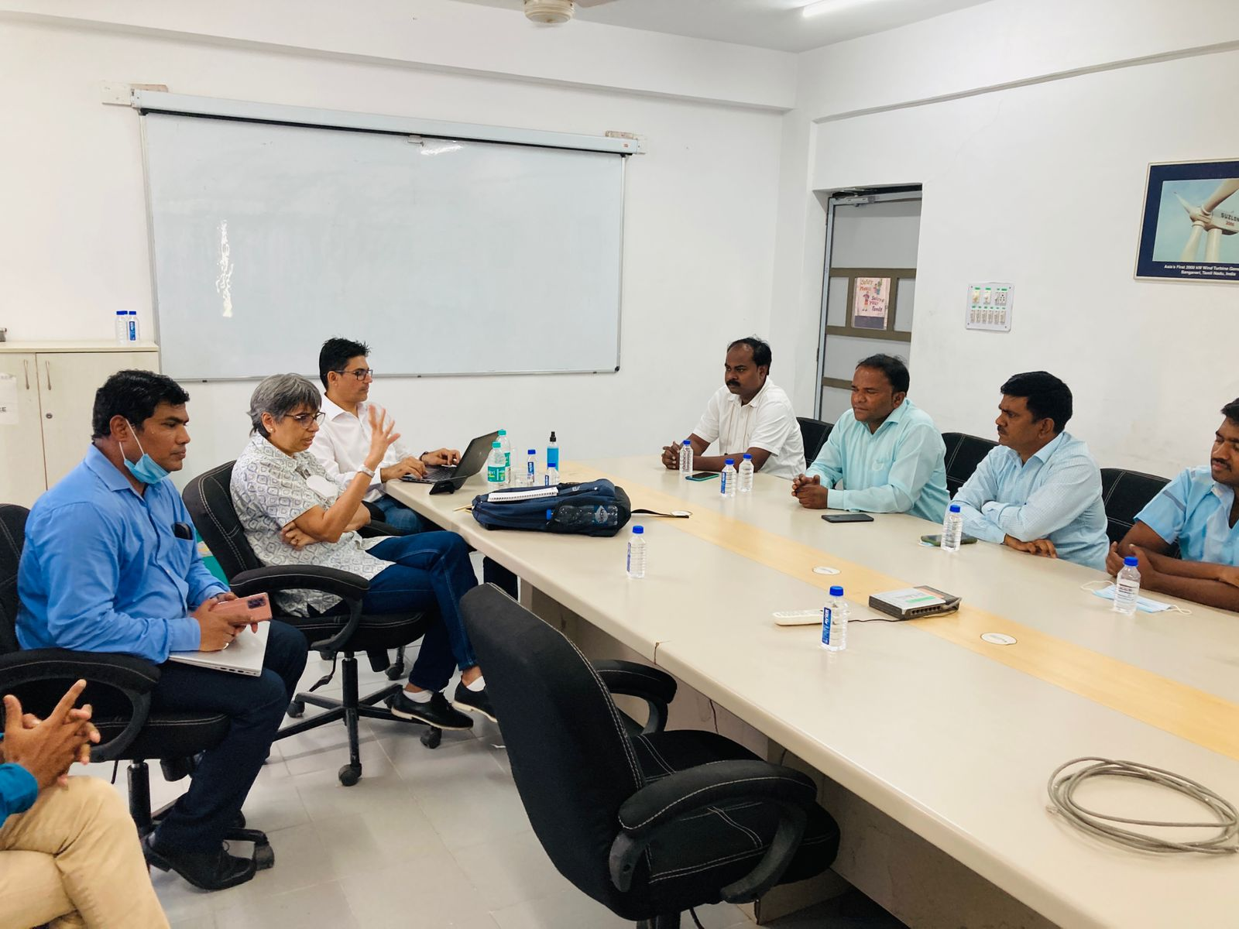
Meeting With Area In-charge, Site In-charge, OE,
About there problem regarding Site stability,
Site performance, Manpower issue

Slide 8
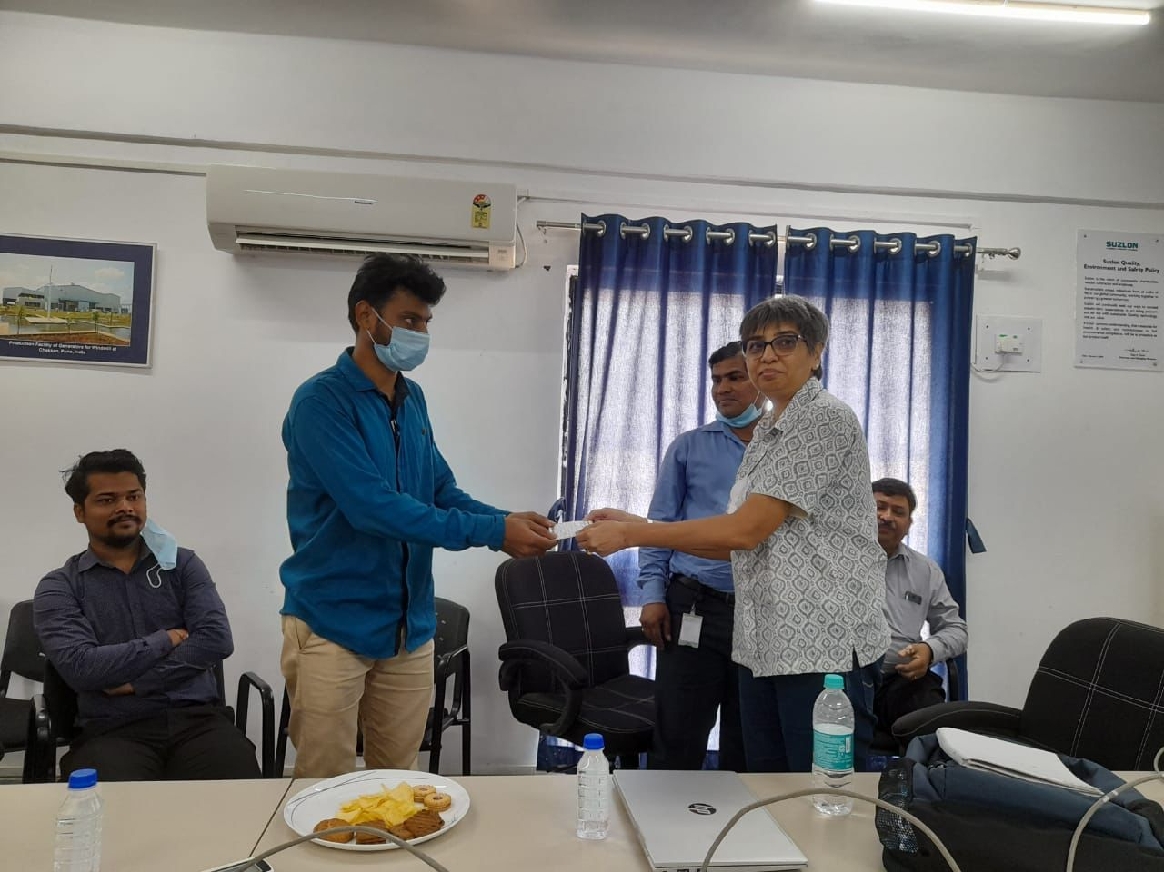
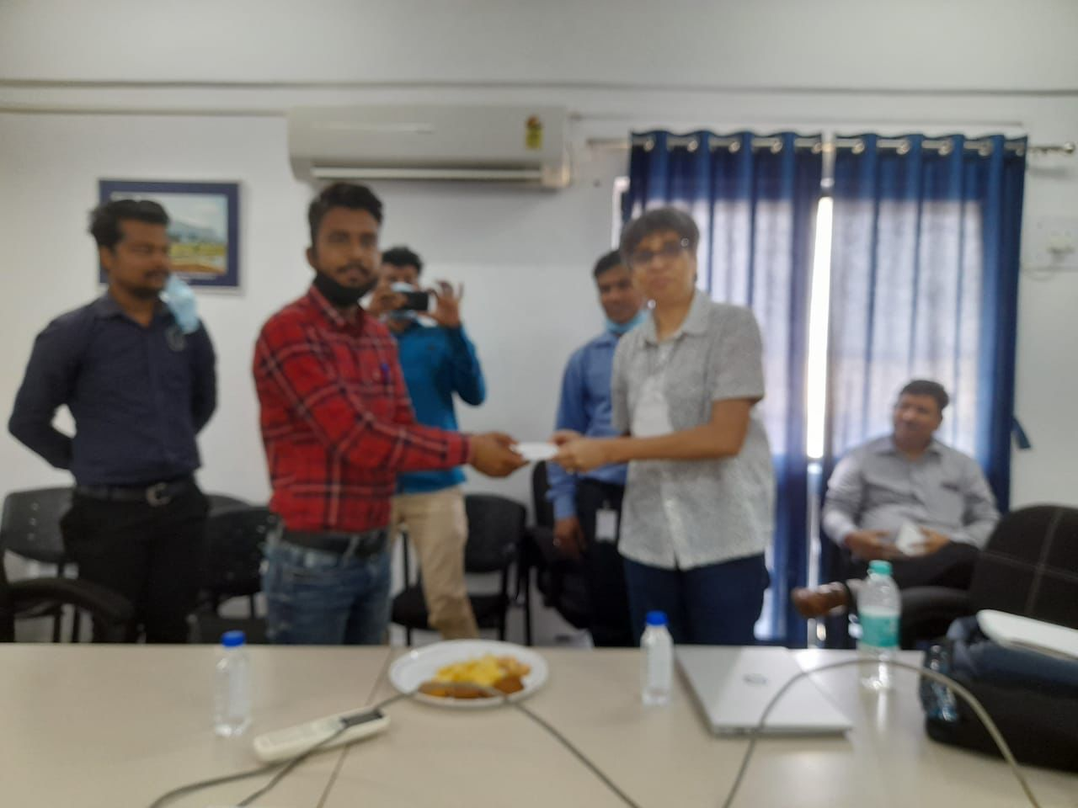
Green Card Given to Employees for
their Good work

Slide 9
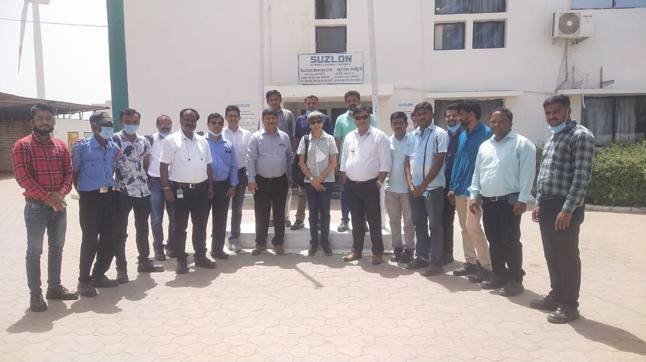
Picture With Nanisindhodi Area Team

Slide 10
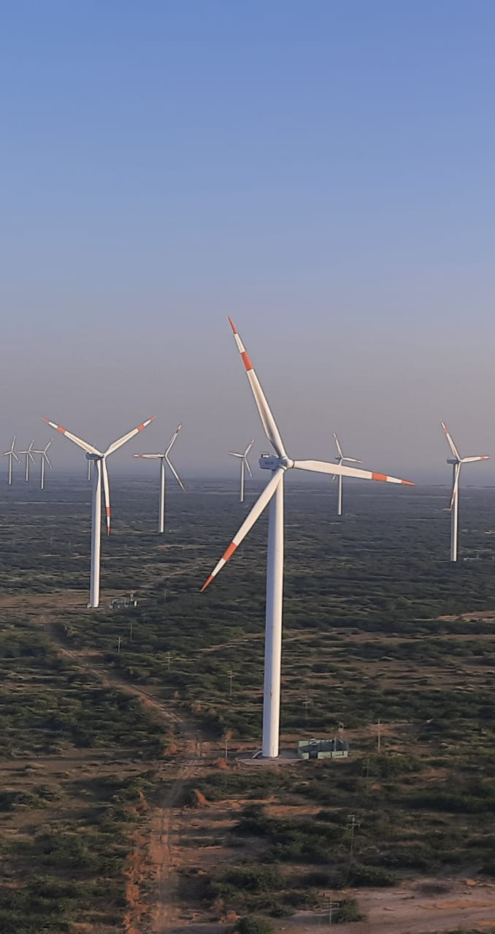
THANK
YOU

