Slide 1
Female Found On Moon & American NASA Never Returned to Moon

Slide 2
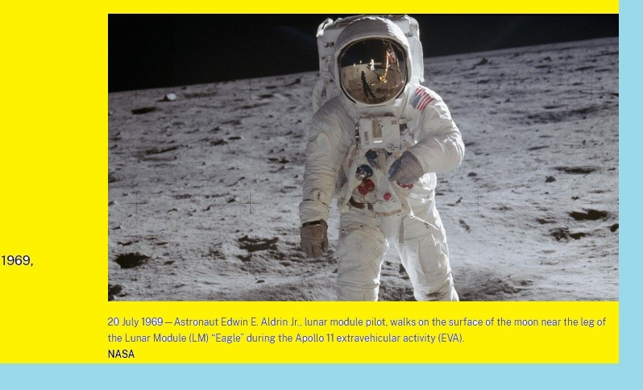
agenda
INTRODUCTION 3
BUILDING CONFIDENCE 4
ENGAGING THE AUDIENCE 5
VISUAL AIDS 6
FINAL TIPS & TAKEAWAYS 11

Slide 3

the power of communication

Slide 4
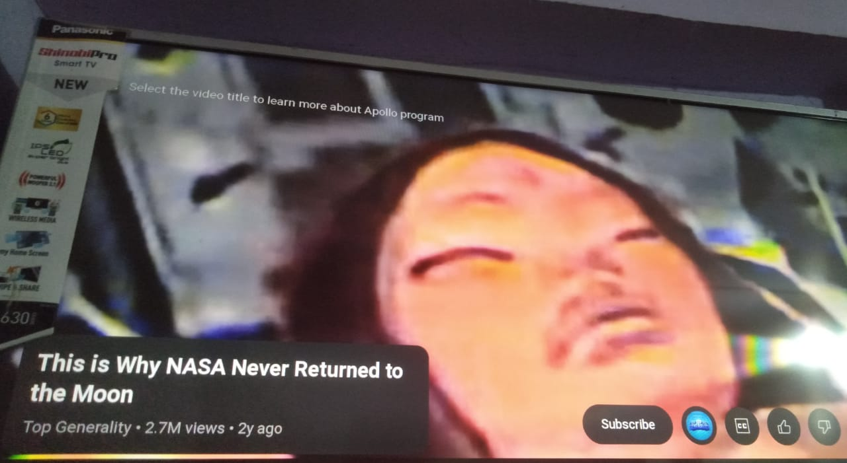

overcoming nervousness
CONFIDENCE-BUILDING STRATEGIES

Slide 5
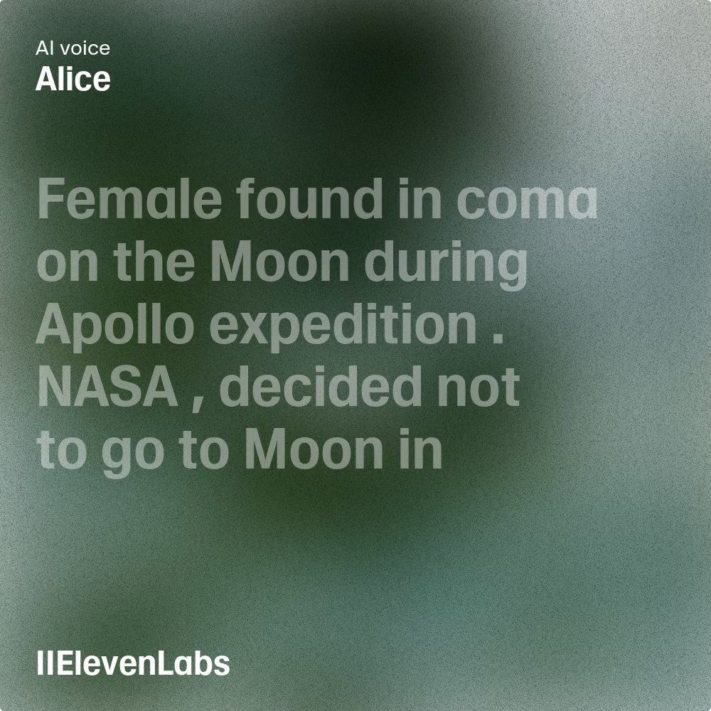






















engaging the audience
In-built Audio-Video
Engaging the Audience
Make eye contact with your audience to create a sense of intimacy and involvement
Weave relatable stories into your presentation using narratives that make your message memorable and impactful
Encourage questions and provide thoughtful responses to enhance audience participation
Use live polls or surveys to gather audience opinions, promoting engagement and making sure the audience feel involved

Slide 6
selecting visual aids
ENHANCING YOUR PRESENTATION

Slide 7
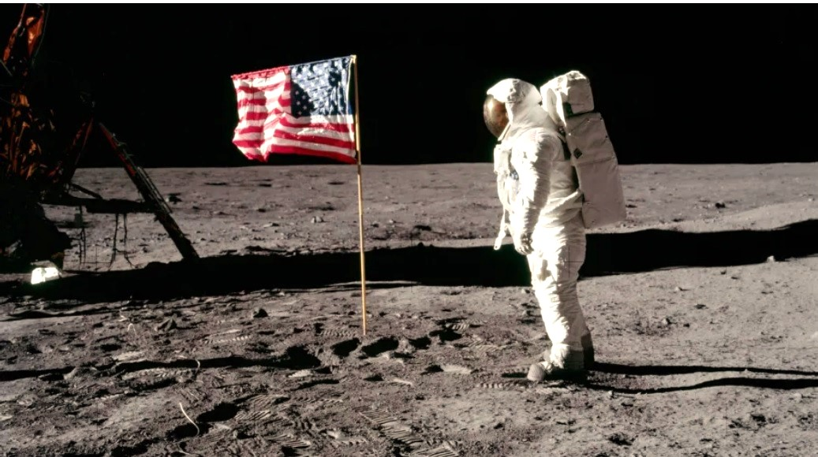


speaking engagement metrics
IMPACT FACTOR | MEASUREMENT | TARGET | ACHIEVED
Audience interaction | Percentage (%) | 85 | 88
Knowledge retention | Percentage (%) | 75 | 80
Post-presentation surveys | Average rating | 4.2 | 4.5
Referral rate | Percentage (%) | 10 | 12
Collaboration opportunities | # of opportunities | 8 | 10

