Slide 1
THE HUMAN EYE AND THE COLOURFUL WORLD
10th Standard science part 2 chapter 11
Notes:
THE HUMAN EYE AND THE COLOURFUL WORLD
10th Standard science part 2 chapter 11

Slide 2
Chapter is Divided into 2-Parts
1. HUMAN EYE
i. Diagram
ii. Parts
iii. Defects
a) Myopia
b) Hypermetropia
c) Presbyopia
Notes:
Chapter is Divided into 2-Parts
1. HUMAN EYE
i. Diagram
ii. Parts
iii. Defects
a) Myopia
b) Hypermetropia
c) Presbyopia

Slide 3
2. COLOURFUL WORLD
i. Dispersion
a) Prism
b) Monochromatic light
c) White light
d) Rainbow
ii. Atmospheric refraction
a) Twinkling of stars
b) Advanced sunrise and delayed sun set
iii. Scattering of light
a) Blue colour of sky
b) Tyndall effect
Notes:
2. COLOURFUL WORLD
i. Dispersion
a) Prism
b) Monochromatic light
c) White light
d) Rainbow
ii. Atmospheric refraction
a) Twinkling of stars
b) Advanced sunrise and delayed sun set
iii. Scattering of light
a) Blue colour of sky
b) Tyndall effect

Slide 4
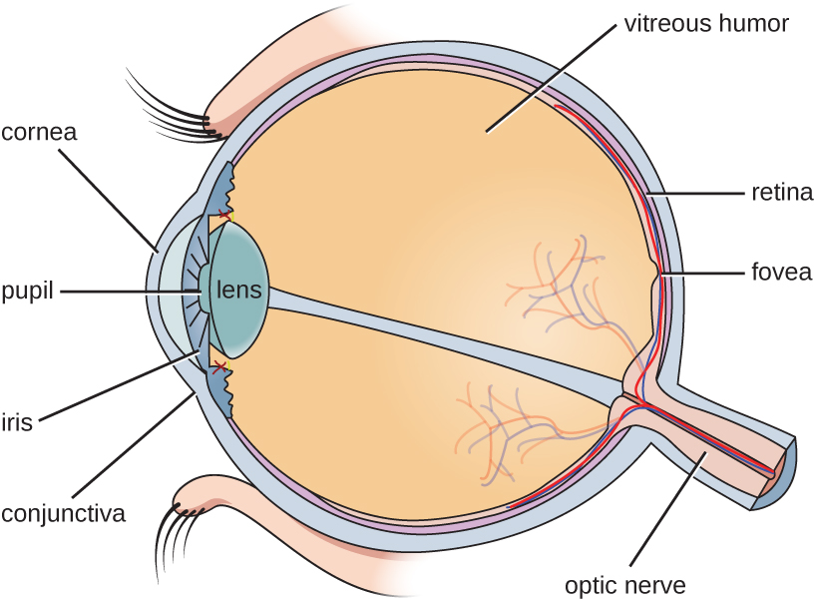
Parts of Human Eye & Its Explanation
Notes:
Parts of Human Eye & Its Explanation

Slide 5
Cornea:
The transparent circular part of the front of the eye ball. It reflects the light entering the eyeball to the lens, which then focuses it onto the retina. The cornea contains no blood vessels and is extremely sensitive to pain.
Aqueous Humour:
The human eye is filled with fluid like substance, termed humors, which maintain the ocular pressure and shape of the eye ball. aqueous humor is a water like fluid that lies in front of the lens.
Iris:
Iris is the colored part of your eye. Muscles in your iris control your pupil. The small black opening that lets light into your eye. It controls the size of the pupil and hence the amount of light entering the eye.
Notes:
Cornea:
The transparent circular part of the front of the eye ball. It reflects the light entering the eyeball to the lens, which then focuses it onto the retina. The cornea contains no blood vessels and is extremely sensitive to pain.
Aqueous Humour:
The human eye is filled with fluid like substance, termed humors, which maintain the ocular pressure and shape of the eye ball. aqueous humor is a water like fluid that lies in front of the lens.
Iris:
Iris is the colored part of your eye. Muscles in your iris control your pupil. The small black opening that lets light into your eye. It controls the size of the pupil and hence the amount of light entering the eye.

Slide 6
Pupil:
The pupil is the black opening in the middle of the colored part of your eye(iris). The pupil gets bigger or smaller in response to changes in light. The pupil looks like a black hole because light usually stays inside the eye.
Crystalline eye lens:
It is the elliptical structure located behind the iris that helps to focus light entering the eye onto the retina. The crystalline lens flexibility allows it to change shape and quickly focus between far and near objects.
Ciliary muscles:
It is an intrinsic muscle of the eye formed as a ring of smooth muscle in the eye’s middle layer. It secrete aqueous fluid and point towards your iris. The ciliary body’s zonular fibers provide support to the lens in the eye.
Notes:
Pupil:
The pupil is the black opening in the middle of the colored part of your eye(iris). The pupil gets bigger or smaller in response to changes in light. The pupil looks like a black hole because light usually stays inside the eye.
Crystalline eye lens:
It is the elliptical structure located behind the iris that helps to focus light entering the eye onto the retina. The crystalline lens flexibility allows it to change shape and quickly focus between far and near objects.
Ciliary muscles:
It is an intrinsic muscle of the eye formed as a ring of smooth muscle in the eye’s middle layer. It secrete aqueous fluid and point towards your iris. The ciliary body’s zonular fibers provide support to the lens in the eye.

Slide 7
Vitreous humor:
It is a large portion of the eyeball. It is a clear gel like substance that occupies the space behind the lens and in front of the retina at the back of the eye. As you get older, the fibers of your vitreous pull away from the retina.
Retina:
It is the layer of photoreceptors cells and glial cells with in the eye that captures incoming photons and transmits them along neuronal pathways as both electrical and chemical signals for the brain to perceive a visual picture.
Optic nerve:
It is critical to your vision. Its an extension of your central nervous system, which includes your brain and spine. The optic nerve transmits electrical impulses from your eyes to your brain. Your brain processes this sensory information so that you can see.
Notes:
Vitreous humor:
It is a large portion of the eyeball. It is a clear gel like substance that occupies the space behind the lens and in front of the retina at the back of the eye. As you get older, the fibers of your vitreous pull away from the retina.
Retina:
It is the layer of photoreceptors cells and glial cells with in the eye that captures incoming photons and transmits them along neuronal pathways as both electrical and chemical signals for the brain to perceive a visual picture.
Optic nerve:
It is critical to your vision. Its an extension of your central nervous system, which includes your brain and spine. The optic nerve transmits electrical impulses from your eyes to your brain. Your brain processes this sensory information so that you can see.

Slide 8
a) The Human eye :-
The human eye is the sense organ which helps us to see the colorful world around us.
The human eye is like a camera. Its lens system forms an image on a light sensitive screen called retina. The eye ball is almost spherical in shape with a diameter of about 2.3cm. Light enters the eye through a transparent membrane called cornea. Behind the cornea is a muscular diaphragm called iris which has an opening called pupil. The pupil controls the amount of light entering the eye. The eye lens helps to focus the image of objects on the retina. The ciliary muscles helps to change the curvature of the lens and to change its focal length.
b) Working of the eye :-
The eye lens forms a real inverted image of the object on the retina. The light sensitive cells in the retina then produce electrical signals which are carried by the optic nerves to the brain. The brain processes the information and sends the message to the eye and then we see the object.
Notes:
a) The Human eye :-
The human eye is the sense organ which helps us to see the colorful world around us.
The human eye is like a camera. Its lens system forms an image on a light sensitive screen called retina. The eye ball is almost spherical in shape with a diameter of about 2.3cm. Light enters the eye through a transparent membrane called cornea. Behind the cornea is a muscular diaphragm called iris which has an opening called pupil. The pupil controls the amount of light entering the eye. The eye lens helps to focus the image of objects on the retina. The ciliary muscles helps to change the curvature of the lens and to change its focal length.
b) Working of the eye :-
The eye lens forms a real inverted image of the object on the retina. The light sensitive cells in the retina then produce electrical signals which are carried by the optic nerves to the brain. The brain processes the information and sends the message to the eye and then we see the object.

Slide 9
HOME WORK
What is the working of its different parts of the human eye.
Notes:
HOME WORK
What is the working of its different parts of the human eye.

Slide 10
c) Power of accommodation of the eye.
The eye lens is composed of a fibrous jelly like material. Its curvature can be changed to some extent by the ciliary muscles. The change in the curvature of the eye lens can change its focal length. When the muscles are relaxed, the lens becomes thin and its focal length increases and when the muscles contract, the lens becomes thick and its focal length decreases. :-
The ability of the eye lens to see both near and distant objects by adjusting its focal length is called the power of accommodation
a) Near point (close focus)
ciliary muscles = contract
eye lens = thick
focal length = decreases
b) Far point (distance focus)
ciliary muscles = relaxed
eye lens = thin
focal length = increases
Notes:
c) Power of accommodation of the eye.
The eye lens is composed of a fibrous jelly like material. Its curvature can be changed to some extent by the ciliary muscles. The change in the curvature of the eye lens can change its focal length. When the muscles are relaxed, the lens becomes thin and its focal length increases and when the muscles contract, the lens becomes thick and its focal length decreases. :-
The ability of the eye lens to see both near and distant objects by adjusting its focal length is called the power of accommodation
a) Near point (close focus)
ciliary muscles = contract
eye lens = thick
focal length = decreases
b) Far point (distance focus)
ciliary muscles = relaxed
eye lens = thin
focal length = increases

Slide 11
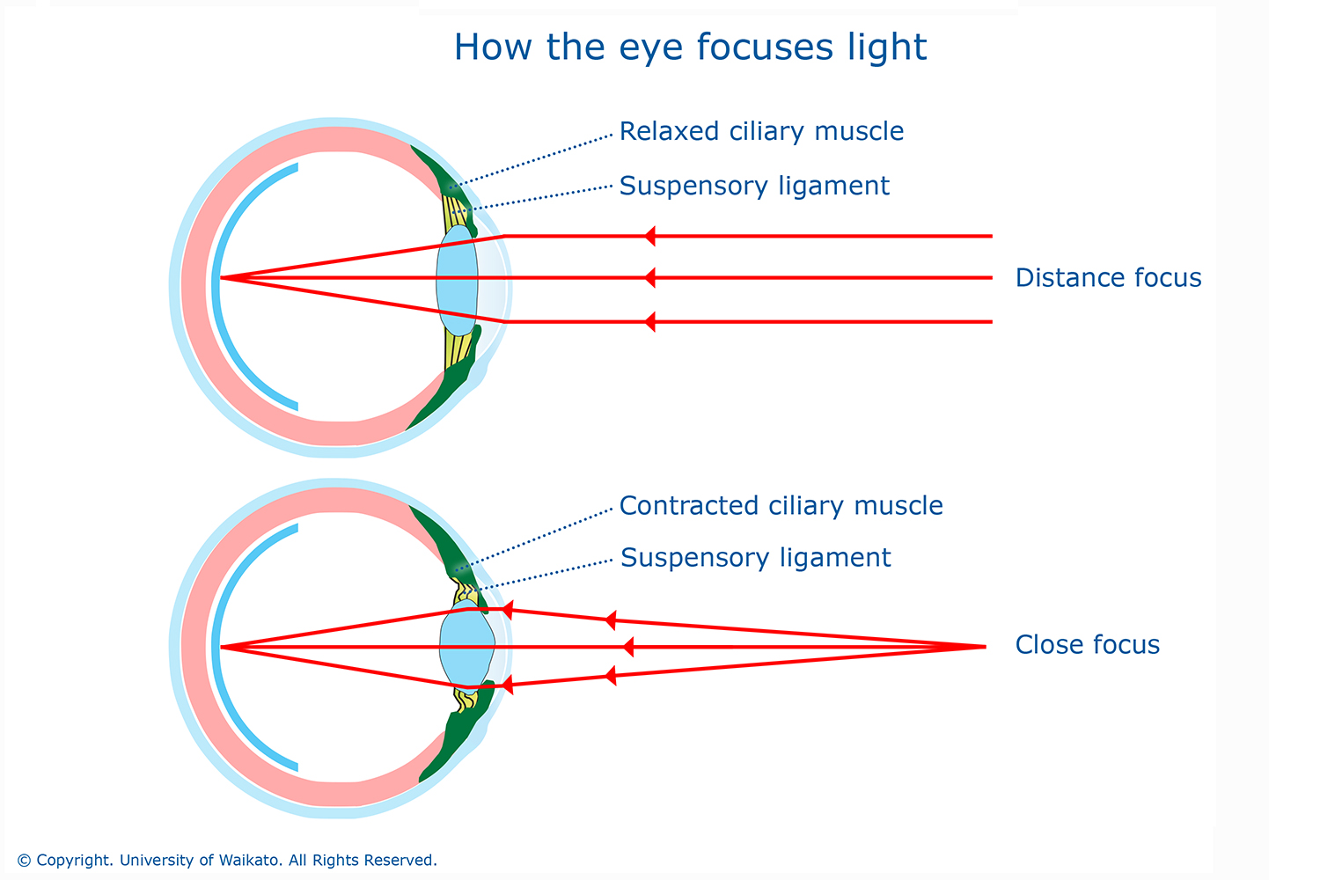

Slide 12

d) Near point :-
The minimum distance at which the eye can see objects clearly is called the near point or least distance of distinct vision. For a normal eye it is 25cm.
Notes:
d) Near point :-
The minimum distance at which the eye can see objects clearly is called the near point or least distance of distinct vision. For a normal eye it is 25cm.

Slide 13

e) Far point :-
The farthest distance up to which the eye can see objects clearly is called the far point of the eye. For a normal eye it is between 25 cm and infinity.
Notes:
e) Far point :-
The farthest distance up to which the eye can see objects clearly is called the far point of the eye. For a normal eye it is between 25 cm and infinity.

Slide 14
Power of accommodation:
The ability of the eye to focus near and far objects clearly on the retina by adjusting its focal length. The focal length of the eye lens cannot be reduced beyond certain minimum limit. A normal eye has a power of which enables objects as far as infinity and as close as 25 cm to be focused on the retina.
HOME WORK
1. What is power of accomodation. How ciliary muscles help in accomodation?
2. What is the power of accomodation for a normal person.
Notes:
Power of accommodation:
The ability of the eye to focus near and far objects clearly on the retina by adjusting its focal length. The focal length of the eye lens cannot be reduced beyond certain minimum limit. A normal eye has a power of which enables objects as far as infinity and as close as 25 cm to be focused on the retina.
HOME WORK
1. What is power of accomodation. How ciliary muscles help in accomodation?
2. What is the power of accomodation for a normal person.

Slide 15
DEFECTS OF VISION AND THEIR CORRECTION
There are 3 types of defects
1. Myopia
2. Hypermetropia
3. Presbyopia
Notes:
DEFECTS OF VISION AND THEIR CORRECTION
There are 3 types of defects
1. Myopia
2. Hypermetropia
3. Presbyopia

Slide 16
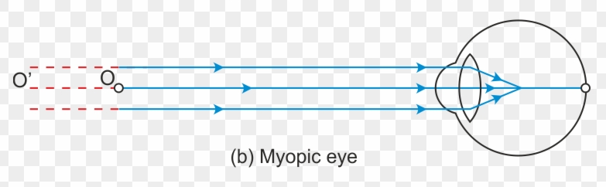
Myopia:
Myopia near-sightedness.
A person with myopia can see near by objects clearly but cannot see distant objects distinctly.
A person with this defect has the far point nearer than infinity. Such a person may see clearly up to a distance of a few meters.
In a myopic eye, the image of a distant object is formed in front of the retina and not at the retina itself.
Image formed in front of retina
retina
image
Parallel rays from distant
object (at infinity)
Notes:
Myopia:
Myopia near-sightedness.
A person with myopia can see near by objects clearly but cannot see distant objects distinctly.
A person with this defect has the far point nearer than infinity. Such a person may see clearly up to a distance of a few meters.
In a myopic eye, the image of a distant object is formed in front of the retina and not at the retina itself.
Image formed in front of retina

Slide 17
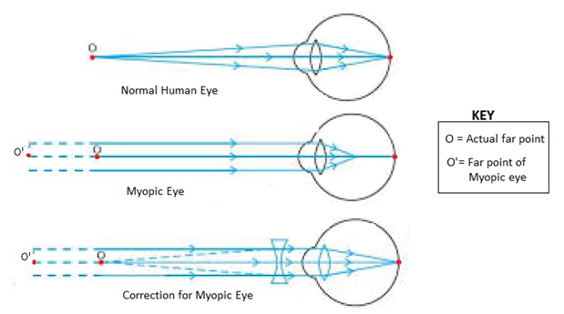
Cause of defect
This defect may arise due to
1) Excessive curvature of the eye lens.
2) Elongation of the eye ball.
Correction of Myopia:
This defect can be corrected by using a concave lens of suitable power.
A concave lens of suitable power will bring the image back on to the retina and thus the defect is corrected.
Notes:
Cause of defect
This defect may arise due to
1) Excessive curvature of the eye lens.
2) Elongation of the eye ball.
Correction of Myopia:
This defect can be corrected by using a concave lens of suitable power.
A concave lens of suitable power will bring the image back on to the retina and thus the defect is corrected.

Slide 18
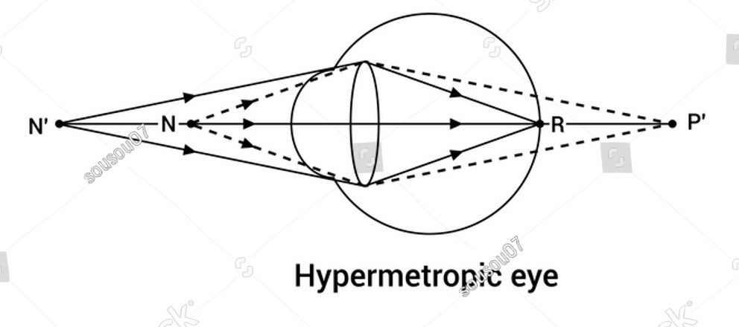
Hypermetropia:
Hypermetropia is also known as far sightedness.
A person with hypermetropia can se distant objects clearly but cannot see near by objects distinctly.
Defects and correction of Hypermetropia
retina
Image formed behind the retina
Notes:
Hypermetropia:
Hypermetropia is also known as far sightedness.
A person with hypermetropia can se distant objects clearly but cannot see near by objects distinctly.
Defects and correction of Hypermetropia

Slide 19
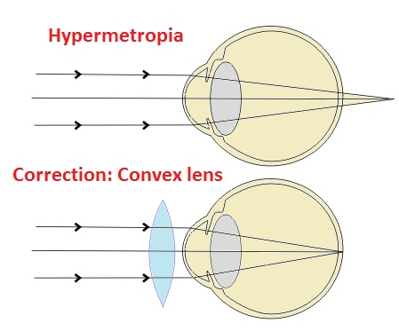
Causes of defect:
This defect arises either because
a) The focal length of the eye lens is too long.
b) The eye ball has become too small.
Correction of hypermetropia:
This defect can be corrected by using a convex lens of appropriate power.
Eye glasses with converging lenses provide the additional focusing power required for forming the image on the retina.
Notes:
Causes of defect:
This defect arises either because
a) The focal length of the eye lens is too long.
b) The eye ball has become too small.
Correction of hypermetropia:
This defect can be corrected by using a convex lens of appropriate power.
Eye glasses with converging lenses provide the additional focusing power required for forming the image on the retina.

Slide 20
Presbyopia:
The power of accommodation of the eye usually decreases with aging, for most people, the near point gradually recedes away. They find it difficult to see near by objects comfortably and distinctly without corrective eye glasses. This defect is called Presbyopia.
Causes of Presbyopia:
1. Gradual weakening of the ciliary muscles.
2. The loss of flexibility of the eye lens.
Remedy of Presbyopia:
1. By using a converging lens for reading and other close work.
2. Some times a person may suffer from both myopia and hypermetropia and may require bi-focal lenses. It consists of both concave and convex lenses. The upper portion consists a convex lens for distant vision and the lower portion consists of a convex lens to facilitate near vision
Notes:
Presbyopia:
The power of accommodation of the eye usually decreases with aging, for most people, the near point gradually recedes away. They find it difficult to see near by objects comfortably and distinctly without corrective eye glasses. This defect is called Presbyopia.
Causes of Presbyopia:
1. Gradual weakening of the ciliary muscles.
2. The loss of flexibility of the eye lens.
Remedy of Presbyopia:
1. By using a converging lens for reading and other close work.
2. Some times a person may suffer from both myopia and hypermetropia and may require bi-focal lenses. It consists of both concave and convex lenses. The upper portion consists a convex lens for distant vision and the lower portion consists of a convex lens to facilitate near vision

Slide 21
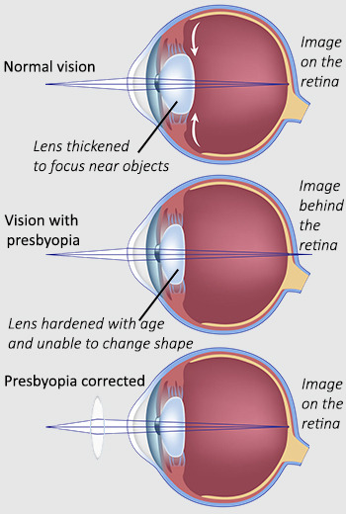

Slide 22
HOME WORK
1. What is cataract?
2. In which defect of vision is eye ball flattened?
3. What is the eye shape defect?
4. The colour of the human eye depends on the the pigment present in the ______ of the eye.
a) Iris b) cornea c)face d) lens
5. What is the nature of the image that is formed on the retina of the human eye?
Notes:
HOME WORK
1. What is cataract?
2. In which defect of vision is eye ball flattened?
3. What is the eye shape defect?
4. The colour of the human eye depends on the the pigment present in the ______ of the eye.
a) Iris b) cornea c)face d) lens
5. What is the nature of the image that is formed on the retina of the human eye?

Slide 23
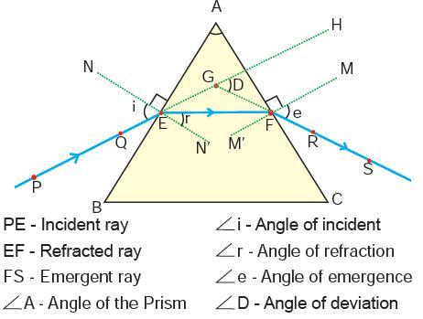
1. a) Refraction of light through a glass prism :-
When a ray of light passes through a glass prism, it gets bent twice at the air- glass interface and glass- air interface.
The emergent ray is deviated by an angle to the incident ray. This angle is called the angle of deviation.
Notes:
1. a) Refraction of light through a glass prism :-
When a ray of light passes through a glass prism, it gets bent twice at the air- glass interface and glass- air interface.
The emergent ray is deviated by an angle to the incident ray. This angle is called the angle of deviation.

Slide 24
HOME WORK
What is the main aim of the refraction through the glass prism experiment?
Notes:
HOME WORK
What is the main aim of the refraction through the glass prism experiment?

Slide 25
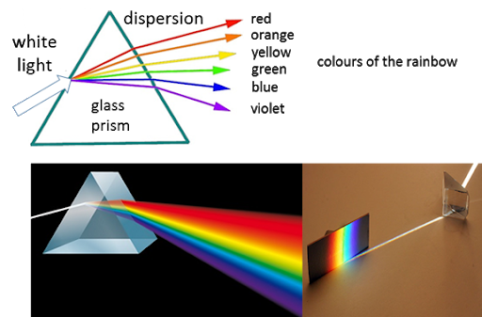
1.b) Dispersion of white light by a glass prism :-
When a beam of white light is passed through a glass prism, it is split up into a band of colours called spectrum. This is called dispersion of white light. The spectrum of white has the colours violet, indigo, blue, green, yellow, orange and red (VIBGYOR). The red light bends the least and the violet light bends the most.
Notes:
1.b) Dispersion of white light by a glass prism :-
When a beam of white light is passed through a glass prism, it is split up into a band of colours called spectrum. This is called dispersion of white light. The spectrum of white has the colours violet, indigo, blue, green, yellow, orange and red (VIBGYOR). The red light bends the least and the violet light bends the most.

Slide 26
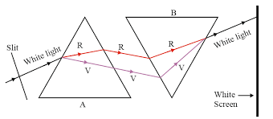
1.c) Recombination of the spectrum of white light produces white light :-
When a beam of white light is passed through a glass prism, it is split up into its component colours. When these colours are allowed to fall on an inverted glass prism it recombines to produce white light.
Notes:
1.c) Recombination of the spectrum of white light produces white light :-
When a beam of white light is passed through a glass prism, it is split up into its component colours. When these colours are allowed to fall on an inverted glass prism it recombines to produce white light.

Slide 27
HOME WORK
1. Draw a diagram to show the dispersion of white light by a glass prism.
2. Draw a diagram to show the recombination of white light by a prism.
Notes:
HOME WORK
1. Draw a diagram to show the dispersion of white light by a glass prism.
2. Draw a diagram to show the recombination of white light by a prism.

Slide 28
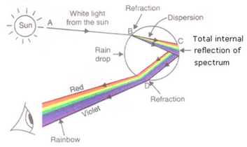
1.d) Rainbow formation :-
A rainbow is a natural spectrum appearing in the sky after a rain shower. It is caused by the dispersion of sunlight by water droplets present in the atmosphere. The water droplets act like small prisms. They refract and disperse the sunlight then reflect it internally and finally refract it again when it comes out of the rain drops. Due to the dispersion of sunlight and internal reflection by the water droplets we see the rainbow colours.
Notes:
1.d) Rainbow formation :-
A rainbow is a natural spectrum appearing in the sky after a rain shower. It is caused by the dispersion of sunlight by water droplets present in the atmosphere. The water droplets act like small prisms. They refract and disperse the sunlight then reflect it internally and finally refract it again when it comes out of the rain drops. Due to the dispersion of sunlight and internal reflection by the water droplets we see the rainbow colours.

Slide 29
HOME WORK
True or false
Rainbow cannot appear at noon.
The colours of the rainbow change when the sun sets.
Rainbows are always present in the sky.
Some colours of the rainbow appear mixed.
A rainbow is an arc of colours.
Rainbows can only be seen when its raining.
Notes:
HOME WORK
True or false
Rainbow cannot appear at noon.
The colours of the rainbow change when the sun sets.
Rainbows are always present in the sky.
Some colours of the rainbow appear mixed.
A rainbow is an arc of colours.
Rainbows can only be seen when its raining.

Slide 30
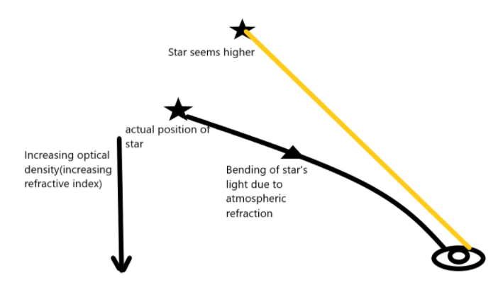
2) Atmospheric refraction :-
Atmospheric refraction is due to the gradual change in the refractive index of the atmosphere. The refractive index of the atmosphere gradually increases towards the surface of the earth because the hot air above is less dense than the cool air below. So light gradually bends towards the normal. So the real position of a star is different from its apparent position.
Notes:
2) Atmospheric refraction :-
Atmospheric refraction is due to the gradual change in the refractive index of the atmosphere. The refractive index of the atmosphere gradually increases towards the surface of the earth because the hot air above is less dense than the cool air below. So light gradually bends towards the normal. So the real position of a star is different from its apparent position.

Slide 31
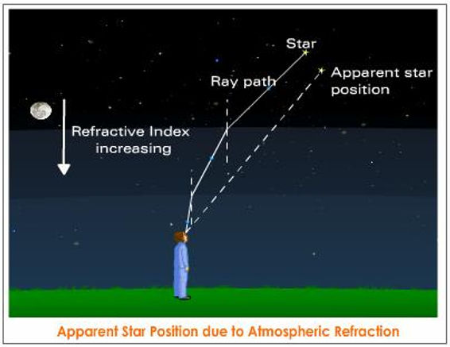

Slide 32
HOME WORK
1. What is the main cause of atmospheric refraction?
Notes:
HOME WORK
1. What is the main cause of atmospheric refraction?

Slide 33
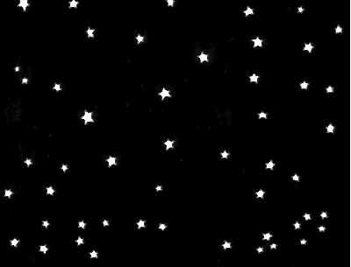
2.a) Twinkling of stars :-
The twinkling of stars is due to the atmospheric refraction of star light and due to the changing in the position of the stars and the movement of the layers of the atmosphere. So the light from the stars is sometimes brighter and sometimes fainter and it appears to twinkle.
Planets are closer to the earth than stars. The light from stars are considered as point source of light and the light from planets are considered as extended source of light. So the light from the planets nullify the twinkling effect.
Notes:
2.a) Twinkling of stars :-
The twinkling of stars is due to the atmospheric refraction of star light and due to the changing in the position of the stars and the movement of the layers of the atmosphere. So the light from the stars is sometimes brighter and sometimes fainter and it appears to twinkle.
Planets are closer to the earth than stars. The light from stars are considered as point source of light and the light from planets are considered as extended source of light. So the light from the planets nullify the twinkling effect.

Slide 34
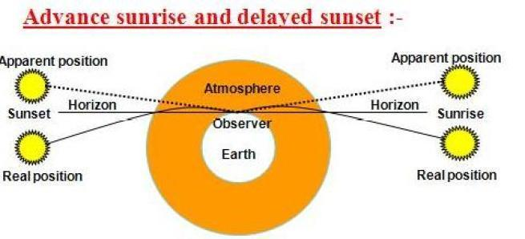
2.b) Advance sunrise and delayed sunset :-
The sun is visible to us about 2 minutes before sunrise and about two minutes after sunset due to atmospheric refraction.
The apparent flattening of the sun’s disc at sunrise and at sunset is also due to atmospheric refraction.
Notes:
2.b) Advance sunrise and delayed sunset :-
The sun is visible to us about 2 minutes before sunrise and about two minutes after sunset due to atmospheric refraction.
The apparent flattening of the sun’s disc at sunrise and at sunset is also due to atmospheric refraction.

Slide 35
HOME WORK
Explain briefly the reason for each of the following
Advanced sun-rise
Delayed sun-set
Twinkling of stars.
Notes:
HOME WORK
Explain briefly the reason for each of the following
Advanced sun-rise
Delayed sun-set
Twinkling of stars.

Slide 36
3) Scattering of light :-
3.a)Tyndall effect :-
When a beam of light passes through a colloidal solution, the path of light becomes visible due to the scattering of light by the colloid particles. This is known as Tyndall effect.
The earth’s atmosphere contains air molecules, water droplets, dust, smoke etc. When sunlight passes through the atmosphere the path of the light becomes visible due to the scattering of light by these particles.
The colour of the scattered light depends upon the size of the scattering particles. Very fine particles scatter blue light. Larger particles scatter different colours of light.
Notes:
3) Scattering of light :-
3.a)Tyndall effect :-
When a beam of light passes through a colloidal solution, the path of light becomes visible due to the scattering of light by the colloid particles. This is known as Tyndall effect.
The earth’s atmosphere contains air molecules, water droplets, dust, smoke etc. When sunlight passes through the atmosphere the path of the light becomes visible due to the scattering of light by these particles.
The colour of the scattered light depends upon the size of the scattering particles. Very fine particles scatter blue light. Larger particles scatter different colours of light.

Slide 37
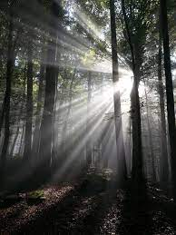
TYNDALL EFFECT
Notes:
TYNDALL EFFECT

Slide 38
3.b) Why is the colour of the clear sky blue ?
The fine particles in the atmosphere have size smaller than the wave length of visible light. They can scatter blue light which has a shorter wave length than red light which has a longer wave length. When sunlight passes through the atmosphere, the fine particles in the atmosphere scatter the blue colours more strongly than the red and so the sky appears blue. If the earth had no atmosphere there would not be any scattering of light and the sky would appear dark. The sky appears dark at very high altitudes.
Notes:
3.b) Why is the colour of the clear sky blue ?
The fine particles in the atmosphere have size smaller than the wave length of visible light. They can scatter blue light which has a shorter wave length than red light which has a longer wave length. When sunlight passes through the atmosphere, the fine particles in the atmosphere scatter the blue colours more strongly than the red and so the sky appears blue. If the earth had no atmosphere there would not be any scattering of light and the sky would appear dark. The sky appears dark at very high altitudes.

Slide 39

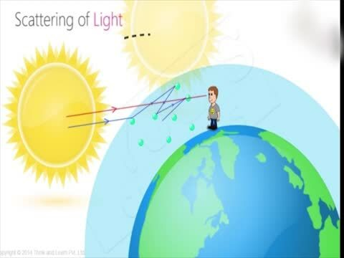
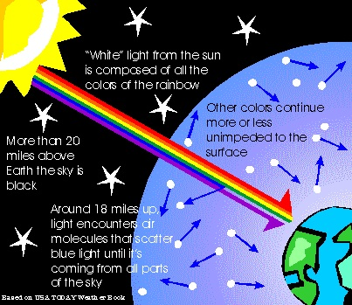
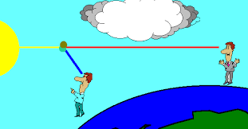

Slide 40
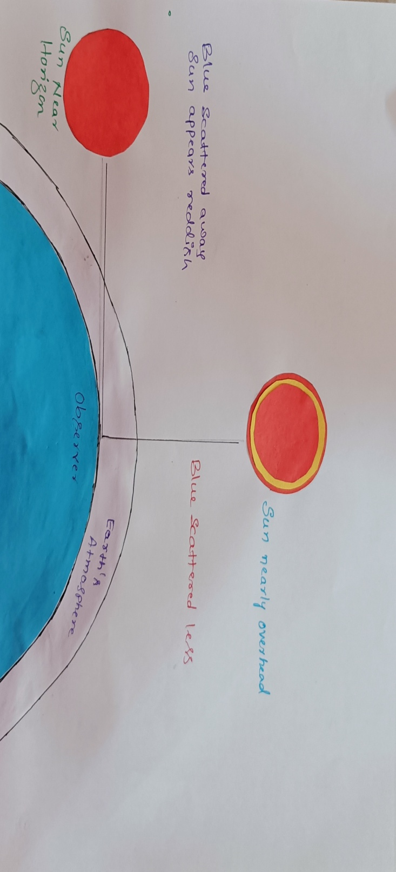
ii) Colour of the sky at sunrise and sunset :-
At sunrise and at sunset the sun is near the horizon and the light from the sun travels through the thicker layers of the atmosphere and longer distance through the atmosphere. Near the horizon most of the blue light and shorter wave lengths are scattered away by the particles of the air and the red light and longer wave lengths reaches our eyes. So the sun appears reddish at sunrise and sunset.
Notes:
ii) Colour of the sky at sunrise and sunset :-
At sunrise and at sunset the sun is near the horizon and the light from the sun travels through the thicker layers of the atmosphere and longer distance through the atmosphere. Near the horizon most of the blue light and shorter wave lengths are scattered away by the particles of the air and the red light and longer wave lengths reaches our eyes. So the sun appears reddish at sunrise and sunset.

Slide 41
HOME WORK
Why does the sky appear dark instead of blue to astronauts?
Which phenomenon is responsible for Tyndall effect?
Wider dispersion of light cannot be the only reason of blue colourof sky. Explain?
Notes:
HOME WORK
Why does the sky appear dark instead of blue to astronauts?
Which phenomenon is responsible for Tyndall effect?
Wider dispersion of light cannot be the only reason of blue colourof sky. Explain?

Slide 42
Reference
Photos from cc search.
NCERT text book
Video references on cc search
Notes:
Reference
Photos from cc search.
NCERT text book
Video references on cc search

Slide 43
Presented by
NAZINA BANU
Assistant teacher
Karnataka public school.
Dandinashivara.
Turuvekere taluk
Tumkur district.
Notes:
Presented by
NAZINA BANU
Assistant teacher
Karnataka public school.
Dandinashivara.
Turuvekere taluk
Tumkur district.

