Slide 1

Problem solving with critical reading
Notes:
Problem solving with critical reading

Slide 2

What is Critical Thinking?
Critical thinking is the ability to analyze and evaluate information to make informed decisions. It involves questioning assumptions, considering multiple perspectives, and weighing evidence.
Notes:
What is Critical Thinking
Critical thinking is the ability to analyze and evaluate information to make informed decisions. It involves questioning assumptions, considering multiple perspectives, and weighing evidence

Slide 3
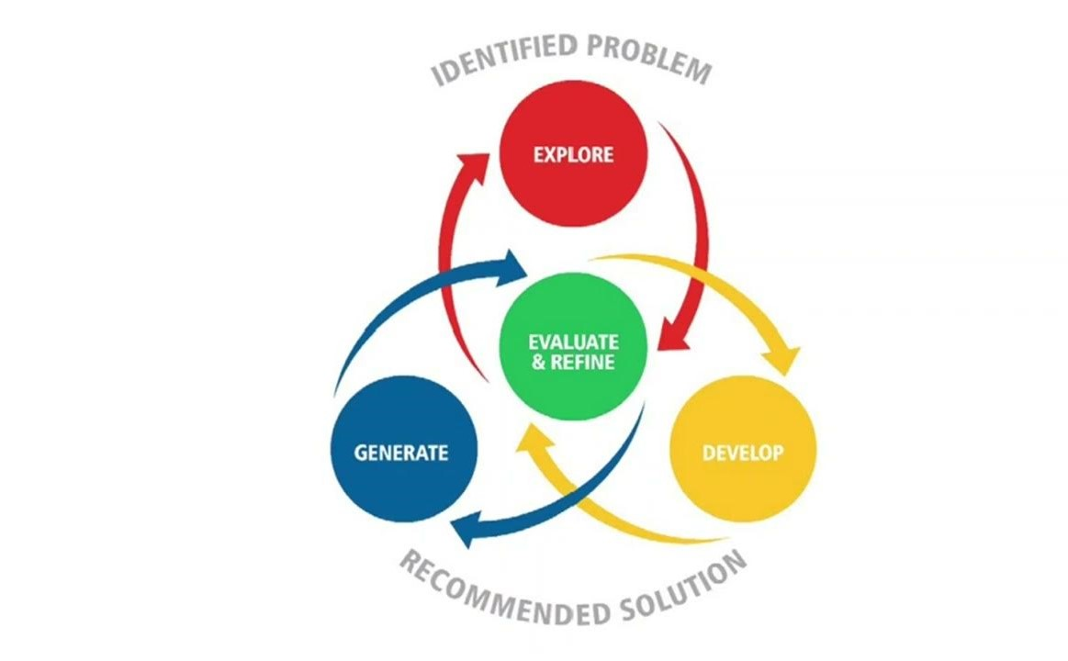
The problem solving process
The problem solving process involves identifying a problem, gathering information, analyzing the information, developing potential solutions, selecting the best solution, and implementing it.
Notes:
The problem solving process
The problem solving process involves identifying a problem, gathering information, analyzing the information, developing potential solutions, selecting the best solution, and implementing it.

Slide 4
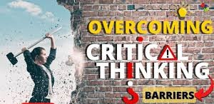
Barriers to critical thinking
One common barrier to critical thinking is confirmation bias. This occurs when individuals seek out information that confirms their existing beliefs and ignore information that contradicts them.
Notes:
Barriers to critical thinking
One common barrier to critical thinking is confirmation bias. This occurs when individuals seek out information that confirms their existing beliefs and ignore information that contradicts them.

Slide 5
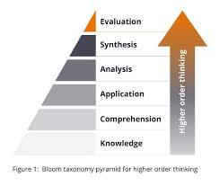
Practical Applications
practical tip is to consider multiple perspectives.
Notes:
Practical Applications
practical tip is to consider multiple perspectives.

Slide 6

Conclusion
By applying critical thinking, we can solve complex problems and make better decisions.
Notes:
Conclusion
By applying critical thinking, we can solve complex problems and make better decisions.

