Slide 1
ACKNOWLEDGEMENT
I would like to express my special thanks of gratitude to SOCIAL TEACHER as well as our principal FR. SHAJI JOSEPH who gave me the golden opportunity to do this wonderful project on the topic COMPARISON BETWEEN UTTAR PRADESH AND MEGHALAYA which also helped me in doing a lot of Research and i came to know about so many new things I am really thankful to them.
Secondly i would also like to thank my parents and friends who helped me a lot in finalizing this project within the limited time frame.
SHIVANSH AGRAWAL
10TH D

Slide 2
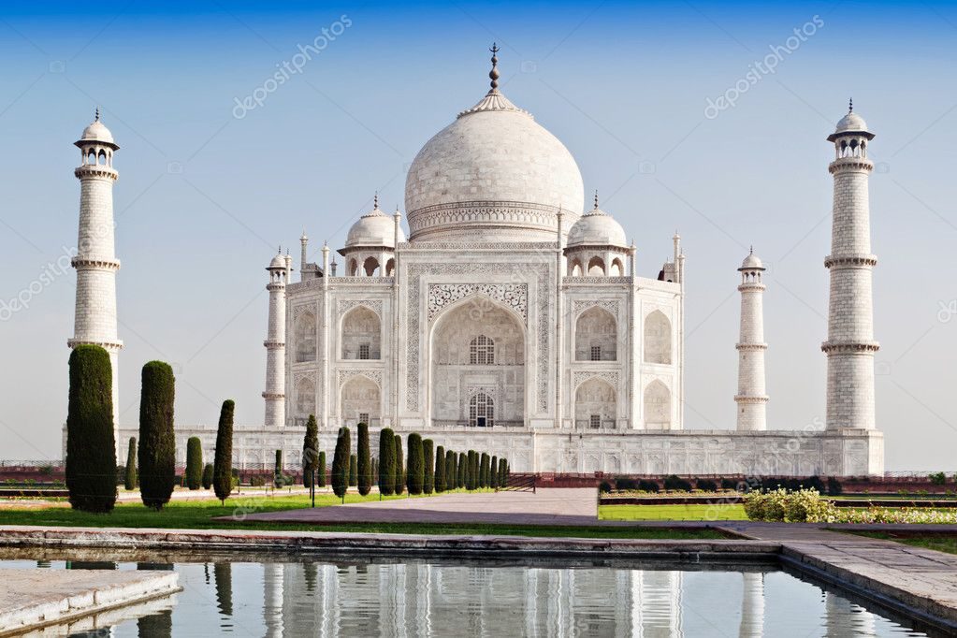
Welcome to
Uttar pradesh
UTTAR PRADESH

Slide 3
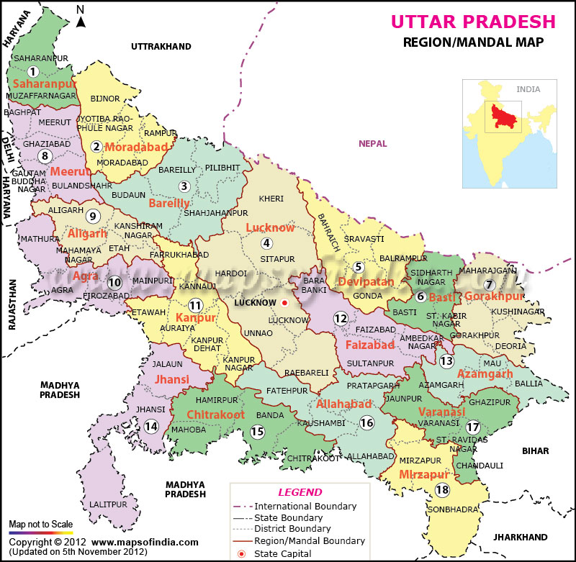
UTTAR PRADESH
Uttar pradesh, the most popular and fourth largest state of india. it lies in the north-central part of the country.
Uttar pradesh is bordered by the state of Uttarakhand the country of Nepal to the north, the state of Bihar to the east, the states of Jharkhand and Chhattisgarh to the southeast, the state of madhya pradesh to the south and the state of rajasthan and haryana and the national capital territory of delhi to the west. its capital is lucknow in the west-central part of the state.

Slide 4
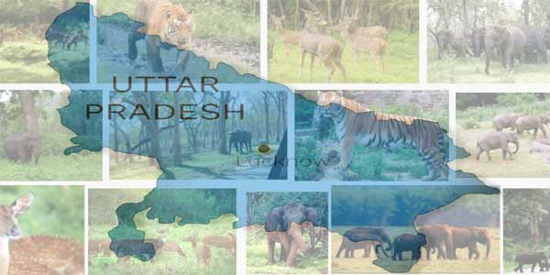
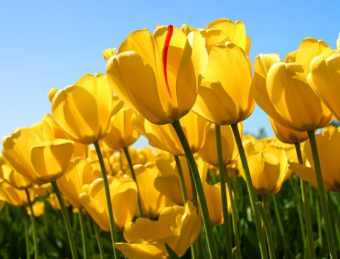
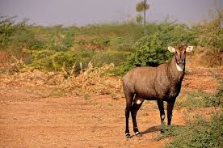
FLORA AND FAUNA
The types of forest that are most common in the state are Tropical Moist Deciduous Forests.They are found in all parts of the plains. Some of the most common plants that are found in the state of Uttar Pradesh are rhododendrons, betula, silver fir, spruce, deodar, chir, oak, sal. Various types of woody plants, shrubs and climbers are also found in the region.
Uttar Pradesh has a wealth of animal life. Especially fauna of the state is richest in the country. The most common birds which are found in the state are crow, pigeon, dove, jungle fowl,, blue jay, parakeet, kite, myna, quail, bulbul, , grey duck, whistling

Slide 5
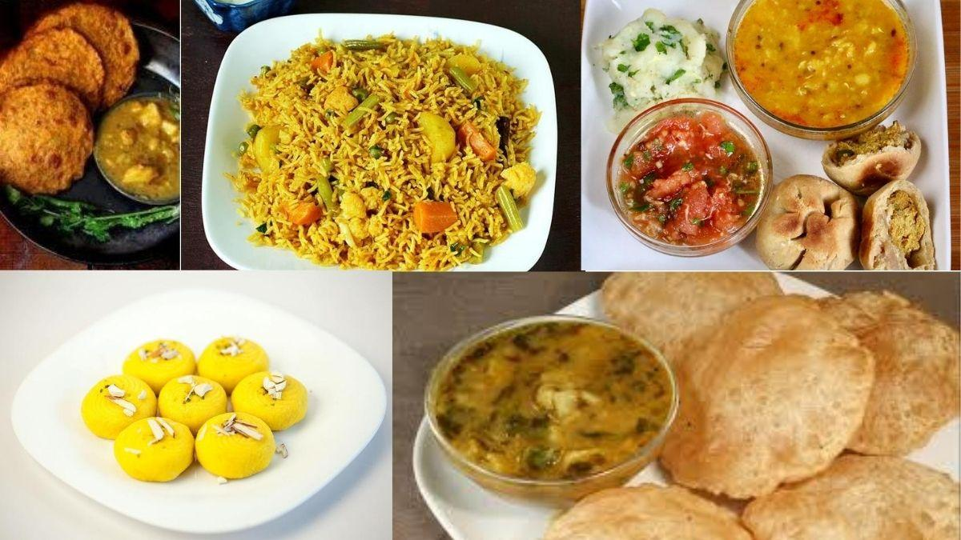
CUISINE
As wheat is the staple food of the state, breads are very significant. Breads are generally flat breads; only a few varieties are raised breads. The breads may be made of different types of flour and can be made in various ways. Popular breads include tandoori naan (naan baked in a tandoor), tandoori roti, kulcha, taftan, sheermal, Rumali Roti, Poori, Paratha. millet (millet flour flatbread), lachha paratha and poori aka oilFRIED roti

Slide 6
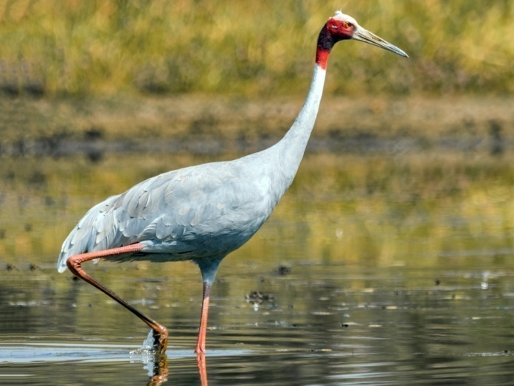
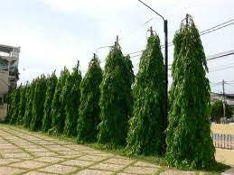
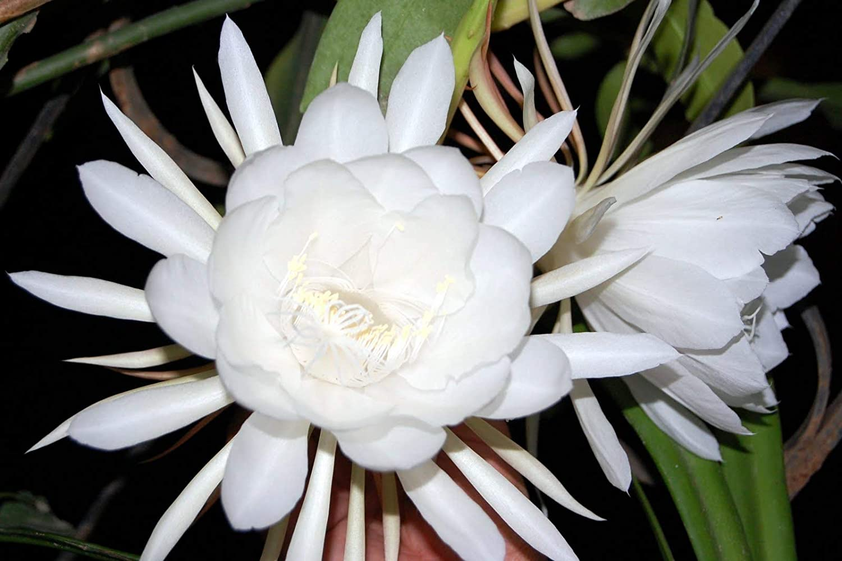
Symbols of Uttar pradesh
THE STATE BIRD IS : SARUS CRANE
THE STATE TREE IS : ASHOK
THE STATE FLOWER IS :BRAHM KAMAL

Slide 7
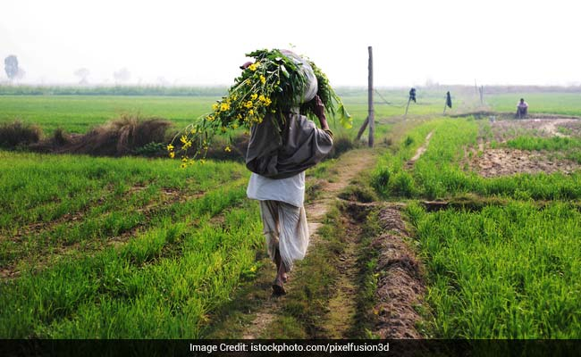
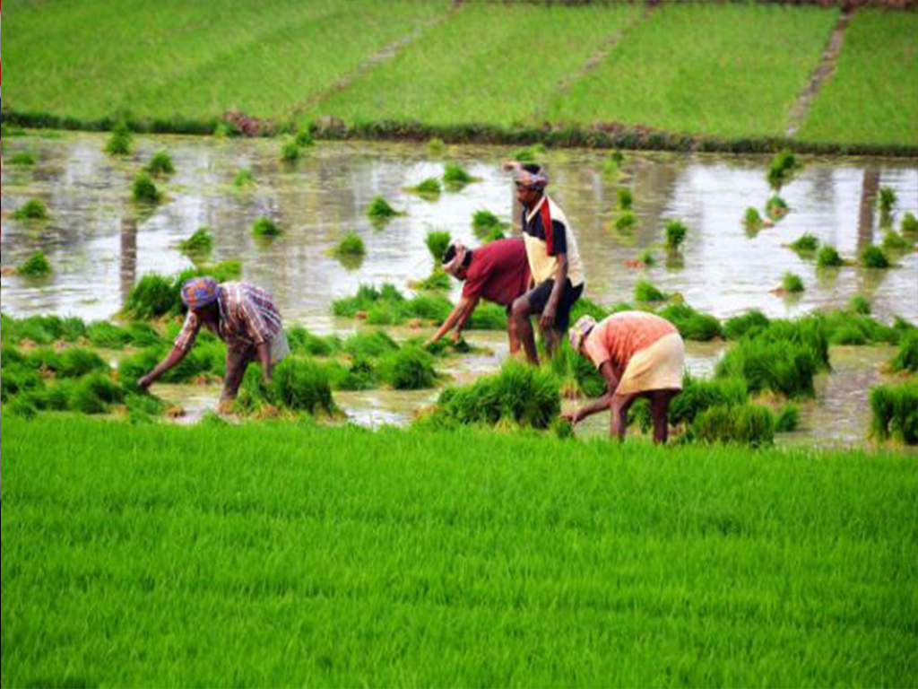
AGRICULTURE
Wheat, rice, pulses, oilseeds, and potatoes are major agricultural products. Sugarcane is the most important cash crop throughout the state. Uttar Pradesh is one of the most important states in India as far as horticulture is concerned. Mangoes are also produced in the state.

Slide 8
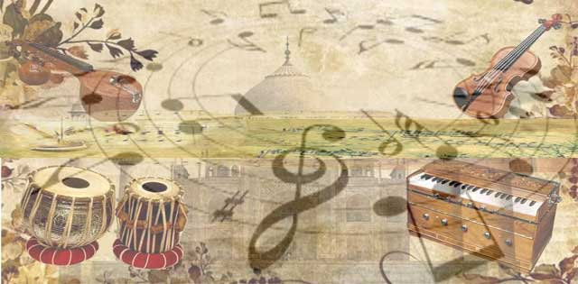
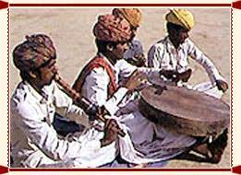
FOLK SONGS
Uttar Pradesh is a state of India.The region's folk heritage includes songs called rasiya(known especially in Braj), which celebrate the divine love of Radha and Shri Krishna. These songs are accompanied by large drums known as bumb and are performed at many festivals.
During the eras of Guptas and Harsh Vardhans Uttar Pradesh was a major center for musical innovation.

Slide 9
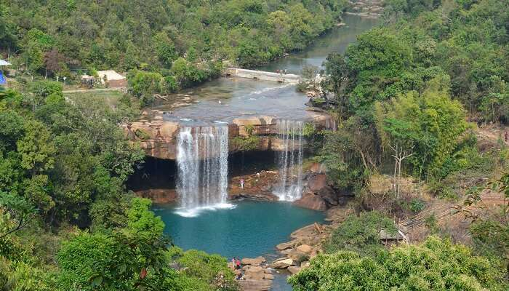
.
MEGHALAYA

Slide 10
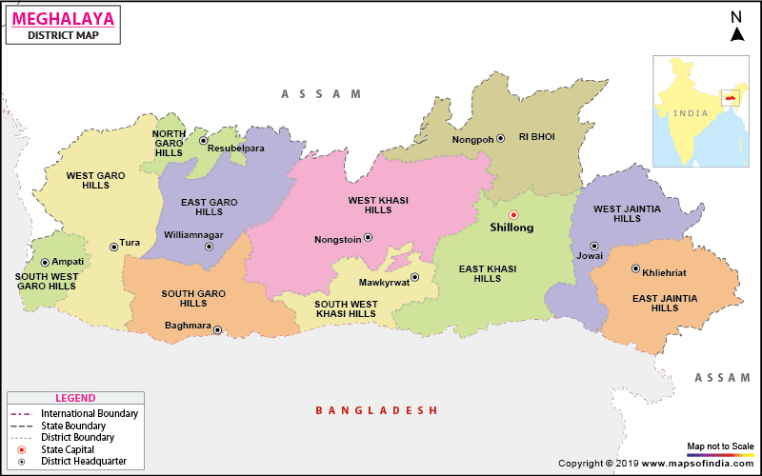
MEGHALAYA
MEGHALAYA a hilly strip in eastern India, covers a total area of 22,429 km2 (8,660 sq mi). Earlier, It was a part of Assam. It is surrounded by Assam to the north and northeast and by Bangladesh to the south and southwest. The formation of Meghalaya as a state took place on January 21, 1972. The capital of Meghalaya is Shillong. The percentage of literacy in this state is 75.84 and the languages mostly spoken are English, Khasi, and Garo.

Slide 11
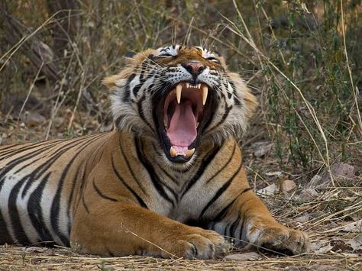
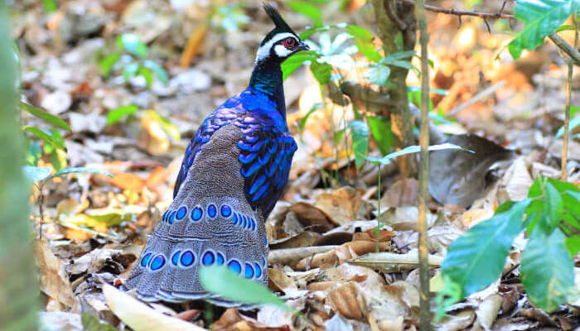
FLORA AND FAUNA
Meghalaya has a forest cover of 9,496 km square, which is 42.34 percent of total geographical area of the state. These forests receive heavy rainfall and support a large variety of floral and faunal biodiversity.
There are patches of forests preserved by communities for religious and cultural beliefs. These forests are reserved for religious purposes and are protected from exploitation. In these sacred forests inhabit many rare varieties of plants and animals. There are a large variety of Parasites and Epiphytes, Sucarge variety of mammals, birds, reptiles and insects also inhabit here. The important mammals are civets, elephants, mongooses, weasels, rodents,gaur,.

Slide 12
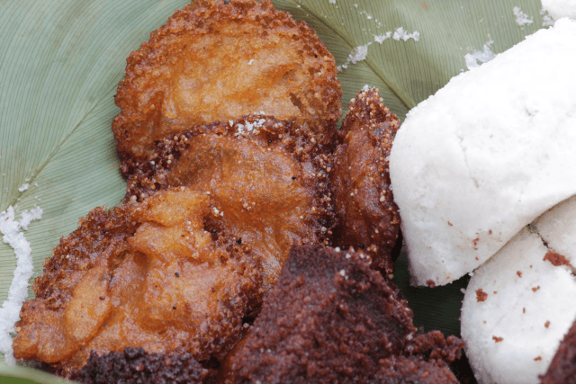
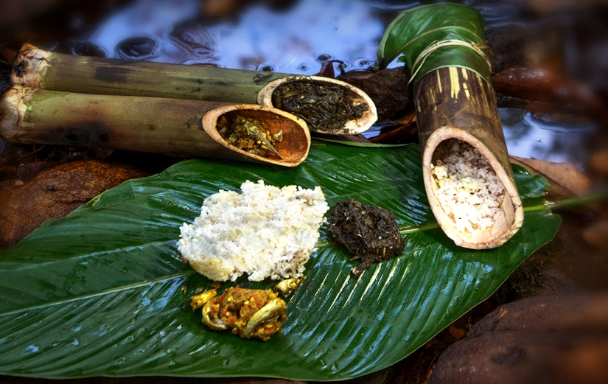
CUISINE
Meghalaya is home to three tribes; it has a unique cuisine, different from the other Seven Sister States of northeast India. The staple food of the people is rice with spicy meat and fish preparations. They rear goats, pigs, fowl, ducks and cows and relish their meat.
The dishes of Khasis and Jaintia are Jadoh, Ki Kpu, tung rymbai and pickled bamboo shoots; bamboo shoots are also a favorite dish of. Garos eat both domesticated and non-domesticated animals, though their everyday staples are simple foods such as rice with kapa, cooked with ingredient called purambhi masala.

Slide 13
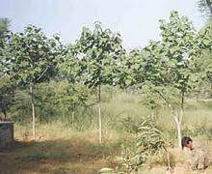
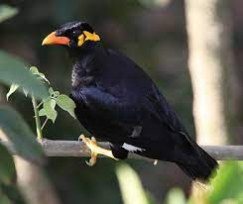
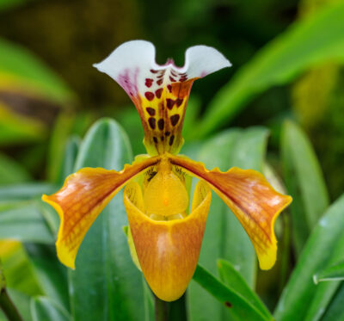
SYMBOL OF MEGHALAYA
THE STATE BIRD IS : COMMON HILL MYNA THE STATE TREE IS : GMELINA ARBOREA THE STATE FLOWER IS: PAPHIOPEDILUM INSIGNE

Slide 14
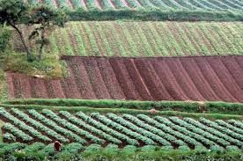
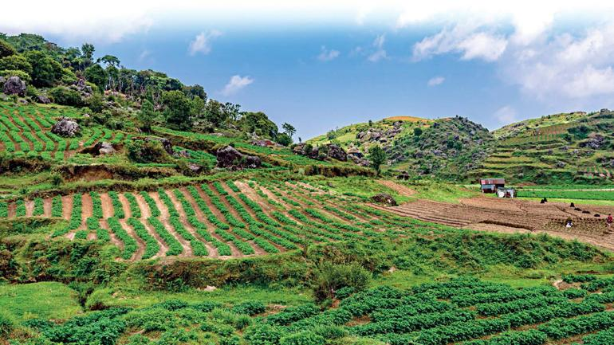
AGRICULTURE
Besides the major food crops of rice and maize, the state is renowned for its horticultural crops like orange, lemon, pineapple, guava, litchi, banana, jack fruits and fruits such as plum, pear and peach. Oilseeds such as rapeseed, mustard, linseed, soybean, castor and sesame are grown on nearly 100 km2
Meghalaya has predominantly an agrarian economy with a significant commercial forestry industry. The important crops are potatoes, rice, maize, pineapples, bananas, papayas, and spices.

Slide 15
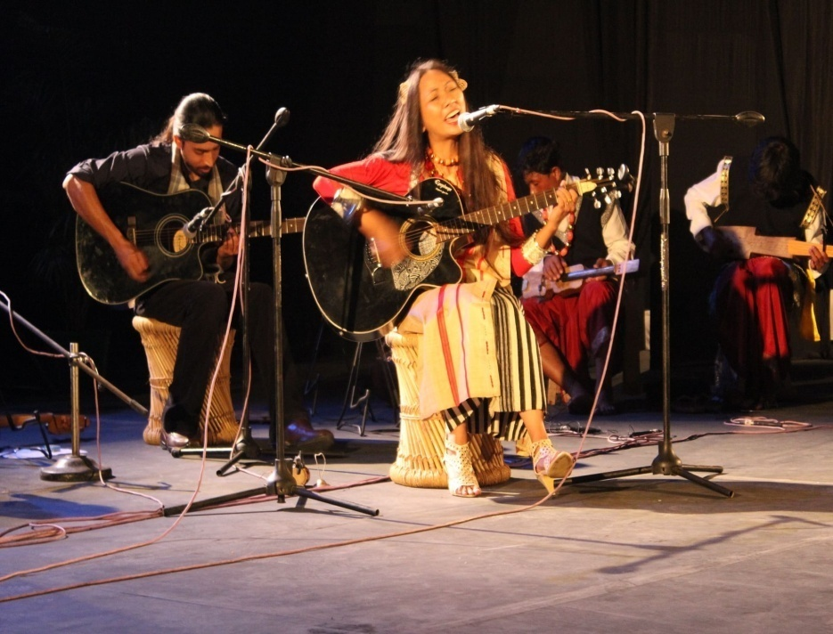
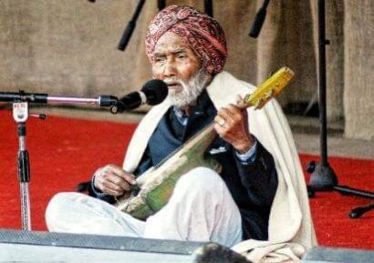
FOLK SONGS
The folk songs sung by the Garo tribe are dedicated to festivals, marriages, love and bravery accompanied by drums and flutes. The songs sung by the Khasis and Jaintias are generally in the praise of Mother nature. They sing songs in the praise of hills, lakes, waterfalls and rivers expressing appreciation for their land. Musical instruments used by them are drums, duitara and instruments similar to guitar, flutes, pipes and cymbals

Slide 16
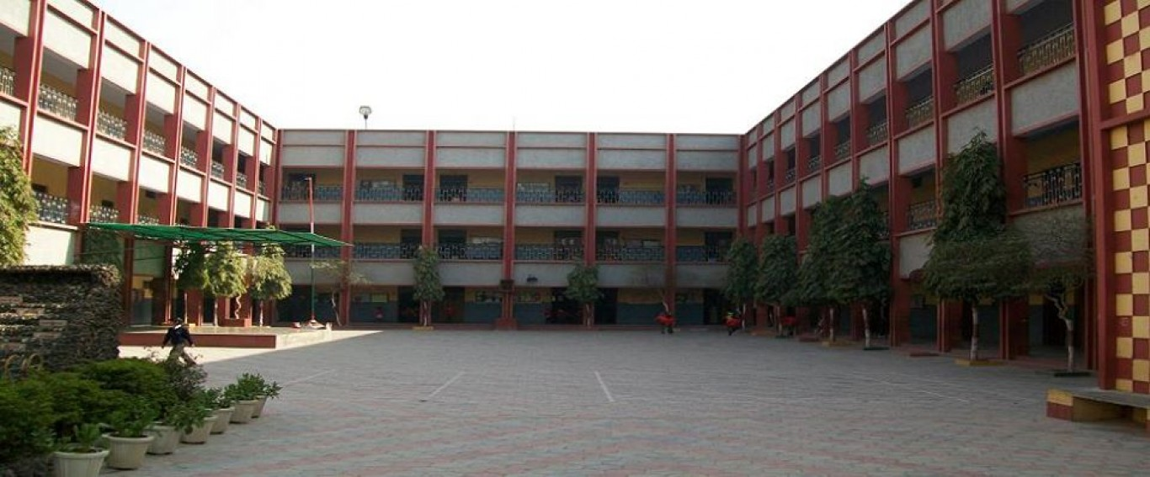
MADE BY-SHIVANSH AGRAWAL
[10TH D]
SUBMIT TO –
SOCIAL TEACHER
SUBMITTED TO-
SOCIAL TEACHER

