Slide 1

EXIT PROCESS

Slide 2
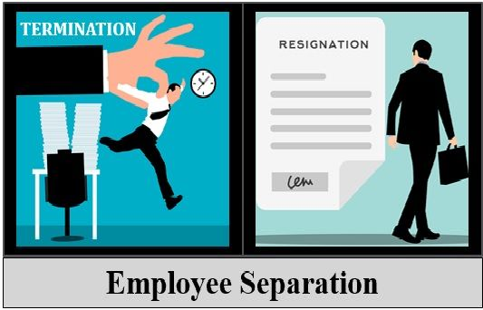
OVERVIEW
    Types of Separation
      Voluntary
      Involuntary
    Reasons of Separation
    Resignation Process

Slide 3
VOLUNTARY SEPARATION
means any termination of employment that is not involuntary and that is not the result of the employee's death, disability.
REASONS FOR VOLUNTARY SEPARATION:
Health Issue
Family Issue
Better Compensation and Opportunity
Career Shift/ Advance Opportunity
Studies
Issues with Immediate Supervisor
Relocation
Proximity Issues (difficulty in commuting, distance from home to office
Work Abroad

Slide 4
INVOLUNTARY SEPARATION
refers to dismissal from employment due to the actions or decisions of the employer and not the employee.
Reasons for InVoluntary Separation:
Admin Case
Non-Regularization
Redundancy
Retrenchment
Termination due to illness/ disability
Retirement
Death

Slide 5
RESIGNATION PROCESS:
EMPLOYEE | RM/OIC/VM | GM/MD
START
Immediate superior will approve the resignation letter, finalize last day of work, and secure final approval of the GM/MD. (Discuss leave balance if any)
GM/MD will approve the agreed effective date of resignation
Employee submits resignation letter to his/her immediate superior and secure approval
GM/MD will notify HR via email and submit the signed copy.
A

Slide 6
RESIGNATION PROCESS
HR
A
HR will acknowledge the receipt of the resignation letter and update payroll system.
HR will send out clearance process within last week of employee cc: RM/OIC/VM/GM
HR will send out clearance completion for final pay computation cc: RM/OIC/VM/GM
END of PROCESS
Note: For food, HR will not provide endorsement letter for separated employees who will be transferring to the same brand within the cooling period of one year.

Slide 7
THANK YOU

