Slide 1
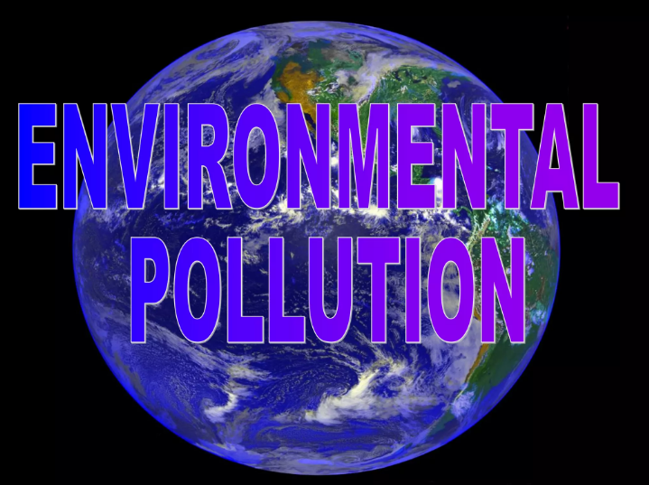

Slide 2
OVERVIEW
Definition of pollution .
Type of pollution.
Air pollution.
Water pollution.
Noise pollution .
Land pollution .
Radio Active pollution.

Slide 3
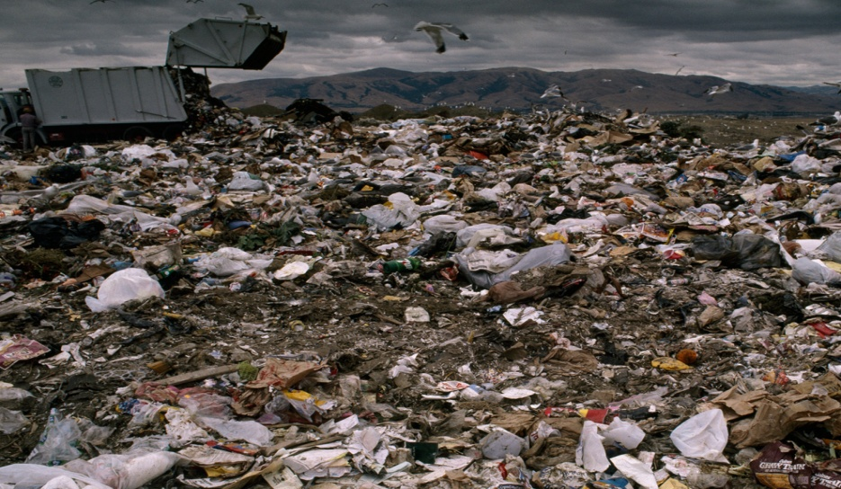
DEFINITION OF POLLUTION
When Harmful Substances Contaminate the Environment, it is Called Pollution .
Pollution refers to the very bed condition of environment in terms of quantity and quality.

Slide 4
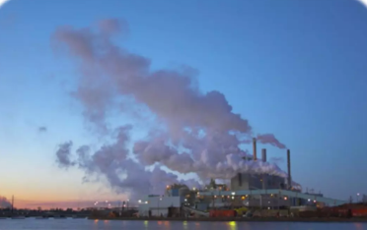
TYPES OF POLLUTION
There are Five types of pollution.
Air pollution
Water pollution
Noise pollution
Land pollution
Radio Active pollution

