Slide 1


PML Transfer Process

Slide 2
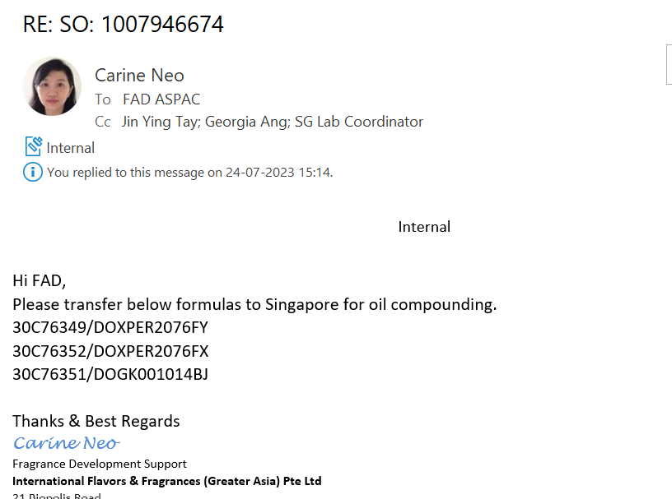
PML means Primary manufacturing location
We will get request from requestor to transfer those 30c, 30f, 30S, 30G IPCs.
For example:

Slide 3
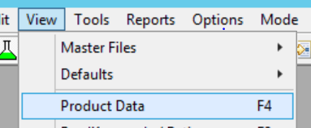
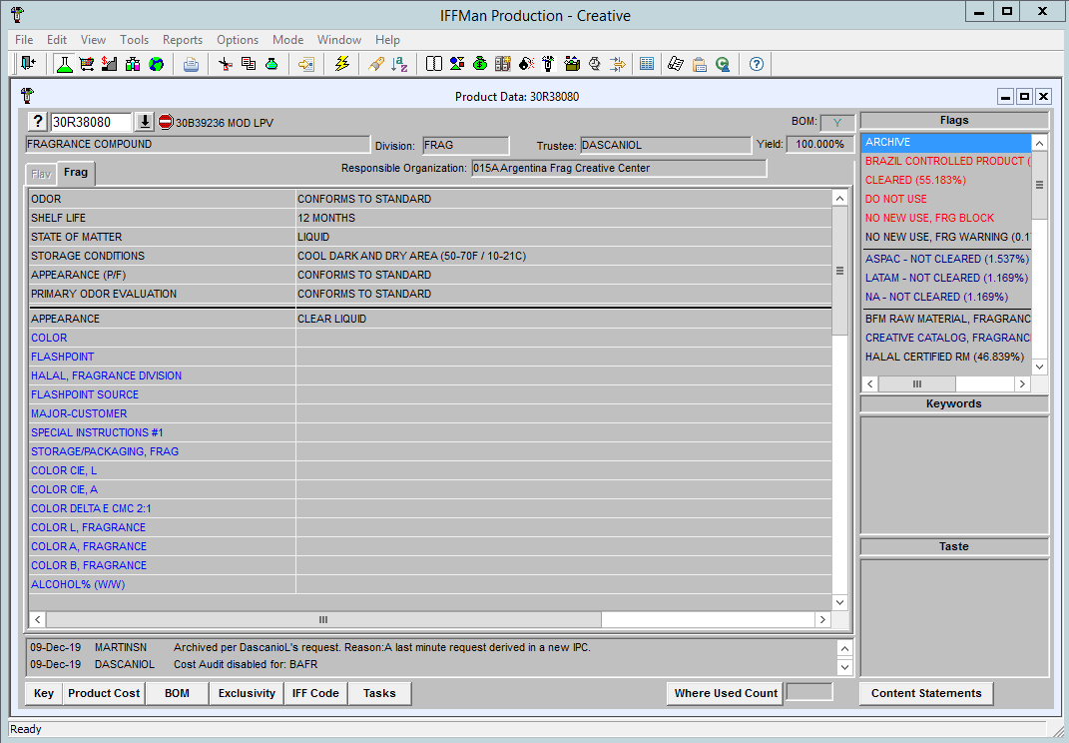
PML transfer Process
  The approval process of the creative center of origin for the requested IPC must be followed prior to setting the PML.
  FAD must review the flags in the product data screen in IFFMAN to ensure that the following flags are not set:

Slide 4
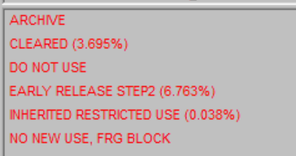
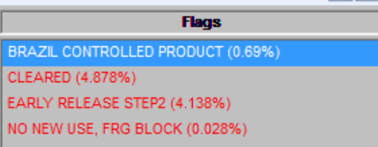

Do Not Use / Archive flag
NO NEW USE FRG BLOCK
India Creative Catalog Flag
Transfer is not allowed
FAD should check with PerfTech and if approved, proceed with the transfer.
BOMs with India Creative Catalog flag contain India raw materials, Inform the requestor that the formula contains India raw materials, and that FAD is not allowed to transfer.

Slide 5
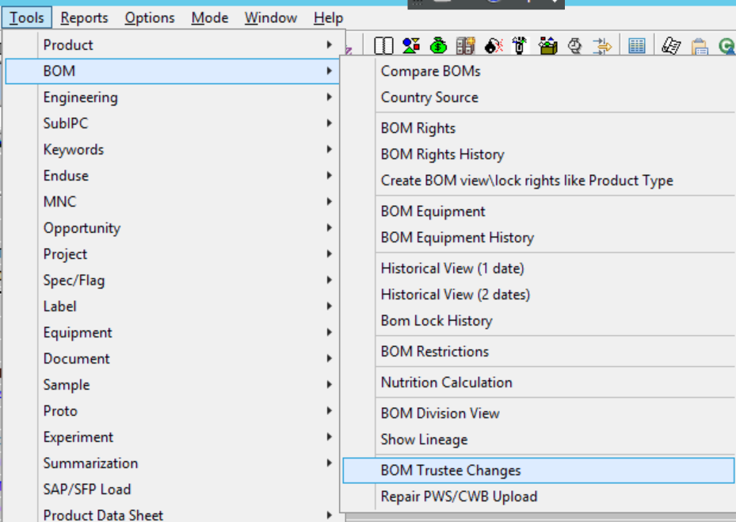
If the transfer request is for 303/30F/30U IPC’s the request must be sent to Neuilly FAD, for further handling.
FAD of the requestor’s site is responsible to gather the approvals from Trustee or CC Director for IPCs of all regions before proceeding with the formula transfer.

Slide 6
According to the (Exception Table) no approval from the Trustee or CC Director is required
Exception Table: DO NOT NEED APPROVAL
IPC series | You can proceed if:
30C (China) | Sample request (stated in e-mail)
30S (Singapore) | Sample request (stated in e-mail)
309 (India) | Already transferred to another plant
300/1/2/G (EAME) | Already transferred to another plant or If trustee is PST or GPIC
30M (Mexico) | Already transferred to another plant
30R (Argentina) | Approval not required
30B (Brazil) | Approval not required
305/6/7/8 (NA) & U & Q | Already transferred to another plant
IPCs for P&G | FAD will transfer formula to these 5 sites (HZ / TB / MX / JR / HP). Upon approval from P&G accounts .

Slide 7
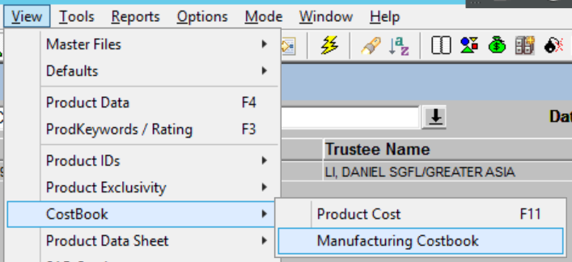
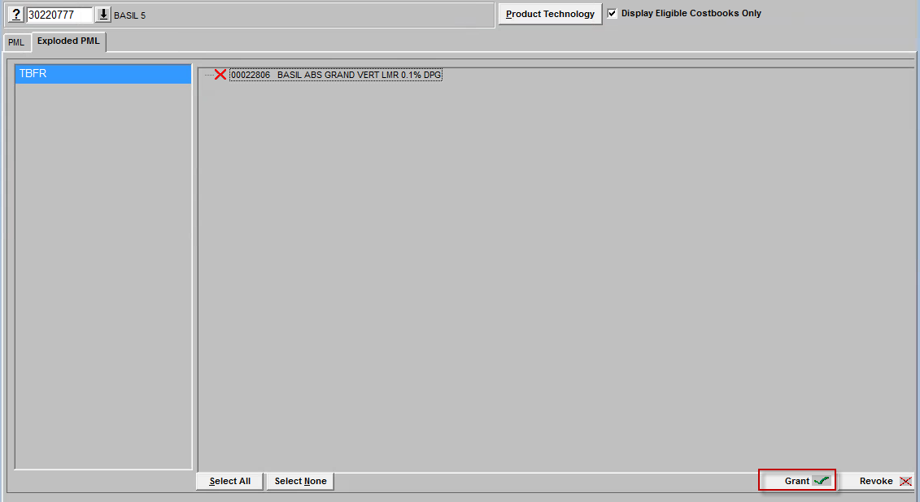
After trustee approval, add PML to the head formula .
2. After setting PML, make sure all the sub formulas transferred as well. Click ‘Exploded PML’ and see whether there’s ‘X’ for subs. If yes, highlight it and click ‘Grant’ button at the lower right corner.

Slide 8
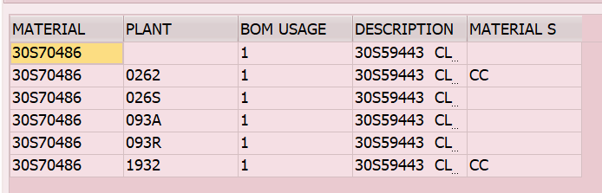
After BOM migration check in PR1(ZBOMASSGN), FAD must reply to the requestor that the transfer was successful.
If the requestor is from Neuilly and Neuilly FAD is already copied then always keep Neuilly FAD in copy on the email.
Please find below the table PML attached to cost book + plant + sample lab plant
COST BOOK | PLANT | SAMPLE LAB PLANT
HZFR | 0012 | 001A, 001C
MXFR | 0112 | 011A
RJFR | 0132 | 013A
BAFR | 0152
JRFR | 0262 | 026S
HPFR | 0282 | 028C, 028H
TBFR & DHFR | 0372 | 033A,037H,0632,150A
APFR | 1932 | 093A, 093R

Slide 9

Thank you

