Slide 1
Karachi City Of Lights
An overview of a vibrant city!
Notes:
Karachi City of Lights. An overview of a vibrant city

Slide 2
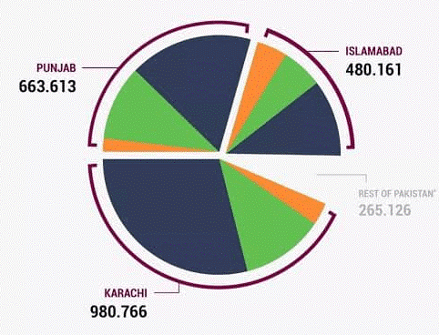
Karachi, often referred to as the “City of Lights,” is the largest city in Pakistan and a major economic hub.
Karachi the business capital generates more revenue than all of Punjab
Contributing significantly to the country’s GDP.
Notes:
Karachi, often referred to as the “City of Lights,” is the largest city in Pakistan and a major economic hub.
Karachi the business capital generates more revenue than all of Punjab
Contributing significantly to the country’s GDP.

Slide 3
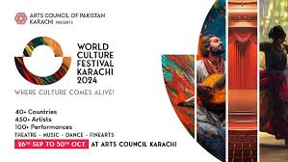
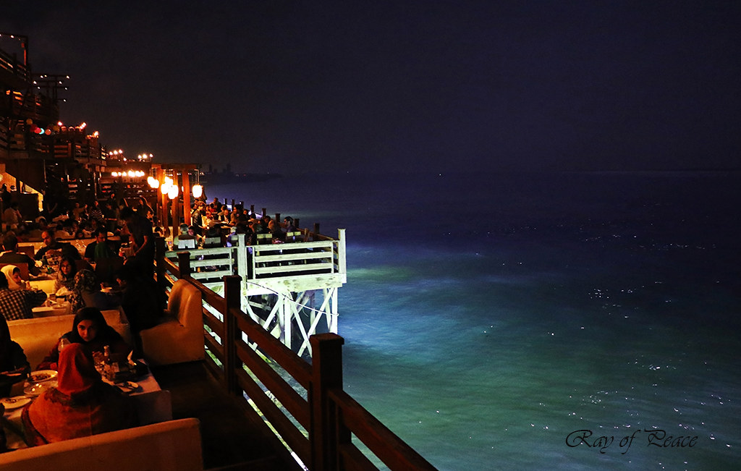

The city is known for its rich cultural diversity, with a mix of various ethnicities, languages, and religions.
This diversity is reflected in its vibrant arts, music, and culinary scenes.
It offers a bustling nightlife with restraunts, events etc!
Notes:
The city is known for its rich cultural diversity, with a mix of various ethnicities, languages, and religions.
This diversity is reflected in its vibrant arts, music, and culinary scenes.
It offers a bustling nightlife with restraunts, events etc!

Slide 4
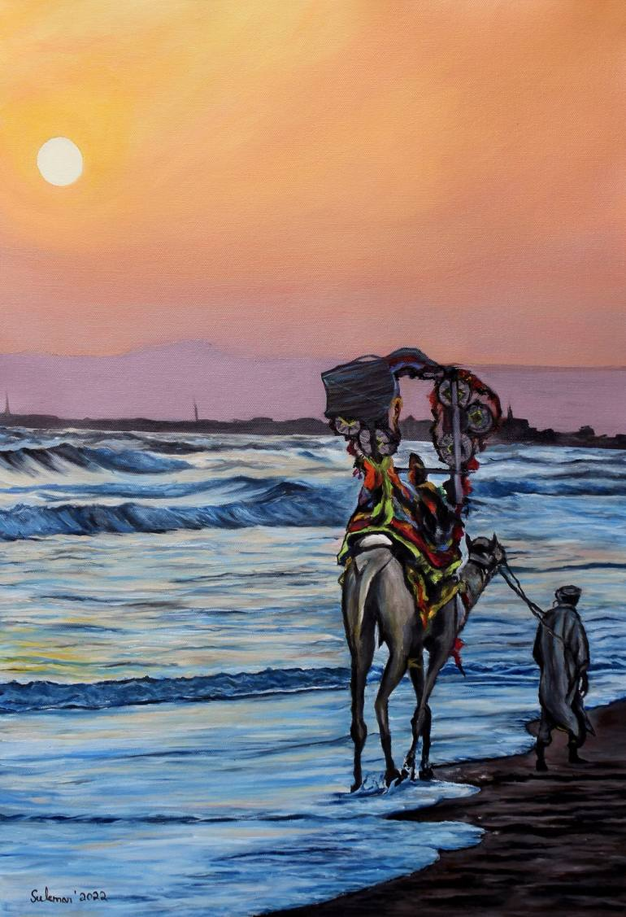
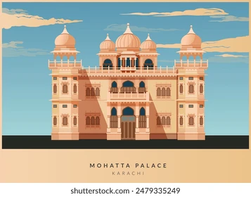
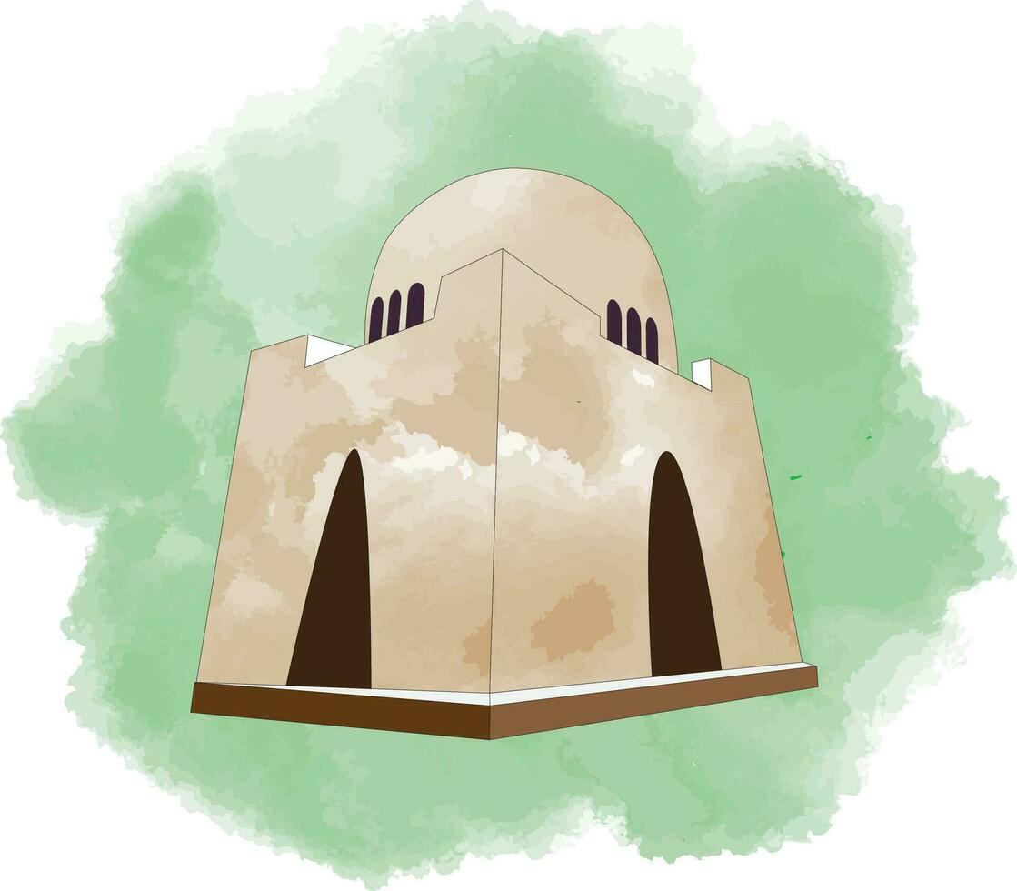
Karachi is also home to many historical and natural sites making it perfect for a change in scenery
Karachi has a deep historical background, with landmarks like the Quaid-e-Azam’s Mausoleum, Mohatta Palace, and Frere Hall¹
The city boasts a beautiful coastline along the Arabian Sea, featuring popular spots like Clifton Beach and Manora Island²
Notes:
Karachi is also home to many historical and natural sites making it perfect for a change in scenery
Karachi has a deep historical background, with landmarks like the Quaid-e-Azam’s Mausoleum, Mohatta Palace, and Frere Hall¹
The city boasts a beautiful coastline along the Arabian Sea, featuring popular spots like Clifton Beach and Manora Island²

