Slide 1
Sustainable Lifestyle
By- Hariansh ,Class 6-C,Mount Carmel School

Slide 2
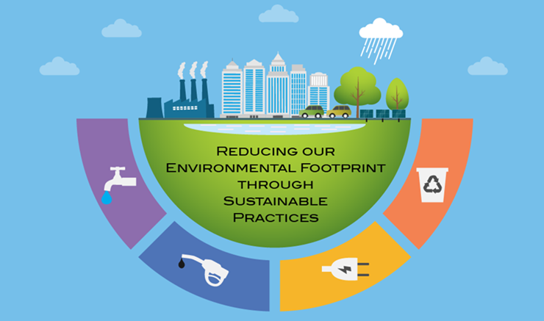
What Is Sustainable Life style?
Sustainable living describes a lifestyle that attempts to reduce the use of Earth's natural resources by an individual or society.
Its practitioners often attempt to reduce their ecological footprint by altering their home designs and methods of transportation, energy consumption and diet.

Slide 3
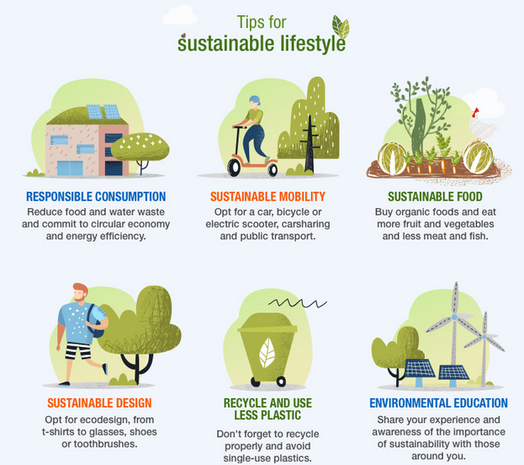

Slide 4
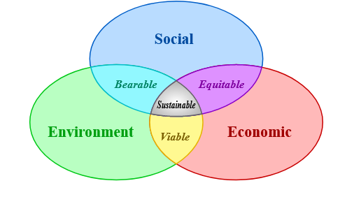
Three Pillars of Sustainability
.

Slide 5

Few steps from where we go for the path of Sustainability?

Slide 6
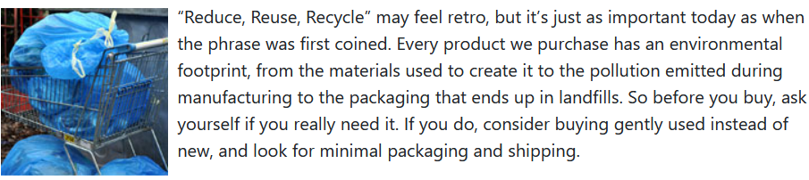
Think twice before shopping?

Slide 7
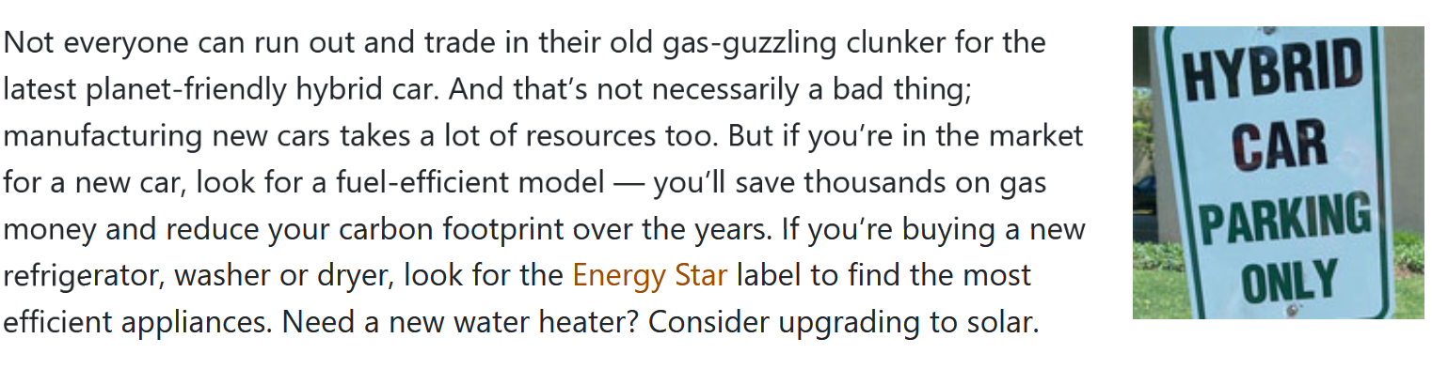
Make sure your purchases have big environmental benefits.

Slide 8
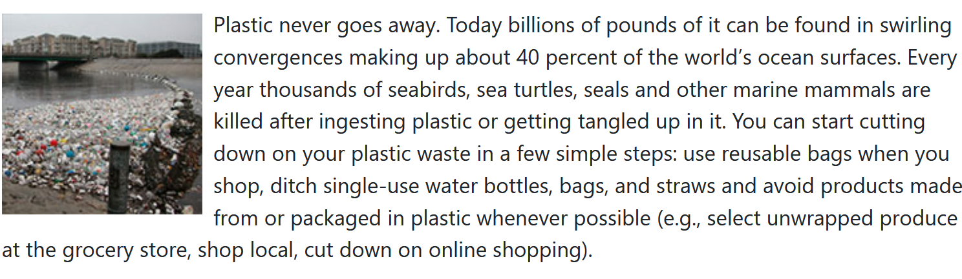
Go #PlasticFree

Slide 9
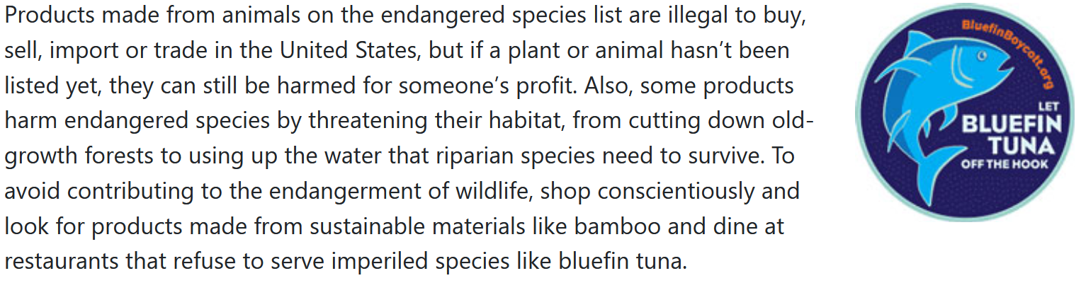
Boycott product that endanger wildlife

Slide 10


