Slide 1


National Programme for Civil Services Capacity Building –
Mission Karmayogi
Indian Maritime University
11th July 2023

Slide 2
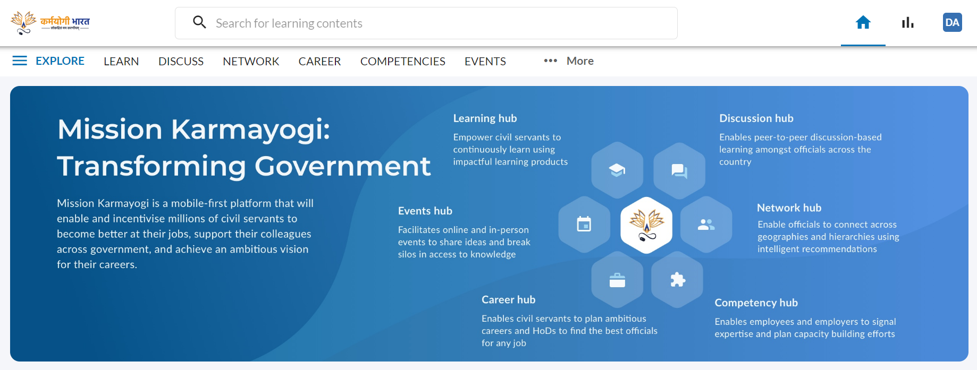
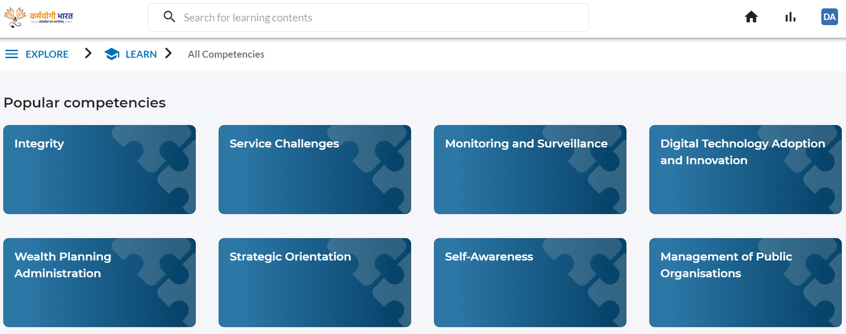
iGOT Karmayogi Platform
iGOT Karmayogi
1
2
3
4
5
6
Learning Hub
Competency building through suitable Content / Competency Building Products (CBPs) & assessments
Discussion Hub
Focused forums for discussion/ query resolution enabling officials to benefit from experience of others
Networking Hub
Enabling officials to connect with experts who may be in a position to help solve a problem
Career Hub
Vacancy postings linked to required competencies, enabling govt. to match right candidates with vacancies
Competency Hub
Repository of FRAC for all positions and competency records for all individuals
Events Hub
Enable synchronous interactive experiential and peer learning

Slide 3




User Growth on iGOT Karmayogi Platform
15.8 lakh+
Registered Learners
Users
No. of Users on iGOT Karmayogi Platform
2966
MDO roles assigned
Hosted on NIC Cloud & Managed by NIC
User growth since August’22
Parichay Single Sign On enabled
3

Slide 4


Course Growth on iGOT Karmayogi Platform
580
Live Courses
1200+
Hours of Content
17
World Bank courses
10
Microsoft courses
No. of Courses on iGOT Karmayogi Platform
Courses
85
ISTM courses
15 COMMIT*
modules - State Frontline Staff
46M+
Learning Minutes
Courses growth since August’22
*Comprehensive Online Modified Modules for Induction Training

Slide 5
WHAT iGOT OFFERS TO COURSE PROVIDERS?
02
Create Programs
Create Courses
01
03
Create Micro Courses
04
Get Data Insights
Scalability
Shareability
Modularity
Reach
Targeting

Slide 6

Various Learning Models Offered

Slide 7
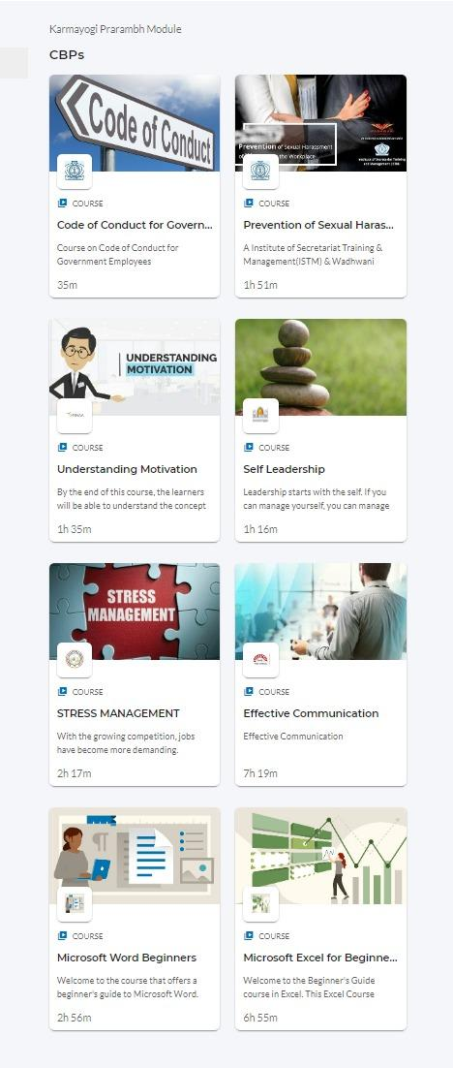
Karmayogi PRARAMBH
Curation of 8 courses
Launched by the Hon’ble PM in the Rozgar Mela held on 22nd November 2022
Purpose is to impart induction training to all government employees
5 beneficiaries got the opportunity to interact with the Hon’ble PM during the recent Rozgar Mela
Karmayogi PRARAMBH module for newly appointed DS/Directors
Karmayogi PRARAMBH module for newly appointed JS

Slide 8
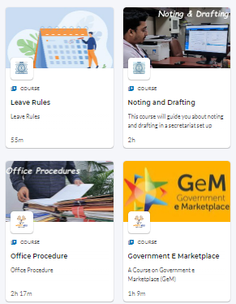
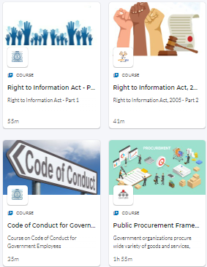
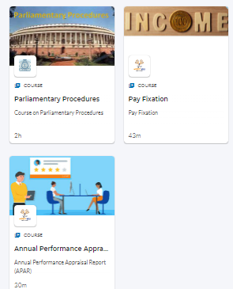
DAKSHTA - Hybrid Model
Development of Attitude, Knowledge, Skill for Holistic Transformation in Administration
Compilation of 11 courses
Developed by Capacity Building Commission (CBC) in collaboration with ISTM.
Offer an applied problem-solving set of 10 courses for the officers of CSS/CSSS cadre, in hybrid (online & offline) mode

Slide 9
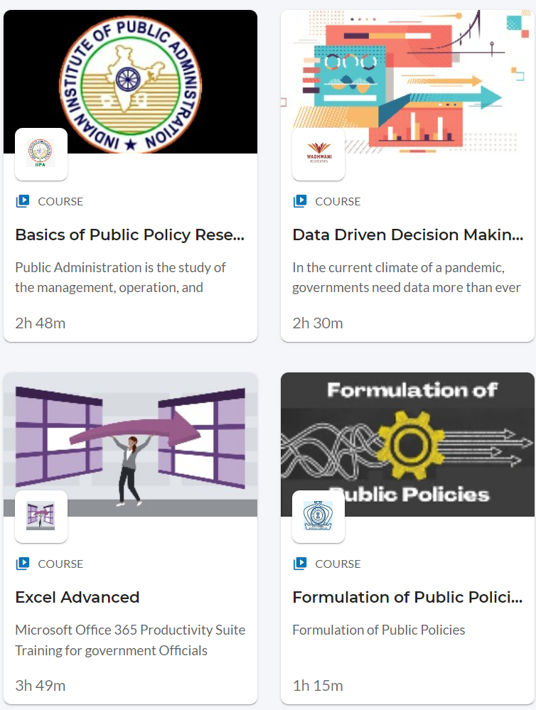
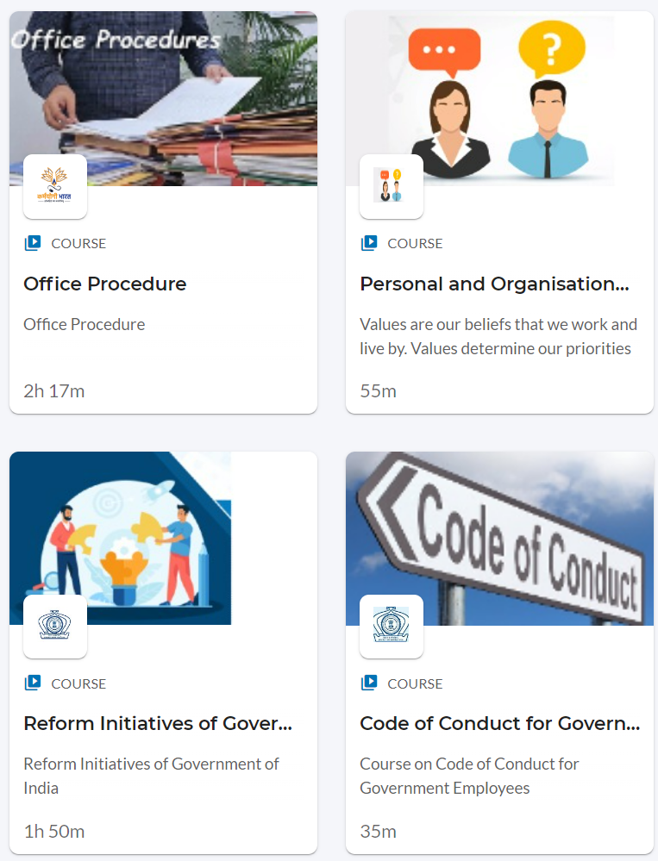
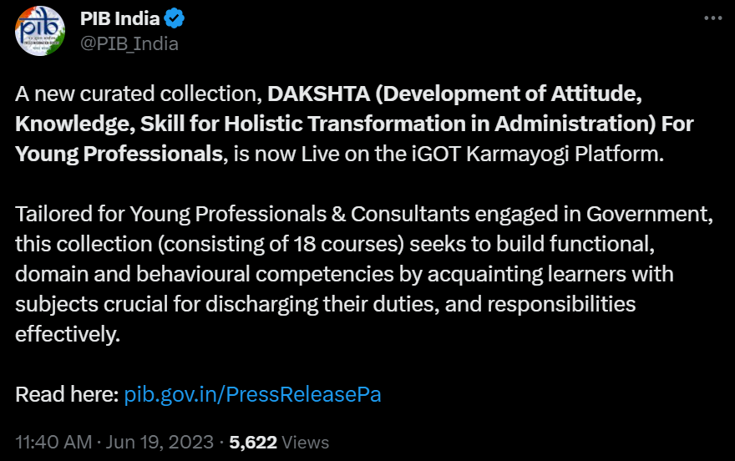
DAKSHTA for Young Professionals
Curation of 18 courses
Launched by the NITI Aayog
Purpose is to impart induction training to all the Young Professionals and Fellows working across central and state departments

Slide 10
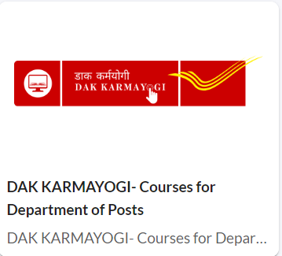
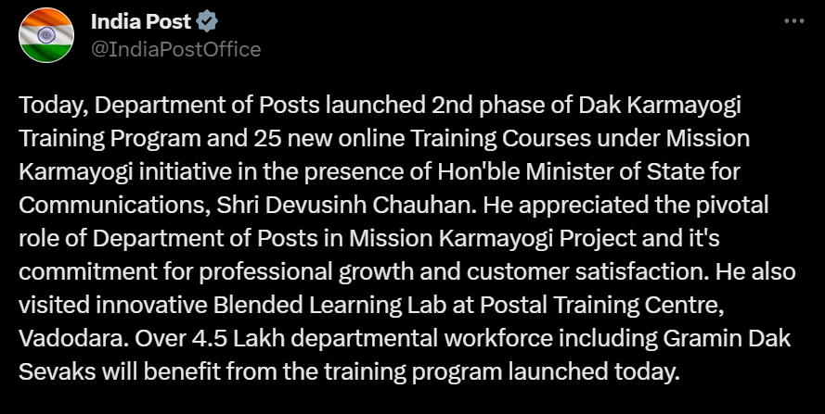
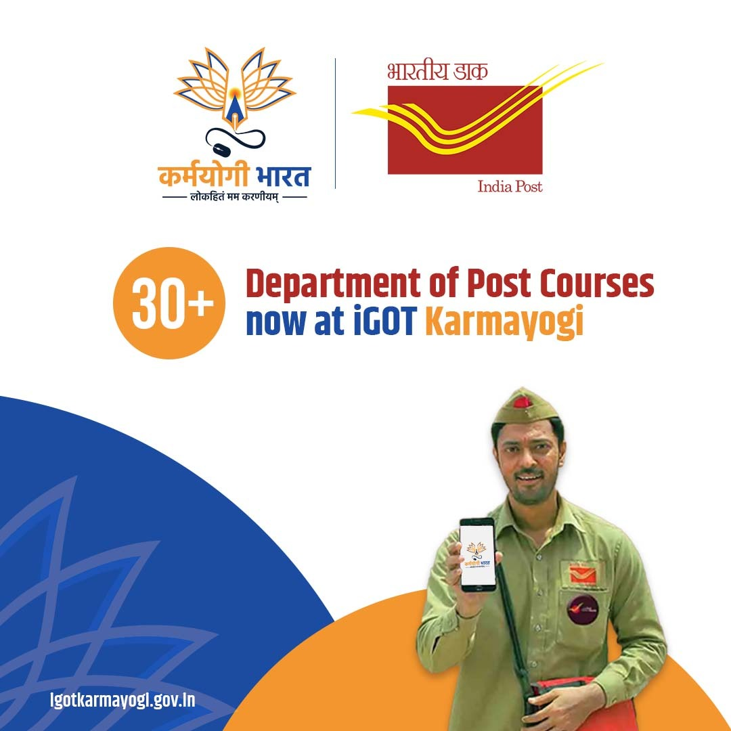
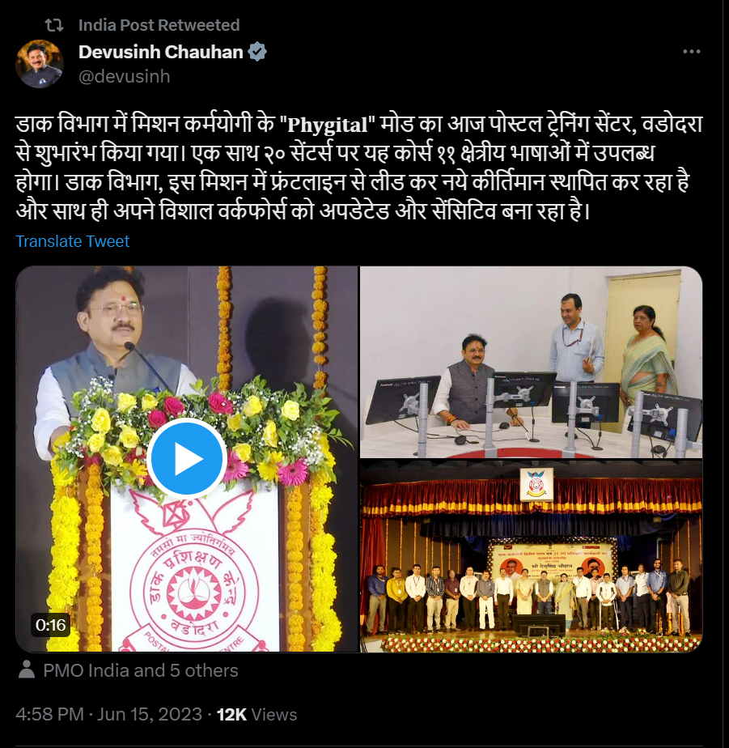
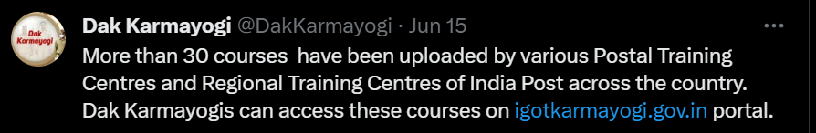
DAK Karmayogi
A curated collection of 60+ courses
Launched by the Hon’ble Union Minister of State for Communications on June 15, 2023
Targeted for over 4.5 lakh workforce of the Department of Posts, which are already onboarded and active on the iGOT Karmayogi platform
Notes:
Swap Chat Bot and Integration

Slide 11


Onboarding Process of Ministries, Departments, and Organisations
Department identifies iGOT MDO Administrators and shares credentials with SPV
iGoT team creates Department on iGOT and provides Admin access for department to nominated administrators
Karmayogi Nodal Officer
MDO Admin
(Format: Generic govt-domain-based Email ID)
Content Team
(Format: Generic govt-domain-based Email ID)
Learners/Govt. Officials
(Format: Personal govt/private-domain-based Email ID)
A
B
C
Authorize learner onboarding, offboarding, profile updates, etc.
Content Creator : A subject matter expert, who creates/authors the content on platform
Individual public officials who will build their competencies through the iGOT platform
Assign Content Creator, Reviewer and Publisher roles
Content Reviewer : A subject matter expert, who reviews the content on platform
Learners can be onboarded through MDO admin or by self registration process
Dashboard and Reports access to track learners’ engagement on iGOT
Content Publisher : Publishes the content on platform
11

Slide 12
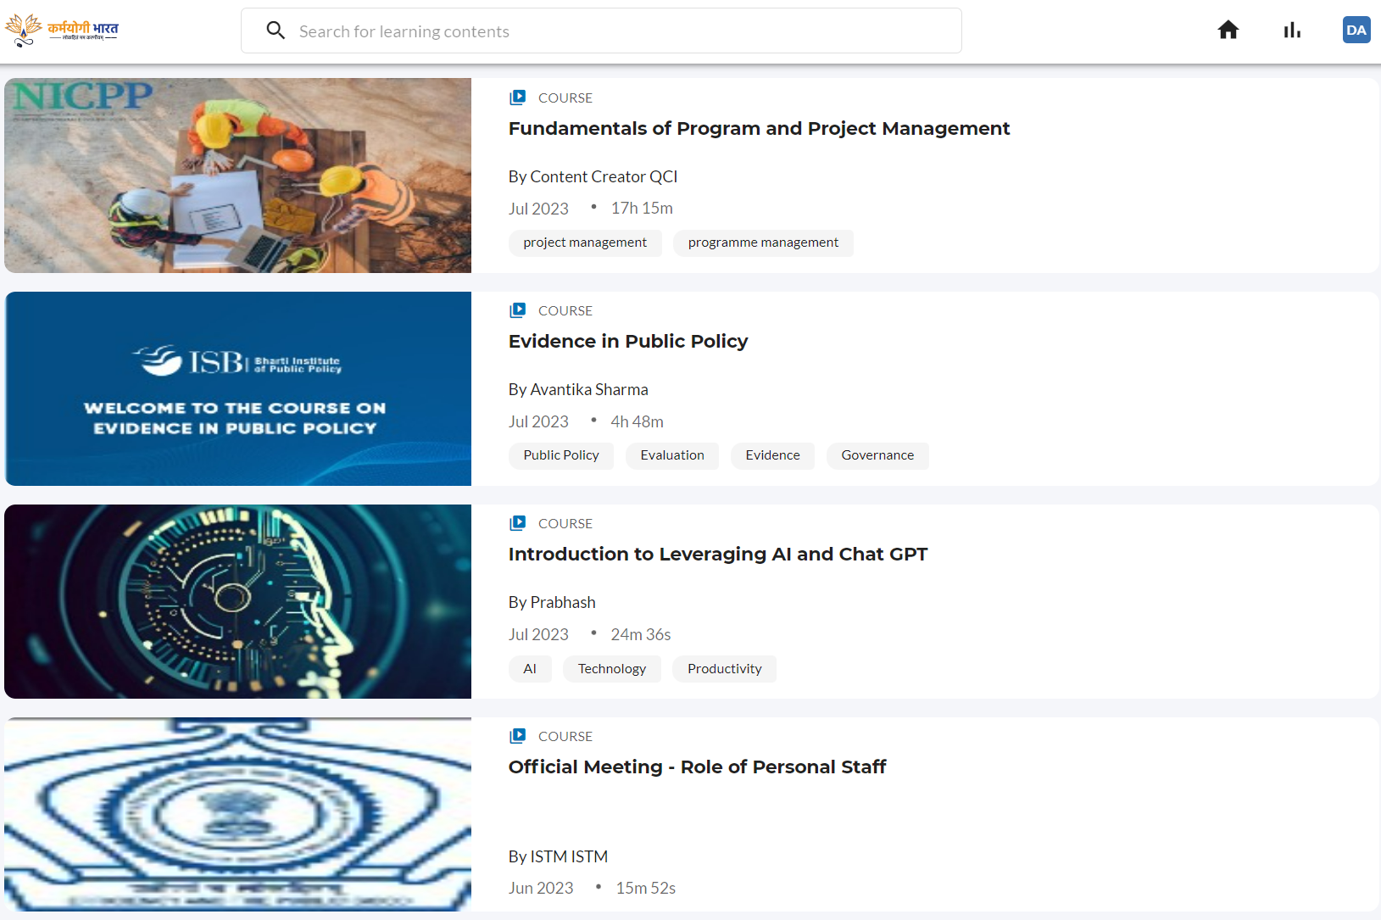
Creating Relevant and Quality Content for
iGOT Karmayogi Platform

Slide 13
Desired Qualities for iGOT Karmayogi Courses

Slide 14
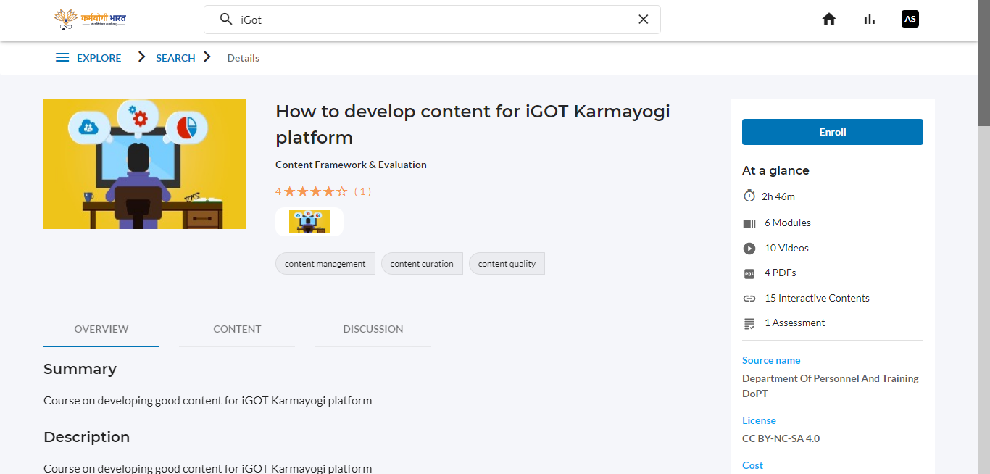
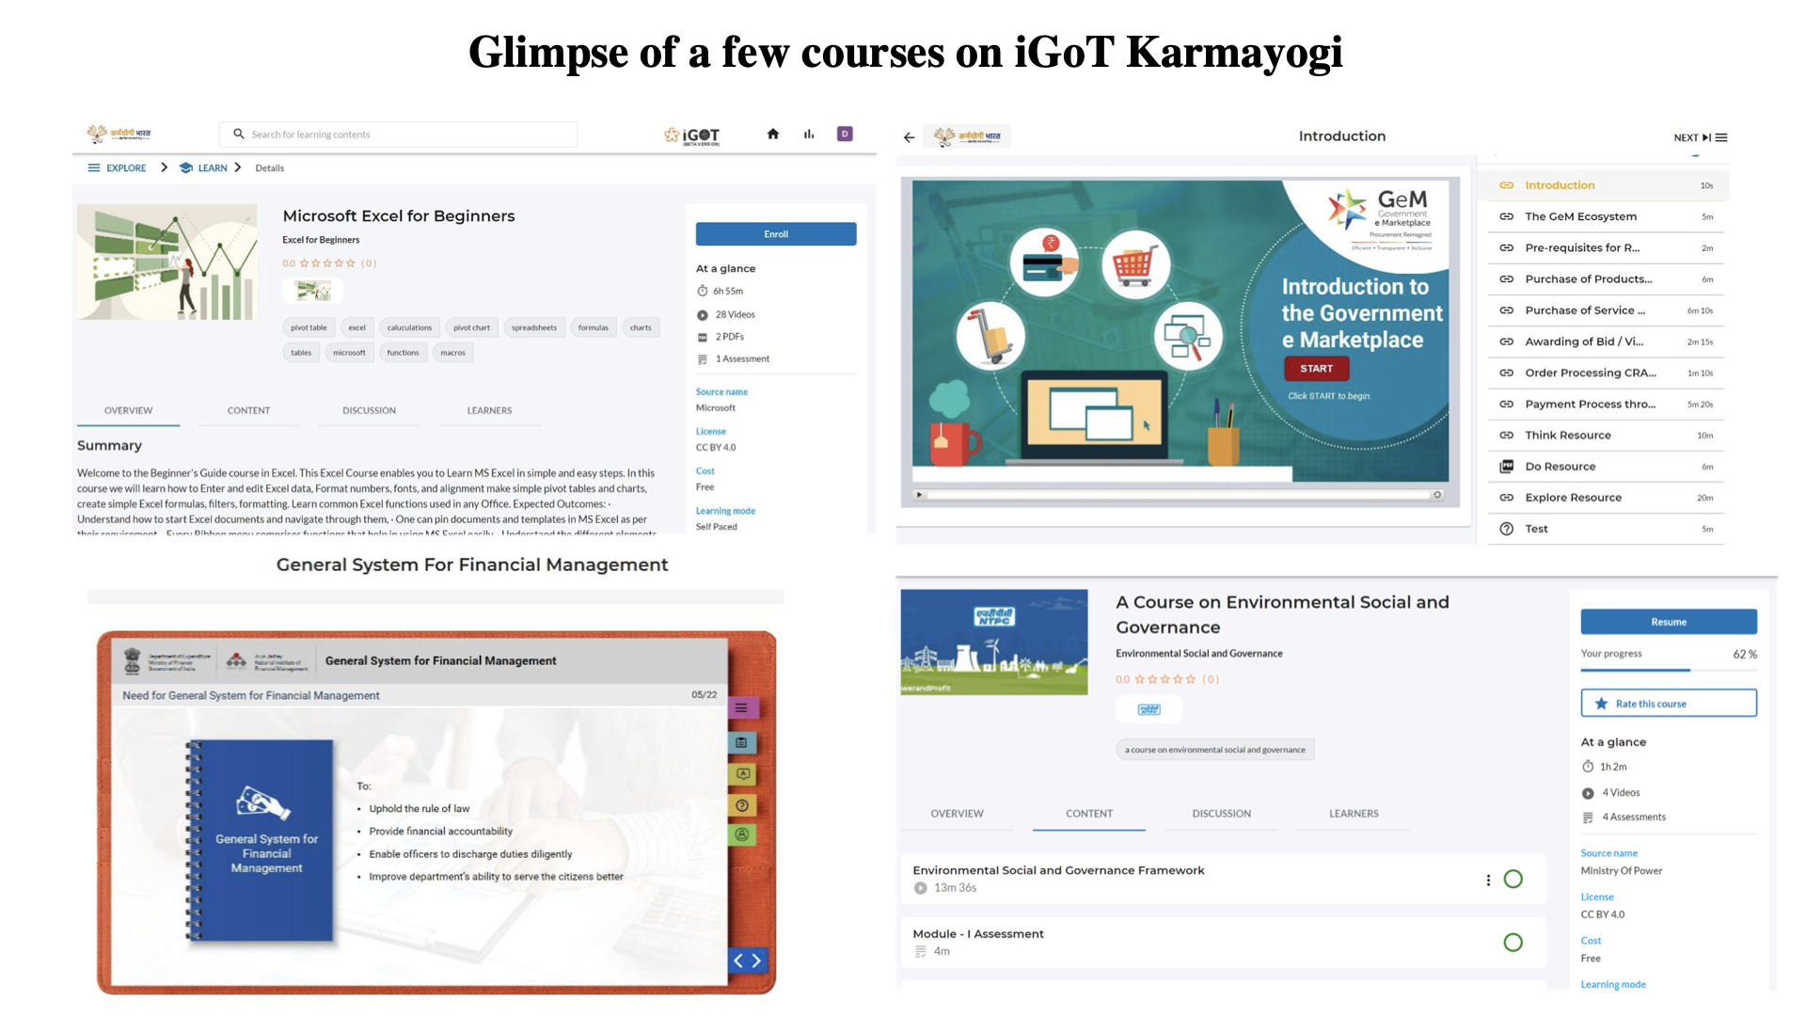
How to develop Content for iGOT Karmayogi Platform

Slide 15
Thoughts for Course Providers
What are the course objectives?
What instructional methods will attract the learners’ attention and maintain engagement?
What target audience is it fit for?
How can I test application of knowledge of my learners?
What are the intended learning outcomes of each module?
What examples can better explain the concepts to the audience?
What knowledge, skill, or attitude (competency) are the learners expected to acquire/strengthen after consumption of this course?

Slide 16
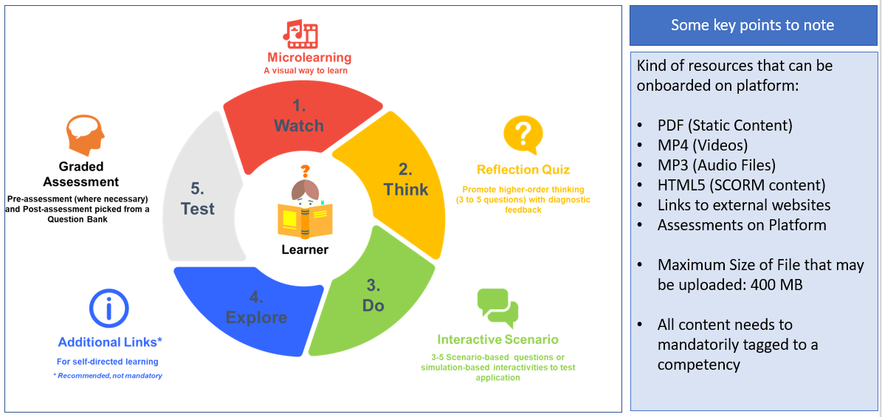
WTDET Model

Slide 17
iGOT Karmayogi Platform Course Duration vs Completion Rate
iGOT Course Duration vs Completion Rate
Course Name | Course Provider | Duration (HH:MM:SS) | Enrolled | Completed | Completion Percentage
Code of Conduct for Government Employees | Institute of Secretariat Training and Management (ISTM) | 00:35:00 | 60404 | 54059 | 89.50%
Prevention of Sexual Harassment of Women at Workplace | ISTM | 01:51:59 | 49956 | 39922 | 79.91%
Introduction to Emerging Technologies | Capacity Building Commission | 02:20:32 | 43931 | 33145 | 75.45%
Noting and Drafting | ISTM | 02:00:00 | 22359 | 16260 | 72.72%
Annual Performance Appraisal Report (APAR) | ISTM | 00:38:00 | 18970 | 15011 | 79.13%
Self Leadership | The Art of Living | 01:26:43 | 18147 | 14571 | 80.29%
STRESS MANAGEMENT | Indian Institute of Public Administration | 01:54:45 | 18902 | 13710 | 72.53%
Microsoft Word Beginners | Microsoft | 02:56:06 | 19986 | 12889 | 64.49%
Leave Rules | ISTM | 00:55:00 | 18383 | 12532 | 68.17%
Effective Communication | IIMB | 05:34:16 | 17049 | 12135 | 71.18%
*Status as of 6th July 2023
*Status as of 7th July 2023

Slide 18
Good Practices: A Bird's Eye View
S. No. | Feature | Course | Provider
1. | Menu | Leave Rules | ISTM
2. | Hover Feature | PM Gatishakti | DPIIT
3. | Voice Modulation | Rail Karmayogi Program | Min. of Railways
4. | Course Description | Public Procurement Framework of GOI | Dept. of Expenditure
5. | Objectives and Outcomes | Code of Conduct for Government Employee | ISTM
6. | Real-life Scenario | POSH | ISTM
7. | Case Study | Time Management | DoPT
8. | Transcripts | Public Procurement Framework of GOI | Dept. of Expenditure
9. | Closed Captions | Fundamentals of Medical Geology | Ministry of Mines
10. | Use of SCORM | Basics of Marathi letters and Numerals | SVPNPA

Slide 19
Good Practices: A Bird's Eye View
S. No. | Feature | Course | Provider
11. | Flip Books | Fundamental Rules (FR) and Supplementary Rules (SR) | Dept. of Expenditure
12. | Descriptive Feedback | Fundamental Rules (FR) and Supplementary Rules (SR) | Dept. of Expenditure
13. | Quiz voice-over | Public Provident Fund | RAKNPA
14. | Additional readings | Fundamental Rules (FR) and Supplementary Rules (SR) | Dept. of Expenditure
15. | Practical Demonstration of Domain Courses | Optical Fibre Network Maintenance | BSNL
16. | Use of Gazette as an Additional reading | Basics of Critical Information Infrastructure | NTIPRIT
17. | Documentary | Bio-Medical Waste Management in Primary Health Care Centers | CPCB
18. | Glossary and Acronyms as a separate PDF in a non-SCORM course | Cantonments Act, 2006 | NIDEM

Slide 20
Good Practices for Menu
What is it? An organised listing of the modules in the beginning of a course
Why should I do it? To help the learners in understanding how the course is organised and easily locate contents of a particular topic
How should I do it?
For SCORM Content: Inbuilt-feature
For non-SCORM content: can be uploaded as a PDF in the beginning of the course so that the learner can refer to it anytime.
• iGOT Compliance: SCORM 1.2 compliant – index.html – no other name (no special characters). All SCORM content need to be under Main Directory (no sub-directory)

Slide 21
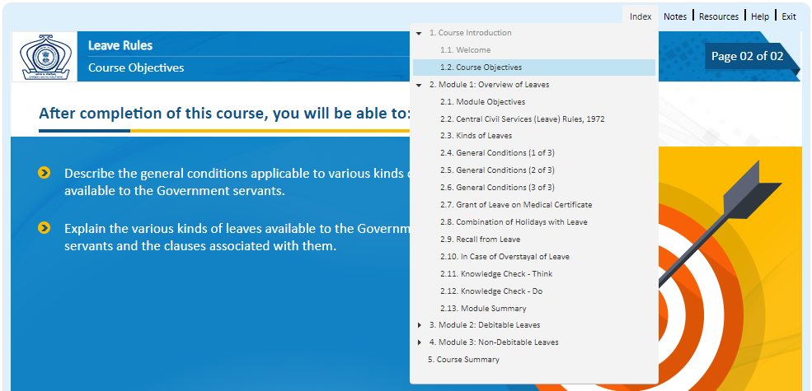
Good Practices for Menu: Leave Rules by ISTM

Slide 22
Good Practices for Hover Feature
What is it? To position the cursor over image or icon and the element responds with transition effect
Why should I do it?
o Provides additional information to any cluttered slide
o To make the courses more interactive, enhance user experience, provide visual cues to navigate through the course
How should I do it? Use Hover Effects plugin

Slide 23
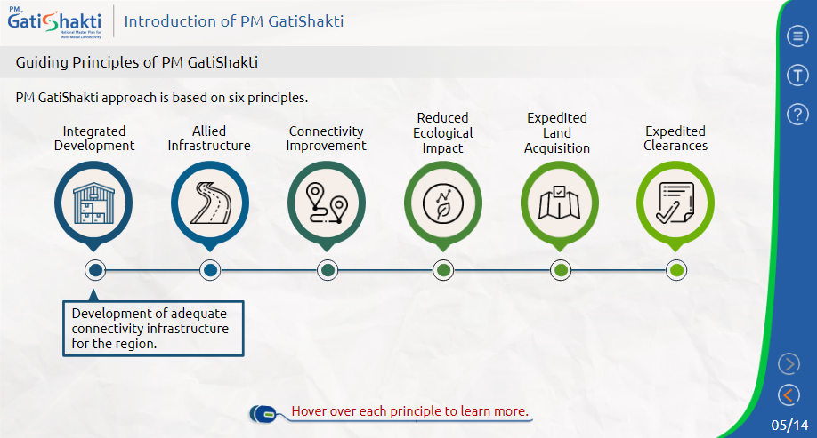
Good Practices for Hover Feature: PM GatiShakti by DPIIT

Slide 24
Good Practices for Voice Modulation
• What is it? Controlling or adjusting the voice, pitch and pace according to the requirement of the sentence.
Why should I do it? To capture learners’ attention, making the sentences more engaging and interesting
How should I do it? Use a voice that is loud and clear, stress on powerful words, effective pauses, sounding enthusiastic and confident, avoid fillers (ahs, umms)

Slide 25
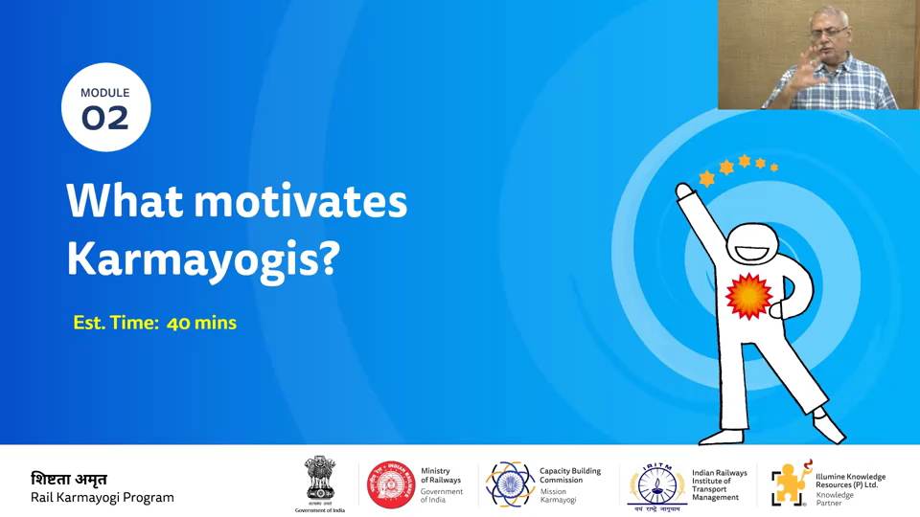
Good Practices for Voice-Modulation:
Rail Karmayogi Program by Ministry of Railways

Slide 26
Good Practices for Course Description
What is it? A brief explanation of all the relevant details of the course
Why should I do it? A good course description emphasizes the benefits to the learner from the value of the subject matter
How should I do it? Do not use abbreviations, write in complete sentences, focus on content of the course, write in active sentences
iGOT compliance:
o Summary – minimum 25 characters, maximum 2000 characters
o Description – no minimum character, maximum 2000 characters

Slide 27
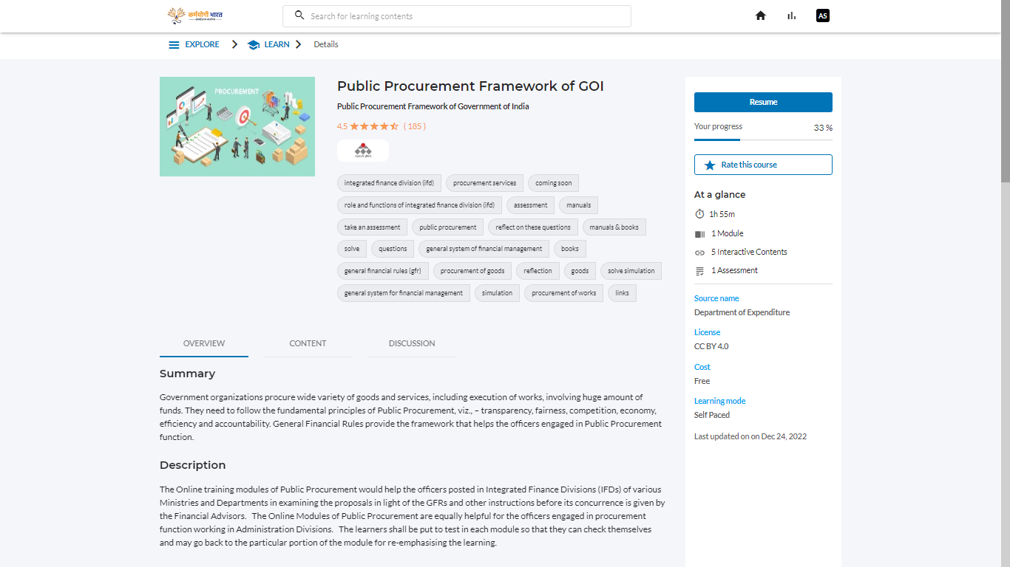
Good Practices for Course Description:
Public Procurement Framework of GOI by Dept. of Expenditure

Slide 28

Good Practices for Objectives and Outcomes
What is it?
o Objective: Milestones for the learners to achieve as they complete the course
o Outcome: describes what a learner is able to do as a result of completing a learning experience
Why should I do it?
o Helps to know why is the course created, what content should be included, what activities to choose, how to gauge success from the course
o Set the learners expectations and guide their learning processes
How should I do it?
o Write from point of View of the learner
o Actionable steps from the point of view of the learner
o Value proposition – what do learners achieve at the end of the course

Slide 29
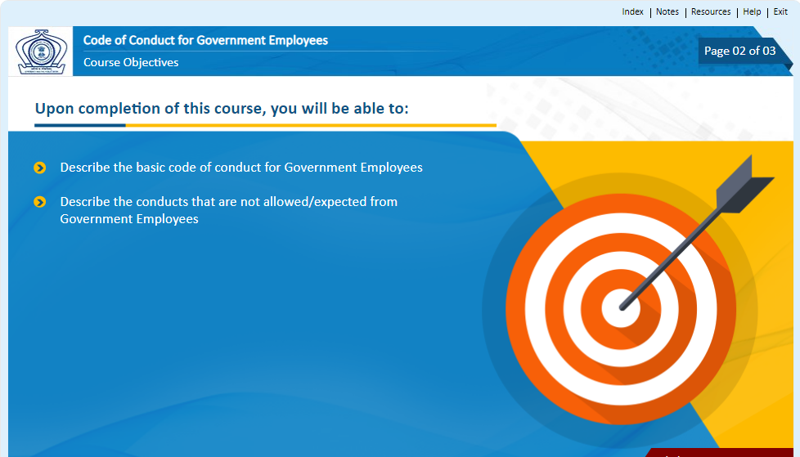
Good Practices for Objectives and Outcomes:
Code of Conduct for Government Employee by ISTM

Slide 30
Good Practices for Real-life Scenario
What is it?
o It actually happens and is not just in a story or in someone’s imagination
o Creating realistic situations or simulations that learners can interact with
Why should I do it? Gives the learners hands-on learning opportunities to improve the learners’ understanding of topics
How should I do it? Analyse the problem, select a situation, prototype first, Create realistic characters, tell a story visually, create problem-solving simulations

Slide 31
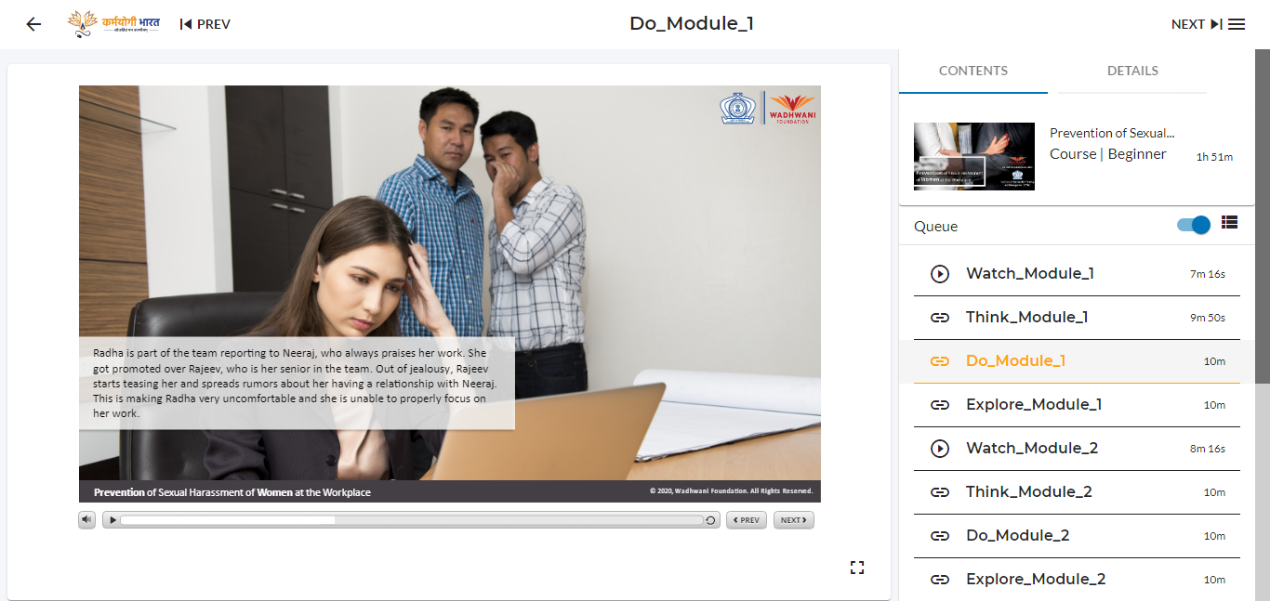
Good Practices for Real-life Scenario: POSH by ISTM

Slide 32
Good Practices for Case Study
What is it? Stories/ scenarios, generally narrated, used as a tool for analysis and discussion
Why should I do it? High-level learning outcomes involving reflection, mentoring and problem solving
How should I do it?
o Introduce the topic, outline objective, key issues, findings, identify the theory, summarise recommendations/ self-simulating questions
o Embed links to reference materials, pop-up boxes, video annotations

Slide 33
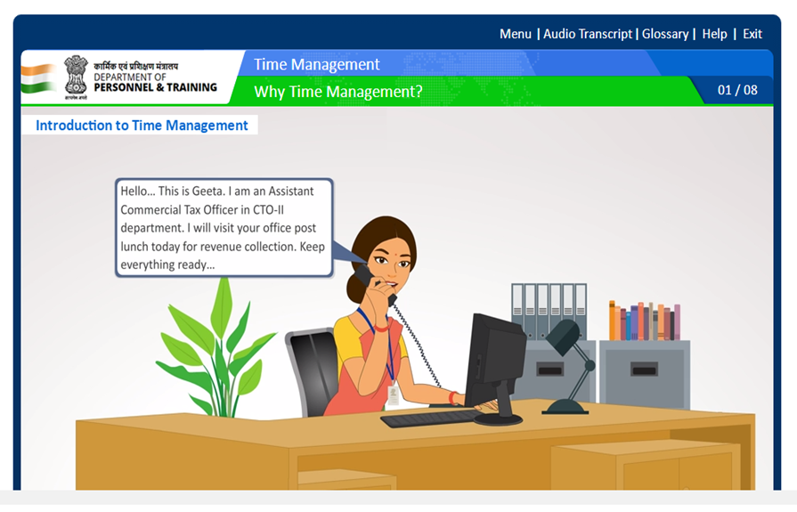
Good Practices for Case study: Time Management by DoPT

Slide 34
Good Practices for Transcripts
What is it? Text version of the speech and non-speech audio information needed to understand the content.
Why should I do it? Learners with different learning styles and facing challenges from virtual classrooms can use transcript as an effective tool.
How should I do it? As a SCORM package

Slide 35
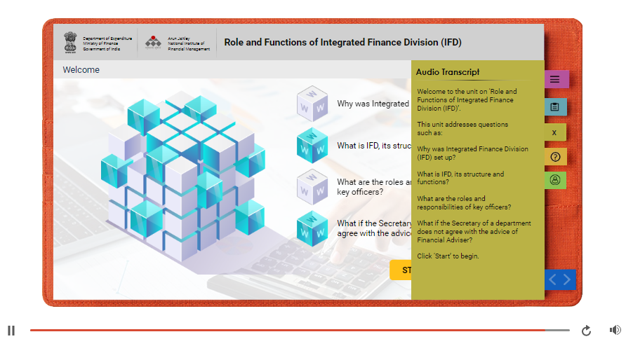
Good Practices for Transcripts:
Public Procurement Framework of GOI by Dept. of Expenditure

Slide 36
Good Practices for Closed Captions
What is it? Time-synchronised text that reflects an audio track and can be read while watching visual content
Why should I do it?
o Important for learner with hearing disabilities
o Improved audience comprehension
How should I do it? Software (SRT file)

Slide 37
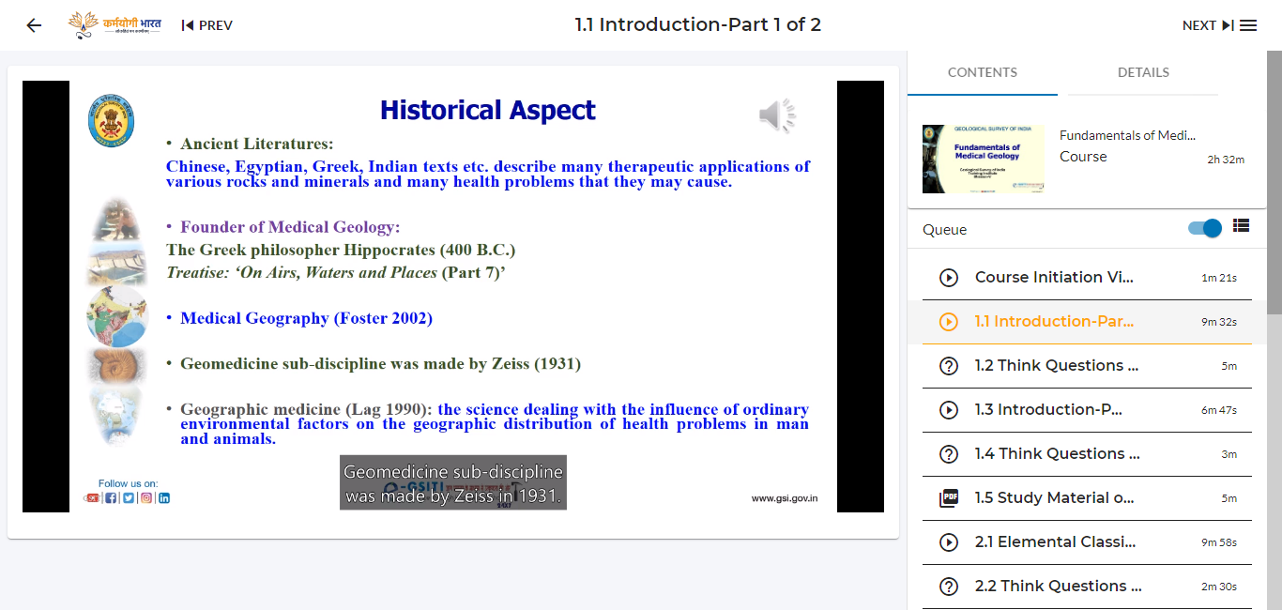
Good Practices for Closed Captions:
Fundamentals of Medical Geology by Ministry of Mines

Slide 38
Good Practices for use of SCORM
(Sharable Content Object Reference Model)
What is it? Set of Technical Standards for e-learning software products.
Why should I do it?
o Content can be created one-time with plug-and-play functionality
o Can be used in many different systems and situations without modification
How should I do it? (e.g., with free tools) – make the course in ppt, publish it to SCORM, upload in LMS

Slide 39
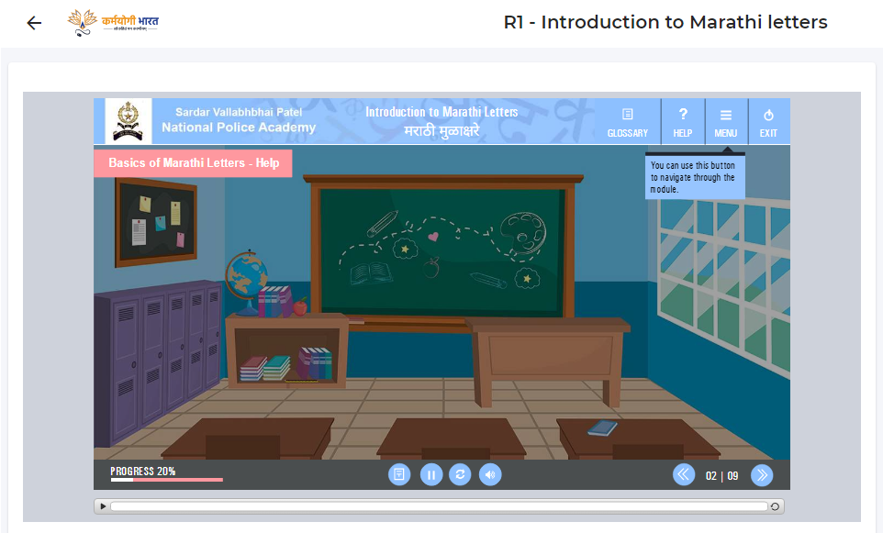
Good Practices for use of SCORM:
Basics of Marathi letters and Numerals by SVPNPA

Slide 40
Good Practices for use of Flip Books
What is it? Interactive online application with a page-turning effect, converted from PDF via Flipping book software
Why should I do it? Digital flipbook is easy to use, responsive across all devices, improved visual appearance of the PDF files
How should I do it?
o Upload a PDF to Flipping book online or Flipping book publisher
o Import PDF into Flip book maker application

Slide 41
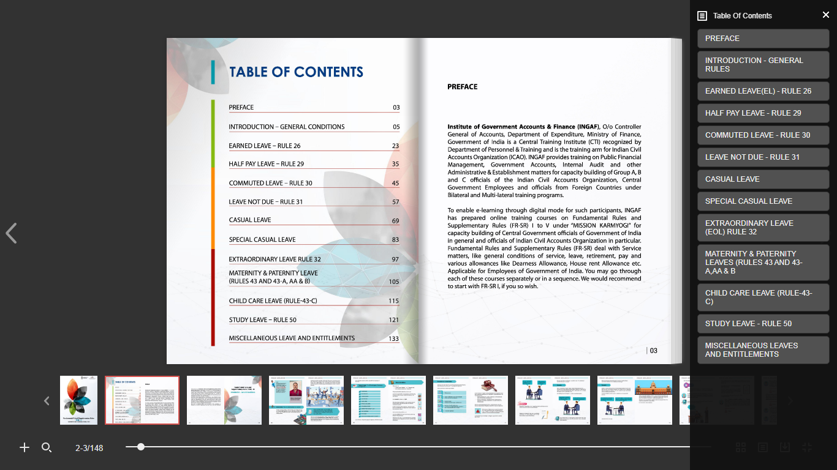
Good Practices for use of Flip Books: Fundamental Rules (FR) and Supplementary Rules (SR) by Department of Expenditure

Slide 42
Good Practices for Descriptive Feedback
What is it? Specific information (written comments or conversations) that help the learners understand what they need to improve their learning
Why should I do it? Provides direction to the learners for developing content knowledge or directing their own learning
How should I do it? Specific examples, what needs to be done for improvement

Slide 43
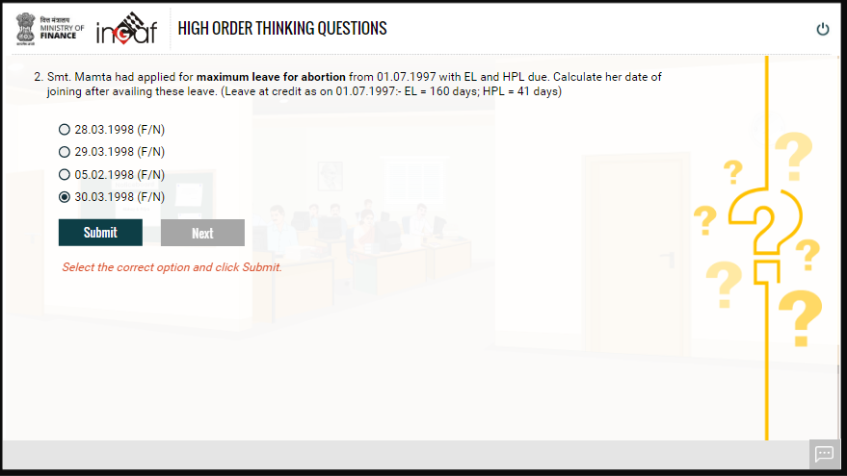
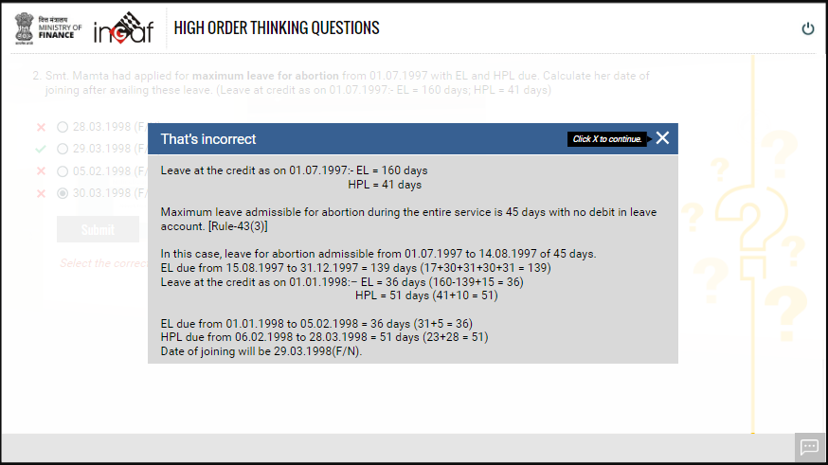
Good Practices for Descriptive Feedback: Fundamental Rules (FR) and Supplementary Rules (SR) by Department of Expenditure

Slide 44
Good Practices for Quiz Voice-Over
What is it? When a person records a voice to narrate the quiz question, its options, feedback
Why should I do it?
o Important for learners with reading disabilities
o Improved audience comprehension
How should I do it? In the same way as voice over is embedded in the main course

Slide 45
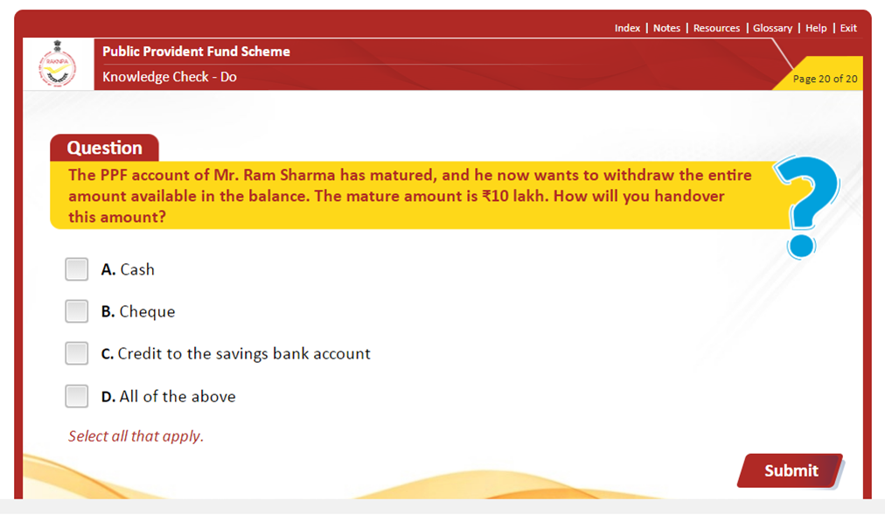
Good Practices for Quiz Voice-Over: Public Provident Fund by RAKNPA

Slide 46
Good Practices for Additional Readings
What is it? Non-required instructional materials where learners can engage in, not materials they have to engage in
Why should I do it? Encourage learning, enhance learner motivation to explore on the topic, stay updated, no stress to complete the additional resources,
How should I do it? Consider the course context, the target audience

Slide 47
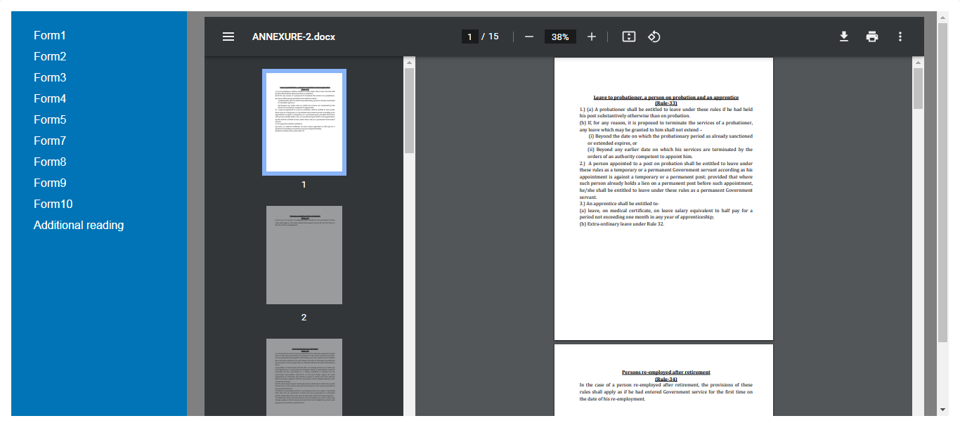
Good Practices for Additional Readings:
Fundamental Rules (FR) and Supplementary Rules (SR)

Slide 48
Good Practices for Practical Demonstration of Domain Courses
What is it? Process of teaching how to make or do something in a step-by-step process – how to tell what you are doing
Why should I do it? Teaching by example rather than simply explaining, so engages the learners
How should I do it? Explaining the idea or skill to be demonstrated, giving explanation as you go along, doing one step at-a-time, repeating/ reinforcing

Slide 49
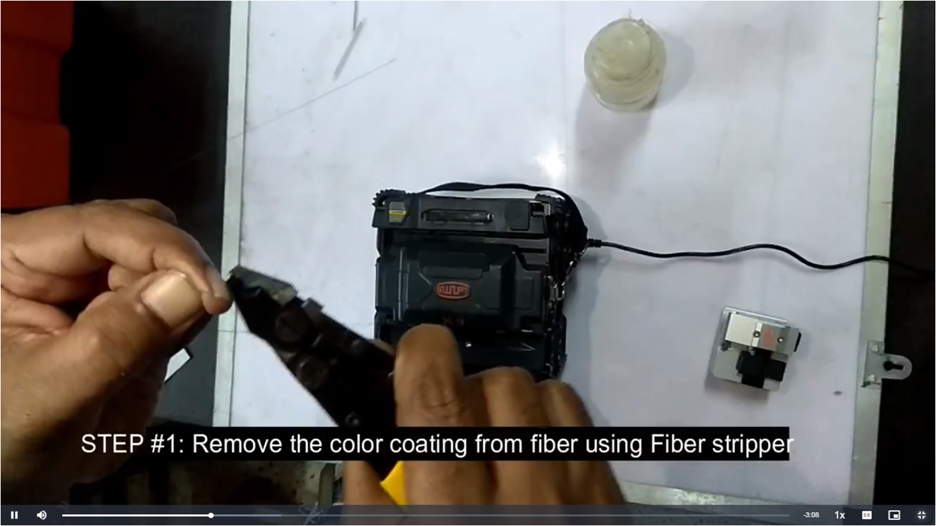
Good Practices for Practical Demonstration of Domain Courses: Optical Fibre Network Maintenance by BSNL

Slide 50
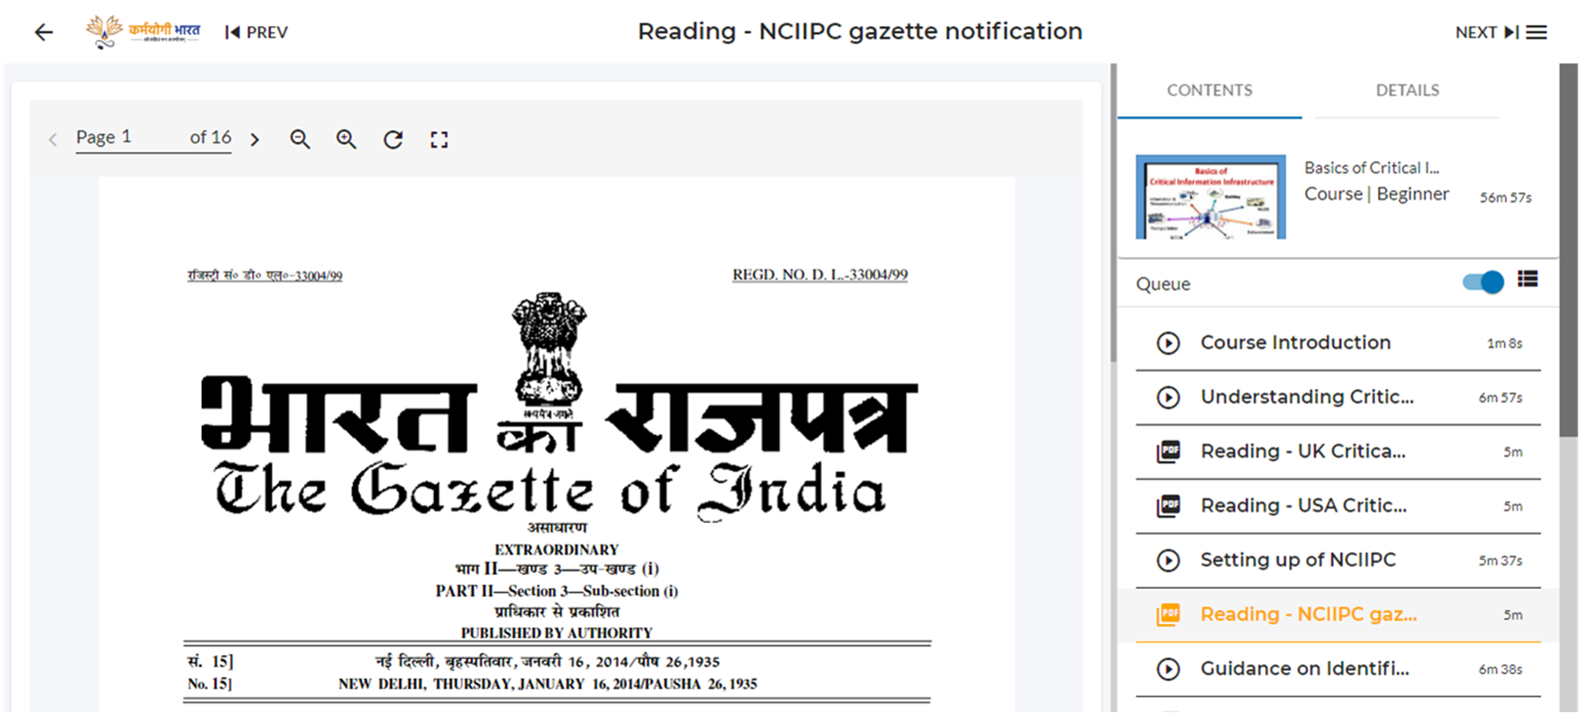
Good Practices for use of Gazette as an additional reading:
Basics of Critical Information Infrastructure by NTIPRIT

Slide 51
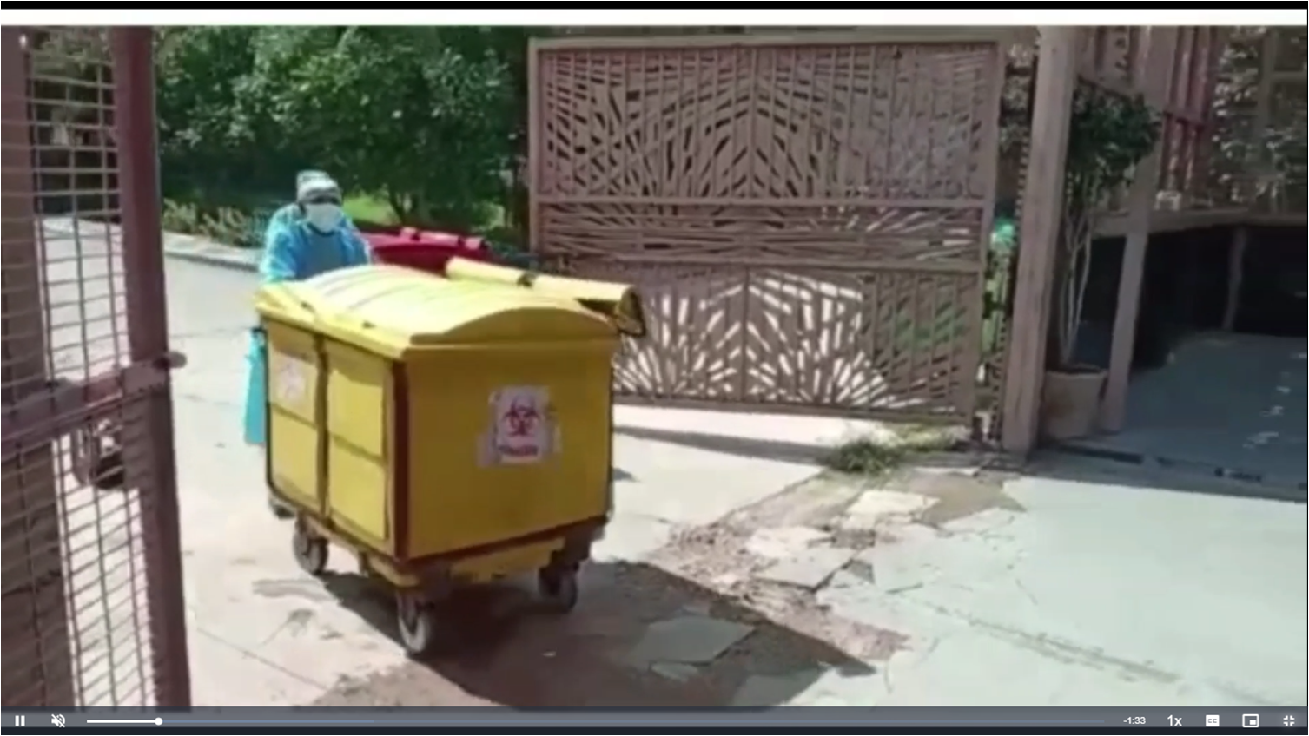
Good Practices for Documentary: Bio-Medical Waste Management in Primary Health Care Centers by CPCB

Slide 52
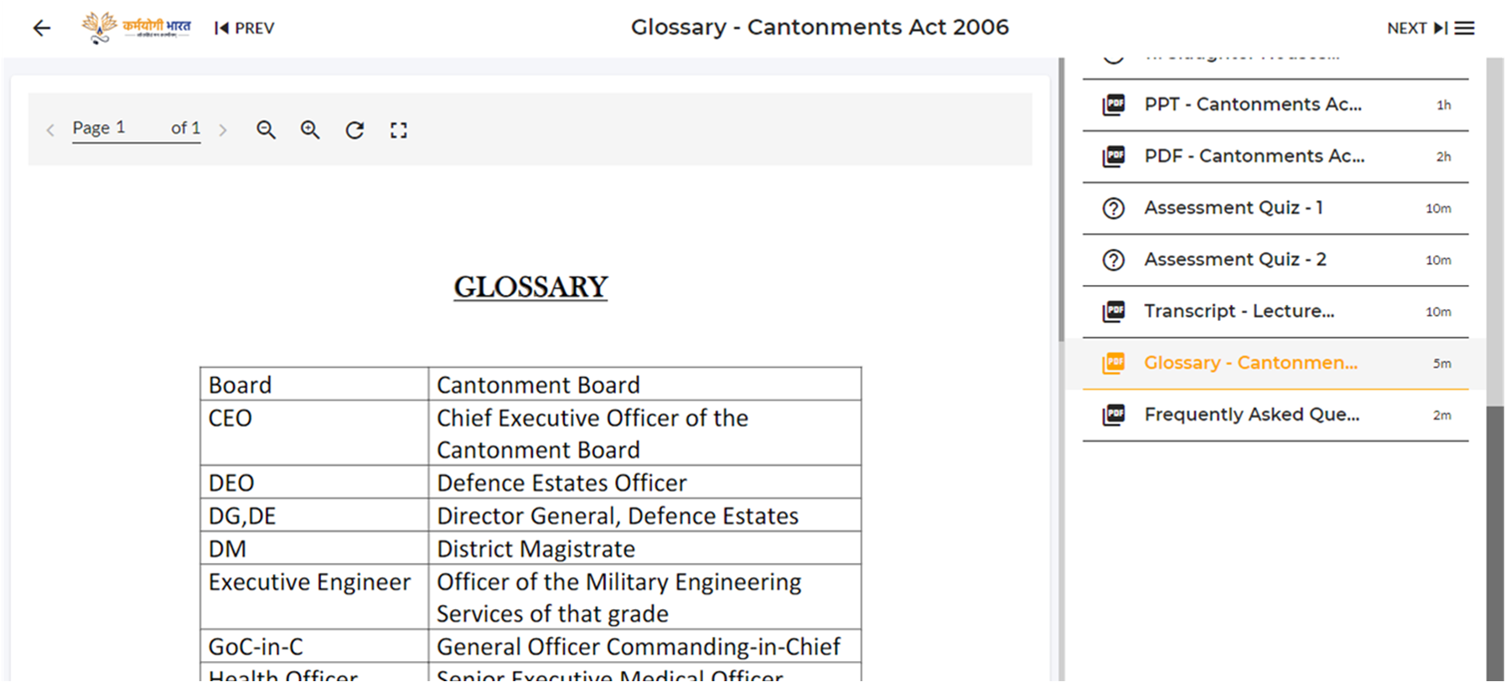
Good Practices for Glossary and Acronyms as a separate PDF in a non-SCORM course : Cantonments Act, 2006 by NIDEM

Slide 53
Demo of the
iGOT Karmayogi Platform
(CBP Portal)

Slide 54
Karmayogi Bharat Helpdesk
Mon-Fri; 9 AM-5 PM – Click Here to Join
Mon-Fri; 3-4 PM – Click Here to Join
You can also write to us at mission.karmayogi@gov.in

Slide 55


